Slide 1
HOSPITAL PATIENT ANALYTICS
Executive Overview & Data Insights
JUNE 2026 • OPERATIONS • COSTS • OUTCOMES
40,596 cleaned records | 21 fields | 8 dashboard visuals
Prepared 16 October 2026 | Analytics team
Source workbook and project data files
Notes:
Sources: hospital_patient_analytics_dash_1.xlsx; clean_patients.csv; clean_patients_cleaned.csv; hospital_patient_data_cleaning.ipynb; hospital_patient_visualization.ipynb. The source files do not name an individual author.

Slide 2
Dataset scope & measures
One month of descriptive patient-record analysis
SCOPE
CORE FIELDS
EXECUTIVE METRICS
40,596
Demographic and patient identifiers
Disease, severity, referral, status
Service, dates, costs, payment
Wait, room time, insurance, rating
30,759
9,837
records after cleaning
OPD records
IPD records
21 source fields
Coverage: 1–30 June 2026
40,000 distinct patient IDs
No unique encounter ID
₹1.10B
total recorded treatment cost
3.96 / 5
average patient rating
Counting caveat
Records are not confirmed unique visits; repeated IDs lack an encounter key.
HOSPITAL PATIENT ANALYTICS / JUNE 2026
02
Notes:
Sources: hospital_patient_analytics_dash_1.xlsx, Dashboard and Chart Data sheets; clean_patients_cleaned.csv. Record counts reflect rows, not validated unique encounters.

Slide 3
Data cleaning & quality checks
Raw extract: 40,600 rows → cleaned extract: 40,596 rows
PROFILE
TRANSFORM
VALIDATE
4
85
0
exact duplicates removed
invalid ages imputed; mean 43
missing values remain
85 ages outside 0–120
No raw missing values
21 fields; 40,600 source rows
Parsed dates and numeric fields
Normalized text; kept other values
Date order checks passed
OPD/IPD timing checks passed
40,596 output rows retained
WHY MEAN
Near-symmetric ages (skew −0.107; mean 43.33; median 44) suited mean imputation. Median suits skewed numeric data; mode fills categorical gaps.
Data limitation
1,192 rows share patient IDs; repeated IDs may be separate encounters.
HOSPITAL PATIENT ANALYTICS / JUNE 2026
03
Notes:
Source: hospital_patient_data_cleaning.ipynb, cleaning and validation cells; clean_patients.csv; clean_patients_cleaned.csv. The notebook removes four exact duplicate rows, flags 85 out-of-range ages (150 and 999), imputes those ages with the valid-age mean rounded to 43, and retains non-identical repeated IDs.

Slide 4
Additional preprocessing & validation
Operations performed, including checks that required no correction
NORMALIZE & TYPE
RANGE CHECKS
RELATIONSHIPS & PRESERVATION
Text, numeric fields, dates
Completed on cleaned records
Keep source meaning intact
Trimmed text and normalized blanks; 0 values changed.
Converted five numeric fields; parsed both date fields.
Exported dates in ISO format.
No categorical gaps; mode imputation unnecessary.
Checked positive costs and ratings within 1–5.
Checked nonnegative service times and valid date order.
No post-cleaning range or date violations remained.
OPD/IPD timing rules: 0 mismatches.
Emergency category and referral checks: 0 mismatches.
Retained repeated IDs with differing records, age zero, and high costs.
WHY KEEP THESE CHECKS?
Validation documents what was tested; passed checks required no edits.
HOSPITAL PATIENT ANALYTICS / JUNE 2026
04
Notes:
Source: hospital_patient_data_cleaning.ipynb, cleaning, range, relationship, and validation cells. Text normalization changed zero values. Five numeric fields were converted; both dates were parsed. After age handling, no date-order, cost, timing, rating, or service-relationship exceptions remained. No categorical values were missing, so categorical mode imputation was not used. Non-identical repeated patient IDs, age zero, and high costs were retained.

Slide 5
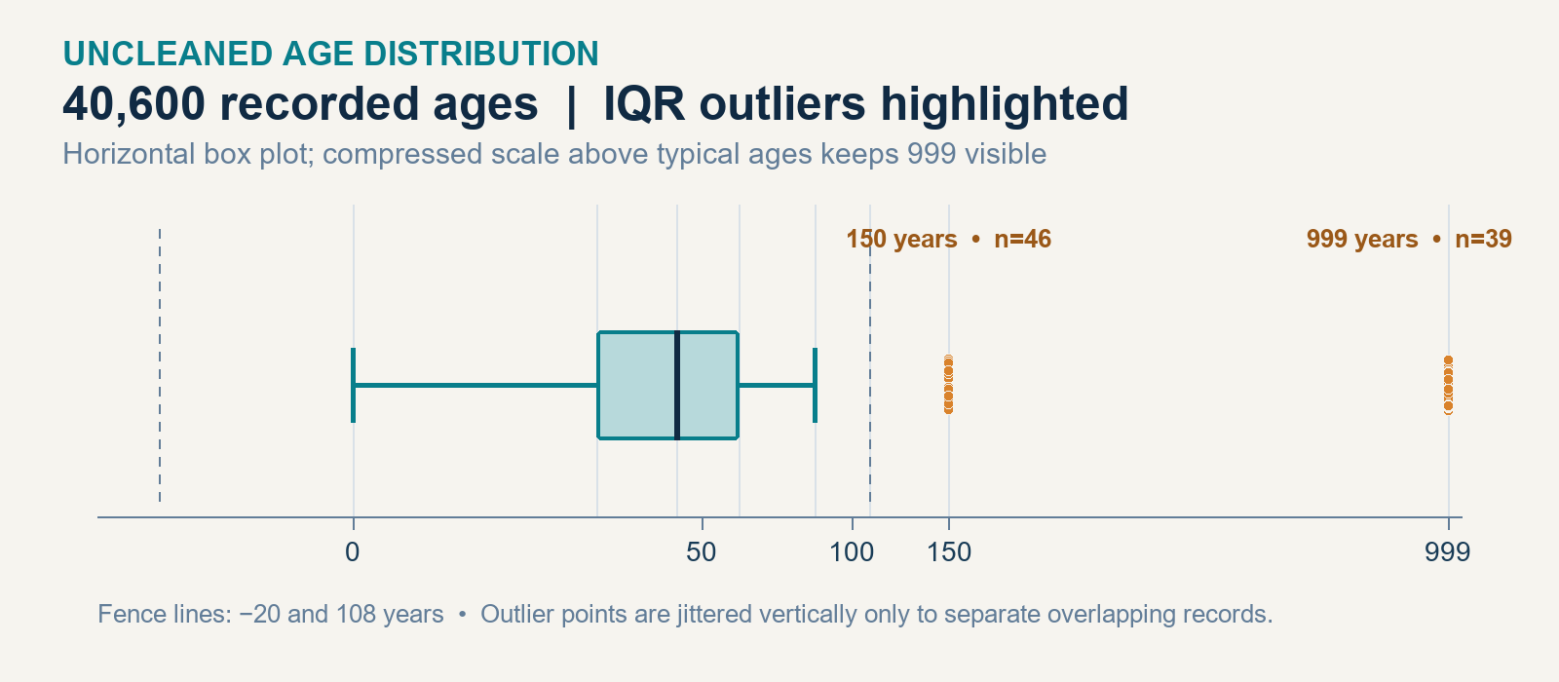
Age outliers in the uncleaned dataset
Box plot only | clean_patients.csv | 40,600 age values
IQR CALCULATION
Q1 = 28 • Median = 44 • Q3 = 60
IQR = Q3 − Q1 = 60 − 28 = 32 years
Fences: 28 − 1.5×32 = −20 | 60 + 1.5×32 = 108
SIX BOXPLOT ELEMENTS
Lower whisker
0 years
Q1
28 years
Median
44 years
Box spans the middle 50%; whiskers stop at in-fence values. The age axis is compressed above typical values.
Q3
60 years
Upper whisker
85 years
Outliers
85 rows: 150×46; 999×39
INTERPRETATION
85/40,600 = 0.21%; all 85 exceed 108, none fall below −20. Review before correction.
HOSPITAL PATIENT ANALYTICS / JUNE 2026
05
Notes:
Source: clean_patients.csv, raw age field before cleaning. 40,600 nonmissing age values. Quartiles use the inclusive linear percentile method (Q1=28, median=44, Q3=60); IQR=32. Fences are −20 and 108. Whiskers end at the minimum and maximum in-fence values (0 and 85). There are 85 upper-fence outliers: 46 records at age 150 and 39 at age 999. The age axis in the embedded plot is compressed above typical values so both outlier groups remain visible. Statistical outliers require source review; the plot alone does not prove data errors.

Slide 6
Daily patient records
Line chart | Admissions by date, June 2026
Primary insight
Most dates cluster near 1,500 records; four Sundays fall sharply.
KEY OBSERVATIONS
Median: 1,529 records per day.
Peak: 1,627 records on 13 June.
Sundays: 190–229 records, about 85% below median.
DECISION IMPLICATION
Verify Sunday reporting and operating schedules before changing staffing.
HOSPITAL PATIENT ANALYTICS / JUNE 2026
06
Notes:
Sources: hospital_patient_analytics_dash_1.xlsx, Chart Data; clean_patients_cleaned.csv; hospital_patient_visualization.ipynb. Counts represent records by admission date. Sunday dips occur on 7, 14, 21, and 28 June; this is a descriptive pattern, not proof of reduced demand.

Slide 7
OPD and IPD service mix
Doughnut chart | Share of cleaned records
Primary insight
OPD represents about three-quarters of recorded service volume.
KEY OBSERVATIONS
OPD: 30,759 records (75.8%).
IPD: 9,837 records (24.2%).
Record mix does not establish capacity utilization.
DECISION IMPLICATION
Align outpatient capacity to volume; protect inpatient staffing and beds.
HOSPITAL PATIENT ANALYTICS / JUNE 2026
07
Notes:
Sources: hospital_patient_analytics_dash_1.xlsx, Dashboard and Chart Data; clean_patients_cleaned.csv. Shares are calculated from 40,596 cleaned rows.

Slide 8
Recorded patient outcomes
Horizontal bar chart | Status distribution
Primary insight
Recovery is the most common recorded status; 18.6% show another status.
KEY OBSERVATIONS
Recovered: 33,038 records (81.4%).
Under treatment: 4,572; referred: 2,255.
LAMA: 464; deceased: 267 (0.7%).
DECISION IMPLICATION
Review non-recovered statuses in clinical context; avoid risk-adjusted claims.
HOSPITAL PATIENT ANALYTICS / JUNE 2026
08
Notes:
Sources: hospital_patient_analytics_dash_1.xlsx, Chart Data; clean_patients_cleaned.csv. Status counts are descriptive administrative labels, not validated clinical outcomes. Percentages are rounded.

Slide 9
Severity distribution
Horizontal bar chart | Recorded case severity
Primary insight
Moderate cases dominate the recorded severity mix.
KEY OBSERVATIONS
Moderate: 27,908 records (68.7%).
Mild: 6,083; severe: 4,312.
Critical: 2,293; severe plus critical: 16.3%.
DECISION IMPLICATION
Use acuity mix in capacity reviews; confirm the source coding definitions.
HOSPITAL PATIENT ANALYTICS / JUNE 2026
09
Notes:
Sources: hospital_patient_analytics_dash_1.xlsx, Dashboard and Chart Data; clean_patients_cleaned.csv. Percentages use 40,596 cleaned records and are rounded.

Slide 10
Average treatment cost per patient-day
Column chart | OPD and IPD, INR
Primary insight
Recorded IPD cost per patient-day is about 3.6× OPD.
KEY OBSERVATIONS
IPD: ₹14,237.55 per patient-day.
OPD: ₹3,972.30 per patient-day.
Compare only after confirming cost and day definitions.
DECISION IMPLICATION
Review inpatient cost drivers and validate patient-day calculations.
HOSPITAL PATIENT ANALYTICS / JUNE 2026
10
Notes:
Sources: hospital_patient_analytics_dash_1.xlsx, Chart Data; hospital_patient_visualization.ipynb. The workbook reports average treatment cost per patient-day of ₹14,237.55 for IPD and ₹3,972.30 for OPD; the source extract does not document the patient-day formula in this chart.

Slide 11
Average service time
Column chart | Service-specific minutes
Primary insight
OPD waiting and IPD room allocation average distinct service times.
KEY OBSERVATIONS
OPD average waiting time: 44.5 minutes.
IPD average room allocation: 34.8 minutes.
Do not compare as equivalent workflow measures.
DECISION IMPLICATION
Set separate service targets and track monthly median alongside averages.
HOSPITAL PATIENT ANALYTICS / JUNE 2026
11
Notes:
Sources: hospital_patient_analytics_dash_1.xlsx, Chart Data; clean_patients_cleaned.csv; hospital_patient_visualization.ipynb. OPD waiting time is calculated for OPD rows; room-allocation time is calculated for IPD rows.

Slide 12
Average recorded treatment cost by payment method
Horizontal bar chart | INR per record
Primary insight
Average recorded cost varies by payment label and case mix.
KEY OBSERVATIONS
Insurance: ₹88,064 average; credit card: ₹40,767.
Debit: ₹22,327; UPI: ₹9,272; cash: ₹7,157.
Averages may reflect service mix and high-cost cases.
DECISION IMPLICATION
Compare payment categories within service type before drawing conclusions.
HOSPITAL PATIENT ANALYTICS / JUNE 2026
12
Notes:
Sources: clean_patients_cleaned.csv; hospital_patient_visualization.ipynb; hospital_patient_analytics_dash_1.xlsx. Means calculated across rows by payment label; these observational differences do not establish payment effects. Rounded to nearest rupee.

Slide 13
Emergency records by insurance status
Horizontal bar chart | Average records per day, June 2026
Primary insight
More daily emergency records are marked uninsured in this extract.
KEY OBSERVATIONS
Uninsured: 130.9 emergency records per day.
Insured: 71.8 emergency records per day.
Validate insurance capture and case mix before action.
DECISION IMPLICATION
Check insurance completeness and emergency case mix before resource decisions.
HOSPITAL PATIENT ANALYTICS / JUNE 2026
13
Notes:
Sources: clean_patients_cleaned.csv; hospital_patient_analytics_dash_1.xlsx, Chart Data. Emergency records are defined by patient_category = Emergency; daily averages divide June totals by 30 calendar days. These are record counts, not unique patients.

Slide 14
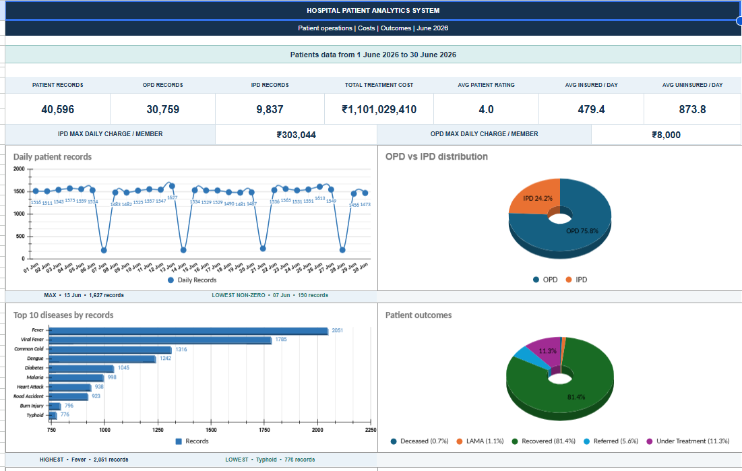
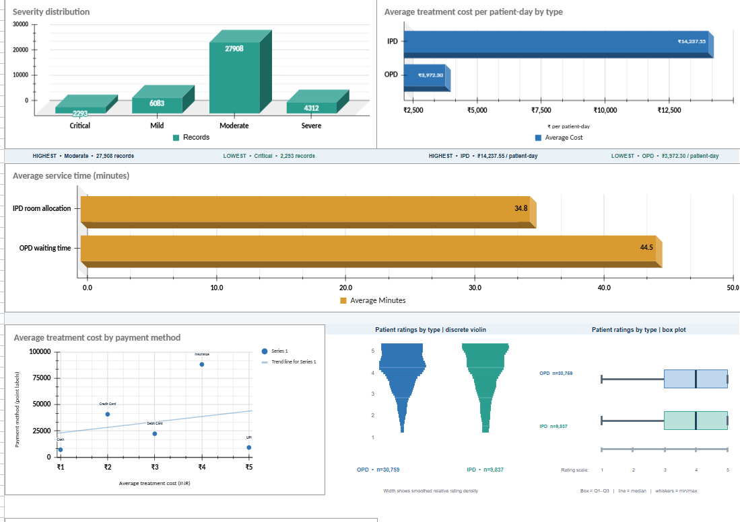
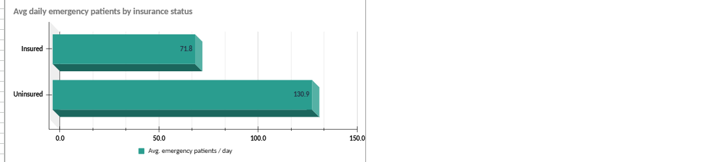
Executive dashboard overview
Dashboard screenshots supplied by the user
HOSPITAL PATIENT ANALYTICS / JUNE 2026
14
Notes:
User-supplied dashboard screenshots embedded without alteration: Screenshot 2026-10-16 184109.png; Screenshot 2026-10-16 184139.png; Screenshot 2026-10-16 184202.png.

Slide 15
Conclusion & strategic goal
CORE CONCLUSION
June provides a one-month baseline; validate reporting anomalies before operational changes.
RECOMMENDED ACTIONS
Verify Sunday volume and insurance capture with source-system owners.
Segment cost comparisons by service type and clinical severity.
Set separate targets for OPD waiting and IPD room allocation.
DELIVERED
40,596 cleaned records • 8 dashboard visuals • Operational baseline
No financial savings or outcome improvement is established by this analysis.
Notes:
Sources: hospital_patient_data_cleaning.ipynb; hospital_patient_visualization.ipynb; hospital_patient_analytics_dash_1.xlsx; clean_patients_cleaned.csv. This analysis is descriptive and does not estimate realized savings or causal clinical effects.

