Slide 1
FRONT-END

Slide 2
Technology Stack
DOM (Document Object Model)
HTML
CSS
JavaScript
FRAMEWORKS
Bootstrap
AngularJS
Flask
AJAX

Slide 3
Flask
Python Framework

Slide 4
What is Flask?
Flask is a micro-framework that follows the Unix philosophy of “do one thing and do it well”. Flask provides very little upfront, not even an ORM, but the community provides a large set of extensions that match a lot of Django’s feature set.
Notes:
ORM – Object Relational Mapping module ---- for database applications ---

Slide 5
Micro framework
The “micro” in micro-framework means Flask aims to keep the core simple but extensible.
Very less in-built functionality
Numerous extensions to add functionality

Slide 6
Why Flask?

Slide 7
Advantages of Flask over Django
Flask provides simplicity, flexibility and fine-grained control. It is unopinionated (it lets you decide how you want to implement things).
if you want more control about which components to use (such as what functionalities you want to use and how you want to interact with them).
At the end, it’s a design choice!
Notes:
1. Django - Django provides an all-inclusive experience: you get an admin panel, database interfaces, an ORM, and directory structure for your apps and projects out of the box.
2. Django, if you're focused on the final product. Especially if you're working on a straight-forward application such as a news site, an e-store, or blog, and you want there to always be a single, obvious way of doing things.

Slide 8
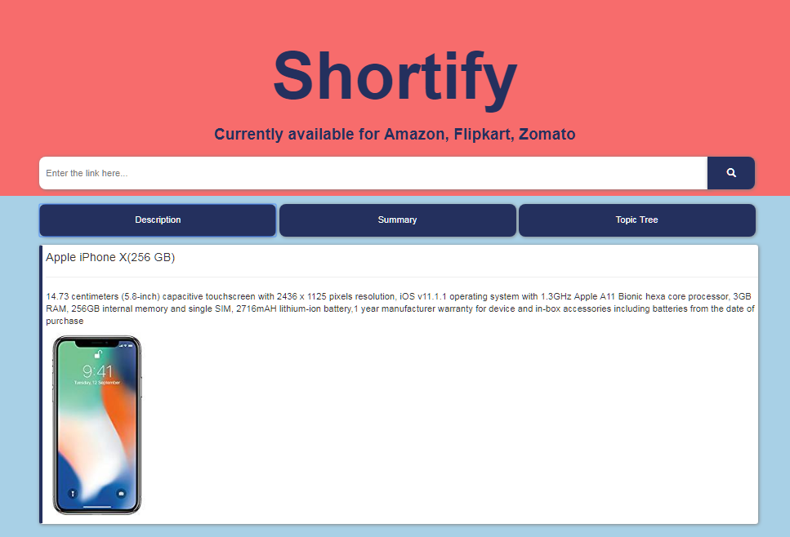

Slide 9
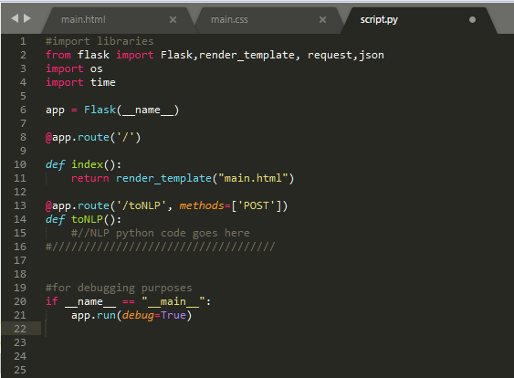

Our Flask code
Terminal Output
default port - 5000

Slide 10
AngularJS

Slide 11
What is AngularJS?
AngularJS lets you extend HTML vocabulary for your application. The resulting environment is extraordinarily expressive, readable, and quick to develop.
Notes:
ORM – Object Relational Mapping module ---- for database applications ---

Slide 12
Why Angular?
Data Binding
Controller
Plain JavaScript
Directives
Reusable Components
Testable

Slide 13
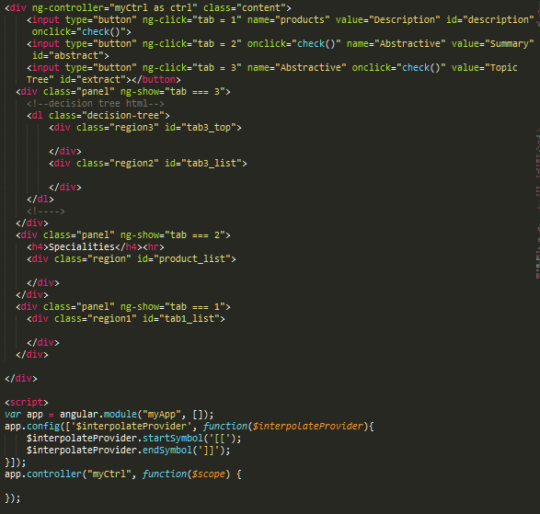
Angular code

Slide 14
AJAX

Slide 15
What is AJAX?
AJAX is a developer's dream, because you can:
Update a web page without reloading the page
Request data from a server after the page loaded
Receive data from a server after the page loaded
Send data to a server - in the background
Notes:
ORM – Object Relational Mapping module ---- for database applications ---

Slide 16
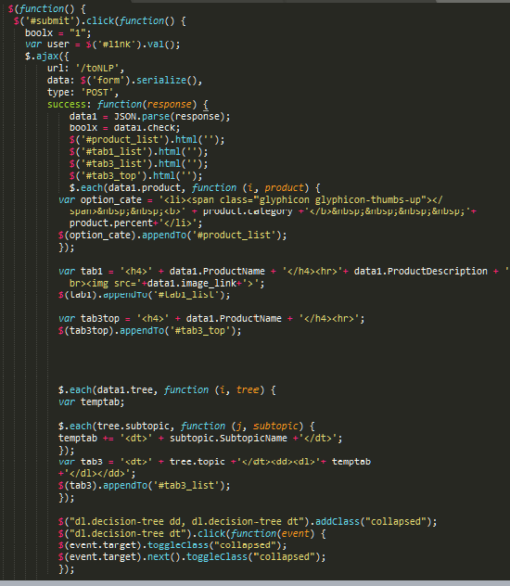
Our AJAX Request & Response handler
POST request
Programmatically creating
HTML on page

Slide 17
JSON Data Sample
{"ProductName" : "Apple iPhone X(256 GB)",
"ProductDescription" : "14.73 centimeters (5.8-inch) capacitive touchscreen with 2436 x 1125 pixels resolution, iOS v11.1.1 operating system with 1.3GHz Apple A11 Bionic hexa core processor, 3GB RAM, 256GB internal memory and single SIM, 2716mAH lithium-ion battery,1 year manufacturer warranty for device and in-box accessories including batteries from the date of purchase" ,
"imagelink" : "https://images-eu.ssl-images-amazon.com/images/I/41yHmwJxbIL._SY300_QL70_.jpg",
"product" : [{"category" : "phone", "percent" : "50.0%"},{"category" : "time", "percent" : "50.0%"},
{"category" : "product", "percent" : "50.0%"}, {"category" : "camera", "percent" : "50.0%"},
{"category" : "service", "percent" : "52.0%”}, {"category" : "year", "percent" : "51.851851851851855%"}],
"tree" : [{ "topic" : "phone", "subtopic" : [{ "SubtopicName" : "Nice phone"},{ "SubtopicName" : "great phone"},
{"SubtopicName" : "awesome phone"}]}, { "topic" : "battery", "subtopic" : [{ "SubtopicName" : "good
battery"}]}, { "topic" : "experience", “subtopic" : [{ "SubtopicName" : "good experience"}]}
]
}

Slide 18
Our process is easy
Step 1
Step 2
Step 3
Flask code initializes the server and renders the template of the website on localhost:5000.
User enters the link on the text box and presses search which invokes an AJAx request (POST method) to Flask function that runs the entire Scraping and Summarization Python code and returns the output.
The data is in JSON format which is then rendered on the website in respective tabs. In the form of extractive, abstractive and topic tree summary.

Slide 19
BootStrap
Makes Responsive Website

Slide 20
Desktop View
Place your screenshot here

Slide 21
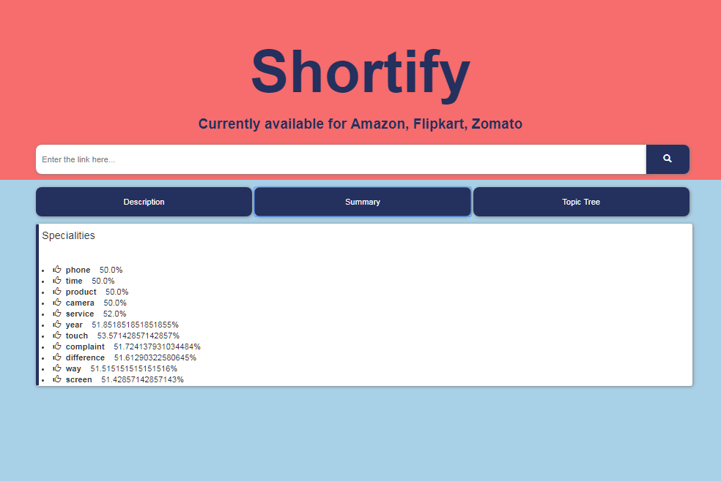
Tablet View
Place your screenshot here

Slide 22
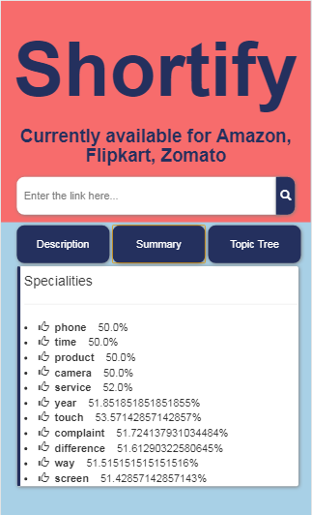
Mobile View
Place your screenshot here

Slide 23
Thanks!
Any questions?

