Slide 1


MEDICAL ASSISTANCE SERVICE SYSTEM
Guided by
Ms.J.Julie
M.E., Assistant Professor
Aditya.G
Krishnan.D
Sairaj.M

Slide 2

ABSTRACT
The quality of healthcare in India is not uniform.
Even in the metros, locating a pharmacy or a healthcare dispensary is very difficult.
“Helping people to locate hospitals and medical shops in the neighborhood along with providing a faster ambulance requesting service” is the main objective of this project.
Additionally, first aid measures along with daily awareness and news from the medical field would be regularly posted.

Slide 3
EXISTING SYSTEM
UNARX
FIND A PHARMACY
Unarx card website allows the users to search based on the zip-code.
It also displays the prices of drugs based on the zip-code.
This website allows users to search based on their address.
It also lets the users to choose the facilities that they would need in the hospital/pharmacy.
The users can also find out the major languages spoken in the pharmacy/hospital.
3

Slide 4
EXISTING SYSTEM
Location Based Emergency Medical Assistance System:
APOLLO-PHARMACY:
Home delivery:
In India, Apollo Pharmacy lets the user call the pharmacy and inform them about the medicines required. The medicines would be delivered to their home.
Online shopping:
Apollo pharmacy also supports online shopping .
The user has to provide the names of the drugs with the description and the drugs would be home-delivered.
It uses OpenStreetMap, to locate the nearest hospitals or pharmacies.
It’s an open source android application that allows users to add medical amenities by providing the location.
4

Slide 5
LIMITATIONS IN EXISTING SYSTEM
UNARX:
The site works only for the United States of America.
Doesn’t support other country and takes a long time for the result if the search radius is above 5 miles.
FIND A PHARMACY:
The site has been designed only to work in Australia. Not supported in other countries.
5

Slide 6
LIMITATIONS IN EXISTING SYSTEM
APOLLO-PHARMACY:
Home delivery:
The major drawback of this system is that the medicines would be delivered only if an ambulance that has been dispatched for an emergency is in the locality of the user.
Online store locator:
It only returns Apollo’s pharmacies and not all the pharmacies in the locality.
Online Shopping
For the delivery, it takes them 24 to 48 hours in Metros subject to the availability of the drug and in non-metros it takes them around 3 to 6 days subject to the availability of the drug.
6

Slide 7
PROPOSED SYSTEM
The user enters as input the required branch of healthcare or the required drug.
The android application gets the user location details using the GPS and searches the database stored in the server.
The result of the search would be the list of nearest hospital that provides the required particular service or the pharmacy in which the required drug is available and its location in a map.
During emergencies the user can also request the service of an ambulance as the application can generate a message to the nearest hospital along with the user location.
7

Slide 8
PROPOSED SYSTEM
Ambulance will be dispatched according to the location specified in the request so that the ambulance reaches the user on time.
Information about expired drugs and their available substitutes , as well as the latest news and developments in the medical field will be provided to the user to create awareness.
8

Slide 9
LITERATURE SURVEY
Location based Emergency Medical Assistance System using OpenStreetMap(OSM) authored by Rajib Chandra Das and Tauhidul Alam focuses on using OSM to locate nearest hospital.
OSM uses an open editable map to enable users to edit and make it accurate.
OSM along with Google Maps can provide a reliable and accurate mapping system.
The API level used for the App uses API level 9 which is Android 2.3.3. This makes the App compatible with 99.97% of the Android Users.
9

Slide 10
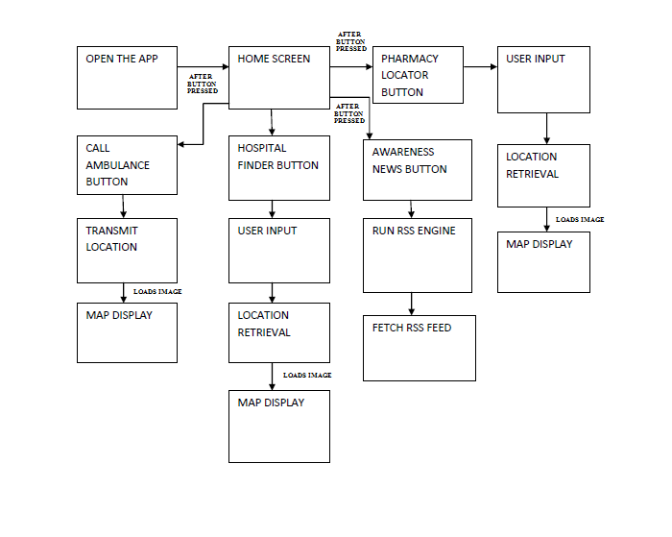
BLOCK DIAGRAM

Slide 11
MODULES
INTERFACE DESIGN AND CODING
Basic Android Interface Design
INFORMATION DISPLAY
Awareness Information
First-aid Information along with news
Android
EMERGENCY SMS SERVICE-CODING
11

Slide 12
MODULES
HOSPITAL/PHARMACY LOCATOR
DBMS Creation
Hospital/Pharmacy Information Listing
TESTING
Sample Space Testing
Real time Testing
DEPLOYMENT
12

Slide 13
REQUIREMENTS
Software Requirements:
Android Studio plus SDK
PHP HOST:
Operating system: Linux orWindows
Web server (Apache, or IIS) PHP MySQL Server
OpenStreetMap for locating the hospitals and pharmacies
GOOGLE MAPS for directions
13

Slide 14
REQUIREMENTS
Hardware Requirements:
PC with MAC or Windows OS(8/7/Vista/2003).
At least 600MB space for SDK plus 1GB for the Android Studio.
CPU with Virtualization(VT) enabled.
2GB RAM Minimum,4GB recommended.
USB drivers.
Android phone with Gingerbread OS or higher.
14

Slide 15
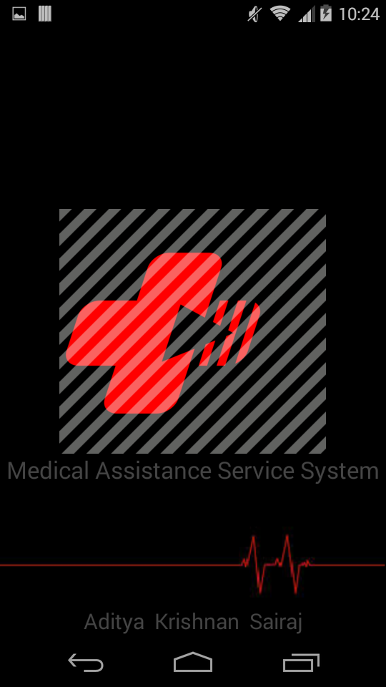
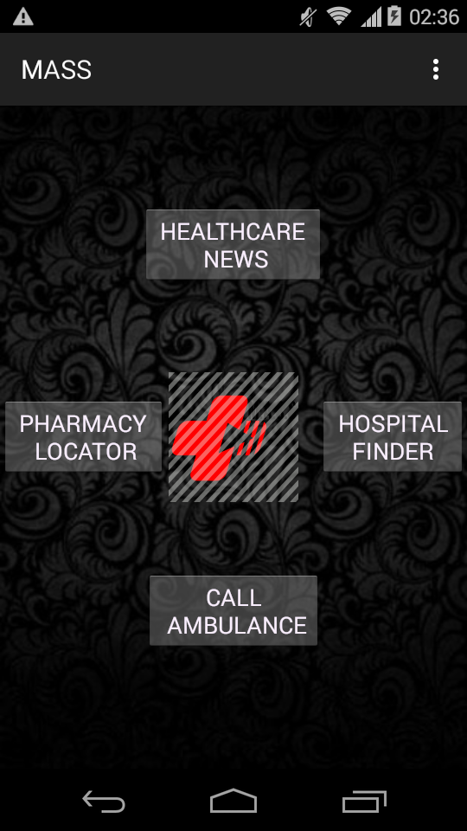
OPERATIONS
The first module, i.e, the basic interface and design of the App has been designed.
The design has a basic splash screen to display logo followed by a central four button design, with each button having a function.
15

Slide 16
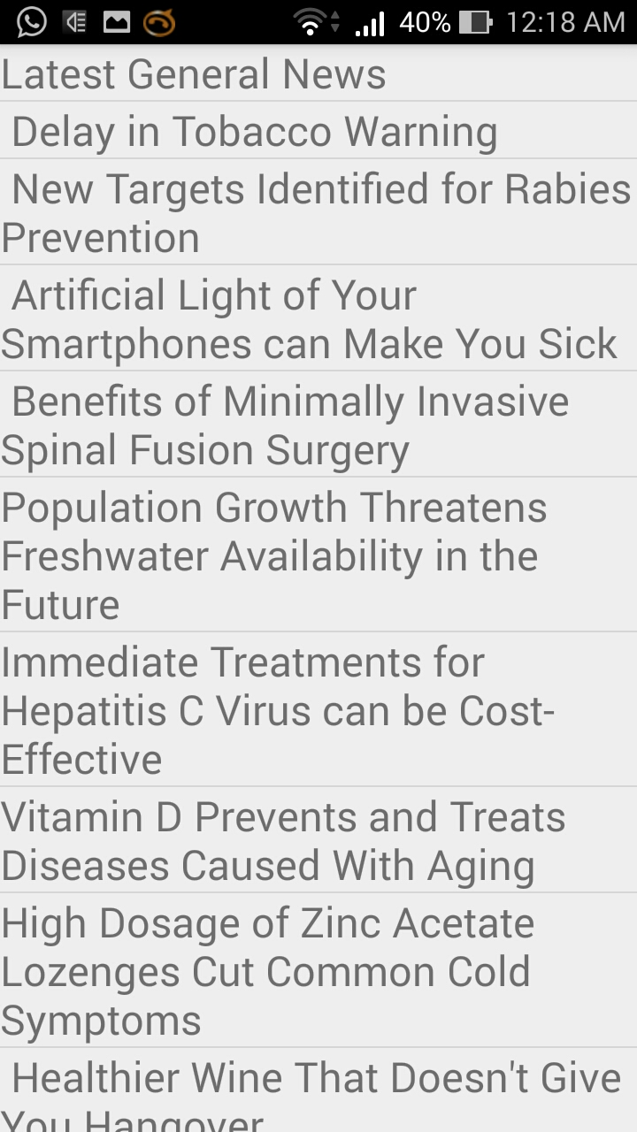
OPERATIONS-NEWS FEED
The second module is the News and Awareness feed.
The News function is used to display current medical news and awareness information.
The News function uses RSS feed concept to get recent trending news from reputable medical web sites.
Each trending title can be opened and read on the browser.
16

Slide 17
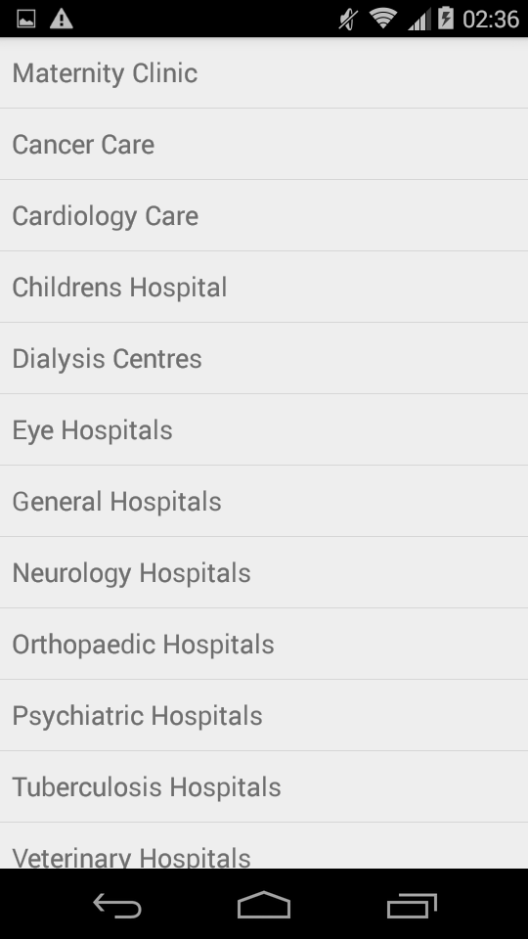
OPERATIONS-HOSPITAL FINDER
The third module focuses on locating the current location of the user using an in-built GPS API and displaying it on the map.
Using user location the nearby Hospitals are discovered and displayed on the map and its details are listed.

Slide 18
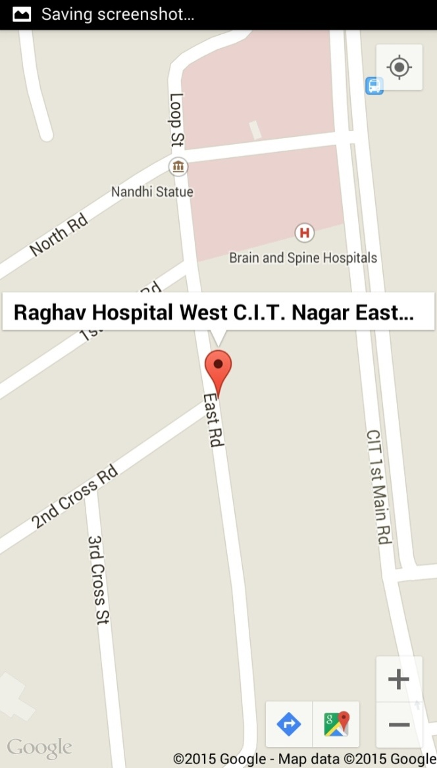
OPERATIONS-HOSPITAL FINDER
Once the hospitals are marked on the map, Haversine’s formula is used to locate the nearest hospital.

Slide 19
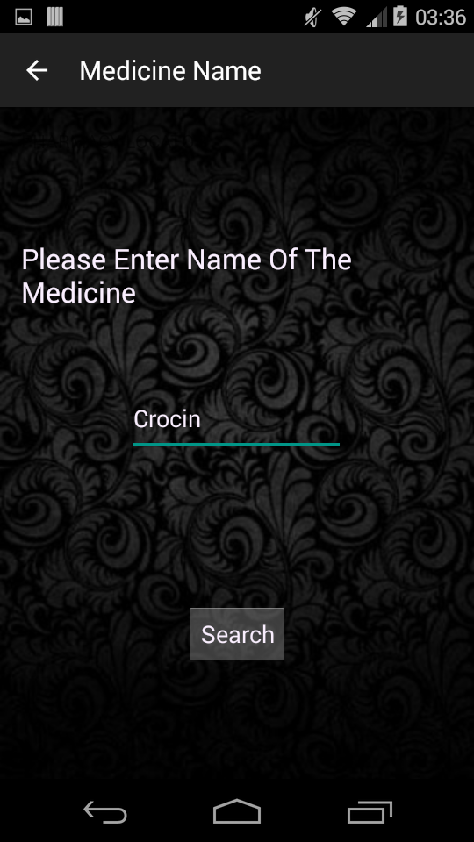
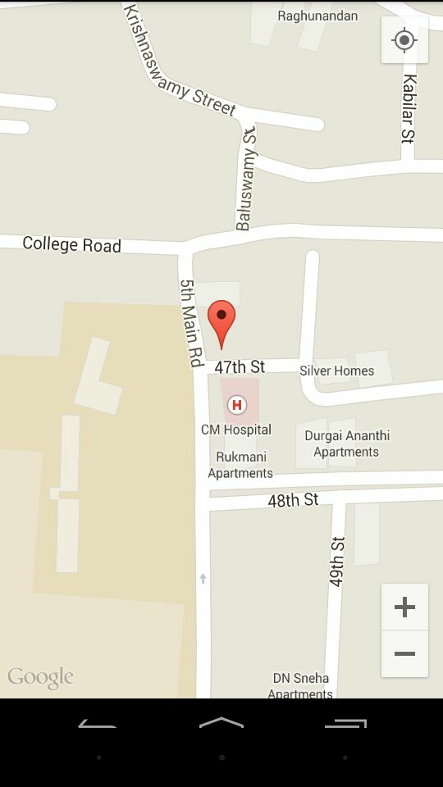
OPERATIONS-PHARMACY LOCATOR
Similarly, the nearest pharmacies can also be located around the user’s current location.
Using the user input for required medicine, the pharmacies are filtered and displayed.

Slide 20
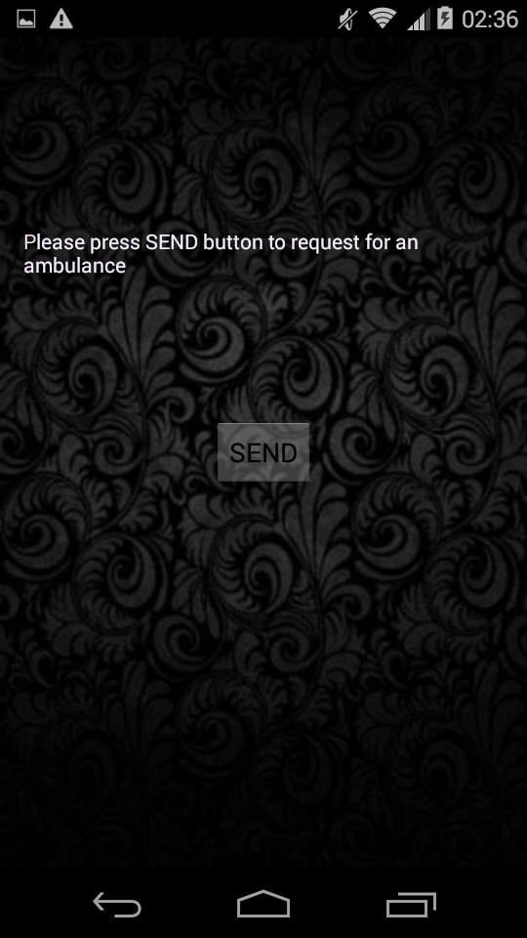
OPERATIONS-AMBULANCE DISPATCH
The ambulance requestor uses socket programming to send user GPS coordinates to the hospital or emergency service.
User has to press the send button upon which there would be message from the server saying that the ambulance has been dispatched to the current location of the user.

Slide 21
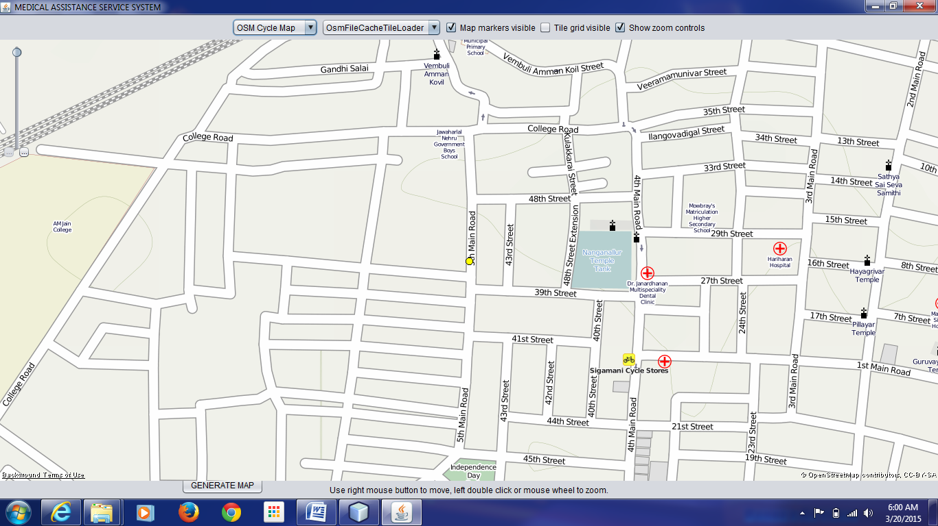
OPERATIONS-AMBULANCE DISPATCH
When the client requests for an ambulance, its GPS coordinates are sent to the server application which displays it in an Open Street Map.

Slide 22
CONCLUSION
The four completed modules of the App have been designed and tested in real time.
Further enhancements are being considered and will be made in future iterations.
22

Slide 23
REFERENCES
Location Based Emergency Medical Assistance System Using OpenStreetMap
http://www.apollopharmac y.in/store-locations
http://unarxcard.com/pharmacy-search.php
http://www.findapharmacy.com.au/Advanced.aspx
http://www.apollopharmacy.in/prescription
http://www.worldlifeexpectancy.com/country-health-profile/india
http://hswsolutions.com/services/mobile-web-development/mobile-website-vs-apps/
http://techcircle.vccircle.com/2014/05/29/india-had-third-largest-smartphone-base-with-117m-users-in-2013-to-grow-45-in-2014-mary-meeker-report/
23

Slide 24
REFERENCES
K.ATHAVAN,”AUTOMATIC AMBULANCE RESCUE SYSTEM”, Department of electronics & comm.Engg,Sri Venkateshwara College of Engg
ISBN:978-1-4673-0471-9, 10.1109/ACCT.2012.34
Mobile Health, “http://en.wikipedia.org/wiki/MHealth”
Location Based Service (LBS), “http://en.wikipedia.org/wiki/Locationbased_service”
OpenStreetMap, “http://wiki.openstreetmap.org/wiki/OpenStreetMap”
24

Slide 25
THANK YOU!

