Slide 1

Customer 360 Decisioning Platform
Team Name : Simplifiers
Team Leader Name : Sairaj Sawant
Team Size : 1
Problem Statement : Customer 360 and Next Best Action Engine

Slide 2

Customers signal what they'll do long before they do it
Insurers and lenders already hold the evidence. It's spread across systems nobody reads together.
Scattered data
WHO IT'S FOR
Policies, claims, payments, calls, emails and tickets live in separate systems.
Relationship Manager
A ranked worklist and the next best action for each customer
Missed warnings
Team Lead
A customer threatens to switch insurers on a call while their claim sits stuck for weeks. Nobody links the two.
Approves larger offers for the team
Analyst
Inconsistent action
Tunes signals, weights and rules without code
Every RM decides alone, and nobody learns which actions actually work.
Indian health insurance and retail lending: IRDAI grievances, cashless claims, portability, EMI stress

Slide 3
From customer question to next best action
Unify every touchpoint, read it with AI, decide with approved rules, and learn from every outcome.
1
Unify
30
8
Calls, emails, tickets, payments and policies become one live customer view.
customers unified, every one scored
source types, in English and Hinglish
2
Understand
AI picks out intent, sentiment and evidence from every conversation.
184
3
3
Decide
live signals, each with its evidence
decision engines running side by side
Approved rules rank the next best action for each role.
4
19
4
Learn
Every outcome updates which actions work best.
reusable CoCo CLI skills
config rows to add a new engine

Slide 4
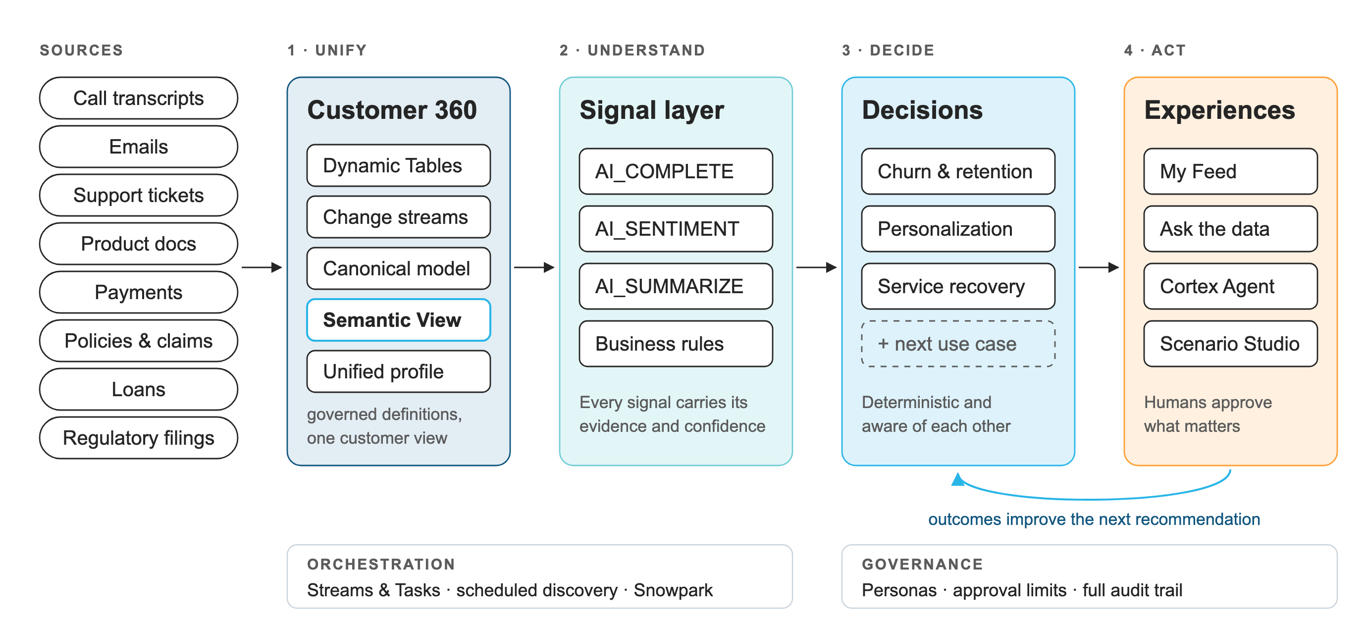
Architecture: four independent layers
Each layer reads only from the one before it, so any layer can change without touching the rest.

Slide 5
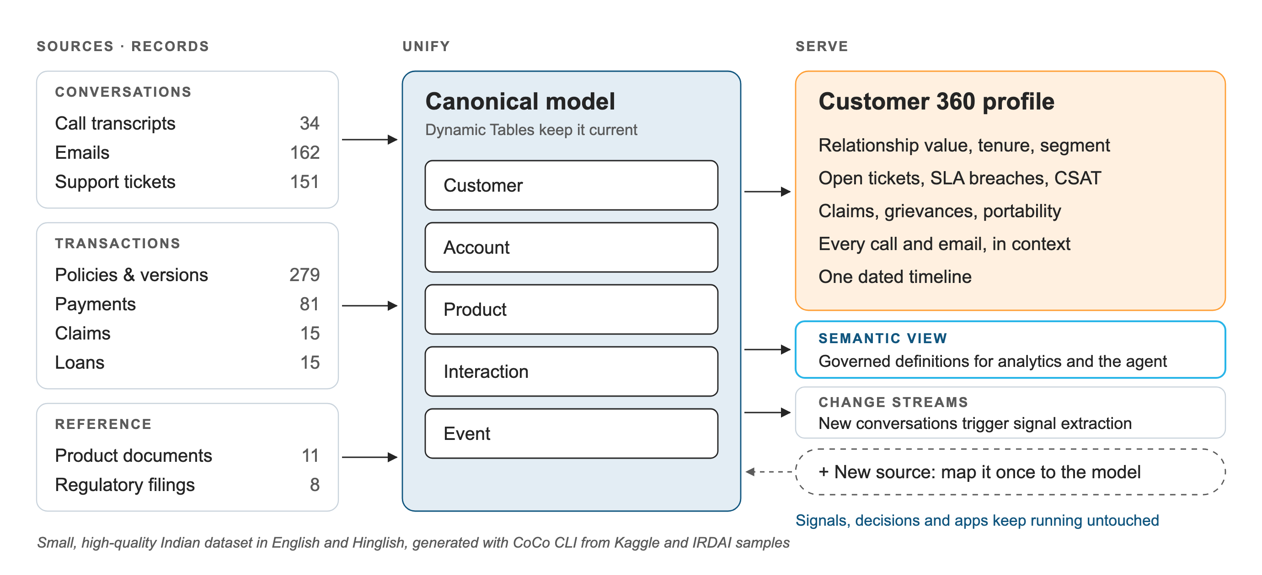
Layer 1 · Every touchpoint, one customer
A small, high-quality Indian dataset. Dynamic Tables keep it current; a semantic view gives everyone the same definitions.

Slide 6
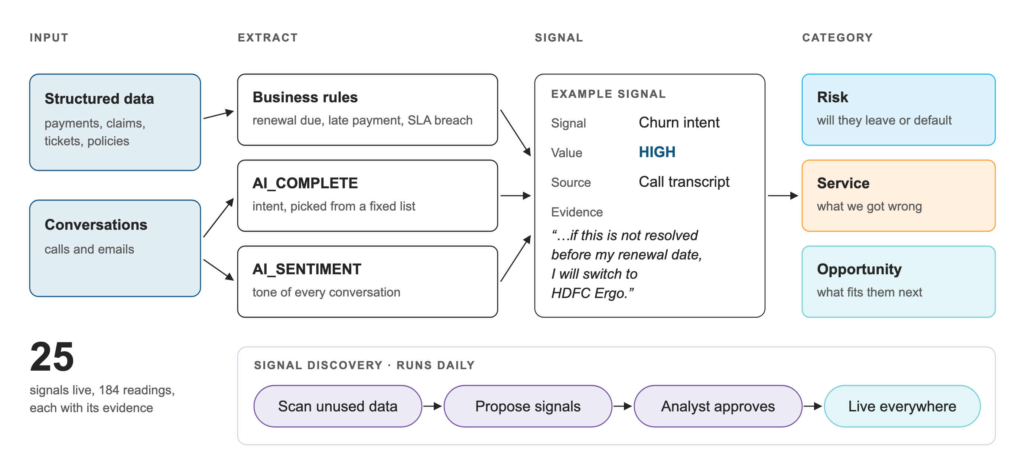
Layer 2 · AI turns conversations into evidence
AI extracts facts into a fixed vocabulary, and every signal keeps the sentence that justifies it.

Slide 7
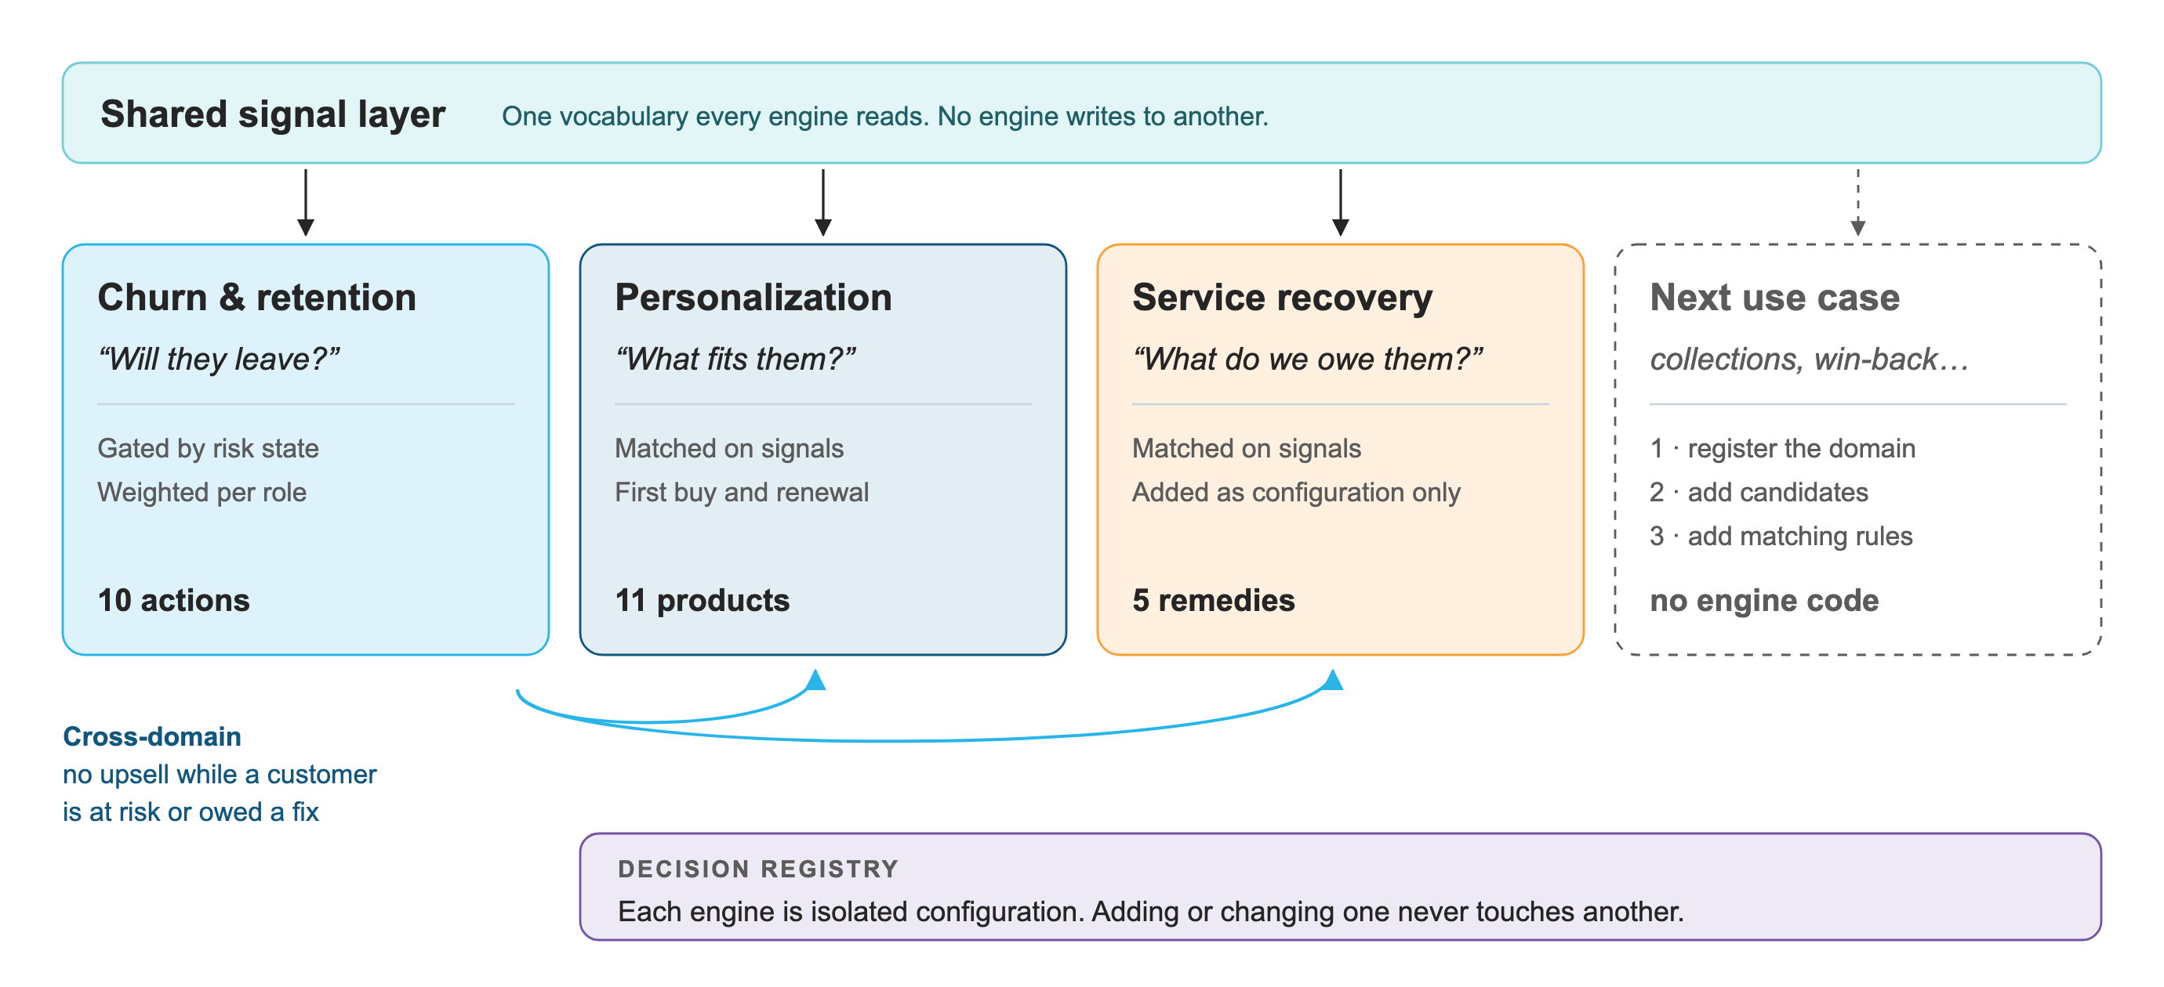
Layer 3 · Isolated engines on a shared vocabulary
Each use case is its own engine. All read the same signals, and none can change another.

Slide 8
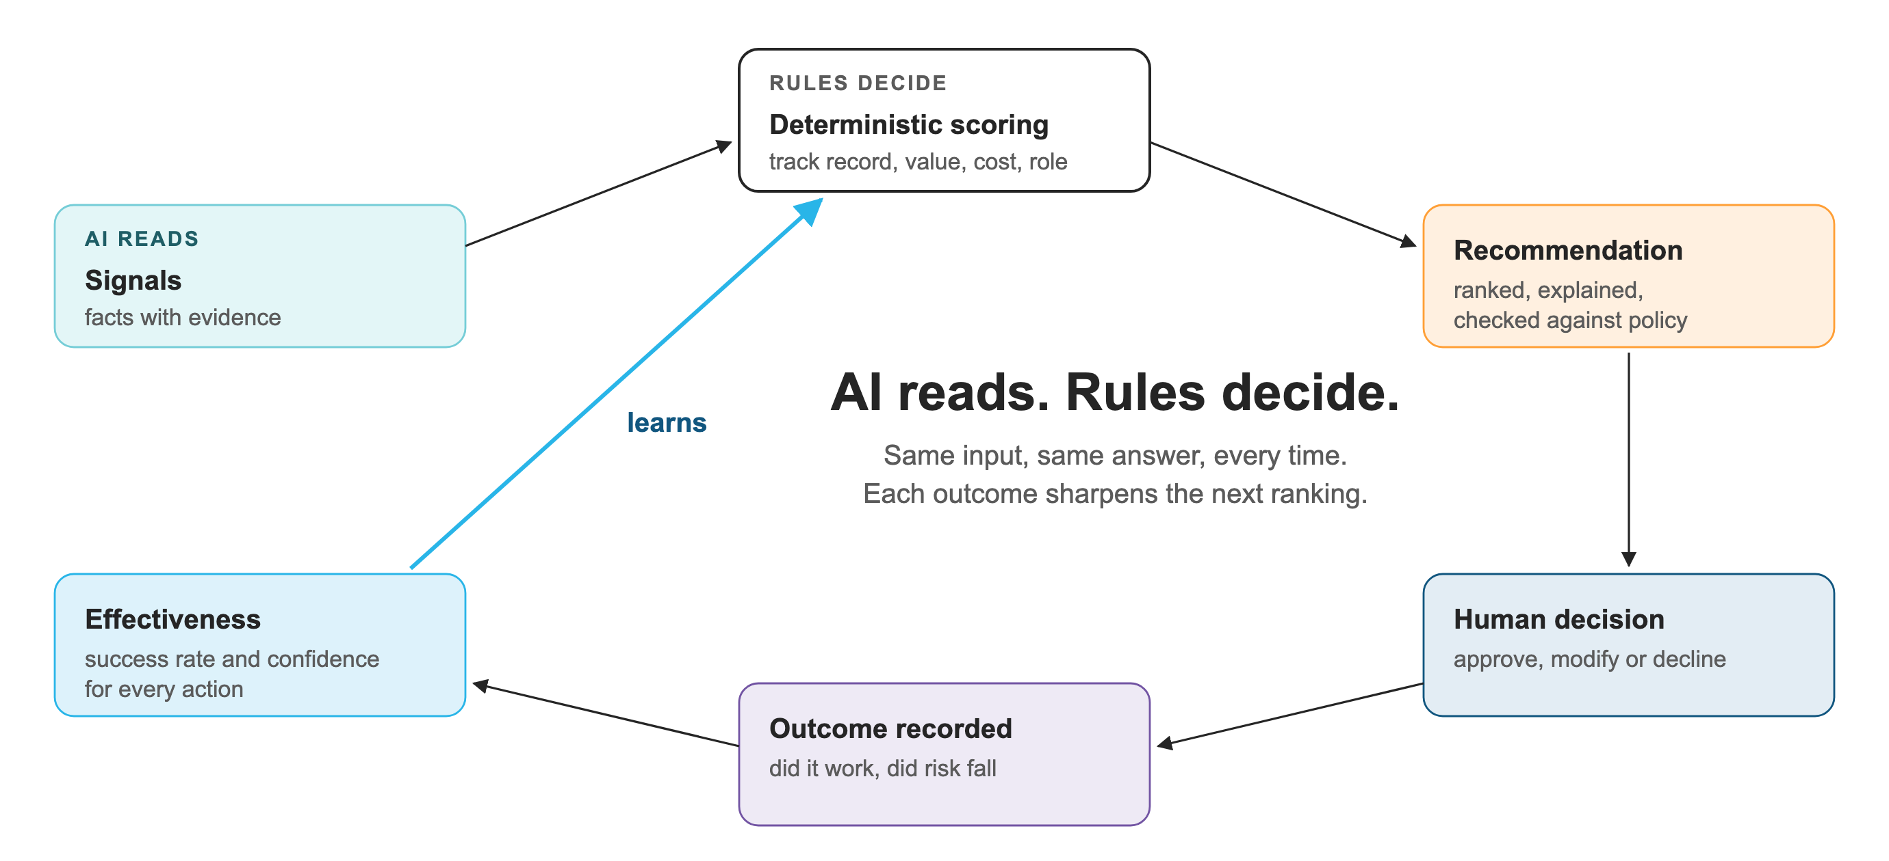
Repeatable recommendations that keep improving
AI reads, rules decide. Scoring runs on measured track records, so every answer can be reproduced and explained.

Slide 9
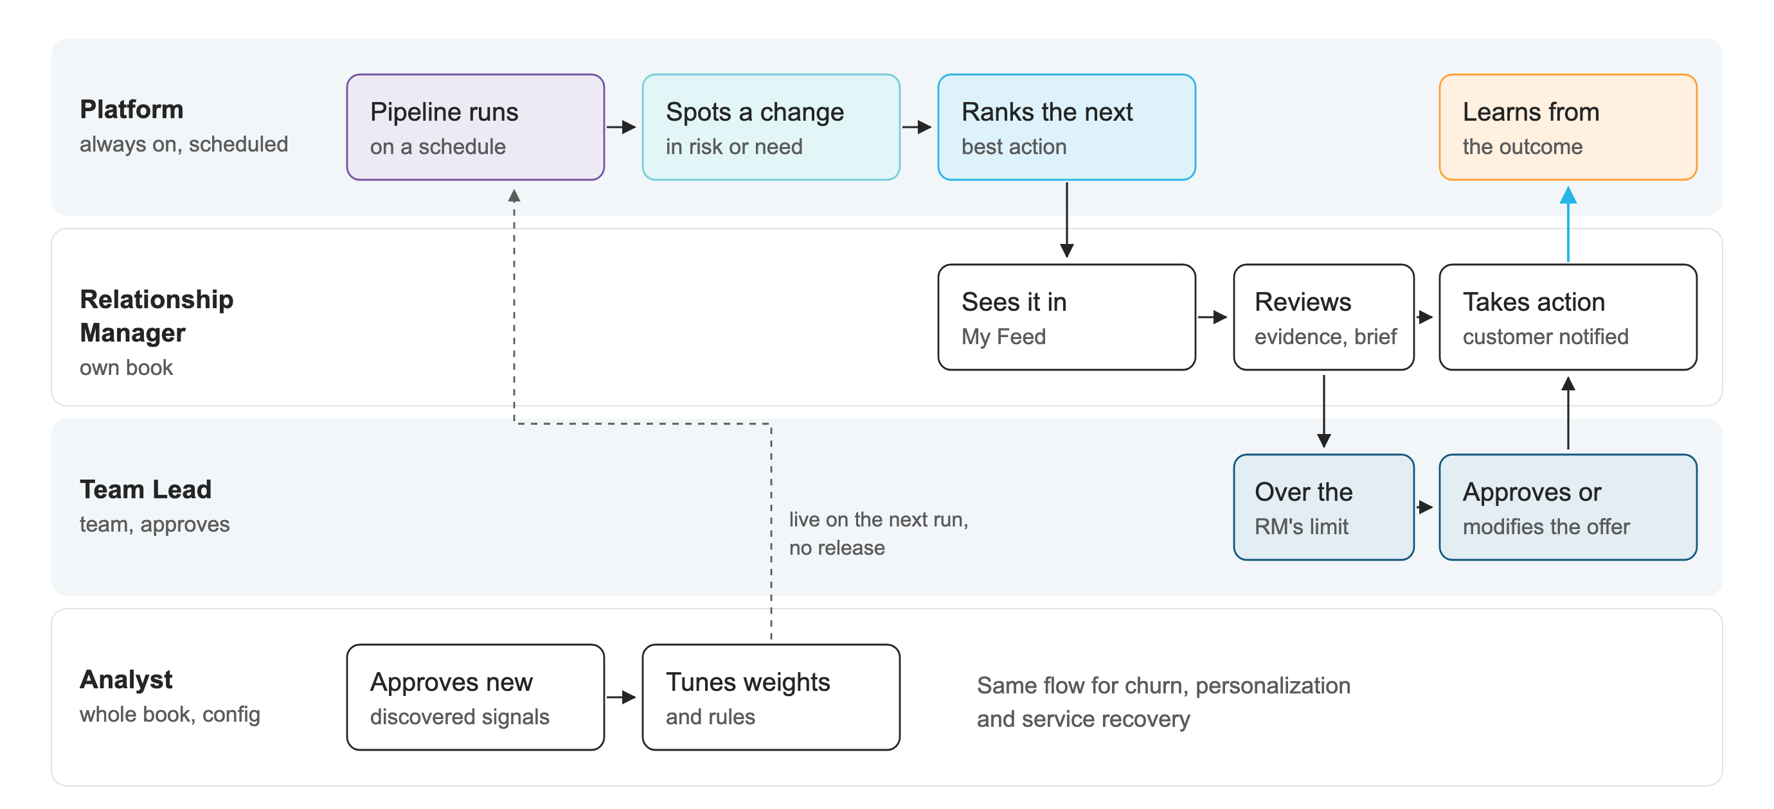
Proactive by default, with people in the loop
The platform watches every customer on a schedule and routes each decision to the person with the right authority.

Slide 10
Adding a use case takes configuration only
We added Service Recovery to the working platform. Nothing that already existed changed.
19
BEFORE
AFTER
3 customers with stuck claims were on nobody's worklist
All 3 now top the list with an expedited claim
configuration rows
0 lines of engine code
2 customers we had let down were offered a loan top-up
Both get a priority callback, and no upsell until it's fixed
Existing engines returned identical results before and after the change.

Slide 11
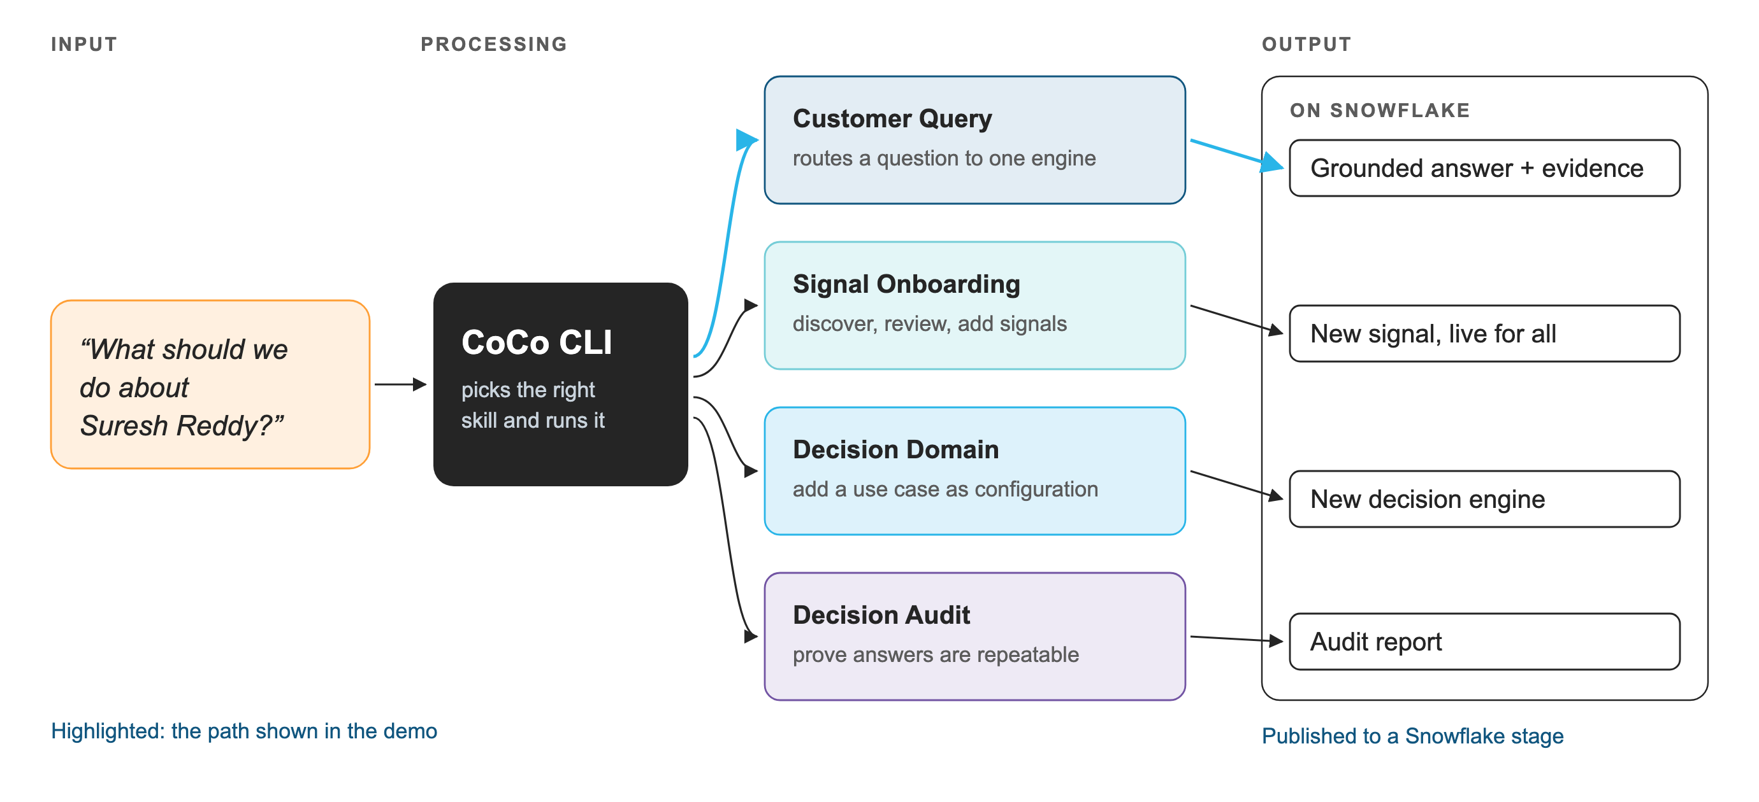
Built and run with CoCo CLI
CoCo CLI seeded the data, built the platform, and publishes four reusable skills to Snowflake for any team.

Slide 12
Snowflake capabilities in use
Data, AI and the app all run inside Snowflake. No customer data leaves the account.
Dynamic Tables
Streams & Tasks
Snowpark Python
Semantic View
Keep the unified customer view current
Detect change and run the pipeline on schedule
Portfolio-wide scoring and signal discovery
Shared, governed business definitions
AI_COMPLETE
AI_SENTIMENT
AI_SUMMARIZE
Cortex Search
Intent from calls, held to a fixed list
Tone of every conversation
A customer's history in one paragraph
Search calls, emails and product documents
Cortex Agent
Streamlit in Snowflake
Masking & row access
CoCo CLI
Natural-language access to every tool
The app runs right next to the data
PII masked, each persona sees only its book
Built the platform and packages it as skills

Slide 13
What's live in the app today
Two modes on live Snowflake data: a guided studio and the everyday console.
Scenario Studio
Operations Console
The full loop on any customer, step by step
Day-to-day product, scoped to the role you pick
1
Stage an event describe it, AI writes a realistic call
My Feed today's ranked worklist
Decision Queue by severity and value
2
Detect signals extracted with their evidence
Approvals offers waiting on you
3
Understand state recomputed, conflicts resolved
Customer 360 profile, evidence, timeline
4
Decide ranked for your role, limits checked
Portfolio & Learning value at risk, what works
5
Ask the data chat that remembers context
Act carried out, customer notified, call brief
Config Studio weights, limits, rules
6
Learn outcome recorded, ranking re-run
Signal Discovery daily suggestions

Slide 14
Enterprise ready by design
Private by default
Scoped by role
Spending limits
Data stays in your account, and masking policies hide PII from roles that don't need it.
Row access policies: RMs see their own book, team leads their team, analysts all.
Offers above a role's limit wait for someone with the authority.
Signals with evidence
Repeatable decisions
Full audit trail
Each signal keeps the quote and confidence behind it.
Same input, same answer. AI reads, rules decide.
Every recommendation, action and outcome is recorded and reversible.
Configuration-driven. Weights, limits, rules, signals and whole use cases change without a release.

Slide 15
Impact
Measured on the prototype's live data.
93 of 184
5
signals come only from what customers said, invisible to structured systems
customers caught who had fallen through the gaps
~1 sec
1 question
to rank every customer into today's worklist
from a customer question to a recommended action
In production: less prep per customer, consistent actions across RMs, and a measured view of which actions work.

Slide 16
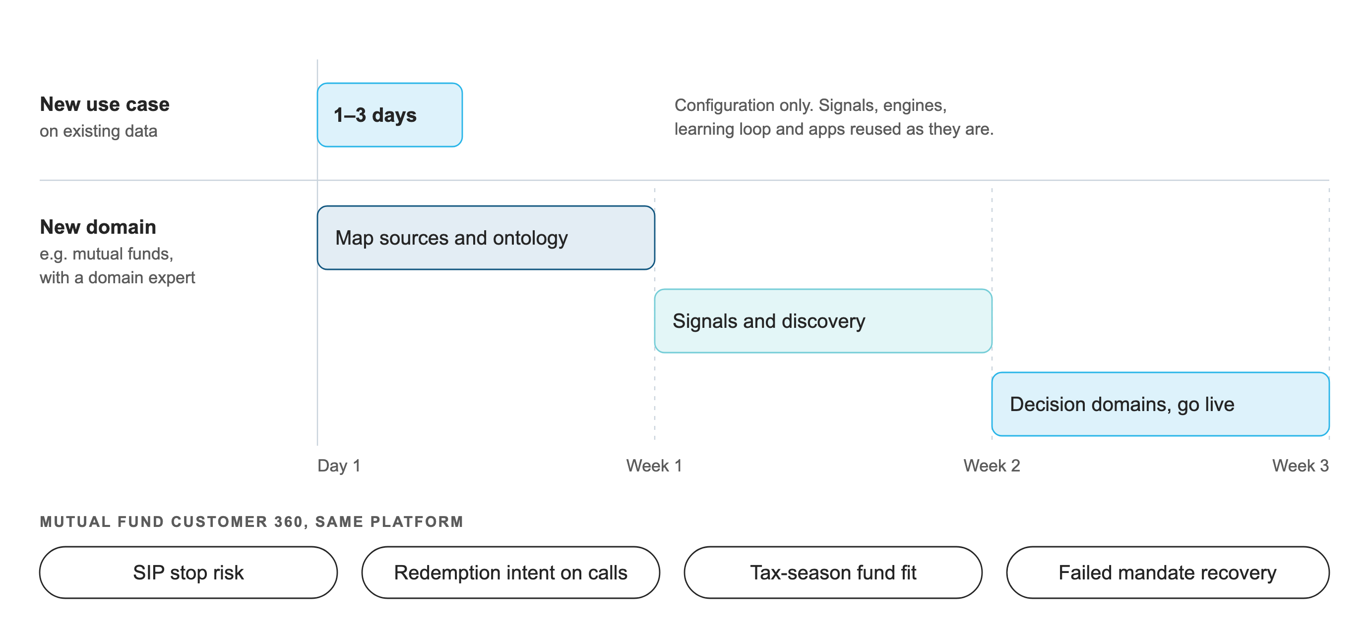
New use cases in days, new domains in weeks
Everything above the data mapping is reused. A domain expert shapes the ontology; the platform does the rest.

Slide 17
An incremental 360 that scales at marginal cost
Work is done only where something changed, so a bigger book doesn't mean a bigger bill.
Incremental Dynamic Tables
Changed-customer streams
Facts refresh only where the data changed
Signals and state recompute only for customers who changed
Daily time tick
Signal fingerprints
Date-based signals touch only customers crossing a threshold today
Customers whose signals didn't change are skipped
AI cost grows with new conversations. Rule cost grows with changed customers, and time-based signals with threshold crossings.

Slide 18
Beyond the demo
Each step builds on the platform as it is. Estimates assume one engineer.
Connect real sources
CRM, core policy and loan systems and the contact centre through Snowflake connectors, mapped once to the canonical model.
1–2 days per source
Actions in Slack and Jira
Approved actions post to the RM's channel and open a ticket automatically.
2–3 days
Fine-grained access
Extend row access by region and branch, and masking to every new source.
2–3 days
Cross-domain, any entity
The same engines over households, SME accounts or policies, with shared suppression across all of them.
1–2 weeks
AI onboarding wizard
Describe a use case or signal in plain English. AI drafts the configuration and a person approves it.
1–2 weeks

Slide 19
What the demo shows
One workflow end to end, input to output, in CoCo CLI and then in the app.
INPUT
PROCESSING
OUTPUT
An RM asks CoCo CLI
Customer Query skill
A grounded answer
“What should we do about Suresh Reddy?” and then a follow-up about another customer.
Finds the customer, picks the one engine that answers the question, and runs it on Snowflake.
The ranked action with its track record and approval status, backed by his own calls.
THEN IN THE APP
My Feed across all three engines · the full loop in Scenario Studio · a follow-up chat that remembers who you asked about

Slide 20


