Slide 1
Auto-QUEST: Question answer Generator
Arjun Karthikeya N
Sai Rakshith A M S
Utham N

Slide 2
Outline
Project Overview
Technology Stack
System Architecture
Dataset
Question Generation Models(M1)
Question Generation Models(M1-Alternative)
Answer Generation Model(M2 – RAG)
Performance Metrics
Demo
Future Works
Contributions
Q&A

Slide 3
Project overview
Generate Question Answer pair for a given context
Built a scalable architecture for knowledge retrieval.
Integrated transformer models with RAG.
Built a frontend application for interacting with the model

Slide 4
Technology Stack
Text to text transformer (T5-small) for question generation
Bidirectional Encoder Representations from Transformers (BERT-GPT2) Hybrid Model for question generation
RAG (Retrieval-Augmented Generation) for answer generation
PyTorch for model training
Vector database (Milvus) for storing of information
Streamlit for frontend Application

Slide 5
Dataset
We have synthetically generated the dataset using Gemini 2.0 Flash API.
Dataset 1
We have generated context for 100 different scientific topics, where each context will have 3 different questions along with its respective difficulty tags.
We have around 6327 unique contexts and a total of around 18,981 questions with its respective difficulty tag.
Dataset 2
We have generated the context for 100 different scientific topics, for each topic we have generated the question and answers.
We have around 67,501 unique context along with its question and answers generated

Slide 6
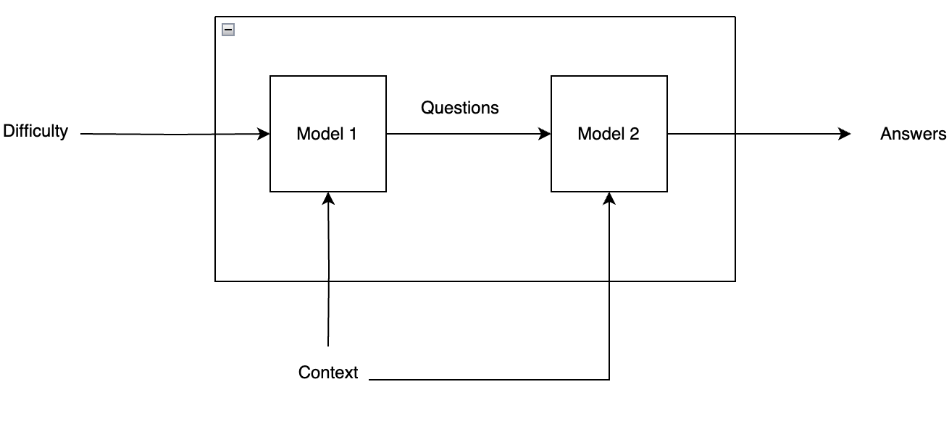
System Architecture
Model 1
Finetuned T5 Text-to-text model
Finetuned BERT-GPT2 model
Model 2
Retrieval Augmented Generation

Slide 7
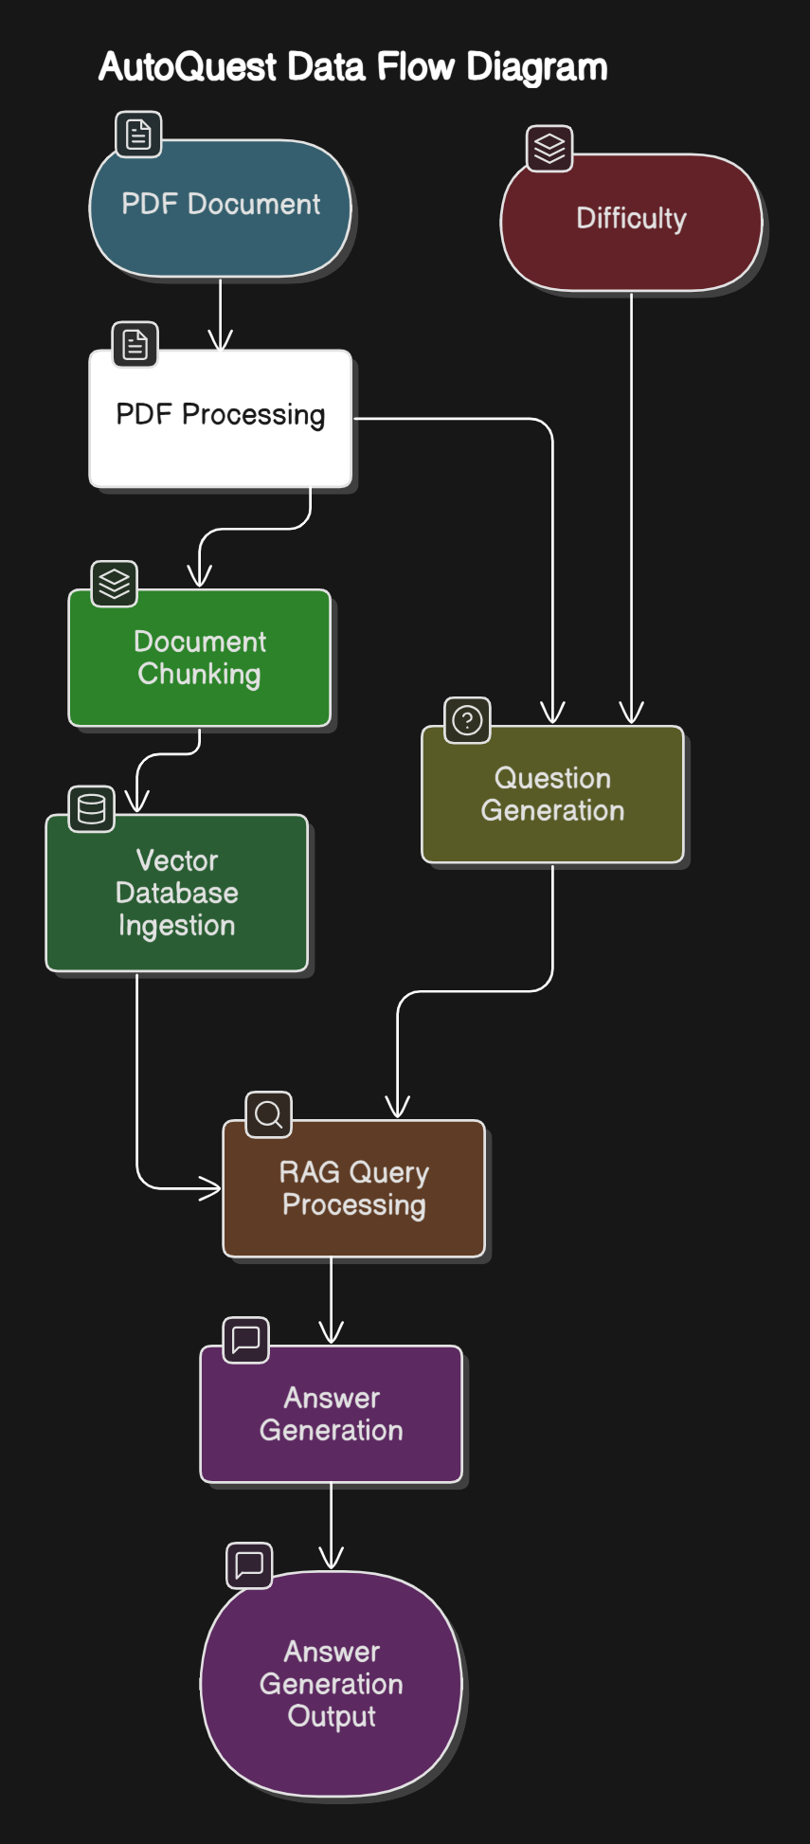
System Architecture – cont.
The diagram in the left is what we designed as a solution for the problem.
The Question Generation box is M1.
The parallel process until answer generation is M2.

Slide 8
Question Generation (M1)
Used T5 small model which is a relatively smaller model compared to T5-base.
sequence-to-sequence framework optimized for text generation task.
Input : A pdf is given as the input and each paragraph is extracted.
Preprocess : The dataset is the preprocessed by extracting context, questions and answers separately.
Output : Top questions from the context, where each repeated question is penalized and asked to generate again.
We then run a cosine similarity on the final questions to further remove questions which are very similar.
Save the trained model.

Slide 9
Question Generation (M1-Alternative)
Encoder – decoder architecture using Bert base uncased - gpt2 model.
Freeze most encoding layers except for the last 2 layers.
Special token are defined for different difficulty levels. (Easy, Medium and Hard)
A pdf file is given as input from which each paragraph is extracted.
We then run a cosine similarity on the final questions to further remove questions which are very similar.
Save the model

Slide 10
Answer Generation model(m2 - RAG)
PDF Processing (PDF Utilities): Extracts text, metadata, and structural elements from PDFs.
Vector Database (vector Database): Chunks text semantically, generates embeddings, and stores content in Milvus with metadata for efficient retrieval.
Answer Generation:
Implements hybrid retrieval (vector similarity + BM25)
Reranks results with cross-encoder models
Generates contextual answers using sequence-to-sequence models
Provides source attribution for verification
PDF Ingestion
Chunking and storing in Vector DB
User Query Processing
Contextual Retrieval
Answer Generation

Slide 11
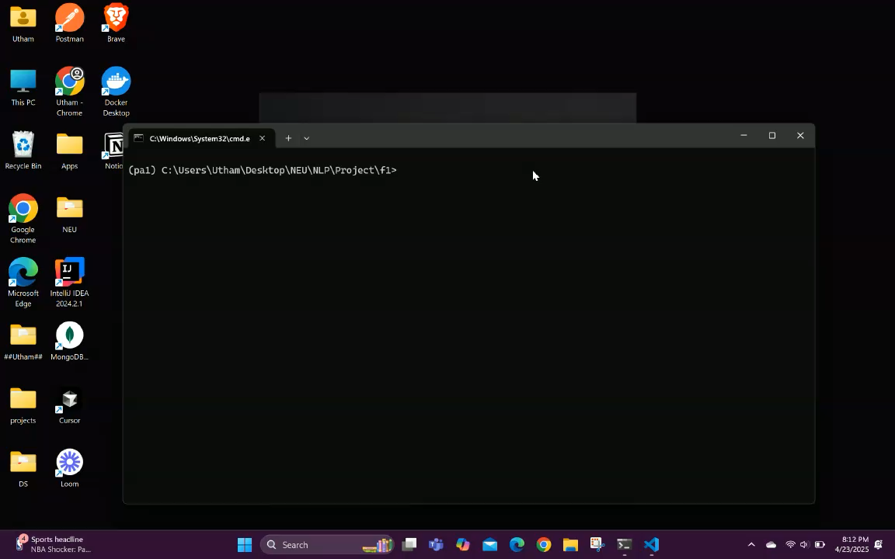
DEMO
Video Link: https://www.loom.com/share/7f3430148d404d17b7906aeb877f5cf9?sid=81920ecb-5b79-43dc-8bc7-1390c3884d19

Slide 12
Performance Metrics
Model Name | BLEU Score | ROUGE Score
T5 (Text to Text Transformers) | 20.19 | Easy Questions – 59.44 Medium Questions – 42.91 Hard Questions – 39.41
BERT – GPT2 Model | 5.58 | Easy Questions – 35.19 Medium Questions – 28.51 Hard Questions – 30.81
RAG Model – Generative Model | 63 | 96.01

Slide 13
Future Enhancements
Developing the model to manage multimodal inputs, such as schematics and pictures.
Extend the core functionalities to accommodate other languages.

Slide 14
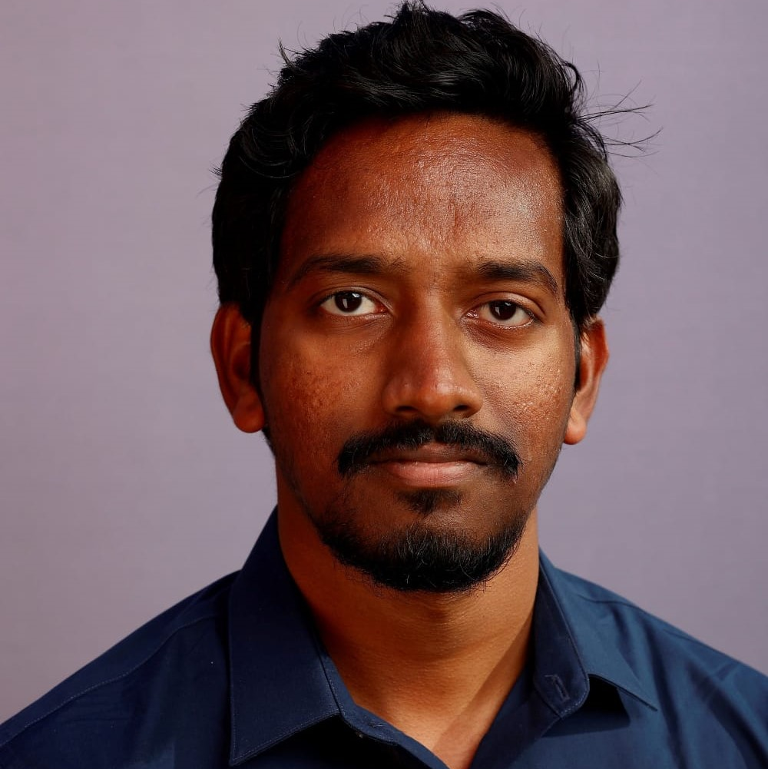
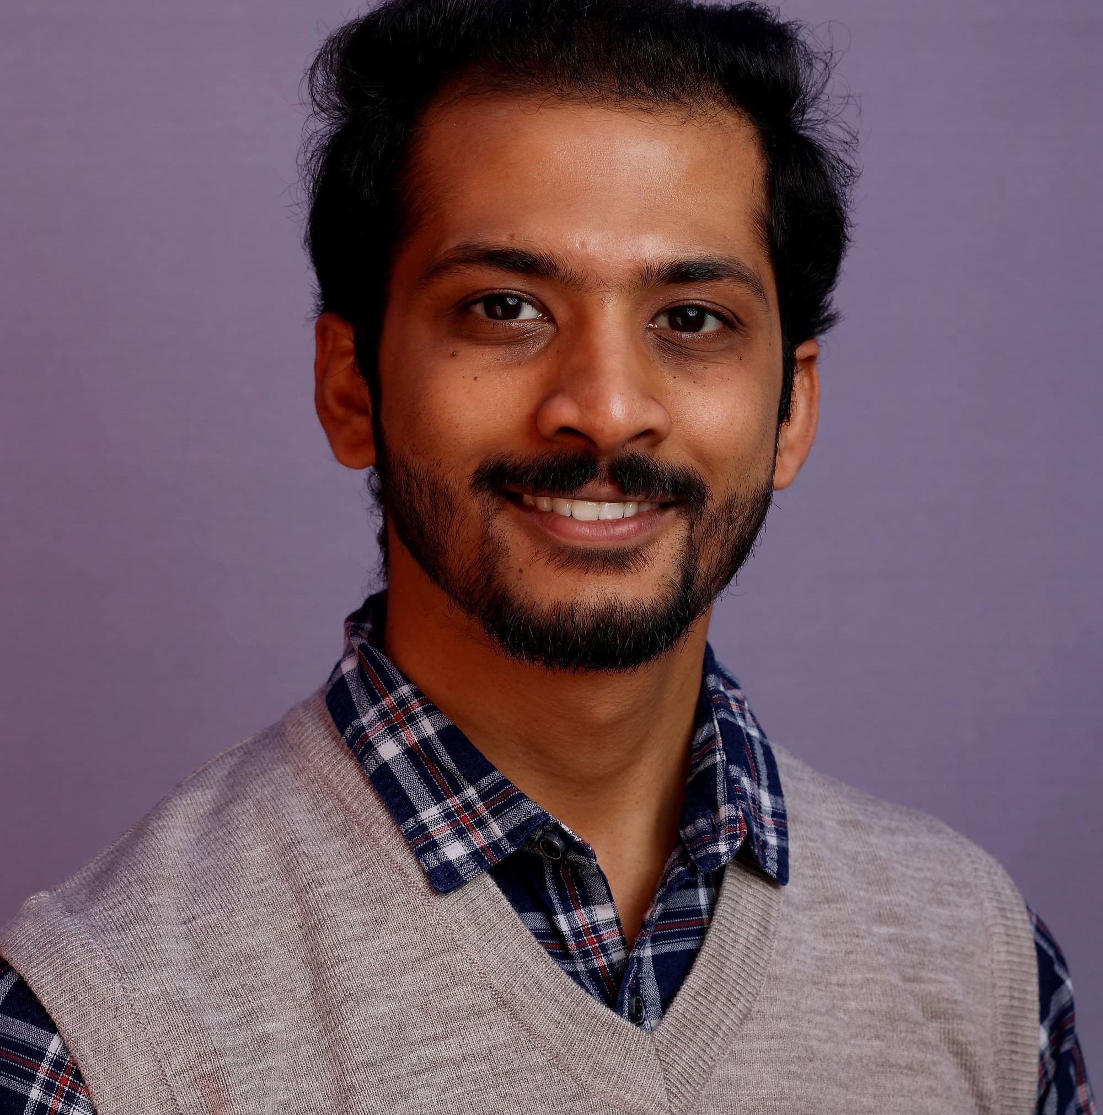
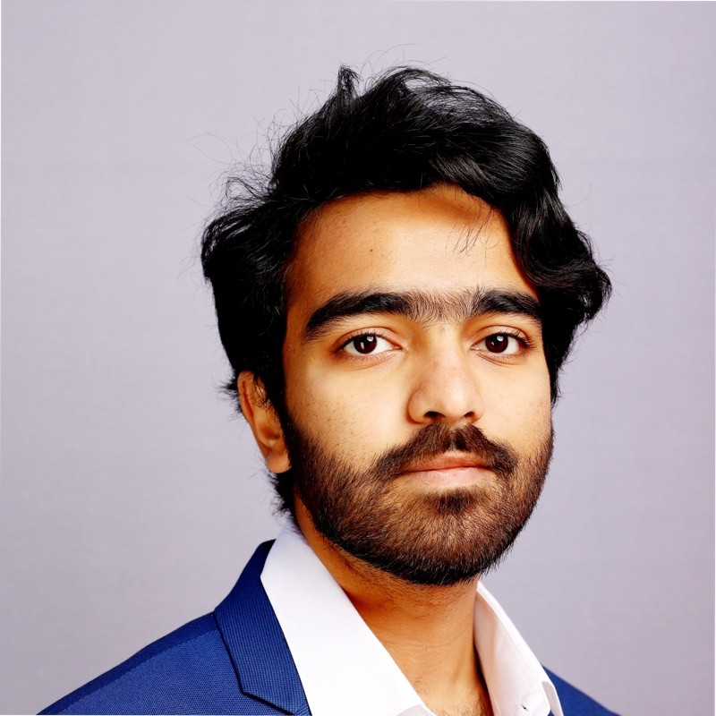
Meet The Team
Arjun K N
Sai Rakshith A M S
Utham N

Slide 15
Contributions
Arjun – Fine tuned Bert – GPT 2 Hybrid model
Sai Rakshith – Fine Tuned T5 (Text-to-text) Transformer model
Utham – RAG Model
Dataset Generation – Combined effort of all the 3 people.
Frontend Integration – Combined effort of all the 3 people.
Report, PPT – Combined effort of all the 3 people.

Slide 16
THANK YOU

