Slide 1
Predicting daily Energy usage for homes in london
Prepared By:
Rami Subramaniam

Slide 2
1. Business Understanding
Business Understanding
Data Understanding
Data Preparation
Modeling
Evaluation
CRISP DM _{TM}
See which factors affect energy usage for the average home on London England
Weather: Temperature, Humidity, Wind, Dewpoint
Household size: # of Rooms and People
Type of neighborhood: Affluent, Comfortable, and Adversity
When: Day of Week
Purpose:
Guide power producers
Planning of future energy policy
Tips for home-owners
“ To better follow the energy consumption, the government wants energy suppliers to install smart meters in every home in England, Wales and Scotland.
This roll out is lead by the European Union who asked all member governments to look at smart meters as part of measures to upgrade the energy supply and tackle climate change. After an initial study, the British government decided to adopt smart meters as part of their plan to update our ageing energy system.”

Slide 3
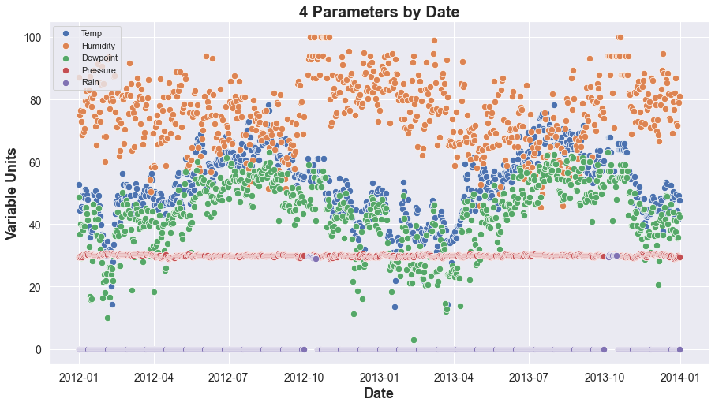
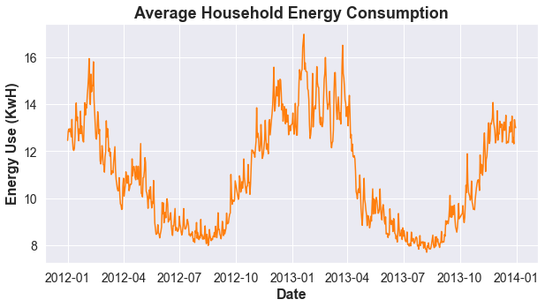
2: Data Understanding
Business Understanding
Data Understanding
Data Preparation
Modeling
Evaluation
Weather Underground:
Scraped historical data from 01/2012 - 12/2013
All Zeroes for Rain!
Energy Usage (Kaggle):
Energy usage from 5000+ smart meters in London Area.
Household info

Slide 4
3. Data Preparation
Business Understanding
Data Understanding
Data Preparation
Modeling
Evaluation
Weather Parameters
Calculated Parameters
Parameter
Temperature(F)
Dew Point(F)
Pressure(Hg)
Humidity(%)
Wind Speed (mph)
Daylight (Min)
Parameter
Expected # of Bedrooms
Expected # of People
Neighborhood by Wealth
Day of Week

Slide 5
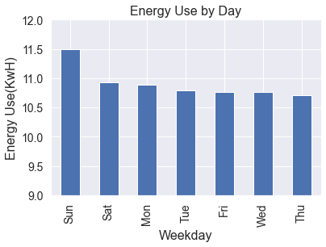
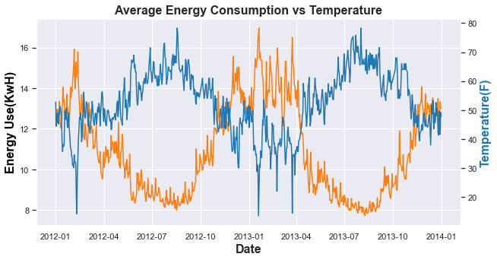
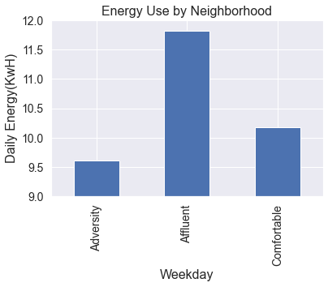
3: Data Preparation
Business Understanding
Data Understanding
Data Preparation
Modeling
Evaluation
Categorical Trends
Energy vs. Temperature

Slide 6
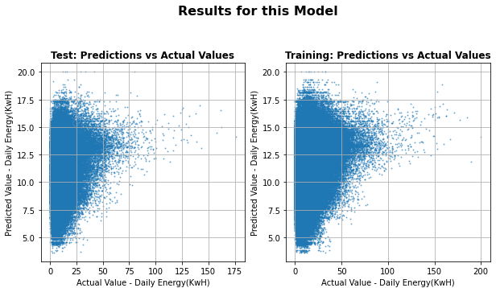
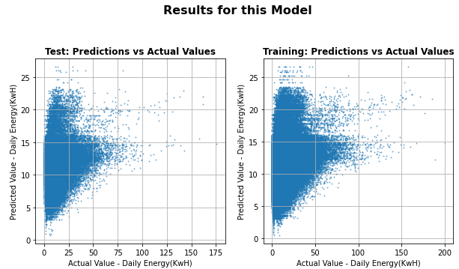
4. Data Modeling
Business Understanding
Data Understanding
Data Preparation
Modeling
Evaluation
1st Pass:
Features – Only Weather-Related
R² = .059
Mean Average Error = 6.29 KwH
2nd Pass:
Features – With Categorical Variables
R² = .075
Mean Average Error = 6.25 KwH

Slide 7
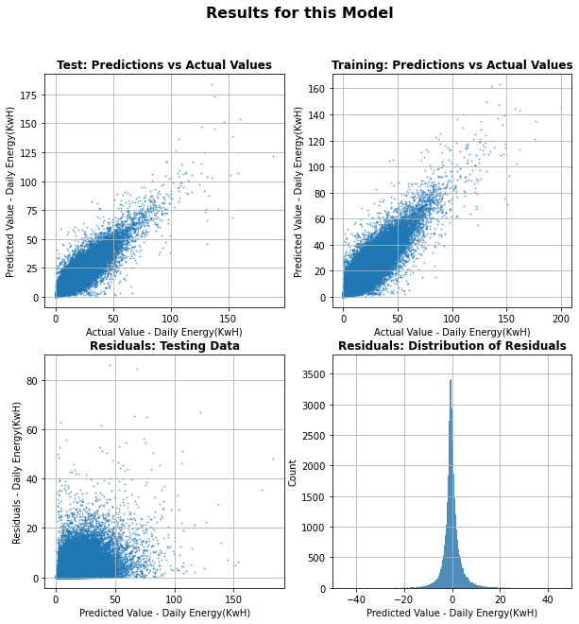
4. Data Modeling
Business Understanding
Data Understanding
Data Preparation
Modeling
Evaluation
Feature Engineering:
Included column which tracks energy for a given home on the day before
Convert to TimeSeries
R² = .839
Mean Avg Error = 2.36KwH

Slide 8
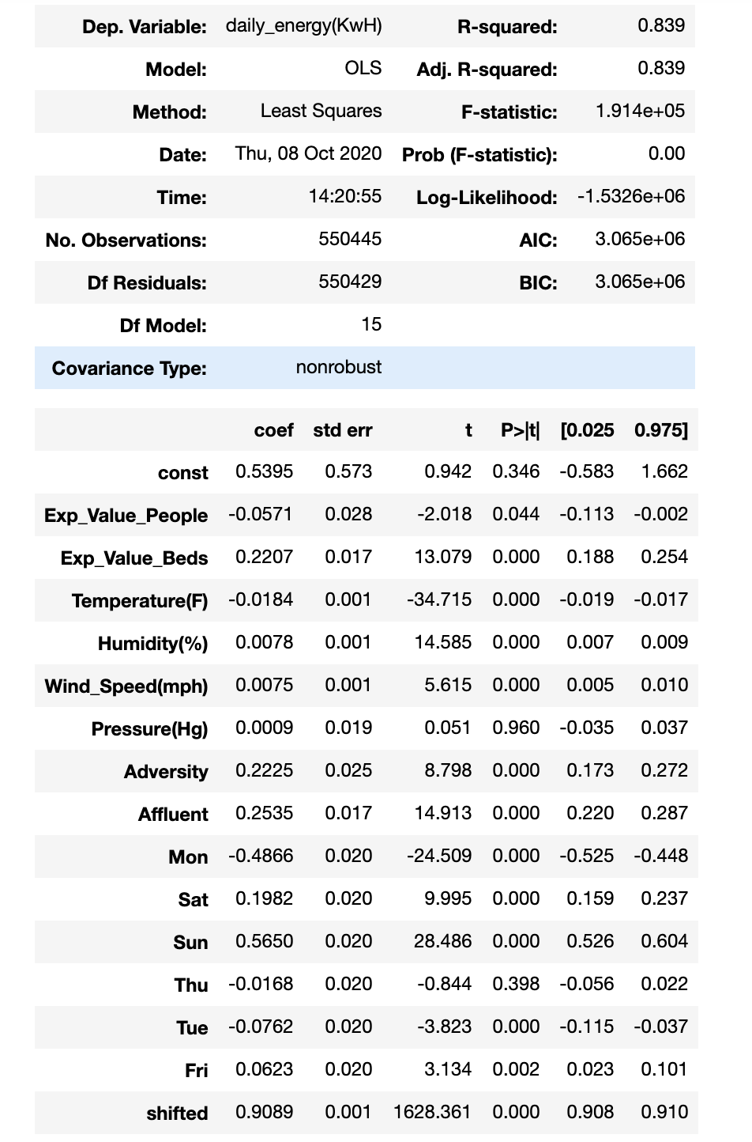
5. Model evaluation
Business Understanding
Data Understanding
Data Preparation
Modeling
Evaluation
Critical Features:
Temperature
# of bedrooms
Neighborhood Affluence
Sunday
Features to Drop:
# of People
Pressure(Hg)
Lasso Modeling Results
Parameter | Coefficient
Exp_Value_People | 0.0000
Exp_Value_Beds | 0.0836
Temperature(F) | -0.1974
Humidity(%) | 0.0719
Wind_Speed(mph) | 0.0248
Pressure(Hg) | 0.0000
Adversity | 0.0283
Affluent | 0.0817
Mon | -0.1591
Sat | 0.0601
Sun | 0.1901
Thu | 0.0000
Tue | -0.0262
Fri | 0.0181
shifted | 8.8792

Slide 9

Closing remarks
Temperature is the low-hanging fruit when it comes to reducing home energy consumption
Do solar panels make sense?
Improve Home Insulation
Efficient Heating
More Scotch!
Future Work
Predict energy use on a national scale
Get more insight into how energy is used in homes

Slide 10
Thank you!

