Slide 1




Multi-Agent RAG Legal Compliance System
Automated Compliance Review Using Azure OpenAI and Cognitive Search

Slide 2




Overview
Automates compliance review of legal MOUs using Azure OpenAI and Cognitive Search
0
0
Modular system with agents
Includes optional interactive chat-bot
ingestion, extraction, rule retrieval, and validation
for queries about compliance

Slide 3

Storage & Index Setup
Legal rules stored as txt files in Azure Blob Storage
03
Azure Cognitive Search index created with id and content fields
02
01
Legal rules stored as txt files in Azure Blob Storage

Slide 4


Multi-Agent Architecture
Multiple agents handle different functions
ingestion, clause extraction, rule retrieval, and compliance validation
Ensures modular, scalable, and traceable processing of MOUs

Slide 5
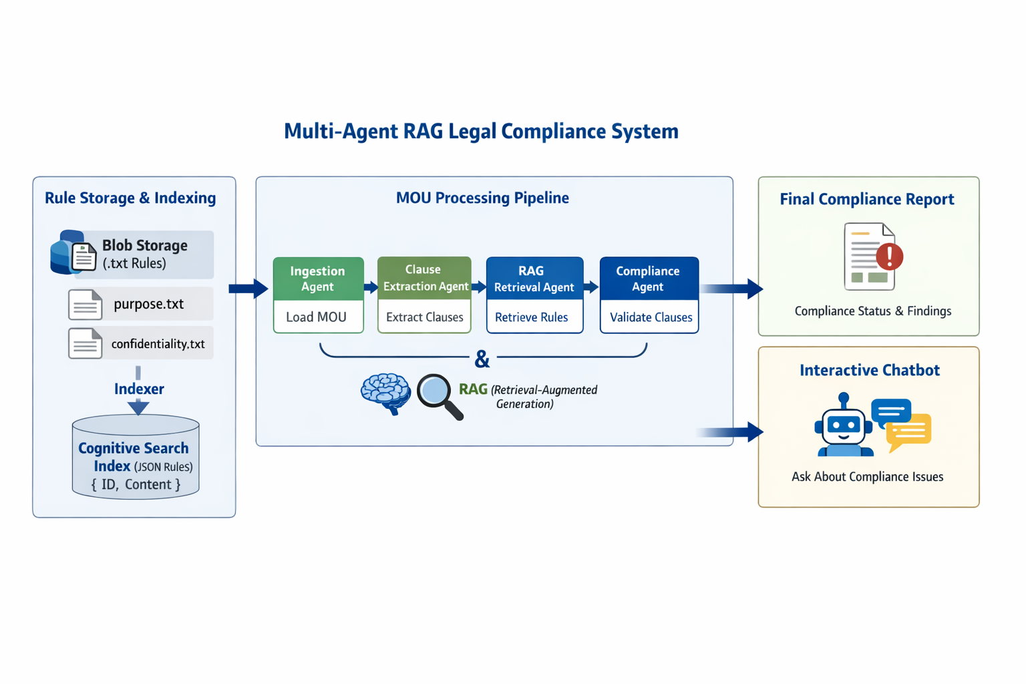
Workflow

Slide 6






Semantic Embedding & RAG
RAG improves accuracy by retrieving relevant rules dynamically
1
Guides OpenAI validation using retrieved rules for up-to-date compliance checks
2

Slide 7




Interactive Bot Layer
Bot answers queries on non-compliance reasons and found issues
First
Second
Third
Users interact via chat-bot post report generation
References structured compliance report for natural answers

Slide 8
Handling Updates & New Rules
Add new txt rule files to Blob Storage for automatic ingestion
03
Indexer updates Cognitive Search index with new rules automatically
02
01
Add new txt rule files to Blob Storage for automatic ingestion

Slide 9



Benefits
Modular, scalable agents allow easy extension and integration
Explainable by extensive logging of agent activities
RAG-driven approach combines semantic search with AI for accuracy
Automated rule conversion from txt to JSON enhances retrieval

Slide 10
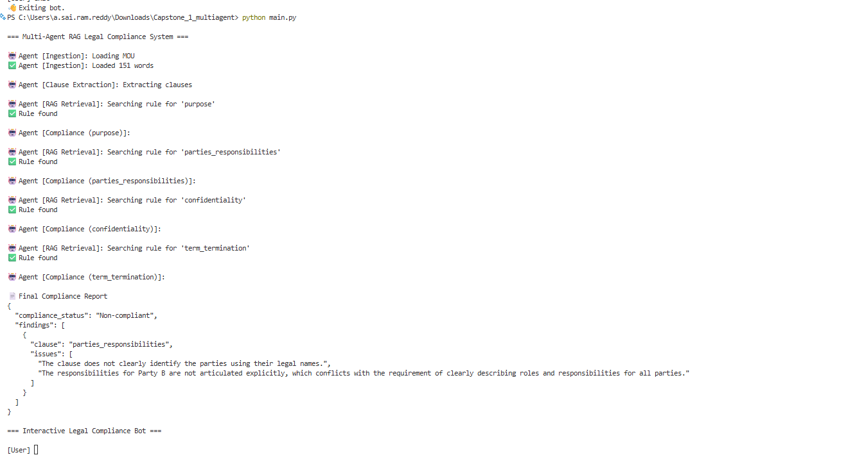
Example System Output

