Slide 1
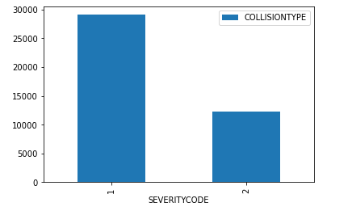
Data Analysis – No. of collisions vs Severity code

Slide 2
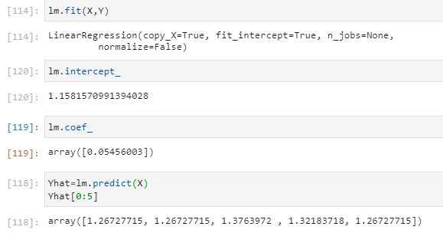
ML – Model To determine the relationship between person count and the severity code

