Slide 1
DAY1
Cucumber S1

Slide 2
Why cucumber

Slide 3
What is Cucumber
Cucumber is a testing framework which supports Behavior Driven Development (BDD).
It lets us define application behavior in plain meaningful English text using a simple grammar defined by a language called Gherkin.
Cucumber itself is written in Ruby. . Cucumber now supports a variety of different programming languages through various implementations, which includes Java, Python, C#

Slide 4
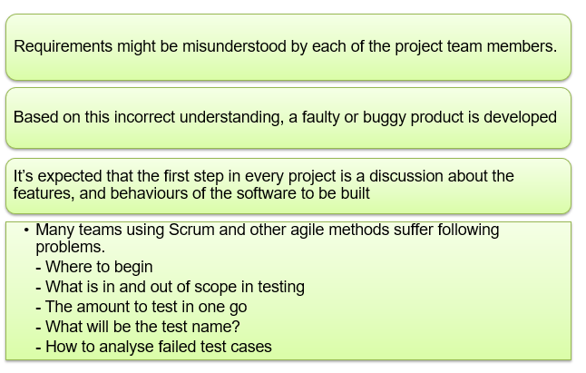
Problem Statement

Slide 5
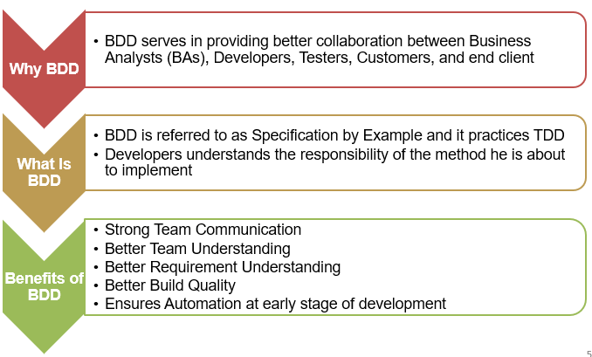
Solution

Slide 6
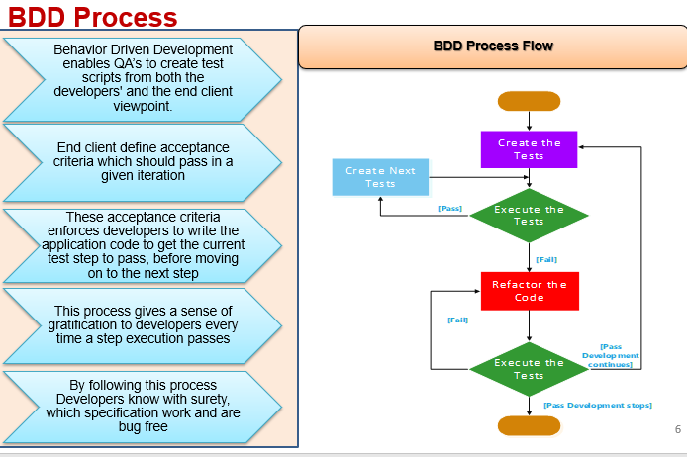
BDD Process

Slide 7
BDD
Behavior Driven testing is an extension of TDD. Like in TDD in BDD also we write tests first and the add application code. The major difference that we get to see here are
Tests are written in plain descriptive English type grammar
Tests are explained as behavior of application and are more user focused
Using examples to clarify requirements
This difference brings in the need to have a language which can define, in an understandable format.
BDD aims to narrow the communication gaps between team members, foster better understanding of the customer and promote continuous communication with real world examples.

Slide 8
BDD
Behaviour-Driven Development (BDD) is a set of practices that aim to reduce some common wasteful activities in software development:
Rework caused by misunderstood or vague requirements
Technical debt caused by reluctance to refactor code
Slow feedback cycles caused by silos and hand-overs
Good BDD examples are concrete rather than abstract. They mention names of people and places, exact dates and amounts, and anything that is relevant to the problem domain of the software

Slide 9
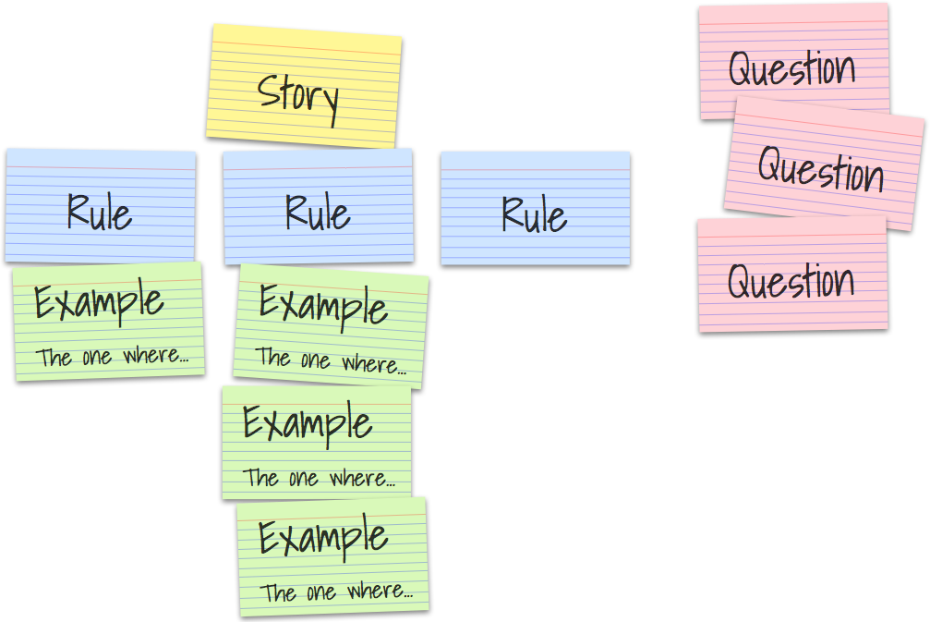
Specification by Example
Specification by example (SBE) is a collaborative approach to defining requirements and business-oriented functional tests for software products based on capturing and illustrating requirements using realistic examples instead of abstract statements. It is applied in the context of agile software development methods, in particular behavior-driven development.

Slide 10
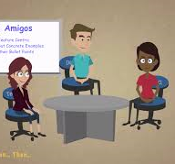
3 Amigos
3 Amigos
Business Analyst
Developer
QA

Slide 11
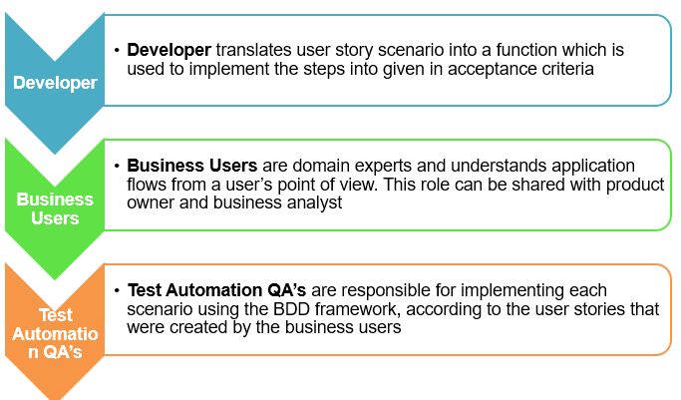
BDD Team Roles

Slide 12

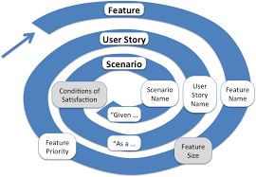

Slide 13
Knowledge check
Is cucumber a functional Testing tool ?

Slide 14
Knowledge Check
Why use Cucumber with Selenium?

