Slide 1
DAY1
Cucumber S1

Slide 2
First Taste

Slide 3
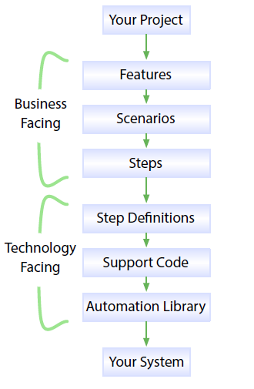
How cucumber works ?

Slide 4
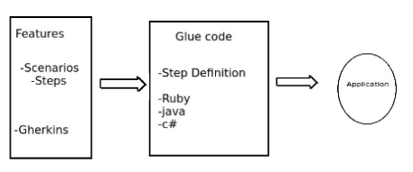
Feature files
Glue code works as bridge between feature file and the application it translates English into your code.
The feature is made up of scenarios and steps written in Gherkin.
This step could be written in your language of your choice.

Slide 5
How cucumber works ?
Feature :When you run cucumber it reads in your specifications from plain –language text files called features.
Scenario: Feature file contains the scenarios to be tested.
Step: Each Scenario is a list of step.
Step Definition: Along with the features, you give Cucumber a set of step definitions, which map the business-readable language of each step into code
support code: In a mature test suite, the step definition itself will probably just be one or two lines of code that delegate to a library of support code, specific to the domain of your application,
automation library: Sometimes that may involve using an automation library, like the browser automation library Selenium, to interact with the system itself.

Slide 6
Creating first feature file
A Feature File is an entry point to the Cucumber tests. This is a file where you will describe your tests in Descriptive language (Like English). It is an essential part of Cucumber, as it serves as an automation test script as well as live documents.
Feature contains Gherkin keywords Feature, Scenario, Given , When, Then

Slide 7
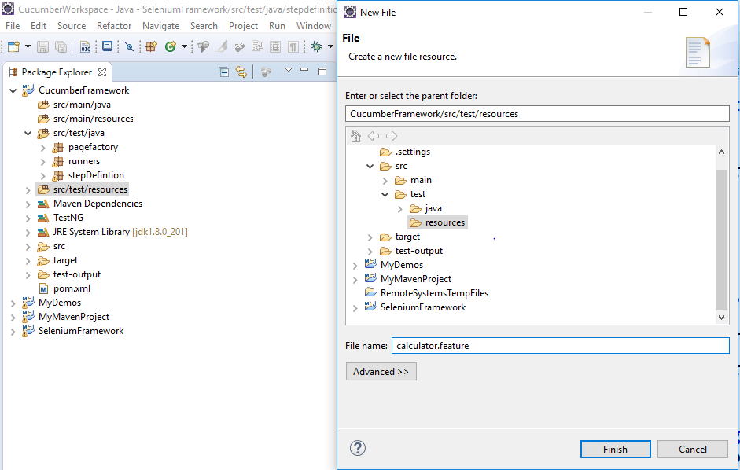
Creating Feature file

Slide 8
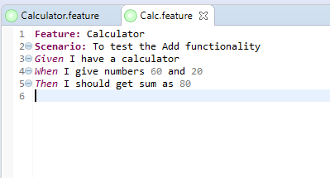
Creating Feature file

Slide 9
Creating Runner class
Cucumber uses Junit framework to run.
So to run a feature file we need to create a Junit as runner class.
This class will use the Junit annotation @RunWith(), which tells JUnit what is the test runner class.

Slide 10
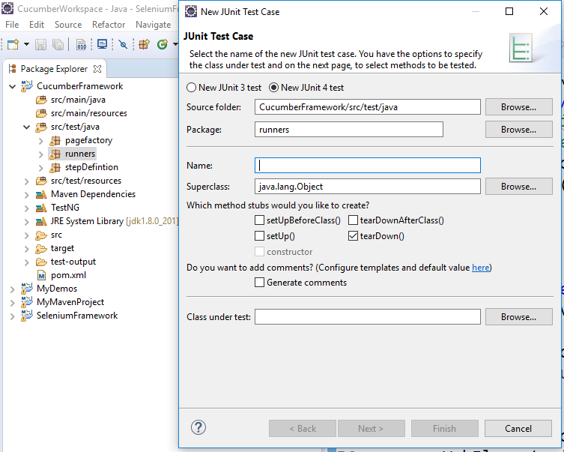
Creating new runner class

Slide 11
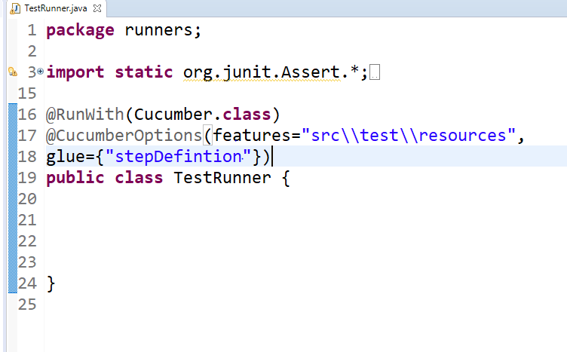
Runner class

Slide 12
@CucumberOptions
This annotation tells Cucumber a lot of things like where to look for feature files, what reporting system to use and some other things also.
Basically @CucumberOptions enables us to do all the things that we could have done if we have used cucumber command line. This is very helpful and of utmost importance if we are using IDE such eclipse only to execute our project.
@CucumberOptions(features=“”)
This attribute tells the cucumber the feature files to be executed.
CucumberOptions(glue=“”)
This attribute tells the cucumber the path of supporting step definition files.

Slide 13
Implementing Our First Step Definition
Step definitions are the glue that binds your Cucumber tests to the application you’re testing.
A Step Definition is a small piece of code with a pattern attached to it or in other words a Step Definition is a java method in a class with an annotation above it.
An annotation followed by the pattern is used to link the Step Definition to all the matching Steps, and the code is what Cucumber will execute when it sees a Gherkin Step.
Cucumber finds the Step Definition file with the help of Glue code in Cucumber Options

Slide 14
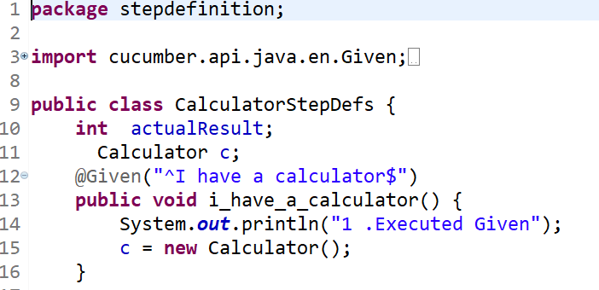
Implementing Step Defintion

Slide 15
Knowledge Check
How many scenarios can a feature file have ?

Slide 16
Knowledge
Can I execute the feature file without the runner class ?

Slide 17
Knowledge check
How does a feature file recognize the step definitions to be executed ?

