Slide 1
DAY1
Cucumber S1

Slide 2
Expressive scenario

Slide 3
Expressive Scenarios
Following Gherkin keyword make the scenarios more readable.
Tags
Hooks

Slide 4
Tags
Let’s say you have got many different feature files which cover all the different functionality of the application. Now there can be certain situation in the project where you like to execute just a SmokeTests or End2EndTests or may be RegressionTests. One approach is that you start creating new feature files with the name of the type like SmokeTests.features or End2EndTests.feature and copy paste your existing tests in the same. But this would make the project filthy and would require more maintenance in future. So how to manage execution in such cases?

Slide 5
Tags
For this, Cucumber has already provided a way to organize your scenario execution by using tags in feature file. We can define each scenario with a useful tag.
Later, in the runner file, we can decide which specific tag (and so as the scenario(s)) we want Cucumber to execute.
Tag starts with “@”. After “@” you can have any relevant text to define your tag like @SmokeTests just above the scenarios you like to mark.
Then to target these tagged scenarios just specify the tags names in the CucumberOptions as tags = {“@SmokeTests”}.

Slide 6
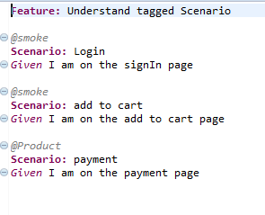
Tags
Feature file

Slide 7
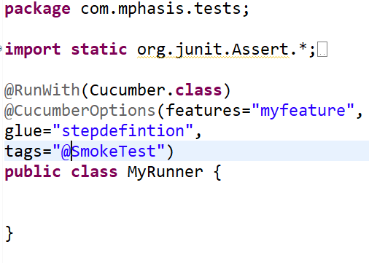
Tags
Executing the single tag ‘SmokeTest’

Slide 8
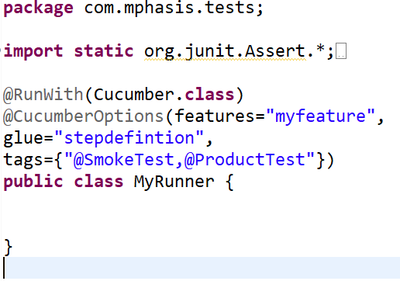
Tags - OR
Executing the scenario that have either tags ‘SmokeTest’ or ‘ProductTest’

Slide 9
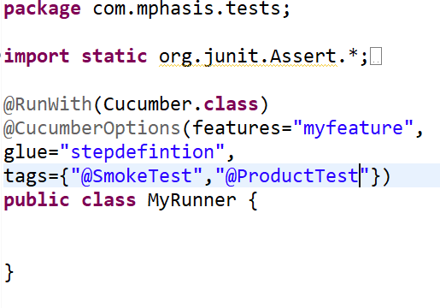
Tags -AND
Executing the scenario that have both tags ‘SmokeTest’ and ‘ProductTest’

Slide 10
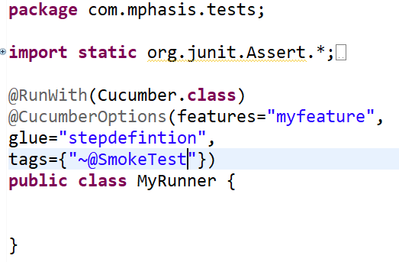
Tags - NOT
Executing the scenario that have tags other than ‘SmokeTest’ .

Slide 11
Hooks
Cucumber supports hooks, which are blocks of code that run before or after each scenario.
You can define them anywhere in your project or step definition layers, using the methods @Before and @After.
Cucumber Hooks allows us to better manage the code workflow and helps us to reduce the code redundancy. We can say that it is an unseen step, which allows us to perform our scenarios or tests.

Slide 12
Why Cucumber Hooks?
In the world of testing, you must have encountered the situations where you need to perform the prerequisite steps before testing any test scenario. This prerequisite can be anything from:
Starting a webdriver
Setting up DB connections
Setting up test data
Setting up browser cookies
Navigating to certain page
or anything before the test
In the same way there are always after steps as well of the tests like:
Killing the webdriver
Closing DB connections
Clearing the test data
Clearing browser cookies
Logging out from the application
Printing reports or logs
Taking screenshots on error
or anything after the test

Slide 13
Why Cucumber Hooks?
To handle these kind of situations, cucumber hooks are the best choice to use.
Unlike TestNG Annotaions, cucumber supports only two hooks (Before & After) which works at the start and the end of the test scenario.
@before hook gets executed well before any other test scenario
@after hook gets executed after executing the scenario.

Slide 14
Execution Order of Hooks
Order hooks to run in a particular sequence is easy to do.
Lets say that you with the multiple hooks in your framework.
The order of the execution of the hooks can be set up by order attribute.
How to set the Order or Priority of Cucumber Hooks?
The very important thing to note here is:
@Before(order = int) : This runs in increment order, means value 0 would run first and 1 would be after 0.
@After(order = int) : This runs in decrements order, means apposite of @Before. Value 1 would run first and 0 would be after 1

Slide 15
Tagged Hooks
if we need to do anything before of after the test, we can use @Before & @After hooks. But this scenario works till the time our prerequisites are same for all the scenarios. For example till the time prerequisite for any test is to start the browser, hooks can solve our purpose.
But what if we have different perquisites for different scenarios. And we need to have different hooks for different scenarios.
Define tagged hooks in Hooks class file. Hooks can be used like @Before(“@TagName”). Create before and after hooks for every scenario.

