Slide 1
DAY1
Cucumber S1

Slide 2
reporting

Slide 3
Cucumber Reports
When we execute Cucumber Scenarios, it automatically generates an output in the eclipse console.
There is a default behavior associated with that output and we can also configure that output as per our needs also.
Pretty Report
This provides more verbose output. To implement this, just specify plugin = “pretty” in CucumberOptions. This is what the code looks like:
@CucumberOptions( plugin = { “pretty” } )

Slide 4
Cucumber Reports
Monochrome Mode Reporting
If the monochrome option is set to false, then the console output is not as readable as it should be.
If the monochrome is not defined in Cucumber Options, it takes it as false by default. How to specify it:
@CucumberOptions( monochrome = true );

Slide 5
Usage Report
If we are more concerned about the time taken by each Step Definition, then we should use the usage plugin. This is how we specify the same in @CucumberOptions:
@CucumberOptions( plugin = { “usage” })

Slide 6
Cucumber Report Output
Cucumber gives us capability to generate reports as well in the form of
HTML
XML
JSON
TXT.
Cucumber frameworks generate very good and detailed reports, which can be shared with all stake holders. There are multiple options available for reports which can be used depending on the requirement

Slide 7

Cucumber HTML Report
For HTML reports, add html:target/cucumber-reports to the @CucumberOptions plugin option.
This will generate an HTML report at the location mentioned in the formatter itself.

Slide 8

Cucumber JSON Report
For JSON reports, add json:target/cucumber-reports/Cucumber.json to the @CucumberOptions plugin option.
This report contains all the information from the gherkin source in the JSON format. This report is meant to be post processed into another visual format by third-party tools, such as Cucumber Jenkins.

Slide 9
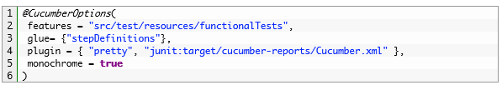
Cucumber JUNIT XML Report
For JUNIT reports, add junit:target/cucumber-reports/Cucumber.xml to the @CucumberOptions plugin option.
This report generates XML files just like Apache Ant’s junit report task. This XML format is understood by most continuous integration servers, who will use it to generate visual reports.

Slide 10
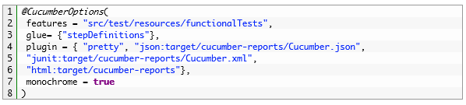
All Reports Together
We can even generate all reports together as well.

Slide 11
Cucumber extend report
With Extent Framework, you can create beautiful, interactive and detailed reports for your tests.
Add events, screenshots, tags, devices, authors or any other relevant information you decide is important to create an informative and a stunning report.

Slide 12
Implementing extend reports
Step 1 – Add Cucumber Extent Reporter library to Maven Project
Since these are the external libraries we need to add the dependency in pom.xml
1 | Add extend report dependency | <dependency> <groupId>com.aventstack</groupId> <artifactId>extentreports</artifactId> <version>3.1.1</version> </dependency>
2 | Add cucumber extend report dependency | <dependency> <groupId>com.vimalselvam</groupId> <artifactId>cucumber-extentsreport</artifactId> <version>2.0.1</version> </dependency>

Slide 13
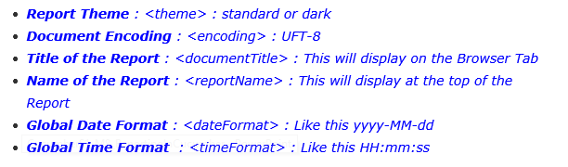
Step 2 – Add Extent Config to the Project
Extent Config is required by the Cucumber Extent Report plugin to read the report configuration. As it gives the capability to set many useful setting to the report from the XML configuration file.

Slide 14
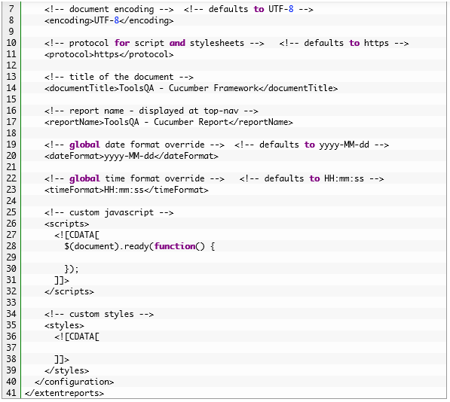

Slide 15

Step 3 : Modify TestRunner to Implement Cucumber Extent Reporter
Modify the runner class and add the com.cucumber.listener.ExtentCucumberFormatter:output/report.html as a plugin followed by the report file as input. This should be done with in the @CucumberOptions annotation.

Slide 16
