Slide 1
DAY1
Cucumber S1

Slide 2
Data Driven testing

Slide 3
Data Driven testing
Data Driven Testing, which allows to automatically run a test case multiple times with different input and validation values

Slide 4
Examples Keyword
Cucumber inherently supports Data Driven testing by the use of the Scenario Outline and Examples section.
It is with these keywords that Cucumber allows for easy Data Driven testing to be completed.
Scenario Outline – This is used to run the same scenario for 2 or more different set of test data. E.g. In our scenario, if you want to register another user you can data drive the same scenario twice.
Examples – All scenario outlines have to be followed with the Examples section. This contains the data that has to be passed on to the scenario.

Slide 5
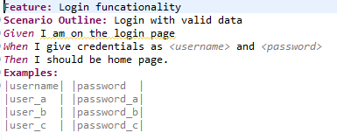
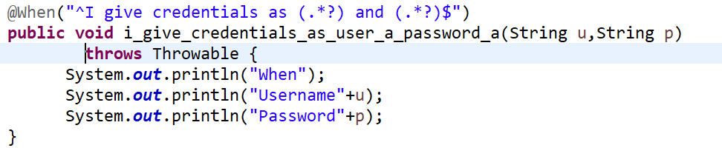
Examples Keyword
Feature file
Step definition

Slide 6
Data table
DataTables are also used to handle large amount of data.
They are quite powerful but not the most intuitive as you either need to deal with a list of maps or a map of lists.
Most of the people gets confused with Data tables & Scenario outline, but these two works completely differently

Slide 7
Difference between Scenario Outline & Data Table
Scenario Outline: | Data table:
This uses Example keyword to define the test data for the Scenario | No keyword is used to define the test data
This works for the whole test | This works only for the single step, below which it is defined
Cucumber automatically run the complete test the number of times equal to the number of data in the Test Set | A separate code is need to understand the test data and then it can be run single or multiple times but again just for the single step, not for the complete test

Slide 8
Implementation of data table
Implementation of data table can be in step definition can be done by change Data Table to one of following:
List<YourType>,
List<List<E>>,
List<Map<K,V>>
Map<K,V>.
E,K,V must be a scalar (String, Integer, Date, enum etc)

Slide 9
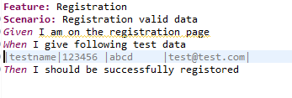
Data Tables without headers
When feature file have data without headers we can retrieve the data from the data table as
List<String> data = d.asList(String.class); ( d is instance of DataTable)

Slide 10
Data Tables with headers
When feature file have data with headers we can retrieve the data from the data table as
List<List<String>> data = d.asLists(String.class); ( d is instance of DataTable)
List<Map<String, String>> data = d.asMaps(String.class, String.class); ( d is instance of DataTable)

Slide 11
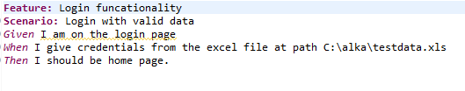
Reading the test data from excel

Slide 12
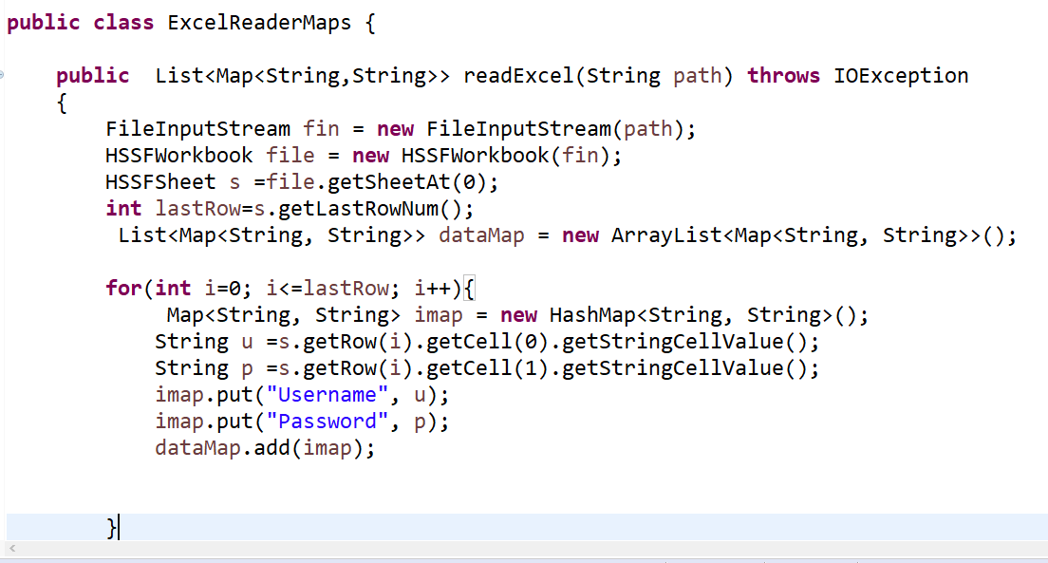
Reading the data from excel

