Slide 1
UrbanCode Deploy

Slide 2
UrbanCode Deploy Offerings
This tool offers automated application deployment through different application environment like development, production and testing etc. This works in agile development process which facilitates continuous delivery and feedback . By the help of this we can get a trail of audits, versioning and implement environment approvals.
Key Offerings
Automated and uniform deployments.
Rollback of applications.
Middleware, provisioning integration.
Approval gates across environments and security configuration
Complete details about the deployments and changes to components
Facilitates integrations with other tools via plugins.

Slide 3
Distinctive Features
Multi-Tier application model support.
Simple process designer to automate application deployment.
Easy tracking of applications and components in different environments.
Environment gates and approval s.
Integrations for application servers, databases, testing tools and load balancers , that replaces custom scripting.
Ability to track the components that makes an application, so they can be deployed together.
It provides snapshot by which we can determine which versions of the different components work well together, making it easy to ensure that those components were tested together are released together.

Slide 4
UrbanCode Release

Slide 5
Typical Uses
Identify Release Dependencies: From initial planning through discovery in testing, easily identify and track release dependencies across applications and infrastructure.
Release Planning and Tracking: Map applications, changes, and initiatives to releases, and track the completion of Application changes and attainment of quality certifications for applications in a release.
Easier Release Days: Build an executable deployment plan that seamlessly notifies team members of work to do, and triggers automated tasks while providing up-to-date status that everyone can see.
Handle More Releases: Accommodate a growing number of release using more templates, automatic rules, and visibility that mitigates risk.
Multi-Application Continuous Delivery: Rules for automatic promotion across groups of applications enables applications to take advantage of continuous delivery techniques.

Slide 6
Key Offerings
Multi-Application Continuous Delivery
Urban Code Release allows you to easy capture these relationships and plan releases spanning multiple applications and setup automatic promotion rules to speed changes through the pipeline.
Impact Analysis
See which other applications may be impacted by an application that has fallen behind with incomplete features, or troubled test results.
Release Pipeline Visualization
From the Pipeline, we can also schedule deployments and see when the
next deployment to each environment is planned. It is also clear when the
previous deployment occurred.
Release Gates
Urban Code Release has Statuses which serve to identify quality certifications
achieved by deployable versions.

Slide 7
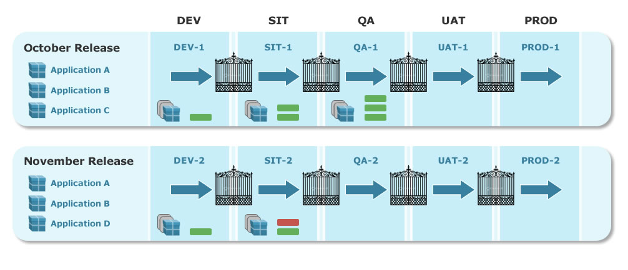
Release Planning
The following figure illustrates two releases, October and November, that use the same lifecycle model. The phases that are defined in the model are listed across the top. Environments are allocated to releases and each phase is assigned one, which is shown in the illustration. The October Release, for example, uses the DEV-1 environment during the DEV phase, while the November Release uses DEV-2 for that phase. The gates between phases are defined in the model

