Slide 1


Slide 2
Tech Mahindra
2016

Slide 3
Artifactory

Slide 4
Agenda
Bamboo task configuration for Artifactory
Artifactory repository browser for artifacts
Build browser
History for Builds
File upload into Artifactory-Single and Bulk deploy

Slide 5
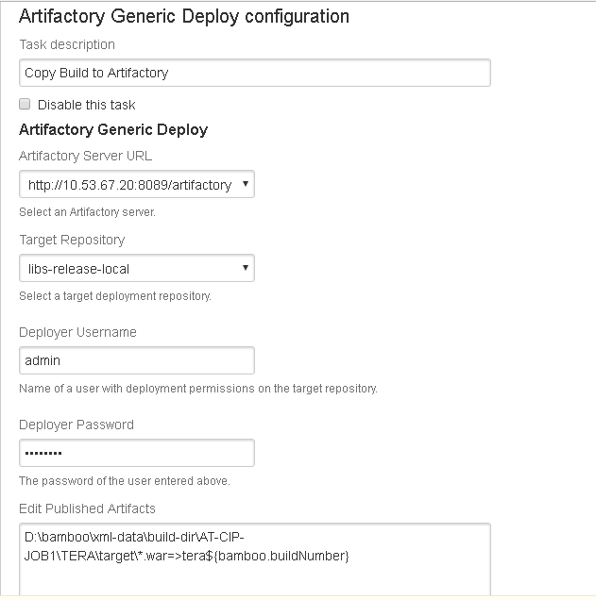
Artifacts can also be uploaded into Artifactory Using Continuous Intgration tool(Bamboo) as show below:

Slide 6
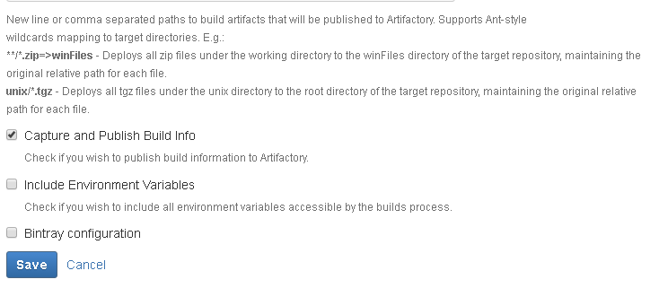
Above configuration is for the Continuous Integration tool called Bamboo

Slide 7
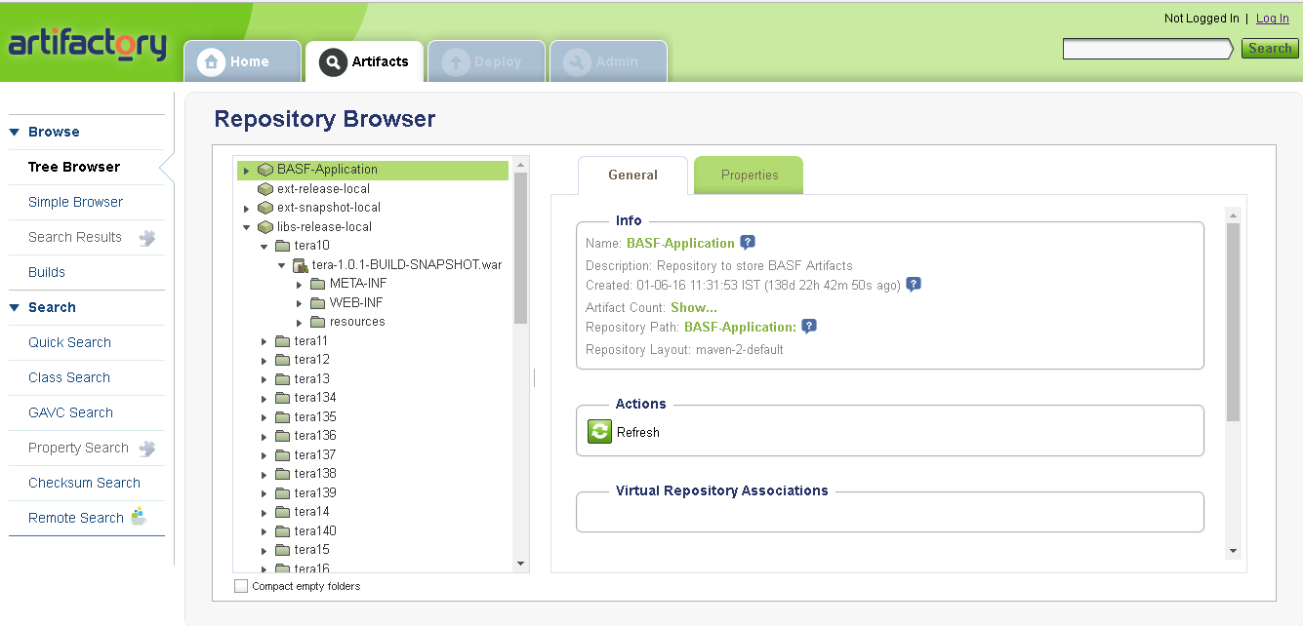
Once It is configured with the CI tool, we will be able to see the artifacts in Artifactory as shown below:

Slide 8
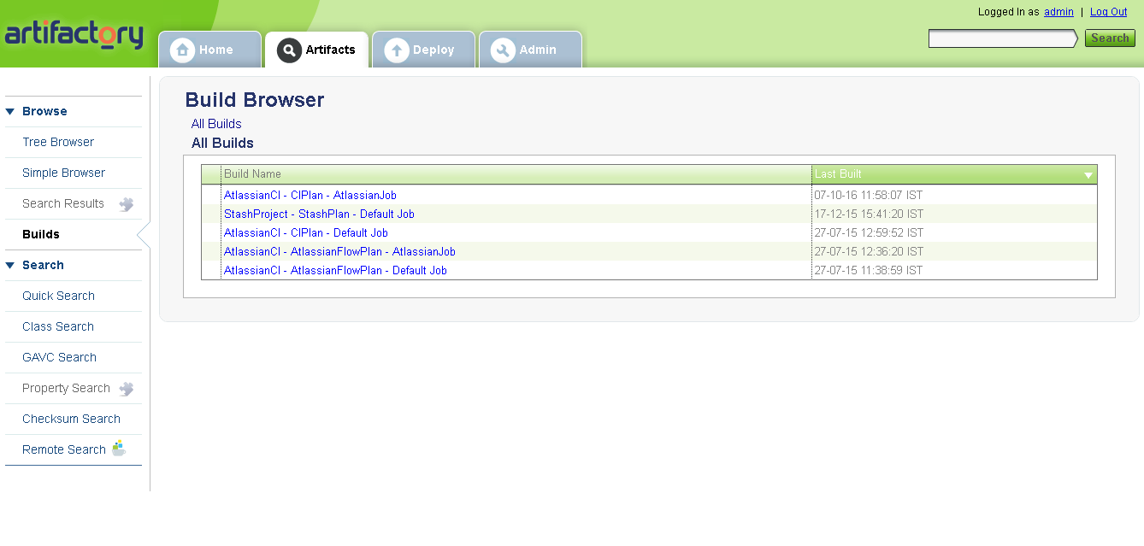
We can also see which build traceability as shown below:

Slide 9
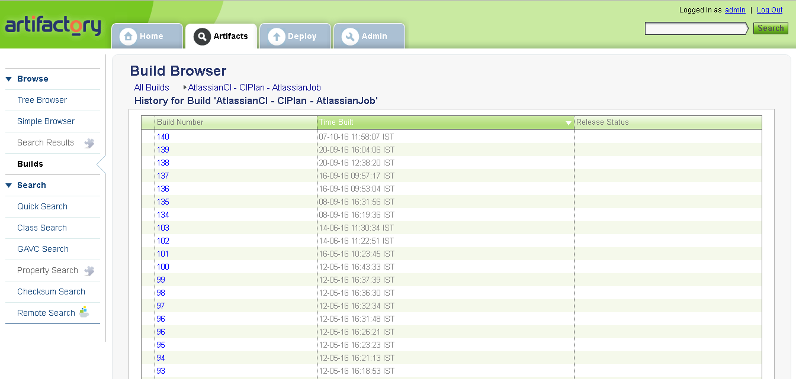

Slide 10
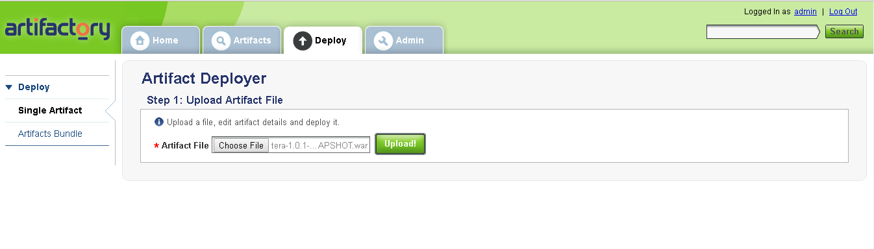
We can also upload artifacts into artifactory manually.
We can upload single artifact or bulk upload them.

Slide 11
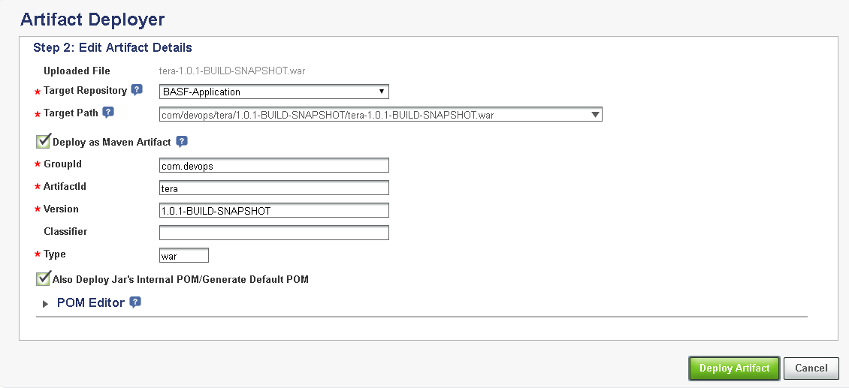

Slide 12
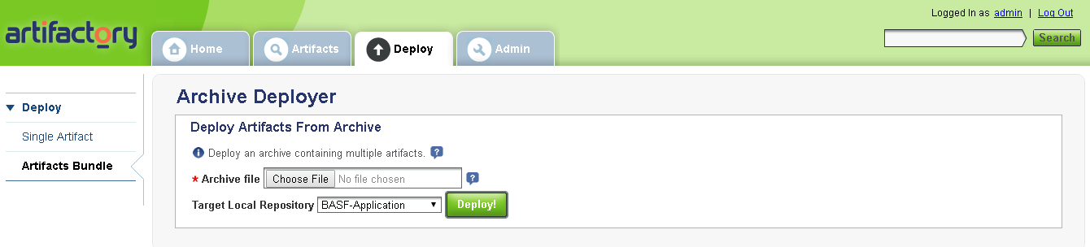
Hence, the artifact gets uploaded.
Bulk upload can be done manually as shown below:

