Slide 1


Slide 2
Tech Mahindra
2016

Slide 3
NEXUS

Slide 4
Agenda
Demo of Proxying feature of Nexus
Configuration of Settings.xml of Maven
Publishing feature of Nexus
Upload artifacts into Nexus manually

Slide 5
Demo of Proxying feature of Nexus
Nexus works as a proxy repository to catalyze you build process. It starts downloading the dependencies from its repository in case the required dependencies are not available during the build.
The settings.xml needs to modifies to enable this feature of Nexus.
Below is the screenshot showing the changes required to be done in settings.xml

Slide 6
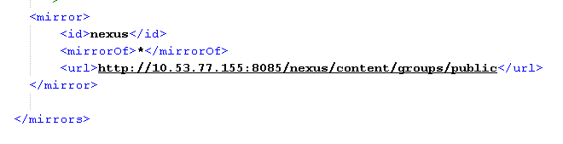

Configuration in settings.xml as shown below

Slide 7
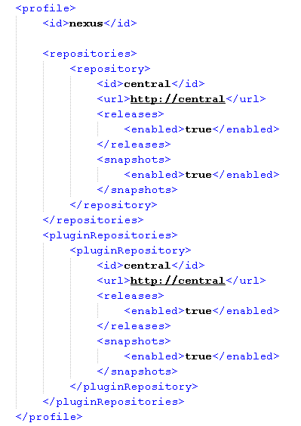

Slide 8
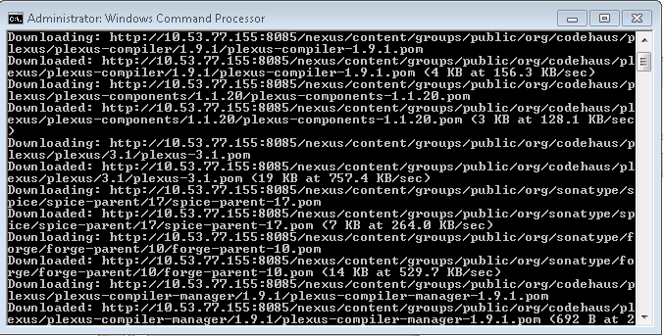
Once the settings.xml is configured and you try to build your code, you will see that the dependencies start getting downloaded as shown below

Slide 9
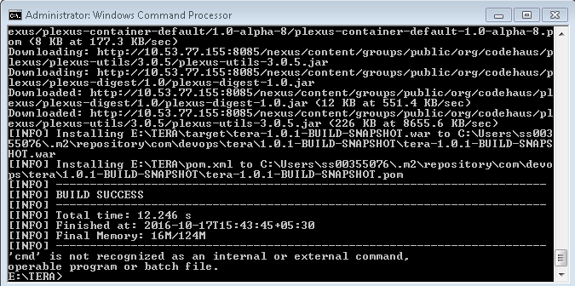
Once the dependencies are downloaded, the code is built.

Slide 10
Publishing feature of Nexus allows us to upload binaries into our Nexus repository.
This can be done either by using scripts like cURL script or by configuring our Continuous Integration tool like Bamboo, Jenkins etc.
Below is the screenshot of the cURL script:
curl -v -u admin:admin123 --upload-file C:\Users\ss00355076\Desktop\nexus-book-examples-master\maven\simple-project --url
http://localhost:8082/nexus/content/repositories/Simple_Project

Slide 11
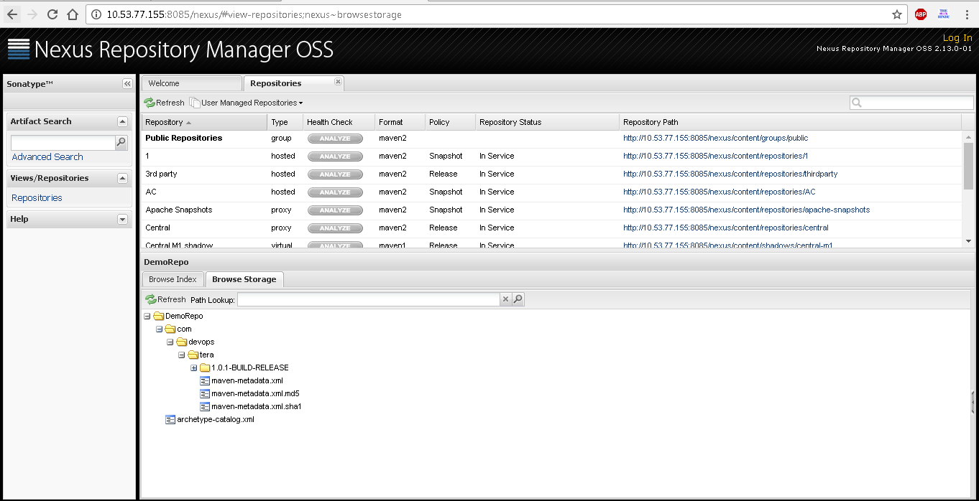

Slide 12
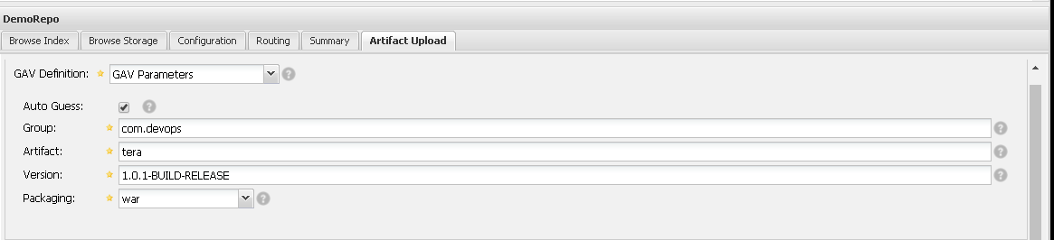
Artifacts can also be uploaded manually into Nexus repository as shown below:

Slide 13
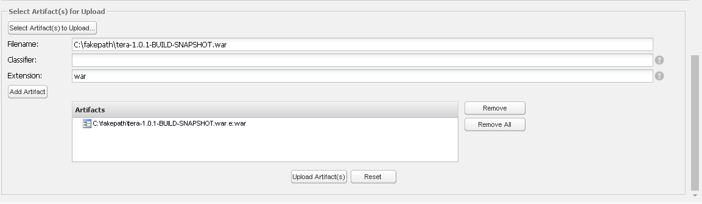

Slide 14
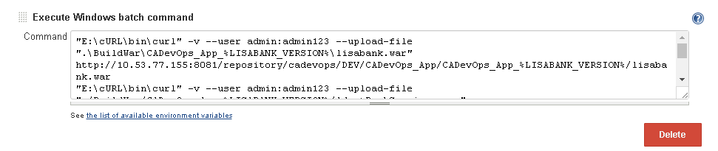
Artifacts can also be uploaded into Nexus Repository using Continuous Integration tool.

