Slide 1






Repository Manager
Using Nexus
Copyright © 2017 Tech Mahindra. All rights reserved.
1

Slide 2



TABLE OF CONTENT
What is Nexus?
Proxying Remote Repositories
Artifacts download and Caching
Hosted Internal Repository
Proxy Repository
Virtual Repository
Release Artifacts
Snapshot Artifacts
Reasons to use Repository Manager
Repository Coordinates
Addressing resource in repository
Browsing repositories
Deploying Snapshots
Manually uploading Artifacts
System Feeds
Creating Repository
Publishing Artifacts to the repository

Slide 3
What is Nexus?
Nexus is a Maven Repository Manager created by Sonatype
Simplifies the maintenance of internal repositories and access to external repositories
Proxies requests for external artifacts and caches the results
Provides a deployment destination for your own generated artifacts

Slide 4
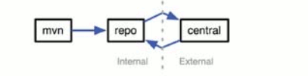
Proxying Remote Repositories
When you proxy a remote repository, your repository manager accepts requests for artifacts from clients
If the artifact is not already cached, the repository manager will retrieve the artifact from the remote repository and cache the artifacts.
Subsequent requests for the same artifact will be served from the local cache.

Slide 5
Artifact Downloads and Caching

Slide 6

Hosted Internal Repositories
When you host a repository, your repository manager takes care of organizing, storing and serving binary artifacts
You can use a hosted internal repository to store internal release artifacts, snapshot artifacts, or 3rd party artifacts

Slide 7
Proxy Repository
A Proxy Repository is a proxy of a remote repository. By default, Nexus Repository Manager ships with the following configured proxy repositories:
Apache Snapshots
This repository contains snapshot releases from the Apache Software
Foundation.
Central
This is the Central Repository containing release components.
Formerly known as Maven Central, it is the default built-in repository for
Apache Maven and directly supported in other build tools like Gradle, SBT or
Ant/Ivy. Nexus Repository Manager connects to the Central Repository via
HTTPS using the URLhttps://repo1.maven.org/maven2/.

Slide 8
Virtual Repository
A Virtual Repository serves as an adaptor to and from different types of repositories. Currently, Nexus Repository Manager Pro supports conversion to and from Maven 1 repositories and Maven 2 repositories. In addition, you can expose any repository format as a NuGet or OBR repository. For example, a Maven 2 repository can contain OSGi Bundles, which can be exposed as a OSGi Bundle repository with the virtual repository Provider set to OBR.

Slide 9
Release Artifacts
These are specific, frozen-in-time artifacts
Considered to be solid, stable, and perpetual in order to guarantee that builds which depend on them are repeatable over time
Released JAR artifacts are associated with PGP signatures and checksums that verify both the integrity and authenticity of the binary software artifact
Maven Central stores release artifacts

Slide 10
Snapshot Artifacts
Snapshots capture a work in progress and are used using development
A snapshot artifact has both a version number such as “1.3.0” or “1.3” and a timestamp
e.g.,
commons-lang-1.3.0-20090314.182342-1.jar

Slide 11
Reasons to Use a Repository Manager
Speeds up builds
Builds will be more stable
You can deploy and host 3rd party artifacts
Easier developer collaboration and sharing of artifacts
Searching and indexing of artifacts
Repository groups makes it easier to retrieve artifacts from a single URL
Procuring External Artifacts: define lists of allowed/blocked repos
Staging and Release Management

Slide 12
Repository Coordinates
Coordinate | Definition
groupId | Groups a set of artifacts into a logical group (e.g. org.apache.maven)
artifactId | Name for a software artifact. (e.g., simple-webapp)
version | Numerical version for a software project (e.g, 1.2.3, 1.2, 1.2-beta)
packaging | Describes the contents of the software artifact (e.g., jar, zip, swc, swr, nar, war, ear, sar

Slide 13
Addressing Resources in a Repository
Tools designed to interact with Maven repositories translate artifact coordinates into a URL which corresponds to a location in a Maven repository
e.g., groupId: castor, artifactId: castor, version 0.9.9 may be found under /castor/castor/0.9.9/castor-0.9.9.jar in the Maven Repository

Slide 14
Browsing Repositories

Slide 15
Deploying a SNAPSHOT: settings.xml

Slide 16
Deploying a SNAPSHOT cont.
$ mvn clean install deploy
Removes build output under target/ folder
Compiles and installs the application in ~/.m2/repository
Deploys the application to the SNAPSHOT repository
Can be simplified by running 'mvn clean deploy'

Slide 17
Deployed SNAPSHOT in Nexus

Slide 18
Deployed release artifacts in Nexus

Slide 19
Manually Uploading Artifacts (3rd party)

Slide 20
System Feeds

Slide 21
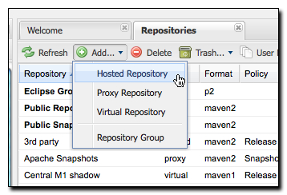
Creating a Maven Site Repository
Add a “Hosted Repository”

Slide 22
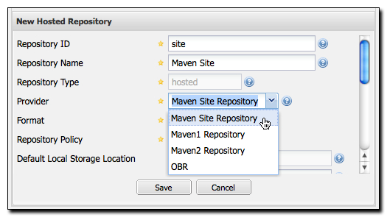
Creating a Maven Site Repository
Change the type (provider) of the repo to “Maven Site Repository”

Slide 23
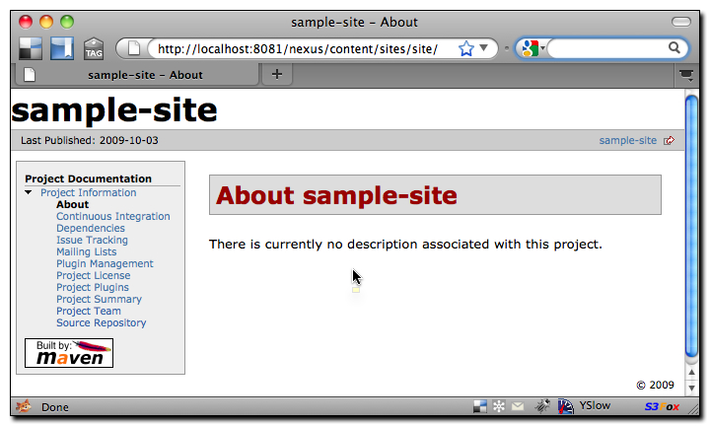
Publishing a Maven Site to Nexus
$ mvn site site:deploy

Slide 24
Agenda
Demo of Proxying feature of Nexus
Configuration of Settings.xml of Maven
Publishing feature of Nexus
Upload artifacts into Nexus manually

Slide 25
Demo of Proxying feature of Nexus
Nexus works as a proxy repository to catalyze you build process. It starts downloading the dependencies from its repository in case the required dependencies are not available during the build.
The settings.xml needs to modifies to enable this feature of Nexus.
Below is the screenshot showing the changes required to be done in settings.xml

Slide 26
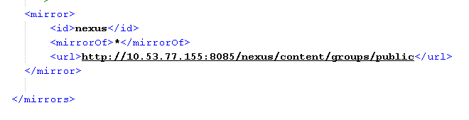

Configuration in settings.xml as shown below

Slide 27
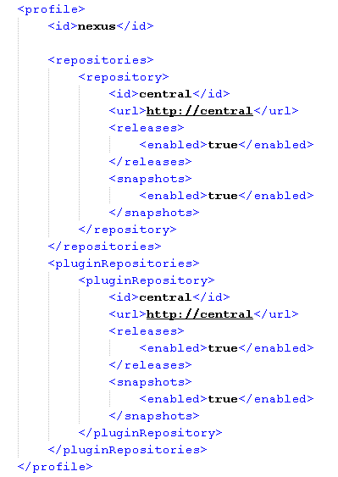

Slide 28
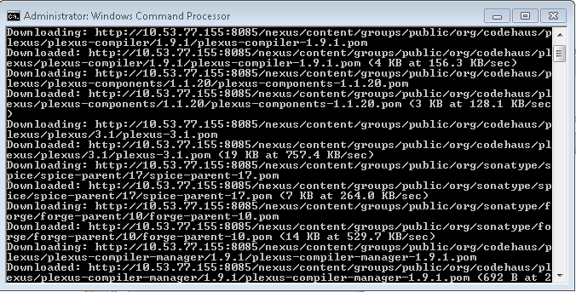
Once the settings.xml is configured and you try to build your code, you will see that the dependencies start getting downloaded as shown below

Slide 29
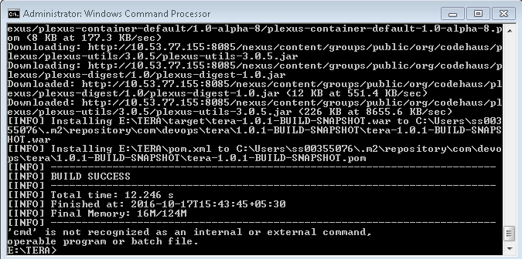
Once the dependencies are downloaded, the code is built.

Slide 30
Publishing feature of Nexus allows us to upload binaries into our Nexus repository.
This can be done either by using scripts like cURL script or by configuring our Continuous Integration tool like Bamboo, Jenkins etc.
Below is the screenshot of the cURL script:
curl -v -u admin:admin123 --upload-file C:\Users\ss00355076\Desktop\nexus-book-examples-master\maven\simple-project --url
http://localhost:8082/nexus/content/repositories/Simple_Project

Slide 31
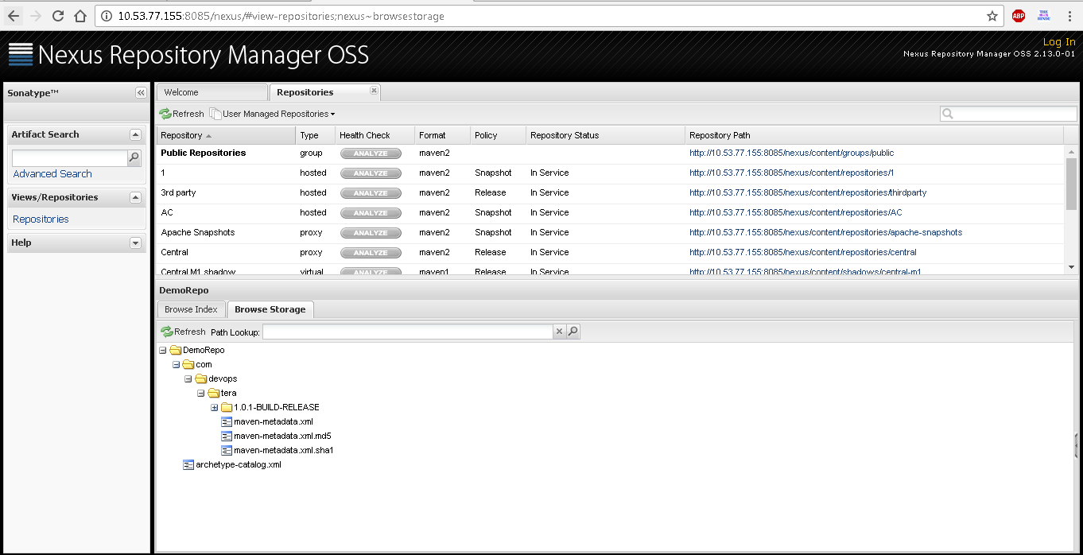

Slide 32
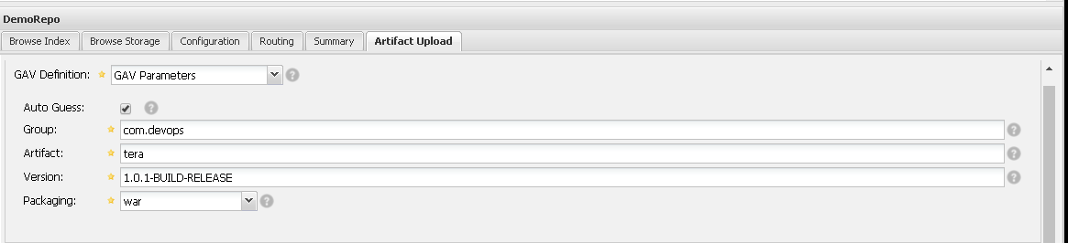
Artifacts can also be uploaded manually into Nexus repository as shown below:

Slide 33
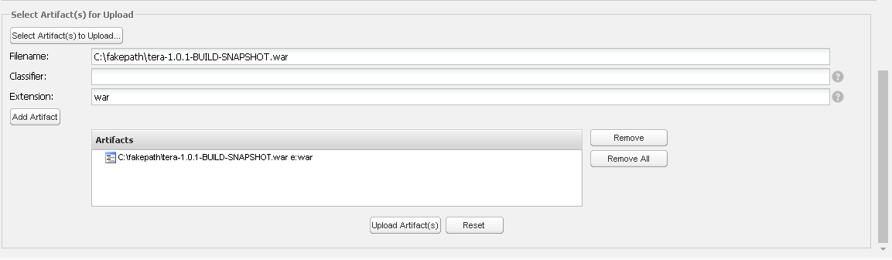

Slide 34
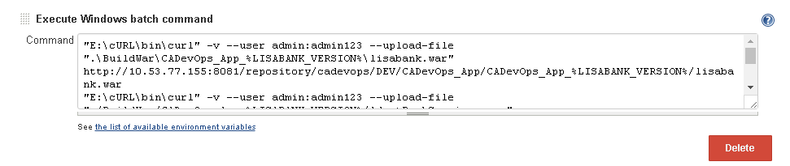
Artifacts can also be uploaded into Nexus Repository using Continuous Integration tool.

Slide 35
Thank you
Visit us at www.techmahindra.com

