Slide 1
Docker
Devops Team
TechM

Slide 2
Contents
Containerization
Containerization vs Virtualization
Containerization by Docker
Docker
Docker Platform
Docker Engine
Docker Hub
Building a Docker image
Dockerfile
Basic Docker CLI commands
Docker Installation

Slide 3
Containerization
OS-level virtualization method
Can deploy and run applications with minimal overheads
Operating above single host , single kernel > Lightweight

Slide 4
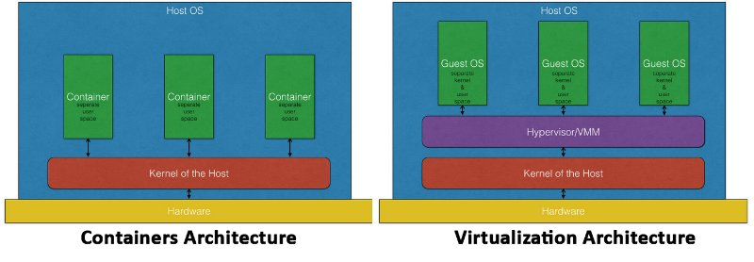
Containerization vs Virtualization
At a higher level, containerization provides execution services up and running above the hardware layer and OS layer.
Without the need of a hypervisor / guest OS level headaches

Slide 5
Containerization vs Virtualization
Containerization
OS based virtualization
Lightweight with minimal
Real-time provisioning
Direct access to hardware resources
Process level isolation
Virtualization
Hardware based virtualization
Heavy with more OS level overheads
Slow provisioning
Access to hardware layer is through a hypervisor
Fully isolated hence more secured

Slide 6
“ Containerization is not a replacement for virtualization ”

Slide 7
Containerization by Docker
The best implementation of containerization
Docker is an open-source platform
It allows to develop , ship and run applications in isolated environment ie Containers
Can run many containers simultaneously on a single host
Provides good control and speed in managing the app container
Can easily move across various environments with minimal or no impact on the application configuration ----> Hence decrease bugs/dependency hell generated due to switiching of env like dev to stage or to prod
So in simple words,it is a happy developer platform. Code and run your app like in production on a dev box. Get all configurations done , build it , fix bugs, rebuild and then move to other environment once 'Done
Docker provides tools for providing a full set of services like storage,network etc to package and host an application

Slide 8
Quick Q & A before moving on
Any Quick revisits needed for topics till now please?
Containerization / Virtualization / Docker
Moving on to Docker Platform

Slide 9
Docker
> 1000 Contributers
> 1 Lakh dockerized applications
> 3 Million developers using Docker
> 7000 github stars
> 2 Lakh pulls
and growing ...

Slide 10
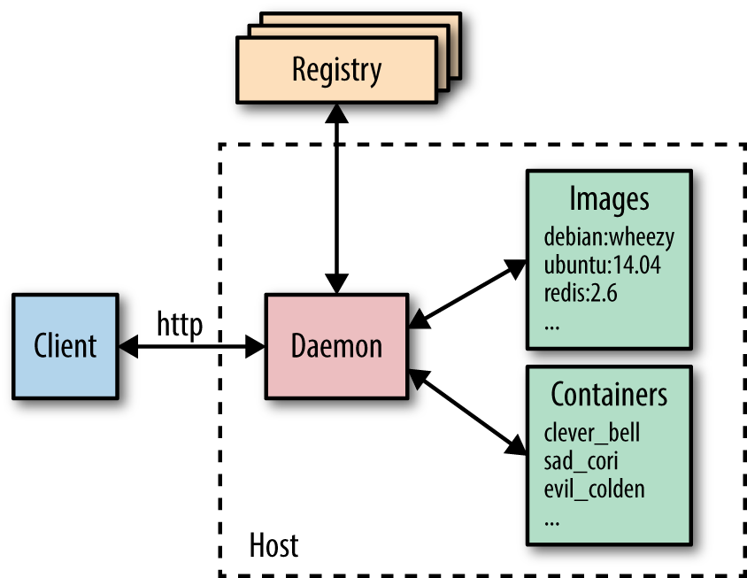
Docker Platform
Comprises of Docker Engine and Docker Hub

Slide 11
Docker Engine
It comprises of Docker Daemon [ Server ] and Docker CLI [ Client ]
It is a client server application
The CLI client uses REST API to interact with the Docker daemon
Scripting / CLI commands can be used to interface between client and server
The Docker daemon creates and manages Docker objects, creates an image , build it and it can be pushed to docker registry

Slide 12
Docker Hub
In simple words it is a library for private and public Docker images
Free public images and paid private images
We can pull existing image and customize it as per our app requirement and then push to private / public repo

Slide 13
Building a Docker image
We can directly use an existing docker image from docker registery eg: pull a base Ubuntu image from repo and run it
For customizing our app / packaging our app in a container we can create a Docker image built from a Dockerfile

Slide 14
Dockerfile
Docker images can be defined/configured via Dockerfile
A Dockerfile consists of set of steps / instructions for setting up an app container
Docker has its own set of instructions to be used in Dockerfile eg : RUN, MAINTAINER , CMD etc.
Dockerfile example >> Next

Slide 15
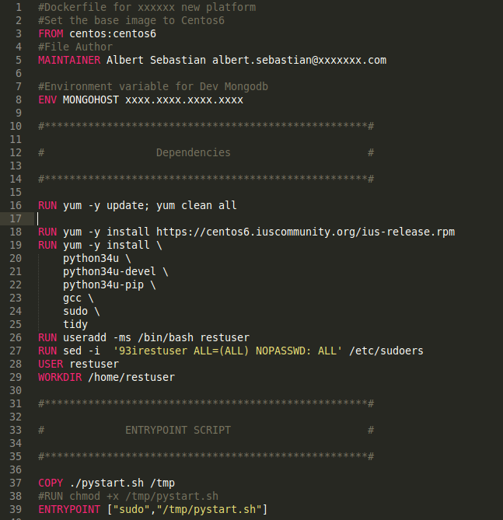
Sample Dockerfile

Slide 16
Basic Docker CLI commands
- docker build : builds an image from Dockerfile
- docker images : list all images
- docker run : run an image
- docker ps : lists all running and stopped instances
- docker stop : stop a running container
- docker rm : removing an instance
- docker rmi : removing an image

Slide 17
Docker Installation
Link

Slide 18
Benefits of Docker for Devops Workflow
Build once run anywhere .
No worries about dependency hell
Each app runs on its own container ( isolation at process level )
A devops resource can deliver entire app lifecycle in an efficient , consistent and continous manner
Can avoid / can say that it automatically avoids inconsistencies between various environments
Lightweight
Addresses performance and cost concerns
Regardless of host distribution ( kernel > 2.6.32 )
Has its on process and network space

Slide 19
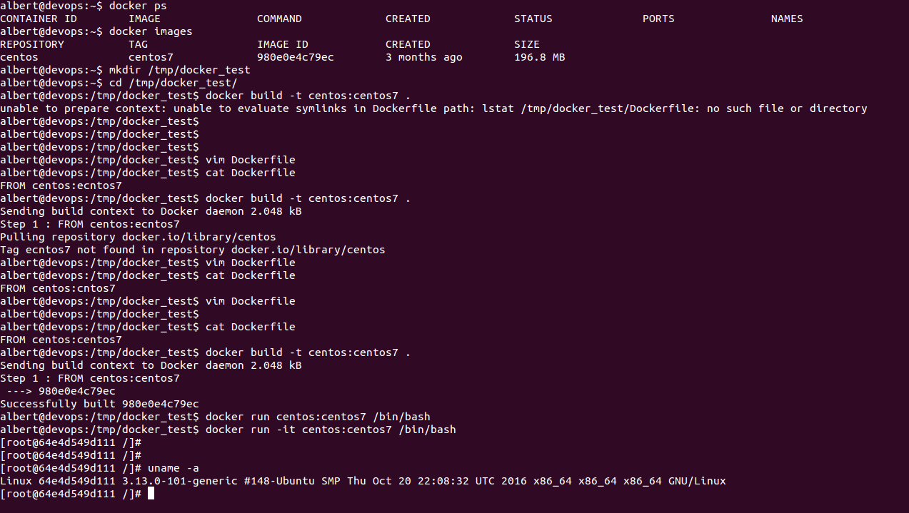
Sample Screen

Slide 20
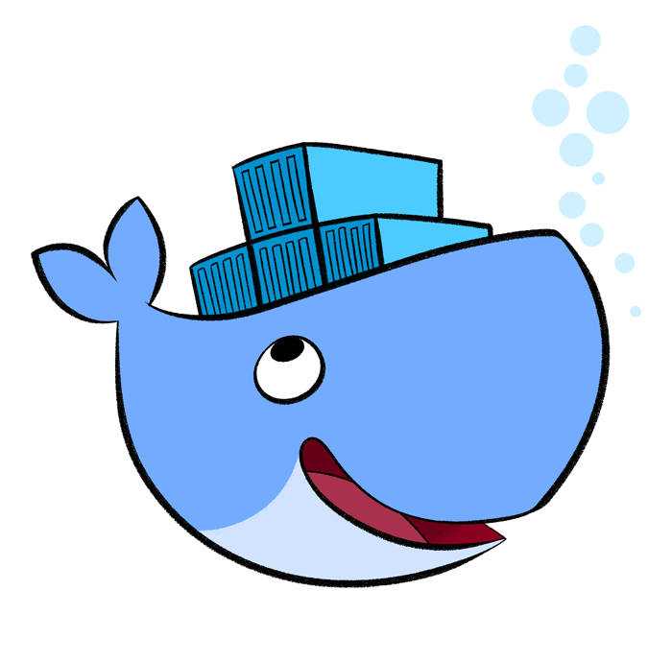
Cheers !!!

