Slide 1


Go[BIG]
with DevOps
End to End DevOps
Enable faster time to value by e2e DevOps
1

Slide 2

Agenda
1
Overview of TechM DevOps Capabilities
(DevOps Capabilities , TechM offerings )
2
TechM’s Approach – End to End DevOps powered by ADOPT
(Walkthrough of TechM’s CPPA approach of DevOps)
3
ADOPT Reference Architecture & Sample Workflow
(Walkthrough of ADOPT reference architecture and sample workflow with tools integrated to establish CI/CD, traceability and reporting with Teamforge, Eclipse, Git, Gerrit, Jenkins, SonarQube, CA RA, & CA LISA and other tools)
4
Customer Experience Snapshot
5
Next Steps and Q&A

Slide 3

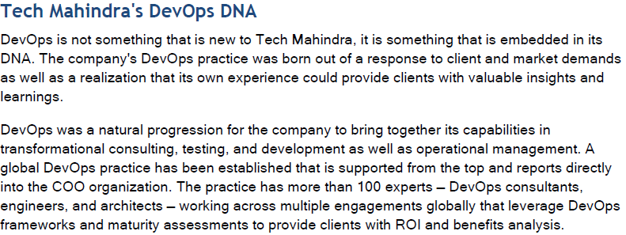
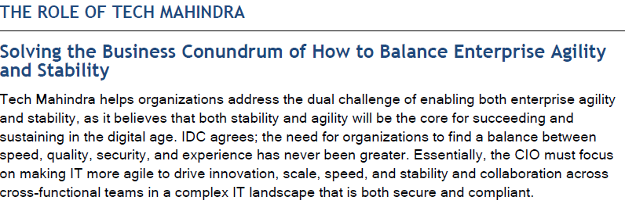
ADOPT: Market Positioning

Slide 4
TechM DevOps Center Of Excellence
DevOps Lab
Joint Solution development
Jump start kit (Templates, Questionnaires)
Advisory Services
Solutions
Business development
Dedicated sales and marketing team for NA, EUR and APAC
Business development managers to support delivery, sales and client teams.
DevOps consulting
Experienced DevOps consultants and architects
DevOps Value Assessment (ROI and benefits showcase) to commit futuristic benefits
Training and enablement
Training and enablement programs
Accreditation and Certification roadmap
Refresher and skill upgrade programs
DevOps lab & solutions
DevOps lab having license from partners – Redhat, Open Source, Atlassian, CA, IBM, HP, Microsoft, Collabnet etc
Build differenciated DevOps offering such as ADOPT (End to End DevOps offering)
DevOps Team
100+ experts delivering engagements globally backed by project implementation experience

Slide 5







TechM DevOps Offerings
Focus Areas
Continuous Planning
Continuous Integration
Continuous Testing
Continuous deployment
Continuous Monitoring & Feedback
Domains
Communication
BFSI
Retail
Healthcare
Media
Oil & Gas
Manufacturing
Partnerships
DevOps Practice
Enterprise architecture Support
Business / Process Consulting
Sales and Marketing
Technology Consulting
Service Offerings | Descriptions
ADOPT | End to end DevOps platform supporting people, process and tools transformation, Real-Time governance, measurement, reporting and traceability, Standardization of process and tooling / automation
Advisory Services | Maturity assessment and roadmap, Business Case identification and solution approach, Tool selection and recommendations
Implementation services | Process model, Solution map, integration, migration & rollout strategy, DevOps use cases, Integrated tooling for E2E solution
Support Services | DevOps Platform Administration and Support, On-boarding projects and roll out, Training, 24x7 support, Patches & Upgrades
DevOps as a Service | Provide ADOPT as a Service, Hosting, Platform Administration and Support, Usage reporting, Enhancement
Point Solutions | Solutions such as Continuous Integration, Continuous Deployment, Environment Automation, Release Automation, Service Virtualization, Virtualized Mainframe Testing etc. enabling the DevOps journey
Organizational Change Management | Provide OCM impact analysis, stakeholder analysis, communication strategy, adoption and training and enable the organizations to use the best practices to succeed in business
DevOps Service Catalogue consists of 15+ Services for customers

Slide 6
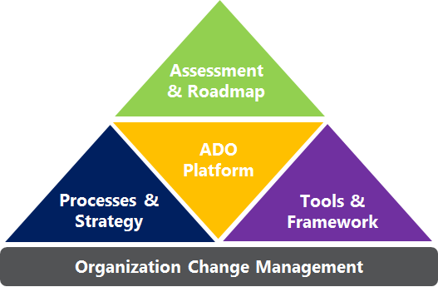
An Insight : TechM DevOps Approach
Tool Agnostic, People and Process centric Application Optimization & Transformation
DevAsset© (DEVOPS Assessment Tool) to baseline Maturity model and recommend roadmap for continuous improvement
ADOPT Platform - completely integrated with capability of end to end orchestration and Dashboard reporting
Drivers
Keys to Bridge the Gaps
Improve Time-to-value
Eliminate waste
Improve productivity
Get feedback
Quality Assurance
Automation
Collaboration
Governance
SDLC process modeling to fit Organization needs
Automation
Culture
ADKAR based OCM framework to train, motivate and facilitate Org culture change
Expertise in end-to-end Tool chaining (Tool selection, Implementation & Integration)
People
Process
Delivered through Application Delivery Optimization PlaTform (ADOPT)
Notes:
People & Culture: Train, Motivate and Facilitate stakeholders to communicate & collaborate through Organizational Change Management
Process & Strategy: Assess the maturity, determine gap and chart strategy & road-map for continuous lean improvement across the SDLC
Tools & Framework: Automate processes by leveraging tools and integrating them to enable continuous delivery

Slide 7






ADOPT – Support tools across the lifecycle
Product Family | Planning & Requirements Management | Continuous Integration & Build Management | Test & Service Virtualization | Release and Deployment Automation | Monitoring and Feedback
 | Rational CLM | RTC | Rational Test Workbench Rational Test Virtualization Server | uRelease uDeploy | IBM Tivoli
 | HP PPM HP ALM HP Agile Manager | Open Source | HP UFT HP Service Virtualization | HP Codar HP OO | HP SM HP SiteScope
 | CA Project & Portfolio Management (CA PPM) Rally | Harvest + 3rd party tool ( Hudson & Jenkins) | CA LISA Test CA Service Virtualization CA Data Finder CA Mobile Test CA Mobile Cloud | CA Release Automation | CA Wiley Introscope CA Unified Infrastructure Management (CA UIM) CA Pathfinder
 | Microsoft – Team Foundation Server Microsoft – ALM | Microsoft – Visual Studio Microsoft – ALM | Microsoft – Test Manager Microsoft – Code UI test | Microsoft – Visual Studio Release Manager
 | ScrumWorks Pro TeamForge (ALM) | TeamForge (ALM) |  | Automic | CloudForge
& Open source | JIRA | Subversion GIT, Nexus Jenkins Sonar Bamboo | Selenium Jmeter iAF ( TechM Test Automation Framework) | Chef Puppet | Nagios Zabbix
* Tech Mahindra’s ADOPT platform is technology independent and vendor agnostic

Slide 8

ADOPT - Reference Architecture
Continuous Planning
Continuous Testing
Continuous Deployment
Continuous Integration
Continuous Monitoring
Ordering Platform
Reports and Dashboard
Administration
User Management
Collaboration / Document Management / Wiki
Integrated ALM
Control center for build pipelines, deployment pipelines and delivery pipelines
ALM Platform
Project Trackers
Defect Tracker
Build Tracker
Deployment Tracker
Issue management
Change Management
Epics & User Stories
Code Search
SCM
Code Review
Reports and Dashboards
Orchestration
Integration Engine
Requirement Management
Build Automation
Test and Defect Management
Release & Deployment Automation
Application & Infrastructure Monitoring
Project and Portfolio Mgmt.
Code Quality
Test Data Management
CMDB: Infrastructure as code
Log-Analysis / Log Aggregation
Functional Platform
Artifact repository
Functional Test Automation
Environment Automation / Provisioning
Capacity Management
Service Virtualization
Service Management
Vulnerability Assessment
Operational Analytics

Slide 9
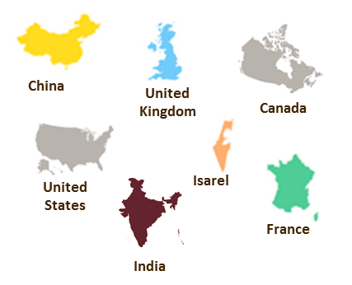
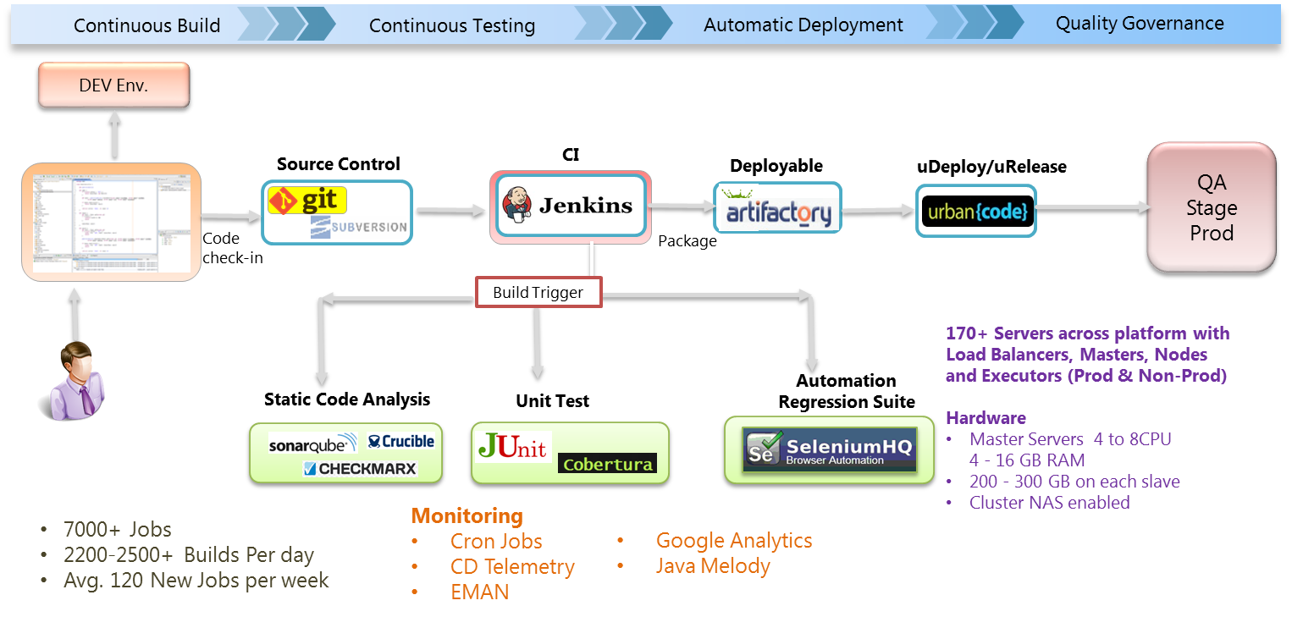



Case Study#1 - Business & IT shared services to drive scale: American IT Org.
Use Case: IT Delivery Platform for ‘Releasing Any Day Any Time
Defined a framework to integrate a set of disparate processes & tools
Designed the target architecture for an integrated DevOps platform
Developed governance/reporting
Developed platform interfaces and integrated the tools for DevOps adoption
Platform deployments, Rollout of the platform and automation across service portfolios
Speed of Development Process improved by 25%
Cost reduced due to CI & Quality Inspection by 15%
Software Quality
improved by 25%

Slide 10




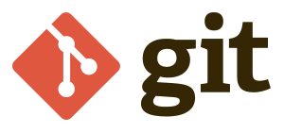

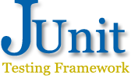






ADOPT - DEMO E2E Workflow
End to End DevOps Solution: Powered by ADOPT™ framework
Demo Start
DemoFinish
Automated Defect Flow
Dev Team
Develops
using
Pass
Fail
Fail
Fail
Code Check in
Quality
Gate
Quality
Gate
Quality
Gate
QA Env
Fail
Fail
Fail
Fail
Fail
Version
Control
Pass
Pass
Pass
Quality
Gate
Repository Manager
Quality
Gate
Quality
Gate
Quality
Gate
Quality
Gate
Code Review
Unit Testing
Code Quality
Binary
Files
Pass
Pass
Pass
Pass
Fetch
Automated Build
Gerrit
AUTOMATED
DEPLOYMENT
Functional Testing (iAF)
Integration Testing
Binary Fetch
Performance Testing
Acceptance Testing
Deployment Tool (CA RA)
Powered by
Powered by
Powered by
Jenkins Job
- Trigger
Jenkins Job
- Trigger
Jenkins Job
- Trigger
Jenkins Job
- Trigger
Jenkins Job
- Trigger
Jenkins Job
- Trigger
Jenkins Job
- Trigger
Jenkins Job
- Trigger
Jenkins Job
- Trigger
Orchestration with Jenkins

Slide 11
Thank you
Visit us at www.techmahindra.com

