Slide 1
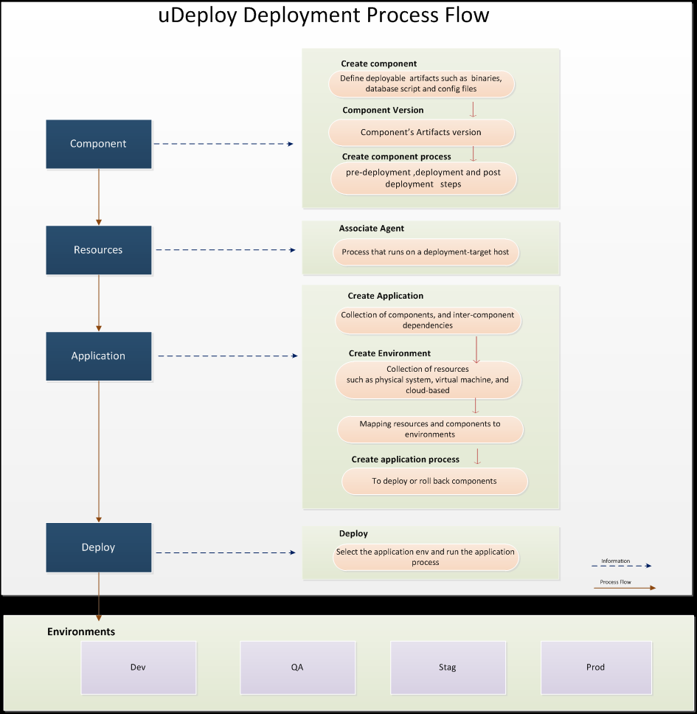
Modeling uDeploy Process Flow for B2B

Slide 2
Features and Benefits
Features | Benefits
GUI based Adding/modifying/deletion of the common configuration parameters in .xml files which is pre requisite for the deployment. | User friendly GUI eases the process of editing the file, saving on time. Probability of misconfiguration gets reduced.
Copying artifacts to target environment | Reduced release time.
Automate the manual B2B deployment process execution. | Once parameter changes done at .xml it is just one click deployment process. Saving on release time and manual errors.
Version Control implementation. | Easy to track the desired state of each environment. Easy to rollback to previous versions.
Automated deployment rollback. | Easy to rollback the deployment, configuration changes etc. in to Model environments.
Deployment changes through user friendly GUI tool. | Adding/modifying of parameters can be done easily through GUI ex: Parameter changes, DB changes etc.
Template creation. | Repetitive tasks are eased out by saving time and reduction in errors.
Build promotion to different stages in an automated fashion (Dev, Test, Dress Rehearsal, Production etc.) | Deployment can be done on different environment and different services simultaneously by creating snap shot of automation flow.
Building of Quality Gates and Approvals. | Helps you to ensure that only the right stuff goes out at the right time.
Detailed Reporting. | Detailed report of deployment Ex: Deployment date, duration, environment name, status, which user executed, count of deployment etc.

Slide 3
Comparative Analysis
Name | Jenkins/Hudson | TeamCity | IBM UrbanCode Deploy | Remarks
Platform | Servlet Container | Servlet Container | Windows, Linux/Unix
License | Creative Commons and MIT | Proprietary | Commercial
Customization | Yes | Yes | Yes
Windows builders | MS Build, NAnt | MS Build, NAnt, Visual Studio, Duplicates finder for .NET
Documentation Availability | Yes(free) | Yes(free) | Yes(free)
Java builders | Ant, Maven 2, Kundo | Ant, Maven 2/3, IDEA .ipr based, IDEA Inspections, IDEA Duplicates finder, Gradle
Other builders | Cmake, Gant, Gradle, Grails, Phing, Rake, Ruby, SCons, Python, Shell script and Command Line | Rake, FxCop, Command Line
Notification | Android, E-mail, Google Calendar, IRC, XMPP, RSS, Twitter | E-mail, XMPP, RSS, IDE, SysTray | Email
IDE Integration | Eclipse, IntelliJ IDEA, NetBeans | Eclipse, Visual Studio, IntelliJ IDEA, RubyMine, PyCharm, PhpStorm, WebStorm
Other Integration | Bugzilla, Google Code, JIRA, Bitbucket, Redmine, FindBugs, Checkstyle, PMD and Mantis, Trac | Jetbrains Youtrack, JIRA, Bugzilla, FishEye, FindBugs, PMD, dotCover, NCover | Integrated with middleware, provisioning and service virtualization

Slide 4
Comparative Analysis (cont..)
Name | Jenkins/Hudson | TeamCity | IBM UrbanCode Deploy | Remarks
Deployment Management |  |  | 3 Level Deployment Authorization, Notifications, Dashboard, Audit Report, Release Repository, Build Traceability, Calendar/Scheduler, Workflows, visualizations, Test/Debug, Multi-user design, Automated, consistent deployments and rollbacks of applications.
Release Execution |  |  | Snapshots/Full & Incremental Versioning
Orchestration |  |  | Orchestration of changes across servers, tiers and components
Scripting | Shell, PowerShell, Groovy, Perl ,python | Shell, PowerShell, Groovy | Shell, PowerShell, Groovy

Slide 5

Functional Capabilities
Automated, consistent deployments and rollbacks of applications
Orchestration of changes across servers, tiers and components
Configuration and security differences across environments
Clear visibility: what is deployed where and who changed what
Integrated with middleware, provisioning and service virtualization
UrbanCode Deploy with Patterns delivers applications to the cloud, at scale, with speed and provides
Rich web-based designer to create fullstack application blueprints for your cloud
Continuous delivery pipeline environments for new applications
Short-lived testing sandboxes for specific infrastructure combinations
Infrastructure changes through environments just like application changes
Consistency across environments, from testing to production even when using multiple clouds

Slide 6
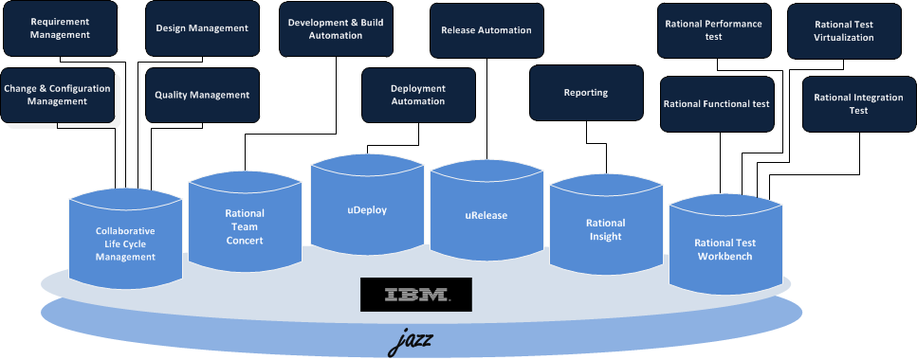
DevOps: IBM Rational Tools
For Monitoring, Tivoli tool sets are used and not part of Rational tool set

Slide 7

Rational Tools : User Perspective
Executives
Release Manager
Reporting & Dashboard
Systems/Component sprint level commitments w.r.t the releases
Release & Sprint level commitments per system/component level
Over all status of Design/Dev/Testing/Defects progress of Past/Present/Future release
Build & Deployment status
Release , Reporting & Dashboard
Create & Map releases with up & down stream components
Sprint level commitments per system/component level
Number of stories are tagged specific to the system/component
System / Component wise overall progress(%) w.r.t the releases
RI
uRelease & RI
Project Manager
BA & Design Team
Planning, Tracking, Tasks Creation,
Reporting & Dashboard
Systems/Component sprint level commitments w.r.t the releases
Release & Sprint level commitments per system/component level
Allocating & Tracking development tasks, defects per system / component level to the individual team member level
Build & Deployment status
CCM
& RI
Req. Capturing &
Design
Capturing requirements, create design document
Mapping of requirements with design cases w.r.t Systems / Components
Can draw diagrams(Ex., Use case, Sequence, State flow diagrams)
Can bring the traceability of solution stories to component level
Assign design doc to dev team members
RSA
Development Team
Build & Deployment Team
Code Dev,
Build,
Reporting & Dashboard
Integrate Eclipse plugin to write code
Configure build tools to pack the complete modules
Configure with application server
Can view the allocated tasks, Target dates of assigned system/component & its development schedule w.r.t planned start/end dates
Build &
Deploy
Authorized to view all the releases which he/she handles
Can view the Systems/Components which are mapped to the releases
System/Component wise build & deployment status on daily level
Number of pass/fail build & deployment status per System/Component wise
RTC,CCM
& RI
RTC & uDeploy
QA &
Testing
Authorized to view all the releases which he/she handles Test Case Creation & Data Mgmt
Can view the Systems/Components which are mapped to the releases Functional Testing
System/Component wise test cases & scenarios status Performance Testing
Assign defects; View number of defects per System/Component wise
RQM, RFT & RPT

Slide 8
Key IBM Rational Tools - Token Consumption
A “Token” is a base unit of license value. It can be exchanged for the right to use specific Rational software.
Tool Name | Token Consumption | Unit of Measure | Teams that can leverage
Rational DOORS | 10 | Floating User | BA
Rational Insight | 13 | Floating User | Executive, PM, Release Team
Rational Team Concert | 8 | Floating User | PM, Development, Build & Deployment Team
Rational Software Architect | 13 | Floating User | Design/Architect Team
Rational Quality Manager | 10 | Floating User | PM, QA Team
Rational Functional Tester | 11 | Floating User | Testing
Rational Performance Tester | 3 | Floating User | Testing
Rational Test Workbench | 21 | Floating User | Testing
Rational Test Virtualization Server | 266 | Server | Testing
Rational uDeploy | 22 | Floating User | Build & Deployment Team
Rational UBCD with Patterns | 112 | Server | Build & Deployment Team
Rational uRelease | 13 | Floating User | Release Team
Flexible Licensing
Use the right tool at the right time during the lifecycle of a development project
Streamline License Management
Help eliminate the concept of temporarily “unused” software as the project moves from one development phase to the next
Flexibility in Configuration
Allow for current product use as well as factoring additional tools that might be needed later in the lifecycle.

Slide 9
Thank you
Visit us at www.techmahindra.com

