Slide 1
Tech Mahindra
2016

Slide 2
Maven
Presenter

Slide 3
Agenda
Maven
Introductionnguage Introduction>
Installationes>
Features
POM
Buid Life Cycle
Dependency Management
Repositories

Slide 4
Introduction
What is Maven?
Maven is a software management and comprehension tool based on the concept of Project Object Model (POM) which can manage project build, reporting, and documentation from a central piece of information
Maven uses Convention over Configuration

Slide 5
Installation
Download Apache maven zip
http://maven.apache.org/download.cgi
Set maven environment variables
MAVEN_HOME, PATH
Verify maven installation using mvn –version command

Slide 6
Features
Maven is not only a build tool
Build-Tool
Dependency Management Tool
Documentation Tool
Consistent project structure
Plugin oriented
Project generated sites

Slide 7
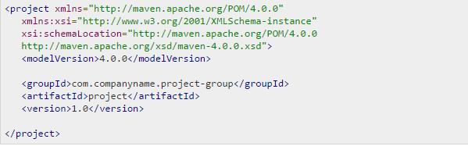
POM.xml
POM: Project Object Model
POM is a fundamental unit of work in Maven, POM is an XML file that contains information about project and configuration details used by Maven to build the project
Root element of POM is project
It contains <groupId>,<artifactId>, <version> fields
Basic POM:

Slide 8
Build Life Cycle
A Maven build follow a lifecycle
Validate
Compile
Test
Package
Install
Deploy

Slide 9
Overview of goals
validate - validate the project is correct and all necessary information is available
compile - compile the source code of the project
test - test the compiled source code using a suitable unit testing framework. These tests should not require the code be packaged or deployed
package - take the compiled code and package it in its distributable format, such as a JAR
integration-test - process and deploy the package if necessary into an environment where integration tests can be run
install - install the package into the local repository, for use as a dependency in other projects locally
deploy - done in an integration or release environment, copies the final package to the remote repository for sharing with other developers and projects

Slide 10
Example Maven goals
To invoke a Maven build you set a lifecycle “goal”
mvn install
Invokes generate* and compile, test, package, integration-test, install
mvn clean
Invokes just clean
mvn clean compile
Clean old builds and execute generate*, compile
mvn test clean
Invokes generate*, compile, test then cleans

Slide 11
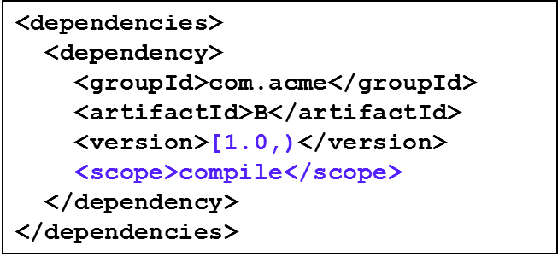
Dependency Management
Maven uses binary dependencies
Dependencies consist of: GAV
Scope: compile, test, provided (default=compile)
Transitive dependencies
Possibility to exclude some dependencies
Need good metadata
Ideally projects should be split
SNAPSHOT handling
Always get latest
Automatic dependency updates
By default every day

Slide 12
Types of repositories
Maven repository is a place i.e. directory where all the project jars, library jar, plugins or any other project specific artifacts are stored and can be used by Maven easily.
Maven repository are of three types
Local
Central
Remote

Slide 13
Local Repository
Maven local repository is a folder location on your machine. It gets created when you run any maven command for the first time.
Maven local repository keeps your project's all dependencies (library jars, plugin jars etc). When you run a Maven build, then Maven automatically downloads all the dependency jars into the local repository. It helps to avoid references to dependencies stored on remote machine every time a project is build.

Slide 14
Central Repository
Maven central repository is repository provided by Maven community. It contains a large number of commonly used libraries.
When Maven does not find any dependency in local repository, it starts searching in central repository using following
URL: http://repo1.maven.org/maven2/

Slide 15
Remote Repository
Remote Repository
Sometime, Maven does not find a mentioned dependency in central repository as well then it stopped build process and output error message to console. To prevent such situation, Maven provides concept of Remote Repository which is developer's own custom repository containing required libraries or other project jars.
Example:
<repositories>
<repository>
<id>companyname.lib1</id>
<url>http://download.companyname.org/maven2/lib1</url>
</repository>
<repository>
<id>companyname.lib2</id>
<url>http://download.companyname.org/maven2/lib2</url>
</repository>
</repositories>

Slide 16
Demo

Slide 17
Thank you

