Slide 1
Tech Mahindra
2016

Slide 2
Maven
Presenter

Slide 3
Agenda
Maven
Introductionnguage Introduction>
Installationes>
Features
POM
Archetype
Lifecycles of Maven
Dependency Management
Distribution management
Repositories
Eclipse integration with maven

Slide 4
Introduction
What is Maven?
Maven is a software management and comprehension tool based on the concept of Project Object Model (POM) which can manage project build, reporting, and documentation from a central piece of information
Maven uses Convention over Configuration

Slide 5
Installation
Download Apache maven zip
http://maven.apache.org/download.cgi
Set maven environment variables
MAVEN_HOME = path of extracted Apache maven folder
PATH= append bin path of Apache maven
Verify maven installation using mvn –version command

Slide 6
Features
Maven is not only a build tool
Build-Tool
Dependency Management Tool
Documentation Tool
Consistent project structure
Plugin oriented
Project generated sites

Slide 7
Maven will have the following terms
Archetype – Telling the maven which type of project structure is to be made and the structure of pom.xml
Group Id – Just the package name
Artifact Id – Name of the application
Version – The versioning
Package – Is the Name of location where my code is to be stored and in which format(JAR,WAR)

Slide 8
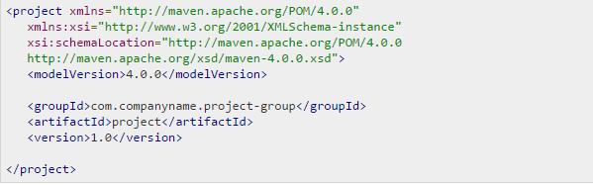
POM.xml
POM: Project Object Model
POM is a fundamental unit of work in Maven, POM is an XML file that contains information about project and configuration details used by Maven to build the project
Root element of POM is project
It contains <groupId>,<artifactId>, <version> fields
Basic POM:

Slide 9
Archetype
Archetype is a Maven project templating toolkit. An archetype is defined as an original pattern or model from which all other things of the same kind are made.
To create a new project based on an Archetype ,run
mvn archetype:generate goal
It will give number of archetypes, choose required archetype(default is quickstart.. It gives folder structure for simple java hello world program)
And give GroupID, ArtifactID, version

Slide 10
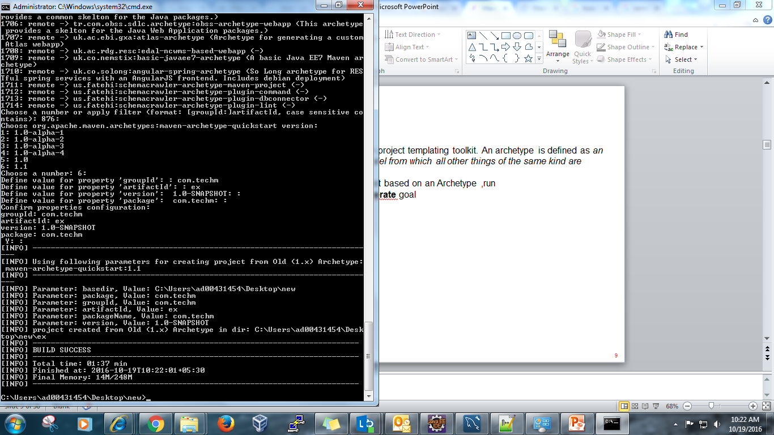
Archetype(cont..)

Slide 11
Archetype(cont..)
Alternate command for archetype generation:
mvn archetype:generate -DgroupId=[your project's group id]
-DartifactId=[your project's artifact id]
-DarchetypeArtifactId=maven-archetype-archetype
Example:
mvn archetype:generate
-DgroupId=com.techm
-DartifactId=demo
-DarchetypeArtifactId=maven-archetype-quickstart

Slide 12
Lifecycles of Maven
Maven defines 3 lifecycles in
default Lifecycle
clean Lifecycle
site Lifecycle

Slide 13
Default lifecycle
Default lifecycle is defined without any associated plugin. There are 23 phases in the cycles. Important build phases are:
Validate
Compile
Test
Package
Install
Deploy
build phase can also have zero or more goals bound to it. If a build phase has no goals bound to it, that build phase will not execute. But if it has one or more goals bound to it, it will execute all those goals.
Some phases have goals bound to them by default. And for the default lifecycle, these bindings depend on the packaging value.

Slide 14
Overview of goals
validate - validate the project is correct and all necessary information is available
compile - compile the source code of the project and generates .class files
test - test the compiled source code using a suitable unit testing framework.
package - take the compiled code and package it in its distributable format, such as a JAR
install - install the package into the local repository, for use as a dependency in other projects locally
deploy - done in an integration or release environment, copies the final package to the remote repository for sharing with other developers and projects

Slide 15
Example Maven goals
Maven can be invoked using following 2 ways(one or more combinations of any or both)
1) Build Phase
mvn install
Invokes validate, compile, test, package and install
mvn clean compile
Clean old builds and execute compile
mvn test clean
Invokes compile, test then cleans
2) plugin:goal (e.g. dependency:copy-dependencies)

Slide 16
Clean lifecycle
clean lifecycle is defined directly with its plugin bindings. It has following phases:
pre-clean : execute processes needed prior to the actual project cleaning
Clean: remove all files generated by the previous build
post-clean: execute processes needed to finalize the project cleaning

Slide 17
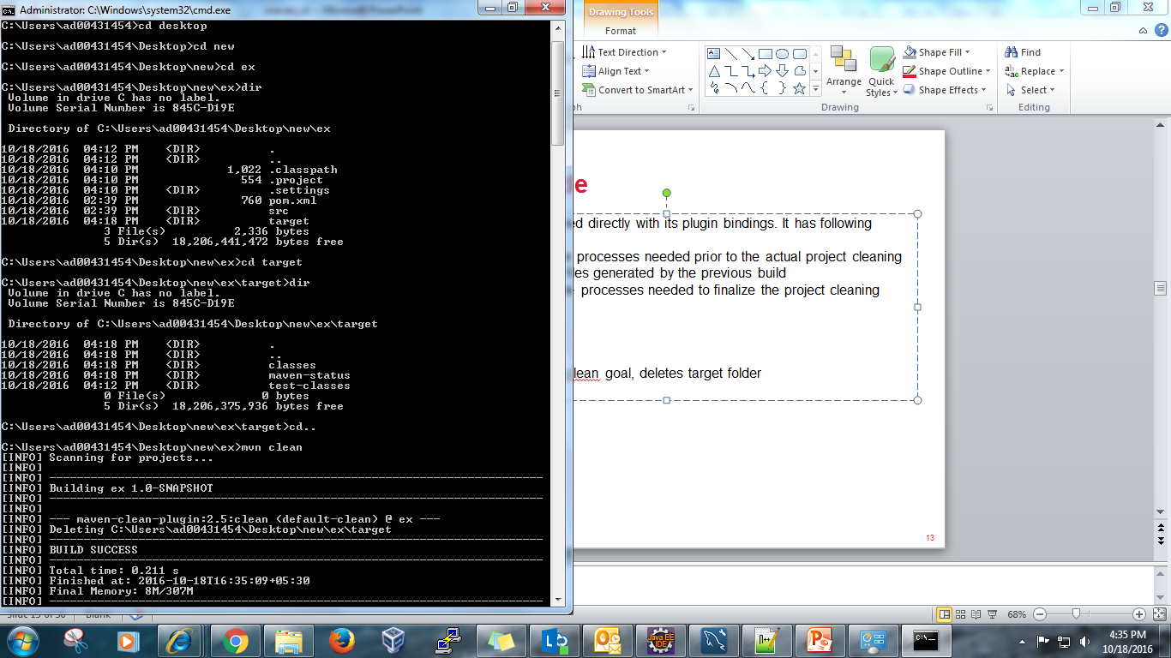
Clean lifecycle..Example
Example:
mvn clean
Maven clean goal (clean:clean) is bound to the clean phase in the clean lifecycle and deletes target folder

Slide 18
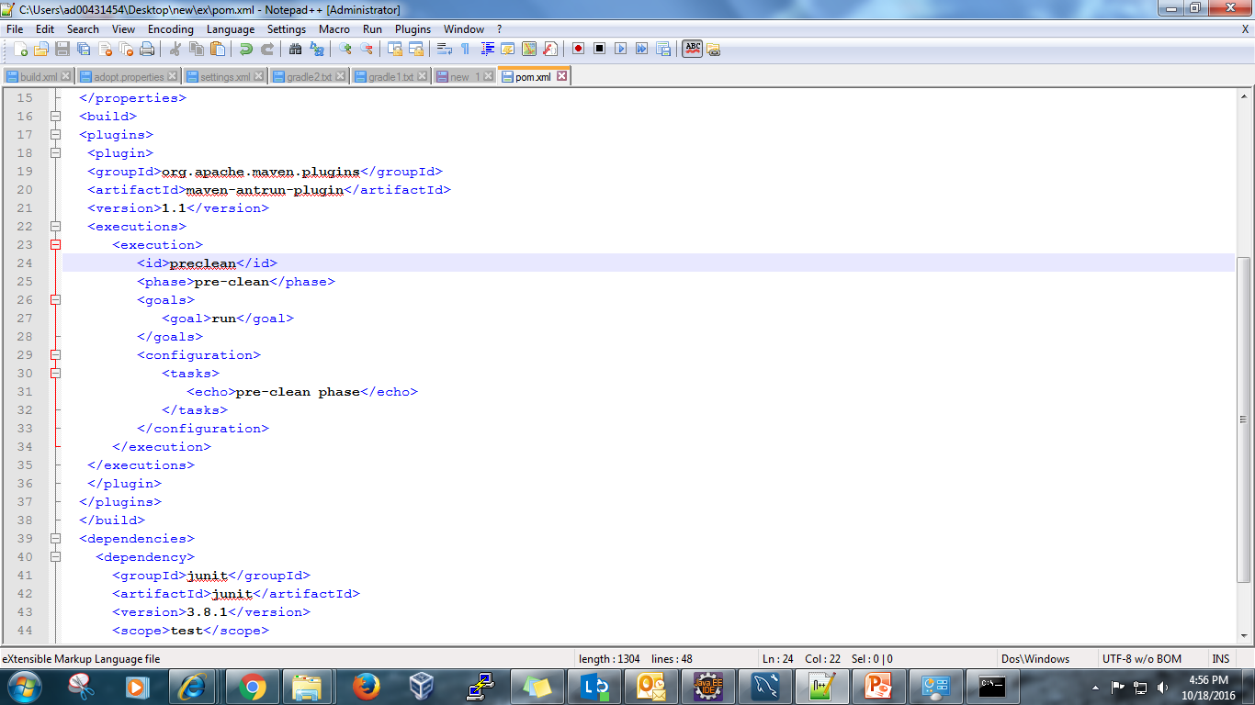
Clean lifecycle..Example
We can customize this behavior by mentioning goals in any of the above phases of clean life cycle.
Attach maven-antrun-plugin:run goal to the pre-clean phase. This will allow us to echo text messages displaying the phases of the clean lifecycle.
POM.xml:

Slide 19
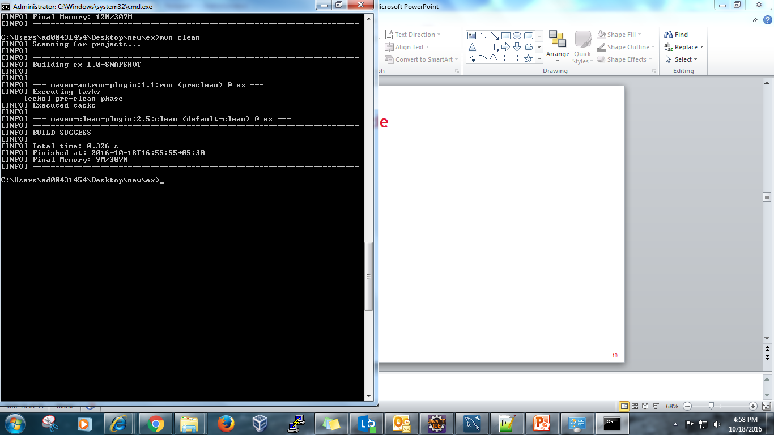
Clean lifecycle..Example
Mvn clean..First executes pre-clean phase and runs the goal attached to it, we can see the echo. And then executes clean phase.

Slide 20
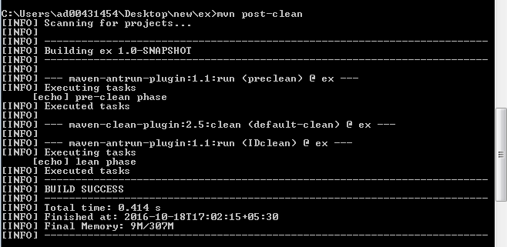
Clean lifecycle..Example
Attach antrun plugin run goal to clean phase also.
Now execute mvn post-clean

Slide 21
Site lifecycle
Pre-site: execute processes needed prior to the actual project site generation
Site: generate the project's site documentation
Post-site: execute processes needed to finalize the site generation, and to prepare for site deployment
Site-deploy: deploy the generated site documentation to the specified web server

Slide 22
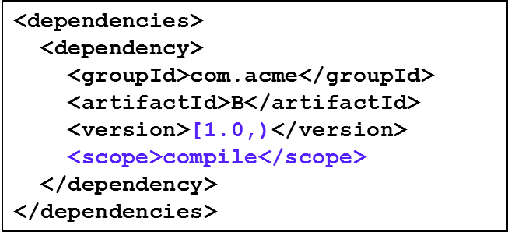
Dependency Management
In maven while compiling the code if we need external JARS or WARS we need not to manually download the jars ,we can automate it by using tags
Dependencies consist of: GAV
Scope: compile, test, provided (default=compile)
Possibility to exclude some dependencies
SNAPSHOT handling
Always get latest

Slide 23
Distribution management
It is primarily used for deployment of artifacts and the site produced by the build.
include distribution management in POM.xml:
<distributionManagement>
<snapshotRepository>
<id>teravirtual</id> <url>http://10.53.77.155:8085/nexus/content/repositories/teravirtual</url>
</snapshotRepository>
</distributionManagement>
To access this repository url, add server authentication under <servers> in global settings.xml.
<server>
<id>teravirtual</id>
<username>deployment</username> <password>deployment123</password>
</server>
mvn deploy command will deploy the Artifact to repository mentioned in the url.
>

Slide 24
Types of repositories
Maven repository is a place i.e. directory where all the project jars, library jar, plugins or any other project specific artifacts are stored and can be used by Maven easily.
Maven repository are of three types
Local
Central
Remote

Slide 25
Local Repository
Maven local repository is a folder location on your machine. It gets created when you run any maven command for the first time.
Maven local repository keeps your project's all dependencies (library jars, plugin jars etc). When you run a Maven build, then Maven automatically downloads all the dependency jars into the local repository. It helps to avoid references to dependencies stored on remote machine every time a project is build.

Slide 26
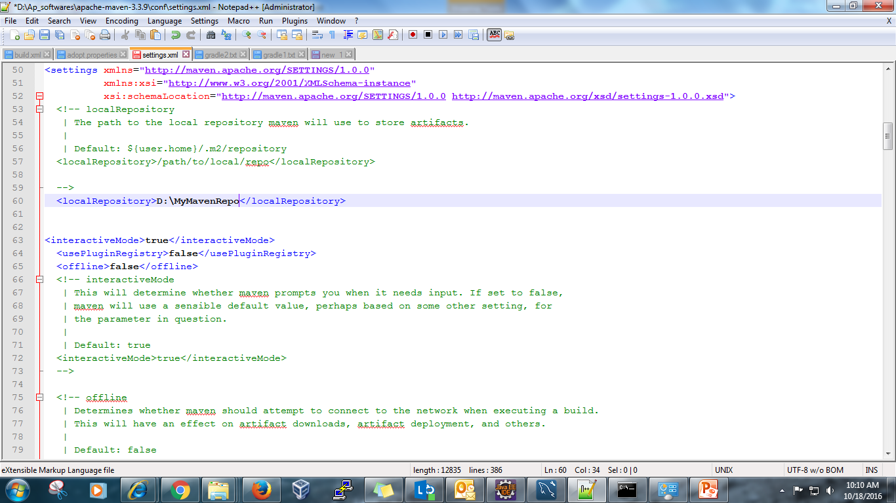
Local Repository(cont..)
By default local repository gets created in c:\users\USERNAME\.m2
This location can be changed by specifying the our own repository path in settings.xml of maven installation folder.

Slide 27
Central Repository
Maven central repository is repository provided by Maven community. It contains a large number of commonly used libraries.
When Maven does not find any dependency in local repository, it starts searching in central repository using following
URL: http://repo1.maven.org/maven2/
It is not required to be configured
It requires internet access to be searched

Slide 28
Remote Repository
Sometime, Maven does not find a mentioned dependency in central repository as well then it stopped build process and output error message to console. To prevent such situation, Maven provides concept of Remote Repository which is developer's own custom repository containing required libraries or other project jars.

Slide 29
Remote Repository(cont..)
Example:
Add like this in pom.xml to connect to that repository
<repositories>
<repository>
<id>nexus</id>
<url>http://10.53.77.155:8085/nexus/content/groups/public</url>
</repository>
</repositories>
To access this repository, add
<servers>
<server>
<id>nexus</id>
<username>admin</username>
<password>admin123</password>
</server>
</servers>
in global settings.xml

Slide 30
Maven Dependency Search Sequence
When we execute Maven build commands, Maven starts looking for dependency libraries in the following sequence:
Step 1 - Search dependency in local repository, if not found, move to step 2 else if found then do the further processing.
Step 2 - Search dependency in central repository, if not found and remote repository/repositories is/are mentioned then move to step 4 else if found, then it is downloaded to local repository for future reference.
Step 3 - If a remote repository has not been mentioned, Maven simply stops the processing and throws error (Unable to find dependency).
Step 4 - Search dependency in remote repository or repositories, if found then it is downloaded to local repository for future reference otherwise Maven as expected stop processing and throws error (Unable to find dependency).

Slide 31
Eclipse Integration with maven
Install m2Eclipse plugin in eclipse. It provides following features
Launching Maven builds from within Eclipse
Dependency management for Eclipse build path based on Maven's pom.xml
Resolving Maven dependencies from the Eclipse workspace without installing to local Maven repository
Automatic downloading of the required dependencies from the remote Maven repositories
Wizards for creating new Maven projects, pom.xml and to enable Maven support on plain Java project
Quick search for dependencies in Maven remote repositories

Slide 32
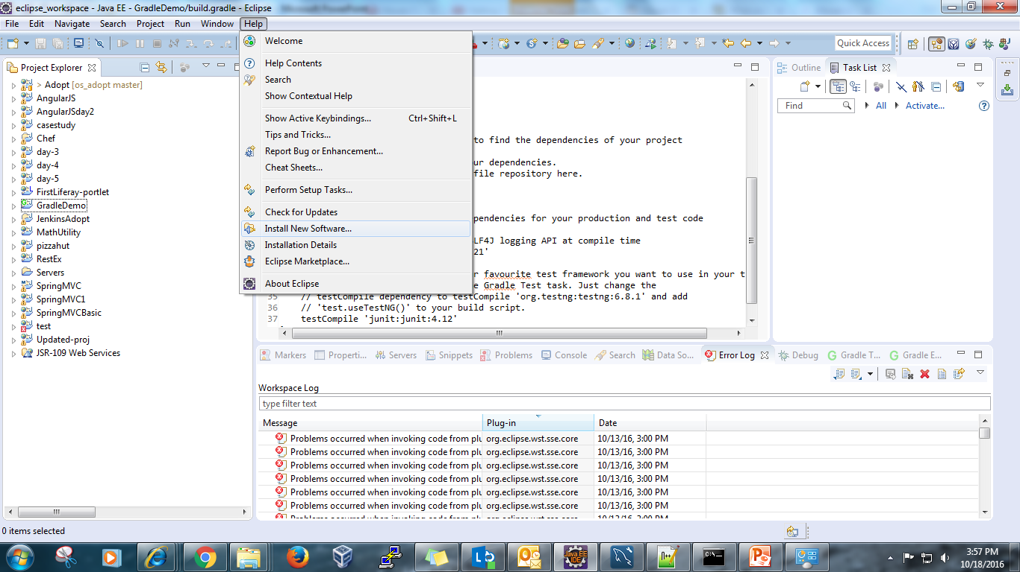
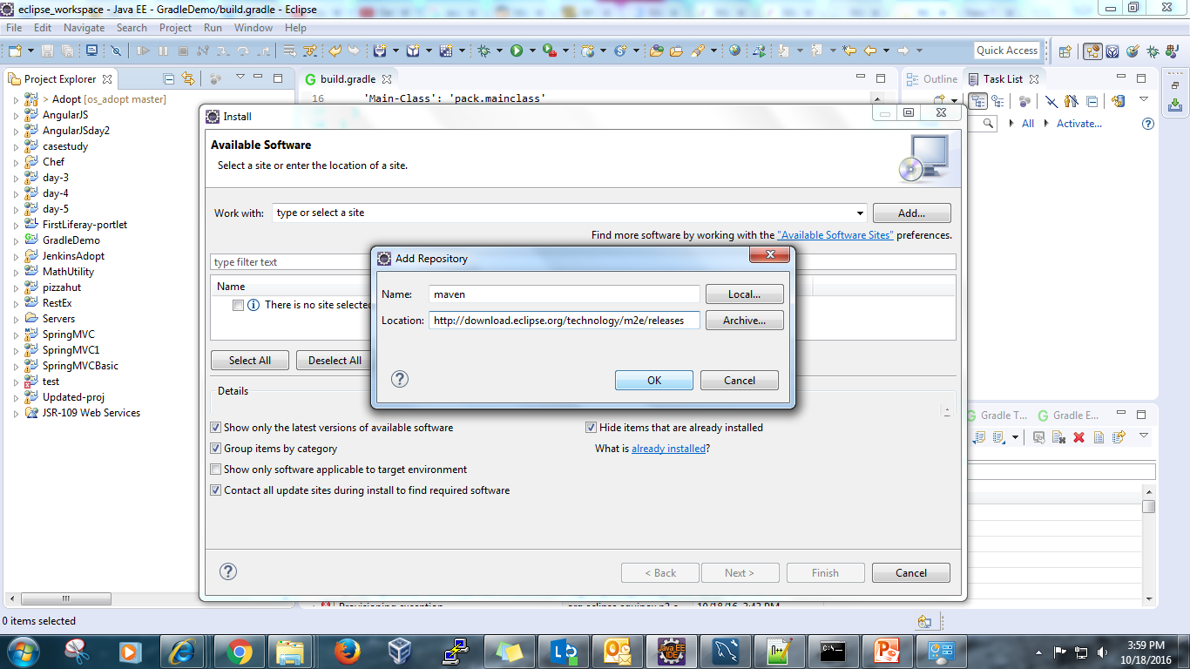
Eclipse Integration with maven(cont..)
Click on install new software, then add repository. Give location http://download.eclipse.org/technology/m2e/releases

Slide 33
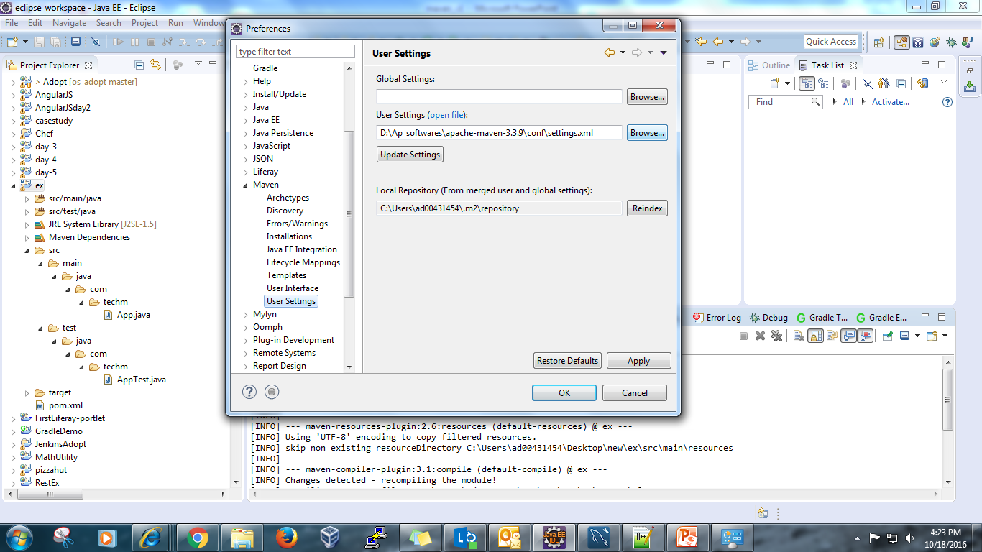
Eclipse Integration with maven(cont..)
Give path of settings.xml of apache installation.

Slide 34
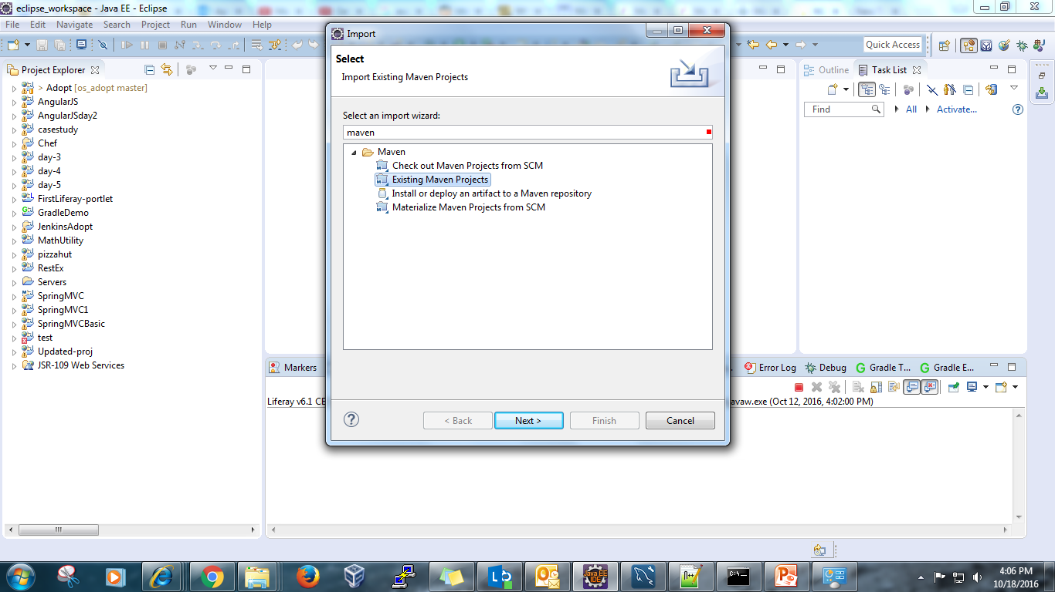
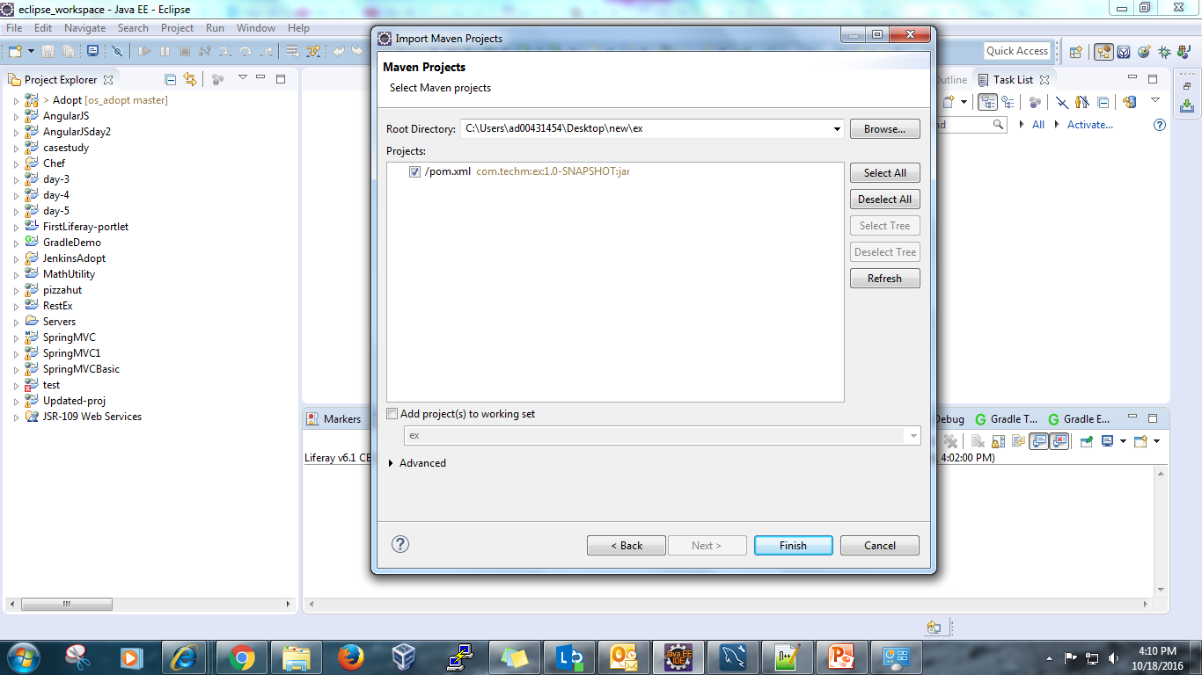
Eclipse Integration with maven(cont..)
Select and install. Restart eclipse.
Now we can see the create or import maven project in Eclipse

Slide 35
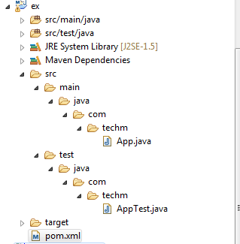
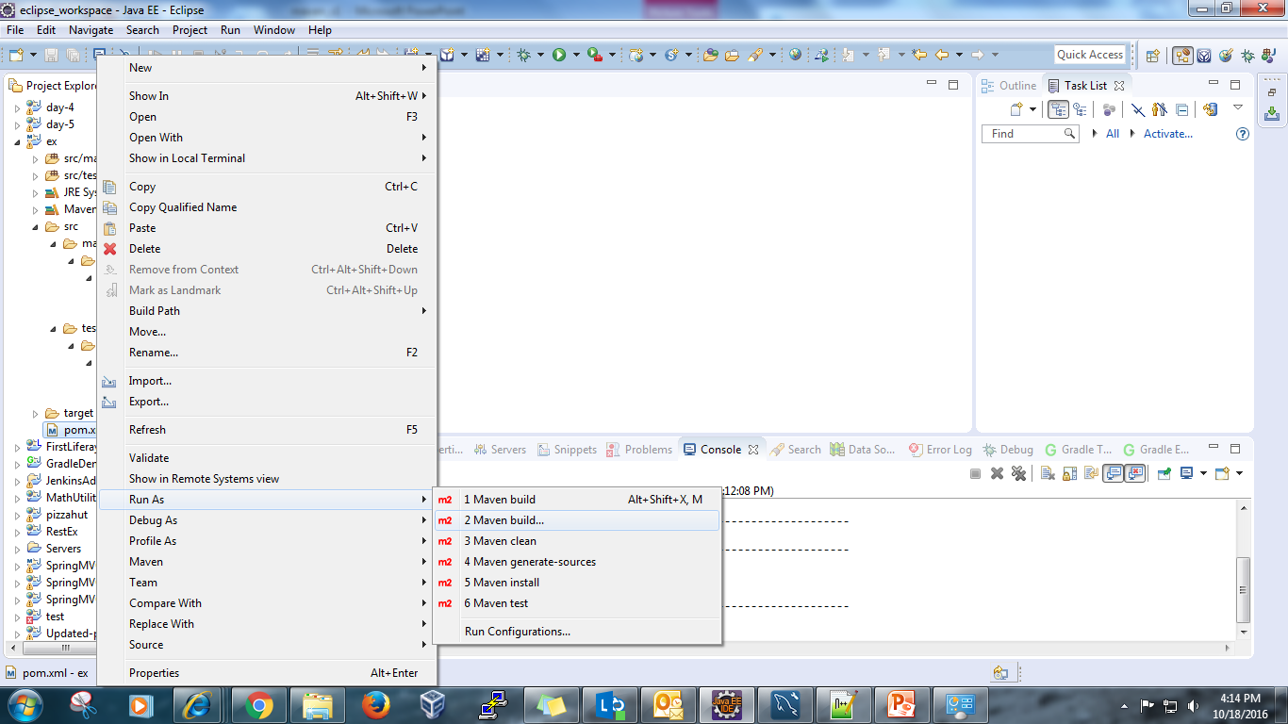
Eclipse Integration with maven(cont..)
Right click on project and click run as, select maven build.

Slide 36
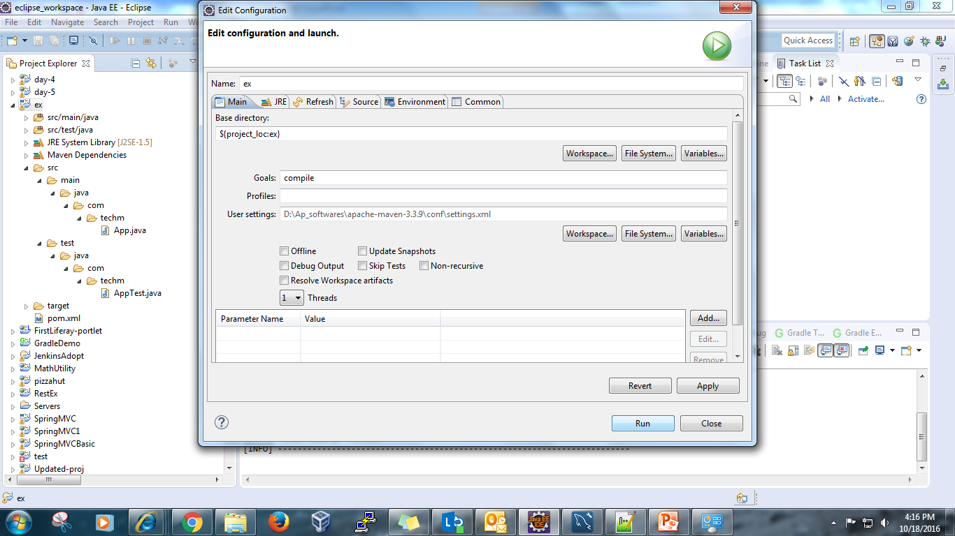
Eclipse Integration with maven(cont..)
Give the required goal and run. To skip the test execution while running, select skip tests and etc..

Slide 37
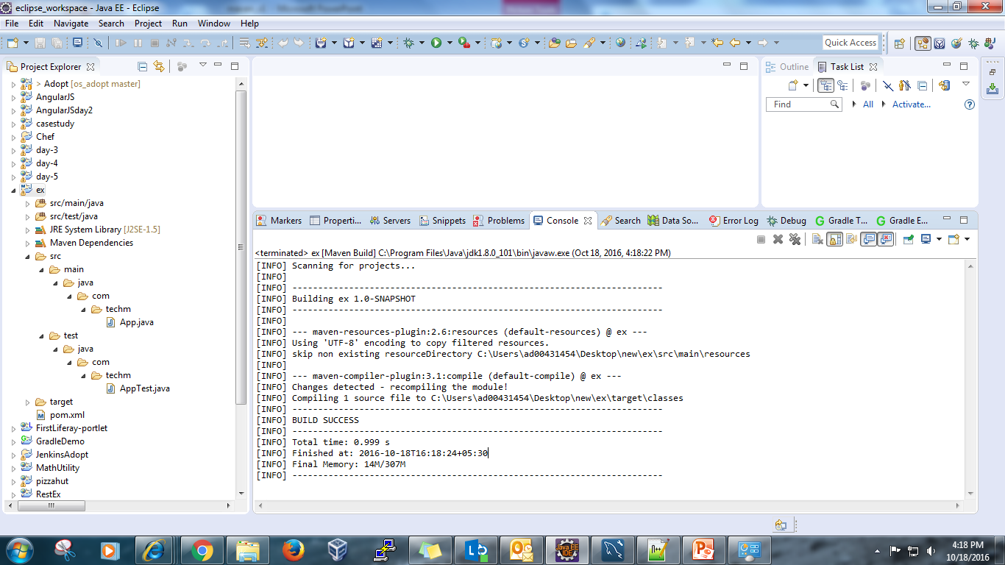
Eclipse Integration with maven(cont..)

Slide 38
Demo

Slide 39
Thank you

