Slide 1
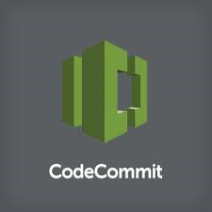
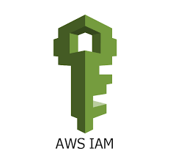

AWS CodeCommit
©2015, Amazon Web Services, Inc. or its affiliates. All rights reserved
Notes:
- now that we've covered how to automate release pipelines, let's talk about the source control system that's at the front of the whole process
- the last service that we'll talk about is AWS CodeCommit

Slide 2
AWS CodeCommit
AWS CodeCommit is a secure, highly scalable, managed source control service that hosts private Git repositories.
AWS CodeCommit eliminates the need for you to operate your own source control system or worry about scaling its infrastructure. You can use AWS CodeCommit to store anything from code to binaries, and it works seamlessly with your existing Git tools.

Slide 3
AWS CodeCommit in Free-Tier
5 active users per month**
50 GB-month of storage per month**
10,000 Git requests per month**

Slide 4
AWS CodeCommit | Other Git Repository
Fully Managed –AWS CodeCommit eliminates the need to host, maintain, backup, and scale your own source control servers | We need to Manage it on ourself.
Secure –AWS CodeCommit automatically encrypts your files in transit and at rest. AWS CodeCommit is integrated with AWS Identity and Access Management (IAM), allowing you to assign user-specific permissions to your repositories. | No Encripted Security
Highly Available – AWS CodeCommit is built on highly scalable, redundant, and durable AWS services such as Amazon S3 and Amazon DynamoDB | No Replica Servers
Scalable - AWS CodeCommit allows you store any number of files and there are no repository size limits. | Limitations are there Example : GitHub will warn you when pushing files larger than 50 MB. You will not be allowed to push files larger than 100 MB.
Faster Development Lifecycle - AWS CodeCommit keeps your repositories close to your build, staging, and production environments in the AWS cloud. This allows you to increase the speed and frequency of your development lifecycle. | Physical Environment latency will be there..

Slide 5
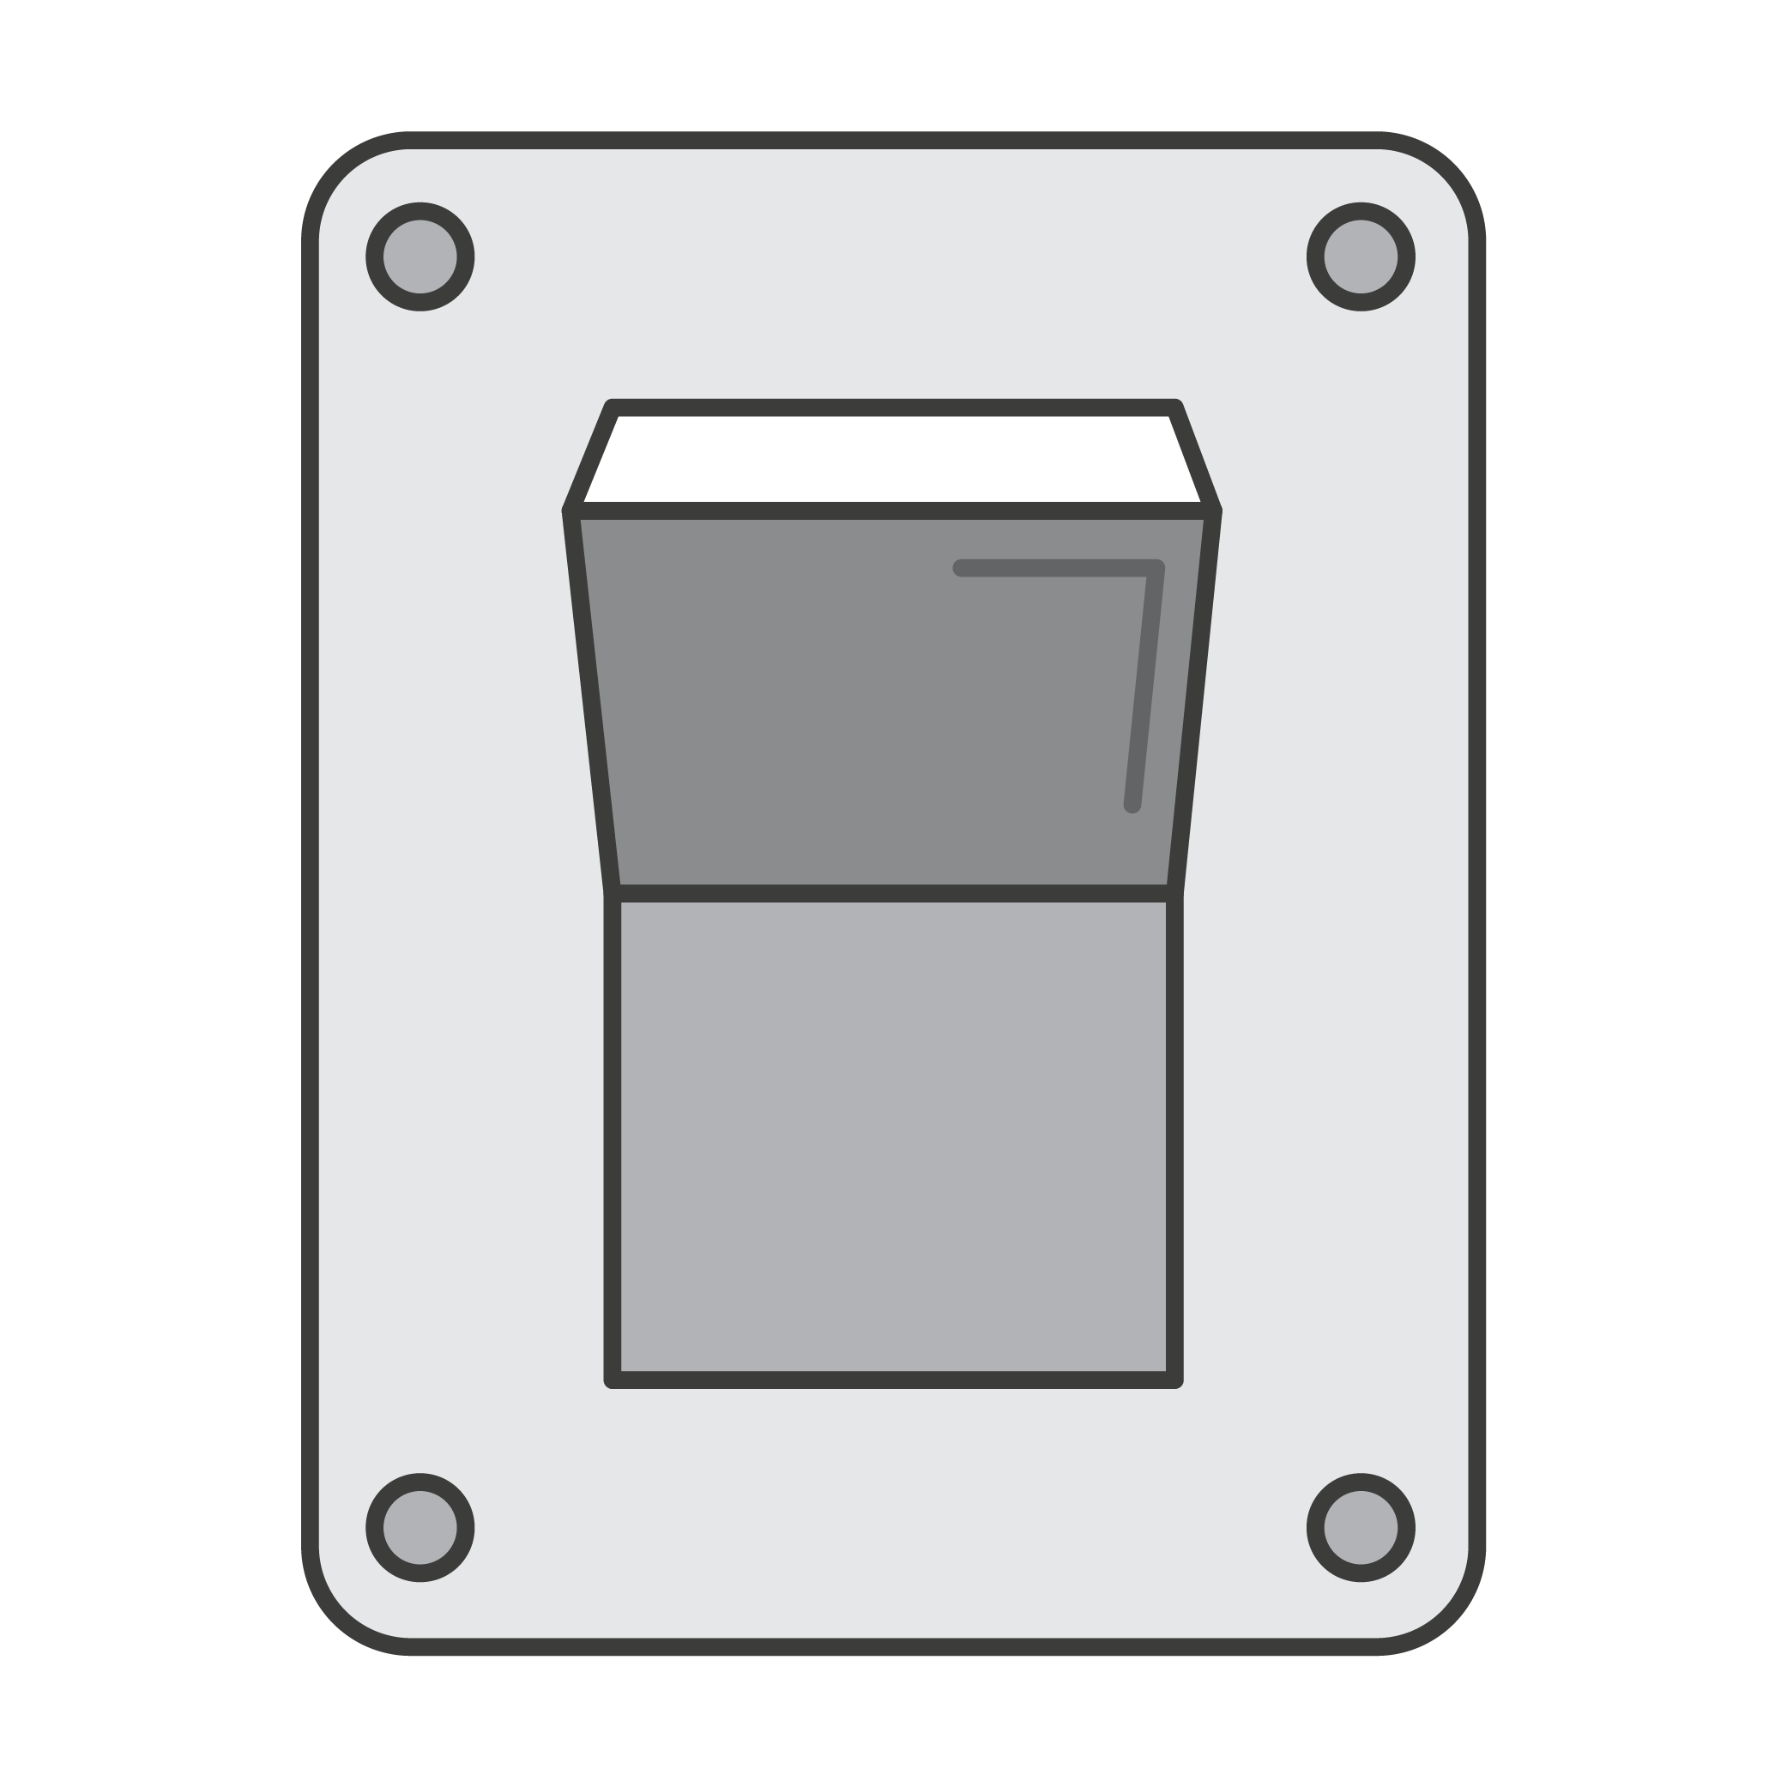

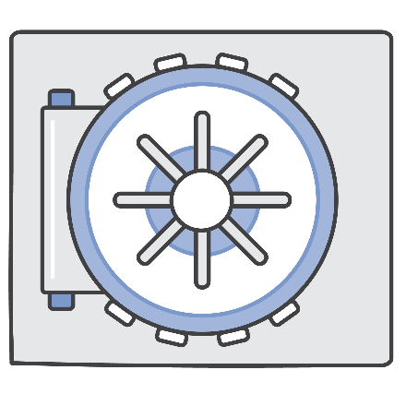

What's required for source control in the cloud?
Fully managed
High availability
Security
Store
anything
Notes:
- when you set up a cloud-based continuous delivery pipeline, you should consider hosting your source control in the cloud as well
- this will cut down on your management overhead, and place your source repositories close to your build, test, and production environments
- but if you do put your source code in the cloud, you're going to have some important requirements
- first, your source control system has to be highly available, because you need to be ready to deploy at any time
- you don't want a critical hotfix to be delayed just because your source control system is getting bogged down
- second, you'll want to take advantage of cloud scale so you're not held back from artificial limits
- you should be able to store whatever assets you want to version with your app, and you shouldn't have limits to your repo size
- third, you need robust security, because your source code is a valuable corporate asset

Slide 6


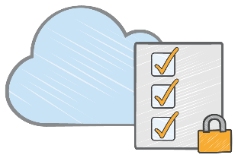
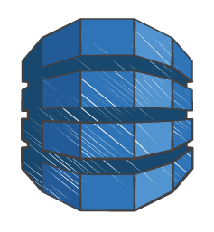

CodeCommit
Git objects
in Amazon S3
Secure, scalable, and managed Git source control
Git index
in Amazon
DynamoDB
SSH or HTTPS
git push
CodeCommit
Encryption key
in AWS KMS
Data redundancy across Availability Zones
Data-at-rest encryption
Integrated with AWS Identity and Access Management
No repo size limit
Notes:
- CodeCommit is Git source control service built on a cloud-scale architecture
- on the front-end, we're just a standard Git remote that you can push to and pull from using the Git CLI or other Git GUI tools
- but behind that Git endpoint is a novel implementation
- rather than use a file system-based implementation, we store the repo data in Amazon S3 and the index in Amazon DynamoDB
- this gives us a number of advantages
- the repo data is automatically stored across multiple availability zones
- this gives us enhanced data durability and service availability
- we also encrypt the data at rest using customer-specific encryption keys that are stored in our Key Management Service
- we use AWS IAM for access management, so you can assign permissions to your repos in the same way you assign permissions to your other AWS resources
- finally, we place no size limits on your repos
- CodeCommit provides a secure, scalable, and reliable Git service to front your continuous delivery pipelines

Slide 7
Same Git experience
$ git clone https://git-codecommit.us-east-1.amazonaws.com/v1/repos/aws-cli
Cloning into 'aws-cli'...
Receiving objects: 100% (16032/16032), 5.55 MiB | 1.25 MiB/s, done.
Resolving deltas: 100% (9900/9900), done.
Checking connectivity... done.
$ nano README.rst
$ git commit -am 'updated README'
[master 4fa0318] updated README
1 file changed, 1 insertion(+)
$ git push
Counting objects: 3, done.
Delta compression using up to 4 threads.
Compressing objects: 100% (3/3), done.
Writing objects: 100% (3/3), 297 bytes | 0 bytes/s, done.
Total 3 (delta 2), reused 0 (delta 0)
remote:
To https://git-codecommit.us-east-1.amazonaws.com/v1/repos/aws-cli
4dacd6d..4fa0318 master -> master

Slide 8

Demo

Slide 9
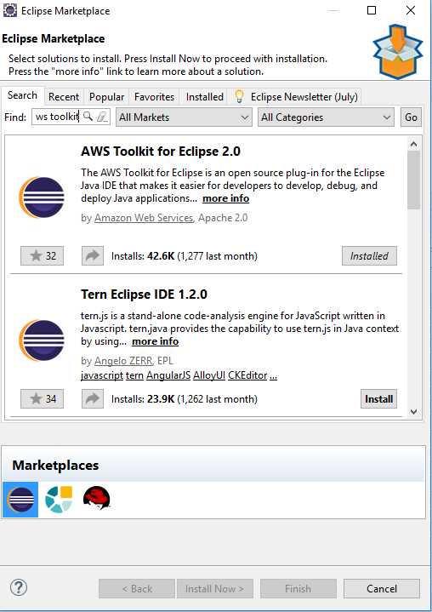
Install AWS Tool Kit Plugin

Slide 10
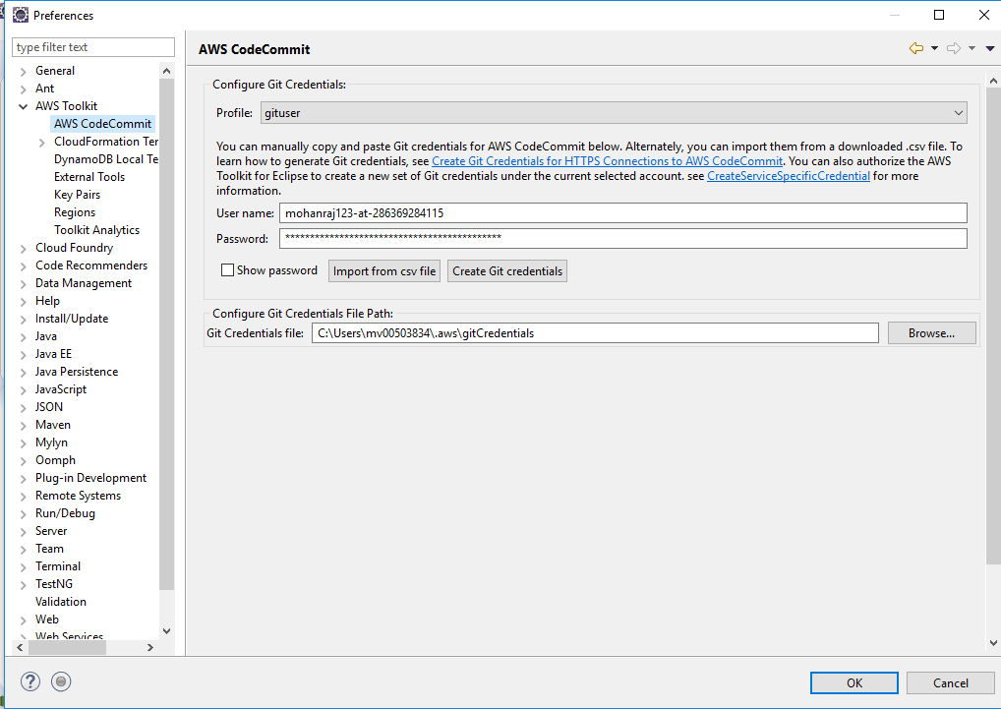
Enter IAM Credential

Slide 11
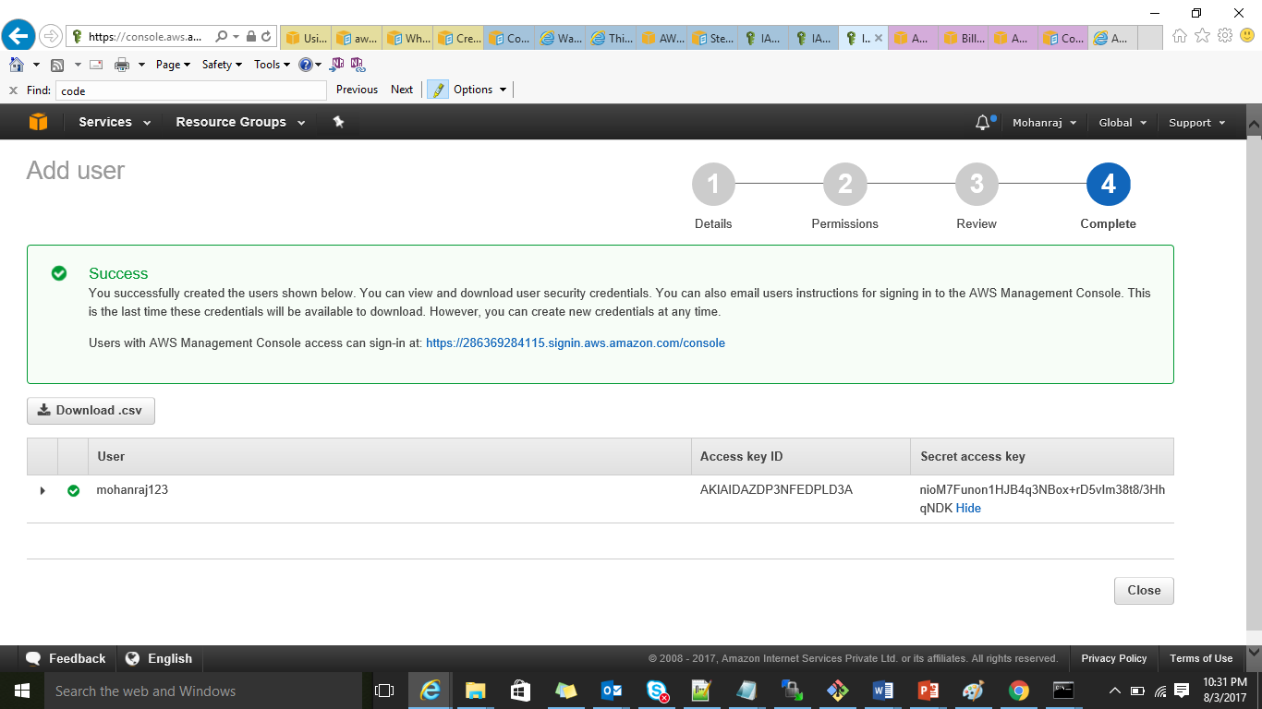
Create an IAM Role With CodeCommit Access

Slide 12
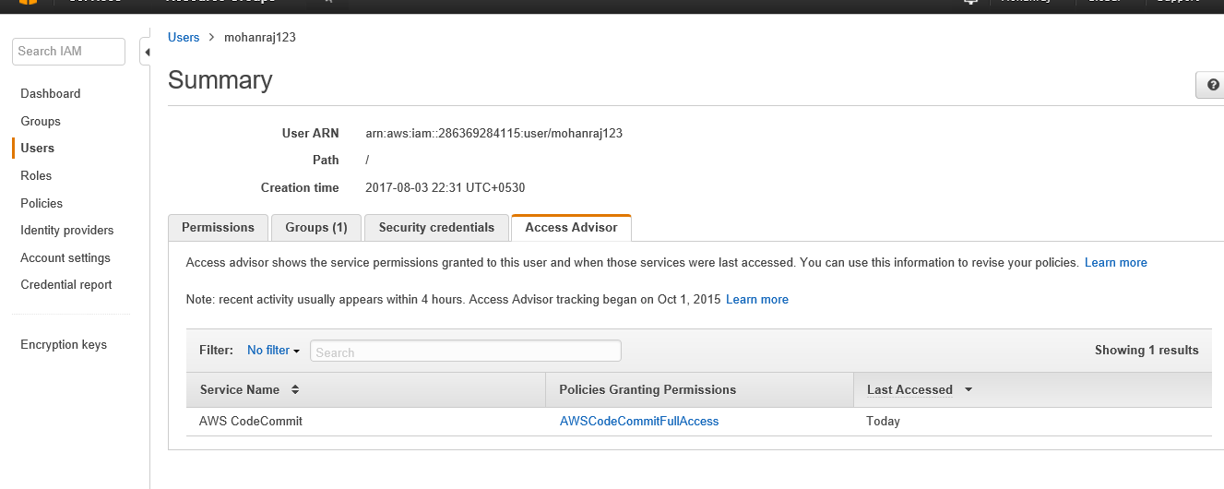

Slide 13
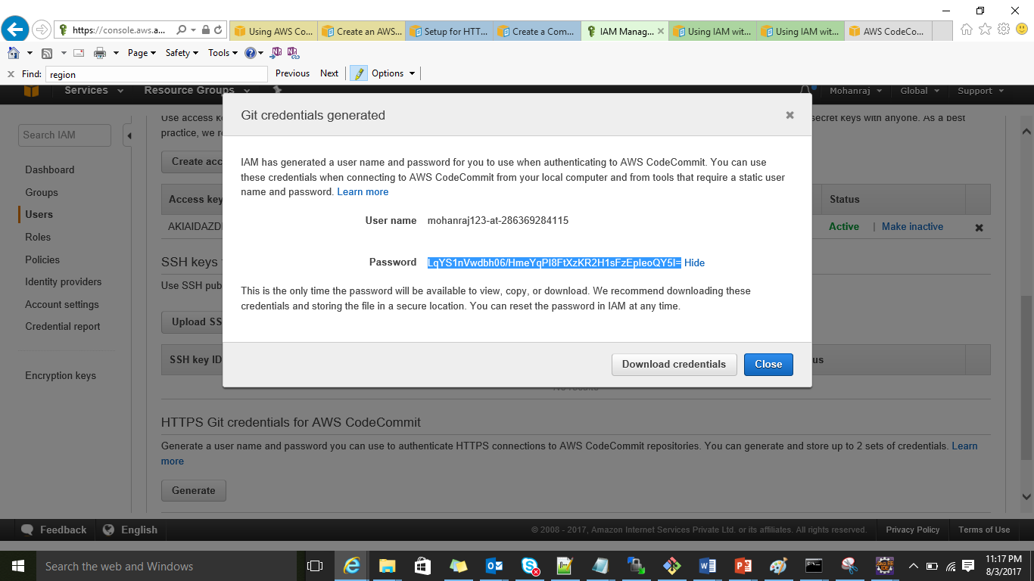
Get Username & Password for HTTP Access

Slide 14
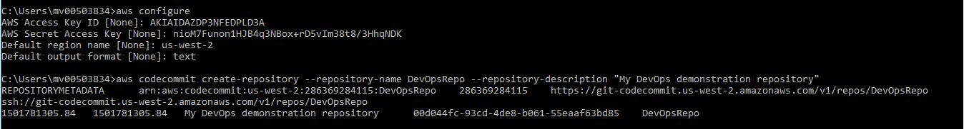
AWS-CLI Configure

Slide 15
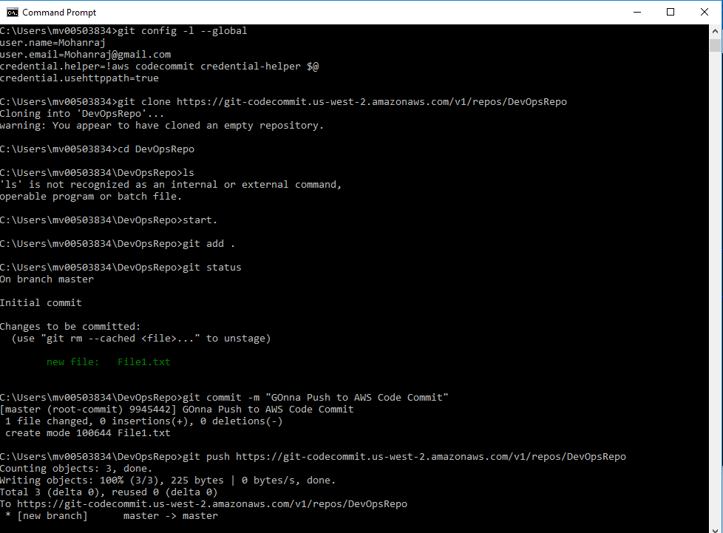

Slide 16
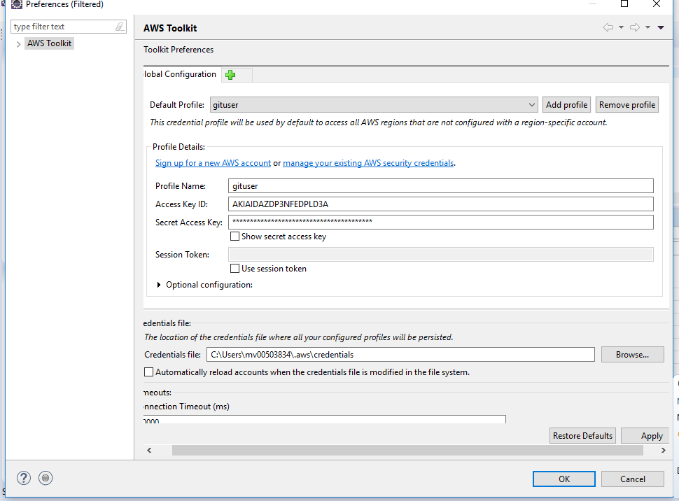

Slide 17
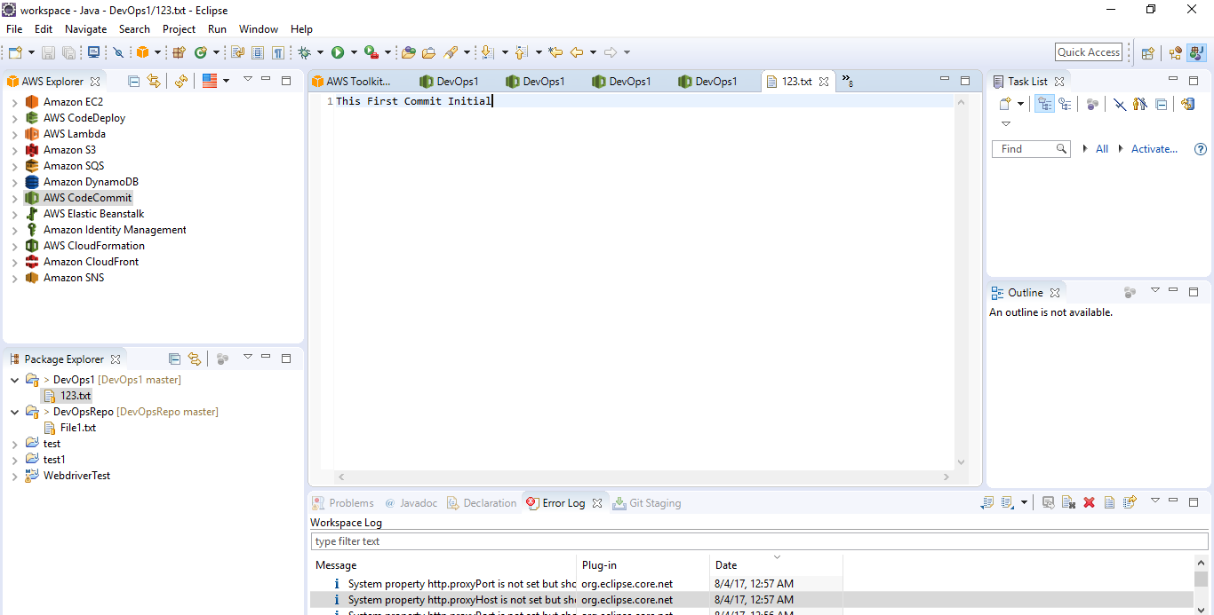

Slide 18
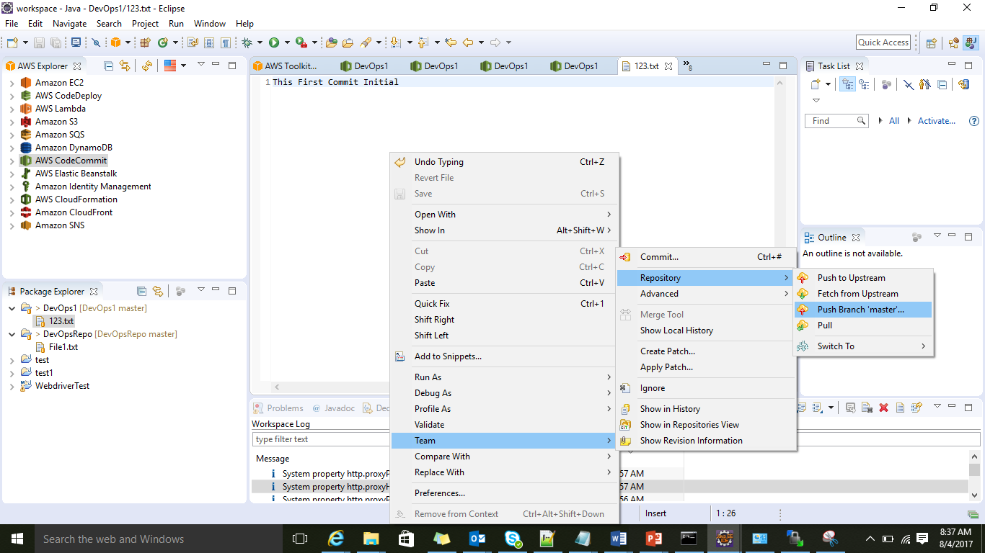

Slide 19
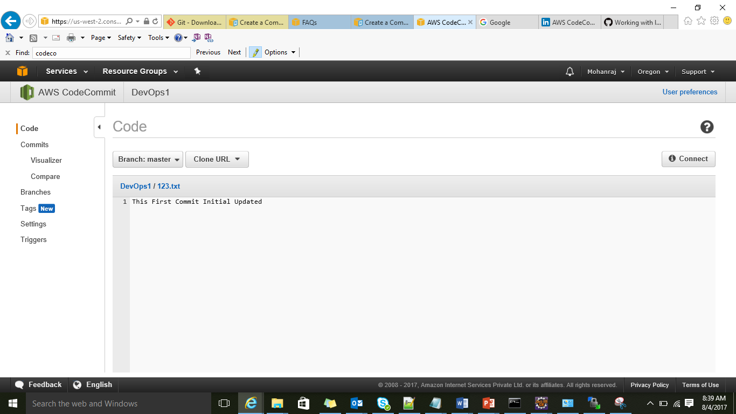

Slide 20
Thank you
Email: Mohanraj.Vellingiri@Techmahindra.com

