Slide 1

Overview of GoCD

Slide 2

Agenda:
1
Continuous Delivery
2
GoCD
3
History of GoCD
4
Architecture of GoCD
5
Features of GoCD

Slide 3
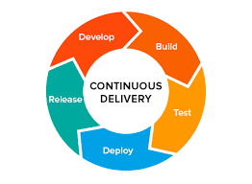
Continuous Delivery
Continuous Delivery is a software development discipline where you build software in such a way that the software can be released to production at any time.
You’re doing Continuous Delivery when:
Your software is deployable throughout its lifecycle
Your team prioritizes keeping the software deployable over
working on new features
Anybody can get fast, automated feedback on the production
readiness of their systems any time somebody makes a change to them
You can perform push-button deployments of any version of the software
to any environment on demand
You achieve continuous delivery by continuously integrating the software done by the development team, building executables, and running automated tests on those executables to detect problems. Furthermore you push the executables into increasingly production-like environments to ensure the software will work in production. To do this you use a Deployment Pipeline. -Martin Fowler

Slide 4
GoCD
Go or GoCD is an open source tool which is used in software development to achieve Continuous Delivery of software, of which Continuous Integration is a part. It supports automating the entire build-test-release process from code check-in to deployment. It helps to keep producing valuable software in short cycles and ensure that the software can be reliably released at any time
Almost everything in the ecosystem that Go spans is OSS, from source control and build, to deployment and configuration management

Slide 5
History of GoCD
Go was originally developed at ThoughtWorks Studios.
It was called as Cruise when it was first released in 2007.
In 2010, it was renamed as GoCD.
GoCD was released as open source in 2014.

Slide 6
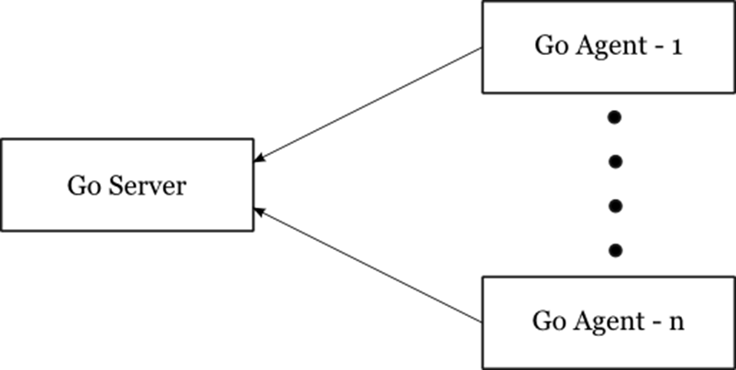
Architecture of GoCD
At the highest level, GoCD consists of two main components, the GoCD Server and the GoCD Agent.
As soon as the server comes up, it opens two ports (an SSL port and a non-SSL port).
The system works on a pull model in the sense that the agents periodically poll the server for work, instead of the server pushing work to the agents. This prevents the agents from having to have listening ports open on their side.
The server coordinates everything, making sure that all the builds that need to run get run and all the agents are assigned work when possible

Slide 7
Features of GoCD
Model complex workflows through intelligent dependency management
The power of right abstractions which makes a complex problem tractable
Promote only trusted artifacts - Know exactly what’s being deployed
Visibility and Traceability - Value Stream Map
Deploy any version, any time
Run and grok your tests
Compare builds
Eliminate bottlenecks
Keep configuration tidy
Auditable deployments
Plugins

Slide 8
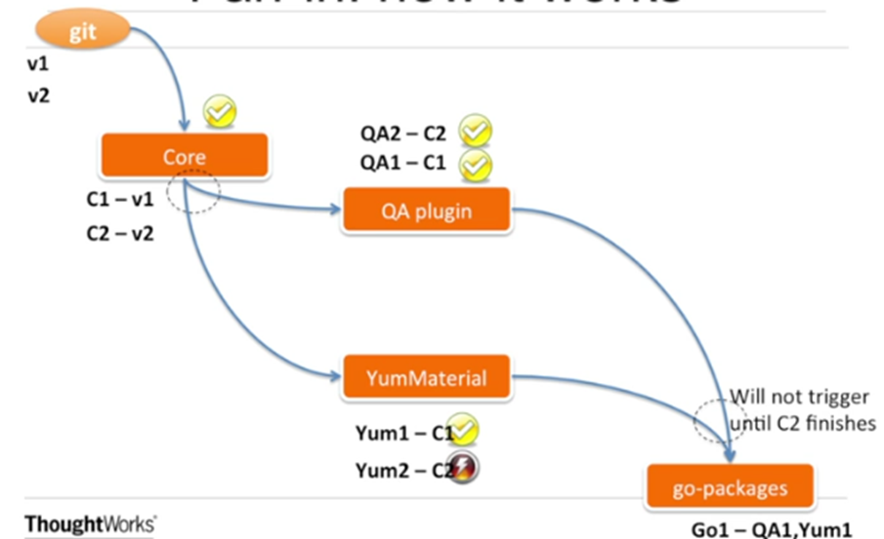
Model complex workflows
With its parallel and sequential execution, GoCD can easily configure dependencies for fast feedback and on-demand deployment. Its fan-in/fan-out dependency management always does the "right thing," avoiding spurious builds.

Slide 9
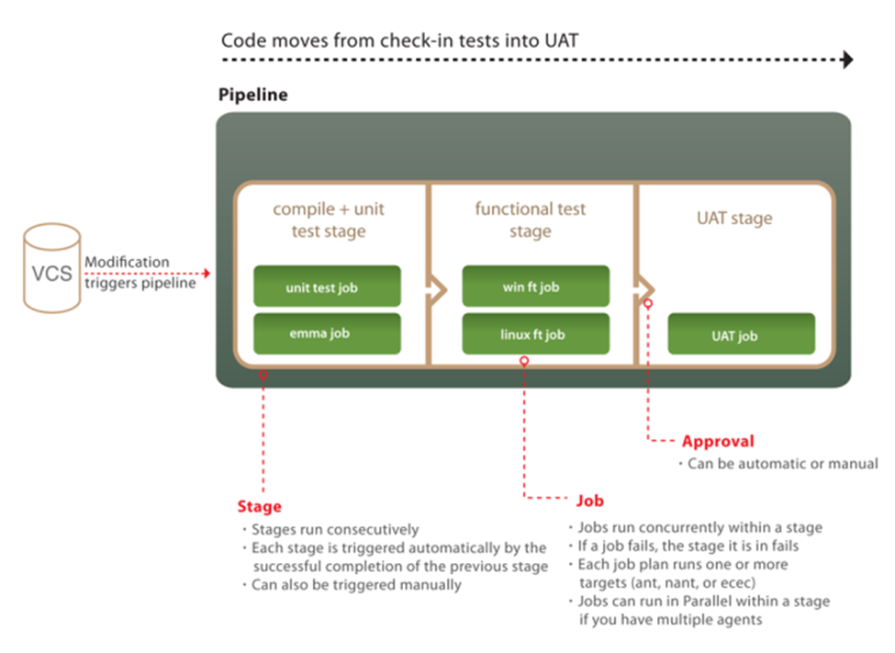
The power of the right abstractions

Slide 10
The power of the right abstractions
Two very important characteristics of GoCD:
Its 4 built-in powerful abstractions and their relationship: Tasks inside Jobs inside Stages inside Pipelines.
The fact that some are executed in parallel (depending on agents availability) while others sequentially:
-Multiple Pipelines run in parallel
-Multiple Stages within a Pipeline run sequentially
-Multiple Jobs within a Stage run in parallel
-Multiple Tasks within a Job run sequentially
This makes your complex and often overcomplicated path from check-in to production tractable

Slide 11
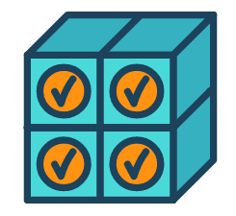
Promote trusted artifacts
Every pipeline instance is anchored to a particular changeset. GoCD makes it easy to pass once-built binaries between stages so you know exactly what's being deployed and that the binary has been tested.

Slide 12
Visibility and Traceability – Value Stream Map
GoCD's real power is in the visibility it provides over your end-to-end workflow. GoCD's Value Stream Map lets you track a change from commit to deploy at a glance. And when things go wrong, it's easy to see both the upstream cause and the downstream effects.
The Value Stream Map (VSM) is an end-to-end view of a pipeline, its upstream dependencies and the downstream pipelines it triggers. When deciding which pipelines to trigger, Go's fan-in and fan-out resolution will take care of all the dependencies consistently.

Slide 13
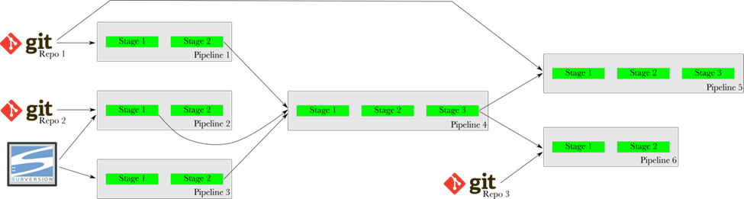
Visibility – Value Stream Map
For instance, in the image above, when a new commit is found in Repo 1 (git), Go will not trigger Pipeline 5 immediately. It will wait for Pipeline 1 to trigger and finish successfully, then it will wait for Pipeline 4 to trigger and finish successfully. Finally, it will trigger Pipeline 5 with the same revision of Repo 1 that was used with Pipeline 1.

Slide 14
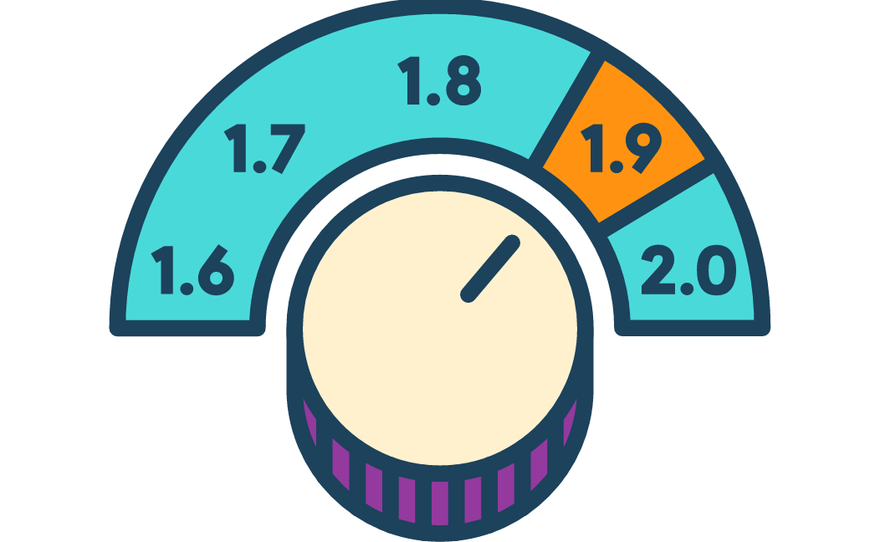
Deploy any version, any time
GoCD's manual triggers allow you to deploy any known good version of your application to wherever you like. This increases reliability of pushing to production, and empowers QA teams with self-service environments. And, if necessary, it's securable and auditable.

Slide 15
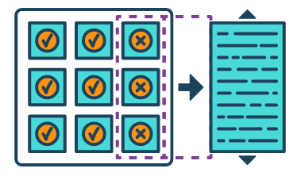
Run and grok your tests
Verification is a key piece of any deployment pipeline. GoCD will execute tests written in most languages or frameworks. GoCD's agent grid provides parallel and cross-platform execution. GoCD's test reporting will tell you in exactly which changeset and on which platform a test started breaking, which comes in extremely handy when fixing a complex broken build.

Slide 16
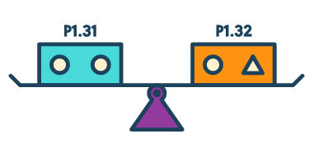
Compare builds
GoCD's compare builds feature can provide a simple bill of materials for any deployment. Perhaps more powerful is its ability to compare the content - both files and commit messages - across any two arbitrary builds. This is invaluable when troubleshooting a broken pipeline.

Slide 17
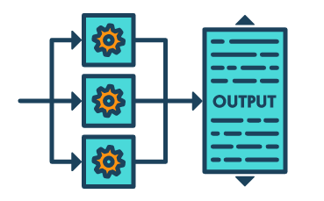
Eliminate bottlenecks
GoCD's agent grid eliminates bottlenecks, providing trivial parallel execution across pipelines, platforms, versions, branches, etc.

Slide 18
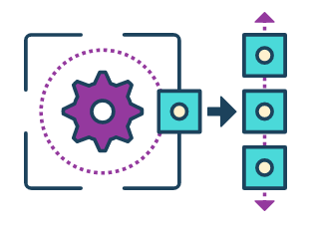
Keep configuration tidy
Easily reuse pipeline configurations via GoCD's template system. This makes managing pipelines for versions and branches easy as pie.

Slide 19
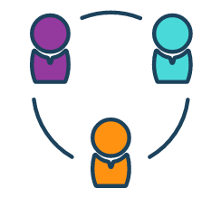
Auditable deployments
While most enterprise applications go overboard with their permission model, GoCD seeks to provide just enough. In particular, GoCD supports auditable deployment and can delegate the configuration of pipelines to users without full-blown admin privileges.

Slide 20

Plugins
GoCD has extension points for which plugins can be created. There are numerous plugins already available, or if you don't see what you need, you can write your own

Slide 21
Thank You
Look forward to engaging you on areas of interest!

