Slide 1
RTC Work Item Importing
Anoop Chathoth/India/IBM@IBMIN

Slide 2
Objective
The following slides gives you a step by step instructions on how to import work items into RTC from comma separated value (csv) files.
Even though ‘Import of Work Items from CSV’ is a single step process from RTC Client, in order to make all the work items that gets imported properly fit in to the process template designed for your project, we need to evaluate the excel file provided by end users thoroughly. We will have to alter few of the columns to accommodate it properly to RTC.

Slide 3
Process Involved
End users will be providing the work item list in an excel sheet.Add/Modify any work item types.
Verify the column values to match that of RTC.
Make sure that all the mandatory field for a particular work item type is populated with values in excel sheet.
After ensuring all the columns have properly filled, convert the excel file to .csv file.
Open RTC Client and connect to the Project Area into which work Items need to be imported.
Open the Import Wizard and choose ‘Work Items from CSV’ to proceed with the import.
After the import, need to verify in the Project Area whether all the work items have got imported properly.

Slide 4
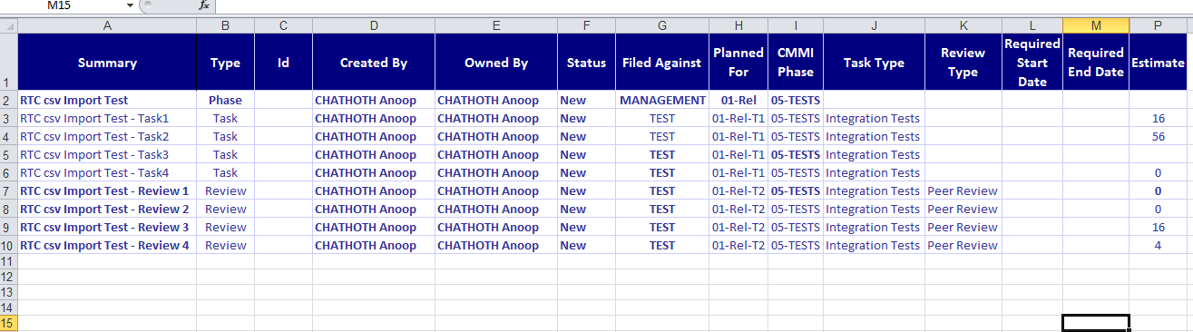
Verify the sample excel sheet as shown below:

Slide 5
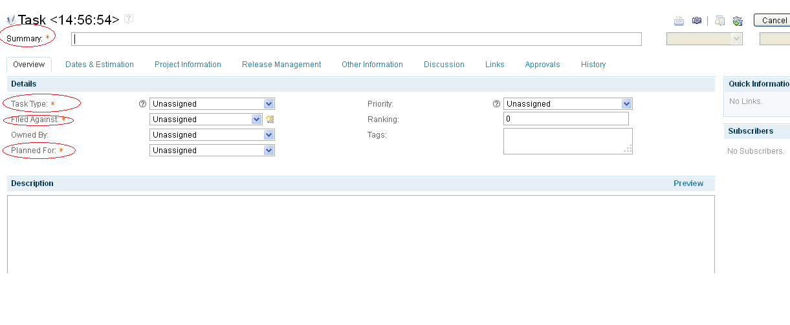
Verify all the column values in RTC

Slide 6
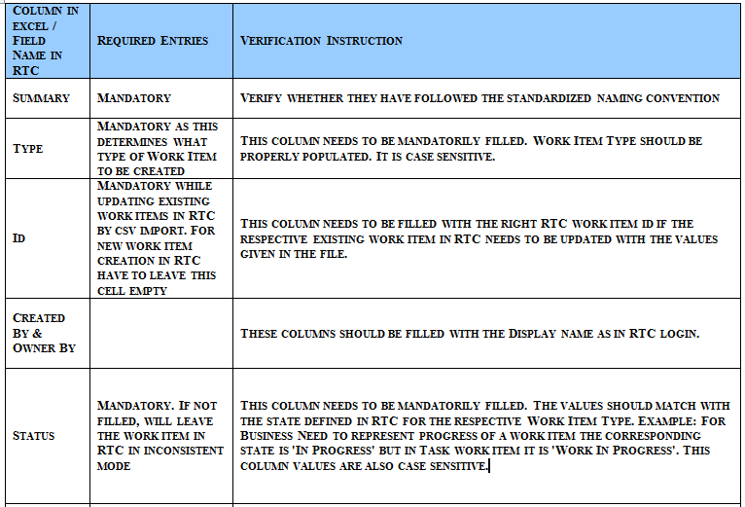
Verification Guidelines -1

Slide 7

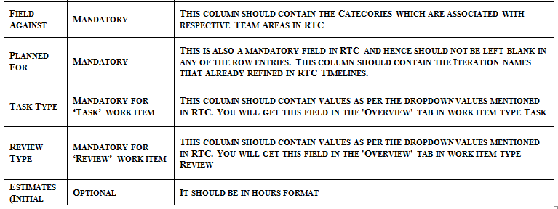
Verification Guidelines -2

Slide 8
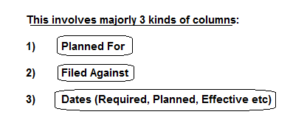
Format the worksheet to make it fit for RTC import
We have to now focus on few column values in the spreadsheet that need to be formatted so as to fit into RTC during import.

Slide 9
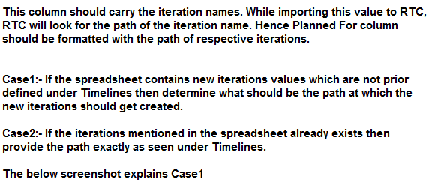
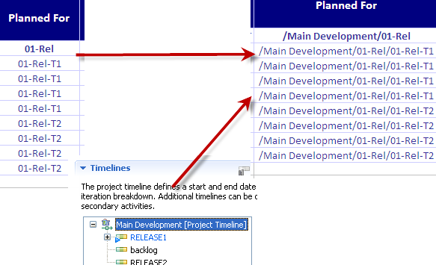
Planned For Value

Slide 10
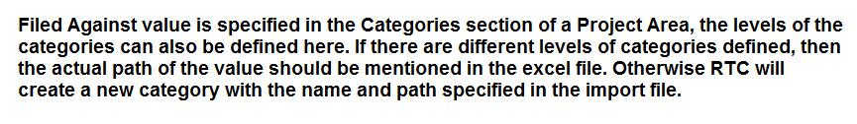
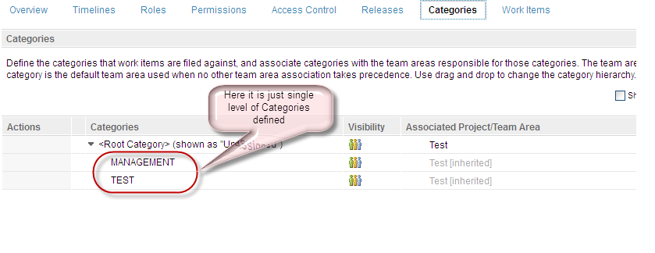
Filed Against Value

Slide 11

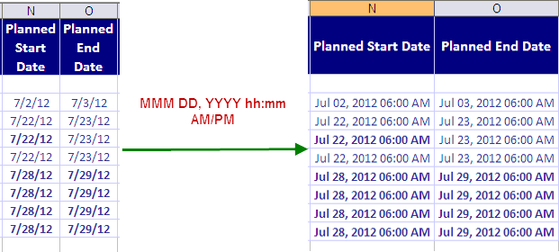
Date Attribute

Slide 12


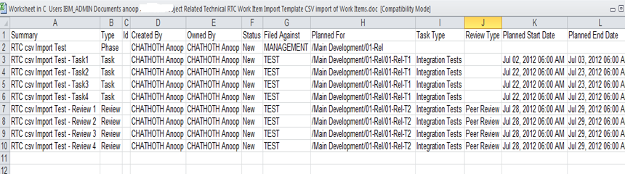
excel sheet in csv (comma separated value) format

Slide 13

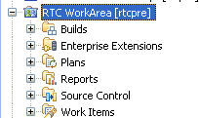
CSV Import through RTC Client

Slide 14
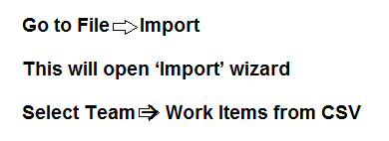
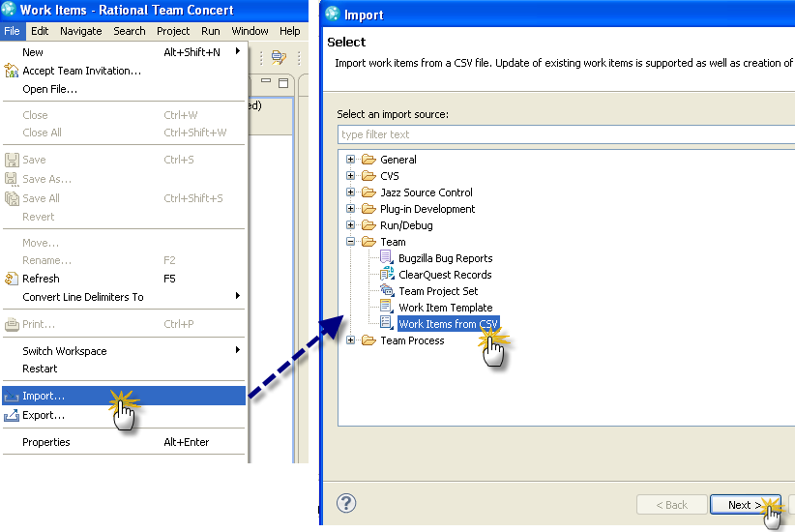
Using the ‘Import’ wizard

Slide 15
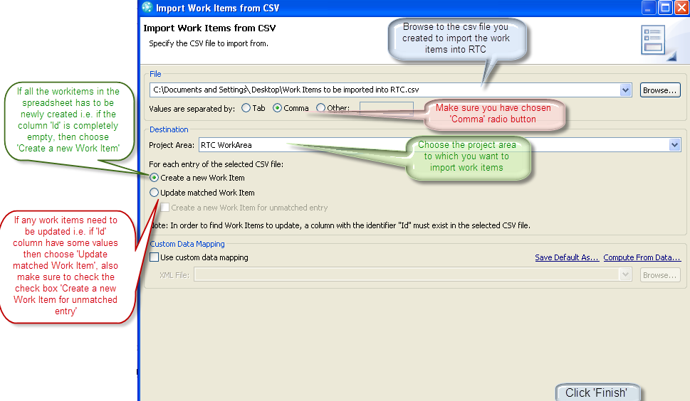
Options to be chosen from the import wizard

Slide 16
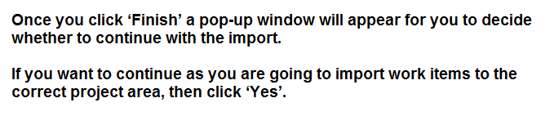
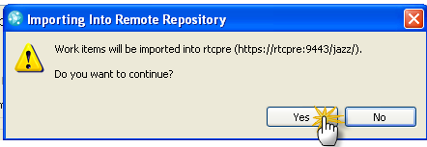
Importing into remote repository

Slide 17
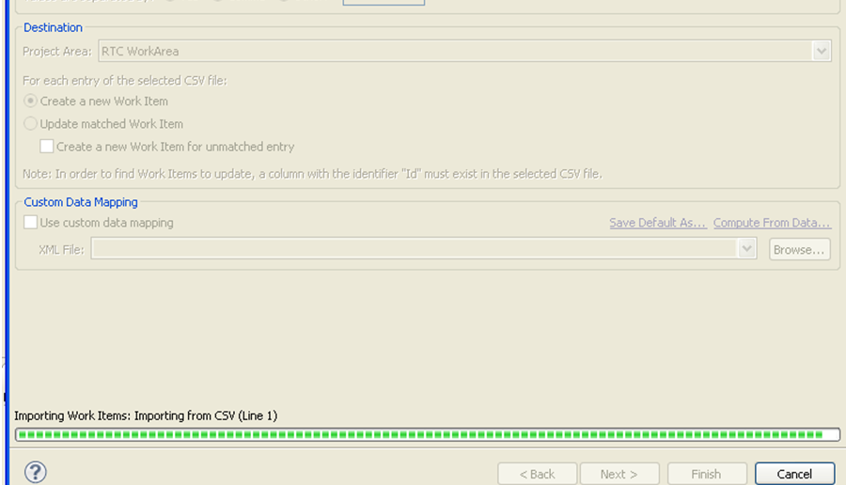
Completion of import operation

Slide 18
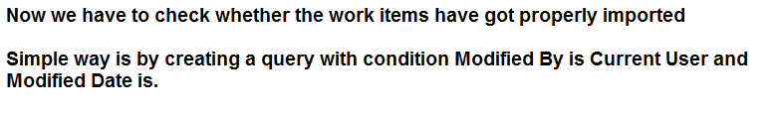
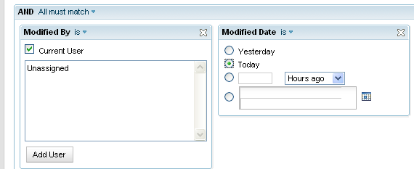
Verify the ‘Import’ operation.

Slide 19
Reference
RTC on Jazz.net Forum:
http://jazz.net/forums/
https://jazz.net/library/article/522
My sincere thanks go to my colleague, Mrs Gayathri Vikraman for the guidance, encouragement and support provided during the testing of this feature.

Slide 20


