Slide 1






Bit Bucket
Copyright © 2017 Tech Mahindra. All rights reserved.
1

Slide 2



TABLE OF CONTENT
Introduction
History
Features
Advantages and disadvantages
Comparison with counterparts
Installation
Sample demo
Conclusion

Slide 3


BitBucket - Introduction
Introduction
Bitbucket is a web-based hosting service for projects that use either the Mercurial or Git revision control systems.
Bitbucket offers both commercial plans and free accounts.
It offers free accounts with an unlimited number of private repositories for upto 5 users and public repositories for all.
Bitbucket is written in Python using the Django web framework.

Slide 4
BitBucket is a web-based code server and also a great management tool for software projects.
History:
Bitbucket was previously an independent startup, founded by Jesper Nohr.
On 29 September 2010, Bitbucket was acquired by Atlassian.
Initially, Bitbucket only offered hosting support for Mercurial projects but on 3 October 2011, it officially announced support for Git hosting.
In September 2015, Atlassian renamed their Stash product to Bitbucket Server.

Slide 5
BitBucket - Benefits
Unlimited Private Repositories:
Host, manage, and share Git and Mercurial repositories in the cloud.
Free, unlimited private repositories for up to 5 developers give teams the flexibility to grow and code without restrictions.
Work as a Team:
Built with small teams in mind.
Consolidate user management.
invite members, and automatically share repositories with all your teammates.
Get your team working as one.

Slide 6
BitBucket - Features
Features :
Cloning- When you want to work on a project by changing its files or adding new files, you need to clone your project to your local system.
Branching- (fork/main repo →branch) Branching offers a way to work on a new feature without affecting the main codebase.
Forking- A fork is really a Github (not Git) construct to store a clone of the repo in your user account. As a clone, it will contain all the branches in the main repo at the time you made the fork.
Pull Requests- Pull requests let you tell others about changes you've pushed to a GitHub repository. Once a pull request is sent, interested parties can review the set of changes, discuss potential modifications, and even push follow-up commits if necessary.

Slide 7
BitBucket - Features
Features :
Commit- A commit is a set of changes to the code. This is one of the most interesting things about Git. You don't transfer files, you transfer logs of changes.
Merging- when we make a pull request with hot fixes, it goes on our production branch. When we accept the pull request, we go to the compare view and merge production(forked) into our staging(main) branch, making sure the fix makes it out both externally and internally.

Slide 8


Advantages and Disadvantages
Advantages:
Free unlimited private repositories for small teams
Integrated issue tracking system
Multiple authentication methods
JIRA integration
Supports hosting static websites
Allows importing existing repositories
Backed by a trustable company that has proved it's worth
Disadvantages:
Private repositories are free for only 5 users
No code search
Not as stable as github

Slide 9


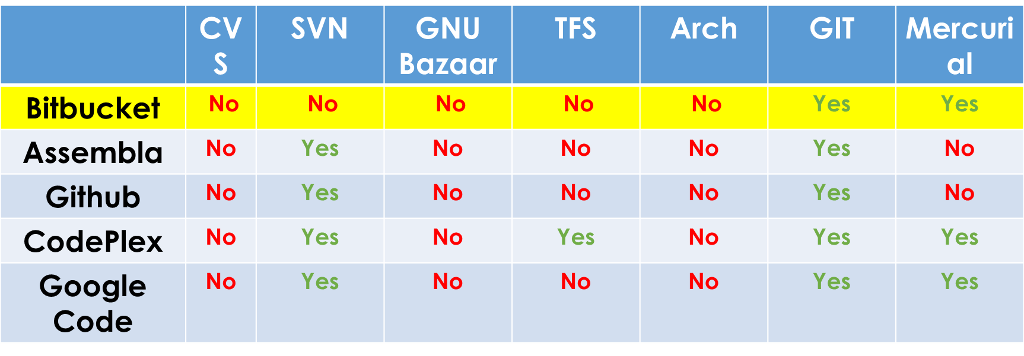
Comparison with counterparts
If price is not an issue, and one don’t mind closed-source, and is OK with its installation options, choose GitHub Enterprise Edition.
If you must have everything Atlassian, choose BitBucket Server. Bitbucket integrates very well with JIRA, a popular project and issue-managing app.
Everyone else should go with GitLab. It’s a great product, it’s open source with the enterprise offering, its pricing is reasonable and there’s nothing it lacks when compared to GitHub.
Available version control systems:

Slide 10


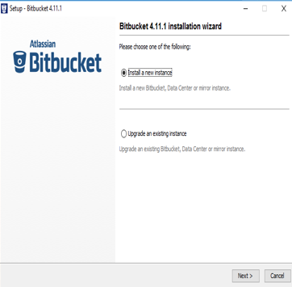
BitBucket- Installation
BitBucket Download url:
https://www.atlassian.com/software/bitbucket/download

Slide 11
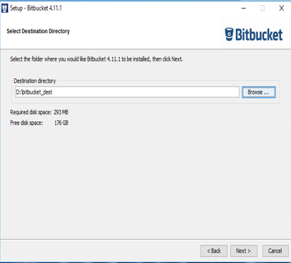
BitBucket- Installation

Slide 12
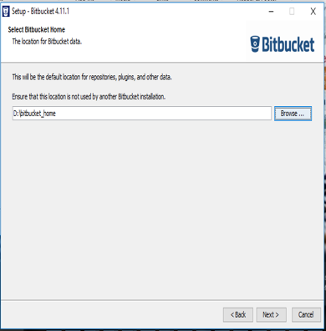
BitBucket- Installation

Slide 13
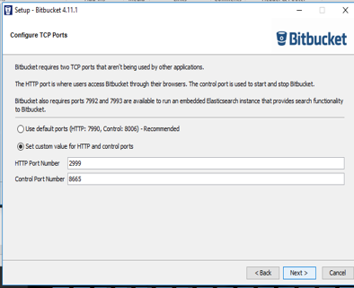
BitBucket- Installation

Slide 14
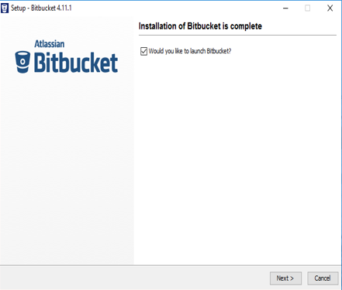
BitBucket- Installation

Slide 15
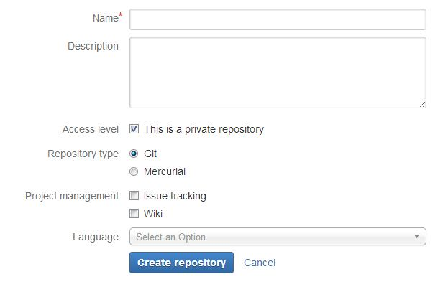
Creating Repository

Slide 16
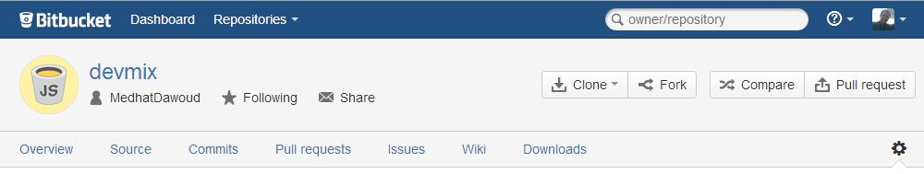
Repository Page
Notice these buttons in the right.
Simple design that gives you only what you want from a code hosting, no noisy design.
Notice the menu ( overview, source, commits, pull requests, issues, wiki, downloads)
This menu has the most important functionality that BitBucket provide for us.
In the right of the menu is the settings of repository

Slide 17
Sample Application
Code review using Bitbucket.
Steps involved:
Fork the repository to copy it to your own account.
Clone the forked repository from Bitbucket to your local system.
Make changes to the local repository.
Push the changes to your forked repository on Bitbucket.
Create a pull request from the original repository you forked to add the changes you made.
Wait for the repository owner to accept or reject your changes.
If a repository owner accepts the pull request, Bitbucket merges your code changes into the original repository.

Slide 18
Configuration
Pusing the project to remote repository from the local system: In the cmd perform the following steps:
Go to project base destination path and initialize Git Repository using git init command.
Add Files in the project to repository using git add --all command
To add a message for this particular task (pushing the code to remote repo)git commit –m “msg” command
Add the origin to the git using git remote add repositoryUrl command
Finally, push the code to the remote repository using git push repositoryUrl master command.
After performing these steps the project is finally pushed to the remote repository.

Slide 19
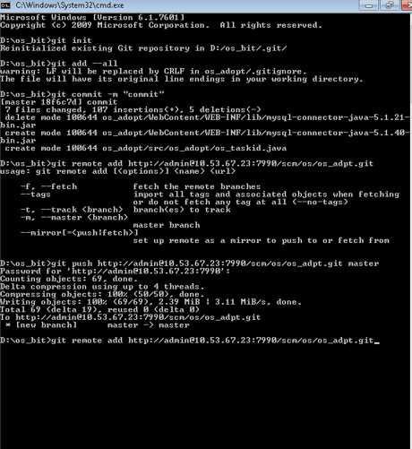
Pushing the code to remote repo
Configuration

Slide 20
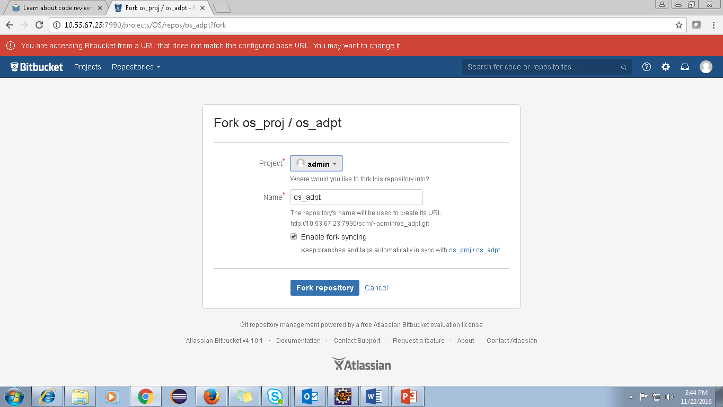
Code Review Process
Fork the repository to copy it to your own account.

Slide 21
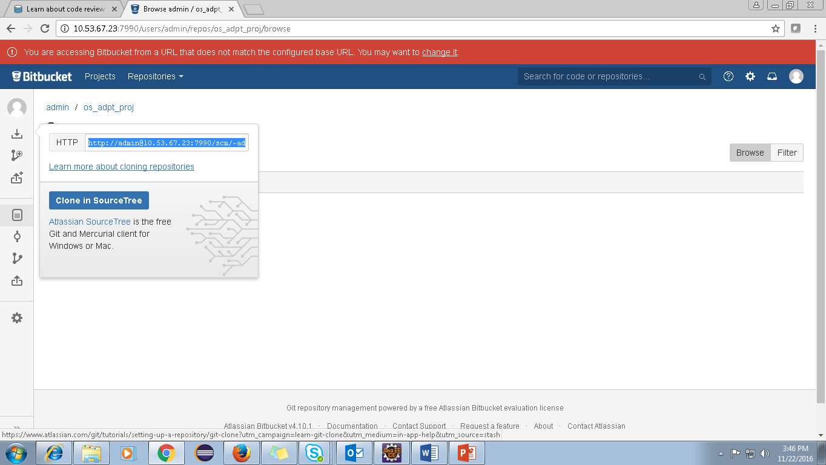
Code Review Process
Clone the forked repository from Bitbucket to your local system.

Slide 22
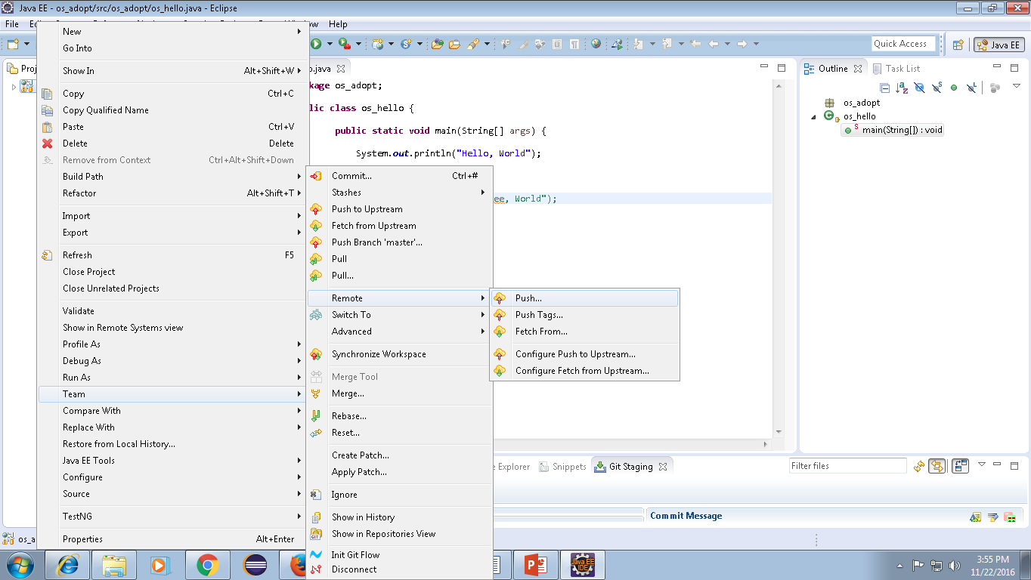
Code Review Process
Push the changes to your forked repository on Bitbucket

Slide 23
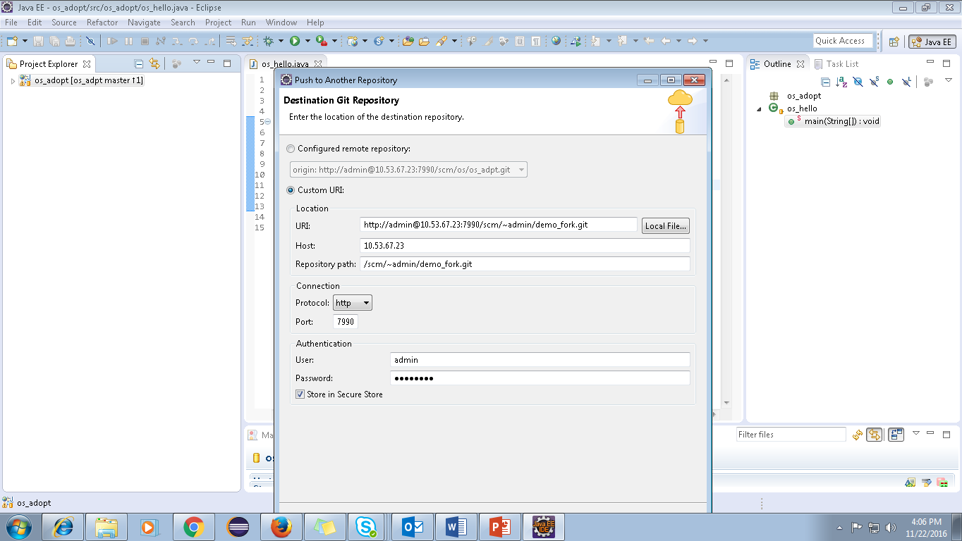
Code Review Process

Slide 24
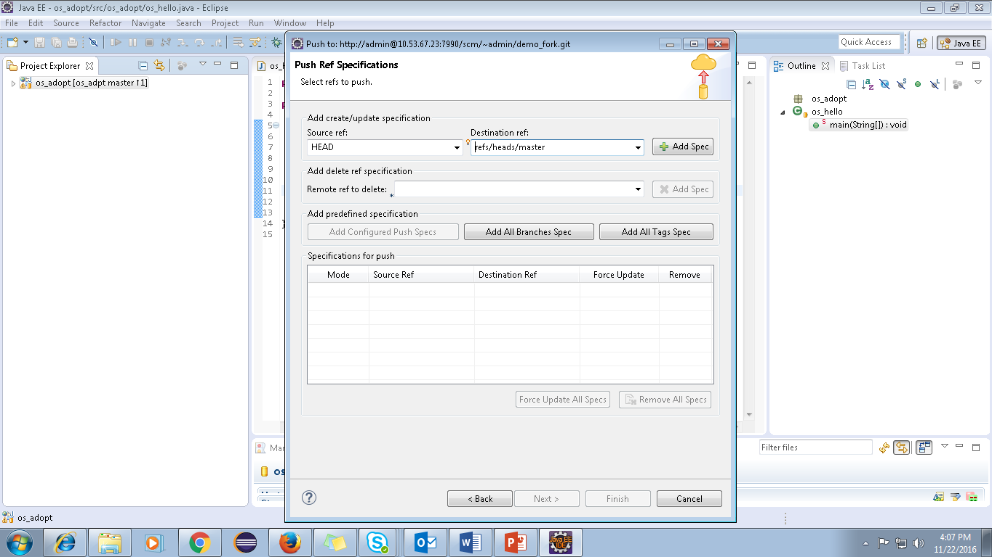
Code Review Process

Slide 25
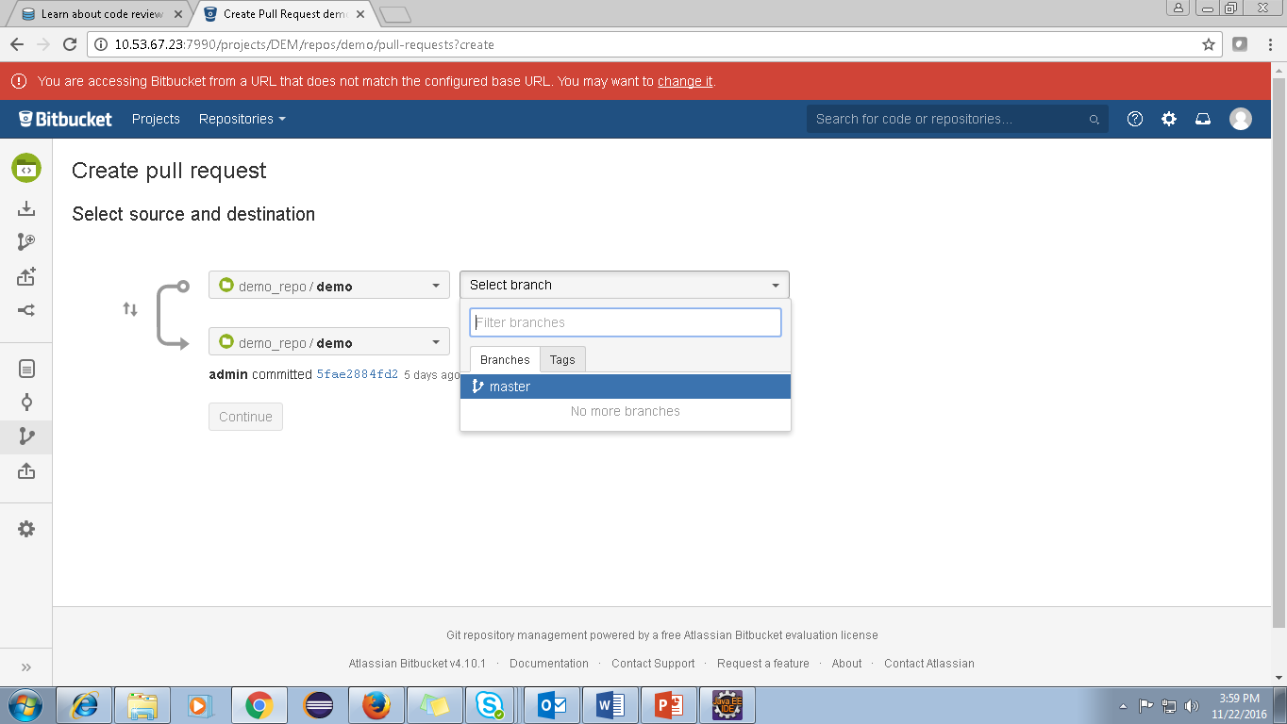
Code Review Process
Create a pull request from the original repository you forked to add the changes you made.

Slide 26
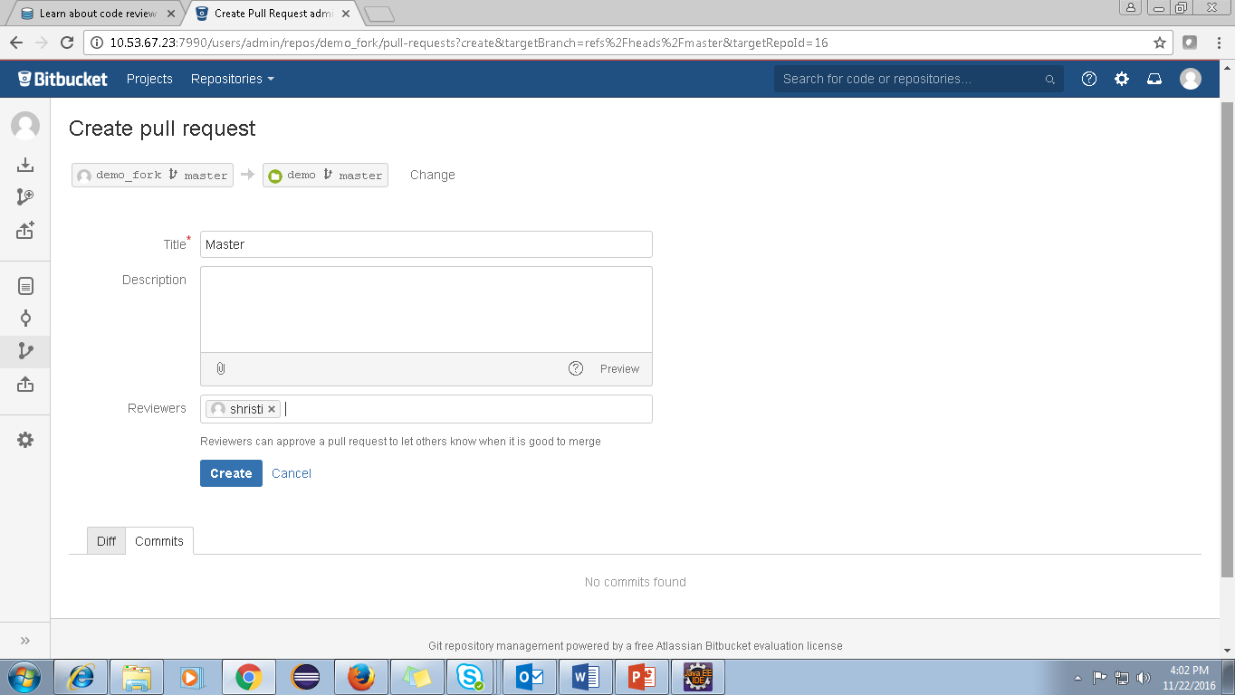
Code Review Process
Wait for the repository owner to accept or reject your changes.

Slide 27
Code Review Process
Login as reviewer and approve.
Finally login as admin and click merge.

Slide 28

Conclusion
Bitbucket has over one million users.
The flexibility of Bitbucket and its free private repositories make up for its social shortcomings and its lack of affection in the open source community.
Bitbucket allows us to log in with Twitter, Google, Facebook, Open ID, and GitHub credentials while its counterparts such as GitHub do not provide such external authentication for its users.
BitBucket has a better pricing model for small teams of single developers. Bitbucket is a better product compared to GitHub, but the main feature that made GitHub more popular was the early support for Git.

Slide 29
Thank You
Disclaimer
Tech Mahindra, herein referred to as TechM provide a wide array of presentations and reports, with the contributions of various professionals. These presentations and reports are for informational purposes and private circulation only and do not constitute an offer to buy or sell any securities mentioned therein. They do not purport to be a complete description of the markets conditions or developments referred to in the material. While utmost care has been taken in preparing the above, we claim no responsibility for their accuracy. We shall not be liable for any direct or indirect losses arising from the use thereof and the viewers are requested to use the information contained herein at their own risk. These presentations and reports should not be reproduced, re-circulated, published in any media, website or otherwise, in any form or manner, in part or as a whole, without the express consent in writing of TechM or its subsidiaries. Any unauthorized use, disclosure or public dissemination of information contained herein is prohibited. Unless specifically noted, TechM is not responsible for the content of these presentations and/or the opinions of the presenters. Individual situations and local practices and standards may vary, so viewers and others utilizing information contained within a presentation are free to adopt differing standards and approaches as they see fit. You may not repackage or sell the presentation. Products and names mentioned in materials or presentations are the property of their respective owners and the mention of them does not constitute an endorsement by TechM. Information contained in a presentation hosted or promoted by TechM is provided “as is” without warranty of any kind, either expressed or implied, including any warranty of merchantability or fitness for a particular purpose. TechM assumes no liability or responsibility for the contents of a presentation or the opinions expressed by the presenters. All expressions of opinion are subject to change without notice.
Copyright © 2015 Tech Mahindra. All rights reserved.

