Slide 1
Copyright © 2017 Tech Mahindra. All rights reserved.

Slide 2
Continuous Integration
"continuous integration" refers to a process that builds and tests code on a
frequent basis.
The continuous integration servers constantly monitor source code repositories and as soon as new changes/commits are detected, they initiate a new build cycle
The build cycle actually involves code compilation and, in addition, may
involve various tests and code analysis

Slide 3

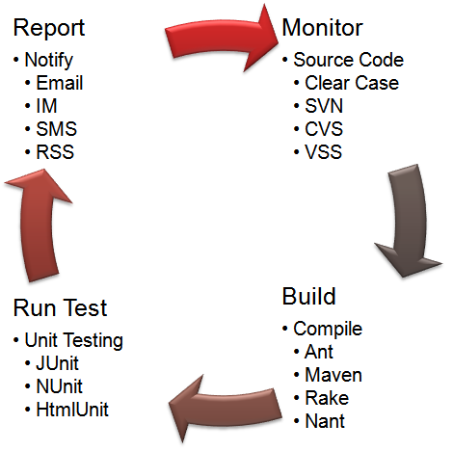
Continuous Integration
Maven
Apache Maven is a software project
management based on the concept of
a project object model (POM)
Maven can manage a project's build,
reporting and documentation from a
central piece of information
Jenkins
Jenkins is a open-source continuous
integration server
Built with Java, it provides over 400
plug-ins to support building and testing virtually any project
Sonar
Sonar is a quality measurement and
reporting tool, which produces metrics on build quality such as unit test coverage and static analysis tools (Findbugs, PMD and Checkstyle)

Slide 4


Introduction to Maven

Slide 5
Agenda
Introduce Maven
Basic Maven POM File and Project Structure
▪
▪
▪
▪
Dependencies
How to create a new Maven project in Eclipse
Maven Plugins
Maven profiles

Slide 6

What is Apache Maven & Prerequisites ?
Apache Maven is a software project management and comprehension tool.
Maven provides developers a complete build lifecycle framework.
Maven can manage a project's build, reporting
and documentation from a central piece of information.
Prerequisites
  Introduction to the Java Stack
  Basic Java and XML skill

Slide 7
Maven Objective and Mindset
Objective
  Making the build process easy.
  Providing a uniform build system.
  Providing quality project information
  Reduce the development effort time to make builds
All build systems are essentially the same:
  Compile Source code
  Copy Resource
  Compile and Run Tests
  Package Project
  Deploy Project
  Cleanup
Describe the project and configure the build
  You don‟t script a build
  Maven has no concept of a condition
  Plugins are configured

Slide 8
Build tools
ANT
  Ant's first official version was released in 2000.
  Multiple targets can be chained to combine single units of work into full workflows.
  Ant doesn't give any guidance on how to structure your project.
  External libraries required by your project are usually checked into version control, because there is no automated mechanism to pull them from a central location.
Maven
  Maven 2, released in October 2005.
  It provided a standardized project and directory structure, as well as dependency
management.
  Projects consisting of multiple modules could define their dependencies on each
other
Gradle
  Gradle build scripts are declarative, readable, and clearly express their intention.
  Writing code in Groovy instead of XML, significantly cuts down the size of a build script and is far more readable.

Slide 9
Problems Without Maven
Adding set of Jars in each project: In case of struts, spring, hibernate frameworks, we need to add set of jar files in each project. It must include all the dependencies of jars also.
Creating the right project structure: We must create the right project structure in servlet, struts etc, otherwise it will not be executed.
Building and Deploying the project: We must have to build and deploy the project so that it may work.
10

Slide 10
Advantages and Disadvantages of Maven
➢Advantages
It maintains the repository of the archives. So does not required to maintain jar archives in local.
All compile/build/dependency info is bundled with your maven spec.
It simplifies the way of your build will work, because every build follows
standard procedure.
All dependencies are downloaded automatically.
Every member of your team will by building/deploying in the same way with
every compile
➢Disadvantages
Your project pretty much has to be laid out the correct way.
Its verbose and complex
If you have dependent jar is not mavenized, it is very difficult to integrate
those jar in your application.
Learning curve should require
Developer should know maven command line or use IDE to integrate
maven.

Slide 11
Maven Features
Dependency System
Multi-module builds
Consistent project structure
Consistent build model
Plugin oriented
Project generated sites
Profiling

Slide 12
Maven POM
Stands for Project Object Model
Describes a project
  Name and Version
  Artifact Type
  Source Code Locations
  Dependencies
  Plugins
  Profiles (Alternate build configurations)
Uses XML by Default
  Not the way Ant uses XML

Slide 13
Maven Project Name (GAV)
Maven uniquely identifies a project using:
  groupID: Arbitrary project grouping identifier (no spaces or colons)
o Usually loosely based on Java package
  artfiactId: Arbitrary name of project (no spaces or colons)
  version: Version of project
    Format {Major}.{Minor}.{Maintanence}
    Add „-SNAPSHOT „ to identify in development
GAV Syntax: groupId:artifactId:version
<?xml version="1.0" encoding="UTF-8"?>
<project>
<modelVersion>4.0.0</modelVersion>
<groupId>com.techm.training</groupId>
<artifactId>maven-training</artifactId>
<version>1.0</version>
</project>

Slide 14
Packaging
Build type identified using the “packaging” element
Tells Maven how to build the project
Example packaging types:
  pom, jar, war, ear, custom
  Default is jar
<?xml version="1.0" encoding="UTF-8"?>
<project>
<modelVersion>4.0.0</modelVersion>
<groupId>com.techm.training</groupId>
<artifactId>maven-training</artifactId>
<version>1.0</version>
<packaging>jar</packaging>
</project>

Slide 15
Maven Folder Structure
Maven is maintained its own project structure
src: All project source files go in this directory
src/main: All sources that go into primary artifact
src/main/java: All java source files
src/main/webapp: All web source files
src/main/resources: All non compiled source files
src/test: All sources contributing to testing project
src/test/java: All java test source files
src/test/resources: All non compiled test source files
target: Default work directory

Slide 16
Maven Build Lifecycle
A Maven build follow a lifecycle
Default lifecycle
  generate-sources/generate-resources
  compile
  test
  package
  integration-test (pre and post)
  Install
  deploy
There is also a Clean lifecycle

Slide 17
Example Maven Goals
To invoke a Maven build you set a lifecycle “goal”
mvn install
  Invokes generate* and compile, test, package, integration-test, install
mvn clean
  Invokes just clean
mvn clean compile
  Clean old builds and execute generate*, compile
mvn compile install
  Invokes generate*, compile, test, integration-test, package, install
mvn test clean
  Invokes generate*, compile, test then cleans

Slide 18
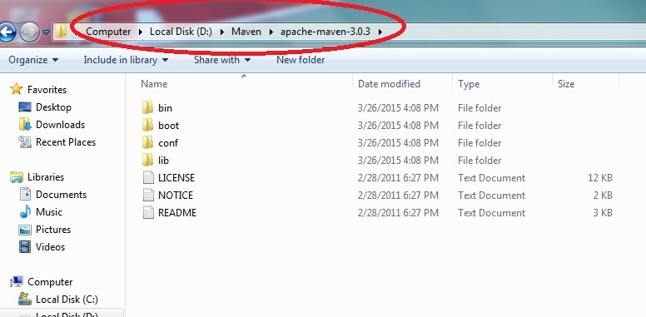
How to Install Maven
Step 1 : Download maven and extract it
apache-maven-3.1.1-bin.zip

Slide 19
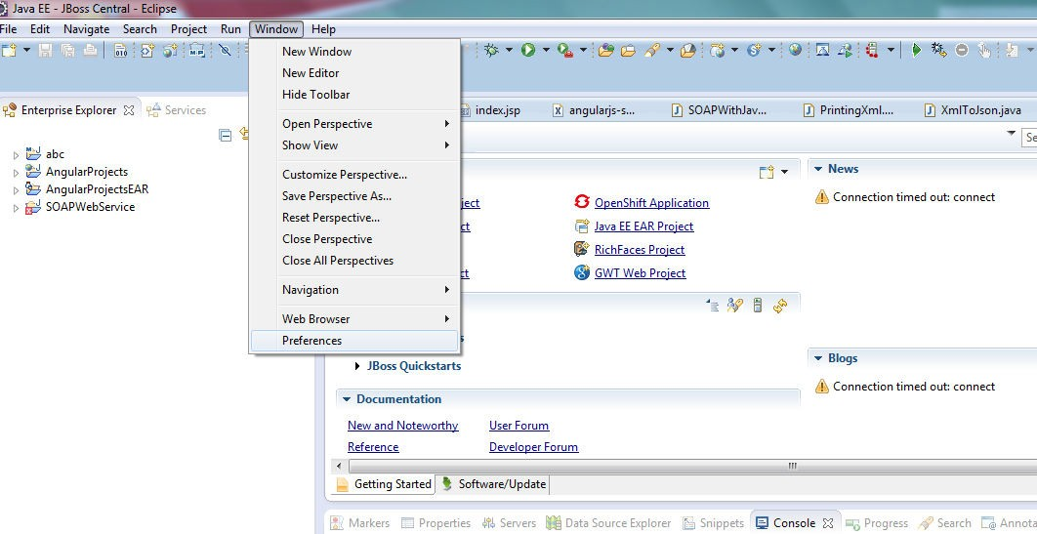
Configuring Maven to Workspace
Step 2 : Open Eclipse IDE
Step 3 : Select Windows -> Preferences
20

Slide 20
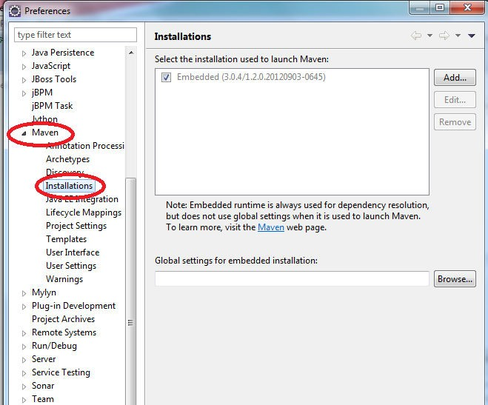
Configuring Maven to Workspace Contd…
Step 4 : Click on Maven Tab -> Installations

Slide 21
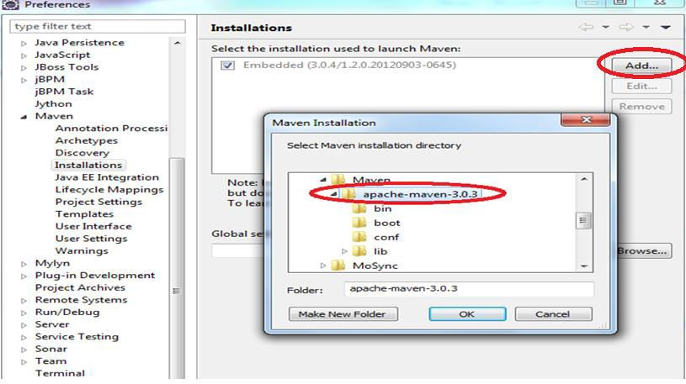
Configuring Maven to Workspace Contd…
Step 5 : Click on Add button and specify the maven extracted folder
path.

Slide 22
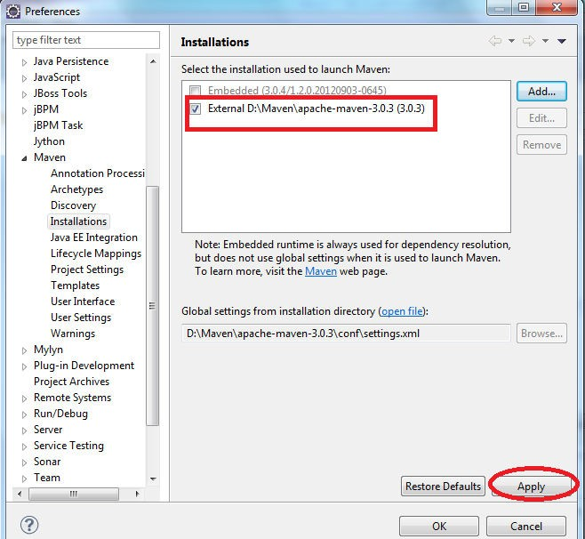
Configuring Maven to Workspace Contd…
Step 6 : The maven extracted folder path is added and click Apply

Slide 23
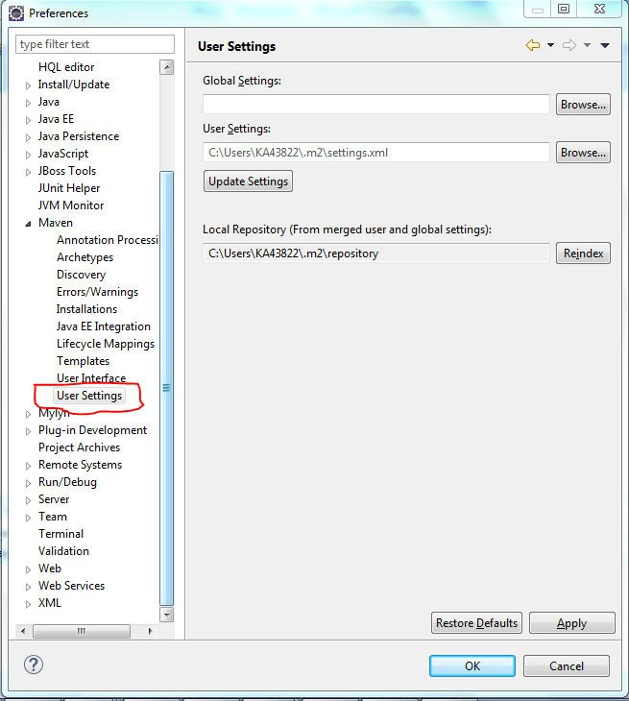
Configuring Maven to Workspace Contd…
Step 7 : Click on Maven -> User Settings

Slide 24
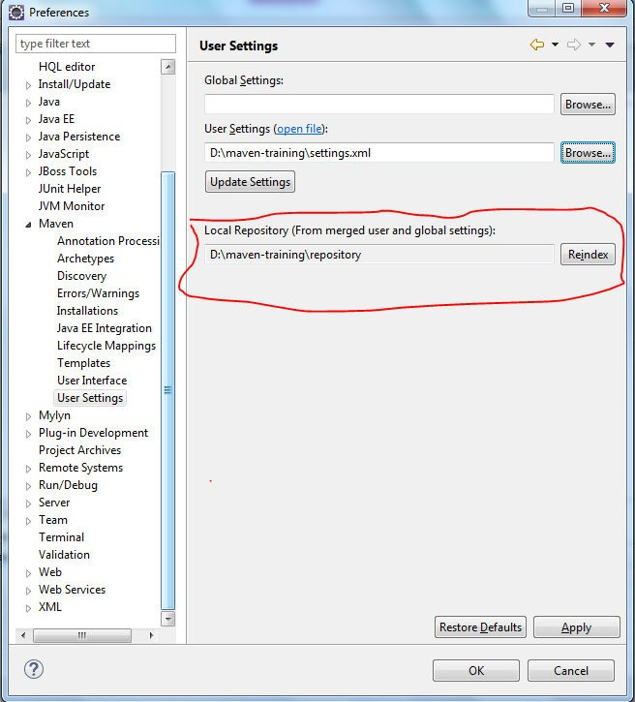
Configuring Maven to Workspace Contd…
Step 8 : In the User Settings tab specify the settings.xml file path
location by clicking Browse button.
Step 9 : Keep that settings.xml file in the extracted folder of apache
maven.

Slide 25
settings.xml
The settings.xml file contains elements used to define values which configure Maven execution in various ways, like the pom.xml.
It should not be bundled to any specific project, or distributed to an audience.
These include values such as the local repository location, alternate remote repository servers, and authentication information.
<settings xmlns="http://maven.apache.org/SETTINGS/1.0.0" xmlns:xsi="http://www.w3.org/2001/XMLSchema-instance" xsi:schemaLocation="http://maven.apache.org/SETTINGS/1.0.0
http://maven.apache.org/xsd/settings-1.0.0.xsd">
<localRepository/>
<interactiveMode/>
<usePluginRegistry/>
<offline/>
<pluginGroups/>
<servers/>
<mirrors/>
<proxies/>
<profiles/>
<activeProfiles/>
</settings>

Slide 26
Local Repository
Maven local repository is a folder location on your machine.
▪
Maven local repository keeps your project's all dependencies (library jars, plugin jars
etc).
When you run a Maven build, then Maven automatically downloads all the dependency
jars into the local repository.
Maven local repository by default get created by Maven in %USER_HOME% directory.
To override the default location, mention another path in Maven settings.xml file.
<settings xmlns="http://maven.apache.org/SETTINGS/1.0.0" xmlns:xsi="http://www.w3.org/2001/XMLSchema-instance" xsi:schemaLocation="http://maven.apache.org/SETTINGS/1.0.0 http://maven.apache.org/xsd/settings-
1.0.0.xsd">
<!-- localRepository
| The path to the local repository maven will use to store artifacts.
|
| Default: ~/.m2/repository -->
<localRepository>Your Local path Ex:D:\Repository </localRepository>

Slide 27
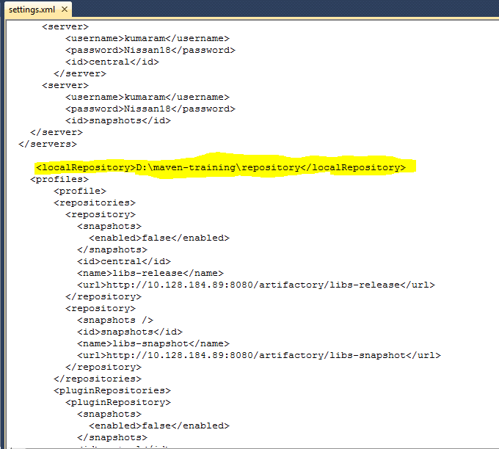
Local Repository
Local Repository path can be specified in settings.xml file under
<localRepository> tag

Slide 28
Local Repository
Local Repository path is mentioned in Maven -> User Settings tab.
The path mentioned in settings.xml file is shown here automatically.

Slide 29
Maven Dependency
Dependency management is one of the features of Maven that is best known to
users. Maven introduced concept of transitive dependency.
Dependencies consist of:
GAV
Scope: compile, test, provided (default=compile),runtime, system
Type: jar, pom, war, ear, zip (default=jar)
<?xml version="1.0" encoding="UTF-8"?>
<project>
<dependencies>
<dependency>
<groupId>junit</groupId>
<artifactId>junit</artifactId>
<version>${junit.version}</version>
<scope>test</scope>
</dependency>
<!-- Adding javaeeapi jar for all layers -->
<dependency>
<groupId>javax</groupId>
<artifactId>javaee-api</artifactId>
<version>${javaeeapi.version}</version>
<scope>provided</scope>
</dependency>
<dependencies>
</project>
30

Slide 30
Transitive Dependencies
Transitive Dependency Definition:
  A dependency that should be included when declaring project itself is a
dependency
ProjectA depends on ProjectB
If ProjectC depends on ProjectA then ProjectB is automatically included
Only compile and runtime scopes are transitive
Transitive dependencies are controlled using:
  Exclusions
  Optional declarations

Slide 31
Dependency Exclusions
Exclusions exclude transitive dependencies
<?xml version="1.0" encoding="UTF-8"?>
<project>
<dependencies>
<dependency>
<groupId>junit</groupId>
<artifactId>junit</artifactId>
<version>${junit.version}</version>
<scope>test</scope>
</dependency>
<!-- Adding javaeeapi jar for all layers -->
<dependency>
<groupId>org.apache.openejb</groupId>
<artifactId>javaee-api</artifactId>
<version>6.0-5</version>
<scope>test</scope>
<exclusions>
<exclusion>
<groupId>org.apache.openejb</groupId>
<artifactId>javaee-api</artifactId>
</exclusion>
</exclusions>
</dependency>
<dependencies>
</project>

Slide 32
Dependency Management
If more than one project depends on a specific dependency, you can list the
dependency in Dependency Management
What do you do when versions collide?
  Allow Maven to manage it?
    Complex and less predictable
  Take control yourself
    Manage the version manually
<?xml version="1.0" encoding="UTF-8"?>
<project>
...
<dependencyManagement>
<dependencies>
<dependency>
<groupId>org.springframework</groupId>
<artifactId>spring-core</artifactId>
<version>3.0.5.RELEASE</version>
</dependency>
</dependencies>
</dependencyManagement>
<dependencies>
<dependency>
<groupId>org.springframework</groupId>
<artifactId>spring-core</artifactId>
</dependency> <!-- Look ma, no version! -->
</dependencies>
</project>

Slide 33
Maven Repository
A repository is a place i.e. directory where all the project jars, library jar, plugins or any
other project specific artifacts are stored and can be used by Maven easily.
Maven repository are of three types
  Local Repository
  Central Repository
  Remote Repository
Maven searches for the dependencies in the following order:
Step 1 Step 2 Step 3
Local Repository Central Repository
Remote Repository

Slide 34
Local Repository
Maven local repository is a folder location on your machine.
▪
Maven local repository keeps your project's all dependencies (library jars, plugin jars
etc).
When you run a Maven build, then Maven automatically downloads all the dependency
jars into the local repository.
Maven local repository by default get created by Maven in %USER_HOME% directory.
To override the default location, mention another path in Maven settings.xml file.
<settings xmlns="http://maven.apache.org/SETTINGS/1.0.0" xmlns:xsi="http://www.w3.org/2001/XMLSchema-instance" xsi:schemaLocation="http://maven.apache.org/SETTINGS/1.0.0 http://maven.apache.org/xsd/settings-
1.0.0.xsd">
<!-- localRepository
| The path to the local repository maven will use to store artifacts.
|
| Default: ~/.m2/repository -->
<localRepository>Your Local path Ex:D:\Repository </localRepository>

Slide 35
Central Repository
Maven central repository is repository provided by Maven community. It contains a large
number of commonly used libraries.
When Maven does not find any dependency in local repository, it starts searching in
central repository using the URL mentioned in configuration file (settings.xml)
Central repositories can be configured in your local intranet system, by using mirror
configurations, can connect local central repository.
<settings xmlns="http://maven.apache.org/SETTINGS/1.0.0" xmlns:xsi="http://www.w3.org/2001/XMLSchema-instance"
xsi:schemaLocation="http://maven.apache.org/SETTINGS/1.0.0 http://maven.apache.org/xsd/settings-1.0.0.xsd">
<servers>
<server>
<id>deploymentRepo</id>
<username>repouser</username>
<password>repopwd</password>
</server>
<profile>
<repositories>
<repository>
<id>jdk14</id>
<name>Repository for JDK 1.4 builds</name>
<url>http://www.myhost.com/maven/jdk14</url>
<layout>default</layout>
<snapshotPolicy>always</snapshotPolicy>
</repository>
</repositories>
</profile>

Slide 36
Remote Repository
Remote repositories refer to any other type of repository, accessed by a variety of
protocols such as file:// and http://
Local and Remote repositories are structured the same way so that scripts can easily
be run on either side, or they can be synced for offline used
Sometime, Maven does not find a mentioned dependency in central repository as well then it stopped build process and output error message to console. To prevent such situation, Maven provides concept of Remote Repository which is developer's own custom repository containing required libraries or other project jars.
If a remote repository has not been mentioned, Maven simply stops the processing and throws error.

Slide 37
Maven Plugins
Maven is actually a plugin execution framework where every task is actually done by
plugins.
A plugin generally provides a set of goals and which can be executed.
Plugins are specified in pom.xml using plugin element.
Each plugin have multiple goals.
Plugin can execute following format mvn [plugin-name]:[goal-name]
Ex: mvn compiler:compile
Plugin | Description
Clean | Clean up target after the build. Deletes the target directory.
Compiler | Compile java source files
Jar | Builds jar file from the current project
War | Builds a war file from the current project
Surefire | Runs the junit unit tests . Creates test report
Javadoc | Generates the javadoc
Antrun | Runs a set ant task from any phase mentioned of the build.

Slide 38
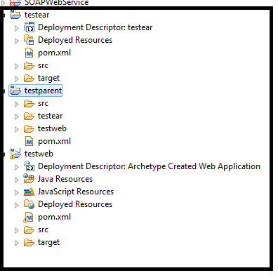
Maven Project Structure
Maven splits project structure into three parts
parent folder ear folder web folder
40

Slide 39
Project Inheritance by using Parent
POM files can inherit configuration
  groupId, version
  Project Config
  Dependencies
  Plugin configuration
<?xml version="1.0" encoding="UTF-8"?>
<project>
<parent>
<artifactId>maven-training-parent</artifactId>
<groupId>com.techm.training</groupId>
<version>1.0</version>
</parent>
<modelVersion>4.0.0</modelVersion>
<artifactId>maven-training</artifactId>
<packaging>jar</packaging>
</project>

Slide 40
Multi Module Projects
Maven can do multi-module support
Each maven project creates one primary artifact
Parent POM is used to group modules
<?xml version="1.0" encoding="UTF-8"?>
<project>
<modelVersion>4.0.0</modelVersion>
<groupId>com.techm.training</groupId>
<artifactId>maven-training-parent</artifactId>
<version>0.0.1-SNAPSHOT</version>
<packaging>pom</packaging>
<!-- adding all
<properties>
<!– Define
</properties>
<!-- adding all
<modules>
properties -->
all properties>
modules -->
<module>training-web</module>
<module>training-ear</module>
</modules>
</project>

Slide 41
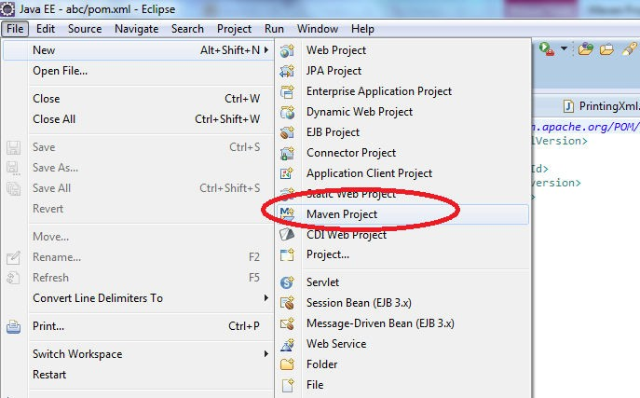
Creating the parent folder
After configuring Maven to workspace successfully, we can create a
maven project.
Click on File menu -> New -> Maven Project.

Slide 42
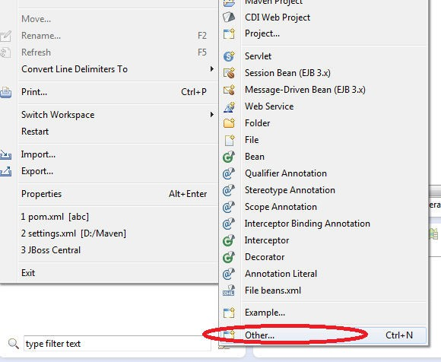
Creating the parent folder contd..
If Maven project is not listed under the New menu options, click
File -> New -> Other…

Slide 43
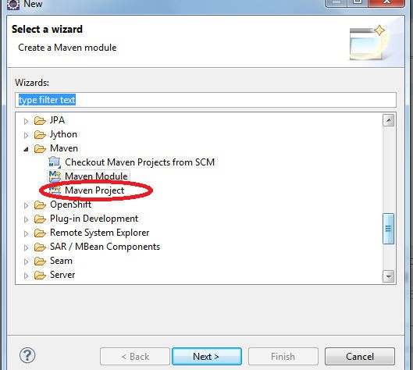
Creating the parent folder contd..
In the Select Wizard, Choose Maven Project and click Next.

Slide 44
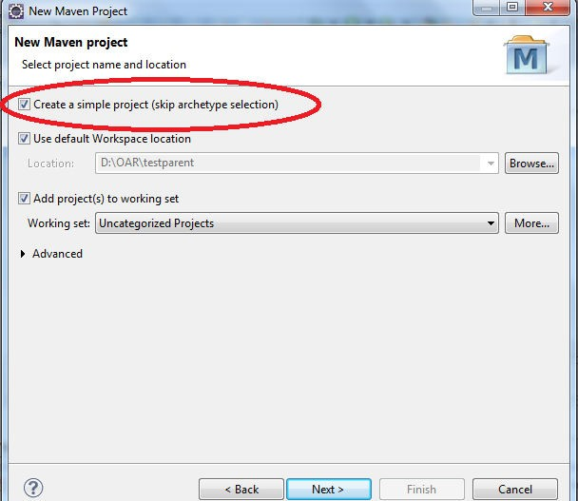
Creating the parent folder contd..
In the New Maven Project Window, enable Create a simple project
Check box and click Next button.

Slide 45
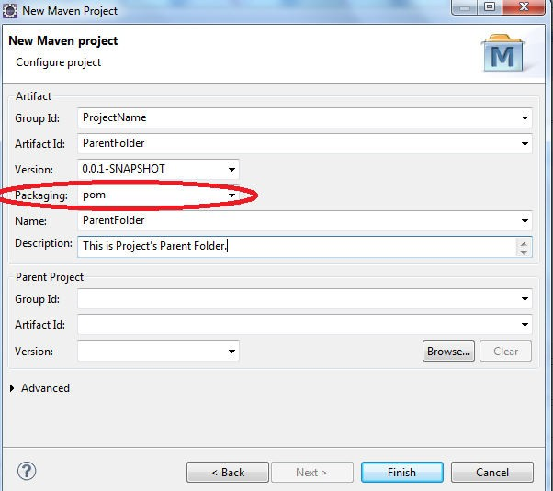
Creating the parent folder contd..
In this window give the project name in Group Id, ParentFolder name in Artifact Id.
Since it is a parent folder, select packaging as POM and click Finish.

Slide 46
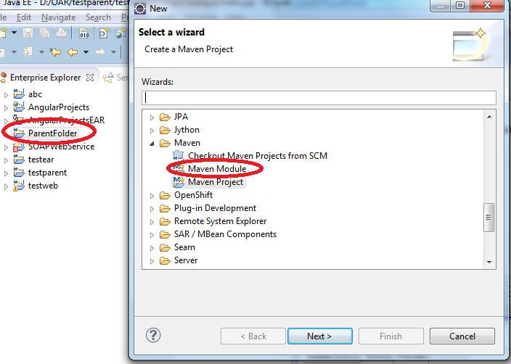
Adding ear module to parent
Right click on ParentFolder -> New -> Other-> Maven Module.
Then Click Next.

Slide 47
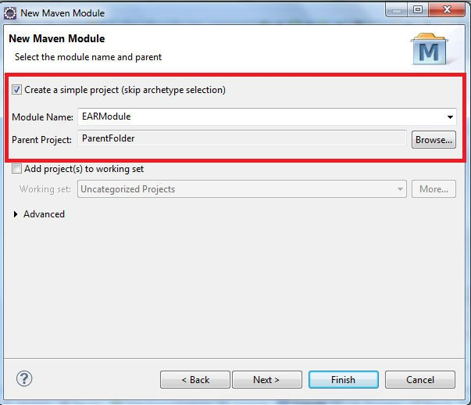
Adding ear module to parent contd…
Enter the EARmodule name in ModuleName Tab.
Check Create a simple project check box is enabled and click Next.

Slide 48
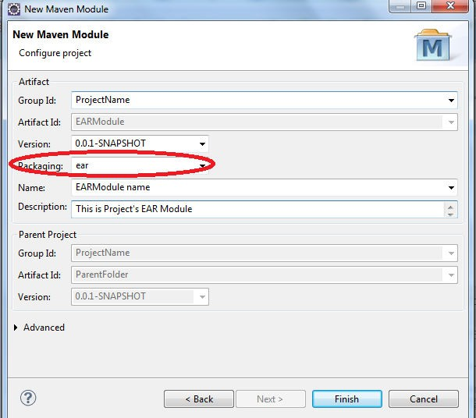
Adding ear module to parent contd…
Since it is a EAR module, type ear in Packaging tab and click Finish.
50

