Slide 1






Static Code Analysis
Using
SonarQube
Copyright © 2017 Tech Mahindra. All rights reserved.
1

Slide 2



TABLE OF CONTENT
SonarQube Overview and Features
SonarQube Architecture
SonarQube – Integration with ALM
Requirements
Installation
SonarQube - Configuration
Analysing Source Code

Slide 3


SonarQube- Overview and Features
SonarQube (previously known as Sonar) is an open source platform for Continuous Inspection of code quality.
SonarQube is written in java and supported for 25+ languages such as
Java, C/C++, C#, PHP, Flex, Groovy, JavaScript, Python, PL/SQL, COBOL etc., It is also supports Android Development projects.
It helps for various tasks and provide reports on
duplicated code, coding standards, unit tests, code coverage, complex code, potential bugs , comments and, design and architecture.
SonarQube is internally uses PMD, Find bugs, Check Style. Additionally plugins can be included according to project requirement.
Records metrics history and provides evolution graphs ("time machine") and differential views
Provides fully automated analyses using Maven, Ant, Gradle and Continuous Integration tools like Jenkins, Bamboo.
Integrates with the Eclipse development environment
Integrates with external tools like JIRA, Mantis, LDAP, Fortify
Implements the SQALE (Software Quality Assessment
methodology to compute technical debt
based
on Lifecycle
Expectations)

Slide 4

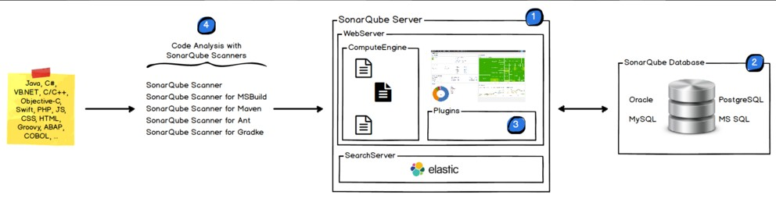
SonarQube- Architecture
The SonarQube Platform is made of 4 components mainly SonarQube Server, Database, Plugins and Scanners. Below are the architecture for SonarQube:
SonarQube Server: It contains mainly 2 process.
Web Server: For developers, managers to browse quality snapshot's
Search Server: Based on Elastic search to back searches from the UI
SonarQube Database: Configuration of the SonarQube instance (security, plugins settings, etc.) and the quality snapshots of projects, views etc.,
SonarQube Plugin: Installers on the server, possibly including language, SCM, integration, authentication, and governance plugins.
SonarQube Scanners: Running on your Build / Continuous Integration Servers to analyse projects

Slide 5


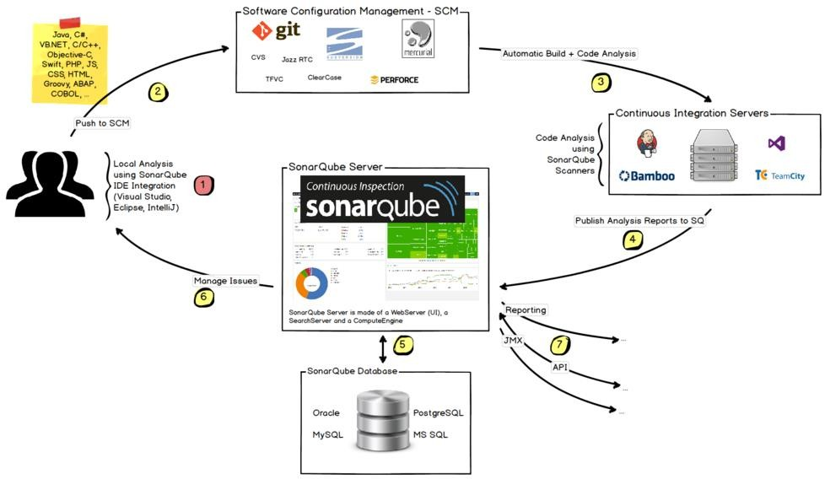
SonarQube- Integration with ALM
The following schema shows how SonarQube integrates with other ALM tools and where the various components of SonarQube are used:
Developers code in their IDEs and use Sonar Lint to run local analysis.
Developers push their code into SCM: GIT, SVN, TFVC, ...
The Continuous Integration Server triggers an automatic build, and the execution of the SonarQube Scanner for analysis
The analysis report is sent to the SonarQube Server for processing.
SonarQube Server processes and stores the analysis report results in the SonarQube Database
Developers review, comment, challenge their Issues to manage and reduce their Technical Debt through the SonarQube UI.
Managers receive Reports from the analysis.
o Ops use APIs to automate configuration and extract data and JMX to monitor SonarQube Server.

Slide 6

SonarQube- Requirements
Prerequisite:
Java (Oracle JRE 7 onwards or OpenJDK 7 onwards)
Requires at least 2 GB of RAM and 50 GB HDD based on project needs
Java Script enabled browser(optional)
Supported Java Platforms:
SonarQube Java analyser is able to analyse any kind of Java source files regardless of the version of Java they comply to. But SonarQube analysis and the SonarQube Server require specific versions of the JVM.
JVM Version | Supported Version
Oracle JRE | 7u75+, 8
Open JDK | 7u55+, 8
IBM JRE / GCJ / Oracle JRocket | No Support
Supported DB Platforms
Supported Browser Platforms
Data Base
MSSQL 2008 onwards
MySQL 5.1 onwards (only InnoDB)
Oracle 11G onwards
PostgreSQL 8.x onwards
Browser Support
IE 11 onwards
Mozilla Firefox
Google Chrome
Safari

Slide 7

SonarQube- Installation
Sonar Server:
Download and unzip the SonarQube distribution from below link http://www.sonarqube.org/downloads/
Start the SonarQube server for executing below command : On Windows, execute:
<<SonarQube path>>/bin/windows-x86-xx/StartSonar.bat On other operating system, execute:
<<SonarQube path>>\/bin/[OS]/sonar.sh console
Browse the results at http://localhost:9000 (default System administrator user id and password are admin / admin)
Sonar Scanner: SonarQube Scanner is recommended as the default launcher to analyse the project with SonarQube server.
Download and unzip the SonarQube Scanner from the below link http://docs.sonarqube.org/display/SONAR/Analyzing+with+SonarQube+Scanner
Update the global settings (server URL) updating <install_directory>/conf/sonar- runner.properties file in below lines:
#SonarQube server
#sonar.host.url=http://localhost:9000
Create a new SONAR_RUNNER_HOME environment variable set to <install_directory>/bin
Opening a new shell and executing the command sonar-runner -h

Slide 8

SonarQube- Configuration
SonarQube server will be configured by setting the values in [Sonar Home]/conf/sonar.properties file
Data base settings:
The default data base was in <install_directory>/conf/sonar.properties:
H2.
These
values
can
be
changed
sonar.jdbc.username=sonarqube sonar.jdbc.password=mypassword sonar.jdbc.url=jdbc:postgresql://localhost/sonarqube
Web Server Configuration:
The default port is "9000" and the context in <install_directory>/conf/sonar.properties:
path
is "/".
These
values
can be changed
sonar.web.host=192.0.0.1 sonar.web.port=80 sonar.web.context=/sonar

Slide 9

SonarQube- Analyse Source Code
The following are the Code Analysis methods to analyze the code from Client machine.
SonarQube Scanner - Launch analysis from the command line
SonarQube Scanner for Ant- Launch analysis from Ant tool
SonarQube Scanner for Maven - Launch analysis from Maven with minimal configuration
SonarQube Scanner for Gradle - Launch Gradle analysis
SonarQube Scanner for MSBuild - Launch analysis of .NET projects
SonarQube Scanner For Jenkins - Launch analysis from Jenkins

Slide 10


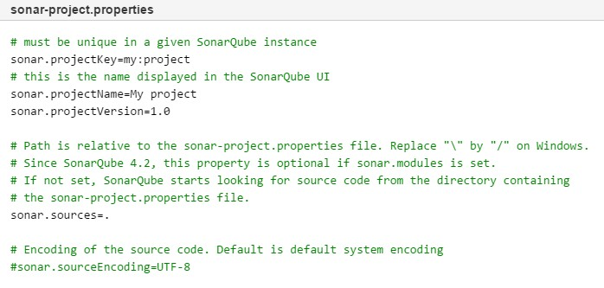
Analyse Source Code - Scanner
The SonarQube Scanner is recommended as the default launcher to analyse a project with SonarQube.
The following are the steps to execute “Simple Project”
Create a configuration file in the root directory for the project: sonar-project.properties
Run the following command from the project base directory to launch the analysis
sonar-runner in command line interface.

Slide 11

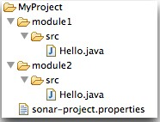
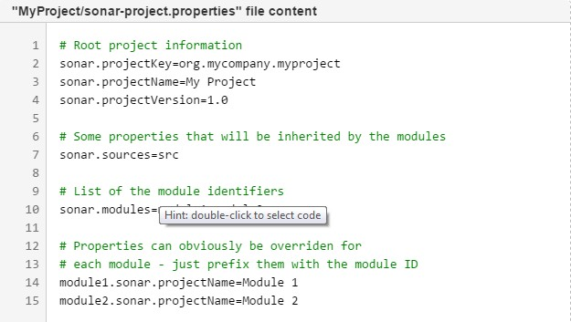
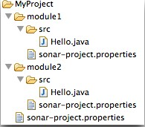
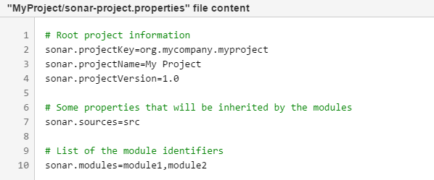


Analyse Source Code - Scanner
The following are the steps to execute “Multi-Module Project”. There are two ways to define a multi- module structure in SonarQube
Way 1 - Set all the configuration in the properties file in the root folder
Way 2 - Set all the configuration in the properties file in multiple folder

Slide 12

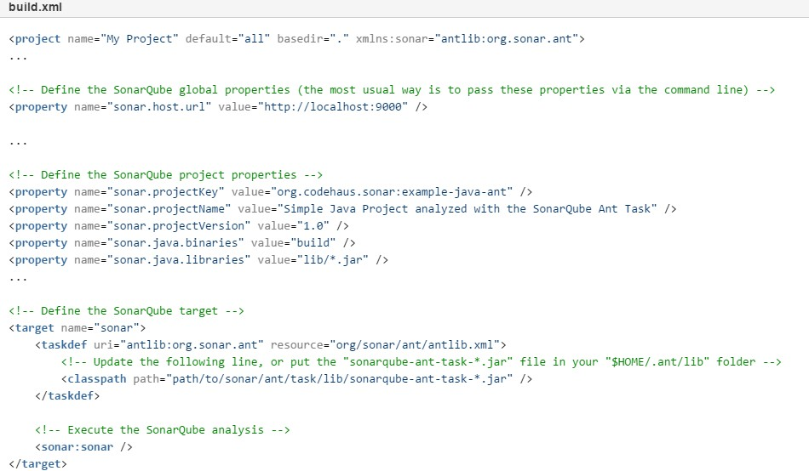
Analyse Source Code - ANT
The SonarQube Ant version 2.4 is compatible with SonarQube platform versions 4.5 and higher. The following are the steps to execute “Simple Project”

Slide 13
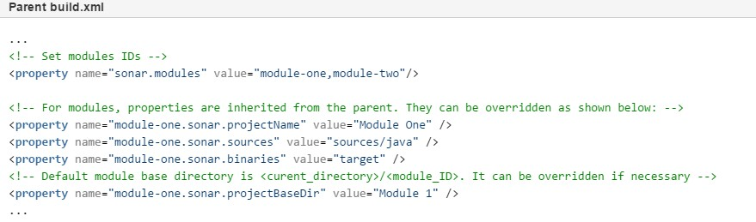
Analyse Source Code - ANT
The configuration for parent and modules must be done in the parent build.xml file:

Slide 14

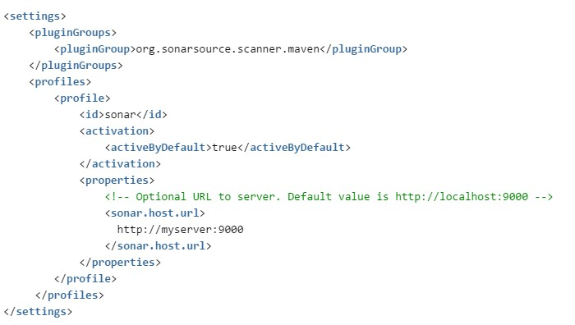
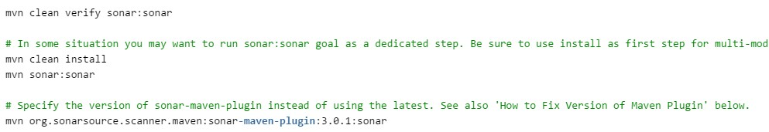
Analyse Source Code - Maven
The SonarQube requires Maven 3 to launch analysis of the project:
Global Setting (Optional): Configure global Maven Setting to support SonarQube
Analysing Maven Project: Analysing a Maven project consists of running sonar:sonar in the directory where the pom.xml file resides
a Maven goal -

Slide 15
TABLE OF CONTENT
Browsing Dashboard
Browser Project
Plugin Library
Customizing User Interface
Quality Profiles
Coding New Rules
Eclipse Integration
Jenkins with SonarQube

Slide 16

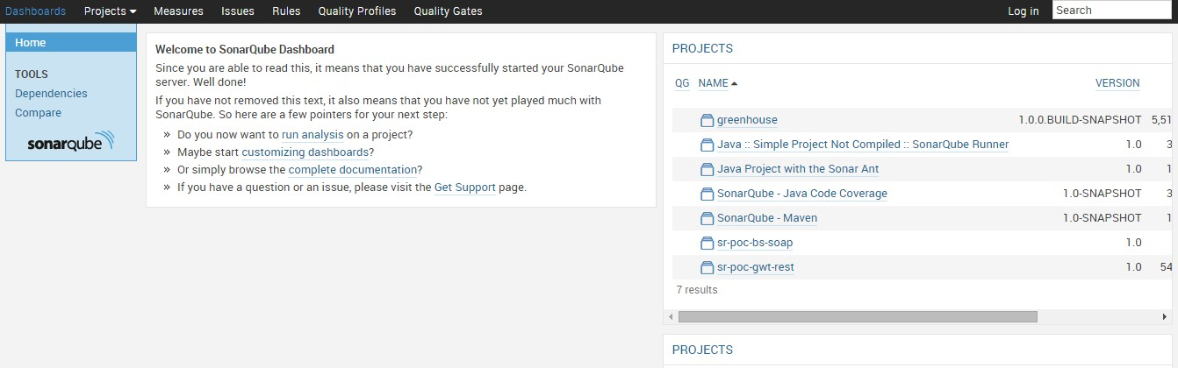
Dashboard
The following is the default view of the SonarQube. All user will view the below dashboard.

Slide 17

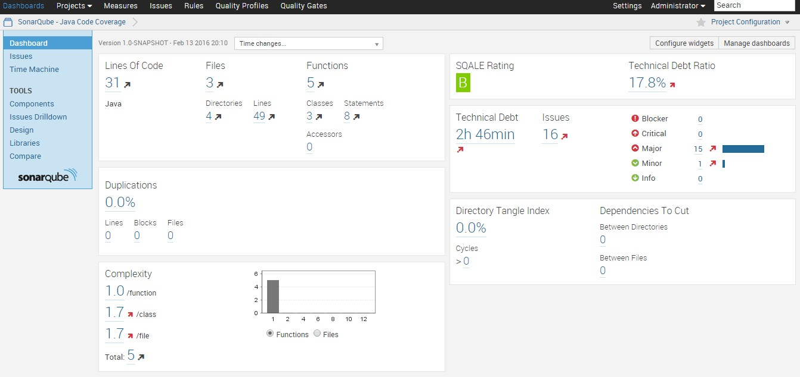
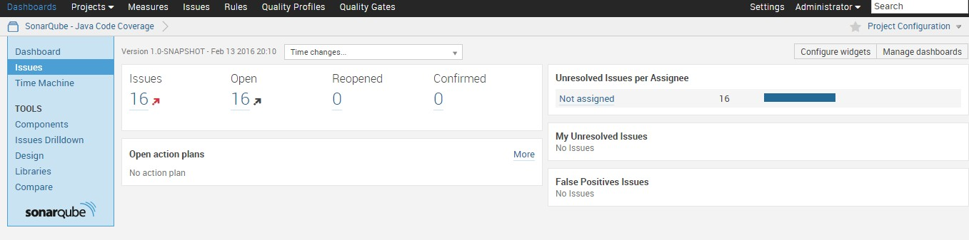
Project View
The following is the default view of the project. All user / admin will view the below dashboard.

Slide 18
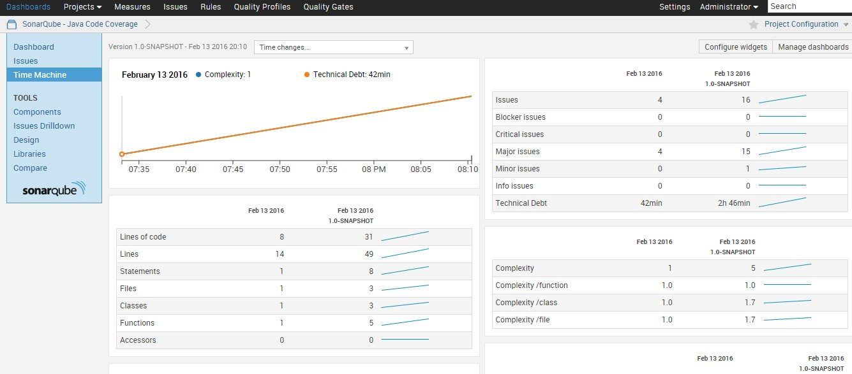
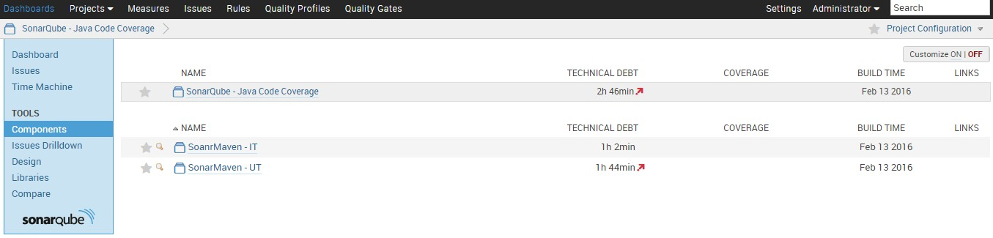
Project View
The following is the default view of the project. All user / admin will view the below dashboard.

Slide 19
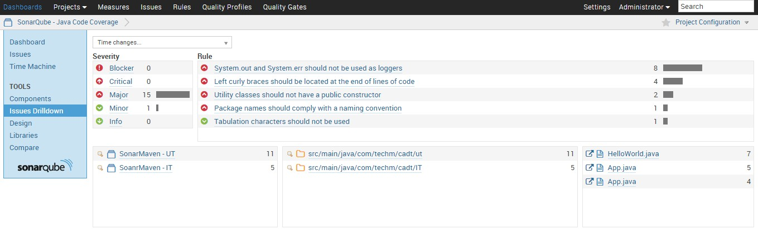
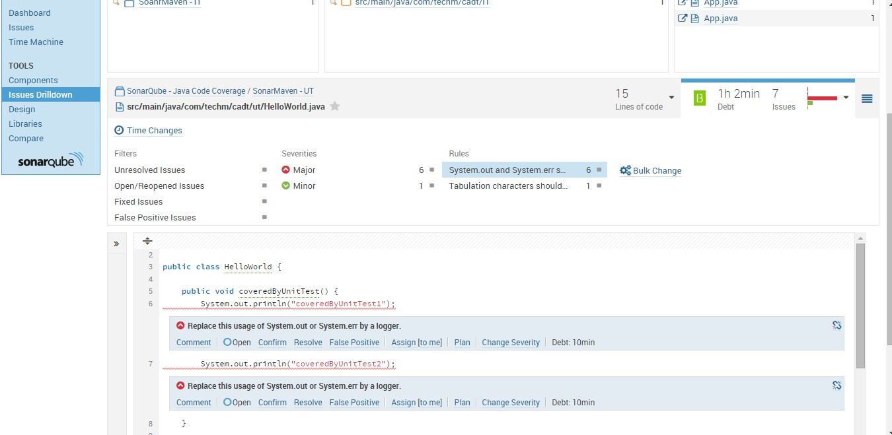
Project View
The following is the default view of the project. All user / admin will view the below dashboard.

Slide 20
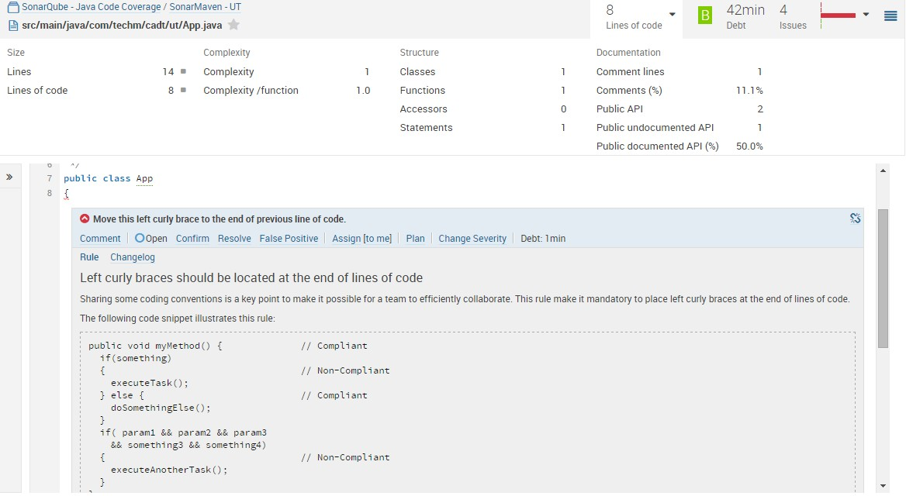
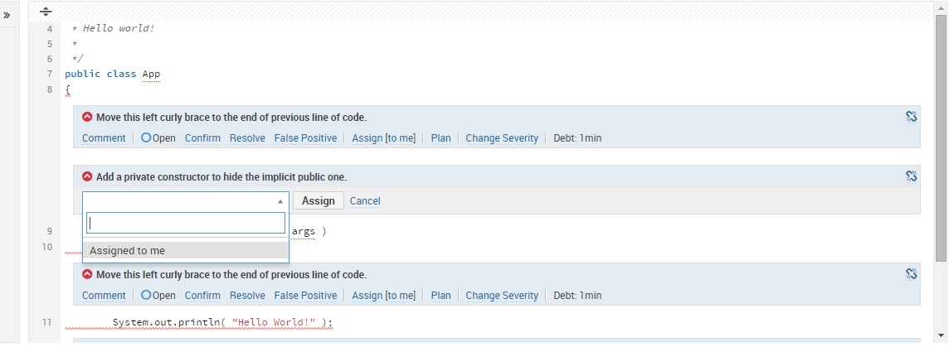
Project View
The following is the default view of the project. All user / admin will view the below dashboard.

Slide 21
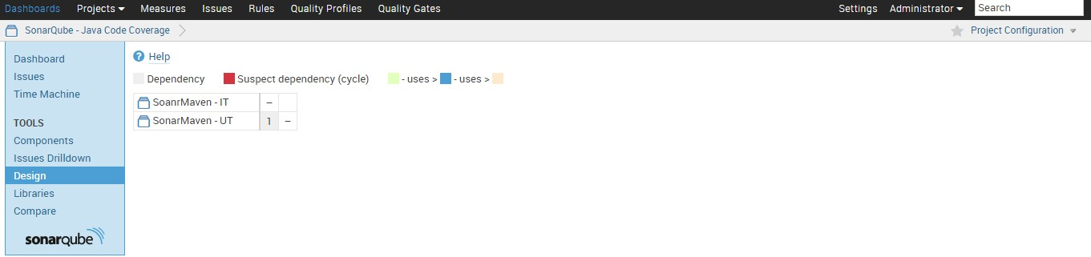
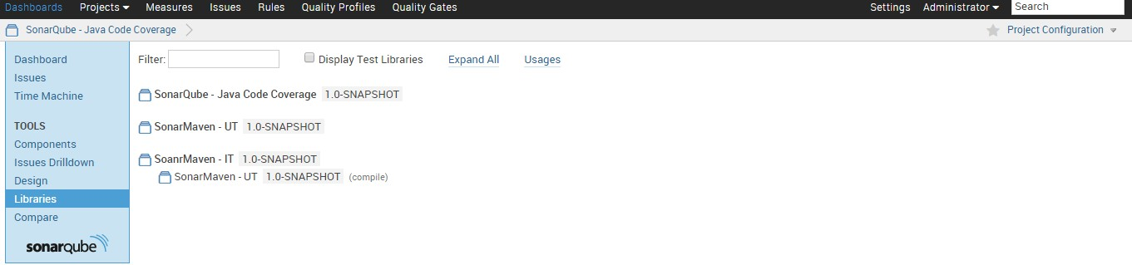
Project View
The following is the default view of the project. All user / admin will view the below dashboard.

Slide 22

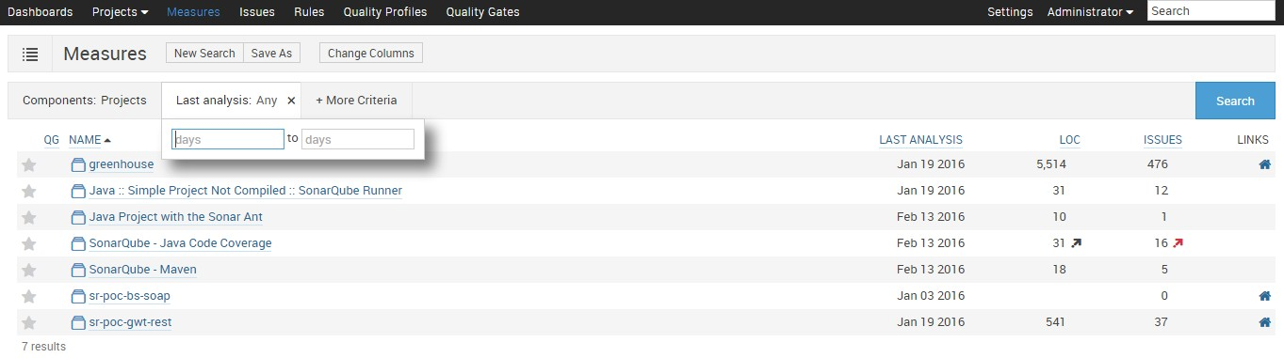
Project Measure
The Measures service provides a way to quickly execute all kinds of queries on project measures.
Example:
the recently inspected projects
the projects with blocker and critical issues
the projects with bad coverage on added/changed code within the 10 past days
The search query can then be saved as a filter to be displayed on dashboards.

Slide 23
Project Measure
The Measures service provides a way to quickly execute all kinds of queries on project measures.
Example:
the recently inspected projects
the projects with blocker and critical issues
the projects with bad coverage on added/changed code within the 10 past days
The search query can then be saved as a filter to be displayed on dashboards.

Slide 24

Jenkins - SonarQube Process Flow
Install Sonar and Sonar Runner
Create Users and Groups in Sonar server using administration login
Assign projects to the sonar by using Sonar runner
Assign Rules for the project
Assign Users and Groups for the project to access
Sonar
Install Jenkins
Add Sonar plugin in Jenkins plugin
Create people OR assign LDAP to the Jenkins
Configure Sonar and Sonar Runner in Jenkins
Assign jobs to the people for execution
Create Job and assign Sonar runner / ANT / Maven task to execute sonar rules
Jenkins
Login to Sonar server with user details
View the project code review report in Sonar Dashboard
Sonar Reports

Slide 25
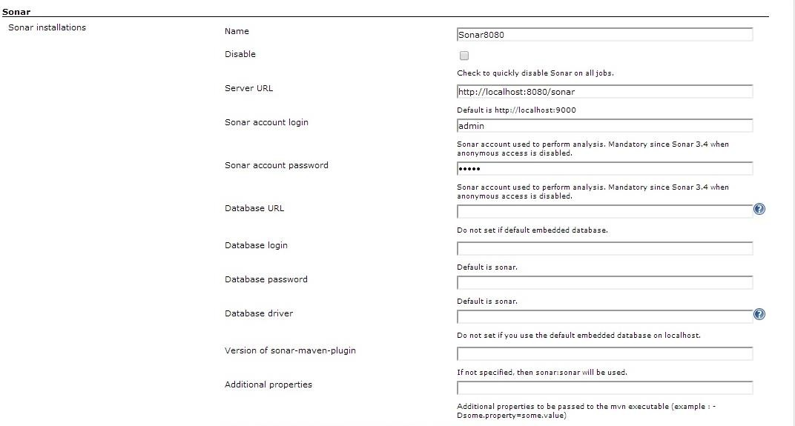
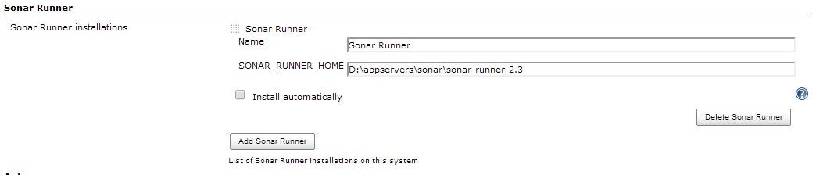
Jenkins and Sonar Configuration
Sonar Server Configuration Details where the SonarQube is running from Jenkins Configuration
Sonar Runner Configuration where the Sonar Runnier is available from Jenkins Configuration

Slide 26
Thank You
Disclaimer
Tech Mahindra, herein referred to as TechM provide a wide array of presentations and reports, with the contributions of various professionals. These presentations and reports are for informational purposes and private circulation only and do not constitute an offer to buy or sell any securities mentioned therein. They do not purport to be a complete description of the markets conditions or developments referred to in the material. While utmost care has been taken in preparing the above, we claim no responsibility for their accuracy. We shall not be liable for any direct or indirect losses arising from the use thereof and the viewers are requested to use the information contained herein at their own risk. These presentations and reports should not be reproduced, re-circulated, published in any media, website or otherwise, in any form or manner, in part or as a whole, without the express consent in writing of TechM or its subsidiaries. Any unauthorized use, disclosure or public dissemination of information contained herein is prohibited. Unless specifically noted, TechM is not responsible for the content of these presentations and/or the opinions of the presenters. Individual situations and local practices and standards may vary, so viewers and others utilizing information contained within a presentation are free to adopt differing standards and approaches as they see fit. You may not repackage or sell the presentation. Products and names mentioned in materials or presentations are the property of their respective owners and the mention of them does not constitute an endorsement by TechM. Information contained in a presentation hosted or promoted by TechM is provided “as is” without warranty of any kind, either expressed or implied, including any warranty of merchantability or fitness for a particular purpose. TechM assumes no liability or responsibility for the contents of a presentation or the opinions expressed by the presenters. All expressions of opinion are subject to change without notice.
Copyright © 2015 Tech Mahindra. All rights reserved.

