Slide 1
XL Deploy and XL Release – Capabilities and Features

Slide 2
XL Deploy & XL Release Features
XL Deploy
Model-based, highly scalable approach where changes are simple to make and propagate to all environments.
.
Integrates with tools like Jenkins, Puppet, Chef, Ansible and Salt.
Dashboard and reports related to deployment status across applications and environments by capturing metrics and analyzing the deployment process.
Agentless architecture across all target platforms. Easily configurable firewalls and security appliances, routers, mobile devices and all the target systems.
XL Release
End-to-end release dashboard and monitoring entire release pipeline to get a clear view and up-to-date status information across tools and systems, from code to production.
Works with the existing tools in environment like Jenkins, Puppet, Git, JIRA and ServiceNow
Model diverse processes using reusable release templates to standardize the process
Automated pipeline steps as well as orchestrate manual steps needed along the way.
.

Slide 3
XL Deploy & XL Release Features
XL Deploy
role-based access for different groups – such as development, operations, and management – to support compliance and governance requirements
Reliably support global deployments Deploy reliably even when faced with slow or unreliable network connections.
Automated rollback by keeping track of all changes made to your environment.
XL Release
Collaboration infrastructure that provides complete auditability, enforces controls, and ensures the right access for the right people across all teams in the enterprise.
Full audit trail and gather evidence for compliance, to mitigate risk for software delivery process.
In-depth analytics and reports capabilities to make data-driven decisions that highlight process bottlenecks to optimize

Slide 4
XL Deploy & XL Release Features
XL Deploy
Jenkins plugin to automate deployments to all environments.
Enterprise security and centralized audit capabilities
XL Release
Proactively avoid delays
and release failures by
tracking resource conflicts,
dependencies and pending tasks.

Slide 5
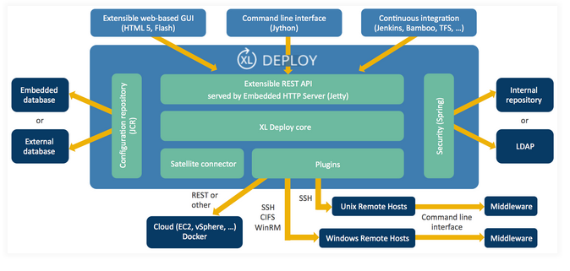
XL Deploy Architecture

Slide 6
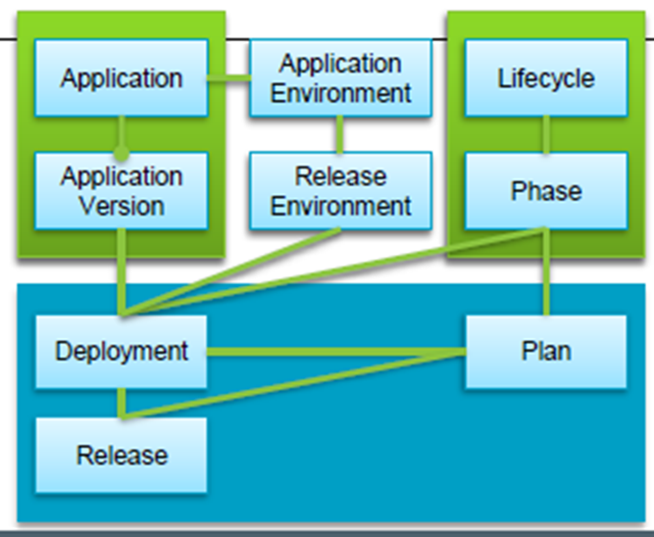
Release Mechanism

Slide 7
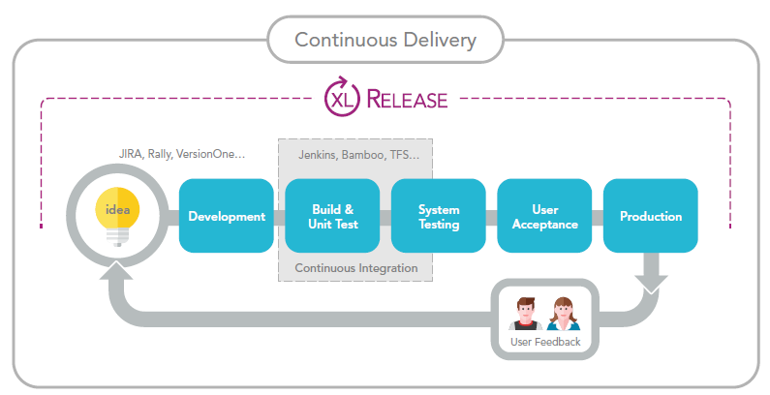
Continuous Delivery Management with XL Release

