Slide 1

Car Rental Management
Gas n
Go
Rachana Goli (801273486)
Shravan Naidu Gollu (801318790)
Sai Rithwik Reddy Bolla (801275495)
Sai Anish Chowdary Bezawada (801312402) Konuganti Vamshi Reddy (801306984)

Slide 2
Intro
A car rental management application is a website that rents automobiles on hourly, daily, weekly, or sometimes monthly based on the requirement of the customer/ the user.
Goal
To develop a web application which helps the user to login to the system and gives the user an option to book/ rent a car based on the availability and choice of the car which they choose to use.

Slide 3




Technologies
Angular
Angular is used for the development of user interface which is the frontend of the project
MongoDB
MongoDB is a flexible schema database used for storing the data in object formats.
This is a backend framework used for building different functional modules in the major web applications.
Node JS
This is a framework built on top of nodeJS to manage several functional modules root redirecting, serever maintainance, etc.
Express JS

Slide 4
Functional Requirements
To develop User Interface which can be easily understood by the user to use.
To create a database where the user data can be stored.
To create a login page where the user can sign up with their credentials.
To create a login page where the user can sign up with their credentials.
To create a booking/ reservation page for the user to book/ rent a car online.
To create a user dashboard where the user can view their previous bookings and add a new booking to the list.
To provide the user with the update/cancel booking status.

Slide 5
Non-Functional Requirements
Application response to commands.
Secure database to store user’s personal information.
Making the website compatible to work in all types of devices.
How likely the system or its element would run without a failure.

Slide 6

Innovations
We have developed an application where the user can book/ rent a car with his desired preferences.
In the application we have worked on user login page and created a user login page where the user can sign up using their mail id and confirming the password twice for confirmation or login into the system using their credentials and when they login into the system they’ll be able to see a car booking page.
Then in the car booking page the user need to enter the information in all the required fields. The main functionality of the application is that the user can book/ rent and cancel his booking according to their need.

Slide 7
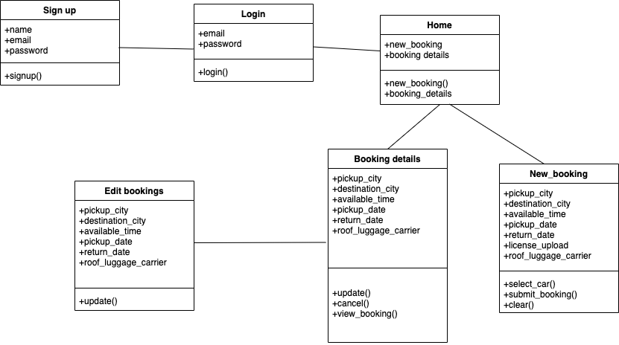
Class Diagram

Slide 8
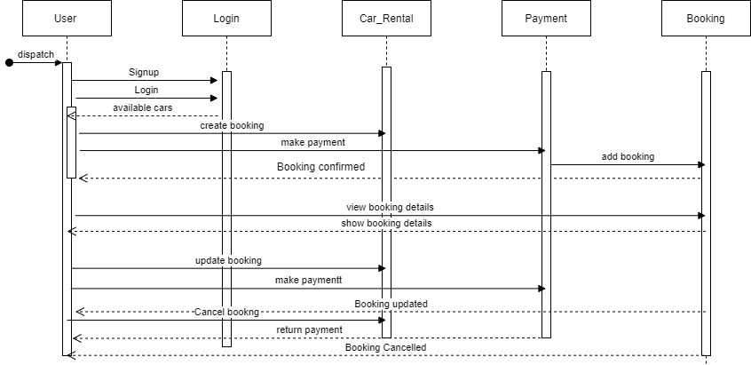
Sequence Diagram

Slide 9
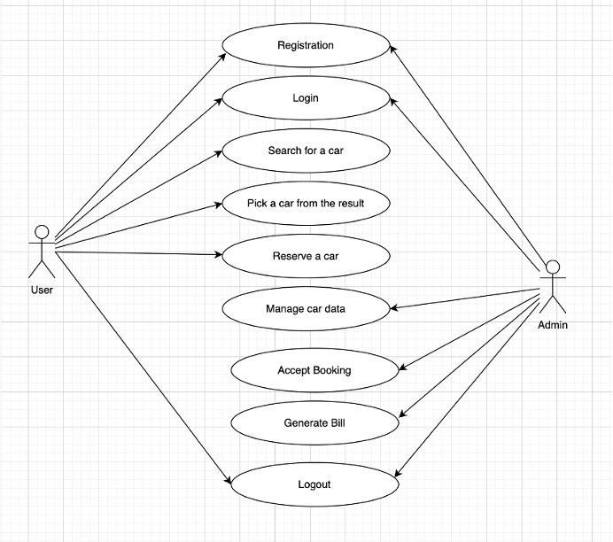
UseCase Diagram

Slide 10
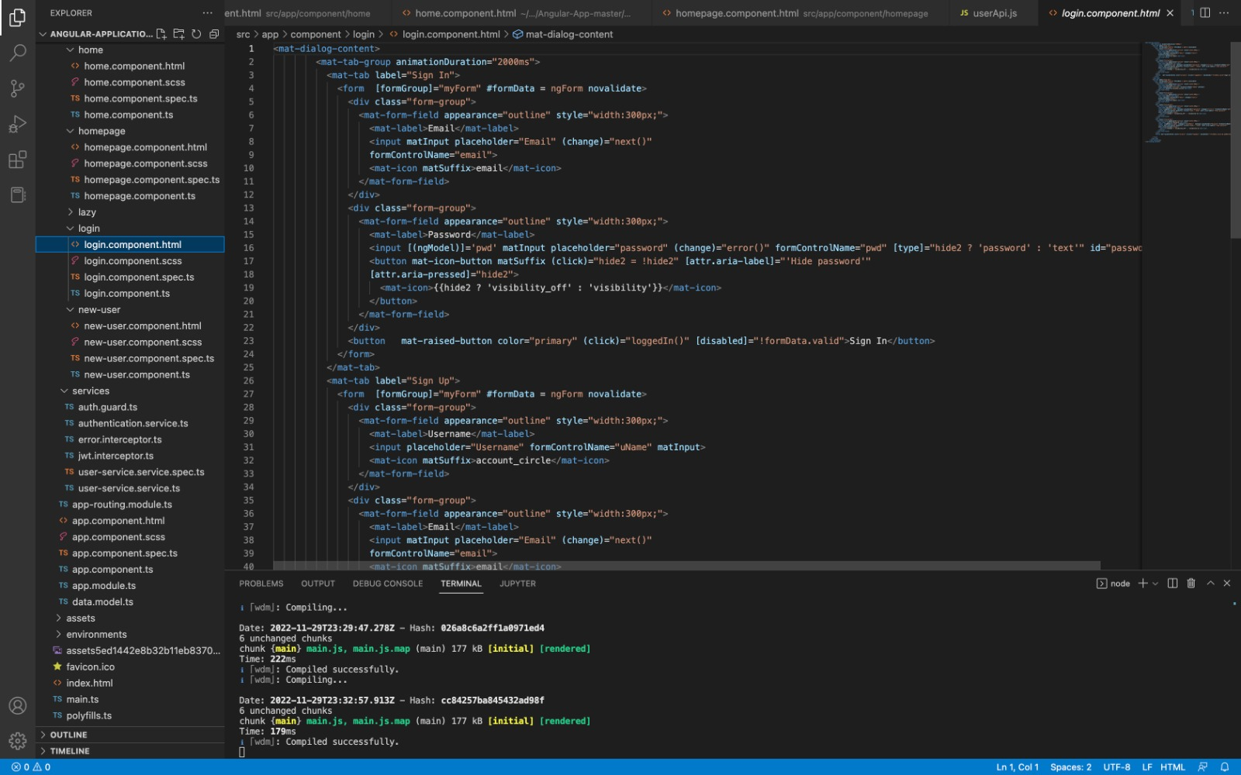
Code Overview

Slide 11
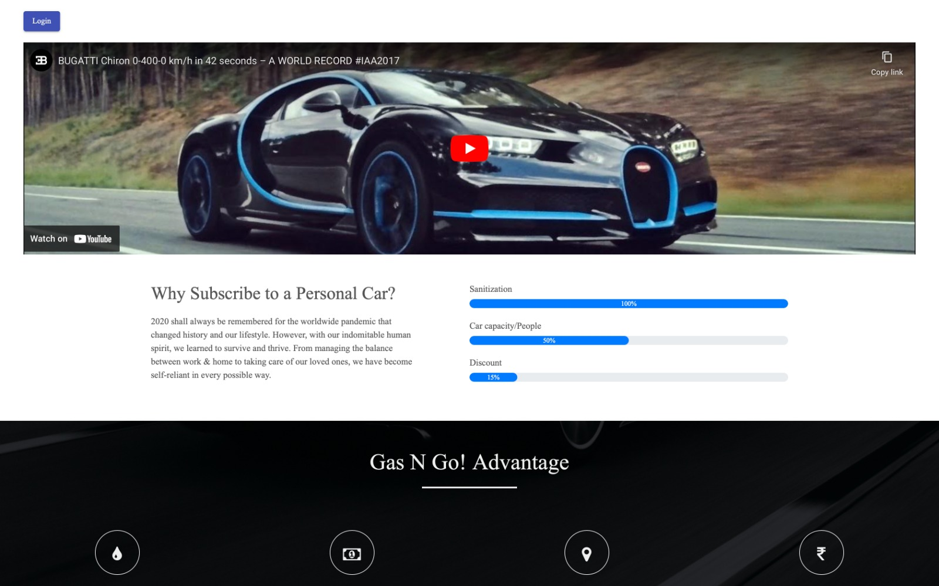
Demo

Slide 12
Future Scope
In the world where everything comes at a single click we try to give the users the same level of comfort by delivering the vehicles to their own place reducing them with the burden of picking up the vehicle.
Also we try to provide better services, use new automated techniques, and offers to get more reservations.
Minimize the task for the management and can concentrate on developing business plans and new strategies for the development of the application.

