Slide 1


CYBR644 – Cyber Practitioner Lab
Spring 2024
University of Maryland, Baltimore County
Michael Hennick

Slide 2
Overview of the course
Week 01 – Introduction, Ethical Hacking Basics, Ethics, Law
Week 02 – Technical Foundations of Hacking
Week 03 – Reconnaissance, Social Media
Week 04 – Scanning and Probing
Week 05 – Vulnerability Identification
Week 06 – Exploiting Weaknesses
Week 07 – Class Presentations / Review for Exam
Week 08 – Spring Break
Week 09 – Midterm Exam
Week 10 – Privilege Escalation, Maintaining Access
Week 11 – Malware, Covering your Tracks
Week 12 – The Web
Week 13 – Wireless and Mobile Security
Week 14 – Physical Security, Social Engineering, and Security Policies
Week 15 – Class Presentations / Review for Exam
Week 16 – Final Exam

Slide 3
Project 2
Two options
Option 1:
Perform research on an information security (cyber security) tool. This could be a deeper dive on the tools we've discussed in class, or you can present on a tool we haven't used/discussed. Whatever tool you choose, please answer the following areas:
1. Background on the tool, such as developer and whether it is "active" as far as being developed and updated.
2. Tool's usage, including a couple use cases on why you would select the tool during a penetration test, or in responding to an incident.
3. Screenshots or demonstration of the tool in use.
4. Comparison of the tool with other's that do similar functions.
Option 2:
Perform a penetration test against all four of the Victim VMs. As you perform the penetration test, be sure to outline the discovery of the systems, what services were found, the vulnerabilities found, and the exploits used. Be sure to also include remediations and recommendations for the vulnerabilities and exploits that you document.
For the report, you can follow a template from Offensive Security (https://www.offensive-security.com/reports/sample-penetration-testing-report.pdf ) or from SANS (https://www.sans.org/reading-room/whitepapers/testing/writing-penetration-testing-report-33343 ), or a combination of the two.

Slide 4
Where are we?
Phase 1 provided us with information on our target
Network Ranges, Key systems of interest, Technologies Used,
Insight into potential attack vectors, Insight into potential passwords
Phase 2 provided us additional information on our target
Active systems, Ports/Services, Versions of applications running,
Versions of Operating Systems
Phase 3 provided us with known vulnerabilities to the services/systems of our target
Patches that weren’t applied, old versions of software
Insecure services, un-configured services
Phase 4 provided us access to the target systems to help reach end goal
Deface webserver
Dump or steal database of customer records
Steal sensitive files
Look for additional systems to compromise
Phase 5 provided us with legitimate access to the target systems
Cracked passwords for real accounts
Networking to facilitate backdoor and malware infections

Slide 5
Take A Step Back…
6. Hide/Cover Tracks
1. Reconnaissance
5. Gain Foothold
2. Network Discovery
4. Compromise Targets
2. Host/Port Discovery
3. Vulnerability Identification
3.Application Identification

Slide 6

Gain Foothold
Now that we’ve gained access to a system….
- Create a form of legitimate access
- Create a service/process that allows for access beyond throwing an exploit
- Create a scheduled event to send data to us periodically

Slide 7
Services/scheduled processes
A service that’s only purpose is to allow an attacker a method of accessing a system?
A process that is running on my system that I didn’t start myself?
A scheduled task that takes my data and sends it to somewhere on the internet?
That sounds bad….
….like bad software….
…. Malware….

Slide 8
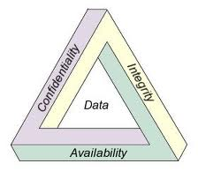
Malware
Malicious code that has an adverse impact on the confidentiality, integrity, or availability of an information system.
Confidentiality – My data is my own, and it hasn’t been breached
Integrity – My data is exactly as I left it, and it hasn’t been tampered with
Availability – My data is accessible
Includes references to:
viruses
trojans
worms
rootkits
backdoors
spyware
some types of adware

Slide 9
Viruses, Worms, Spyware, Trojans, Oh My!
Viruses and worms are types of malware that can cause a wide range of damages such as displaying error messages, crashing programs, or destroying data.
Viruses place self-replicating code in other programs.
Worms are viruses that can be spread without human intervention.
Spyware is similar to Trojans and is used to steal information from the user and consume bandwidth.

Slide 10
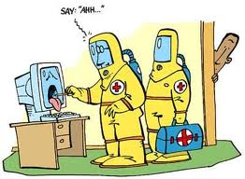
Virus
Malicious code triggered by user action that can copy itself and infect a computer without permission or knowledge of the user.
– Typically affect one or more of:
• Program files, Boot sector files, MBR
Examples:
Michaelangelo Virus (1992)
• Boot Sector virus, remained dormant until 3/6/92 – erased portion of disk, rendering data “lost” for average users.
Melissa Virus (1999)
• A VBA macro virus, targeting MS Word and Outlook

Slide 11
Types and Transmission Methods of Viruses
Viruses require human activity to spread.
Basic ways viruses propagate:
Master boot record infection:
Attacks the master boot record of the hard drive
File infection:
Relies on the user to execute a file
Macro infection:
Exploit scripting services installed on the computer
Polymorphic
Multipart

Slide 12
Types and Transmission Methods of Viruses cont.
Types of viruses:
Fast infection viruses
Spreads quickly and infects all the files it can
Sparse infection:
Takes longer to infect other files to avoid detection
RAM resident infection:
Loads itself in RAM
The only way boot sector viruses can spread
Multipartite virus:
Uses more than one propagating method
Polymorphic viruses:
Changes its signature every time it replicates and infects a new file

Slide 13
Virus Payloads
Prependers:
Place the virus code in the beginning of the infected file
Appenders:
Place the virus code at the end of the infected file
Virus components:
Search routine:
Present in all viruses
Responsible for locating new files, disk space, or RAM to infect
Infection routine:
Present in all viruses
Responsible for copying the virus and attaching it to a suitable host
Payload routine:
Is not required
Contains the actual virus code
Antidetection routine:
Helps the virus avoid detection
Trigger routine:
Launches the payload at a given date and time

Slide 14
History of Viruses
Fred Cohen coined the term computer virus in 1984.
Ralf Burger created one of the first replicated programs, Virdem, in 1985.
The Brain virus:
The first documented computer attack recorded at the University of Delaware
Targets floppy disk’s boot sector
Lehigh virus:
Discovered at Lehigh University
Hid itself in command.com and counted how many files were infected
Wipes out data on the floppy disk when the counter reached a predetermined number
MacMag:
Developed by Drew Davidson in 1988
Shows drawing of the world on Mac machines
Scores:
Another Mac virus reported by EDS
Prevents users from saving data
Staog:
The first well-known Linux virus found in 1996
Attempts to affect binaries as they are executed by the system user
Bliss
Considered the second Linux virus
Locates binary files with write access and overwrites them with its own code

Slide 15
Well-Known Viruses
Late 1980s:
Stoned and Cascade viruses
RTM: First worm released on the Internet
Protocol worm
Developed by Robert Morris
Disabled approximately 6000 computers
1990s:
Norton Antivirus released in 1991
Chameleon and Tequila: Polymorphic viruses
Win95Boza
First Windows 95 virus, released in 1996
Melissa
First macro virus; spread via email and infected the Normal.dot template in Microsoft Word

Slide 16
Well Known Viruses cont.
2000 and beyond
I Love You - Hybrid mass mailing worm
Anna Kournikova- 2001 VBS hybrid worm attacked Microsoft Outlook
Code Red - Exploited .ida buffer overflow vulnerability
Nimba - Worm that targets IIS servers
Klez - Worm released in 2002 and exploited a vulnerability that enabled an incorrect MIME header to cause IE to execute an email attachment
Slammer – Worm that targets SQL
MyDoom – Worm that spreads through email
Sasser – Worm that exploited lsass vulnerability
Virut – Used for cybercrime activities
Conficker – Uses dictionary attack on the Administrator account to propagate

Slide 17
Virus Tools
Viruses can be created from scratch or a virus toolkit canbe used.
Virus toolkits:
VBS worm generator
Virus creation laboratory
Macro virus development kit
Instant virus production kit
Windows virus creation tool kit
Smeg virus construction kit

Slide 18
Virus Phases
–Dormant phase. During this phase, the virus just exists—the virus is laying low and avoiding detection.
–Propagation phase. During this phase, the virus is replicating itself, infecting new files on new systems.
–Triggering phase. In this phase, some logical condition causes the virus to move from a dormant or propagation phase to perform its intended action.
–Action phase. In this phase, the virus performs the malicious action that it was designed to perform, called payload.

Slide 19
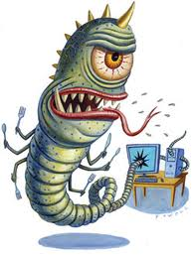
Worm
A self-replicating, self-propagating, self-contained program that uses networking mechanisms to spread itself.
Examples:
SQL Slammer
•Buffer overflow (not SQL-based)
•Patch released 6 months earlier
•Infected orgs included Microsoft
•DDOS, one of fastest spreading ever
Conficker
•Exploits windows network vulnerability
•Uses dictionary attacks on passwords
•Botnet

Slide 20
Buffer Overflow
Occurs when a program puts more data into a buffer than it can hold
Buffer: Temporary storage area the program uses to store data
Types:
Smashing the stack:
Stack: The reserved area of memory where the program saves the return address when a call instruction is received.
Organized in LILO structure: First thing placed in the stack is the last thing removed.
The attacker can place too much information on the stack or change the value of the return pointer to carry out the attack.
The attacker’s code is placed in the buffer.
The code could be used to run commands or execute a series of instructions.
Heap-based:
The memory space is dynamically allocated.

Slide 21
Common Buffer Overflow Attacks
Morris worm:
Uses a buffer overflow in a UNI program fingerd
Code Red worm:
Affects IIS 5.0 allowing the attacker admin privileges
SQL Slammer worm:
Affects Windows SQL 2000 server and allows execution of arbitrary code
Microsoft Windows Print Spooler:
Enables full access after sending a buffer overflow of 420 bytes
Apache 1.3.20
Microsoft Outlook 5.01
Remote procedure Call (RPC)

Slide 22
Example Buffer Overflow
/* my_program.c */
int main (int argc, char *arv[ ])
{
char buffer[50];
if (argc>=2)
strcpy(buffer, argv[1]);
return 0;
}
myprogram.exe Baltimore
myprogram.exe Llanfair­pwllgwyngyll­gogery­chwyrn­drobwll­llan­tysilio­gogo­goch

Slide 23
Preventing Buffer Overflows
If the program is developed in-house, the following could be done:
Audit the code.
Use safer functions.
Improve compiler techniques.
Disable stack execution.
If not custom application:
Turn off application if not used.
Apply latest patches.
Use a firewall.
Test the application.
Use the principle of least privilege.

Slide 24

Trojan Horse
Based on ancient Greek history. After numerous unsuccessful battles, the Greeks hid inside of a huge wooden horse and left it at the gates of Troy as a gift to the Trojans. When the Trojans brought it inside the walls of the fortified facility, the Greeks attacks and took the city.
Same concept applies to computers today.
By opening an unknown program or attachment,
you could “invite” an attack into your computer.

Slide 25
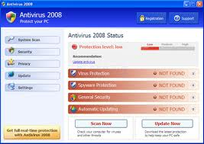
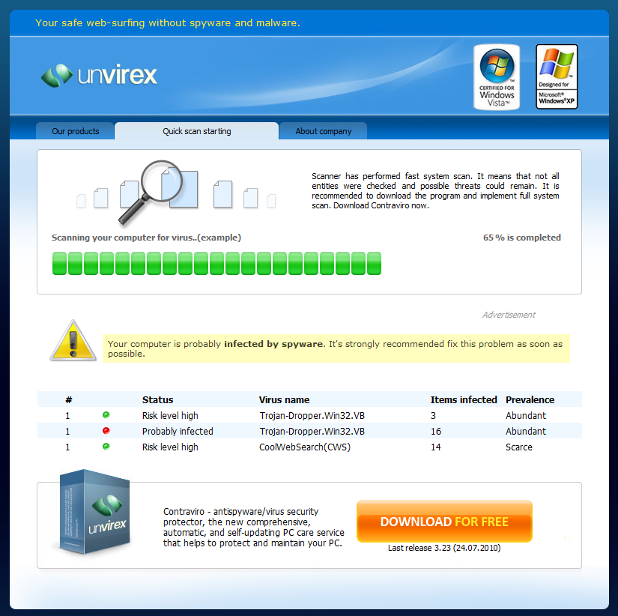
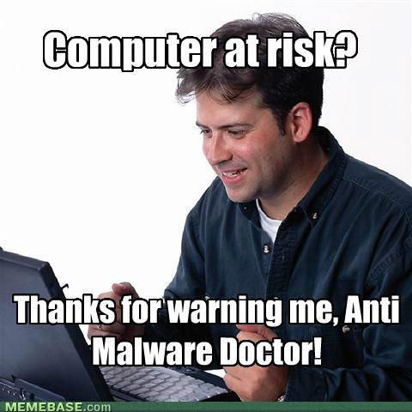
Trojan Horse
Examples:

Slide 26
Overview of Trojans
A program that disguises itself as a legitimate program but delivers malicious content when executed
Cannot spread itself as worms and viruses do
Depends on a user to execute it

Slide 27
Trojan Types
EC–Council groups Trojans into seven types:
Remote access
Data hiding
E-banking
Denial-of-service
Proxy
FTP
Security software disablers

Slide 28
Trojan Ports and Communication Methods
Trojans can communicate using
Overt communications
Covert communications
Backdoors
A program allows a connection that bypasses the normal authentication process.
Some programs connect back to the hacker’s machine.

Slide 29
Trojan Goals
Trojans can have different purposes:
Destroy data.
Obtain credit card data.
Obtain passwords.
Obtain Insider information.
Data storage.
Advanced persistent threat (APT).

Slide 30
Trojan Infection Mechanisms
Trojans can be distributed through
Peer-to-peer networks
Instant messaging
Internet relay chat
Email attachments
Physical access
Browser bugs
Freeware

Slide 31
Trojan Tools
Remote access Trojans have two components:
Server – runs on the victim machine.
Client – runs on the hackers machine.
After installation the Trojan opens a port on the victim’s machine for the hacker to access.
Tini:
Small backdoor coded in assembly language
Used on Windows systems
Listens to TCP port 7777 and opens a remote command prompt
Qaz:
Copies itself to the computer by renaming Notepad.exe to Note.exe and naming itself Notepad.exe
Listens for a connections at port 7597

Slide 32
Trojan Tools cont.
NetBus:
Older Trojan
When executed copies itself to the Windows directory and creates a file KeyHook.dll
Uses TCP and opens ports 12345 and 12346
Can use redirection to send traffic to another machine
SubSeven:
Can mutate and change its signature to avoid detection
Usually distributed as an email attachment
Enables attacker to monitor victim’s keystrokes, watch through a web cam, and listens through the microphone

Slide 33
Trojan Tools cont.
Poison ivy
Gives the hackers access to the local file system.
Hacker can browse, create and delete directories, and edit the Registry.
GhostRat
Enables a hacker to turn on the webcam and record audio and use the microphone to spy on people
Let me rule
Jumper
Phatbot
Amitis
Zombam.B
Beast
MoSucker

Slide 34
Distributing Trojans
Wrappers:
A program used to combine two or more executables into a single packaged program
When installed malicious program is loaded with the legitimate program
EliteWrap
Saran Wrap
Advanced File Joiner
Teflon Oil Patch
Restorator
Pretty Good Malware Protection (PGMP)

Slide 35
Trojan Toolkits
Trojan horse construction kit:
Command-line utility that can be used to create a Trojan with multiple features
Senna Spy:
Requires Visual Basic
Enables many custom options such as file transfer, keyboard control, and executing DOS commands
Stealth tool:
Not a real Trojan toolkit but a stealth tool designed to make Trojans harder to detect
Steps to successfully deploy a Trojan:
Creation of a Trojan
Modification of a Trojan to avoid detection
Bind a Trojan with legitimate file
Transmit a Trojan to victim

Slide 36
Covert Communications
Trusted Computer System Evaluation Criteria (TCSEC) divided covert communications in two categories:
Covert timing channel attacks
Difficult to detect
Based on system time and function by altering a component or modifying resource timing
Covert storage channel attacks
Uses two process: one to write data and a second to read the data
Covert communications can use IP, TCP, UDP, and ICMP protocols

Slide 37
Covert Communication Tools
Port redirection:
Listens on certain ports and redirects the packets to a secondary target
Tools
Datapipe
UNIX port redirection tool
Fpipe
Port redirection tool for Windows platforms
Netcat/Socat
Command-line utility for Windows and UNIX
Performs port redirection and other tasks

Slide 38
Other Redirection and Covert Tools
Loki
Acts as a backdoor or covert channel
Uses ICMP
ICMP backdoor
Uses only ping reply packets
007Shell
ICMP covert communication tool
Rounds packet to 64 bytes to avoid detection
ICMPSend
Uses ping packets
Reverse WWW Tunneling Shell
Allows communication with a shell through a firewall
AckCmd
Covert channel programs
Provides command shell to Windows systems
Uses only TCP ACK segments

Slide 39
Keystroke Logging
Software or hardware device that record user’s keystrokes
Can be configured to email the information back to the attacker
Can be configured to run in a stealth mode
Hardware keystroke loggers
Keyghost
Software
IKS Software Keylogger
Ghost Keylogger
Spector Pro
Fake GINA
Eblaster

Slide 40
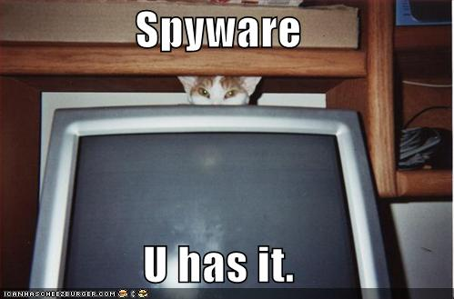
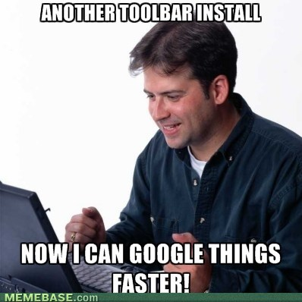
Spyware/Adware
Spyware
–Tracks user data such as keystrokes, screen capture
–May also install a backdoor, data harvester
Adware
–Tracks browsing or buying habits, typically with cookies
–New form: Google Adsense

Slide 41
Spyware
Form of malicious code similar to a Trojan
Installed without the user knowledge or consent
Configured to run in the background and monitors computer and Internet usage
Purposes:
Surveillance
Advertising
Antispyware programs:
Adaware
Microsoft Antispyware Beta
HijackThis
Pest Patrol
Spy Sweeper
Spybot Search and Destroy
Spyware Blaster
MacAfee Antispyware

Slide 42

Root Kit
Modifies an operating system to hide the existence of malware.
Hides malicious processes from Task Manager
Hides malicious files from view in Windows Explorer

Slide 43
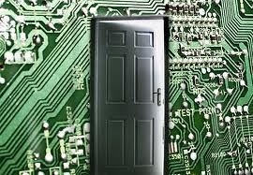
Backdoor
Allows access to a machine, referring to “Front Doors” being used by normal users….
Could be put in place on purpose by the software developer
In this context, it is put in place on purpose by an attacker
Examples:
Netcat
Metasploit Listener on victim
Trojan horse delivered malware
APT

Slide 44
Trojan and Backdoor Countermeasures
Have the latest version of antivirus software installed.
Educate users.
Scan for suspicious ports, processes, files and folders, Registry entries, device drivers, Windows services, and Startup programs.
Tools to investigate infected system:
Process Monitor
Task Manager
Ps
Netstat
CurrPorts
TCPView
Process Viewer
IceSword

Slide 45
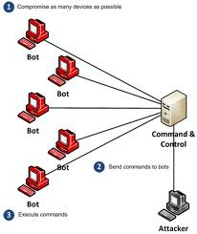
BOTs/BOTNETS
Specific malware can turn a computer in to a zombie, which is a machine that is controlled externally to perform malicious attacks, usually as a part of a botnet.
One system acts as the Command & Control server
Individual bots “call home” for updated instruction
periodically
The attacker (Bot Herder) updates the C&C server
with an attack, then sits back and watches
Examples:
Zeus Botnet (2010)
Mariposa (2008)

Slide 46
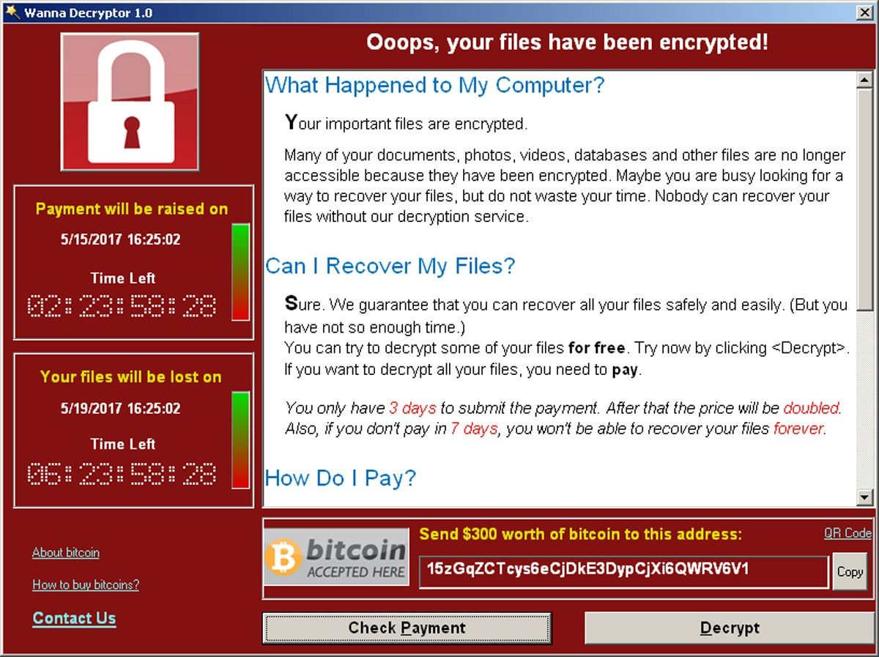
RANSOMWARE
Malware specifically created to encrypt data and then deliver a “ransom”
If the ransom isn’t paid, goodbye data
If the ransom is paid, MAYBE you get to keep your data…
Crypto ransomware affects files
Locker ransomware affects devices
Examples:
Wannacry (2017)
AIDS Information Trojan (1989)

Slide 47

Break

Slide 48
Preventing Viruses
Install antivirus software.
Keep virus definitions up to date.
Don’t open attachments from unknown sources.
Patch the system regularly.
Avoid sending attachments.
Have a backup of your system in case of infections.

Slide 49

Anti-Malware?
Software that is designed to get rid of unwanted software
Anti-Virus
Symantec, Norton, McAfee, Kaspersky, AVG
Anti-Spyware
Webroot, Microsoft
Anti-Malware
Malwarebytes

Slide 50
Antivirus
A number of antivirus programs are available:
Norton Antivirus
McAfee VirusScan
Trend Micro PC-cillin
Sophos Antivirus
AVG Antivirus
Antivirus programs use one of the following techniques to check for viruses:
Signature scanning:
Checks the beginning and end of executable files for known virus signatures
Heuristic scanning:
Examines computer files for irregular or unusual instructions
Integrity checking:
Checks files against a database of hash values
Activity blocking:
Intercepts a virus when it starts to execute and blocks it

Slide 51

How do they find malware?
Signature Based
- Detection based on code matching a “known bad” sequence of code.
- Very Accurate
- Very Slow, especially for zip files
Heuristics Based
- Detection based on portions of code being
similar to “known bad” sequences of code
- Very Fast
- Higher False Positive rate
Factors in deciding which to use:
Polymorphic malware
Packers/obfuscators
Speed you need to access data

Slide 52
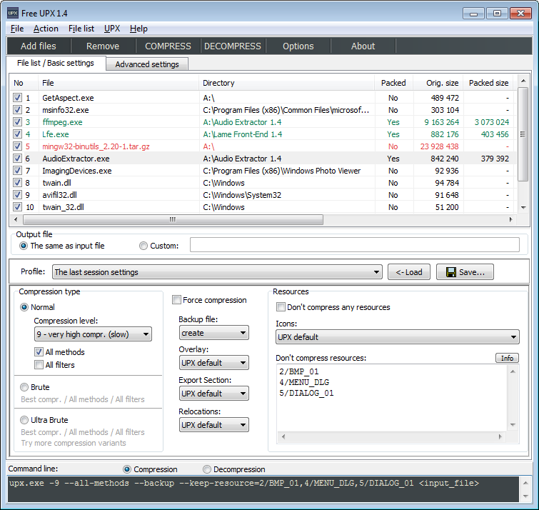
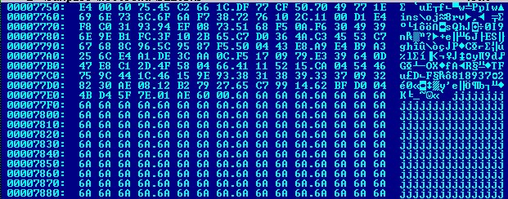
Adapting Malware
Polymorphism
After each infection, modify
a portion of the code before
moving on.
Packer/Obfuscator
Before sending malware,
“pack” the executable with
extra data to modify the
signature of the file.

Slide 53
Malware Analysis
Two basic methods to analyze viruses and malware
Static analysis
Involves decompiling, reverse engineering, and analyzing the malicious software
Dynamic analysis
Monitoring the network traffic to identify unusual or suspicious activity

Slide 54
Covering your tracks
Hiding traces of your presence on a system or network
Commands that were run
Files that were modified
Accounts that were added
Access logs of a service
Web server scanning
SQL probing
File Sharing access
LOGS

Slide 55
Covering Tracks
Disable logging:
Auditpol command-line tool
Clear the log file:
Winzapper, Evidence Eliminator, and Elsave
Use rootkits:
FU and Vanquish
File Hiding
Locate hidden attribute.
Use Alternative Data Streams (ADS).
Hide in slack space.

Slide 56
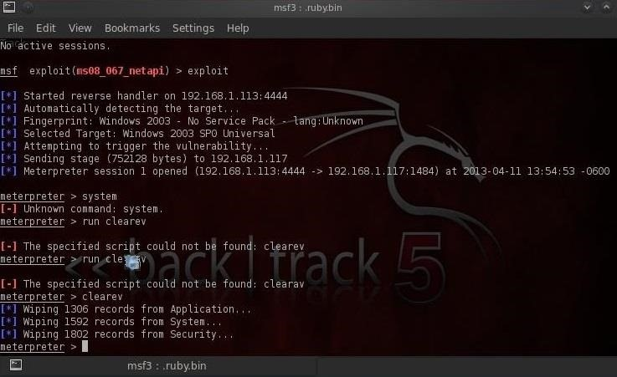
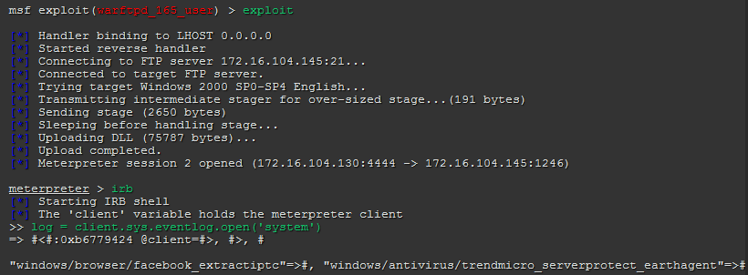
Covering your tracks
Automated methods to remove log files?
Metasploit Meterpreter Shell
clearev
IRB (Post Exploitation script)
log.clear

Slide 57
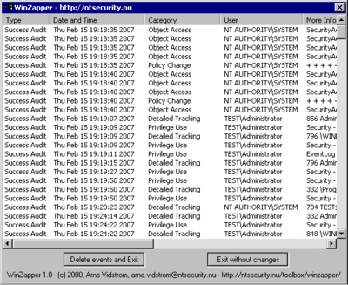
Covering your tracks
Elsave.exe
Clears event log
Winzapper.exe
Clears event log, or selectively delete a log at a time
EvidenceEliminator.exe
Clears data at the drive level that can’t be seen via Forensics Tools such as FTK or EnCase

Slide 58
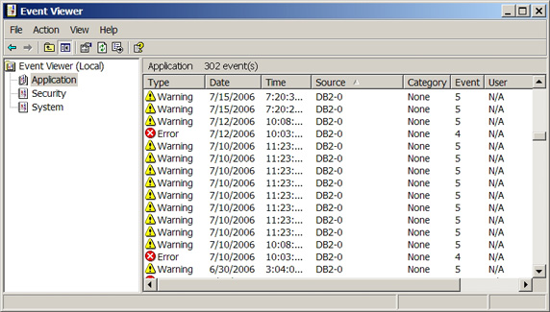
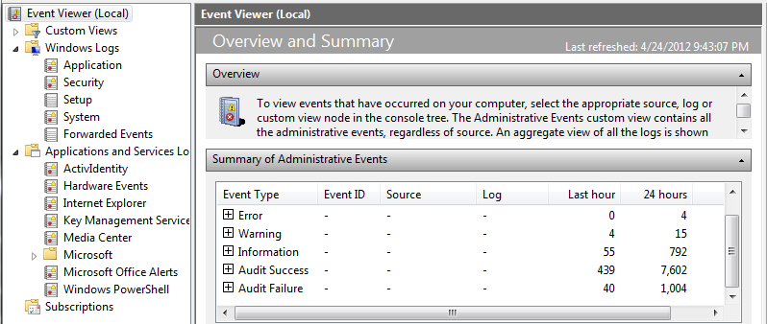
Windows OS LOGs
Windows XP/2003
Event Viewer
Application
System
Security
Windows 7/2008
Event Viewer
Application
System
Security
Setup
Forwarded Events
Applications/Services
.evt file names

Slide 59
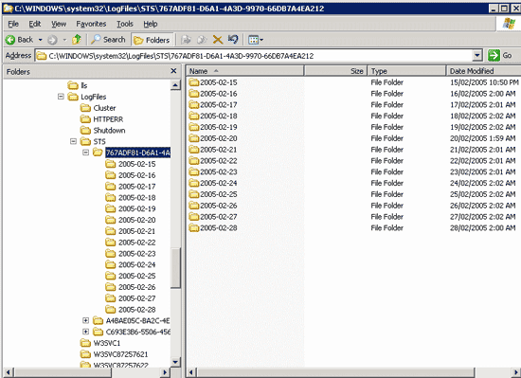
Windows Application LOGs
Windows XP/7/2003/2008
Event Viewer
Application
Application/Services
%SYSTEMROOT%\system32\
or
%SYSTEMROOT%\syswow64\
\LogFiles\

Slide 60
Linux Os/application LOGs
/var/log/
/var/log/message: General message and system related stuff
/var/log/auth.log: Authentication logs
/var/log/kern.log: Kernel logs
/var/log/cron.log: Crond logs (cron job)
/var/log/maillog: Mail server logs
/var/log/qmail/ : Qmail log directory (more files inside this directory)
/var/log/httpd/: Apache access and error logs directory
/var/log/lighttpd: Lighttpd access and error logs directory
/var/log/boot.log : System boot log
/var/log/mysqld.log: MySQL database server log file
/var/log/secure: Authentication log
/var/log/sshd: SSH Daemon log
/var/log/utmp or /var/log/wtmp : Login records file
/var/log/yum.log: Yum log files

Slide 61
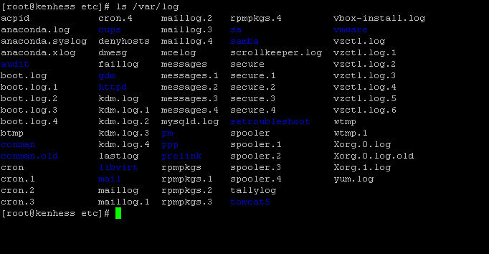
Linux Os/application LOGs

Slide 62
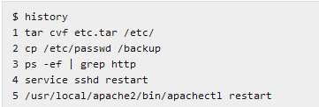
Linux bash history
Keeps every command a user typed in the command line terminal into a file named .bash_history.
“What is good about this is that user can re-used the command in case they are lazy to type a very long argument presented with the command. It also faster to use bash command history rather than typing the same command all over again.”

Slide 63
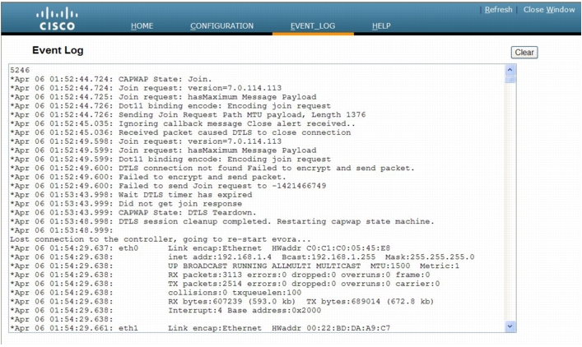
network logs
Network devices log as well
Switches
Routers
Intrusion Detection/Prevention Systems
Access Points

Slide 64
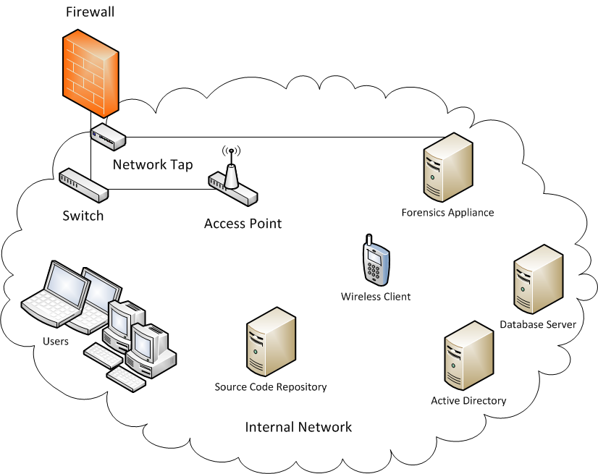
Logs, Logs, and Logs
Every computer system on a network has its own set of logs
Every server on a network has its own set of logs
Network devices have specific sets of logs (firewall, access points, IDS/IPS, etc)

Slide 65
Log Collection Servers
Copy log files from all endpoints on a network and store them on a centralized log management server for review/analysis.
Log files are copied onto collection server on a schedule task/cron job, to later be analyzed.
Linux
Syslog/Syslog-ng
Windows
Server Solutions Log Collector
Easily scales to 100s to 1000s of log files being copied over the network
(Bandwidth concerns)
(Information overload concerns)

Slide 66
Log Collection Servers
What if we could build a “Log Collection System” that analyzes log files in real time?
Security Event Manager (SEM)
Security Information Manager (SIM)
Security Information and Event Manager (SIEM)
A SEM can provide secure, forensically sound storage and archival of event logs
Events can be parsed as they hit the SEM for significance, and alerts and notifications can be immediately sent out to interested parties as warranted
Related events which occur on multiple systems can be detected which would be impossible to detect if each system had a separate log
Events which are sent from a system to a SEM remain on the SEM even if the sending system fails or the logs on it are accidentally or intentionally erased

Slide 67
Perspectives
Attacker Perspective
1. Once on a system, provide additional means of accessing the systems such as a backdoor or worm
2. Hide your communication channel process via a rootkit
3. If you can’t exploit a vulnerability to get on, send an attack via a trojan horse or virus, or via spyware/adware
4. Utilize 100s or 1000s of bots to generate a distributed attack against a sole target
5. Understand what tools you need to use to delete any and all evidence of what you just did on the system
6. Know what files contain evidence pertinent to your attack so you can selectively delete them
7. Understand how Log Collection Systems work and what to look for on your exploited system to know if you are safe
…LEARN… + ATTACK!!!!!!

Slide 68
Perspectives
Defender Perspective
1. Monitor network activity and look for anomalous activity
2. Monitor systems for unknown processes or unknown files
3. Prevent users from installing trojan horses by not allowing them to run as administrator
4. Know what log files are important for daily review
5. Understand what tools/methodology a hacker can use to tamper with the log files on your systems
6. Understand how quickly logs can get out of hand and the potential need for implementing a SEM system
…VERIFY… + MONITOR

Slide 69
Perspectives
Investigator Perspective
1. Perform network forensics of affected systems to see what network traffic came/went and on which ports to which destinations
2. Perform system forensics on affected systems to see what new services or programs were installed
3. Check for scheduled tasks that are suspicious that would indicate how/when an attack was initiated
4. Utilize a SEM appliance to conduct an investigation and compare log information on it with log information of suspect system
5. Look at log files for suspicious gaps in coverage
…COMPARE…

Slide 70
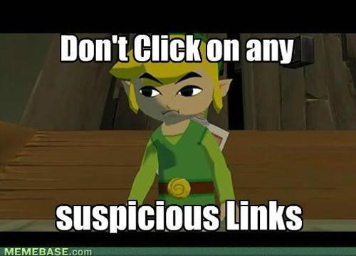
Summary
Malware Components
CIA Triad
Virus
Virus Phases
Worm
Trojan Horse
Root Kit
Backdoor
Covert Communications
Spyware/Adware
Keyloggers
Bots
Countermeasures
Anti-Malware
Signature vs Heuristics
Adapting Malware
Malware Analysis

Slide 71
Summary
Explain how buffer overflow attacks work.
Know common buffer overflow attacks and how to prevent them.
Know the difference between viruses and worms.
Describe virus types and transmission methods.
Be familiar with well-known viruses.
Know virus tools.
Explain how to protect against viruses.
Describe how antivirus software works.

Slide 72
Summary
Automated Log “cleaners”
Windows Logs
Event Viewer
%SystemRoot%\system32\LogFiles
%SystemRoot%\syswow64\LogFiles
Linux Logs
/var/log/
Network Logs
Firewall
IDS/IPS
Access Points
Routers
Switches
Centralized Collection
Syslog/Syslog-ng
Log Collector
SEM/SIM/SIEM

Slide 73
Lab

