Slide 1
Random variables, distributions and limit theorems
Gil McVean, Department of Statistics
Wednesday 11th February 2009

Slide 2
Questions to ask…
What is a random variable?
What is a distribution?
Where do ‘commonly-used’ distributions come from?
What distribution does my data come from?
Do I have to specify a distribution to analyse my data?

Slide 3
What is a random variable?
A random variable is a number associated with the outcome of a stochastic process
  Waiting time for next bus
  Average number hours sunshine in May
  Age of current prime-minister
In statistics, we want to take observations of random variables and use this to make statements about the underlying stochastic process
  Did this vaccine have any effect?
  Which genes contribute to disease susceptibility?
  Will it rain tomorrow?
Parametric models provide much power in the analysis of variation (parameter estimation, hypothesis testing, model choice, prediction)
  Statistical models of the random variables
  Models of the underlying stochastic process

Slide 4

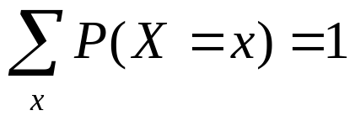

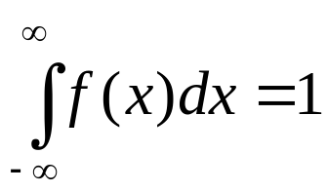
What is a distribution?
A distribution characterises the probability (mass) associated with each possible outcome of a stochastic process
Distributions of discrete data characterised by probability mass functions
Distributions of continuous data are characterised by probability density functions (pdf)
For RVs that map to the integers or the real numbers, the cumulative density function (cdf) is a useful alternative representation
0
1
2
3
x
x

Slide 5


Some notation conventions
Instances of random variables (RVs) are usually written in uppercase
Values associated with RVs are usually written in lowercase
pdfs are often written as f(x)
cdfs are often written as F(x)
Parameters are often defined as θ
Hence
Probability that the ith random variable takes value x given sample size n and parameter(s) θ
The probability density associated with outcome x given some parameter(s) θ

Slide 6
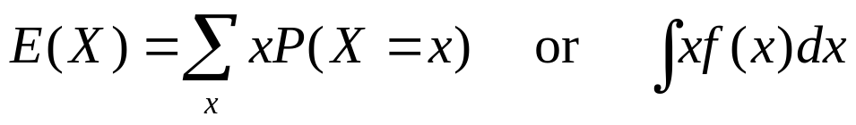
Expectations and variances
Suppose we took a large sample from a particular distribution, we might want to summarise something about what observations look like ‘on average’ and how much variability there is
The expectation of a distribution is the average value of a random variable over a large number of samples
The variance of a distribution is the average squared difference between randomly sampled observations and the expected value

Slide 7


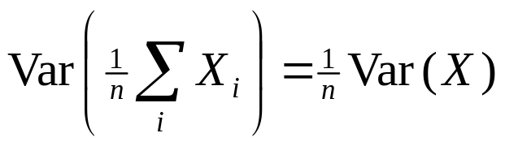
iid
In most cases, we assume that the random variables we observe are independent and identically distributed
The iid assumption allows us to make all sorts of statements both about what we expect to see and how much variation to expect
Suppose X, Y and Z are iid random variables and a and b are constants

Slide 8
Where do ‘commonly-used’ distributions come from?
At the core of much statistical theory and methodology lie a series of key distributions (e.g. Normal, Poisson, Exponential, etc.)
These distributions are closely related to each other and can be ‘derived’ as the limit of simple stochastic processes when the random variable can be counted or measured
In many settings, more complex distributions are constructed from these ‘simple’ distributions
  Ratios: E.g. Beta, Cauchy
  Compound: E.g. Geometric, Beta
  Mixture models

Slide 9
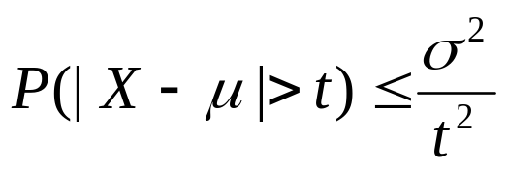
An aside on Chebyshev’s inequality
Let X be a random variable with mean μ and variance σ²
Chebyshev’s inequality states that for any t > 0
This allows us to make statements about any distribution with finite variance
  The probability that a value lies more than 2 standard deviations from the mean is less than or equal to 0.25
Note that this is an upper bound. In reality, the distribution might be considerably tighter
  E.g. for the normal distribution the probability is 0.046, for the exponential distribution the probability is 0.05

Slide 10
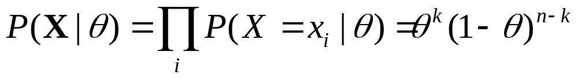
The simplest model
Bernoulli trials
  Outcomes that can take only two values: (0 and 1) with probabilities θ and 1 - θ respectively. E.g. coin flipping, indicator functions
The likelihood function calculates the probability of the data
What is the probability of observing the sequence (if θ = 0.5)
  01001101100111101001?
  11111111111000000000?
Are they both equally probable?

Slide 11
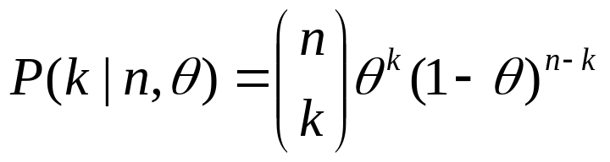
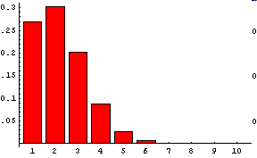
The binomial distribution
Often, we don’t care about the exact order in which successes occurred. We might therefore want to ask about the probability of k successes in n trials. This is given by the binomial distribution
For example, the probability of exactly 3 heads in 4 coins tosses =
  P(HHHT)+P(HHTH)+P(HTHH)+P(THHH)
  Each order has the same Bernoulli probability = (1/2)⁴
  There are 4 choose 3 = 4 orders
Generally, if the probability of success is θ, the probability of k successes in n trials
The expected number of successes is nθ and the variance is nθ(1-θ)
n = 10
θ = 0.2

Slide 12

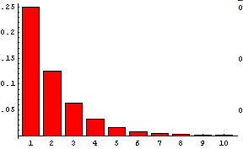
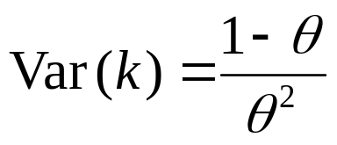
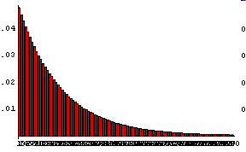
The geometric distribution
Bernoulli trials have a memory-less property
  The probability of success (X = 1) next time is independent of the number of successes in the preceding trials
The number of trials between subsequent successes takes a geometric distribution
  The probability that the first success occurs at the k^{th} trial
You can expect to wait an average of 1/θ trials for a success, but the variance is
θ = 0.5
θ = 0.05
0
20
100

Slide 13
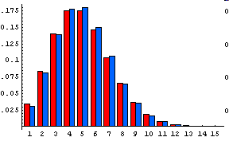
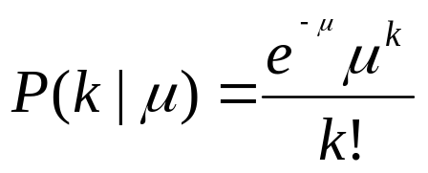
The Poisson distribution
The Poisson distribution is often used to model ‘rare events’
It can be derived in two ways
  The limit of the Binomial distribution as θ→0 and n→∞ (nθ = μ)
  The number of events observed in a given time for a Poisson process (more later)
It is parameterised by the expected number of events = μ
  The probability of k events is
The expected number of events is μ, and the variance is also μ
For large μ, the Poisson is well approximated by the normal distribution
red = Poisson(5)
blue = bin(100,0.05)

Slide 14
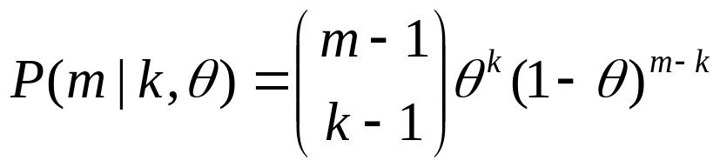
Other distributions for discrete data
Negative binomial distribution
  The distribution of the number of Bernoulli trials until the kth success
  If the probability of success is θ, the probability of taking m trials until the kth success is
  (like a binomial, but conditioning on the last event being a success)
Hypergeometric distribution
  Arises when sampling without replacement
  Also arises from Hoppe Urn-model situations (population genetics)

Slide 15
Going continuous
In many situations while the outcome space of random variables may really be discrete (or at least measurably discrete), it is convenient to allow the random variables to be continuously distributed
For example, the distribution of height in mm is actually discrete, but is well approximated by a continuous distribution (e.g. normal)
Commonly-used continuous distributions arise as the limit of discrete processes

Slide 16
The Poisson process
Consider a process when in every unit of time some event might occur
E.g. every generation there is some chance of a gene mutating (with probability of approx 1 in 100,000 )
The probability of exactly one change in a sufficiently small interval h ≡ 1/n is P = vh ≡ v/n, where P is the probability of one change and n is the number of trials.
The probability of two or more changes in a sufficiently small interval h is essentially 0
In the limit of the number of trials becoming large the total number of events (e.g. mutations) follows the Poisson distribution
h
h
Time

Slide 17
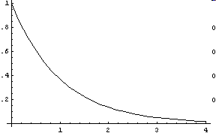
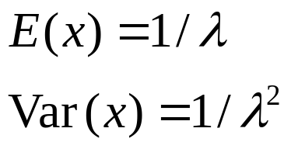

The exponential distribution
In the Poisson process, the time between successive events follows an exponential distribution
  This is the continuous analogue of the geometric distribution
  It is memory-less. i.e. f(x + t | X > t) = f(x)
f(x)
x

Slide 18
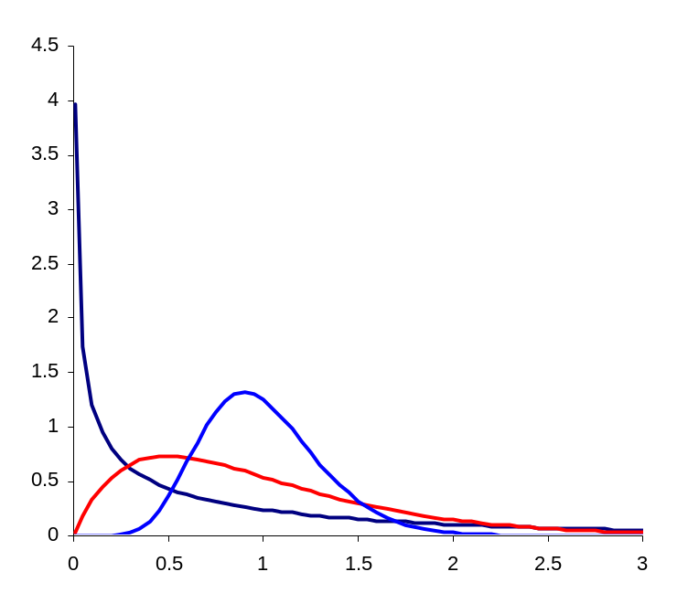
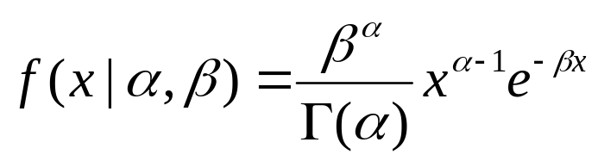
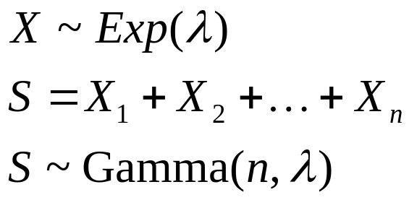
The gamma distribution
The gamma distribution arises naturally as the distribution of a series of iid random exponential variables
The gamma distribution has expectation α/β and variance α/β²
More generally, α need not be an integer (for example, the Chi-square distribution with one degree of freedom is a Gamma(½, ½) distribution)
α = β = 0.5
α = β = 2
α = β = 10

Slide 19
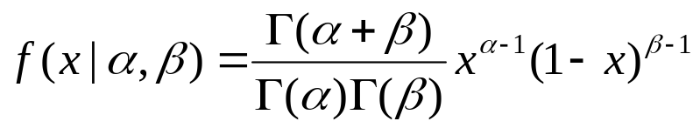
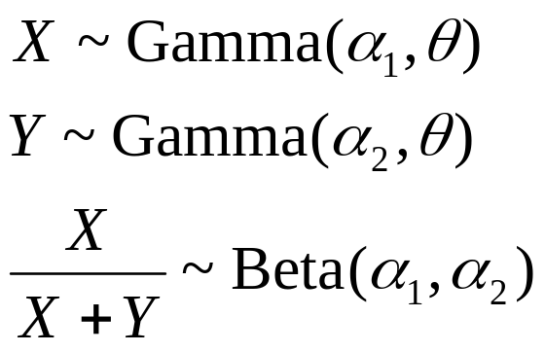
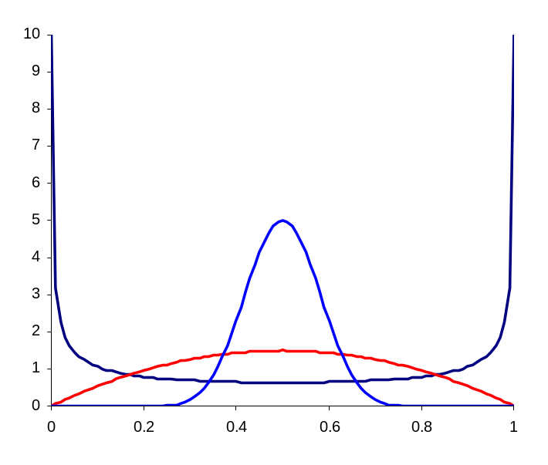
The beta distribution
The beta distribution models random variables that take the value [0,1]
It arises naturally as the proportional ratio of two gamma distributed random variables
The expectation is α/(α + β)
In Bayesian statistics, the beta distribution is the natural prior for binomial proportions (beta-binomial)
  The Dirichlet distribution generalises the beta to more than 2 proportions
α = β = 0.5
α = β = 10
α = β = 2

Slide 20
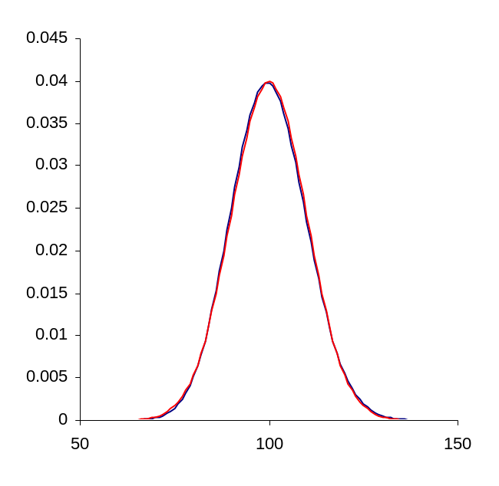
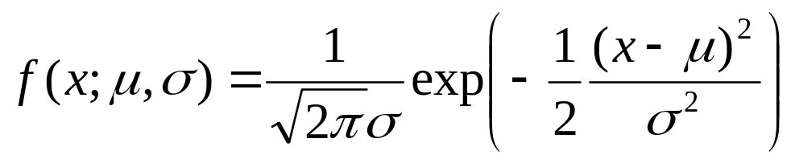
The normal distribution
As you will see in the next lecture, the normal distribution is related to most distributions through the central limit theorem
The normal distribution naturally describes variation of characters influenced by a large number of processes (height, weight) or the distribution of large numbers of events (e.g. limit of binomial with large np or Poisson with large μ)
blue = Poiss(100)
red = N(100,10)

Slide 21
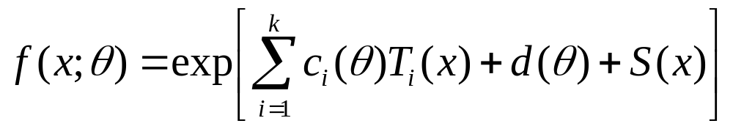
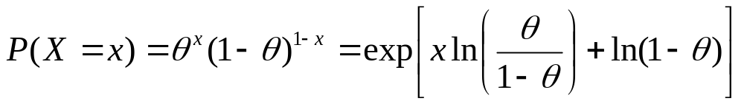
The exponential family of distributions
Many of the distributions covered (e.g. normal, binomial, Poisson, gamma) belong to the exponential family of probability distributions
a k-parameter member of the family has a density or frequency function of the form
E.g. the Bernoulli distribution (x = 0 or 1) is
Such distributions have the useful property that simple functions of the data, T(x), contain all the information about model parameter
  E.g. in Bernoulli case T(x) = x

Slide 22
What distribution does my data come from?
When faced with a series of measurements the first step in statistical analysis is to gain an understanding of the distribution of the data
We would like to
  Assess what distribution might be appropriate to model to data
  Estimate parameters of the distribution
  Check to see whether the distribution really does fit
We might refer to the distribution + parameters as being a model for the data

Slide 23
Which model?
Step 1: Plot the distribution of the random variables (e.g. a histogram)
Step 2: Choose a candidate distribution
Step 3: Estimate the parameters of the candidate distribution (e.g. by method of moments)
Step 4: Compare the empirical distribution to that observed (e.g. using a QQplot)
Step 5: Test model fit
Step 6: Refine, transform, repeat

Slide 24
Method of moments
We wish to compare observed data to a possible model
We should choose the model parameters such that they match the data
A simple approach is to match the sample moments to those of the model
  Start with the lowest moments
Model | Parameters | Matching
Poisson | μ | sample mean = μ
Binomial | p | sample successes = np
Exponential | λ | waiting time = λ
Gamma | α, β | sample mean = α/β, sample variance = α/β²

Slide 25
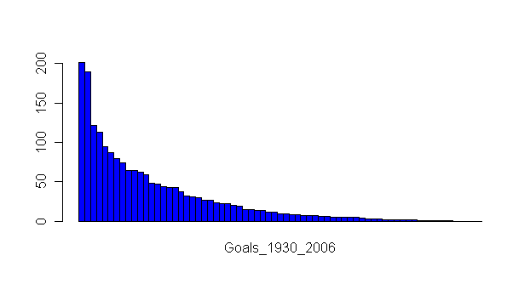
Example: world cup goals 1930-2006
Total number of goals scored by country over period
Brazil
Congo

Slide 26
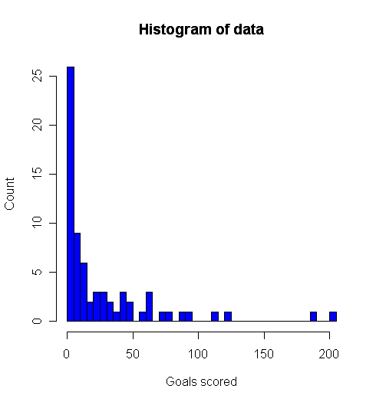
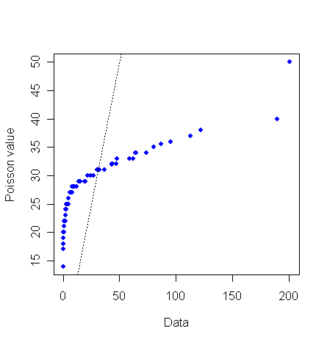
Fitting a model
The data are discrete – perhaps a Poisson distribution is appropriate
To fit a Poisson, we just estimate the parameter from the mean (28.0)
Compare the distributions with histograms and QQplots
QQplot

Slide 27
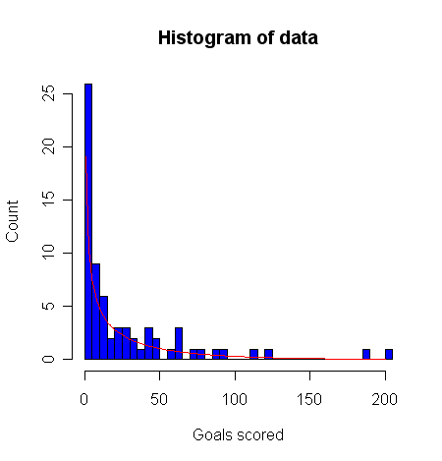
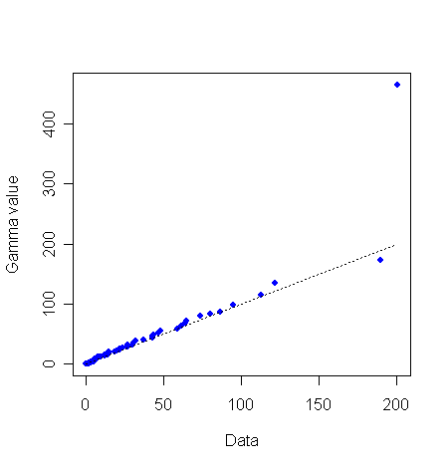
A better model
The number of goals scored is over-dispersed relative to the Poisson
We could try an exponential? This too is under-dispersed.
We can generalise the exponential to the gamma distribution. We estimate (by moments) the shape parameter to be 0.47 (approximately the Chi-squared distribution!)
QQplot

Slide 28
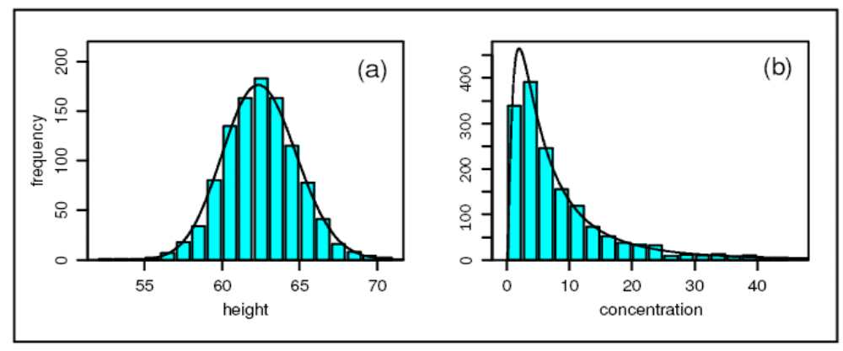
What do I do if I can’t find a model that fits?
Sometimes data needs to be transformed before it fits an appropriate distribution
  E.g. log transformations, power transformations
Also the removal of (a few!) outliers is a common (and justifiable) approach
Female height in inches
Concentration of HMF in honey
Limpert et al (2001). BioScience 51: 341

Slide 29
Testing model fit
A QQplot provides a visual inspection of model fit. However, we might also wish to ask whether we can reject the hypothesis that the model is an accurate description of the data
Testing model fit is a special case of hypothesis testing
Briefly, specify some statistic of the data that is sensitive to model fit and hasn’t been used directly to estimate parameters (e.g. location of quantiles) and compare observed data to repeated simulations from distribution
It is worth noting that a model may be wrong (all models are wrong) but still useful.

Slide 30
Do I have to specify a distribution to analyse my data?
For some situations in statistical inference it is possible to make inferences without specifying the distribution that data has been drawn from
Such approaches are called nonparametric
Some examples of nonparametric approaches include
  Sign tests
  Rank-based tests
  Bootstrap techniques
  Bayesian nonparametrics
They are typically more robust than parametric approaches, but have lower power
It is important to stress that these methods are not ‘parameter-free’ – rather they are not tied to specific distributions

Slide 31
Limit theorems and their applications
Gil McVean, Department of Statistics
Monday 3rd November 2008

Slide 32
Questions
What happens to our inferences as we collect more and more data?
How can we make statements about our certainty (or uncertainty) in parameter estimates?
What do the extreme values look like?

Slide 33

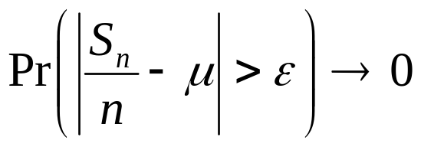
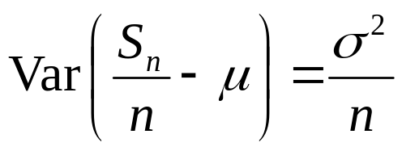
Things can only get better - the law of large numbers
Suppose we have a series of iid samples from a distribution that has a mean μ
The weak law of large numbers states that as n → ∞ and for any ε
The result follows from application of Chebyshev’s inequality to the variance of the sample mean

Slide 34
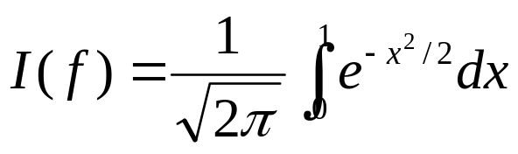
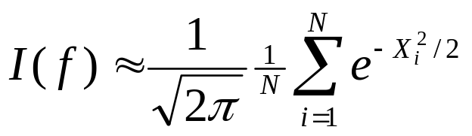
Using the law of large numbers
Monte Carlo integration is widely used in modern statistics where analytical expressions for quantities of interest cannot be obtained
Suppose we wish to evaluate
We can estimate the integral by drawing N pseudorandom U[0,1] numbers
More generally, the law of large numbers tells us that any distribution moment (or function of the distribution) can be estimated from the sample

Slide 35
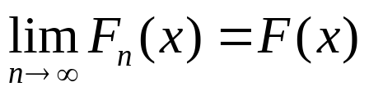
Convergence in distribution
Suppose that F₁, F₂, ... is a sequence of cumulative distribution functions corresponding to random variables X₁, X₂, ..., and that F is a distribution function corresponding to a random variable X
X_{n} converges in distribution to X if (for every point at which F is continuous)
A simple example is that the empirical CDF obtained from the sample converges in distribution to the distribution CDF
  This provides the justification for the nonparametric bootstrap (Efron)

Slide 36
The Bootstrap method of resampling
Suppose we have n observations from a distribution we do not wish to attempt to parameterise. We wish to know the mean of the distribution
We would like to know something about how good our estimate of some function, e.g. the mean, is from this sample
We can estimate the sampling distribution of the function simply by repeatedly re-sampling n observations from our data set with replacement
(This will tend to have slow convergence for heavy-tailed distributions)

Slide 37
Warning!
Note, the convergence of sample moments to distribution moments may be slow
http://www.ds.unifi.it/VL/VL_EN/poisson/index.html

Slide 38
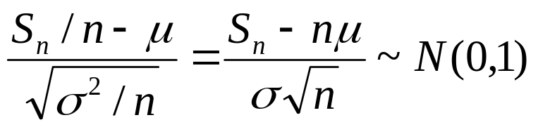
The central limit theorem
Suppose we have a series of iid samples from a distribution that has a mean μ and standard deviation σ
The central limit theorem states that as n → ∞, the scaled sample mean converges in distribution to the standard normal distribution
This result holds for any distribution (with finite mean and variance)
Distribution mean
Sample mean
Variance of the mean
Standard normal distribution

Slide 39
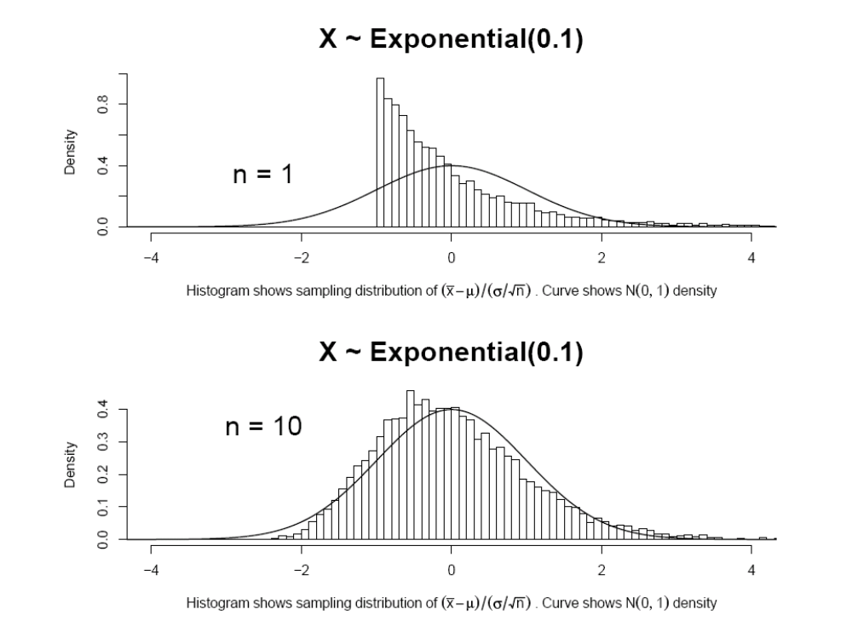

Slide 40
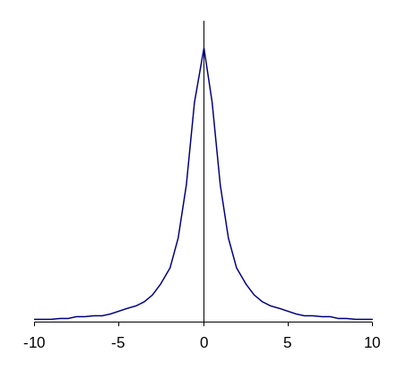
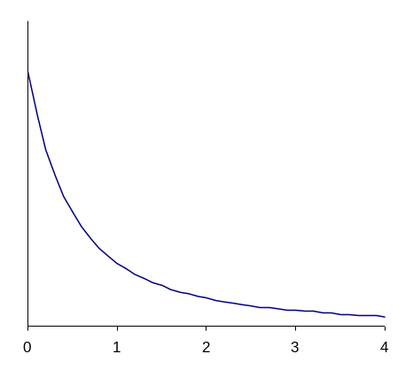
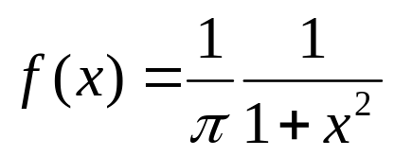
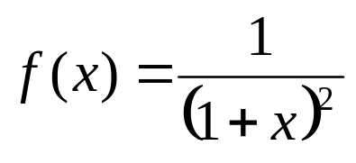
A warning!
Not all distributions have finite mean and variance
For example, neither the Cauchy distribution (the ratio of two standard normal random variables) nor the distribution of the ratio of two iid exponentially distributed random variables have any moments!
For such distributions, the CLT does not hold
Cauchy

Slide 41
Consequences of the CLT
When asking questions about the mean(s) of distributions from which we havea sample, we can use theory based on the normal distribution
  Is the mean different from zero?
  Are the means different from each other?
Traits that are made up of the sum of many parts are likely to follow a normal distribution
  True even for mixture distributions
Distributions related to the normal distribution are widely relevant to statistical analyses
  χ² distribution [Distribution of the sum of squared normal RVs]
  t-distribution [Sampling distribution of mean with unknown variance]
  F-distribution [Ratio of two chi-squared RVs]

Slide 42
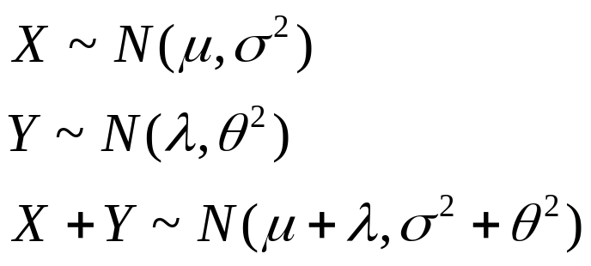
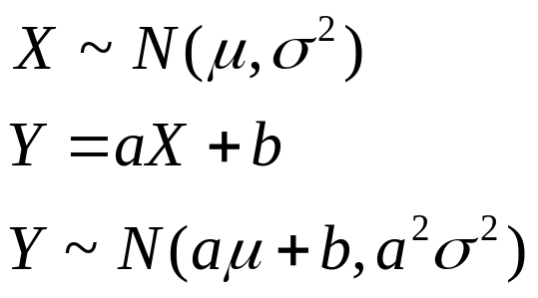
Properties of the normal distribution
The sum of two normal random variables also follows a normal distribution
Linear transformations of normal random variables also result in normal random variables

Slide 43
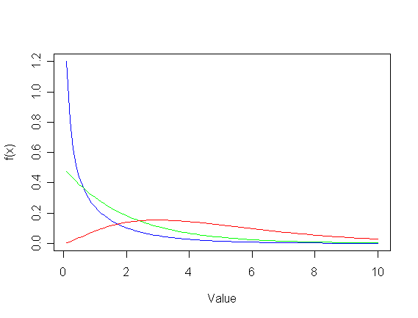
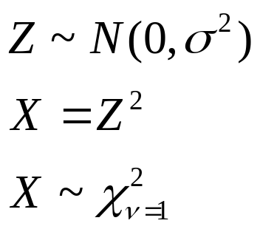
Other functions of normal random variables
The distribution of the square of a standard normal random variable is the chi-squared distribution
The chi-squared distribution (χ²₁) with 1 df is a gamma distribution with α = ½ and β = ½
The sum of n independent chi-squared (1 df) random variables is the chi-squared distribution with n degrees of freedom
  A gamma distribution with α = n/2 and β = 1/2
υ=1
υ=2
υ=5

Slide 44
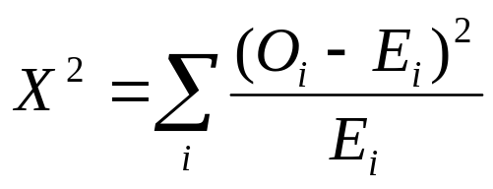
Uses of the chi-squared distribution
Under the assumption that a model is a correct description of the data, the difference between observed and expected means is asymptotically normally distributed
The square of the difference between model expectation and observed value should take a chi-squared distribution
Pearson’s chi-squared statistic is a widely used measure of goodness-of-fit
For example, in a n x m contingency table analysis, the distribution of the test statistic under the null is asymptotically (as the sample size gets large) chi-squared distributed with (n-1)(m-1) degrees of freedom

Slide 45

Extreme value theory
In many situations you may be particularly interested in the tails of a distribution
  P-values for rare events
Remarkably, the distribution of certain rare events is largely independent of the distribution from which the data are drawn
Specifically, the maximum of a series of iid observations takes one of three limiting forms
  Gumbel distribution (Type I): e.g. Exponential, Normal
  Frechet distribution (Type II): Heavy-tailed, e.g. Pareto
  Weibull distribution (Type III): Bounded distributions, e.g. Beta
These limiting forms can be expressed as special cases of a generalised extreme value distribution

Slide 46
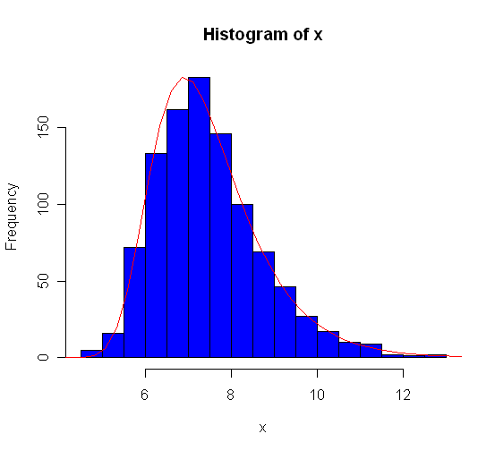
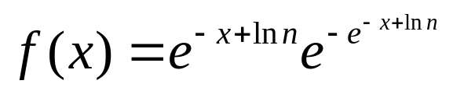
Example: Gumbel distribution
Distribution of max of 1000 samples from Exp(1)

Slide 47




More generally..
Re-centered by expected maximum
Re-scaled by...
e.g. 1000 samples from Normal(0,1)

