Slide 1
Hypothesis Testing

Slide 2

Steps for Hypothesis Testing
Fig. 15.3
Formulate H₀ and H₁
Select Appropriate Test
Choose Level of Significance
Calculate Test Statistic TS_{CAL}
Determine Prob Assoc with Test Stat
Determine Critical Value of Test Stat
TS_{CR}
Determine if TS_{CR}
falls into (Non) Rejection Region
Compare with Level of Significance, α
Reject/Do not Reject H₀
Draw Marketing Research Conclusion

Slide 3
Step 1: Formulate the Hypothesis
A null hypothesis is a statement of the status quo, one of no difference or no effect. If the null hypothesis is not rejected, no changes will be made.
An alternative hypothesis is one in which some difference or effect is expected.
The null hypothesis refers to a specified value of the population parameter (e.g., ), not a sample statistic (e.g., ).
μ
,
σ
,
π
X

Slide 4



Example of a Hypothesis Test
For the data in Table 15.1, suppose we wanted to test
the hypothesis that the mean familiarity rating exceeds
4.0, the neutral value on a 7 point scale. A significance
level of = 0.05 is selected. The hypotheses may be
formulated as:
α
H₀:
< 4.0
H₁:
> 4.0
t_{CAL} = (4.724-4.0)/0.293 = 2.471
= 0.293

Slide 5
One Sample : t Test
The df for the t stat is n - 1. In this case, n - 1 = 28.
The probability assoc with 2.471 is less than 0.05. So the null hypothesis is rejected
Alternatively, the critical t_{α} value for a significance level of 0.05 is 1.7011
Since, 1.7011 <2.471, the null hypothesis is rejected.
The familiarity level does exceed 4.0.
Note that if the population standard deviation was known to be 1.5, rather than estimated from the sample, a z test would be appropriate.

Slide 6
Step 1: Formulate the Hypothesis
A null hypothesis may be rejected, but it can never be accepted based on a single test.
In marketing research, the null hypothesis is formulated in such a way that its rejection leads to the acceptance of the desired conclusion.
A new Internet Shopping Service will be introduced if more than 40% people use it:
H
:
π
≤
0
.
4
0
0
H
1
:
π
>
0
.
40

Slide 7
Step 1: Formulate the Hypothesis
In eg on previous slide, the null hyp is a one-tailed test, because the alternative hypothesis is expressed directionally.
If not, then a two-tailed test would be required as foll:
H
:
π
=
0
.
4
0
0
H
:
π
≠
0
.
4
0
1

Slide 8
Step 2: Select an Appropriate Test
The test statistic measures how close the sample has come to the null hypothesis.
The test statistic often follows a well-known distribution (eg, normal, t, or chi-square).
In our example, the z statistic, which follows the standard normal distribution, would be appropriate.
p
-
π
z
=
σ
p
Where σ_{p} is standard deviation

Slide 9
Step 3: Choose Level of Significance
Type I Error
Occurs if the null hypothesis is rejected when it is in fact true.
The probability of type I error ( α ) is also called the level of significance.
Type II Error
Occurs if the null hypothesis is not rejected when it is in fact false.
The probability of type II error is denoted by β .
Unlike α, which is specified by the researcher, the magnitude of β depends on the actual value of the population parameter (proportion).
It is necessary to balance the two types of errors.

Slide 10
Step 3: Choose Level of Significance
Power of a Test
The power of a test is the probability (1 - β) of rejecting the null hypothesis when it is false and should be rejected.
Although β is unknown, it is related to α. An extremely low value of α (e.g., = 0.001) will result in intolerably high β errors.

Slide 11
Probability of z with a One-Tailed Test
Fig. 15.5
Shaded Area
= 0.9699
Unshaded Area
= 0.0301
0
z_{CAL} = 1.88

Slide 12
Step 4: Collect Data and Calculate Test Statistic
The required data are collected and the value of the test statistic computed.
In our example, 30 people were surveyed and 17 shopped on the internet. The value of the sample proportion is
= 17/30 = 0.567.
The value of is:
p
σ
p
σ
p
=0.089

Slide 13
Step 4: Collect Data and Calculate Test Statistic
The test statistic z can be calculated as follows:
ˆ
−
π
p
z_{CAL}
=
σ
p
= 0.567-0.40
0.089
= 1.88

Slide 14
Step 5: Determine Probability Value/
Critical Value
Using standard normal tables (Table 2 of the Statistical Appendix), the area to the right of z_{CAL} is .0301 (z_{CAL} =1.88)
The shaded area between 0 and 1.88 is 0.4699. Therefore, the area to the right of 1.88 is 0.5 - 0.4699 = 0.0301.
Thus, the p-value is .0301
Alternatively, the critical value of z, called z_{α}, which will give an area to the right side of the critical value of α=0.05, is between 1.64 and 1.65. Thus z_{α} =1.645.
Note, in determining the critical value of the test statistic, the area to the right of the critical value is either α or α/2. It is α for a one-tail test and α/2 for a two-tail test.

Slide 15
Steps 6 & 7: Compare Prob and Make the Decision
If the prob associated with the calculated value of the test statistic ( z_{CAL}) is less than the level of significance (α), the null hypothesis is rejected.
In our case, the p-value is 0.0301.This is less than the level of significance of α =0.05. Hence, the null hypothesis is rejected.
Alternatively, if the calculated value of the test statistic is greater than the critical value of the test statistic ( z_{α}), the null hypothesis is rejected.

Slide 16
Steps 6 & 7: Compare Prob and Make the Decision
The calculated value of the test statistic z_{CAL}= 1.88 lies in the rejection region, beyond the value of z_{α}=1.645. Again, the same conclusion to reject the null hypothesis is reached.
Note that the two ways of testing the null hypothesis are equivalent but mathematically opposite in the direction of comparison.
Writing Test-Statistic as TS:
If the probability of TS_{CAL} < significance level ( α ) then reject H₀ but if TS_{CAL} > TS_{CR} then reject H₀.

Slide 17
Step 8: Mkt Research Conclusion
The conclusion reached by hypothesis testing must be expressed in terms of the marketing research problem.
In our example, we conclude that there is evidence that the proportion of Internet users who shop via the Internet is significantly greater than 0.40. Hence, the department store should introduce the new Internet shopping service.

Slide 18
Using a t-Test
Assume that the random variable X is normally dist, with unknown pop variance estimated by the sample variance s ².
Then a t test is appropriate.
The t-statistic, is t distributed with n - 1 df.
The t dist is similar to the normal distribution: bell-shaped and symmetric. As the number of df increases, the t dist approaches the normal dist.
t
=
(
X
-
μ
)
/
s
X

Slide 19

Broad Classification of Hyp Tests
Hypothesis Tests
Tests of Association
Tests of Differences
Means
Proportions
Means
Proportions

Slide 20
Hypothesis Testing for Differences
Hypothesis Tests
Parametric Tests (Metric)
Non-parametric Tests (Nonmetric)
One Sample
Two or More Samples
* t test
* Z test
Independent Samples
* Two-Group t test
* Z test
* Paired
t test

Slide 21


Two Independent Samples: Means
In the case of means for two independent samples, the hypotheses take the following form.
The two populations are sampled and the means and variances computed based on samples of sizes n1 and n2.
The idea behind the test is similar to the test for a single mean, though the formula for standard error is different
Suppose we want to determine if internet usage is different for males than for females, using data in Table 15.1

Slide 22
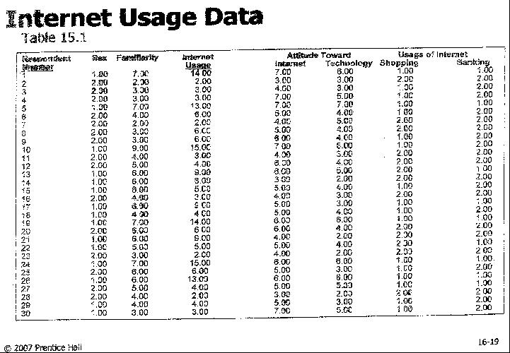

Slide 23
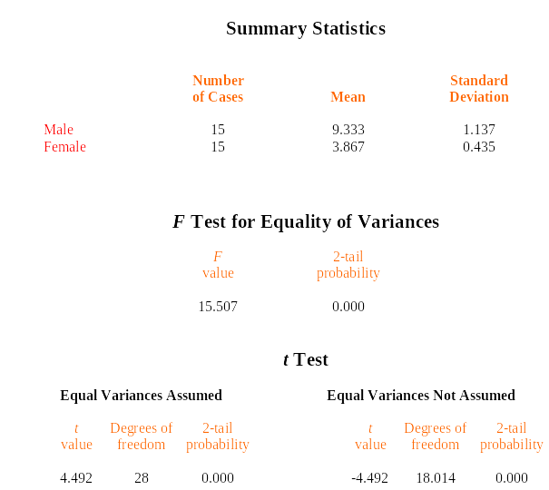

Two Independent-Samples: t Tests
Table 15.14
Table 15.14
-

Slide 24
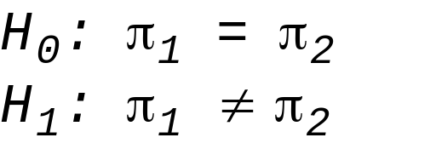
Two Independent Samples: Proportions
Consider data of Table 15.1
Is the proportion of respondents using the Internet for shopping the same for males and females?
The null and alternative hypotheses are:
The test statistic is similar to the one for difference of means, with a different formula for standard error.

Slide 25
Summary of Hypothesis Tests for Differences
Sample
Application
Level of Scaling
Test/Comments
One Sample
Proportion
Metric
Z test
One Sample
Means
Metric
t
test, if variance is unknown
z
test, if variance is known

Slide 26
Summary of Hypothesis Tests for Differences
Two Indep Samples
Application
Scaling
Test/Comments
Two indep samples
Means
Metric
Two
-
group
t
test
F
test for equality of
variances
Two indep samples
Proportions
Metric
z
test
Nonmetric
Chi
-
square test

