Slide 1
Distributions of Random Variables
(§4.6 - 4.10)
In this Lecture we discuss the different types of random variables and illustrate the properties of typical probability distributions for these random variables.
RVDist-<number>

Slide 2
What is a Random Variable?
A variable is any characteristic, observed or measured. A variable can be either random or constant in the population of interest.
Note this differs from common English usage where the word variable implies something that varies from individual to individual.
For a defined population, every random variable has an associated distribution that defines the probability of occurrence of each possible value of that variable (if there are a finitely countable number of unique values) or all possible sets of possible values (if the variable is defined on the real line).
RVDist-<number>

Slide 3
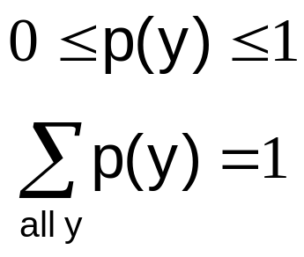
Probability Distribution
A probability distribution (function) is a list of the probabilities of the values (simple outcomes) of a random variable.
Table: Number of heads in two tosses of a coin
y P(y)
outcome probability
0 1/4
1 2/4
2 1/4
For some experiments, the probability of a simple outcome can be easily calculated using a specific probability function. If y is a simple outcome and p(y) is its probability.
RVDist-<number>

Slide 4
Discrete Distributions
Relative frequency distributions for “counting” experiments.
Yes-No responses.
  Bernoulli Distribution
  Binomial Distribution
  Negative Binomial
  Poisson Distribution
  Geometric Distribution
  Multinomial Distribution
Sums of Bernoulli responses
Number of trials to k^{th} event
Points in given space
Number of trials until first success
Multiple possible outcomes for each trial
RVDist-<number>

Slide 5
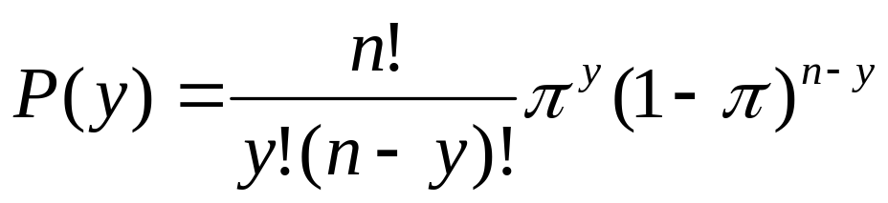
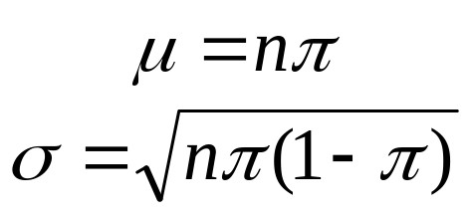
Binomial Distribution
The experiment consists of n identical trials (simple experiments).
Each trial results in one of two outcomes (success or failure)
The probability of success on a single trial is equal to π and π remains the same from trial to trial.
The trials are independent, that is, the outcome of one trial does not influence the outcome of any other trial.
The random variable y is the number of successes observed during n trials.
n!=1x2x3x…x n
Mean
Standard deviation
RVDist-<number>

Slide 6

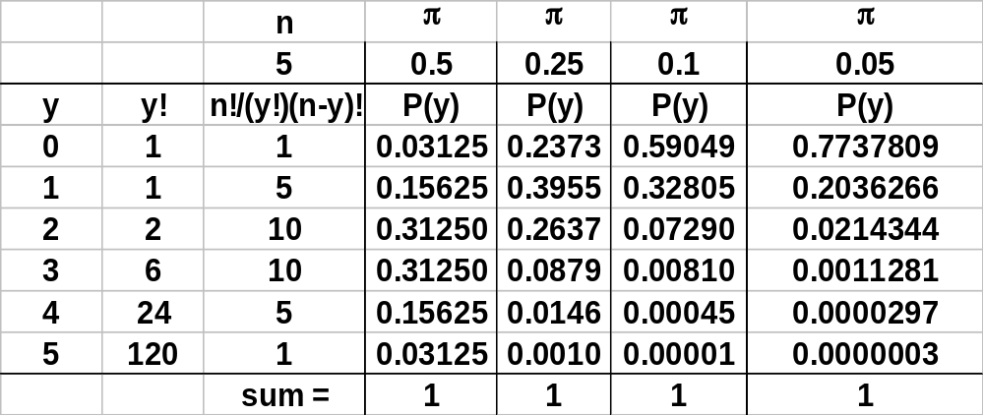
Example n=5
RVDist-<number>

Slide 7
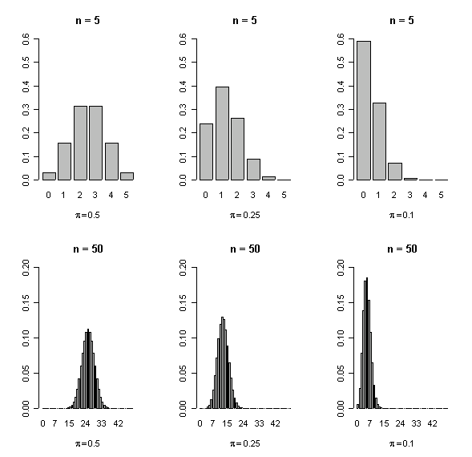
Binomial probability density function forms
As the n goes up, the distribution looks more symmetric and bell shaped.
RVDist-<number>

Slide 8
Binomial Distribution Example
Basic Experiment: 5 fair coins are tossed.
Event of interest: total number of heads.
Each coin is a trial with probability of a head coming up (a success) equal to 0.5. So the number of heads in the five coins is a binomial random variable with n=5 and π=.5.
20
18
16
14
12
10
8
6
4
2
0
The Experiment is repeated 50 times.
# of heads Observed Theoretical
0 1 1.56
1 11 7.81
2 11 15.63
3 19 15.63
4 6 7.81
5 2 1.56
0 1 2 3 4 5
RVDist-<number>

Slide 9
Two Dice Experiment
Two dice are thrown and the number of “pips” showing are counted (random variable X). The simple experiment is repeated 50 times.
Outcome Frequency Relative Freq
2 2 0.04
3 4 0.08
4 4 0.08
5 3 0.06
6 4 0.08
7 7 0.14
8 9 0.18
9 3 0.06
10 5 0.10
11 7 0.14
12 2 0.04
total 50 1.00
Approximate probabilities for the random variable X:
P(X≤8)=
33/50 =.66
P(X≥6)=
37/50 = .74
P(4≤X≤10)=
34/50 = .68
RVDist-<number>

Slide 10
Vegetation Sampling Data
A typical method for determining the density of vegetation is to use “quadrats”, rectangular or circular frames in which the number of plant stems are counted. Suppose 50 “throws” of the frame are used and the distribution of counts reported.
Count Frequency
(stems) (quadrats)
0 12
1 15
2 9
3 6
4 4
5 3
6 0
7 1
total 50
20
18
16
14
12
10
8
6
4
2
0
If stems are randomly dispersed, the counts could be modeled as a Poisson distribution.
0 1 2 3 4 5 6 7
# of stems per quadrat
RVDist-<number>

Slide 11
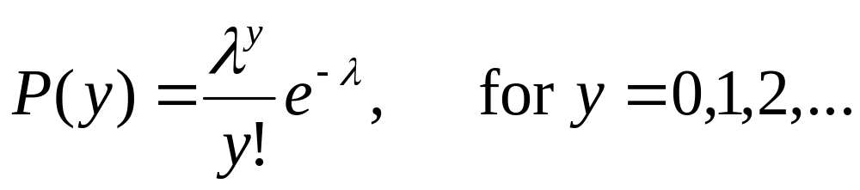
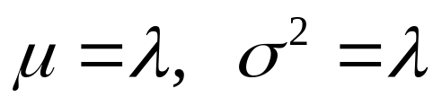
Poisson Distribution
A random variable is said to have a Poisson Distribution with rate parameter λ, if its probability function is given by:
e=2.718…
Mean and variance for a Poisson
Ex: A certain type of tree has seedlings randomly dispersed in a large area, with a mean density of approx 5 per sq meter. If a 10 sq meter area is randomly sampled, what is the probability that no such seedlings are found?
P(0) = 50⁰(e⁻⁵⁰)/0! = approx 10⁻²²
(Since this probability is so small, if no seedlings were actually found, we might question the validity of our model…)
RVDist-<number>

Slide 12
Environmental Example
Van Beneden (1994,Env. Health. Persp., 102, Suppl. 12, p.81-83) describes an experiment where DNA is taken from softshell and hardshell clams and transfected into murine cells in culture in order to study the ability of the murine host cells to indicate selected damage to the clam DNA. (Mouse cells are much easier to culture than clam cells. This process could facilitate laboratory study of in vivo aquatic toxicity in clams).
The response is the number of focal lesions seen on the plates after a fixed period of incubation. The goal is to assess whether there are differences in response between DNA transfected from two clam species.
The response could be modeled as if it followed a Poisson Distribution.
Ref: Piegorsch and Bailer, Stat for Environmental Biol and Tox, p400
RVDist-<number>

Slide 13
Discrete Distributions
Take Home Messages
Primarily related to “counting” experiments.
Probability only defined for “integer” values.
Symmetric and non-symmetric distribution shapes.
Best description is a frequency table.
Examples where discrete distributions are seen.
Wildlife - animal sampling, birds in a 2 km x 2 km area.
Botany - vegetation sampling, quadrats, flowers on stem.
Entomology - bugs on a leaf
Medicine - disease incidence, clinical trials
Engineering - quality control, number of failures in fixed time
RVDist-<number>

Slide 14
Continuous Distributions
Foundations for much of statistical inference
  Normal Distribution
  Log Normal Distribution
  Gamma Distribution
  Chi Square Distribution
  F Distribution
  t Distribution
  Weibull Distribution
  Extreme Value Distribution (Type I and II)
Environmental variables
Time to failure, radioactivity
Basis for statistical tests.
Lifetime distributions
Continuous random variables are defined for continuous numbers on the real line. Probabilities have to be computed for all possible sets of numbers.
RVDist-<number>

Slide 15
Probability Density Function
A function which integrates to 1 over its range and from which event probabilities can be determined.
f(x)
Area under curve
sums to one.
Random variable range
A theoretical shape - if we were able to sample the whole (infinite) population of possible values, this is what the associated histogram would look like.
A mathematical abstraction
RVDist-<number>

Slide 16
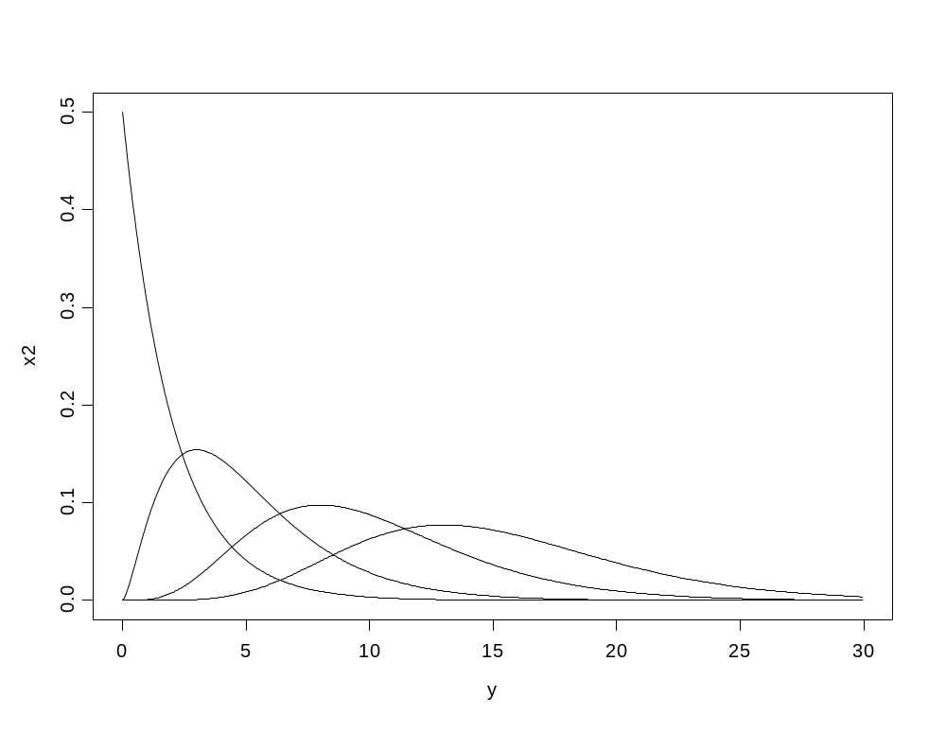
Probability Density Function
The pdf does not have to be symmetric, nor be defined for all real numbers.
Chi Square density functions
f_{X}(x|β)
The shape of the curve is determined by one or more distribution parameters.
RVDist-<number>

Slide 17
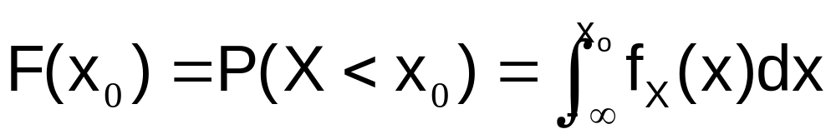
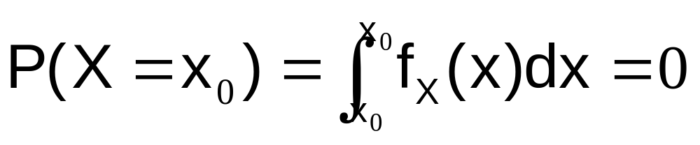
Continuous Distribution Properties
Probability can be computed by integrating the density function.
Continuous random variables only have positive probability for events which define intervals on the real line.
Any one point has zero probability of occurrence.
RVDist-<number>

Slide 18
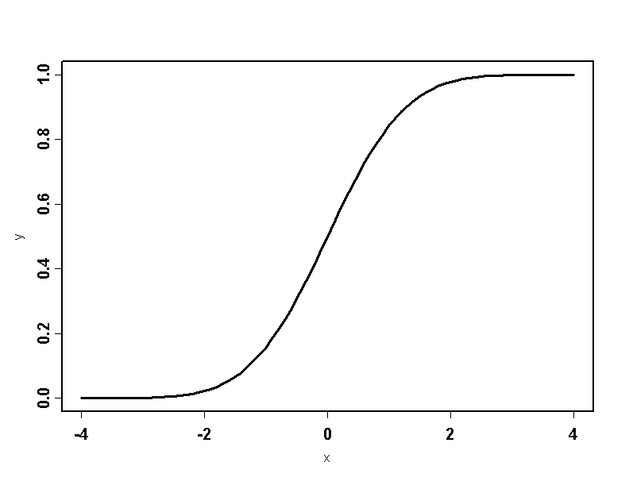
Cumulative Distribution Function
P(X<x)
x
RVDist-<number>

Slide 19
Using the Cumulative Distribution
P(x_{o} < X < x₁) = P(X< x₁ ) - P(X < x_{o}) = .8-.2 = .6
P(X< x₁)
P(X< x_{o})
x_{o}
x₁
RVDist-<number>

Slide 20
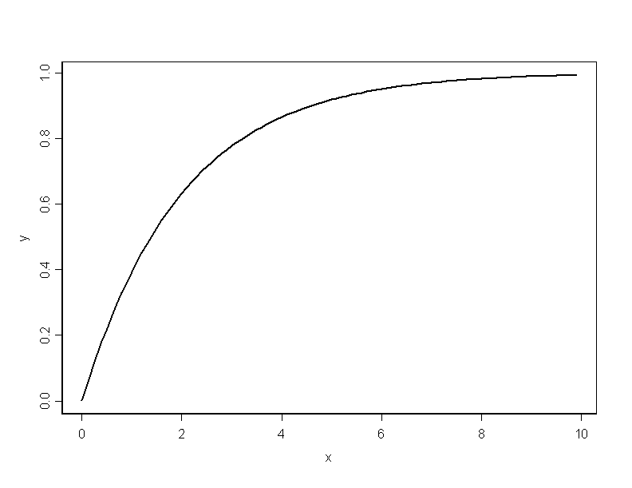
Chi Square Cumulative Distribution
Cumulative distribution does not have to be S shaped. In fact, only the normal and t-distributions have S shaped distributions.
RVDist-<number>

Slide 21
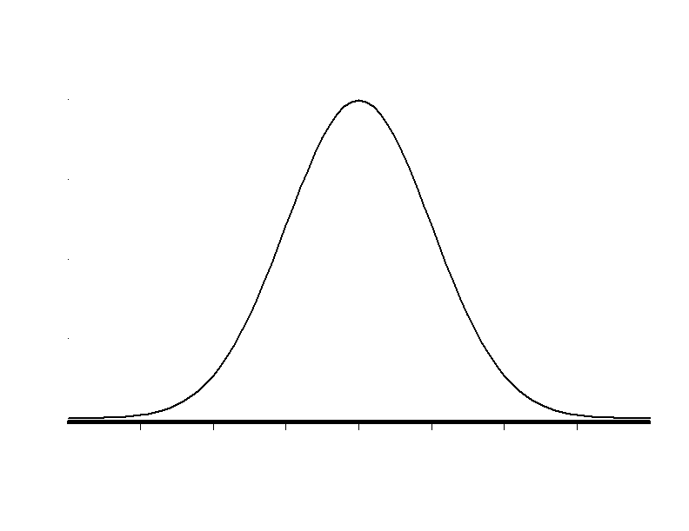

Normal Distribution
A symmetric distribution defined on the range -∞ to + ∞ whose shape is defined by two parameters, the mean, denoted μ, that centers the distribution, and the standard deviation, σ, that determines the spread of the distribution.
68% of total area
is between μ-σ and μ+σ.
Area=.68
μ−σ
μ
μ+σ
RVDist-<number>

Slide 22
Standard Normal Distribution
All normal random variables can be related back to the standard normal random variable.
A Standard Normal random variable has mean 0 and standard deviation 1.
μ−3σ
μ−2σ
μ−σ
μ
μ+σ
μ+2σ
μ+3σ
-3
-2
-1
0
+1
+2
+3
RVDist-<number>

Slide 23
Illustration
Density of (X-μ)/σ
Density of X-μ
Density of X
σ
1
0
μ
RVDist-<number>

Slide 24
Notation
Suppose X has a normal distribution with mean μ and standard deviation σ, denoted X ~ N(μ, σ).
Then a new random variable defined as Z=(X- μ)/ σ, has the standard normal distribution, denoted Z ~ N(0,1).
Z=(X- μ)/ σ
To standardize we subtract the mean and divide by the standard deviation.
To create a random variable with specific mean and standard deviation, we start with a standard normal deviate, multiply it by the target standard deviation, and then add the target mean.
σ Z+ μ = X
Why is this important? Because in this way, the probability of any event on a normal random variable with any given mean and standard deviation can be computed from tables of the standard normal distribution.
RVDist-<number>

Slide 25

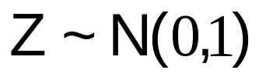
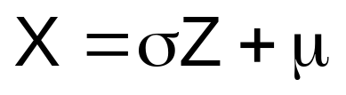
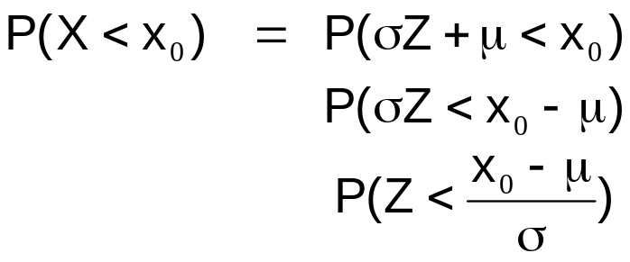
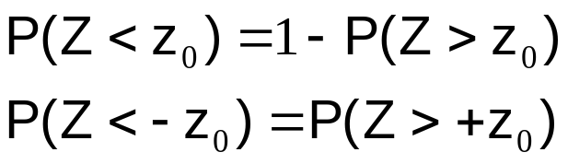
Relating Any Normal RV to a Standard Normal RV
This probability can be found in a table of standard normal probabilities (Table 1 in Ott and Longnecker)
This value is just a number, usually between ±4
Other Useful Relationships
Probability of complementary events.
Symmetry of the normal distribution.
RVDist-<number>

Slide 26
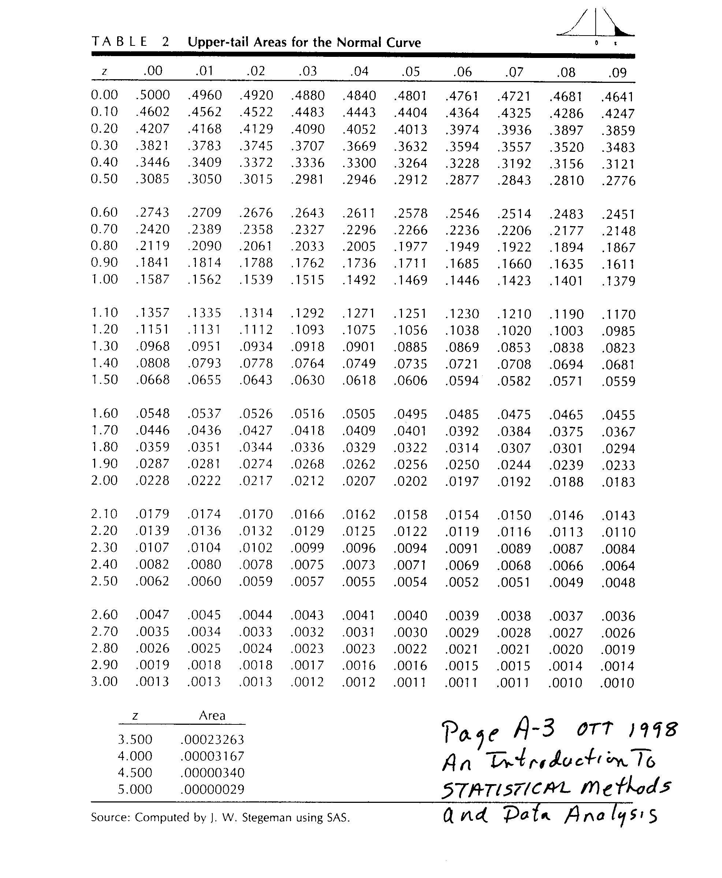
Normal Table
0.0
1.0
Z
Ott & Longnecker, Table 1 page 676, gives areas left of z. This table from a previous edition gives areas right of z.
RVDist-<number>

Slide 27
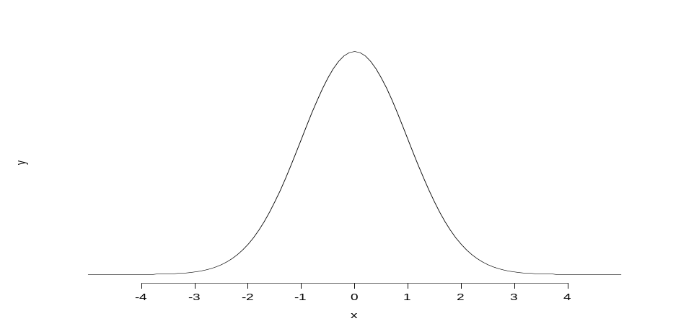
Using a Normal Table
Find P(2 < X < 4) when X ~ N(5,2).
The standarization equation for X is:
Z = (X-μ)/σ = (X-5)/2
when X=2, Z= -3/2 = -1.5
when X=4, Z= -1/2 = -0.5
P(2<X<4) = P(X<4) - P(X<2)
P(X<2) = P( Z< -1.5 )
= P( Z > 1.5 ) (by symmetry)
P(X<4) = P(Z < -0.5)
= P(Z > 0.5) (by symmetry)
P(2 < x < 4) = P(X<4)-P(X<2)
= P(Z>0.5) - P( Z > 1.5)
= 0.3085 - 0.0668 = 0.2417
RVDist-<number>

Slide 28
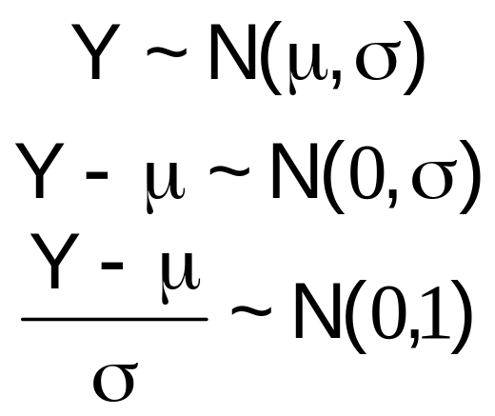
Properties of the Normal Distribution
Symmetric, bell-shaped density function.
68% of area under the curve between μ ± σ.
95% of area under the curve between μ ± 2σ.
99.7% of area under the curve between μ ± 3σ.
Empirical Rule
.68
.95
μ−2σ
μ−σ
μ
μ+σ
μ+2σ
Standard Normal Form
RVDist-<number>

Slide 29
Probability Problems
Using symmetry and the fact that the area under the density curve is 1.
Pr(Z > 1.83) =
0.0336
Pr(Z < 1.83)=
1-Pr( Z> 1.83)
=1-0.0336 = 0.9664
-1.83
1.83
Pr(Z < -1.83) =
Pr( Z> 1.83)
=0.0336
By Symmetry
RVDist-<number>

Slide 30
Probability Problems
Cutting out the tails.
Pr ( Z > -0.6) =
Pr ( Z < +0.6 ) =
1 - Pr (Z > 0.6 ) =
1 - 0.2743 =
0.7257
Pr( -0.6 < Z < 1.83 )=
Pr( Z < 1.83 ) - Pr( Z < -0.6 )
Or
Pr( Z > -0.6 ) - Pr( Z > 1.83 )
Pr( Z > 1.83 ) =
0.0336
= 0.7257 - 0.0336
= 0.6921
-0.6
1.83
RVDist-<number>

Slide 31
Given the Probability - What is Z₀ ?
Working backwards.
Pr (Z > z₀ ) = .1314
z₀
= 1.12
Pr (Z < z₀ ) = .1314
Pr ( Z < z₀ ) = 0.1314
1. - Pr (Z > z₀ ) = 0.1314
Pr ( Z > z₀ ) = 1 - 0.1314
= 0.8686
z₀
z₀ must be negative,
since Pr ( Z > 0.0 ) = 0.5
= -1.12
RVDist-<number>

Slide 32
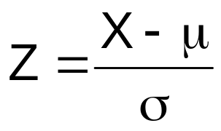
Converting to Standard Normal Form
Suppose we have a random variable (say weight), denoted by W, that has a normal distribution with mean 100 and standard deviation 10.
W ~ N( 100, 10)
Pr ( W < 90 ) =
Pr( Z < (90 - 100) / 10 ) = Pr ( Z < -1.0 )
= Pr ( Z > 1.0 ) = 0.1587
Pr ( W > 80 ) =
Pr( Z > (80 - 100) / 10 ) = Pr ( Z > -2.0 )
= 1.0 - Pr ( Z < -2.0 )
= 1.0 - Pr ( Z > 2.0 )
= 1.0 - 0.0228 = 0.9772
80
100
RVDist-<number>

Slide 33
Decomposing Events
W ~ N( 100, 10)
100
93
106
Pr ( 93 < W < 106 ) =
Pr( W > 93 ) - Pr ( W > 106 )
= Pr [ Z > (93 - 100) / 10 ] - Pr [ Z > (106 - 100 ) / 10 ]
= Pr [ Z > - 0.7 ] - Pr [ Z > + 0.6 ]
= 1.0 - Pr [ Z > + 0.7 ] - Pr [ Z > + 0.6 ]
= 1.0 - 0.2420 - .2743 = 0.4837
RVDist-<number>

Slide 34
Finding Interval Endpoints
W ~ N( 100, 10)
What are the two endpoints for a symmetric area centered on the mean that contains probability of 0.8 ?
Symmetry requirement
0.4
|100 - w_{L}| = | 100 - w_{U} |
0.4
w_{L}
100
w_{U}
Pr ( w_{L} < W < w_{U} ) = 0.8
Pr ( 100 < W < w_{U} ) = Pr (w_{L} < W < 100 ) = 0.4
Pr ( 100 < W < w_{U} ) = Pr ( W > 100 ) - Pr ( W > w_{U} ) =
Pr ( Z > 0 ) - Pr ( Z > (w_{U} – 100)/10 ) = .5 - Pr ( Z > (w_{U} – 100)/10 ) = 0.4
Pr ( Z > (w_{U} - 100)/10 ) = 0.1 => (w_{U} - 100)/10 = z_{0.1} ≈ 1.28
w_{U} = 1.28 * 10 + 100 = 112.8
w_{L} = -1.28 * 10 + 100 = 87.2
RVDist-<number>

Slide 35
Probability Practice
Using Table 1 in Ott &Longnecker
Read probability in table using row (. 4) + column (.07) indicators.
Pr( Z < .47) =
.6808
Pr(Z > .47) =
1-P(Z<.47)=
1-.6808=.3192
Pr ( Z < -.47 ) =
.3192
Pr ( Z > -.47 ) =
1.0 - Pr ( Z < -.47)
= 1.0 - .3192 = .6808
Pr( .21 < Z < 1.56 ) =
Pr ( Z <1.56) - Pr ( Z < .21 )
.9406 - 0.5832 = .3574
Pr( -.21 < Z < 1.23 ) =
Pr ( Z < 1.23) - Pr ( Z < -.21 )
.8907 - .4168
= .4739
RVDist-<number>

Slide 36
Finding Critical Values from the Table
Find probability in the Table, then read off row and column values.
Pr ( Z > z_{.2912} ) = 0.2912
z_{.2912} =
0.55
Pr ( Z > z_{.05} ) = 0.05
z_{.05} =
1.645
Pr ( Z > z_{.025} ) = 0.025
z_{.025} =
1.96
Pr ( Z > z_{.01} ) = 0.01
z_{.01} =
2.326
RVDist-<number>

