Slide 1
Pitfalls of Hypothesis Testing
Pitfalls of Hypothesis Testing

Slide 2
Hypothesis Testing
The Steps:
1. Define your hypotheses (null, alternative)
2. Specify your null distribution
3. Do an experiment
4. Calculate the p-value of what you observed
5. Reject or fail to reject (~accept) the null hypothesis
Follows the logic: If A then B; not B; therefore, not A.

Slide 3
Summary: The Underlying Logic of hypothesis tests…
Follows this logic:
Assume A.
If A, then B.
Not B.
Therefore, Not A.
But throw in a bit of uncertainty…If A, then probably B…

Slide 4
Error and Power
Type-I Error (also known as “α”):
  Rejecting the null when the effect isn’t real.
Type-II Error (also known as “β “):
  Failing to reject the null when the effect is real.
POWER (the flip side of type-II error: 1- β):
  The probability of seeing a true effect if one exists.
Note the sneaky conditionals…

Slide 5
Think of…
Pascal’s Wager
Your Decision
The TRUTH
God Exists
God Doesn’t Exist
Reject God
BIG MISTAKE
Correct
Accept God
Correct—
Big Pay Off
MINOR MISTAKE

Slide 6
Type I and Type II Error in a box
Your Statistical Decision
True state of null hypothesis
H₀ True
(example: the drug doesn’t work)
H₀ False
(example: the drug works)
Reject H₀
(ex: you conclude that the drug works)
Type I error (α)
Correct
Do not reject H₀
(ex: you conclude that there is insufficient evidence that the drug works)
Correct
Type II Error (β)

Slide 7
Error and Power
Type I error rate (or significance level): the probability of finding an effect that isn’t real (false positive).
    If we require p-value<.05 for statistical significance, this means that 1/20 times we will find a positive result just by chance.
Type II error rate: the probability of missing an effect (false negative).
Statistical power: the probability of finding an effect if it is there (the probability of not making a type II error).
    When we design studies, we typically aim for a power of 80% (allowing a false negative rate, or type II error rate, of 20%).

Slide 8
Pitfall 1: over-emphasis on p-values
Clinically unimportant effects may be statistically significant if a study is large (and therefore, has a small standard error and extreme precision).
Pay attention to effect size and confidence intervals.

Slide 9
Example: effect size
A prospective cohort study of 34,079 women found that women who exercised >21 MET hours per week gained significantly less weight than women who exercised <7.5 MET hours (p<.001)
Headlines: “To Stay Trim, Women Need an Hour of Exercise Daily.”
Physical Activity and Weight Gain Prevention. JAMA 2010;303:1173-1179.

Slide 10
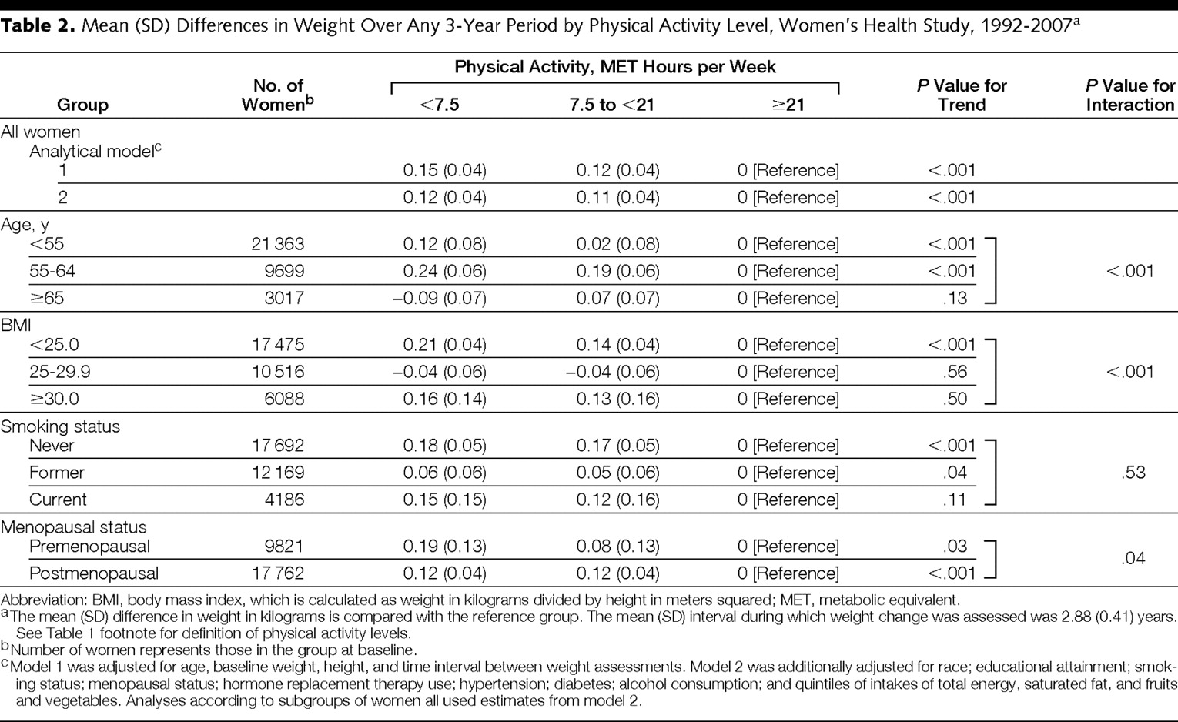

Mean (SD) Differences in Weight Over Any 3-Year Period by Physical Activity Level, Women's Health Study, 1992-2007a
Lee, I. M. et al. JAMA 2010;303:1173-1179.
Copyright restrictions may apply.

Slide 11
What was the effect size? Those who exercised the least 0.15 kg (.33 pounds) more than those who exercised the most over 3 years.
Extrapolated over 13 years of the study, the high exercisers gained 1.4 pounds less than the low exercisers!
Classic example of a statistically significant effect that is not clinically significant.

Slide 12
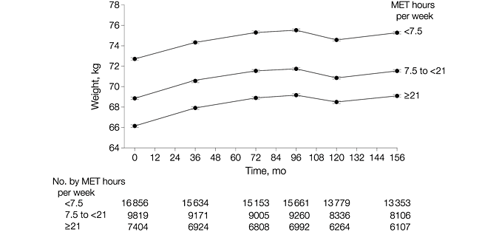
A picture is worth…

Slide 13
A picture is worth…
Authors explain: “Figure 2 shows the trajectory of weight gain over time by baseline physical activity levels. When classified by this single measure of physical activity, all 3 groups showed similar weight gain patterns over time.”
But baseline physical activity should predict weight gain in the first three years…do those slopes look different to you?

Slide 14
Another recent headline
Drinkers May Exercise More Than Teetotalers
Activity levels rise along with alcohol use, survey shows
“MONDAY, Aug. 31 (HealthDay News) -- Here's something to toast: Drinkers are often exercisers”…
“In reaching their conclusions, the researchers examined data from participants in the 2005 Behavioral Risk Factor Surveillance System, a yearly telephone survey of about 230,000 Americans.”…
For women, those who imbibed exercised 7.2 minutes more per week than teetotalers. The results applied equally to men…

Slide 15
Pitfall 2: association does not equal causation
Statistical significance does not imply a cause-effect relationship.
Interpret results in the context of the study design.

Slide 16
Pitfall 3: data dredging/multiple comparisons
In 1980, researchers at Duke randomized 1073 heart disease patients into two groups, but treated the groups equally.
Not surprisingly, there was no difference in survival.
Then they divided the patients into 18 subgroups based on prognostic factors.
In a subgroup of 397 patients (with three-vessel disease and an abnormal left ventricular contraction) survival of those in “group 1” was significantly different from survival of those in “group 2” (p<.025).
How could this be since there was no treatment?
(Lee et al. “Clinical judgment and statistics: lessons from a simulated randomized trial in coronary artery disease,” Circulation, 61: 508-515, 1980.)

Slide 17
Pitfall 3: multiple comparisons
The difference resulted from the combined effect of small imbalances in the subgroups

Slide 18
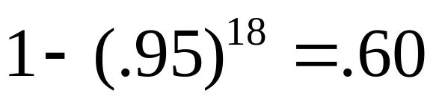
Multiple comparisons
By using a p-value of 0.05 as the criterion for significance, we’re accepting a 5% chance of a false positive (of calling a difference significant when it really isn’t).
If we compare survival of “treatment” and “control” within each of 18 subgroups, that’s 18 comparisons.
If these comparisons were independent, the chance of at least one false positive would be…

Slide 19
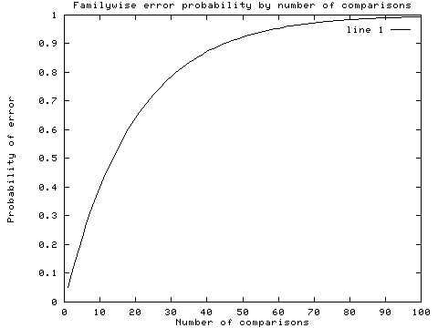
Multiple comparisons
With 18 independent comparisons, we have 60% chance of at least 1 false positive.

Slide 20
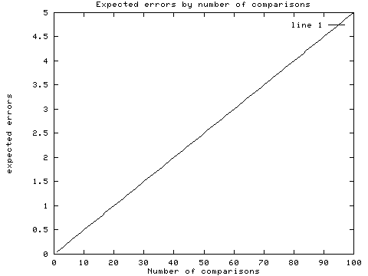
Multiple comparisons
With 18 independent comparisons, we expect about 1 false positive.

Slide 21
Pitfall 3: multiple comparisons
A significance level of 0.05 means that your false positive rate for one test is 5%.
If you run more than one test, your false positive rate will be higher than 5%.
Control study-wide type I error by planning a limited number of tests. Distinguish between planned and exploratory tests in the results. Correct for multiple comparisons.

Slide 22
Results from Class survey…
My research question was actually to test whether or not being born on odd or even days predicted anything about your future.
In fact, I discovered that people who were born on even days:
  Had significantly better English SATs (p=.04)
  Tended to enjoy manuscript writing more (p=.09)
  Tended to be more pessimistic (p=.09)

Slide 23
Results from Class survey…
The differences were clinically meaningful. Compared with those born on odd days (n=11), those born on even days (n=13):
  Scored 65 points higher on the English SAT (720 vs. 655)
  Enjoyed manuscript writing by 1.5 units more (6.2 vs. 4.8)
  Were less optimistic by 1.5 units (6.7 vs. 8.2)

Slide 24
Results from Class survey…
I can see the NEJM article title now…
“Being born on even days makes you a better writer, but may predispose to depression.”

Slide 25
Results from Class survey…
Assuming that this difference can’t be explained by astrology, it’s obviously an artifact!
What’s going on?…

Slide 26
Results from Class survey…
After the odd/even day question, I asked you 25 other questions…
I ran 25 statistical tests (comparing the outcome variable between odd-day born people and even-day born people).
So, there was a high chance of finding at least one false positive!

Slide 27
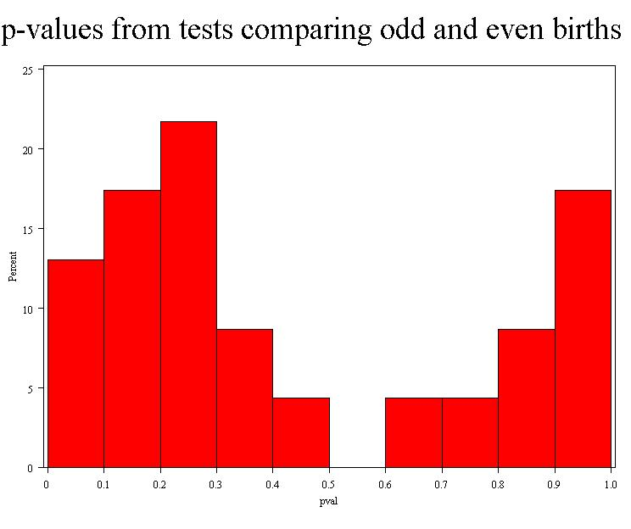
P-value distribution for the 25 tests…
Under the null hypothesis of no associations (which we’ll assume is true here!), p-values follow a uniform distribution…
My “significant” and near significant p-values!

Slide 28
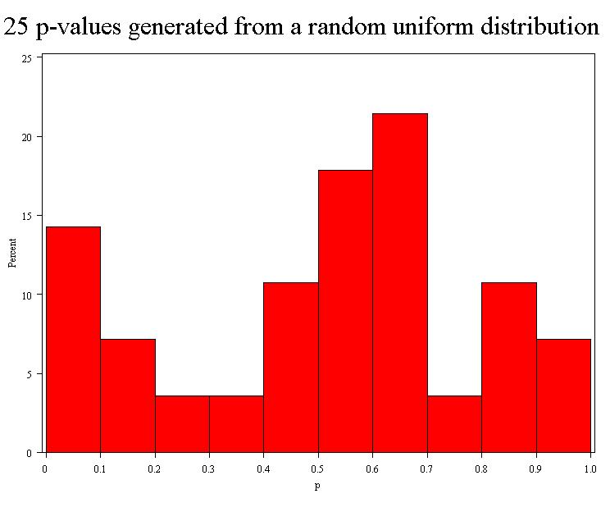
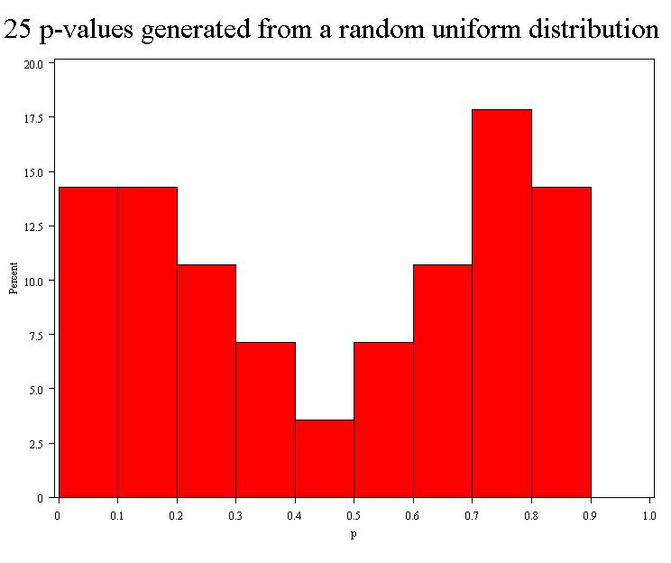
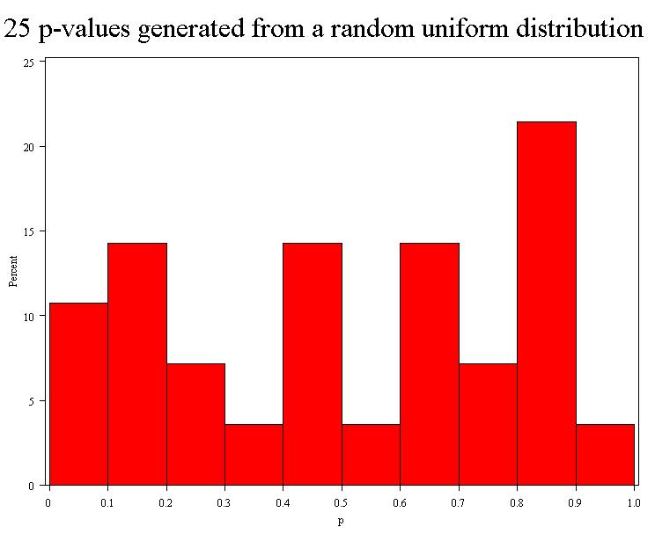
Compare with…
Next, I generated 25 “p-values” from a random number generator (uniform distribution). These were the results from three runs…

Slide 29
In the medical literature…
Researchers examined the relationship between intakes of caffeine/coffee/tea and breast cancer overall and in multiple subgroups (50 tests)
  Overall, there was no association
  Risk ratios were close to 1.0 (ranging from 0.67 to 1.79), indicated protection (<1.0) about as often harm (>1.0), and showed no consistent dose-response pattern
  But they found 4 “significant” p-values in subgroups:
    coffee intake was linked to increased risk in those with benign breast disease (p=.08)
    caffeine intake was linked to increased risk of estrogen/progesterone negative tumors and tumors larger than 2 cm (p=.02)
    decaf coffee was linked to reduced risk of BC in postmenopausal hormone users (p=.02)
Ishitani K, Lin J, PhD, Manson JE, Buring JE, Zhang SM. Caffeine consumption and the risk of breast cancer in a large prospective cohort of women. Arch Intern Med. 2008;168:2022-2031.

Slide 30
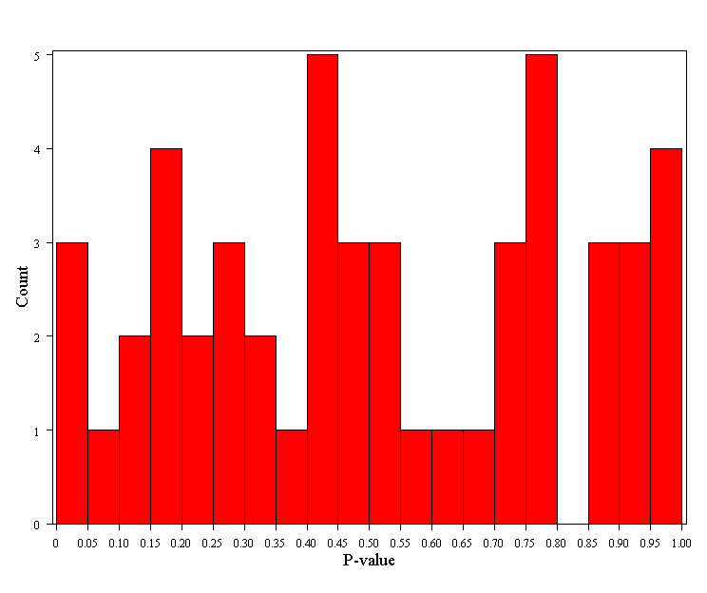
Distribution of the p-values from the 50 tests
Likely chance findings!
Also, effect sizes showed no consistent pattern.
The risk ratios:
-were close to 1.0 (ranging from 0.67 to 1.79)
-indicated protection (<1.0) about as often harm (>1.0)
-showed no consistent dose-response pattern.

Slide 31
Hallmarks of a chance finding:
Analyses are exploratory
Many tests have been performed but only a few are significant
The significant p-values are modest in size (between p=0.01 and p=0.05)
The pattern of effect sizes is inconsistent
The p-values are not adjusted for multiple comparisons

Slide 32
Pitfall 4: high type II error (low statistical power)
Results that are not statistically significant should not be interpreted as "evidence of no effect,” but as “no evidence of effect”
Studies may miss effects if they are insufficiently powered (lack precision).
Example: A study of 36 postmenopausal women failed to find a significant relationship between hormone replacement therapy and prevention of vertebral fracture. The odds ratio and 95% CI were: 0.38 (0.12, 1.19), indicating a potentially meaningful clinical effect. Failure to find an effect may have been due to insufficient statistical power for this endpoint.
Design adequately powered studies and interpret in the context of study power if results are null.
Ref: Wimalawansa et al. Am J Med 1998, 104:219-226.

Slide 33
Pitfall 5: the fallacy of comparing statistical significance
“the effect was significant in the treatment group, but not significant in the control group” does not imply that the groups differ significantly

Slide 34
Example
In a placebo-controlled randomized trial of DHA oil for eczema, researchers found a statistically significant improvement in the DHA group but not the placebo group.
The abstract reports: “DHA, but not the control treatment, resulted in a significant clinical improvement of atopic eczema.”
However, the improvement in the treatment group was not significantly better than the improvement in the placebo group, so this is actually a null result.

Slide 35
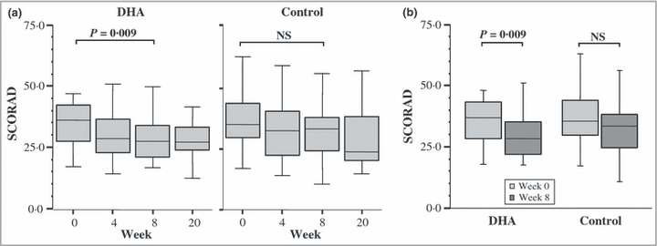
Misleading “significance comparisons”
The improvement in the DHA group (18%) is not significantly greater than the improvement in the control group (11%).
Koch C, Dölle S, Metzger M, et al. Docosahexaenoic acid (DHA) supplementation in atopic eczema: a randomized, double-blind, controlled trial. Br J Dermatol 2008;158:786-792.

Slide 36
Within-group vs. between-group tests
Examples of statistical tests used to evaluate within-group effects versus statistical tests used to evaluate between-group effects
Statistical tests for within-group effects | Statistical tests for between-group effects
Paired ttest | Two-sample ttest
Wilcoxon sign-rank test | Wilcoxon sum-rank test (equivalently, Mann-Whitney U test)
Repeated-measures ANOVA, time effect | ANOVA; repeated-measures ANOVA, group*time effect
McNemar’s test | Difference in proportions, Chi-square test, or relative risk

Slide 37
Also applies to interactions…
Similarly, “we found a significant effect in subgroup 1 but not subgroup 2” does not constitute prove of interaction
  For example, if the effect of a drug is significant in men, but not in women, this is not proof of a drug-gender interaction.

Slide 38
Overview of statistical tests

Slide 39
Which test should I use?
Outcome Variable | Are the observations independent or correlated? |  | Assumptions
 | independent | correlated
Continuous (e.g. pain scale, cognitive function) | Ttest ANOVA Linear correlation Linear regression | Paired ttest Repeated-measures ANOVA Mixed models/GEE modeling | Outcome is normally distributed (important for small samples). Outcome and predictor have a linear relationship.
Binary or categorical (e.g. fracture yes/no) | Relative risks Chi-square test Logistic regression | McNemar’s test Conditional logistic regression GEE modeling | Sufficient numbers in each cell (>=5)
Time-to-event (e.g. time to fracture) | Kaplan-Meier statistics Cox regression | n/a | Cox regression assumes proportional hazards between groups

Slide 40
Which test should I use?
1. What is the dependent variable?
Outcome Variable | Are the observations independent or correlated? |  | Assumptions
 | independent | correlated
Continuous (e.g. pain scale, cognitive function) | Ttest ANOVA Linear correlation Linear regression | Paired ttest Repeated-measures ANOVA Mixed models/GEE modeling | Outcome is normally distributed (important for small samples). Outcome and predictor have a linear relationship.
Binary or categorical (e.g. fracture yes/no) | Relative risks Chi-square test Logistic regression | McNemar’s test Conditional logistic regression GEE modeling | Sufficient numbers in each cell (>=5)
Time-to-event (e.g. time to fracture) | Kaplan-Meier statistics Cox regression | n/a | Cox regression assumes proportional hazards between groups

Slide 41
Which test should I use?
2. Are the observations correlated?
Outcome Variable | Are the observations independent or correlated? |  | Assumptions
 | independent | correlated
Continuous (e.g. pain scale, cognitive function) | Ttest ANOVA Linear correlation Linear regression | Paired ttest Repeated-measures ANOVA Mixed models/GEE modeling | Outcome is normally distributed (important for small samples). Outcome and predictor have a linear relationship.
Binary or categorical (e.g. fracture yes/no) | Relative risks Chi-square test Logistic regression | McNemar’s test Conditional logistic regression GEE modeling | Sufficient numbers in each cell (>=5)
Time-to-event (e.g. time to fracture) | Kaplan-Meier statistics Cox regression | n/a | Cox regression assumes proportional hazards between groups

Slide 42
Which test should I use?
3. Are key model assumptions met?
Outcome Variable | Are the observations independent or correlated? |  | Assumptions
 | independent | correlated
Continuous (e.g. pain scale, cognitive function) | Ttest ANOVA Linear correlation Linear regression | Paired ttest Repeated-measures ANOVA Mixed models/GEE modeling | Outcome is normally distributed (important for small samples). Outcome and predictor have a linear relationship.
Binary or categorical (e.g. fracture yes/no) | Relative risks Chi-square test Logistic regression | McNemar’s test Conditional logistic regression GEE modeling | Sufficient numbers in each cell (>=5)
Time-to-event (e.g. time to fracture) | Kaplan-Meier statistics Cox regression | n/a | Cox regression assumes proportional hazards between groups

Slide 43
Are the observations correlated?
What is the unit of observation?
  person* (most common)
  limb
  half a face
  physician
  clinical center
Are the observations independent or correlated?
  Independent: observations are unrelated (usually different, unrelated people)
  Correlated: some observations are related to one another, for example: the same person over time (repeated measures), legs within a person, half a face

Slide 44
Example: correlated data
Split-face trial:
  Researchers assigned 56 subjects to apply SPF 85 sunscreen to one side of their faces and SPF 50 to the other prior to engaging in 5 hours of outdoor sports during mid-day. The outcome is sunburn (yes/no).
  Unit of observation = side of a face
  Are the observations correlated? Yes.
Russak JE et al. JAAD 2010; 62: 348-349.

Slide 45
Results ignoring correlation:
Table I -- Dermatologist grading of sunburn after an average of 5 hours of skiing/snowboarding (P = .03; Fisher’s exact test)
Sun protection factor | Sunburned | Not sunburned
85 | 1 | 55
50 | 8 | 48
Fisher’s exact test compares the following proportions: 1/56 versus 8/56. Note that individuals are being counted twice!

Slide 46
Correct analysis of data:
Table 1. Correct presentation of the data from: Russak JE et al. JAAD 2010; 62: 348-349. (P = .016; McNemar’s exact test).
 | SPF-50 side
SPF-85 side | Sunburned | Not sunburned
Sunburned | 1 | 0
Not sunburned | 7 | 48
McNemar’s exact test evaluates the probability of the following: In all 7 out of 7 cases where the sides of the face were discordant (i.e., one side burnt and the other side did not), the SPF 50 side sustained the burn.

Slide 47
Correlations
Ignoring correlations will:
  overestimate p-values for within-person or within-cluster comparisons
  underestimate p-values for between-person or between-cluster comparisons

Slide 48
Common statistics for various types of outcome data
Are key model assumptions met?
Outcome Variable | Are the observations independent or correlated? |  | Assumptions
 | independent | correlated
Continuous (e.g. pain scale, cognitive function) | Ttest ANOVA Linear correlation Linear regression | Paired ttest Repeated-measures ANOVA Mixed models/GEE modeling | Outcome is normally distributed (important for small samples). Outcome and predictor have a linear relationship.
Binary or categorical (e.g. fracture yes/no) | Relative risks Chi-square test Logistic regression | McNemar’s test Conditional logistic regression GEE modeling | Sufficient numbers in each cell (>=5)
Time-to-event (e.g. time to fracture) | Kaplan-Meier statistics Cox regression | n/a | Cox regression assumes proportional hazards between groups

Slide 49
Key assumptions of linear models
Assumptions for linear models (ttest, ANOVA, linear correlation, linear regression, paired ttest, repeated-measures ANOVA, mixed models):
Normally distributed outcome variable
  Most important for small samples; large samples are quite robust against this assumption.
Predictors have a linear relationship with the outcome
  Graphical displays can help evaluate this.

Slide 50
Common statistics for various types of outcome data
Outcome Variable | Are the observations independent or correlated? |  | Assumptions
 | independent | correlated
Continuous (e.g. pain scale, cognitive function) | Ttest ANOVA Linear correlation Linear regression | Paired ttest Repeated-measures ANOVA Mixed models/GEE modeling | Outcome is normally distributed (important for small samples). Outcome and predictor have a linear relationship.
Binary or categorical (e.g. fracture yes/no) | Relative risks Chi-square test Logistic regression | McNemar’s test Conditional logistic regression GEE modeling | Sufficient numbers in each cell (>=5)
Time-to-event (e.g. time to fracture) | Kaplan-Meier statistics Cox regression | n/a | Cox regression assumes proportional hazards between groups
Are key model assumptions met?

Slide 51
Key assumptions for categorical tests
Assumptions for categorical tests (relative risks, chi-square, logistic regression, McNemar’s test):
Sufficient numbers in each cell (np>=5)
  In the sunscreen trial, “exact” tests (Fisher’s exact, McNemar’s exact) were used because of the sparse data.

Slide 52
Continuous outcome (means); HRP 259/HRP 262
Outcome Variable | Are the observations independent or correlated? |  | Alternatives if the normality assumption is violated (and small sample size):
 | independent | correlated
Continuous (e.g. pain scale, cognitive function) | Ttest: compares means between two independent groups ANOVA: compares means between more than two independent groups Pearson’s correlation coefficient (linear correlation): shows linear correlation between two continuous variables Linear regression: multivariate regression technique used when the outcome is continuous; gives slopes | Paired ttest: compares means between two related groups (e.g., the same subjects before and after) Repeated-measures ANOVA: compares changes over time in the means of two or more groups (repeated measurements) Mixed models/GEE modeling: multivariate regression techniques to compare changes over time between two or more groups; gives rate of change over time | Non-parametric statistics Wilcoxon sign-rank test: non-parametric alternative to the paired ttest Wilcoxon sum-rank test (=Mann-Whitney U test): non-parametric alternative to the ttest Kruskal-Wallis test: non-parametric alternative to ANOVA Spearman rank correlation coefficient: non-parametric alternative to Pearson’s correlation coefficient

Slide 53
Binary or categorical outcomes (proportions); HRP 259/HRP 261
Outcome Variable | Are the observations correlated? |  | Alternative to the chi-square test if sparse cells:
 | independent | correlated
Binary or categorical (e.g. fracture, yes/no) | Chi-square test: compares proportions between more than two groups Relative risks: odds ratios or risk ratios Logistic regression: multivariate technique used when outcome is binary; gives multivariate-adjusted odds ratios | McNemar’s chi-square test: compares binary outcome between correlated groups (e.g., before and after) Conditional logistic regression: multivariate regression technique for a binary outcome when groups are correlated (e.g., matched data) GEE modeling: multivariate regression technique for a binary outcome when groups are correlated (e.g., repeated measures) | Fisher’s exact test: compares proportions between independent groups when there are sparse data (some cells <5). McNemar’s exact test: compares proportions between correlated groups when there are sparse data (some cells <5).

Slide 54
Time-to-event outcome (survival data); HRP 262
Outcome Variable | Are the observation groups independent or correlated? |  | Modifications to Cox regression if proportional-hazards is violated:
 | independent | correlated
Time-to-event (e.g., time to fracture) | Kaplan-Meier statistics: estimates survival functions for each group (usually displayed graphically); compares survival functions with log-rank test Cox regression: Multivariate technique for time-to-event data; gives multivariate-adjusted hazard ratios | n/a (already over time) | Time-dependent predictors or time-dependent hazard ratios (tricky!)

