Slide 1
Continuous Probability Distributions
Continuous Random Variable:
  Values from Interval of Numbers
  Absence of Gaps
Continuous Probability Distribution:
Distribution of a Continuous Variable
Most Important Continuous Probability
Distribution: the Normal Distribution

Slide 2
The Normal Distribution
‘Bell Shaped’
Symmetrical
Mean, Median and
Mode are Equal
Random Variable has
Infinite Range
f(X)
X
μ
Mean Median Mode

Slide 3
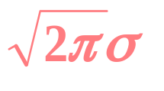
The Mathematical Model
2
1
(-1/2)
((X- μ)/σ)
f(X) =
e
f(X) = frequency of random variable X
π = 3.14159; e = 2.71828
σ = population standard deviation
X = value of random variable (-∞ < X < ∞)
μ = population mean

Slide 4
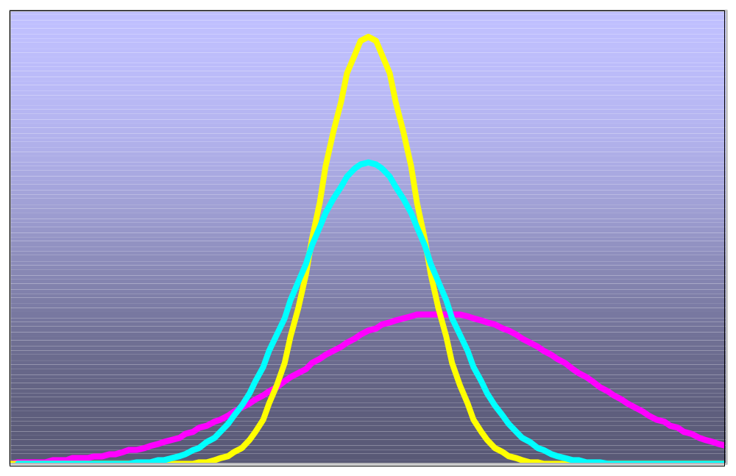
Many Normal Distributions
There are an Infinite Number
Varying the Parameters σ and μ, we obtain Different Normal Distributions.

Slide 5
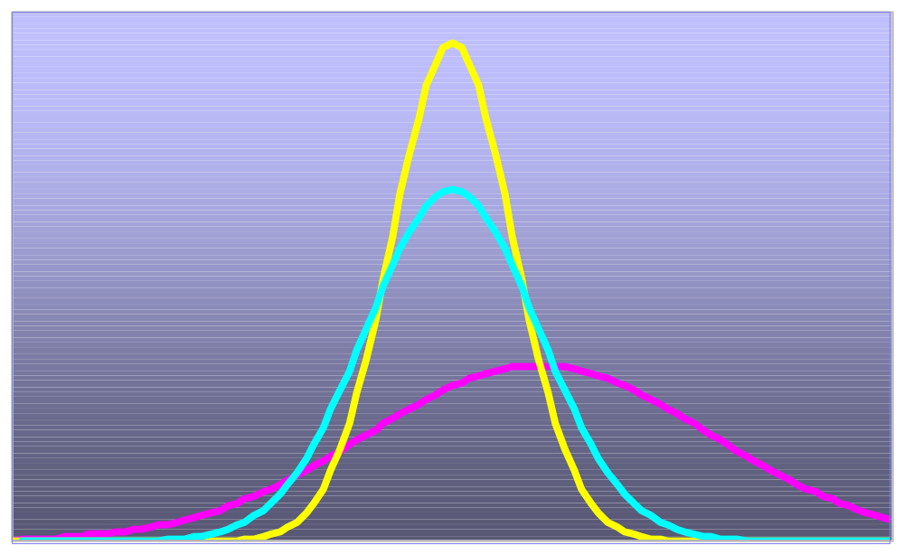
Which Table?
Each distribution has its own table?
Infinitely Many Normal Distributions Means Infinitely Many Tables to Look Up!

Slide 6
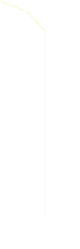
The Standardized Normal Distribution
Standardized Normal Probability
Table (Portion) μ = 0 and σ = 1
Z
Z
.0478
Z
.00
.01
.02
0.0
.0000
.0040
.0080
0.1
.0398
.0438
.0478
0.2
.0793
.0832
.0871
Z = 0.12
0.3
.0179
.0217
.0255
Shaded Area Exaggerated
Probabilities

Slide 7
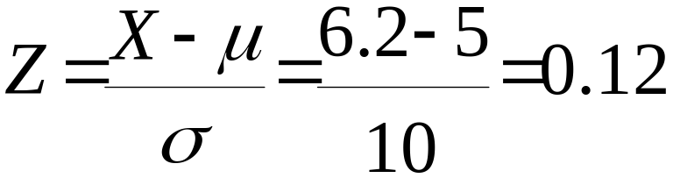
Standardizing Example
Normal
Distribution
Standardized Normal Distribution
σ
= 10
σ
= 1
Z
μ
= 5
6.2
X
μ
= 0
.12
Z
Shaded Area Exaggerated

Slide 8
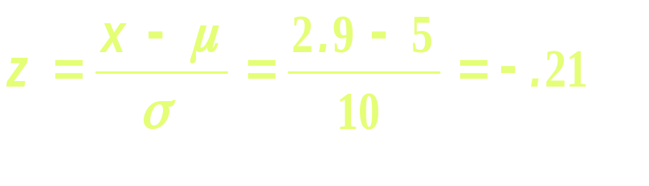
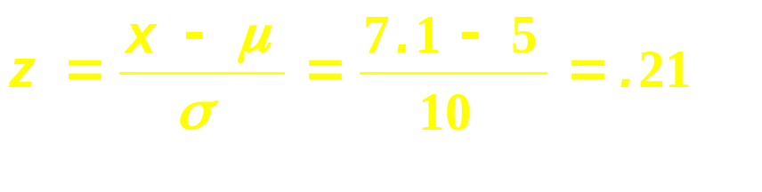
Example:
P(2.9 < X < 7.1) = .1664
Normal
Distribution
Standardized Normal Distribution
σ
= 10
σ
= 1
.1664
.0832
.0832
2.9
5
7.1
X
-.21
0
.21
Z
Shaded Area Exaggerated

Slide 9
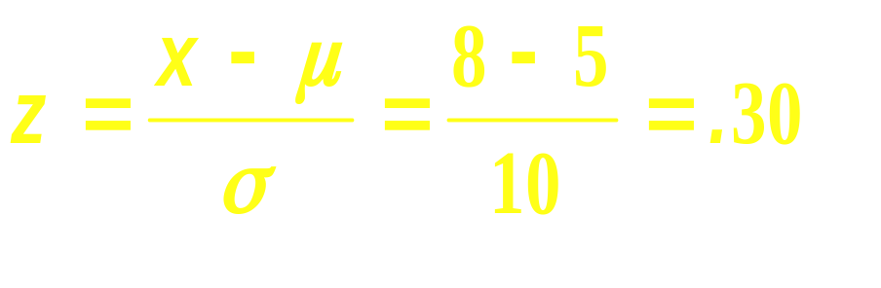
Example: P(X ≥ 8) = .3821
.
Normal
Distribution
Standardized Normal Distribution
σ
= 10
σ
= 1
.5000
.3821
.1179
μ
= 5
8
X
μ
= 0
.30
Z
Shaded Area Exaggerated

Slide 10
Finding Z Values for Known Probabilities
What Is Z Given
P(Z) = 0.1217?
Standardized Normal Probability Table (Portion)
σ
= 1
Z
.00
.01
0.2
.1217
0.0
.0000
.0040
.0080
0.1
.0398
.0438
.0478
μ
= 0
.31
Z
0.2
.0793
.0832
.0871
Shaded Area Exaggerated
0.3
.1179
.1217
.1255

Slide 11
Finding X Values for Known Probabilities
Normal Distribution
Standardized Normal Distribution
σ
= 10
σ
= 1
.1217
.1217
μ
= 5
?
X
μ
= 0
.31
Z
X
= μ + Zσ = 5 + (0.31)(10) =
8.1
Shaded Area Exaggerated

Slide 12
Assessing Normality
Compare Data Characteristics
to Properties of Normal
Distribution
Put Data into Ordered Array
Find Corresponding Standard
Normal Quantile Values
Plot Pairs of Points
Assess by Line Shape
Normal Probability Plot for Normal Distribution
90
X
60
30
Z
-2
-1
0
1
2
Look for Straight Line!

Slide 13
Normal Probability Plots
Left-Skewed
Right-Skewed
90
90
X
60
X
60
30
Z
30
Z
-2
-1
0
1
2
-2
-1
0
1
2
Rectangular
U-Shaped
90
90
X
60
X
60
30
Z
30
Z
-2
-1
0
1
2
-2
-1
0
1
2

Slide 14
Estimation
Sample Statistic Estimates Population Parameter
e.g. X = 50 estimates Population Mean, μ
Problems: Many samples provide many estimates of the Population Parameter.
Determining adequate sample size: large sample give better estimates. Large samples more costly.
How good is the estimate?
Approach to Solution: Theoretical Basis is Sampling Distribution.
_

Slide 15
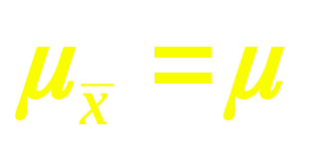
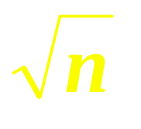
Properties of Summary Measures
Population Mean Equal to
Sampling Mean
The Standard Error (standard deviation) of the Sampling distribution is Less than Population Standard Deviation
Formula (sampling with replacement):
σ
σ
_
=
σ
_
x
As n increase, decrease.
x

Slide 16
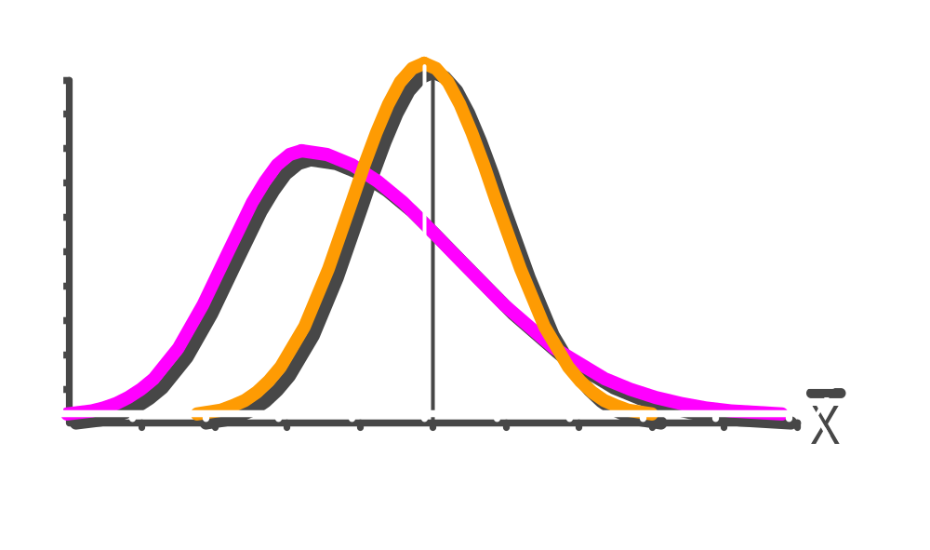
Central Limit Theorem
As Sample Size Gets Large Enough
Sampling Distribution
Becomes
Almost Normal regardless of shape of population

Slide 17
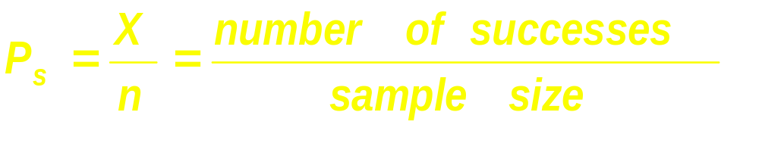
Population Proportions
Categorical variable (e.g., gender)
% population having a characteristic
If two outcomes, binomial distribution
  Possess or don’t possess characteristic
Sample proportion (p_{s})

Slide 18
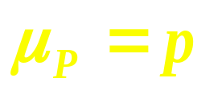
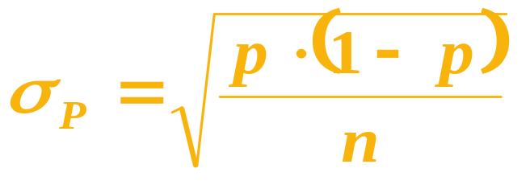
Sampling Distribution of Proportion
Approximated by normal distribution
  n·p ≥ 5
  n·(1 - p) ≥ 5
Mean
Standard error
Sampling Distribution
✓
P(p_{s})
✓
.3
.2
.1
0
p_{s}
0 . 2 .4 .6 8 1
p = population proportion

Slide 19
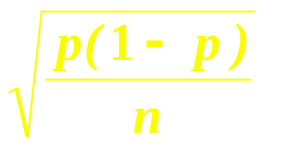
Standardizing Sampling Distribution of Proportion
p
p
- μ
-
s
s
p
Z
p
≅
=
σ
p
Sampling Distribution
Standardized
Normal Distribution
σ_{p}
σ = 1
p_{s}
Z
μ_{p}
μ = 0

