Slide 1

Joint Probability Distributions and
Random Samples
5
Copyright © Cengage Learning. All rights reserved.

Slide 2
The Distribution of the Sample Mean
5.4
Copyright © Cengage Learning. All rights reserved.

Slide 3

The Distribution of the Sample Mean
The importance of the sample mean springs from its use in drawing conclusions about the population mean μ. Some of the most frequently used inferential procedures are based on properties of the sampling distribution of .
A preview of these properties appeared in the calculations and simulation experiments of the previous section, where we noted relationships between E( ) and μ and also among V( ), σ ², and n.

Slide 4



The Distribution of the Sample Mean
Proposition
Let X₁, X₂, . . . , X_{n} be a random sample from a distribution with mean value μ and standard deviation σ. Then
1.
2.
In addition, with T₀ = X₁+ . . . + X_{n} (the sample total),

Slide 5

The Distribution of the Sample Mean
According to Result 1, the sampling (i.e., probability) distribution of is centered precisely at the mean of the population from which the sample has been selected. Result 2 shows that the distribution becomes more concentrated about μ as the sample size n increases.
In marked contrast, the distribution of T_{o} becomes more spread out as n increases.
Averaging moves probability in toward the middle, whereas totaling spreads probability out over a wider and wider range of values.

Slide 6

The Distribution of the Sample Mean
The standard deviation is often called the standard error of the mean; it describes the magnitude of a typical or representative deviation of the sample mean from the population mean.

Slide 7
Example 24
In a notched tensile fatigue test on a titanium specimen, the expected number of cycles to first acoustic emission (used to indicate crack initiation) is μ = 28,000, and the standard deviation of the number of cycles is σ = 5000.
Let X₁, X₂, . . . , X₂₅ be a random sample of size 25, where each X_{i} is the number of cycles on a different randomly selected specimen.
Then the expected value of the sample mean number of cycles until first emission is E( )μ = 28,000, and the expected total number of cycles for the 25 specimens is
E(T_{o}) = nμ = 25(28,000) = 700,000.

Slide 8
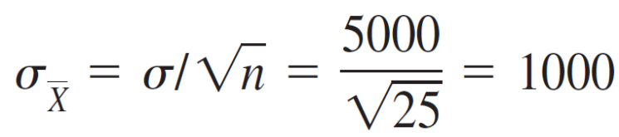
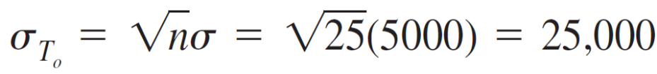

Example 24
cont’d
The standard deviation of (standard error of the mean) and of T_{o} are
If the sample size increases to n = 100, E( ) is unchanged, but = 500, half of its previous value (the sample size must be quadrupled to halve the standard deviation of ).

Slide 9
The Case of a Normal Population Distribution

Slide 10


The Case of a Normal Population Distribution
Proposition
Let X₁, X₂, . . . , X_{n} be a random sample from a normal distribution with mean μ and standard deviation σ. Then for any n, is normally distributed (with mean μ and standard deviation , as is T_{o} (with mean nμ and standard
Deviation ).
We know everything there is to know about the and T_{o} distributions when the population distribution is normal. In particular, probabilities such as P(a ≤ ≤ b) and
P(c ≤ T_{o} ≤ d) can be obtained simply by standardizing.

Slide 11
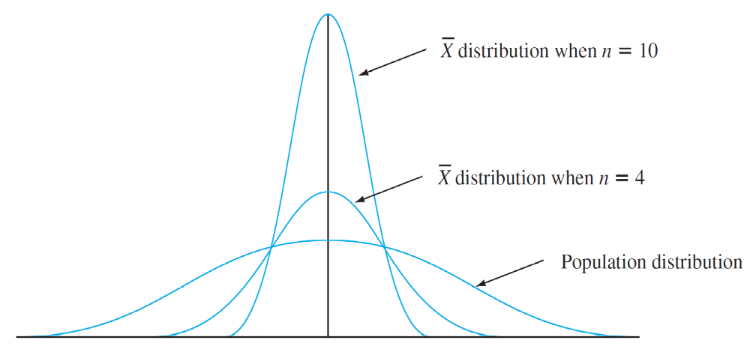
The Case of a Normal Population Distribution
Figure 5.14 illustrates the proposition.
A normal population distribution and sampling distributions
Figure 5.14

Slide 12
Example 25
The time that it takes a randomly selected rat of a certain subspecies to find its way through a maze is a normally distributed rv with μ = 1.5 min and σ = .35 min. Suppose five rats are selected.
Let X₁, . . . , X₅ denote their times in the maze. Assuming the X_{i}’s to be a random sample from this normal distribution, what is the probability that the total time T_{o} = X₁ + . . . + X₅ for the five is between 6 and 8 min?

Slide 13



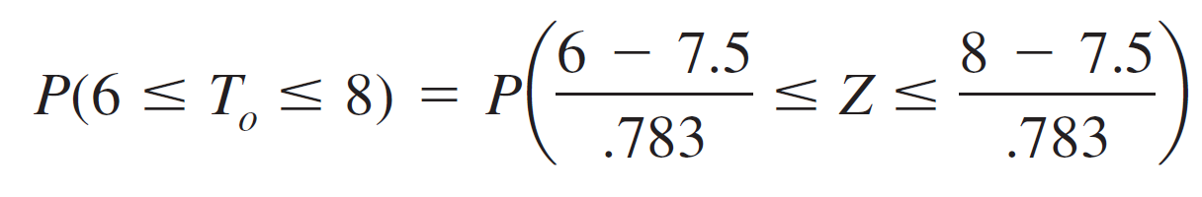
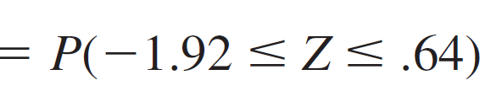


Example 25
cont’d
By the proposition, T_{o} has a normal distribution with
= nμ = 5(1.5) = 7.5
and
variance = nσ ² = 5(.1225) = .6125, so = .783.
To standardize T_{o}, subtract and divide by :

Slide 14



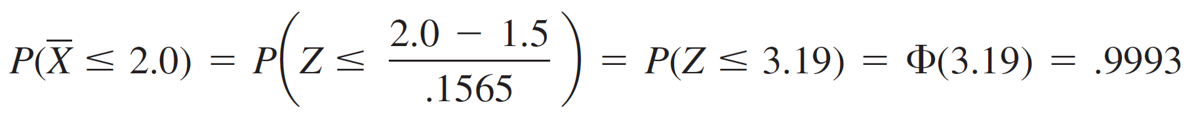
Example 25
cont’d
Determination of the probability that the sample average time (a normally distributed variable) is at most 2.0 min requires = μ = 1.5 and = = .1565.
Then

Slide 15
The Central Limit Theorem

Slide 16
The Central Limit Theorem
When the X_{i}’s are normally distributed, so is for every sample size n.
Even when the population distribution is highly nonnormal, averaging produces a distribution more bell-shaped than the one being sampled.
A reasonable conjecture is that if n is large, a suitable normal curve will approximate the actual distribution of . The formal statement of this result is the most important theorem of probability.

Slide 17



The Central Limit Theorem
Theorem
The Central Limit Theorem (CLT)
Let X₁, X₂, . . . , X_{n} be a random sample from a distribution with mean μ and variance σ ². Then if n is sufficiently large, has approximately a normal distribution with and
and T_{o} also has approximately a normal distribution with The larger the value of n, the better the approximation.

Slide 18
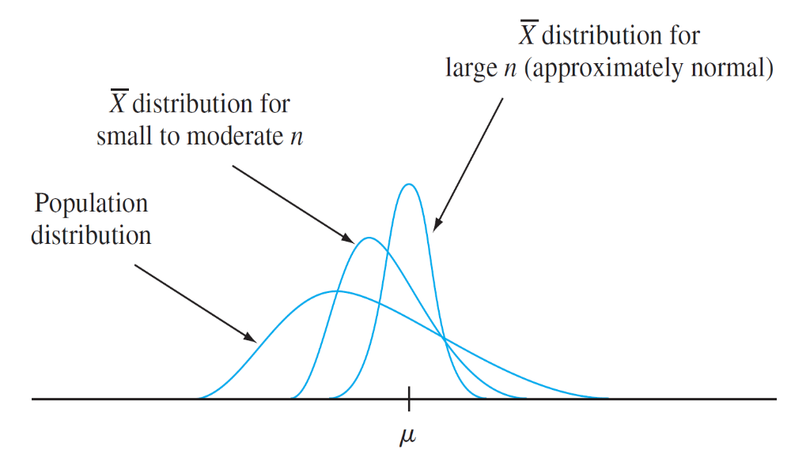
The Central Limit Theorem
Figure 5.15 illustrates the Central Limit Theorem.
The Central Limit Theorem illustrated
Figure 5.15

Slide 19
The Central Limit Theorem
According to the CLT, when n is large and we wish to calculate a probability such as P(a ≤ ≤ b), we need only “pretend” that is normal, standardize it, and use the normal table.
The resulting answer will be approximately correct. The exact answer could be obtained only by first finding the distribution of , so the CLT provides a truly impressive shortcut.

Slide 20
Example 26
The amount of a particular impurity in a batch of a certain chemical product is a random variable with mean value 4.0 g and standard deviation 1.5 g.
If 50 batches are independently prepared, what is the (approximate) probability that the sample average amount of impurity is between 3.5 and 3.8 g?
According to the rule of thumb to be stated shortly, n = 50 is large enough for the CLT to be applicable.

Slide 21


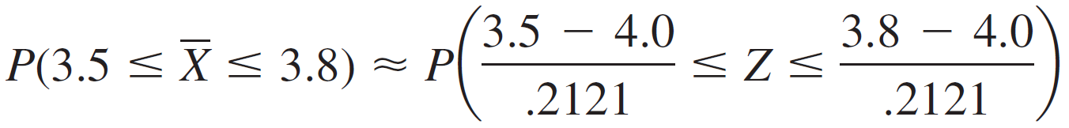

Example 26
cont’d
then has approximately a normal distribution with mean value = 4.0 and
so

Slide 22
The Central Limit Theorem
The CLT provides insight into why many random variables have probability distributions that are approximately normal.
For example, the measurement error in a scientific experiment can be thought of as the sum of a number of underlying perturbations and errors of small magnitude.
A practical difficulty in applying the CLT is in knowing when n is sufficiently large. The problem is that the accuracy of the approximation for a particular n depends on the shape of the original underlying distribution being sampled.

Slide 23
The Central Limit Theorem
If the underlying distribution is close to a normal density curve, then the approximation will be good even for a small n, whereas if it is far from being normal, then a large n will be required.
Rule of Thumb
If n > 30, the Central Limit Theorem can be used.
There are population distributions for which even an n of 40 or 50 does not suffice, but such distributions are rarely encountered in practice.

Slide 24
The Central Limit Theorem
On the other hand, the rule of thumb is often conservative; for many population distributions, an n much less than 30 would suffice.
For example, in the case of a uniform population distribution, the CLT gives a good approximation for n ≥ 12.

Slide 25
Other Applications of the Central Limit Theorem

Slide 26
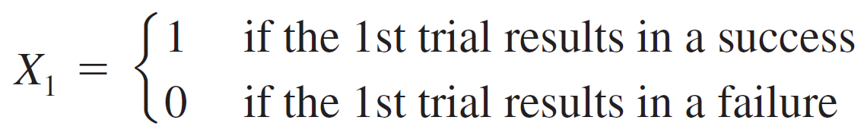
Other Applications of the Central Limit Theorem
The CLT can be used to justify the normal approximation to the binomial distribution discussed earlier.
We know that a binomial variable X is the number of successes in a binomial experiment consisting of n independent success/failure trials with p = P(S) for any particular trial. Define a new rv X₁ by
and define X₂, X₃, . . . , X_{n} analogously for the other n – 1 trials. Each X_{i} indicates whether or not there is a success on the corresponding trial.

Slide 27
Other Applications of the Central Limit Theorem
Because the trials are independent and P(S) is constant from trial to trial, the X_{i} ’s are iid (a random sample from a Bernoulli distribution).
The CLT then implies that if n is sufficiently large, both the sum and the average of the X_{i} ’s have approximately normal distributions.

Slide 28
Other Applications of the Central Limit Theorem
When the X_{i}’s are summed, a 1 is added for every S that occurs and a 0 for every F, so X₁ + . . . + X_{n} = X. The sample mean of the X_{i}’s is X/n, the sample proportion of successes.
That is, both X and X/n are approximately normal when n is large.

Slide 29
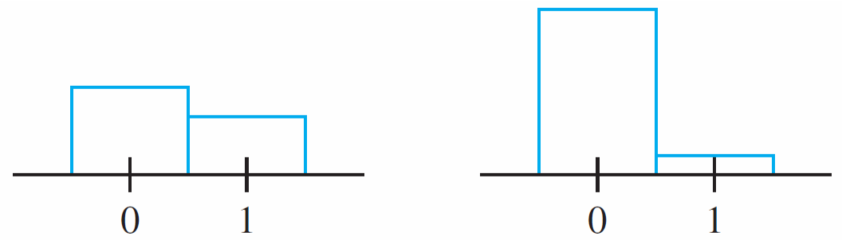
Other Applications of the Central Limit Theorem
The necessary sample size for this approximation depends on the value of p: When p is close to .5, the distribution of each X_{i} is reasonably symmetric (see Figure 5.19), whereas the distribution is quite skewed when p is near
0 or 1. Using the approximation only if both np ≥ 10 and
n(1 ≥ p) ≥ 10 ensures that n is large enough to overcome any skewness in the underlying Bernoulli distribution.
(a)
(b)
Two Bernoulli distributions: (a) p = .4 (reasonably symmetric); (b) p = .1 (very skewed)
Figure 5.19

Slide 30
Other Applications of the Central Limit Theorem
We know that X has a lognormal distribution if ln(X) has a normal distribution.
Proposition
Let X₁, X₂, . . . , X_{n} be a random sample from a distribution for which only positive values are possible [P(X_{i} > 0) = 1].
Then if n is sufficiently large, the product
Y = X₁X₂ . . . . . X_{n} has approximately a lognormal distribution.

Slide 31
Other Applications of the Central Limit Theorem
To verify this, note that
Since ln(Y) is a sum of independent and identically distributed rv’s [the ln(X_{i})s], it is approximately normal when n is large, so Y itself has approximately a lognormal distribution.

Slide 32
Other Applications of the Central Limit Theorem
As an example of the applicability of this result, Bury (Statistical Models in Applied Science,Wiley, p. 590) argues that the damage process in plastic flow and crack propagation is a multiplicative process, so that variables such as percentage elongation and rupture strength have approximately lognormal distributions.

