Slide 1
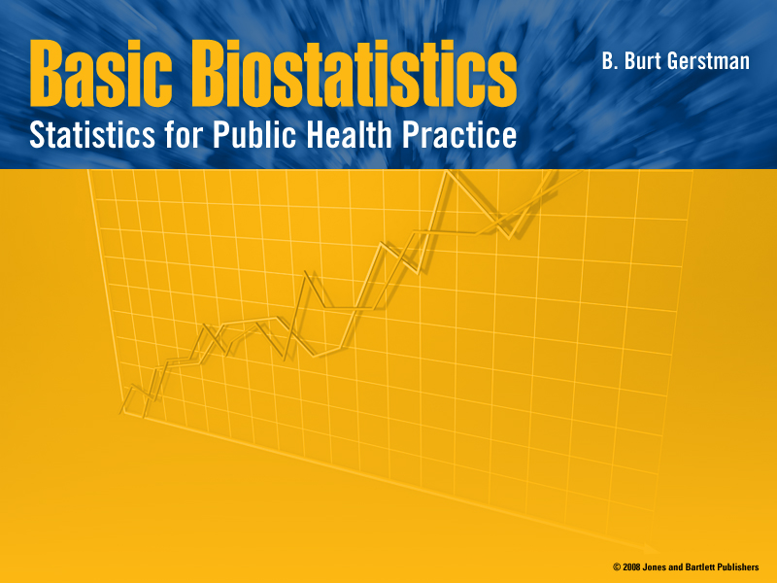
Chapter 7:
Normal Probability Distributions

Slide 2

In Chapter 7:
7.1 Normal Distributions
7.2 Determining Normal Probabilities
7.3 Finding Values That Correspond to Normal Probabilities
7.4 Assessing Departures from Normality
Notes:
Chapter 7
Basic Biostat

Slide 3
§7.1: Normal Distributions
This pdf is the most popular distribution for continuous random variables
First described de Moivre in 1733
Elaborated in 1812 by Laplace
Describes some natural phenomena
More importantly, describes sampling characteristics of totals and means

Slide 4
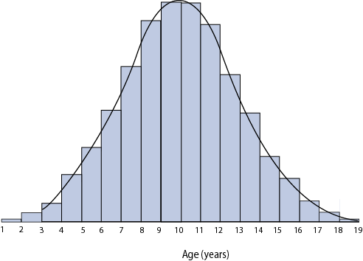
Normal Probability Density Function
Recall: continuous random variables are described with probability density function (pdfs) curves
Normal pdfs are recognized by their typical bell-shape
Figure: Age distribution of a pediatric population with overlying Normal pdf

Slide 5
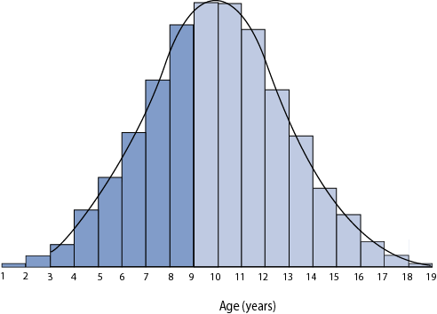
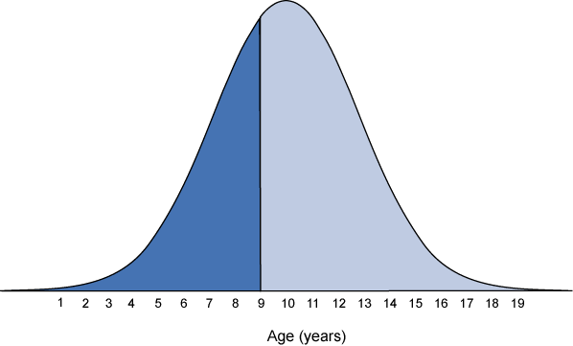
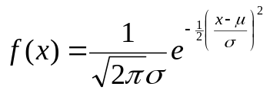
Area Under the Curve
pdfs should be viewed almost like a histogram
Top Figure: The darker bars of the histogram correspond to ages ≤ 9 (~40% of distribution)
Bottom Figure: shaded area under the curve (AUC) corresponds to ages ≤ 9 (~40% of area)

Slide 6
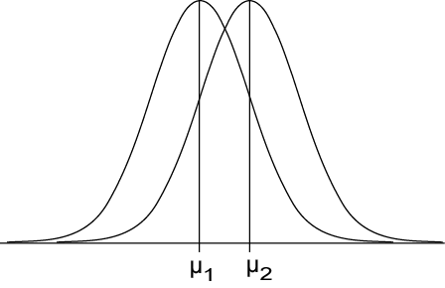
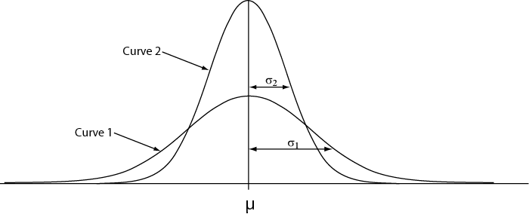
Parameters μ and σ
Normal pdfs have two parameters
μ - expected value (mean “mu”)
σ - standard deviation (sigma)
μ controls location
σ controls spread

Slide 7
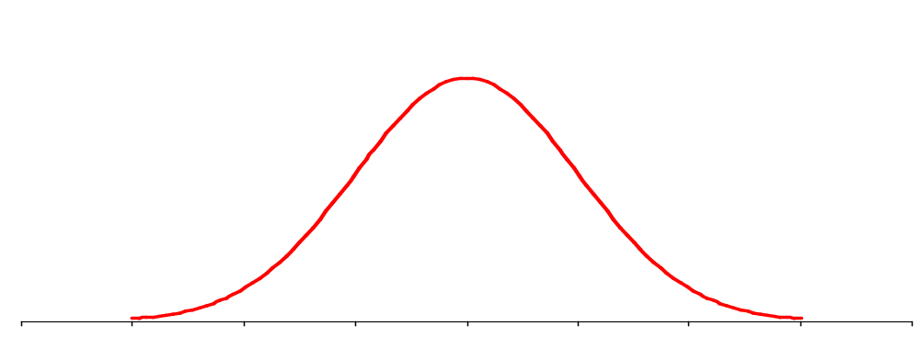
Mean and Standard Deviation of Normal Density
σ
μ
Notes:
Chapter 7
Basic Biostat

Slide 8
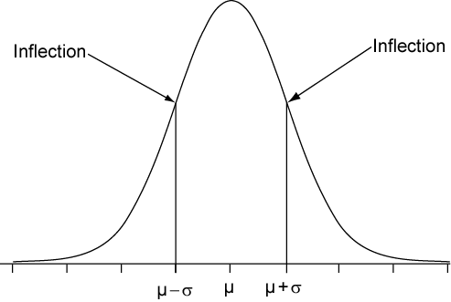
Standard Deviation σ
Points of inflections one σ below and above μ
Practice sketching Normal curves
Feel inflection points (where slopes change)
Label horizontal axis with σ landmarks

Slide 9
Two types of means and standard deviations
The mean and standard deviation from the pdf (denoted μ and σ) are parameters
The mean and standard deviation from a sample (“xbar” and s) are statistics
Statistics and parameters are related, but are not the same thing!
Notes:
Chapter 7
Basic Biostat

Slide 10
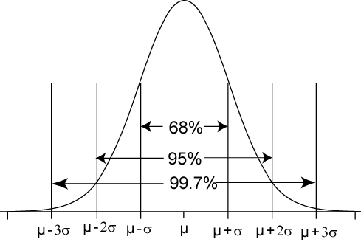
68-95-99.7 Rule for
Normal Distributions
68% of the AUC within ±1σ of μ
95% of the AUC within ±2σ of μ
99.7% of the AUC within ±3σ of μ
Notes:
Chapter 7
Basic Biostat

Slide 11
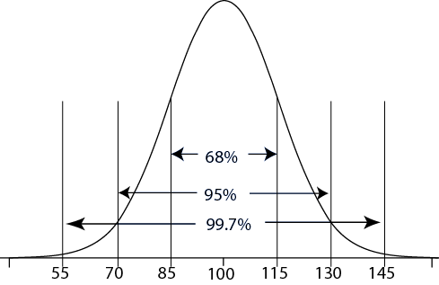
Example: 68-95-99.7 Rule
Wechsler adult intelligence scores: Normally distributed with μ = 100 and σ = 15; X ~ N(100, 15)
68% of scores within
μ ± σ
= 100 ± 15
= 85 to 115
95% of scores within
μ ± 2σ
= 100 ± (2)(15)
= 70 to 130
99.7% of scores in
μ ± 3σ =
100 ± (3)(15)
= 55 to 145
Notes:
Chapter 7
Basic Biostat

Slide 12
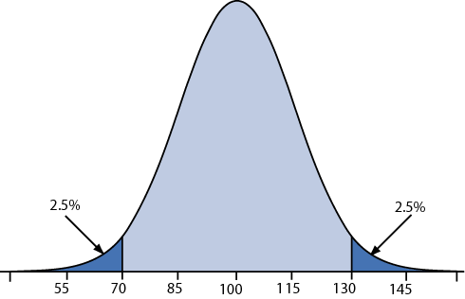
Symmetry in the Tails
Because the Normal curve is symmetrical and the total AUC is exactly 1…
… we can easily determine the AUC in tails
95%

Slide 13
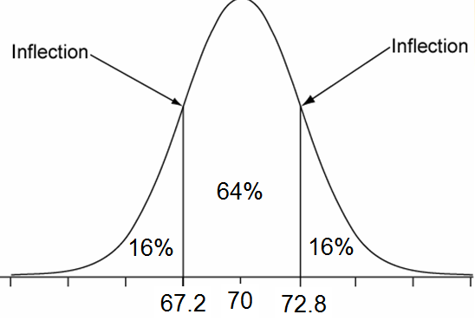
Example: Male Height
Male height: Normal with μ = 70.0˝ and σ = 2.8˝
68% within μ ± σ = 70.0 ± 2.8 = 67.2 to 72.8
32% in tails (below 67.2˝ and above 72.8˝)
16% below 67.2˝ and 16% above 72.8˝ (symmetry)
Notes:
Chapter 7
Basic Biostat

Slide 14
Reexpression of Non-Normal Random Variables
Many variables are not Normal but can be reexpressed with a mathematical transformation to be Normal
Example of mathematical transforms used for this purpose:
  logarithmic
  exponential
  square roots
Review logarithmic transformations…

Slide 15
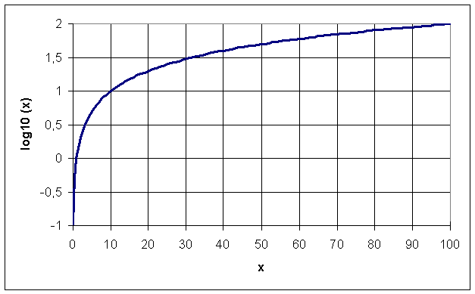
Logarithms
Logarithms are exponents of their base
Common log
(base 10)
  log(10⁰) = 0
  log(10¹) = 1
  log(10²) = 2
Natural ln (base e)
  ln(e⁰) = 0
  ln(e¹) = 1
Base 10 log function

Slide 16
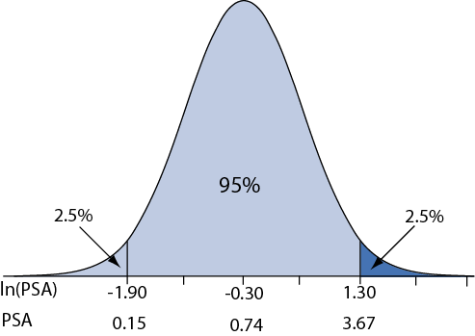
Example: Logarithmic Reexpression
Prostate Specific Antigen (PSA) is used to screen for prostate cancer
In non-diseased populations, it is not Normally distributed, but its logarithm is:
ln(PSA) ~N(−0.3, 0.8)
95% of ln(PSA) within
= μ ± 2σ
= −0.3 ± (2)(0.8)
= −1.9 to 1.3
Take exponents of “95% range”
⇒ e^{−1.9,1.3} = 0.15 and 3.67
⇒ Thus, 2.5% of non-diseased population have values greater than 3.67 ⇒ use 3.67 as screening cutoff
Notes:
Chapter 7
Basic Biostat

Slide 17
§7.2: Determining Normal Probabilities
When value do not fall directly on σ landmarks:
1. State the problem
2. Standardize the value(s) (z score)
3. Sketch, label, and shade the curve
4. Use Table B

Slide 18
Step 1: State the Problem
What percentage of gestations are less than 40 weeks?
Let X ≡ gestational length
We know from prior research:
X ~ N(39, 2) weeks
Pr(X ≤ 40) = ?
Notes:
Chapter 7
Basic Biostat

Slide 19
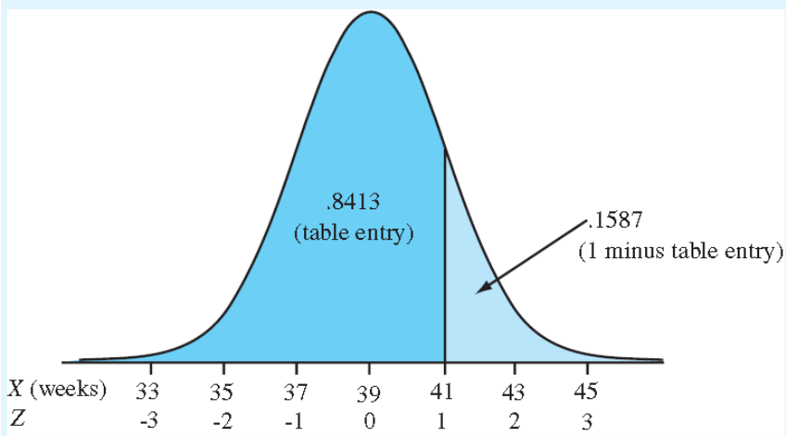
Step 2: Standardize
Standard Normal variable ≡ “Z” ≡ a Normal random variable with μ = 0 and σ = 1,
Z ~ N(0,1)
Use Table B to look up cumulative probabilities for Z

Slide 20
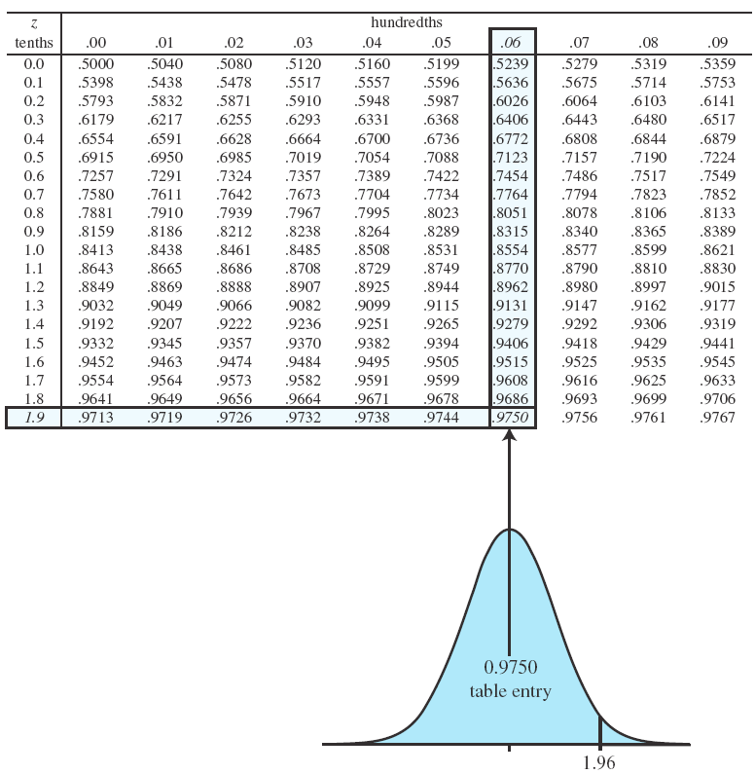
Example: A Z variable of 1.96 has cumulative probability 0.9750.

Slide 21
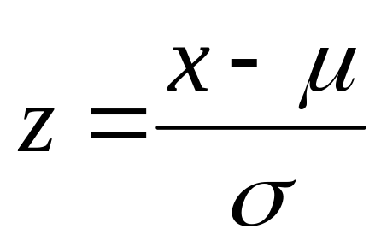
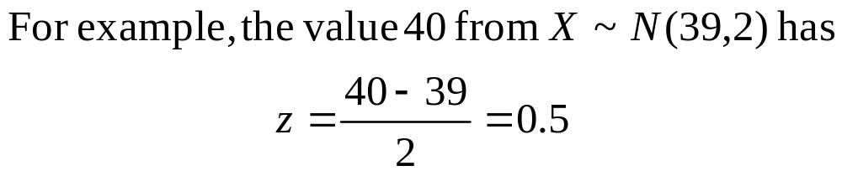
Step 2 (cont.)
Turn value into z score:
z-score = no. of σ-units above (positive z) or below (negative z) distribution mean μ

Slide 22
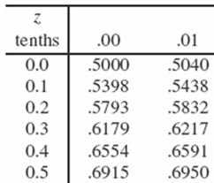
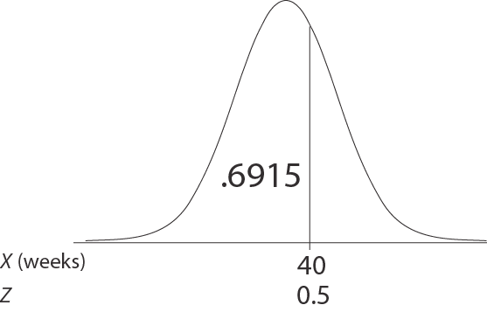
Steps 3 & 4: Sketch & Table B
3. Sketch
4. Use Table B to lookup Pr(Z ≤ 0.5) = 0.6915

Slide 23
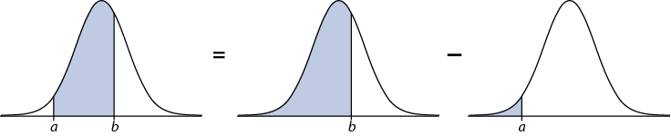
Probabilities Between Points
a represents a lower boundary
b represents an upper boundary
Pr(a ≤ Z ≤ b) = Pr(Z ≤ b) − Pr(Z ≤ a)

Slide 24
Between Two Points
Pr(-2 ≤ Z ≤ 0.5) = Pr(Z ≤ 0.5) − Pr(Z ≤ -2)
.6687 = .6915 − .0228
.6687
.6915
.0228
-2
0.5
0.5
-2
See p. 144 in text

Slide 25
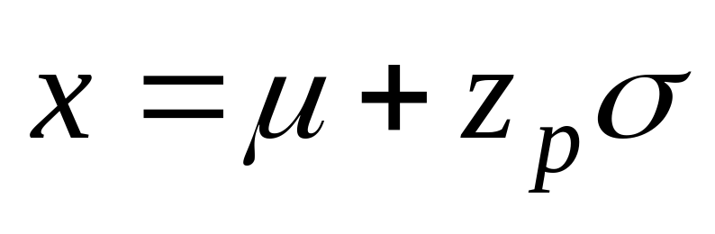
§7.3 Values Corresponding to Normal Probabilities
State the problem
Find Z-score corresponding to percentile (Table B)
Sketch
4. Unstandardize:

Slide 26
z percentiles
z_{p} ≡ the Normal z variable with cumulative probability p
Use Table B to look up the value of z_{p}
Look inside the table for the closest cumulative probability entry
Trace the z score to row and column

Slide 27
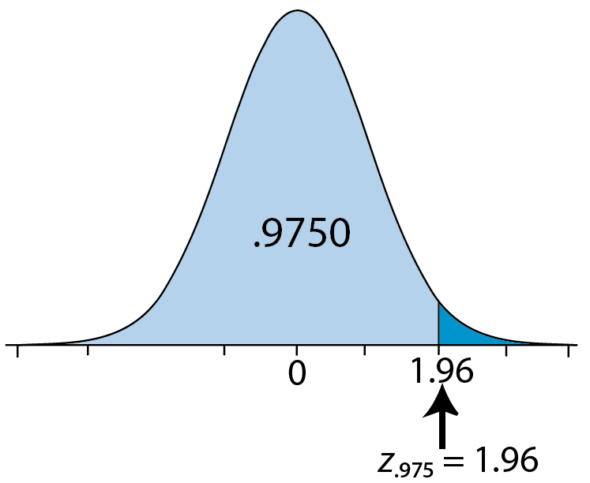
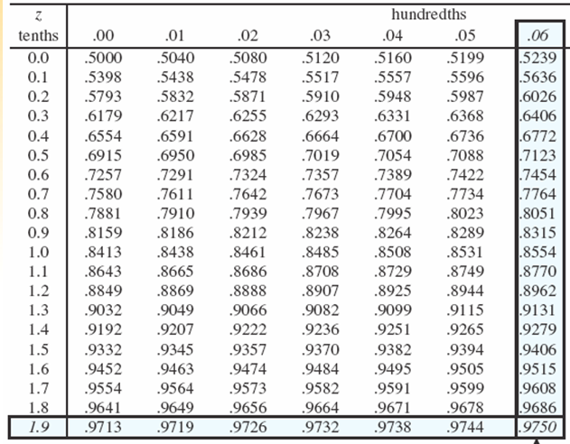
e.g., What is the 97.5th percentile on the Standard Normal curve?
z_{.975} = 1.96
Notation: Let z_{p} represents the z score with cumulative probability p,
e.g., z_{.975} = 1.96

Slide 28
Step 1: State Problem
Question: What gestational length is smaller than 97.5% of gestations?
Let X represent gestations length
We know from prior research that
X ~ N(39, 2)
A value that is smaller than .975 of gestations has a cumulative probability of.025
Notes:
Chapter 7
Basic Biostat

Slide 29
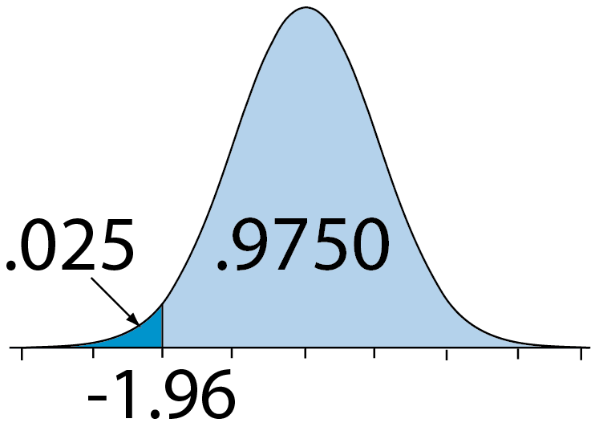
Step 2 (z percentile)
Less than 97.5% (right tail) = greater than 2.5% (left tail)
z lookup:
z_{.025} = −1.96
z | .00 | .01 | .02 | .03 | .04 | .05 | .06 | .07 | .08 | .09
–1.9 | .0287 | .0281 | .0274 | .0268 | .0262 | .0256 | .0250 | .0244 | .0239 | .0233
Notes:
Chapter 7
Basic Biostat

Slide 30
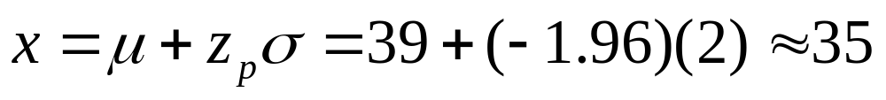
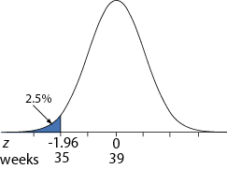
Unstandardize and sketch
The 2.5th percentile is 35 weeks

Slide 31
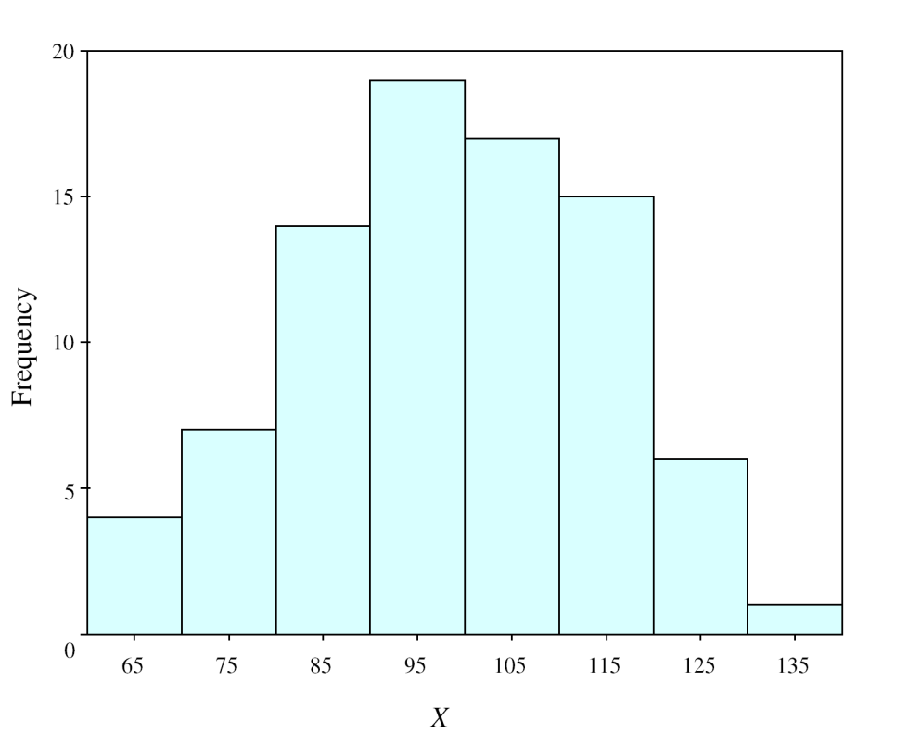
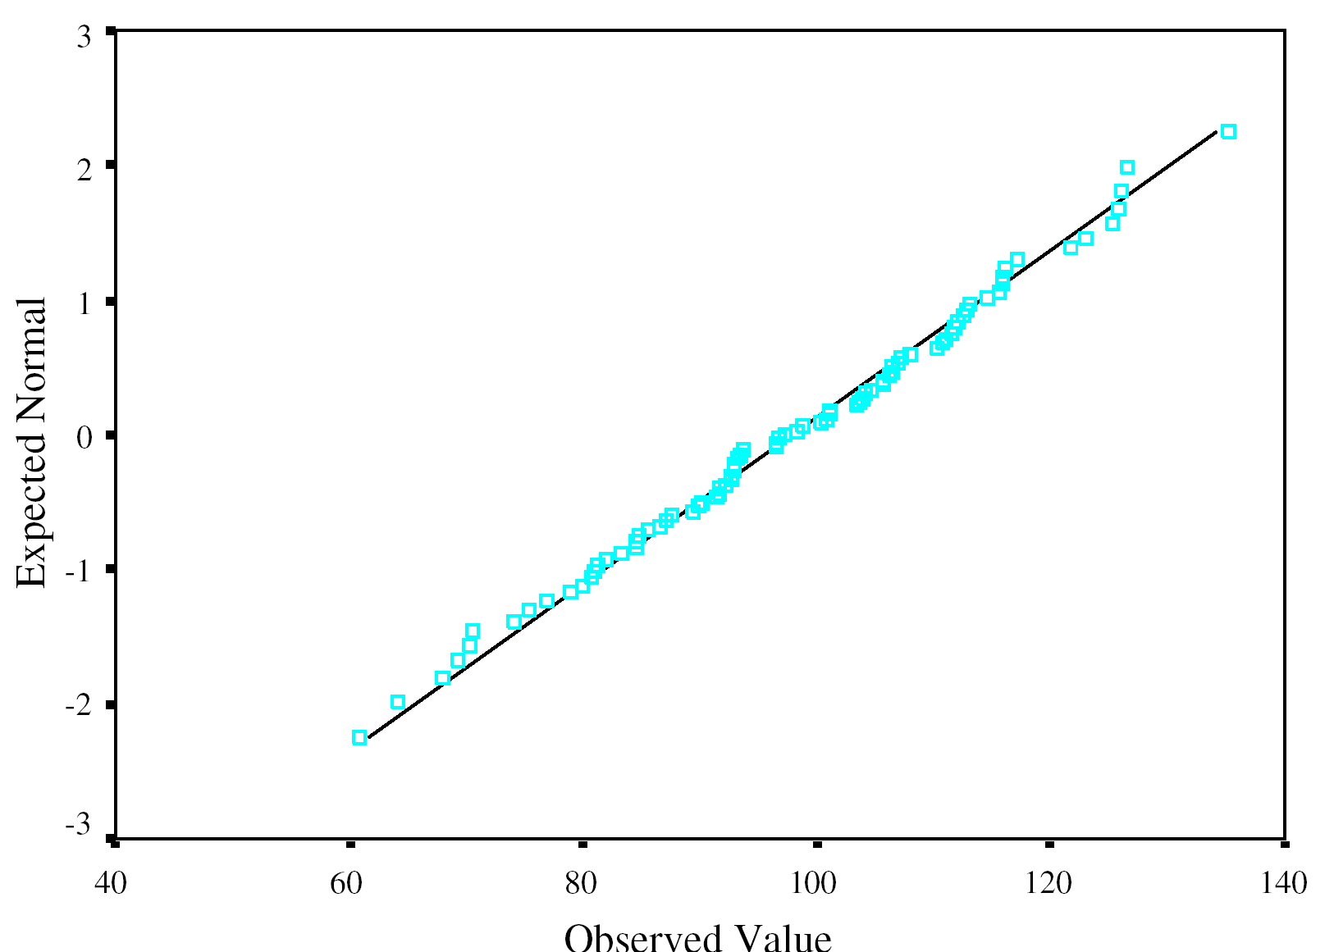
7.4 Assessing Departures from Normality
Approximately Normal histogram
Same distribution on Normal “Q-Q” Plot
Normal distributions adhere to diagonal line on Q-Q plot

Slide 32
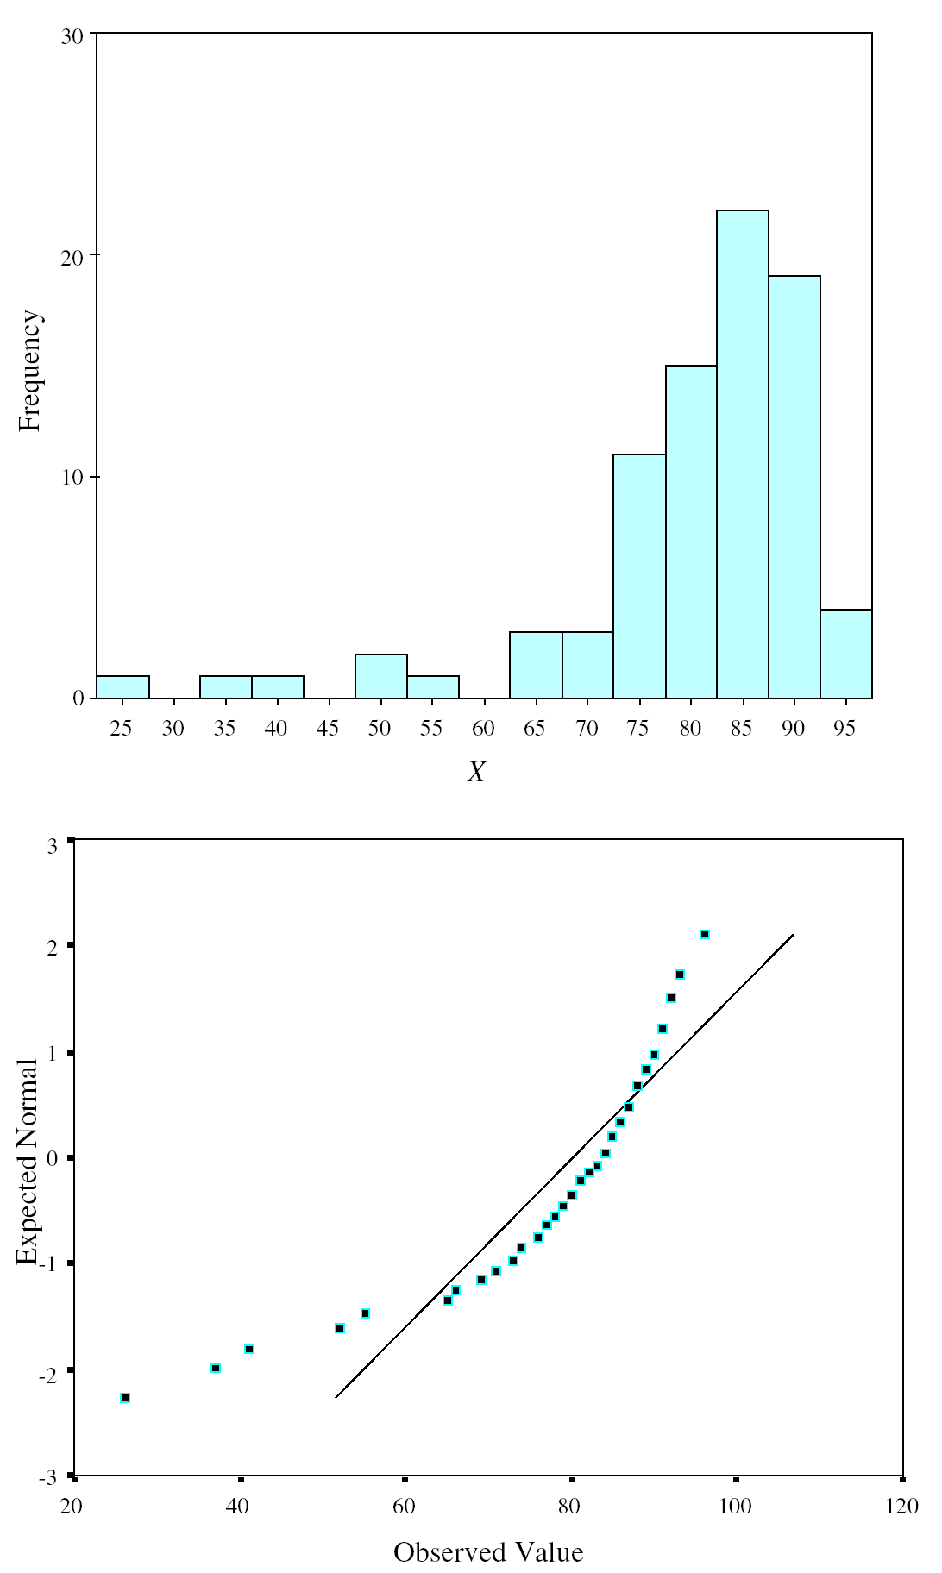
Negative Skew
Negative skew shows upward curve on Q-Q plot

Slide 33
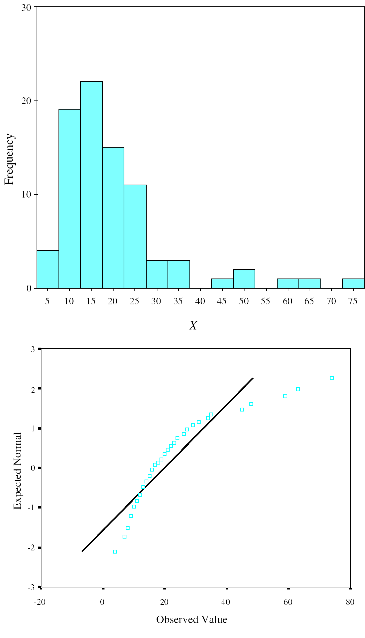
Positive Skew
Positive skew shows downward curve on Q-Q plot

Slide 34
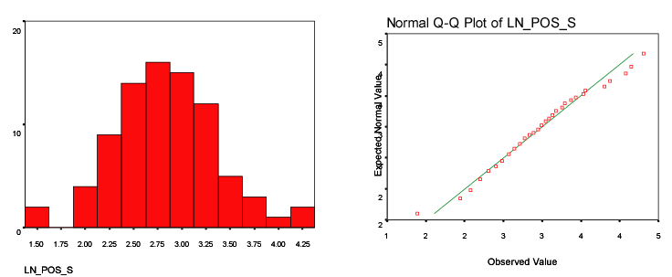
Same data as prior slide with logarithmic transformation
The log transform Normalize the skew

Slide 35
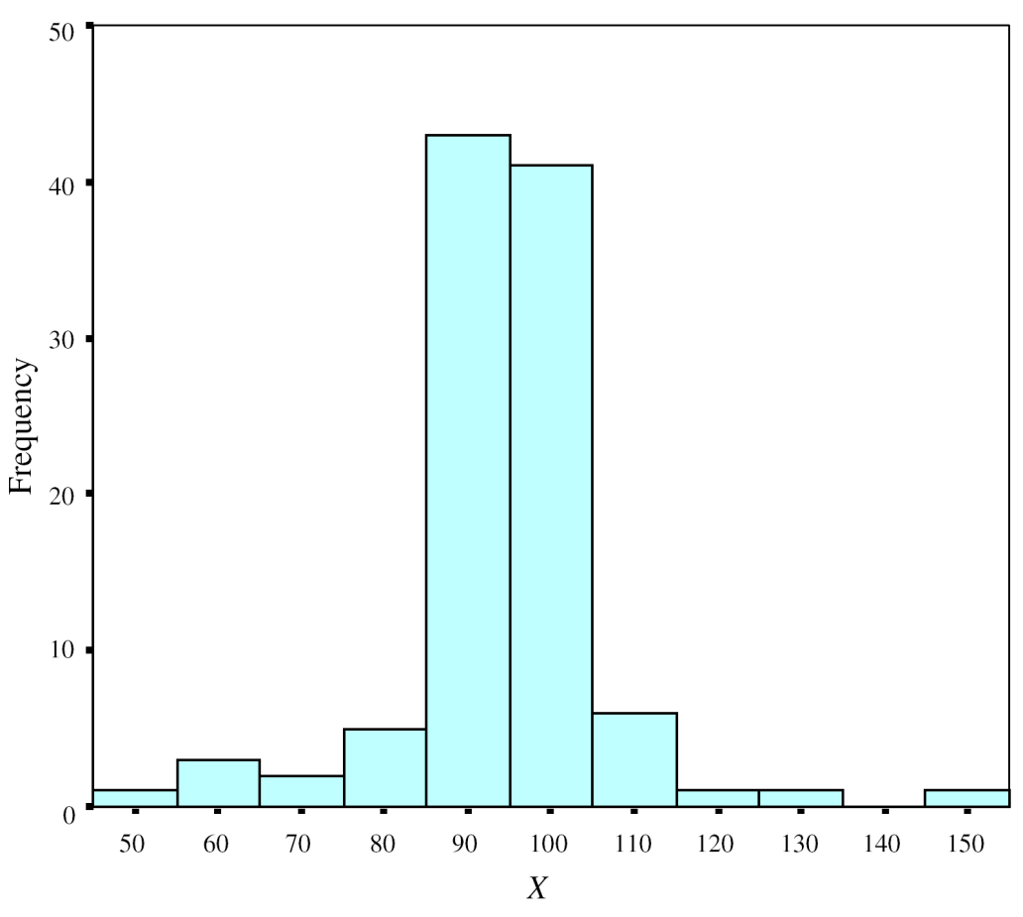
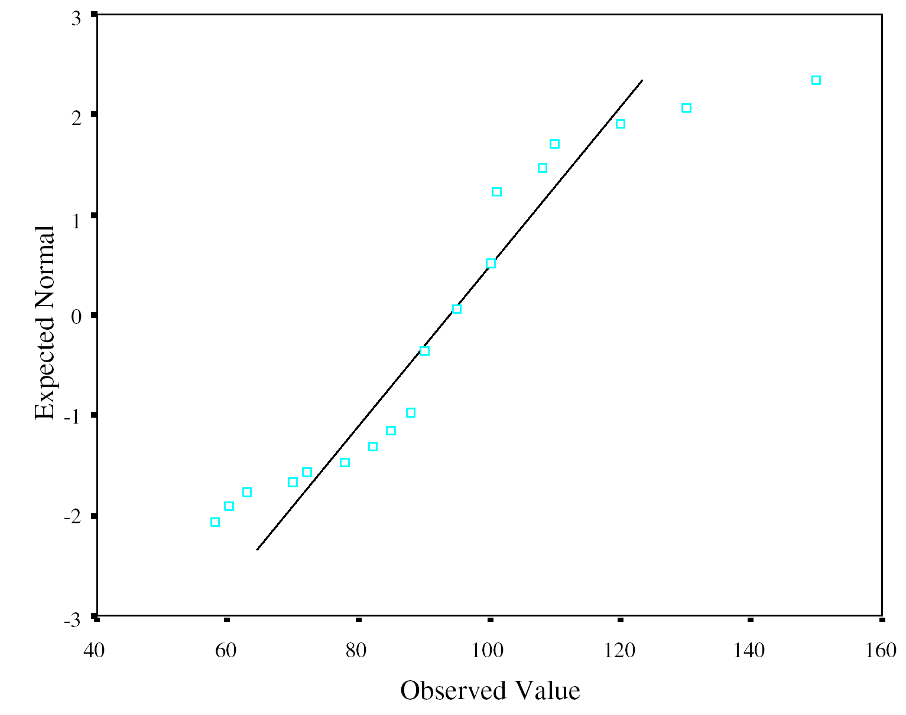
Leptokurtotic
Leptokurtotic distribution show S-shape on Q-Q plot

