Slide 1
Analysis on Venue Categories in Toronto Downtown and Manhattan¶

Slide 2
Background
New York, like Toronto,With every new wave of immigration, a new food scene inevitably follows. Now neighborhoods such as Coney Island, Corona, Flushing, Jackson Heights and Sunset Park are being revitalized the same way with new foods,New hangout spots from Ethiopian to Malaysian style.The New wave of immigration has led to explosion of population. There is a need to have new city planning.

Slide 3
Problem
Here in this study we are analyzing about different venues in Manhattan ,NY(lively neighborhoods with huge population) and Toronto Downtown (CA) neighborhoods.The ever growing population in Toronto has led to the expansion of Toronto Downtown area by 7000 sq km.Therefore a Canadian based real estate company ABC wants to invest on commercial properties to make Toronto more livelier and enjoyable experience.

Slide 4
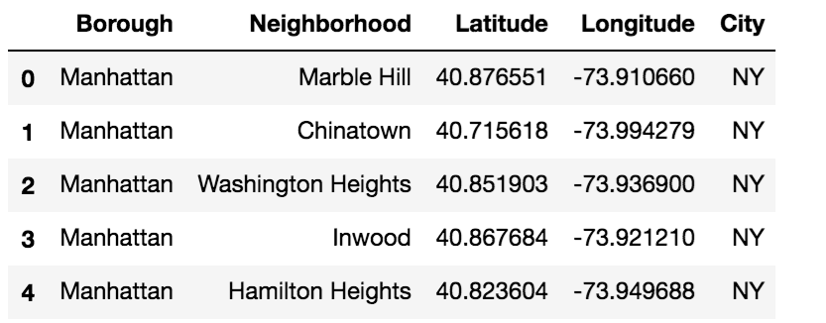
Data Acquisition and Cleaning:
Now,we need to create a data-frame for Newyork that contains Neighborhood,Latitude,Longitude and Boroughs values.Filter this data-frame by Manhattan.Like mentioned above create a data-frame for Toronto and then filter by Downtown Toronto borough containing the same columns as Manhattan data-frame. Merge the Manhattan data-frame, Downtown Toronto data-frame as shown:

Slide 5
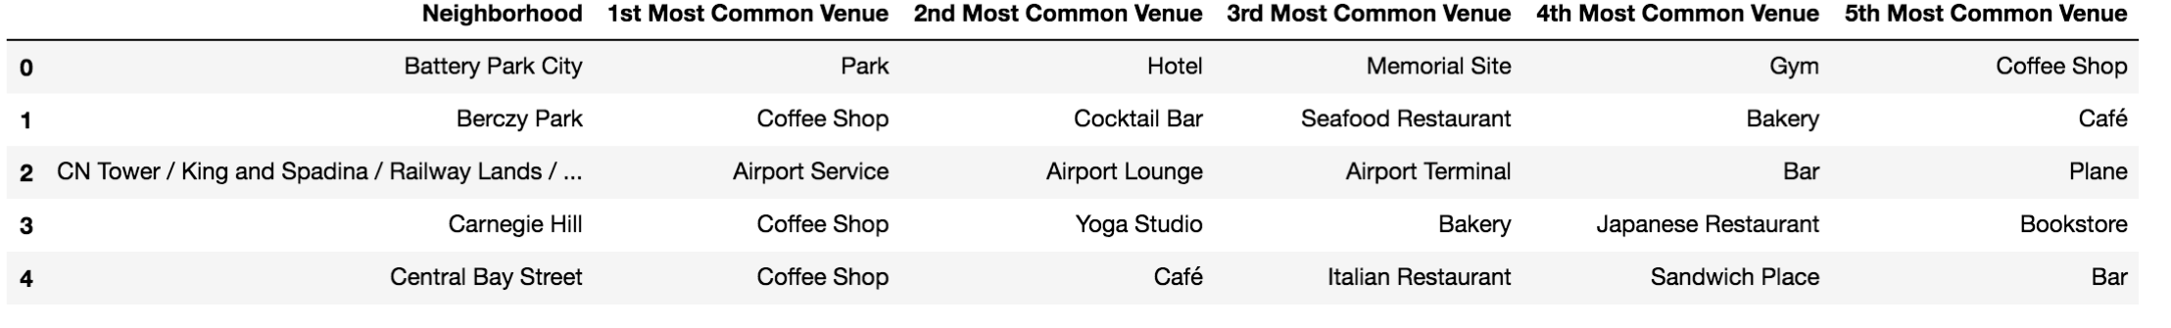
Data Analysis
Find the nearby venue categories of each neighborhoods in downtown Toronto and Manhattan .Now find mean of each venue by neighborhood .This gives the most frequented category in each neighborhood.Table gives the top 5 frequented venue category.

Slide 6
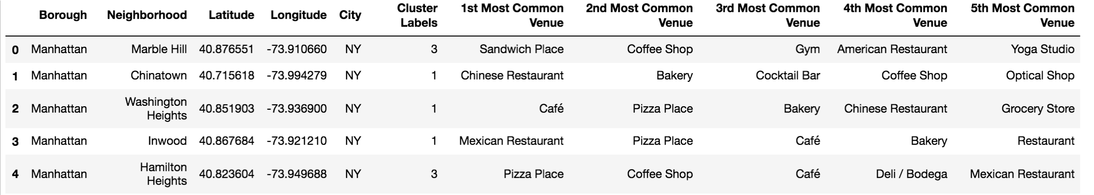
Predictive Model
In our analysis , k-means algorithm is used to cluster the neighborhood into 4 clusters.The result should give us either neighborhoods of downtown Toronto and Manhattan in one single cluster which means they have similarity between each other in terms of venue category or they don't come together in any cluster ,then its not similar.The kmeans algorithm is run on top5 frequented venues data-frame.It divides the neighborhoods of Manhattan and Downtown Toronto into 4 cluster by frequented venue categories , which is indicated by cluster labels column.

Slide 7
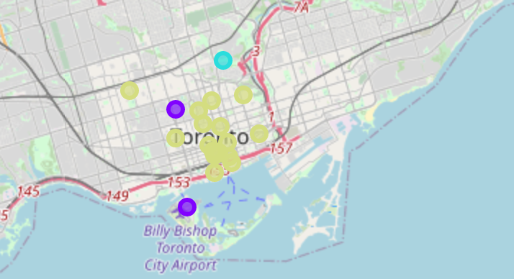
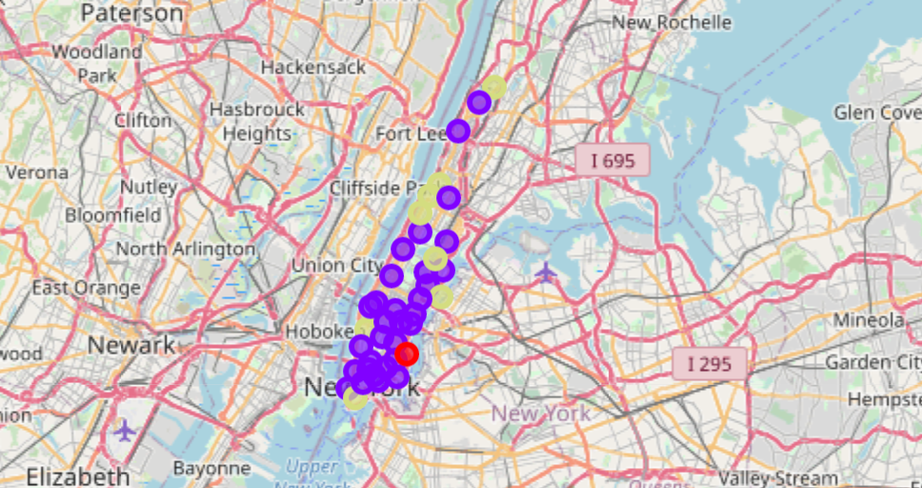
Lets Visualize the 4 clusters in the Map
fig1:location of Clusters in Toronto Neighborhood
fig2:location of Clusters in Manhattan Neighborhood

Slide 8
Observation
Cluster 1 : Contains Venues such as boating/ferry ,baseball court etc from Manhattan
Cluster 2:.The most frequently occurred categories are restaurants(Italian,Mexican,Chinese,African),theaters,Gyms,Yoga studios seems to be the frequented places. The venues are mainly from neighborhoods of Manhattan
Cluster 3: Contains Venues such as Park,Playground,etc from Downtown Toronto. Cluster 4: Contains venues in neighborhoods from Manhattan and Toronto.Coffee shop and cafe seems to be extremely frequently occurred category for the respective neighborhoods.Adding to the above art gallery,park,sandwich store seems to be a frequented category for Manhattan neighborhood.

Slide 9
Discussions
There are lot more varieties of restaurants ranging from Italian,middle eastern to African in Manhattan whereas in Toronto Downtown it seems one dimensional with too many coffee shops and cafes,though there are many restaurants, it lacks variety. But to me a safe bet would be a art gallery or Sandwich shop as all the manhattan neighborhood that had cafe and coffee shop as a frequented venue ,the art gallery and Sandwich shop was also a frequented Venue.These venues on the other hand complements well with coffee shops and cafes
Conclusions
I did not have any datas of number of people who visited the venues each day(popular??).Though both the places have diverse population it is also better to know the ethnic demographics of each neighborhood to come to a better conclusion.The above venue is the best possible recommendation with the data available.

