Slide 1

VELLORE INSTITUTE OF TECHNOLOGY
2024 September 04
Title:
Developing an Automated Anomaly Detection System for Network Logs
Advisor
Team Members
Dr. Jannath Nisha O S
N Sairam Gopal - 21BRS1459
D L K Trinadh - 21BAI1579
Rishi Patri - 21BPS1396
BCSE409J - Project -1

Slide 2
I
Area of the project
2024 September 04
The area of our project lies at the intersection of network security, machine learning, and data analysis. Specifically, we’re focusing on developing an automated system for detecting anomalies within network logs using K-means clustering. This involves analyzing patterns in network activity to identify unusual or potentially malicious behavior. Such a system is important for improving network security because it helps quickly spot and address threats that could harm or damage network systems.
2
2

Slide 3
II
Background of the problem
Growing Complexity of Network Infrastructures: Modern networks are increasingly complex, consisting of various interconnected systems, devices, and applications. This complexity results in a huge amount of network log data, making it hard to keep track of and manage everything effectively. As networks grow, so does the difficulty in identifying anomalous behavior that could signal security threats or system malfunctions.
Volume and Variety of Network Logs: Network logs generate massive volumes of data that include different types of records such as traffic data, error logs, and system events. The sheer quantity of data combined with its diverse formats and sources makes manual analysis impractical. Automated systems are crucial for efficient processing and analyzing this data to detect anomalies in real time.
Importance of Anomaly Detection: Anomalies in network logs often signify important events such as security breaches, system failures, or performance issues. Early detection of these anomalies is critical for mitigating potential damage, enhancing security, and ensuring smooth operation. Traditional methods of anomaly detection often rely on predefined rules, which may not adapt well to evolving patterns of network behavior.
2024 September 04
3
2

Slide 4
II
Background of the problem
Limits of Traditional Methods: Modern Older methods for spotting anomalies can be inflexible and may not handle the changing nature of networks very well. These methods often need a lot of manual adjustment and may not provide useful insights without significant human effort.
Using K-means Clustering: K-means clustering is a method that groups similar data points. When used on network logs, it can help identify normal patterns and make deviations from these patterns easier to spot as potential problems. However, finding the right number of groups and dealing with complex data can be challenging.
Need for Automated Solutions: With the growing complexity and amount of network data, automated anomaly detection systems are essential. These systems need to handle large amounts of data, adapt to new patterns, and provide useful insights with minimal manual input. K-means clustering can be a valuable tool for developing such systems.
2024 September 04
4
2

Slide 5
III
Problem Statement
2024 September 04
Our project aims to build an automated system that can spot unusual patterns in network logs using a mix of K-means clustering, Isolation Forest, and t-SNE. The goal of this project is to detect anomalies in server log data using machine learning techniques. The anomalies in the logs represent unusual or unexpected behaviors that could indicate issues like system failures, security breaches, or other operational problems, which are generated by a remote server over one month. The dataset comprises 721,547 rows with three columns: timestamp, user ID, and IP address. The challenge is to identify unusual patterns in this data that could indicate anomalies using various unsupervised learning methods, including clustering and isolation forests.
5
2

Slide 6
IV
Abstract
2024 September 04
Anomaly detection is essential for identifying unusual patterns in system logs, ensuring reliability, and security. Our project, Anomaly Log Detection, uses machine learning techniques to detect anomalies in log data. It employs K-means clustering and t-SNE for reducing dimensionality and presenting data visually. Isolation Forest and One-Class SVM boost precision in identifying infrequent or abnormal occurrences.
By integrating these techniques, the project establishes a strong foundation for identifying abnormalities in areas such as cybersecurity, performance tracking, and proactive maintenance. The findings indicate that this method successfully detects anomalies, allowing for timely recognition of possible problems.
6
2

Slide 7
V
Introduction
2024 September 04
As systems generate massive volumes of log data, the detection of unusual patterns and anomalies is essential for the reliability and security of such systems. The older methods find it hard to handle the complexity and scale of the modern logs, and thus, there is a need for anomaly detection. Our project “Anomaly Log Detection” makes use of techniques such as K-means clustering, t-SNE for dimensionality reduction, and more advanced models of Isolation Forest and One-Class SVM for detecting outlying points in log data. The objective is to furnish an efficient scalable solution for the early detection of potential system issues and security threats.
7
2

Slide 8
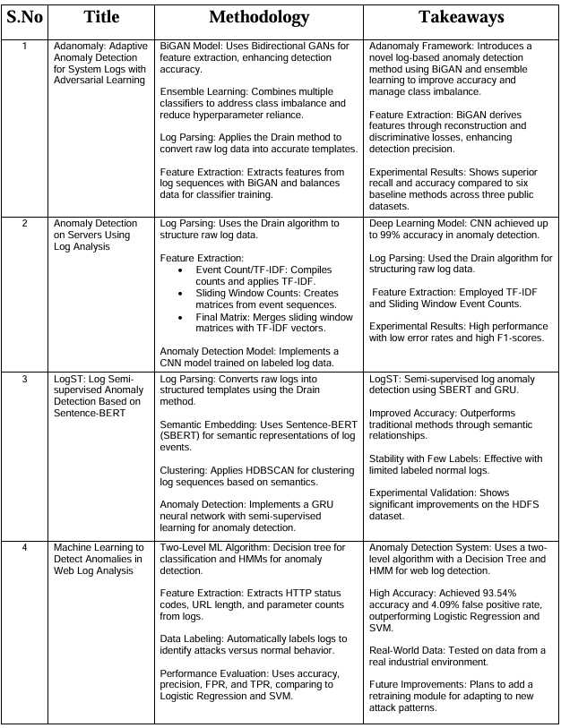
VI
Literature Survey
2024 September 04
8
2

Slide 9
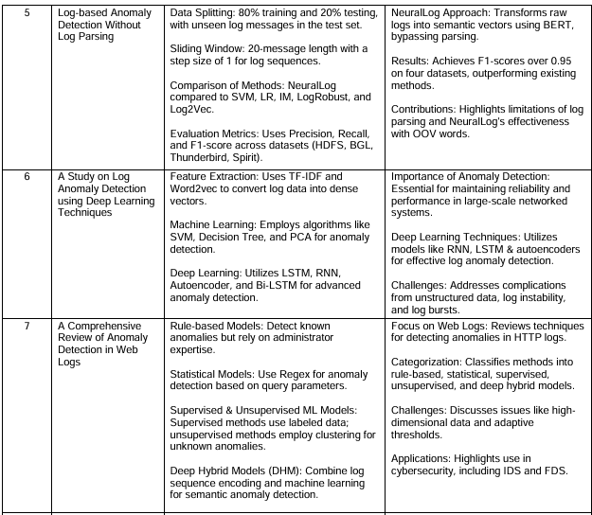
VI
Literature Survey
2024 September 04
9
2

Slide 10
VII
Methodology
Our project “Anomaly Log Detection” employs a multi-step machine learning approach for identifying anomalies in system log data. The methodology consists of the following key components:
1) Data Preprocessing:
Log data is collected and preprocessed by eliminating unwanted data, normalizing structure, and identifying important characteristics. This leads to the cleaning of the data before modeling.
2) Baseline Classifiers:
The baseline models calculate the initial performance metrics. These classifiers are compared with more complex models based on these baseline models. Baseline scores and weighted F1-score are metrics that indicate how well each model copes with imbalanced data.
3) Dimensionality Reduction:
We apply t-SNE for a better visualization and comprehension of the high-dimensional log data by reducing the data into lower dimensions while trying to maintain the relationships between the points and to identify the clusters and possibly anomalies.
2024 September 04
10
2

Slide 11
VII
Methodology
4) Stacking Classifier Approach:
A stacking classifier is used to merge several basic classifiers into a stronger model. The way the stacking classifier works is as follows:
Estimators: A compilation of basic classifiers (such as K-means, Isolation Forest, and One-Class SVM) act as the foundational models.
Meta-Classifier: A final meta-classifier is defined to combine the outputs of the base classifiers, improving the overall prediction performance.
Cross-validation (CV): This is conducted to verify the strength of the model. It prevents overfitting and makes sure that the model generalizes well to unseen data.
5) Model Evaluation:
The anomaly detection models are rated based on metrics such as the mean F1-weighted score, precision, recall, and accuracy. These depict how perfectly the models can identify anomalies without giving false positives or false negatives.
2024 September 04
11
2

Slide 12
VIII
Comparison of Traditional
2024 September 04
Method | Traditional Methods | Our Approach
Detection Flexibility | Limited to known patterns | Capable of detecting unknown or evolving anomalies
Threshold | Requires explicit thresholds/rules | Automatically clusters and detects outliers based on patterns
Handling High Dimensionality | Challenging | Effective (especially with t-SNE for visualization)
Scalability | Limited | Scalable; models like Isolation Forest and One-Class SVM handle large data well
Adaptability to New Patterns | Low | High, with models adjusting based on underlying log data patterns
False Positive Rate | Higher for unknown anomalies | Generally lower, as patterns are learned rather than fixed
12
2

Slide 13
IX
Results
2024 September 04
In our project Anomaly Log Detection, a K-Means model was performed on the log data using clustering that showed an optimum number of clusters as 6; t-SNE plotting was conducted in two-dimensional space, and for the anomaly-detection task, the best model applied was a Isolation Forest model with 0.028 contamination with 11 anomalies detected among 386 samples.
13
2

Slide 14
Implementation
2024 September 04
Data Preprocessing:
Steps like data cleaning and normalization to prepare input.
Feature Reduction & Clustering:
Applied t-SNE for dimensionality reduction and K-means for clustering.
Anomaly Detection:
Used Isolation Forest to identify and filter outliers.
14
2

Slide 15
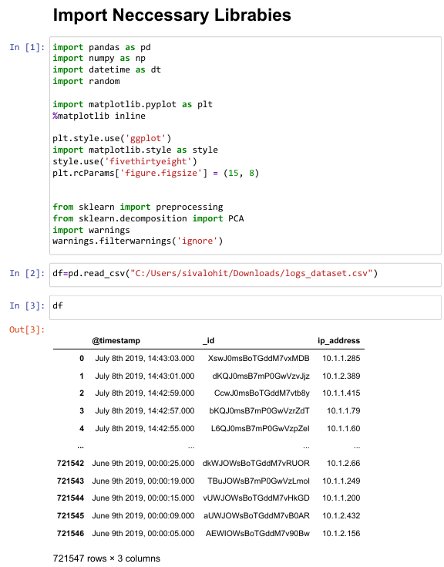

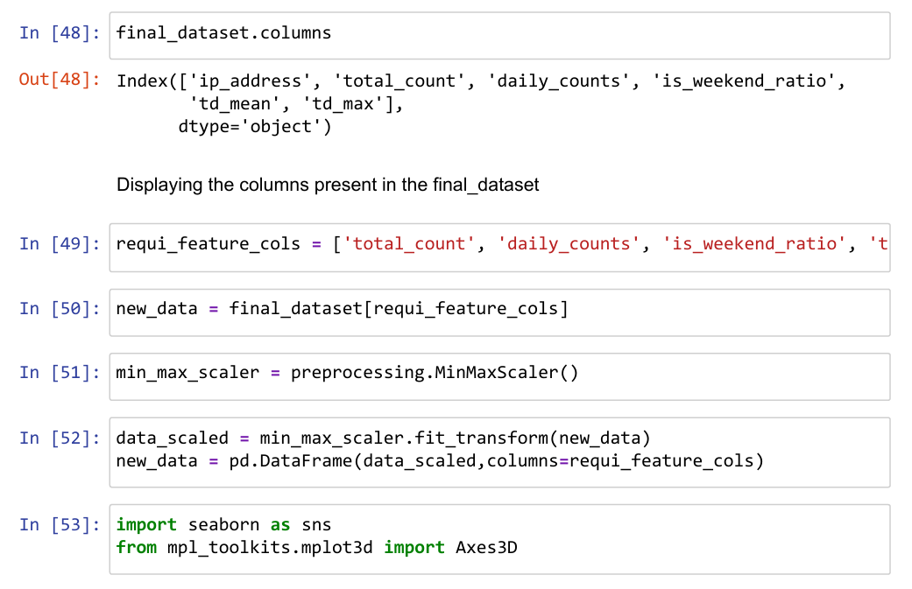
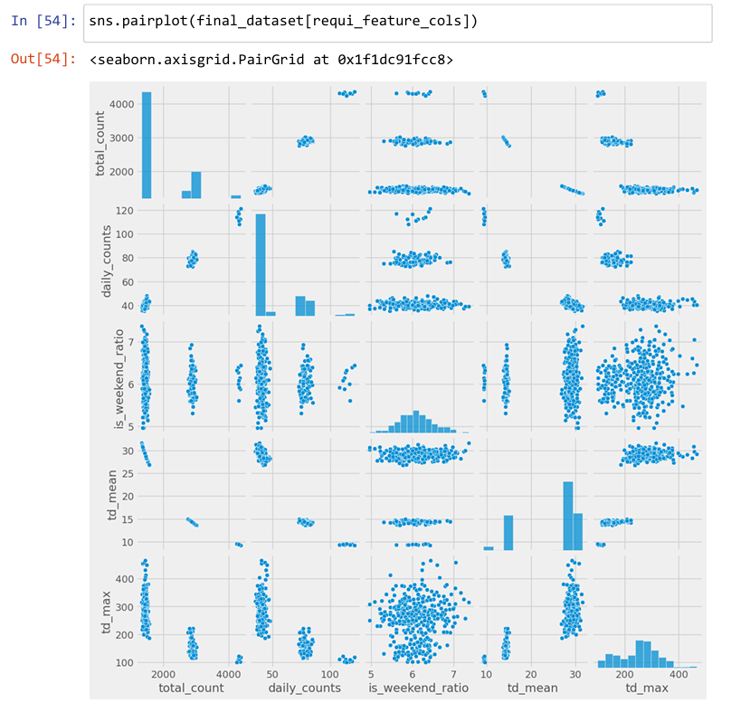
Implementation
2024 September 04
15
2

Slide 16
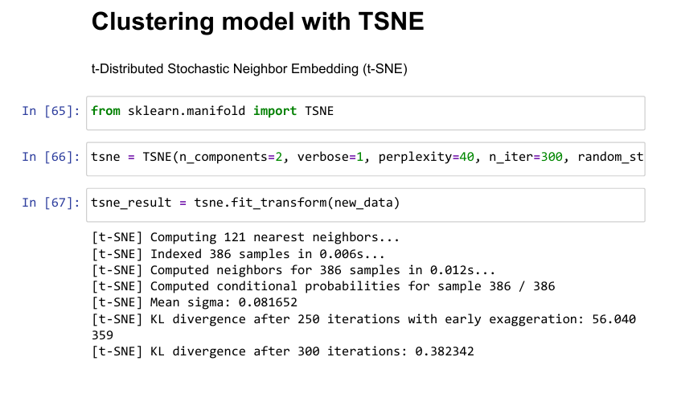

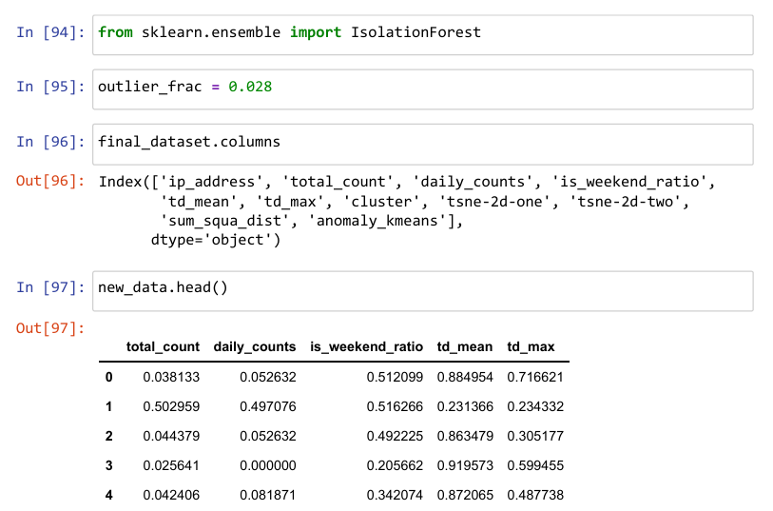
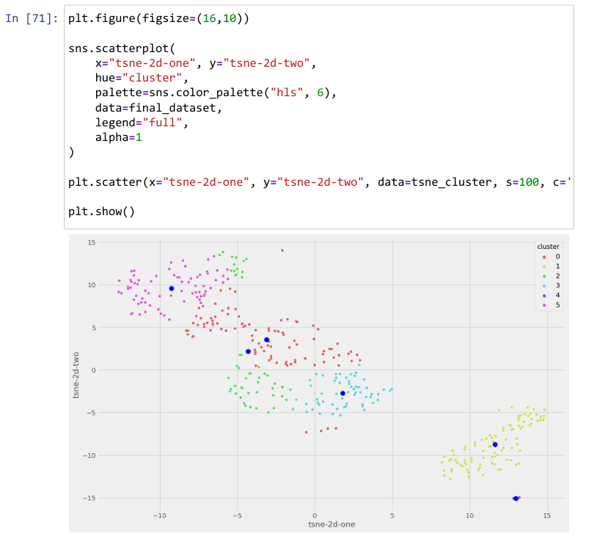
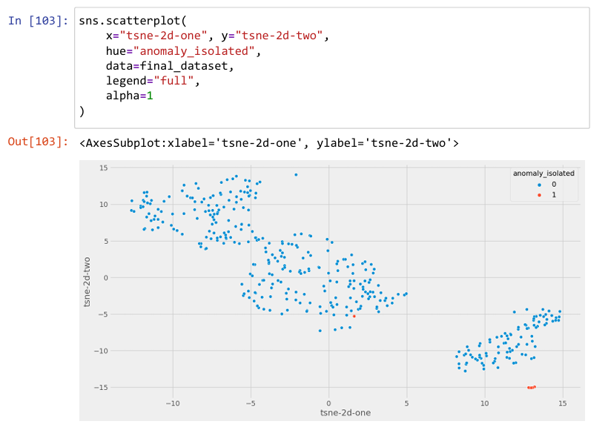
Implementation
2024 September 04
16
2

Slide 17
X
Discussions
2024 September 04
The automated anomaly detection system for network logs aims to improve the security of the network by identifying unusual patterns with the help of machine learning techniques such as K-means clustering, Isolation Forest, and One-Class SVM. The stacking of multiple classifiers improves the accuracy of anomaly detection.
The system still shows promise but needs further optimization toward scalability and real-time integration into network monitoring systems. The tool aims to go beyond detecting anomalies and dynamically adapt to the changing behavior of networks for continued security.
17
2

Slide 18
XI
Conclusion
2024 September 04
An automated anomaly detection system for network logs offers the most effective way to track anomalies and potential security threats in real-time. This it achieves by making use of techniques such as K-Means clustering, Isolation Forest, and One-Class SVM for unknown anomaly identification without a need for labeled data.
The stacking classifier enhances the accuracy of the detection and is, therefore, a good tool for network monitoring. In all, more testing and optimizations in diverse networks are required to guarantee its scalability and appropriateness for performance within real-time scenarios on the security aspects. This is prone to significantly influencing the management of network security within this digital age.
18
2

Slide 19
VELLORE INSTITUTE OF TECHNOLOGY
2024 September 04
Thank you
BCSE409J - Project -1

