Slide 1
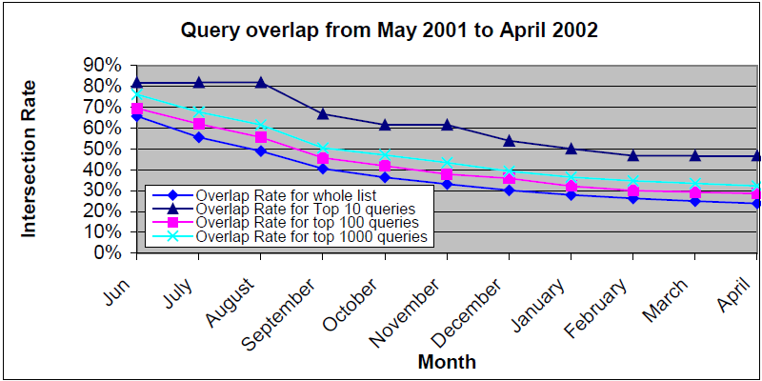
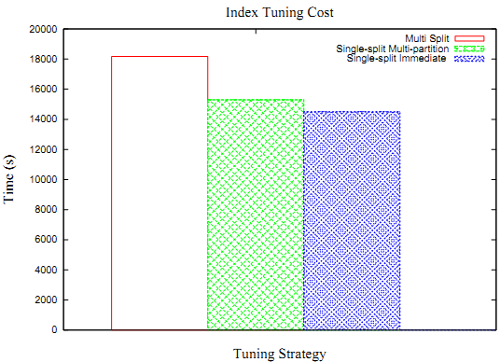
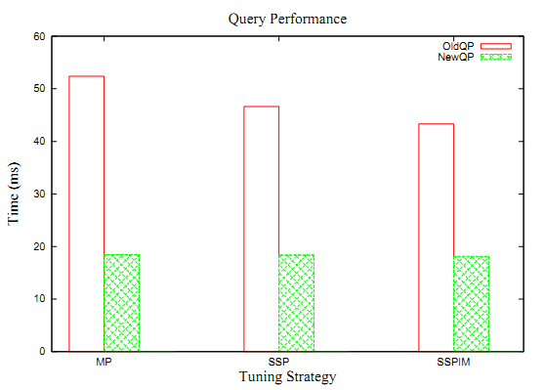



Index Tuning for Query-log based On-line Index Maintenance Sairam Gurajada and Sreenivasa Kumar P gurajada@mpi-inf.mpg.de, psk@cse.iitm.ac.in
Motivation
AOL Query log analysis^{[3]}
How to update existing inverted
index On-line efficiently??
Solution: Static Query-log based approaches
Challenges: Rely on frequency distribution of terms in a static query-log and NOT adaptable to changes in query-log
Solution: Index Tuning
Measures:
❖ Overlap Rate
Correlation coefficient
Findings | Average Correlation Coefficient | Average Overlap Rate
Month-to-Month | 0.905 | 0.881
Quarterly | 0.833 | 0.820
Semi Yearly | 0.795 | 0.785
Static Query-log based approaches
Exploits query-log statistics for on-line index maintenance
❖ Only 20-30% of all unique queries survive for the whole year
Terms are classified into
Frequent-terms (freq > threshold)
Infrequent-terms (freq < threshold)
Horizontal Partition of index into
Frequent-term index (findex) (using Active Merge Policy)
Infrequent-term index (ifindex) (using Lazy Merge Policy)
Algorithm
Identifying the diff-terms Step 1
Diff-terms are the terms whose frequencies got changed and are previously misclassified by static query-log based approaches.
Limitations
❖ Threshold used for classification of terms is static
❖ Not adaptable to dynamic changes in query-log
Building diff-term index Step 2
Extracting postings list for diff-term - is similar to querying the index for diff-term with deletion (lazy)
Extracted postings lists are grouped to form diff-term index
Index Tuning
Index Tuning refers to transforming existing on-disk index
to new index incorporating changes to query-log
Merging diff-term index with existing index Step 3
Diff-term index is treated like any other auxiliary index
Inserted into the existing index by using the corresponding merge policy of static query-log approaches
Three step approach
❖ Identifying the diff-terms
❖ Building diff-term index
❖ Merging diff-term index with existing index
Experimental Evaluation
SSIM – Single-split Immediate Merge, SSMP – Single-split Multiple Partition, MSI – Multi-split Indexing
Index Tuning cost for SSIM is 7% less of SSMP,
and 25% less of MSI
Query costs improved by
58% - SSIM
61% - SSMP
64% - MSI
Index tuning costs for three on-line indexing approaches
Query performance after index tuning
References
[1] Sairam Gurajada, and Sreenivasa Kumar P, On-line Index Maintenance Using Horizontal Partitioning, CIKM 2009
[2] G. Pass, A. Chowdhury, and C. Torgeson. A picture of search. InfoScale '06
[3] Query-Log Analysis, www.ir.iit.edu/~abdur/publications/QueryResearch.pdf
Indian Institute of Technology
Madras

