Slide 1


Using Graph Summarization for Join-ahead Pruning in a Distributed RDF Store
Sairam Gurajada (MPI Informatics, Germany), Stephan Seufert (MPI Informatics, Germany)
Iris Miliaraki (MPI Informatics, Germany)*
Martin Theobald (University of Antwerp, Belgium)
*currently with Yahoo Labs, Barcelona

Slide 2
Motivation
RDF is becoming more ubiquitous
Many organizations now support and publish RDF data
>30 billion triples in LOD !
Many of the existing centralized and distributed RDF systems are relational-based…
Face performance issues because of generating large intermediate relations (most of them are “dangling triples”)
Reasons: inaccurate/insufficient statistics and resulting poor query plans
How to prune dangling (irrelevant) triples – join-ahead pruning
Some solutions: Sideways Information Passing (SIP) (runtime), Graph Summarization

Slide 3
Recap: Join-ahead Pruning
Sideways Information Passing
Is a powerful technique to prune irrelevant triples
R_{1,2,3,4}
?p ∈{B}
SELECT ?p, ?c, ?a, ?g
WHERE {
R1: ?p <born> ?c.
R2: ?c <located> <USA>.
R3: ?p <won> ?a.
R4: ?p <governor> ?g }
R_{1,2}
R_{3,4}
?p ∈{B}
?p ∈{B}
R₁
R₂
R₃
R₄
?p ∈
{A,B,C}
?p ∈ ?p
{B,D,E}
Works well for certain class of queries – star queries
Many false positives – less savings in I/O costs
Requires synchronization in a distributed setting
Notes:
Partial reduction in I/O costs

Slide 4
Recap: Graph Summarization
Graph Summarization is an approach to represent information/data in concise form
Summary encodes all characteristic properties of the graph
Summarization helps in making query processing faster
First lookup in the summary, if yes, then lookup only in the relevant portions of the data graph
Extensively studied in XML and other domains
Data guides, bi-simulation,…

Slide 5
Join-ahead Pruning via Graph Summarization
A summary is constructed for the RDF data graph
Query processing is performed in two stages:
Stage 1: On Summary graph to identify portions of the graph that (may) contribute to the query answers
Stage 2: On induced data graph – considering summary information
Advantages:
Decouples join-ahead pruning and data graph query processing
Which kinds of summaries are good for RDF data?
Locality-based, Bi-simulation

Slide 6
1. Locality-based Graph Summariztion
1:Barack_Obama
2:won
15:Lady_Gaga
Locality-based non-overlapping
Partitioning
1:born
2:won
2:won
3:type
3:type
1:born
2:Honolulu
4:member
14:Grammy_Award
13:New_York
3:Democrates
5:located
12:Artist
5:located
4:USA
Summary Graph
5:located
5:located
6:Texas
11:Peace_Nobel_Price
2:won
P₂
1:born
2:won
3:type
6:governor
3:type
5:located
10:Plains
2:won
P₁
7:George_W_Bush
3:type
1:born
1:born
1:born
4:member
5:located
3:type
5:New_Haven
4:member
9:Jimmy_Carter
2:won
8:Republicans
4:member
5:located
5:located
P₄
P₃
Intuition: with constants in the query, results are in the neighborhood of the constants
4:member
SELECT ?c, ?a
WHERE {
<Barack_Obama> <born> ?c.
?c <located> <USA>.
<Barack_Obama> <won> ?a }
1:born
2:won
1:born
4:member
6:governor

Slide 7
2. Bi-simulation-based Graph Summarization
Barack_Obama
won
Grammy_Award Peace_Nobel_Prize
won
Jimmy_Carter
isA
bornIn
bornIn
won
isA
bornIn
Honolulu
Plains
New_Haven
New_York
Artist
Lady_Gaga
member
bornIn
locIn
member
governor
Democrates
Republicans
George_W_Bush
Texas
locIn
USA
SELECT ?c, ?a
WHERE {
<Barack_Obama> <born> ?c.
?c <located> <USA>.
<Barack_Obama> <won> ?a }
Bi-simulation summaries can be as large as the data graphs
Summary size can be controlled by the bi-simulation depth
Good for queries that do not or have less constants
For rest of the talk, we consider only locality-based graph summarization

Slide 8
Querying Summary Graph
Approaches:
Relational joins
Graph exploration
1-hop exploration [Trinity.RDF]
Full exploration [TriAD]
2:won
P₂
1:born
2:won
3:type
P₁
3:type
SELECT ?c, ?a
WHERE {
(R1) <Barack_Obama> <born> ?c.
(R2) ?c <located> <USA>.
(R3) <Barack_Obama> <won> ?a }
1:born
4:member
5:located
3:type
2:won
5:located
5:located
P₄
P₃
4:member
(R1) <Barack_Obama> <born> ?c.
(R2) ?c <located> <USA>.
(R3) <Barack_Obama> <won> ?a }
1:born
2:won
1:born
4:member
6:governor
Global Dictionary:
Barack_Obama → P₁ USA → P₁
Lady_Gaga → P₂ Piece_Nobel_Price → P₄
…
For efficiency, exploration order matters!!

Slide 9
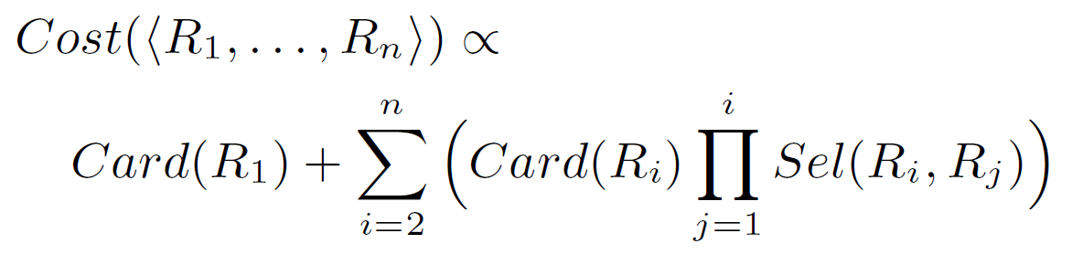
Exploration Order Optimization
Given a conjunctive query Q with patterns {R1, R2, R3, … Rn}
One possible exploration order is: < R2, R5, R1, … R6>
We use statistics to compute the best exploration order
Where Card(R) is the cardinality of relation R,
Sel (R,S) is the join selectivity of relations R,S

Slide 10
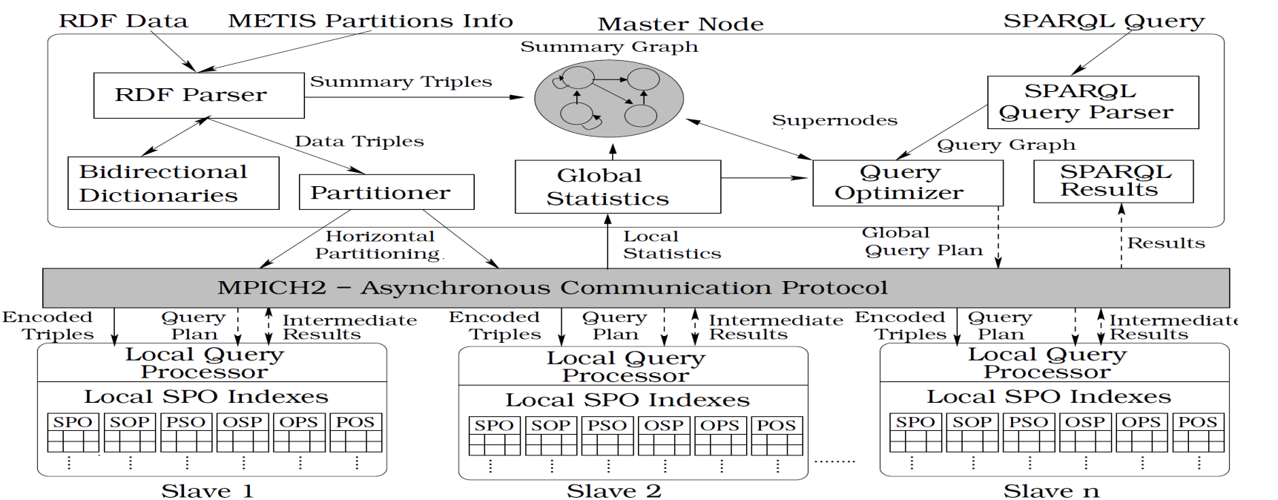
Graph Summarization in TriAD
TriAD is a distributed RDF engine (SIGMOD ‘14)
TriAD Architecture
Locality-based summarization
Stage 1
Stage 2

Slide 11
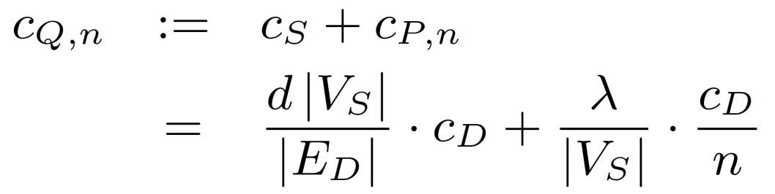
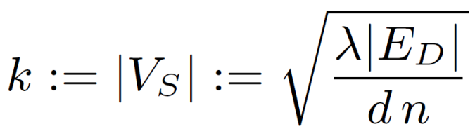
Choosing Optimal Number of Partitions
Cost of processing a query on ‘n’ slave nodes:
Cost c_{Q,n} is convex in |V_{S}|, thus choose:
|E_{D}| - number of edges in the data graph
|V_{S}| - number of nodes in the summary graph
|c_{D}| - cost of processing query over data graph
d - average degree of G_{D}
n - number of slaves nodes
2:won
2
1:born
2:won
3:type
1
3:type
1:born
4:member
5:located
3:type
5:located
2:won
5:located
4
Single tuning parameter λ:
Measure just once for given hardware setup and expected query workload!
3
4:member
1:born
4:member
6:governor
1:born
2:won

Slide 12
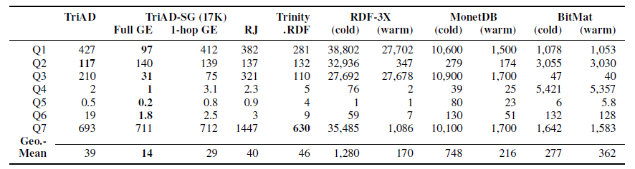
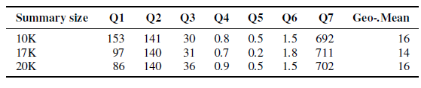
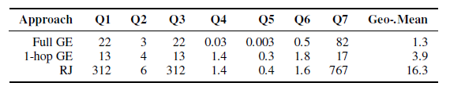
Evaluation – Query Performance
LUBM 160 dataset (27 million)
Different summary sizes
Different exploration strategies (Stage 1 only)

Slide 13
Conclusions
We leveraged summarization approach for join-ahead pruning in distributed RDF stores
Graph summarization:
Locality-based
Bi-simulation
We evaluated different summary exploration techniques
Integrated locality-based summarization into TriAD RDF store

Slide 14
Thank You
Sairam Gurajada (MPI Informatics, Germany), Stephan Seufert (MPI Informatics, Germany)
Iris Miliaraki (MPI Informatics, Germany)*
Martin Theobald (University of Antwerp, Belgium)
*currently with Yahoo Labs, Barcelona

