Slide 1
OOPs & Java

Slide 2
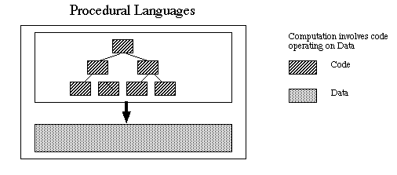
Procedural Language(POP) - ex. ‘C’
Characteristics:
Emphasis is on doing things (algorithms)
Large programs are divided into smaller functions
Most of the functions share global data
Data moves openly across the system from function to function
Functions transform data from one form to another
Uses top-down approach to program design

Slide 3
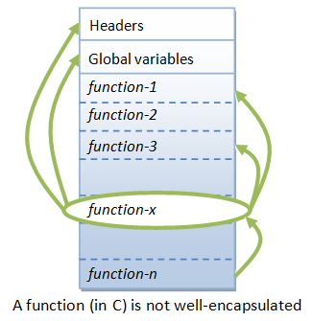
Procedural Languages - Drawbacks
Drawbacks:
As functions openly access global data, new programmer could easily corrupt data accidentally
Can easily access data from one function in another function, no protection!
In large projects, it becomes difficult to identify what data is being used by which functions
If program is modified to handle new data, all functions need to be modified to access data
Functions transform data from one form to another
Does not model real-time problems very well

Slide 4
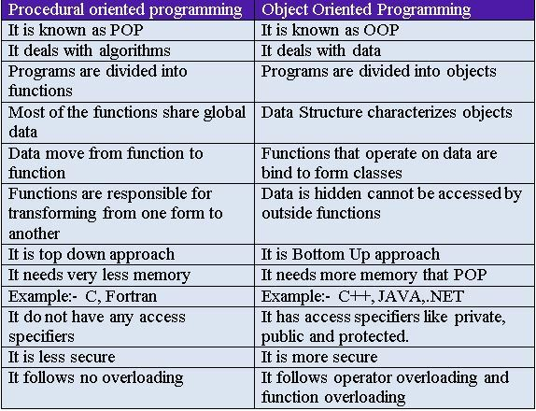
Difference between POP & OOP’s

Slide 5
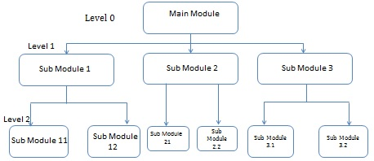
Top-down approach – ‘C’
Overview of system is formulated
For each part; refine (+add) details
Keep adding details everywhere until system is ready
Large program broken
into smaller functions
Complex code
Global data focused
Limited; to no code reuse

Slide 6
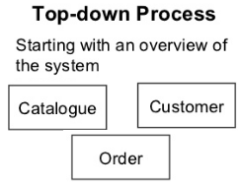
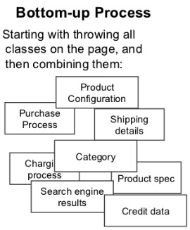
Bottom-up approach – Java
Describe entities then how they interact
Start with concrete business case, proceed to implementation
Easy to develop
Unit test it here, and validate now
Easy to change & modify later
No duplication of code
Reuse, wherever needed

Slide 7

Object Oriented - Advantages
Code reuse & recycle
Improved s/w development productivity
Improved software maintainability
Lesser development time
Reduced cost of development
Higher quality software
Encapsulation

Slide 8
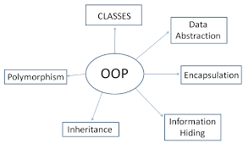
Object Oriented Concepts
Class
Object
Inheritance
Abstraction
Encapsulation
Polymorphism

Slide 9
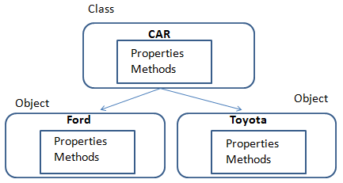
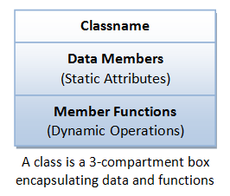
Class – OO Concepts
The basic unit of OOP’s is a ‘class’.
Class encapsulates both the static attributes and dynamic behaviors within a "box“
Class combines “data structures” + “entity’s algorithm”
A class is a blueprint from which objects get created.
Class defines the state and behavior, typically, of a real-world object

Slide 10
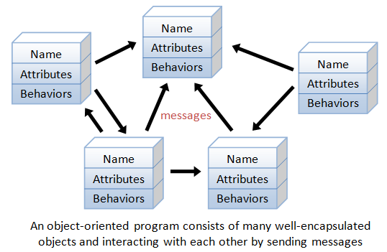
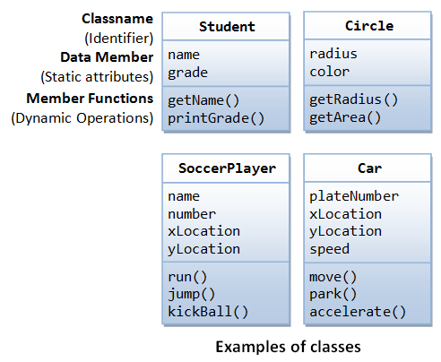
Class – OO Concepts
A class is a definition of objects of the same kind.
Class is a blueprint, template, or prototype that defines and describes the static attributes and dynamic behaviors common to all objects of the same kind.

Slide 11
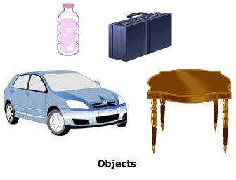
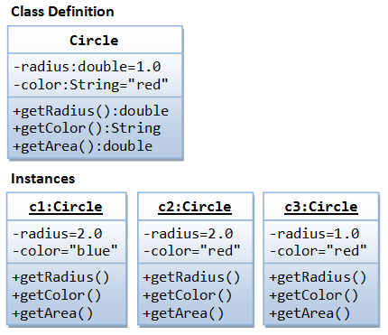
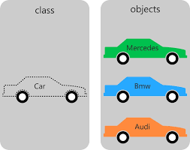
Object – OO Concepts
An object is a realization of a particular item of a class.
All instances (objects) of a class have same properties as in class definition
Ex. Define a class called Student, create 3 instances: “Peter”, “Paul” & “Mary”.

Slide 12
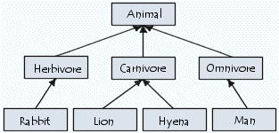
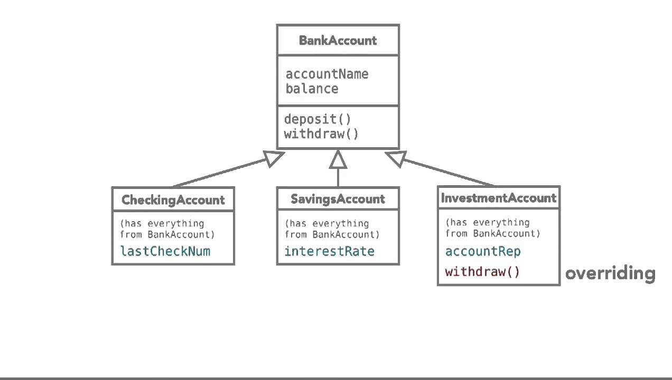
Inheritance – OO Concepts
Inheritance enables new objects to take on the properties of existing objects.
A class that is used as the basis for inheritance is called a superclass or base class.
A class that inherits from a superclass is called a subclass or derived class.

Slide 13
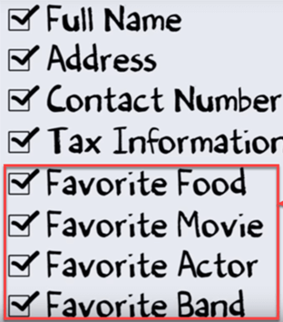
Abstraction – OO Concepts
Hide internal details
only show essential data about object to reduce complexity and increase efficiency
Abstraction is selecting data from a larger pool to show only the relevant details of the object

Slide 14
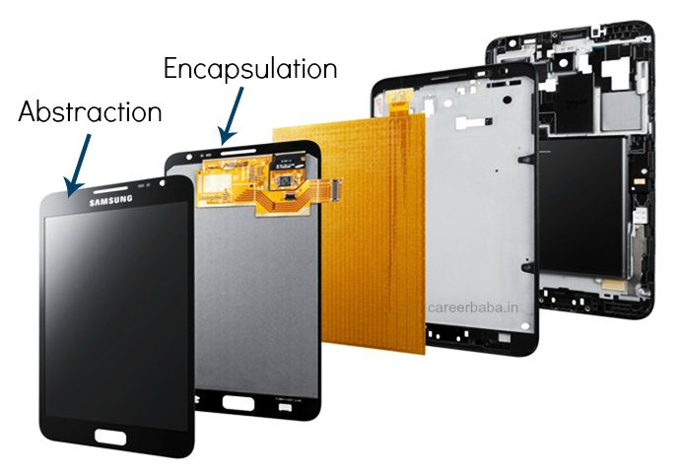
Encapsulation – OO Concepts
Also called ‘data binding’
Hide the state (value) of attributes within a class, preventing unauthorized direct access to it
Control access to state of attributes + methods
Bundling data and methods together in a class

Slide 15
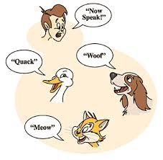
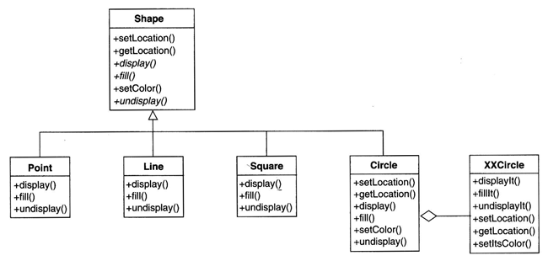
Polymorphism – OO Concepts
Generally, the ability to appear in many forms
Ability to process objects differently depending on their data types or class
Single interface to entities of different types
Instances (subclass) derived from superclass
Static @ compile time
Dynamic @ run time

Slide 16
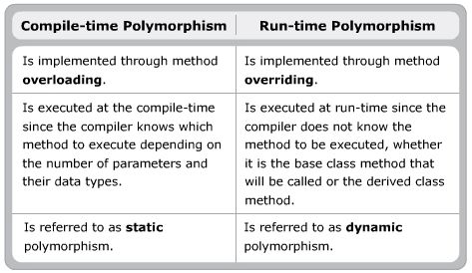
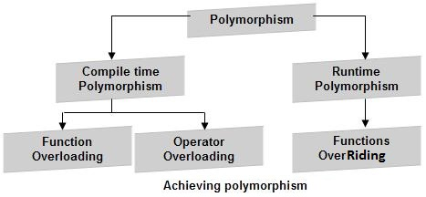
Compile & Run-time Polymorphism

Slide 17


Instance – OO Concepts
An ‘instance’ is a unique copy of a class, that represents an object.
When a new instance of a class is created, the JVM will allocate space in memory for that class instance.
‘Instance ‘and ‘object’ can be used interchangeably

Slide 18
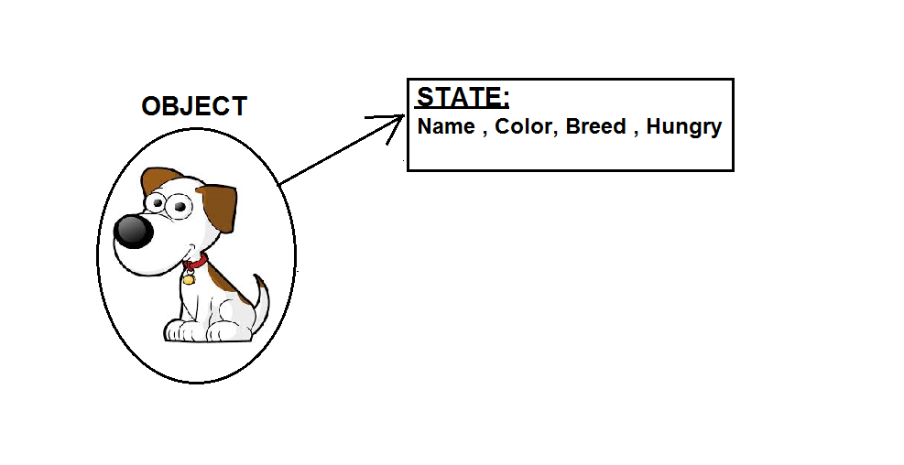
State – OO Concepts
An object has state (data) and behavior (functions).
Is the instances (variables) inside the object that contains the data.
State is the values of its attributes.

Slide 19
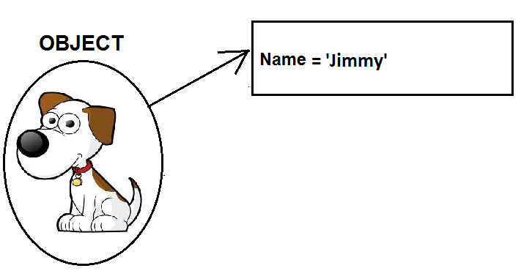
Attribute – OO Concepts
An Attribute is a named property of a class.
It has a type.
It describes the range of values that this property may hold.
A object can contain any number of attributes

Slide 20
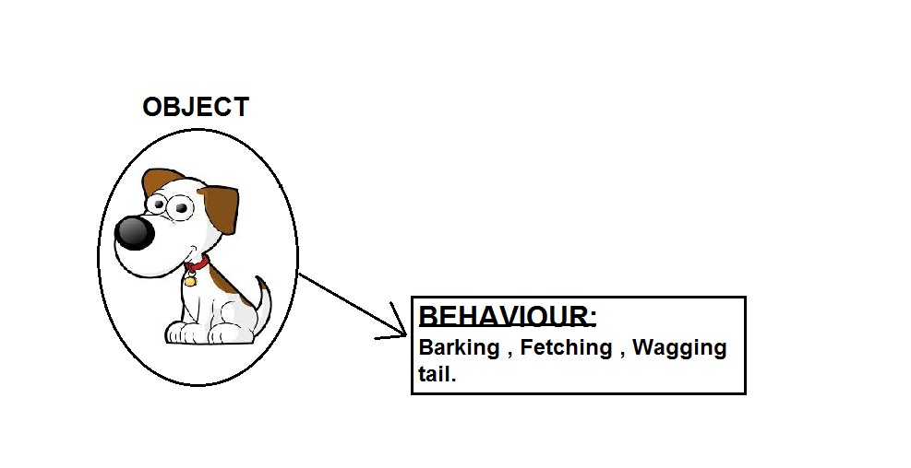
Method (Operation) – OO Concepts
The behaviour of an object is defined by its methods, which are the functions and subroutines defined within the object class.
An operation that an object can perform.

Slide 21
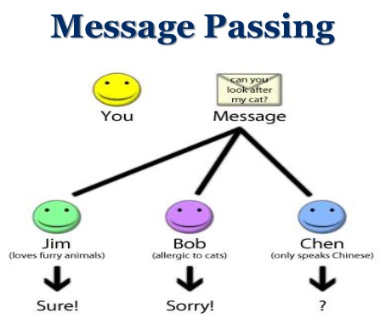
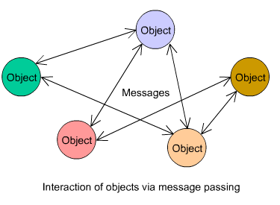
Message Passing – OO Concepts
Message passing is the communication between processes.
Message passing is a form of communication used in object-oriented programming.
Communications are completed by the sending of messages (functions and data) to recipients.

Slide 22
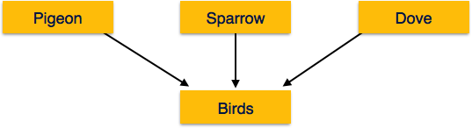
Generalization – OO Concepts
The generalized entities contain the properties of all the generalized entities
Also called as the ‘superclass’
Example: Pigeon, House sparrow, Crow and Dove can all be generalized as ‘Birds’.

Slide 23
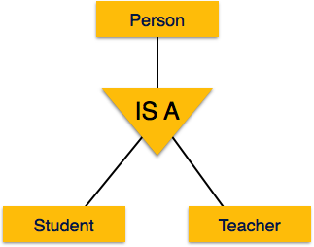
Specialization – OO Concepts
Specialization is the opposite of generalization.
In specialization, a group of entities is divided into sub-groups based on their characteristics.
For example: A ‘Person’ has name, date of birth, gender, etc. These properties are common in all persons, human beings.
But in a company, persons can be identified as employee, employer, customer, or vendor, based on what role they play in the company.

Slide 24

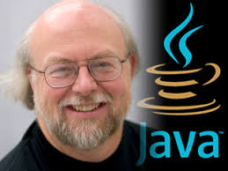
History of Java
1990: ‘Oak’
To control microprocessors, embedded in customer products
Oak needed to be:
Platform Independent
Extremely reliable
Compact
1993: ‘Java’
Internet and web exploration
Internet applications
1995: ‘Java 1.0’
James Gosling:
Inventor of Java

Slide 25
Features of Java
Compile & Interpret: Java compiler converts Java Source code into Java bytecode. Java interpreter converts bytecode into machine code
Portable & Platform Independent: Java programs are easily transferred from one computer to another, bytecode interpreted on JVM
Object Oriented: Java is 100% object oriented language
Robust: Java supports automatic memory management and exception handling.
Distributed: Has the ability to share & access data remotely

Slide 26
Features of Java
Simple: Easy to understand syntax, doesn't support pointers, operator overloading, multiple inheritance
Multithreaded: Java has the ability to write programs that do multiple tasks simultaneously
Dynamic: Java allocates memory at runtime for classes, methods and objects as and when required

Slide 27
References
https://www.javatpoint.com/java-oops-concepts
https://beginnersbook.com/2013/04/oops-concepts/
https://www.guru99.com/java-oops-concept.html
https://www.journaldev.com/12496/oops-concepts-java-example

Slide 28
Happy Oops Programming!! Thank you!

