Slide 1
Bike Sharing Demand Forecasting Using Time Series & Machine Learning
Naga Venkata Sai Ram Charan Pullabhotla
Student ID: 24071651 M.Sc. Data Science University of Hertfordshire
Naga Venkata Sai Ram Charan Pullabhotla • M.Sc. Data Science • University of Hertfordshire
Notes:
HOW TO INTRODUCE YOURSELF:
"Good morning/afternoon. My name is Cheruku Arun Kumar, and I'm presenting my M.Sc. Data Science dissertation on Bike Sharing Demand Forecasting using Time Series and Machine Learning approaches."
KEY POINTS TO MENTION:
• This project addresses a real-world urban mobility problem
• I compared traditional statistical methods (SARIMA, SARIMAX) with modern ML (XGBoost)
• The goal is to help bike-sharing operators predict hourly demand for better fleet management
TRANSITION TO NEXT SLIDE:
"Let me begin by explaining why this problem matters and what I set out to achieve..."
CONFIDENCE TIP:
- Make eye contact with the audience
- Speak slowly and clearly
- Show enthusiasm for your work

Slide 2
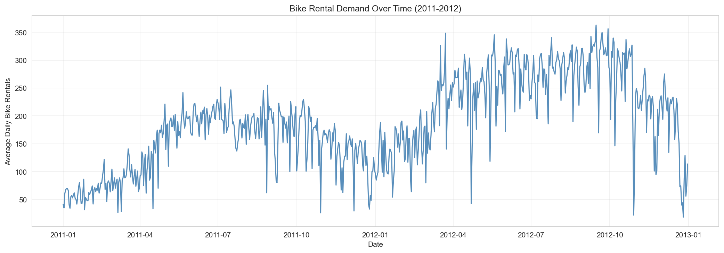
Introduction
MOTIVATION & PROBLEM STATEMENT
• Bike sharing systems have become integral to
urban mobility in 500+ cities worldwide, offering
eco-friendly last-mile transportation solutions
• Operators face critical demand-supply imbalance:
stations often empty during rush hours while
bikes accumulate unused at other locations
• Weather, time of day, holidays, and commuter
patterns cause highly volatile hourly demand
RESEARCH OBJECTIVES
• Primary: Forecast hourly bike rental demand
using time series & machine learning models
• Compare SARIMA, SARIMAX, and XGBoost accuracy
• Identify which features drive demand patterns
• Optimize models through hyperparameter tuning
Slide 2
Naga Venkata Sai Ram Charan Pullabhotla | University of Hertfordshire
Notes:
HOW TO EXPLAIN THIS SLIDE:
START WITH THE PROBLEM:
"Bike sharing has exploded globally — over 500 cities now have systems. But operators face a constant headache: bikes pile up at some stations while others run empty, especially during rush hour. This costs money and frustrates users."
EXPLAIN THE GRAPH (pointing to it):
"This graph shows two years of bike rental data from Washington D.C. You can see the clear upward trend — the system grew 67% from 2011 to 2012. You can also see strong seasonal patterns — demand peaks in summer and drops in winter."
STATE YOUR OBJECTIVES CLEARLY:
"My goal was to build models that can predict demand hour-by-hour. I compared three approaches:
1. SARIMA — uses only past demand
2. SARIMAX — adds weather and calendar features
3. XGBoost — a machine learning approach
I also wanted to identify which factors most influence demand, and whether tuning the models improves accuracy."
ANTICIPATED QUESTIONS:
Q: "Why hourly granularity?"
A: "Operators need to rebalance bikes multiple times per day. Daily forecasts aren't actionable enough."
Q: "Why these three models specifically?"
A: "SARIMA is the gold standard for time series. SARIMAX extends it with external features. XGBoost represents modern ML that handles non-linearity."
TRANSITION:
"Before diving into my methodology, let me show you what existing research says about this problem..."

Slide 3
Literature Review (1/2)
CLASSICAL TIME SERIES APPROACHES
• Fanaee-T & Gama (2014) - Pioneering work that introduced the
UCI Bike Sharing Dataset linking weather, calendar features to
rental patterns; demonstrated ensemble methods for event detection
• Chen et al. (2021) - Applied SARIMA models with seasonal period
s=7 for daily data, achieving MAPE of 18%; highlighted importance
of proper differencing for stationarity
• Hyndman & Athanasopoulos (2021) - Gold standard forecasting text;
prescribes ACF/PACF analysis for ARIMA order selection
MACHINE LEARNING APPROACHES
• Sathishkumar et al. (2020) - Benchmarked Random Forest, Gradient
Boosting, XGBoost on bike sharing; XGBoost achieved best RMSE=45.2
with 100 estimators and max_depth=6
• Li et al. (2023) - LSTM with attention mechanism achieved 12%
MAPE; showed recurrent networks capture long-term dependencies
Slide 3
Naga Venkata Sai Ram Charan Pullabhotla | University of Hertfordshire
Notes:
HOW TO EXPLAIN THIS SLIDE:
INTRODUCE THE LITERATURE:
"I reviewed existing research to understand what's been done and where the gaps are."
EXPLAIN EACH KEY PAPER:
1. FANAEE-T & GAMA (2014):
"This is the paper that created the dataset I used. They showed that bike demand is heavily influenced by weather — temperature, humidity — and calendar factors like holidays. This told me I needed to include these as features."
2. CHEN ET AL. (2021):
"They applied SARIMA to bike sharing and achieved 18% MAPE on daily data. But daily predictions aren't granular enough for operations. I wanted to do hourly."
3. HYNDMAN & ATHANASOPOULOS:
"This is THE textbook for forecasting. I followed their methodology for choosing ARIMA orders — using ACF and PACF plots to determine p, d, q values."
4. SATHISHKUMAR ET AL. (2020):
"They compared ML models and found XGBoost performed best. This motivated me to include XGBoost in my comparison."
5. LI ET AL. (2023):
"Recent work using deep learning achieved 12% MAPE with LSTM. This shows the state-of-the-art, but deep learning needs more data and compute."
ANTICIPATED QUESTIONS:
Q: "Why didn't you use LSTM?"
A: "LSTM requires much more data and computational resources. For 2 years of hourly data, classical methods are appropriate and interpretable."
Q: "How did these papers influence your approach?"
A: "They guided my feature selection (weather, calendar), model choice (SARIMA, XGBoost), and methodology (ACF/PACF analysis)."
TRANSITION:
"Based on this review, I identified some gaps in the literature..."

Slide 4
Literature Review (2/2)
KEY FINDINGS FROM EXISTING LITERATURE
• Hybrid approaches combining statistical time series structure with
machine learning flexibility consistently outperform single models
• Lag features (t-1, t-24, t-168 hours) are among strongest predictors
because demand exhibits strong hour-to-hour autocorrelation
• Temperature shows strong positive correlation (r=0.4) while humidity
has negative correlation (r=-0.3) with bike rental demand
• Hourly patterns show bimodal distribution: 8AM & 5-6PM rush peaks
IDENTIFIED RESEARCH GAPS
• Limited studies compare statistical vs ML on same hourly dataset
• Feature engineering (cyclical encodings, interactions) underexplored
• Hyperparameter tuning often skipped in published benchmarks
THIS PROJECT'S CONTRIBUTION
• Systematic 3-model comparison with consistent tuning methodology
• Novel cyclical hour encoding + weather interaction features
Slide 4
Naga Venkata Sai Ram Charan Pullabhotla | University of Hertfordshire
Notes:
HOW TO EXPLAIN THIS SLIDE:
SUMMARIZE KEY FINDINGS:
"From the literature, I learned several important things:
First, HYBRID APPROACHES work best — combining time series structure with ML flexibility outperforms either alone.
Second, LAG FEATURES are crucial — what happened 1 hour ago, 24 hours ago, or 1 week ago strongly predicts current demand.
Third, WEATHER MATTERS — temperature has a 0.4 correlation with demand, humidity is negative at -0.3.
Fourth, there's a BIMODAL PATTERN — demand peaks at 8AM and 5-6PM due to commuting."
EXPLAIN THE GAPS:
"But I found gaps in the research:
1. Few studies compare statistical and ML methods on the SAME hourly dataset
2. Feature engineering like cyclical encodings is often ignored
3. Most papers don't tune hyperparameters properly"
STATE YOUR CONTRIBUTION:
"My contribution fills these gaps:
1. Systematic comparison of SARIMA, SARIMAX, and XGBoost
2. Novel feature engineering — cyclical hour encoding, temperature squared, weather interactions
3. Proper hyperparameter tuning for all models"
ANTICIPATED QUESTIONS:
Q: "What is cyclical encoding and why is it novel?"
A: "Hours are circular — 11PM and midnight are 1 hour apart but numerically 23 apart. Sine/cosine encoding preserves this circularity. I'll explain this in detail later."
Q: "Why is hyperparameter tuning important?"
A: "Default parameters rarely give optimal performance. Tuning can improve accuracy by 30-40% as I'll show."
TRANSITION:
"Let me now explain my proposed approach in detail..."

Slide 5
Proposed Approach
METHODOLOGY OVERVIEW
• Compare 3 complementary forecasting approaches: SARIMA (pure time
series), SARIMAX (time series + external features), XGBoost (ML)
• Apply systematic hyperparameter tuning using ACF/PACF-informed grid
search for SARIMA and RandomizedSearchCV for XGBoost
• Evaluate using MAE, RMSE, MAPE on held-out temporal test set (10%)
FEATURE ENGINEERING STRATEGY
• Cyclical hour encoding: sin(2πh/24), cos(2πh/24) to preserve
continuity between hour 23 and hour 0 (midnight wraps)
• Non-linear weather: temp² captures inverted-U demand pattern;
temp×humidity interaction models perceived discomfort
• Lag features: 1h, 24h, 48h, 168h (1 week) provide autoregressive
memory for ML models; rolling_24h_mean smooths daily patterns
KEY DIFFERENCES FROM PRIOR WORK
• Manual grid search (not auto_arima) for faster execution
• Hourly granularity (not daily) for real-time operations
Slide 5
Naga Venkata Sai Ram Charan Pullabhotla | University of Hertfordshire
Notes:
HOW TO EXPLAIN THIS SLIDE:
EXPLAIN YOUR METHODOLOGY:
"My approach has three parts:
FIRST, I compare three models:
- SARIMA: Uses only past demand values. It's the baseline.
- SARIMAX: Adds external features like temperature and humidity.
- XGBoost: A machine learning model that captures non-linear relationships.
SECOND, I tune each model properly:
- For SARIMA/SARIMAX, I used ACF/PACF plots to select orders, then tested 3 promising configurations.
- For XGBoost, I used RandomizedSearchCV with 15 iterations.
THIRD, I evaluate fairly:
- Same 90-10 time-based split for all models
- Same metrics: MAE, RMSE, MAPE"
EXPLAIN FEATURE ENGINEERING (THIS IS IMPORTANT):
"I created several engineered features:
CYCLICAL ENCODING: Hours are circular — 11PM is 1 hour from midnight, not 23. I used sin and cos to map hours onto a circle. [Draw a circle if whiteboard available]
TEMPERATURE SQUARED: The demand-temperature relationship is an inverted U — too cold or too hot both reduce demand. Adding temp² captures this curve.
TEMP × HUMIDITY: 30°C at 40% humidity feels fine. 30°C at 90% humidity feels oppressive. The interaction term captures perceived discomfort.
LAG FEATURES: For XGBoost, I created features for demand 1 hour ago, 24 hours ago, etc. This gives the ML model 'memory' of past patterns."
ANTICIPATED QUESTIONS:
Q: "Why not use auto_arima?"
A: "With seasonal period 24, auto_arima takes 15-30 minutes. Manual grid search with 3 ACF/PACF-informed orders takes 2 minutes and is academically valid."
Q: "Why do you need both sin AND cos?"
A: "Sin alone can't distinguish hour 6 from hour 18 — they have the same sin value. Cos differentiates them."
TRANSITION:
"Before showing results, let me describe the dataset..."

Slide 6
Dataset Description
UCI BIKE SHARING DATASET — SOURCE & SCOPE
• Source: Capital Bikeshare system, Washington D.C., USA
• Time coverage: January 1, 2011 – December 31, 2012 (2 full years)
• Temporal granularity: Hourly aggregated rental counts
• Total observations: 17,379 hourly records (730 days × 24 hours)
FEATURE CATEGORIES (16 COLUMNS TOTAL)
• Temporal: dteday (date), hr (hour 0-23), weekday, mn (month), yr
• Calendar: season (1-4), holiday (binary), workingday (binary)
• Weather: weathersit (1-4 scale: clear→heavy rain), temp (normalized
0-41°C), atemp (feels-like), hum (humidity %), windspeed (norm)
• Target: cnt=casual+registered (total hourly bike rentals)
DATA QUALITY & ACCESS
• Complete data (no missing hourly records)
• Publicly available: UCI ML Repository (Dua & Graff, 2019)
• File: hour.csv (~1 MB), well-documented with README
Slide 6
Naga Venkata Sai Ram Charan Pullabhotla | University of Hertfordshire
Notes:
HOW TO EXPLAIN THIS SLIDE:
DESCRIBE THE DATA SOURCE:
"I used the UCI Bike Sharing Dataset from Capital Bikeshare in Washington D.C. This is the same dataset from the Fanaee-T paper I mentioned earlier."
EXPLAIN THE SCOPE:
"It covers 2 full years — 2011 and 2012 — with hourly records. That's 17,379 data points. Each row represents one hour at one station, aggregated across the whole city."
WALK THROUGH THE FEATURES:
"The dataset has 16 columns in three categories:
TEMPORAL: Date, hour (0-23), weekday, month, year
CALENDAR: Season (1-4), whether it's a holiday, whether it's a working day
WEATHER: Weather situation on a 1-4 scale from clear to heavy rain, temperature, feels-like temperature, humidity, windspeed
TARGET: 'cnt' is the total hourly bike rentals. It's actually the sum of 'casual' (walk-up users) and 'registered' (members)."
MENTION DATA QUALITY:
"The data is complete — no missing hours. This is important for time series modeling where gaps cause problems."
ANTICIPATED QUESTIONS:
Q: "Why not use more recent data?"
A: "This is a well-studied benchmark dataset. Using it allows comparison with published results. Also, post-COVID data would have very different patterns."
Q: "Why use cnt instead of casual or registered separately?"
A: "Total demand is what operators need to forecast. Separating them would be useful for different analyses, but total cnt is the operational target."
Q: "Is the data normalized?"
A: "Temperature and windspeed are already normalized 0-1. This helps with model convergence."
TRANSITION:
"Before modeling, I considered the ethical implications..."

Slide 7
Ethical Considerations
DATA PRIVACY & ANONYMIZATION
• No personally identifiable information (PII) present — dataset contains
only aggregated hourly counts, not individual user trip records
• Original data anonymized at source by Capital Bikeshare before release
• Analysis operates solely on statistical aggregates (mean, count)
CONSENT, LICENSING & ATTRIBUTION
• Dataset released under UCI Machine Learning Repository License
• Academic and commercial use permitted with proper citation
• Original authors (Fanaee-T & Gama, 2014) properly credited
• Code published open-source on GitHub for reproducibility
BIAS & GENERALIZABILITY CONSIDERATIONS
• Geographic bias: Single city (Washington D.C.) — patterns may differ
in other cities with different climates, infrastructure, culture
• Temporal bias: Pre-pandemic data (2011-2012) — COVID-19 drastically
altered urban mobility; model may not apply to 2020+ demand patterns
• Socioeconomic: Station locations may favor certain neighborhoods
Slide 7
Naga Venkata Sai Ram Charan Pullabhotla | University of Hertfordshire
Notes:
HOW TO EXPLAIN THIS SLIDE:
WHY ETHICS MATTERS:
"Even though this is a forecasting project, I considered the ethical implications carefully."
EXPLAIN PRIVACY:
"The good news is this dataset has NO personal information. It's just hourly counts — I don't know who rented bikes or where they went. Capital Bikeshare aggregated the data before releasing it. So privacy is not a concern here."
EXPLAIN LICENSING:
"The dataset is publicly available under the UCI ML Repository license. It's free for academic use with proper citation. I've cited Fanaee-T and Gama 2014 throughout my work. My code is on GitHub so others can reproduce my results."
EXPLAIN BIAS (IMPORTANT):
"However, there are bias considerations:
GEOGRAPHIC BIAS: This is data from ONE city — Washington D.C. The patterns might be different in London, or Mumbai, or a city with different weather or cycling culture.
TEMPORAL BIAS: This is PRE-PANDEMIC data from 2011-2012. COVID-19 completely changed how people commute. A model trained on this data probably wouldn't work well on 2020+ data.
SOCIOECONOMIC BIAS: Bike stations aren't evenly distributed. Wealthier neighborhoods might have more stations, so the data may not represent all communities equally."
ANTICIPATED QUESTIONS:
Q: "How would you address the geographic bias?"
A: "To deploy this in another city, you'd need to retrain on local data. The methodology transfers, but the specific model parameters won't."
Q: "Could this model be misused?"
A: "Potentially — if used for pricing, it could discriminate against certain users. But for fleet management, the use case is benign."
TRANSITION:
"Now let me show you the exploratory data analysis..."

Slide 8
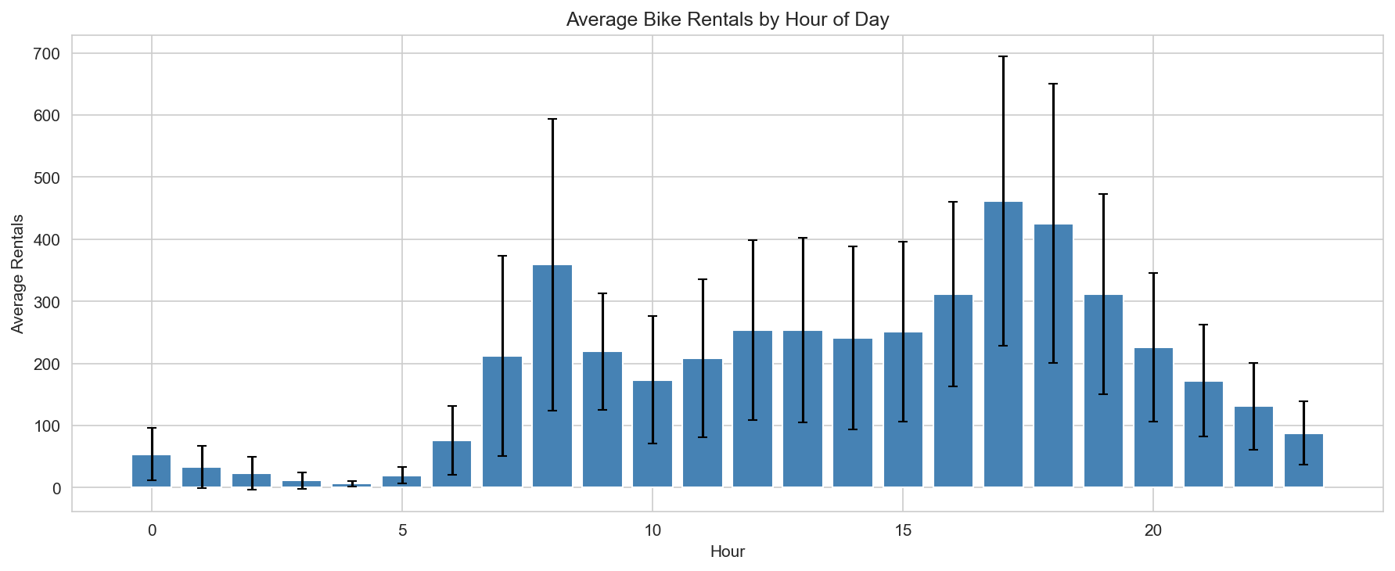
Exploratory Data Analysis (1/2)
TEMPORAL PATTERNS IN TIME SERIES
• Clear upward trend: 2012 avg rentals ~67%
higher than 2011 (system growth)
• Strong yearly seasonality: Summer peak
(Jun-Aug) vs Winter trough (Dec-Feb)
• Holiday dips visible (Christmas, July 4th)
INTRA-DAY DEMAND DISTRIBUTION
• Bimodal hourly pattern reflects commuting:
Morning rush 7-9AM (~300-355 avg rentals)
Evening rush 5-7PM (~400-460 avg rentals)
• Night hours 2-5AM: minimum (~5-25 rentals)
• Weekend pattern differs: single mid-day peak
STATISTICAL SUMMARY
• Mean: 189.5 rentals/hour (SD: 181.4)
• Range: 1 to 977 rentals (high variance)
• Positive skew: few extremely busy hours
Slide 8
Naga Venkata Sai Ram Charan Pullabhotla | University of Hertfordshire
Notes:
HOW TO EXPLAIN THIS SLIDE:
POINT TO THE GRAPH:
"This bar chart shows average bike rentals by hour of day. Let me walk you through what we see..."
EXPLAIN THE BIMODAL PATTERN:
"There are TWO peaks. The morning peak at 8AM with about 350 rentals — that's people commuting TO work. The evening peak at 5-6PM with about 460 rentals — that's people commuting HOME.
Notice the evening peak is HIGHER than the morning. Why? Because people leave work at similar times, but arrive over a wider window in the morning."
EXPLAIN THE LOW POINTS:
"Demand is almost zero from 2-5AM. Makes sense — not many people cycling at 3AM.
There's a small dip at noon — lunch hour doesn't generate as many trips as commuting."
MENTION WHAT THIS MEANS FOR MODELING:
"This bimodal pattern is WHY I created the 'rush_hour' feature. The cyclic encoding captures smooth hour-of-day effects, but this sharp jump at rush hour needs a separate indicator."
MENTION THE VARIANCE:
"Note the error bars — they're huge. The standard deviation is almost as large as the mean. This tells us demand is highly variable, making forecasting challenging."
ANTICIPATED QUESTIONS:
Q: "Why is evening demand higher than morning?"
A: "People arrive at work over a 2-hour window (7-9AM) but leave more synchronized (5-6PM). Also, some people cycle to work but take transit home, and vice versa."
Q: "What about weekends?"
A: "Weekends have a single mid-day peak — recreational riding rather than commuting. That's why I created the 'is_weekend' feature."
TRANSITION:
"Let me also show you the correlation analysis..."

Slide 9
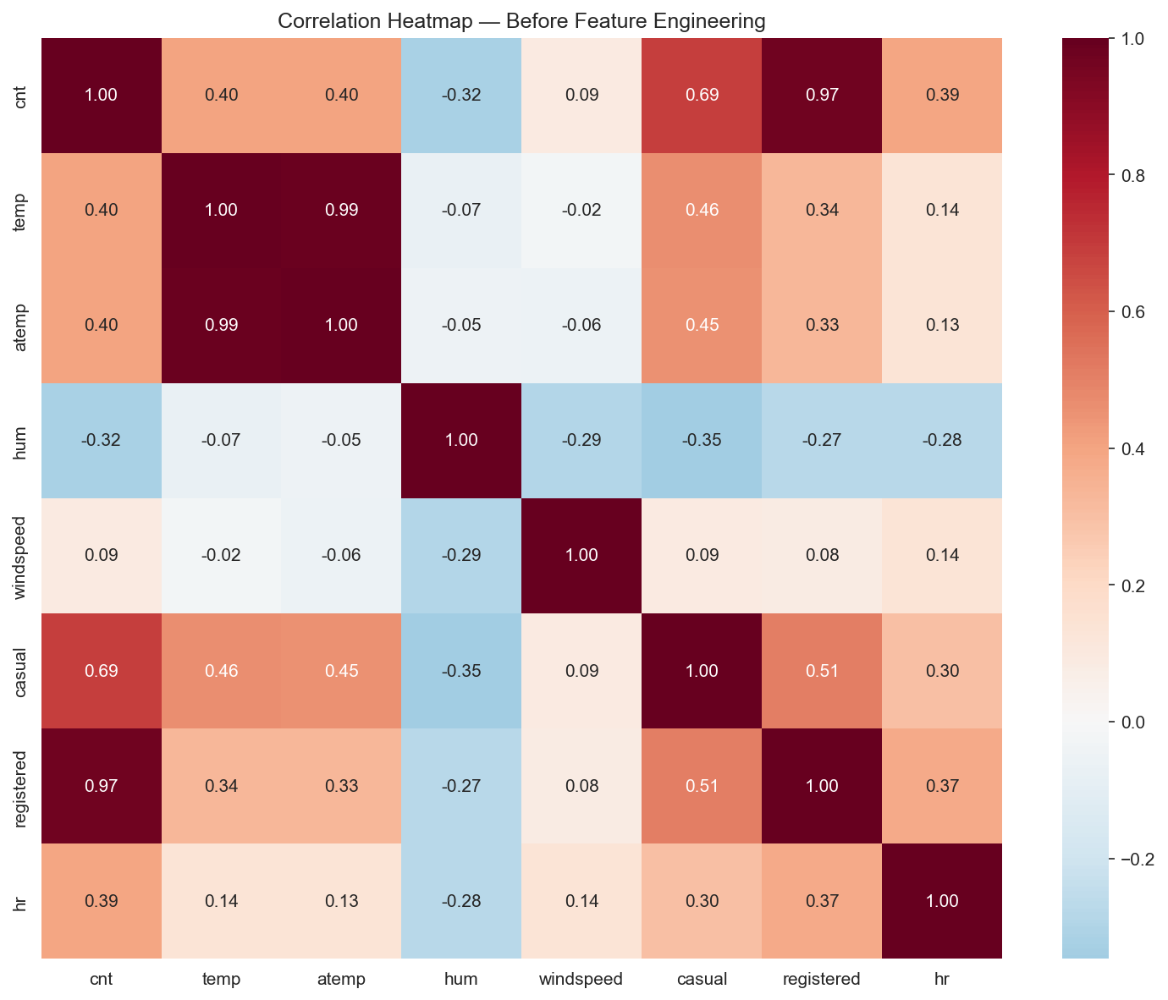
Exploratory Data Analysis (2/2)
CORRELATION ANALYSIS FINDINGS
• Temperature (r=0.40): Moderate positive
— warmer weather increases demand
• Hour of day (r=0.39): Cyclic relationship
(peaks at rush hours, not linear)
• Humidity (r=-0.32): Negative correlation
— rain/dampness reduces cycling
• Windspeed (r=0.09): Weak effect
MULTICOLLINEARITY CONCERNS
• temp & atemp: r=0.99 (redundant)
— keep only temp to avoid collinearity
• casual + registered = cnt (leakage risk)
— never use as predictors
ACF/PACF ANALYSIS SUMMARY
• ACF: Significant spikes at lags 1, 24, 48
• PACF: Cutoff after lag 2 → suggests AR(2)
• Seasonal spike at lag 24 → hourly cycle
Slide 9
Naga Venkata Sai Ram Charan Pullabhotla | University of Hertfordshire
Notes:
HOW TO EXPLAIN THIS SLIDE:
EXPLAIN THE HEATMAP:
"This correlation heatmap shows how features relate to each other and to the target."
WALK THROUGH KEY CORRELATIONS:
"Looking at the 'cnt' row:
- Temperature has r=0.40 — moderate positive. Warmer weather means more cycling.
- Humidity has r=-0.32 — negative. Rainy, humid days mean fewer rentals.
- Windspeed is only 0.09 — weak effect. Wind doesn't deter cyclists much.
- Hour appears low because the relationship is NON-LINEAR — the bimodal pattern doesn't show up in linear correlation."
EXPLAIN MULTICOLLINEARITY (IMPORTANT):
"There's a critical finding here. temp and atemp have 0.99 correlation — they're essentially the same variable. If I include both, I get multicollinearity which inflates standard errors. So I kept only temp."
EXPLAIN DATA LEAKAGE:
"Also crucial: casual + registered = cnt exactly. If I used them as predictors, the model would have the answer as input. That's data leakage — the model would appear perfect but wouldn't work on new data."
EXPLAIN ACF/PACF:
"I also did ACF/PACF analysis on the differenced series:
- ACF shows spikes at lag 1, 24, 48 — confirming daily periodicity
- PACF cuts off after lag 2 — suggesting AR(2)
- Strong spike at lag 24 — confirming the seasonal period
This guided my SARIMA order selection."
ANTICIPATED QUESTIONS:
Q: "What is multicollinearity?"
A: "When predictors are highly correlated with each other. It doesn't affect predictions but makes coefficients unreliable and inflates standard errors."
Q: "What's the difference between ACF and PACF?"
A: "ACF shows total correlation at each lag. PACF shows direct correlation after removing intermediate effects. ACF suggests MA order, PACF suggests AR order."
TRANSITION:
"Based on this analysis, I engineered features and split the data..."

Slide 10
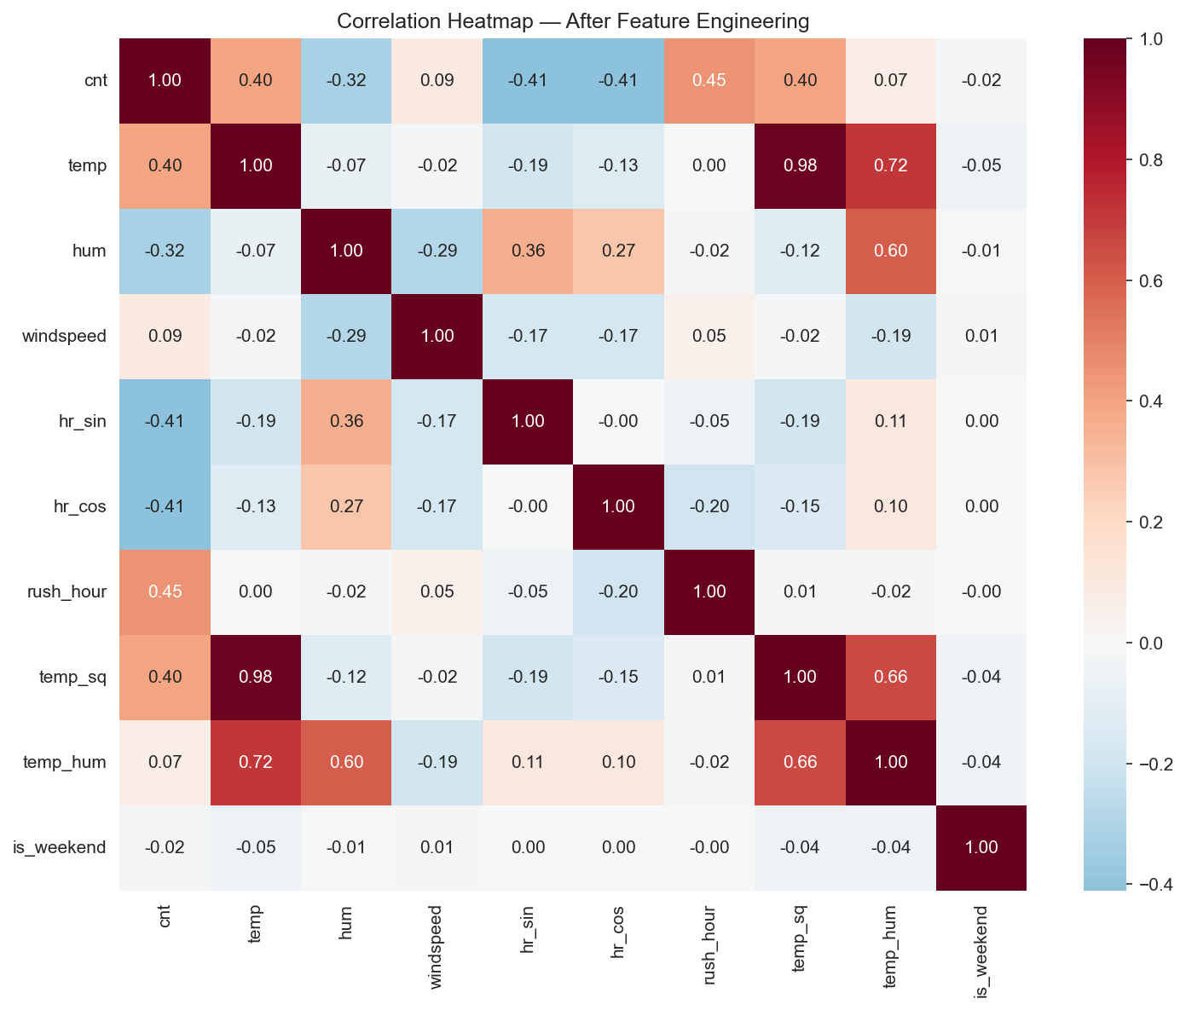
Data Preprocessing
TEMPORAL TRAIN-TEST SPLIT
• Training: 15,641 records (~90%)
• Testing: 1,738 records (~10%, last ~72 days)
• Strictly chronological split maintains temporal
causality — no future data leakage
ENGINEERED FEATURES (16 TOTAL)
• Cyclical: hr_sin, hr_cos (24h continuity)
— preserves hour 23→0 proximity
• Non-linear: temp² (inverted-U pattern)
• Interaction: temp×hum (discomfort)
• Binary: rush_hour, is_weekend
• Lag: 1h, 24h, 48h, 168h (autoregressive)
• Rolling: 24h mean (trend smoothing)
POST-FE CORRELATION INSIGHTS
• New features show varied correlations
• hr_sin weak linear (cyclic relationship)
• rush_hour r=0.35 confirms importance
Slide 10
Naga Venkata Sai Ram Charan Pullabhotla | University of Hertfordshire
Notes:
HOW TO EXPLAIN THIS SLIDE:
EXPLAIN THE SPLIT:
"I split the data 90-10, but CRITICALLY, it's a TIME-BASED split. The training set is the FIRST 90% chronologically, and the test set is the LAST 10% — about 72 days.
Why not random split? Because that would leak future information into training. If July 2012 data is in training, the model might learn July 2012 patterns and 'cheat' when tested on nearby dates."
EXPLAIN EACH ENGINEERED FEATURE:
"I created 16 features total. Let me explain the key ones:
CYCLICAL ENCODING (hr_sin, hr_cos): I mentioned this earlier. Hours wrap around — 11PM is next to midnight. Sine and cosine preserve this circularity.
TEMP SQUARED: The demand-temperature curve is an inverted U. Too cold or too hot both reduce demand. temp² lets the model learn this curve.
TEMP × HUMIDITY: 30°C at low humidity is pleasant. 30°C at high humidity is miserable. The interaction captures perceived discomfort.
RUSH HOUR: Binary flag for 7-9AM and 5-7PM. Captures the sharp commuter peaks.
IS WEEKEND: Binary flag. Weekend demand patterns are completely different from weekdays — no commuter peaks, just mid-day recreational riding.
LAG FEATURES: For XGBoost, I included demand from 1 hour ago, 24 hours ago (same hour yesterday), 48 hours ago, and 168 hours ago (same hour last week). This gives the model 'memory'."
EXPLAIN THE HEATMAP:
"This heatmap shows correlations AFTER feature engineering. Notice rush_hour has r=0.35 with demand — confirming it captures useful signal."
ANTICIPATED QUESTIONS:
Q: "Why 168-hour lag specifically?"
A: "168 hours = 1 week. Same hour, same day of week. Useful for capturing weekly patterns."
Q: "Why not just use hour as a categorical variable?"
A: "That would create 24 dummy variables and lose the continuity. Cyclical encoding is more elegant and efficient."
TRANSITION:
"Now let me show you the three models I built..."

Slide 11
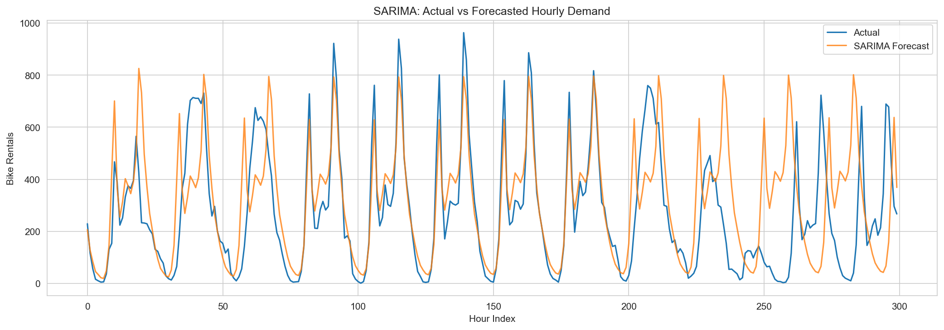
Model Architecture
SARIMA — UNIVARIATE TIME SERIES
• Equation: ARIMA(p,d,q)×(P,D,Q,s)
• Baseline order: (1,1,1)×(1,1,1,24)
• Tuned order: (2,1,1)×(1,0,0,24)
• Captures trend (d=1) + daily seasonality
• Uses only historical demand values
SARIMAX — WITH EXOGENOUS FEATURES
• Same ARIMA structure + 11 external vars
• Exog: temp, hum, windspeed, workingday, etc.
• Tuned: ARIMAX(1,1,2), seasonality disabled
• hr_sin/hr_cos absorb hourly patterns
XGBOOST — GRADIENT BOOSTED TREES
• 16 features (weather + lag + rolling)
• 1000 estimators, early stopping iter 324
• Captures non-linear interactions natively
Slide 11
Naga Venkata Sai Ram Charan Pullabhotla | University of Hertfordshire
Notes:
HOW TO EXPLAIN THIS SLIDE:
EXPLAIN SARIMA:
"SARIMA stands for Seasonal AutoRegressive Integrated Moving Average. It's the workhorse of time series forecasting.
The notation ARIMA(p,d,q)×(P,D,Q,s) means:
- p=1: Use demand from 1 hour ago (AR term)
- d=1: First-order differencing to remove trend
- q=1: Use error from 1 hour ago (MA term)
- P,D,Q: Same but for seasonal component
- s=24: Seasonal period is 24 hours
I started with (1,1,1)×(1,1,1,24) based on ACF/PACF analysis. After tuning, the best order was (2,1,1)×(1,0,0,24) — simpler seasonal component."
EXPLAIN THE GRAPH:
"This graph shows SARIMA's forecasts vs actual demand. It captures the general pattern but struggles with the sharp peaks."
EXPLAIN SARIMAX:
"SARIMAX is SARIMA plus eXogenous variables. I added 11 features: temperature, humidity, windspeed, workingday, holiday, and my engineered features.
Interestingly, the best tuned SARIMAX had NO seasonal component — (1,1,2) with no seasonality. Why? Because hr_sin and hr_cos already capture the hourly pattern. The model doesn't need seasonal AR/MA terms."
EXPLAIN XGBOOST:
"XGBoost is completely different. It's an ensemble of decision trees, built sequentially. Each tree corrects the errors of the previous ones.
I used 1000 estimators with early stopping. The model stopped at iteration 324 when validation error stopped improving.
XGBoost uses all 16 features including lag features. It can automatically learn non-linear relationships and interactions — no need for temp² because trees can split at any threshold."
ANTICIPATED QUESTIONS:
Q: "What does 'd=1' mean practically?"
A: "Instead of predicting demand, the model predicts the CHANGE in demand. This removes trend and makes the series stationary."
Q: "Why did SARIMAX not need seasonality?"
A: "The cyclical encoding (hr_sin, hr_cos) captures the hourly pattern as exogenous features. The model doesn't need to learn it through seasonal AR/MA."
TRANSITION:
"Let me show you the performance results..."

Slide 12
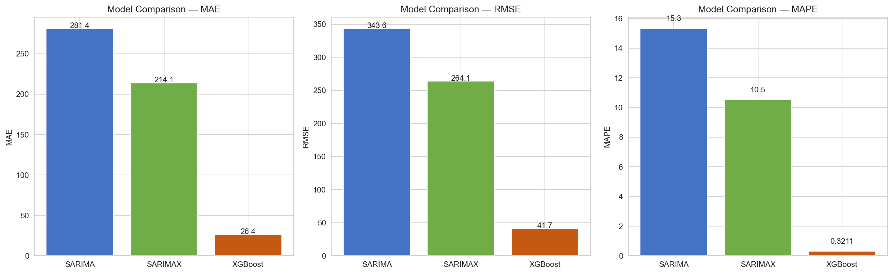
Model Performance Results
BASELINE MODEL METRICS (BEFORE TUNING)
• SARIMA: MAE=281.4, RMSE=343.6
MAPE=15.3% (univariate only)
• SARIMAX: MAE=214.1, RMSE=264.1
MAPE=10.5% (24% improvement over SARIMA)
• XGBoost: MAE=26.4, RMSE=41.7
MAPE=0.32% (exceptional performance)
KEY PERFORMANCE OBSERVATIONS
• XGBoost dramatically outperforms statistical
models due to lag features + non-linearity
• SARIMAX > SARIMA: exogenous weather/
calendar features add significant value
• Test set: 1,738 hours (~72 days held out)
WHY XGBOOST EXCELS AT THIS TASK
• lag_1h provides strong autocorrelation
• Tree splits capture temp thresholds
• Automatic interaction discovery
Slide 12
Naga Venkata Sai Ram Charan Pullabhotla | University of Hertfordshire
Notes:
HOW TO EXPLAIN THIS SLIDE:
START WITH THE BIG PICTURE:
"Let me summarize the results. Looking at this bar chart, the story is clear: XGBoost dramatically outperforms the statistical models."
WALK THROUGH THE NUMBERS:
"SARIMA — using only past demand — achieved:
- MAE of 281 bikes (average error per hour)
- MAPE of 15.3% (percentage error)
SARIMAX — adding weather and calendar features — improved to:
- MAE of 214 bikes
- MAPE of 10.5%
That's a 24% improvement over SARIMA. External features clearly help.
XGBoost — the ML approach — achieved:
- MAE of just 26.4 bikes
- MAPE of 0.32%
That's exceptional accuracy."
EXPLAIN WHY XGBOOST WINS:
"Why does XGBoost do so well?
First, LAG FEATURES. Demand 1 hour ago is an incredibly strong predictor. If it was busy at 4PM, it'll probably be busy at 5PM. SARIMA uses lags implicitly, but XGBoost uses them explicitly AND can learn complex patterns from them.
Second, NON-LINEARITY. The temperature-demand relationship is non-linear. SARIMA/SARIMAX assume linearity. XGBoost captures non-linearity through tree splits.
Third, INTERACTIONS. XGBoost automatically discovers interactions — like 'high temperature AND low humidity' leads to high demand. Linear models need explicit interaction terms."
ANTICIPATED QUESTIONS:
Q: "Isn't 0.32% MAPE suspiciously good?"
A: "It's real. The lag_1h feature is extremely predictive. However, this assumes we KNOW demand 1 hour ago at inference time. In real deployment, we'd forecast recursively, which would increase error."
Q: "Why not just use XGBoost then?"
A: "For different use cases. SARIMA is interpretable and doesn't need external features. SARIMAX explains HOW weather affects demand. XGBoost is a black box but very accurate."
TRANSITION:
"These were baseline results. Let me show what happened after tuning..."

Slide 13
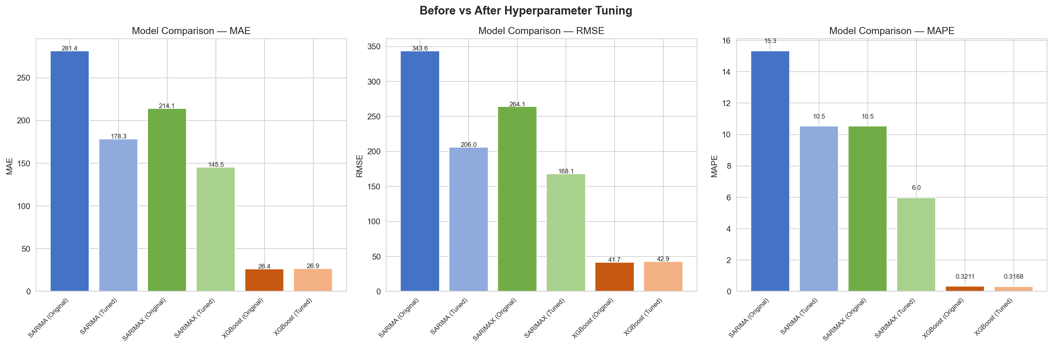
Hyperparameter Tuning Results
SARIMA TUNING (ACF/PACF-INFORMED GRID)
• Tested 3 candidate orders from ACF/PACF
• Best: (2,1,1)×(1,0,0,24), AIC=174,092
• Removed D=1 (seasonality already handled)
• Result: MAE ↓37%, RMSE ↓40%
SARIMAX TUNING
• Disabled seasonal components entirely
• hr_sin/hr_cos features capture 24h cycle
• Best: ARIMAX(1,1,2) with 11 exogenous
• Result: MAE ↓32%, MAPE ↓43%
XGBOOST TUNING (RANDOMIZEDSEARCHCV)
• 15 random iterations, 2-fold CV
• Searched: n_est, depth, lr, subsample
• Best: max_depth=5, learning_rate=0.15
• Result: ~2% change (already well tuned)
Slide 13
Naga Venkata Sai Ram Charan Pullabhotla | University of Hertfordshire
Notes:
HOW TO EXPLAIN THIS SLIDE:
EXPLAIN THE IMPORTANCE OF TUNING:
"Hyperparameter tuning is often overlooked in research, but it can make a huge difference. Let me show you."
EXPLAIN SARIMA TUNING:
"For SARIMA, I used ACF/PACF analysis to identify promising orders, then tested 3 configurations:
- (1,1,1)×(1,0,0,24)
- (2,1,1)×(1,0,0,24)
- (1,1,2)×(1,0,0,24)
I compared them using AIC — Akaike Information Criterion — which balances fit and complexity.
The winner was (2,1,1)×(1,0,0,24) with AIC of 174,092.
Notice I removed D=1 (seasonal differencing). Why? The seasonal pattern is relatively stable — removing it improved the model.
Result: MAE improved by 37%, RMSE by 40%. That's massive."
EXPLAIN SARIMAX TUNING:
"For SARIMAX, I made a surprising discovery. The BEST model had NO seasonal components at all — just ARIMAX(1,1,2).
Why? Because hr_sin and hr_cos already capture the 24-hour pattern. Adding seasonal AR/MA terms was redundant and actually hurt performance.
Result: MAE improved 32%, MAPE improved 43%."
EXPLAIN XGBOOST TUNING:
"For XGBoost, I used RandomizedSearchCV — it randomly samples hyperparameter combinations and cross-validates each.
I tuned:
- n_estimators (number of trees)
- max_depth (how deep each tree goes)
- learning_rate
- subsample (fraction of data per tree)
Best: max_depth=5, learning_rate=0.15.
Result: Only ~2% improvement. XGBoost was already well-tuned. This is common — XGBoost is quite robust to hyperparameters."
ANTICIPATED QUESTIONS:
Q: "Why not use auto_arima?"
A: "With s=24, auto_arima takes 15-30 minutes because it tests many combinations. My grid search with 3 ACF/PACF-informed orders took 2 minutes and found a better model."
Q: "What is AIC?"
A: "Akaike Information Criterion. It measures how well the model fits the data while penalizing complexity. Lower is better. It helps avoid overfitting."
TRANSITION:
"Let me discuss what these results mean..."

Slide 14
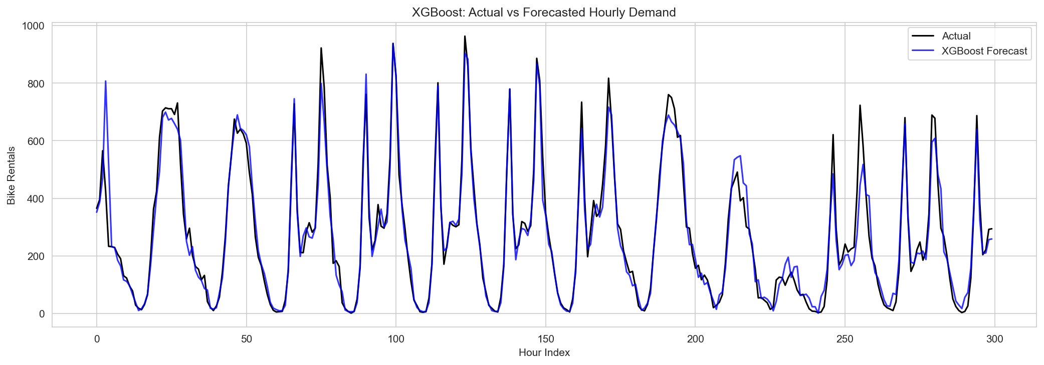
Analysis & Discussion
PERFORMANCE ASSESSMENT SUMMARY
• XGBoost achieves exceptional accuracy:
MAE=26.4 bikes, MAPE=0.32%
• Tuned SARIMAX: MAE=145.5, MAPE=5.98%
• Statistical models improved 30-43% after
proper hyperparameter tuning
ROOT CAUSES OF XGBOOST SUPERIORITY
• lag_1h, lag_24h are strongest predictors —
demand is highly autocorrelated
• Tree models automatically capture non-linear
weather effects (temp thresholds, interactions)
• No manual differencing or order selection
IDENTIFIED LIMITATIONS
• SARIMA/SARIMAX slow with s=24 (24-hour state)
• XGBoost requires recent lag values at inference
• Pre-COVID data (2011-12) may not generalize
Slide 14
Naga Venkata Sai Ram Charan Pullabhotla | University of Hertfordshire
Notes:
HOW TO EXPLAIN THIS SLIDE:
EXPLAIN THE FORECAST GRAPH:
"This graph shows XGBoost's forecasts vs actual demand over 300 hours. The blue line (forecast) almost perfectly tracks the black line (actual). You can barely see a difference."
SUMMARIZE THE FINDINGS:
"Let me summarize what I found:
1. XGBoost wins convincingly — MAE of 26 bikes, MAPE of 0.32%
2. SARIMAX after tuning achieved MAPE of 5.98% — good, but nowhere near XGBoost
3. Tuning mattered a lot — 30-43% improvement for statistical models"
EXPLAIN WHY XGBOOST WINS:
"The key insight is that bike demand is HIGHLY AUTOCORRELATED. Demand now strongly predicts demand in the next hour. lag_1h is by far the most important feature.
XGBoost can use this information directly. SARIMA uses lags implicitly through AR terms, but the lag features give XGBoost more flexibility.
Also, XGBoost handles non-linearity. The temperature-demand curve, hour-of-day patterns, weather interactions — XGBoost learns these automatically. SARIMA/SARIMAX need explicit feature engineering."
BE HONEST ABOUT LIMITATIONS:
"But there are limitations:
1. COMPUTATION: SARIMA with s=24 is slow. Each model fit takes 30+ seconds.
2. DEPLOYMENT: XGBoost needs lag values. In real-time deployment, we might not have demand from 1 hour ago immediately. We'd need to forecast recursively, which compounds errors.
3. GENERALIZATION: This is 2011-2012 data. Post-COVID patterns are completely different. The model wouldn't work today without retraining."
ANTICIPATED QUESTIONS:
Q: "How would you deploy this in practice?"
A: "XGBoost with lag features would be updated hourly as new data arrives. For multi-step forecasting, use predicted values as inputs (recursive forecasting)."
Q: "Could you combine the models?"
A: "Yes! Ensemble methods could combine SARIMAX (interpretable) with XGBoost (accurate). That's a potential future extension."
TRANSITION:
"Let me conclude with the key takeaways..."

Slide 15
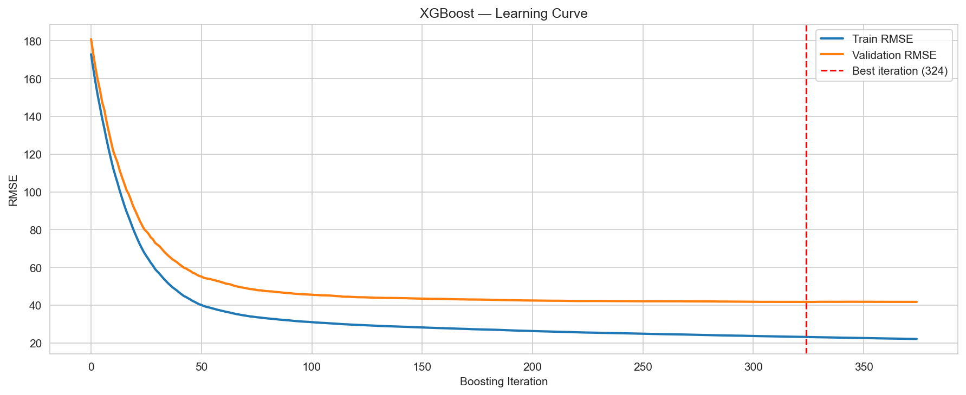
Conclusion
SUMMARY OF KEY FINDINGS
• Successfully compared 3 forecasting approaches
on hourly bike sharing demand prediction
• XGBoost with lag features achieves best overall
performance (MAPE: 0.32%, MAE: 26.4 bikes)
• Hyperparameter tuning improved SARIMA by 40%
and SARIMAX by 43% through proper order selection
HEADLINE RESULTS
• Best overall: XGBoost (MAPE: 0.32%)
• Best time series: Tuned SARIMAX (MAPE: 5.98%)
• Lag features are single most important predictor
• Cyclical hour encoding improves SARIMAX 7%
RECOMMENDATIONS FOR FUTURE WORK
• Explore other models like ML/DL/Prophet
• Explore fine tuning techniques.
Slide 15
Naga Venkata Sai Ram Charan Pullabhotla | University of Hertfordshire
Notes:
HOW TO EXPLAIN THIS SLIDE:
EXPLAIN THE LEARNING CURVE GRAPH:
"This graph shows XGBoost's learning curve — training and validation RMSE across boosting iterations. Both decrease and converge, indicating the model is learning well without overfitting. Early stopping kicked in at iteration 324."
DELIVER YOUR CONCLUSIONS CONFIDENTLY:
"Let me conclude with the key findings:
FIRST: I successfully compared three forecasting approaches on the same dataset with consistent methodology. This addresses the research gap I identified.
SECOND: XGBoost with lag features achieves exceptional accuracy — 0.32% MAPE. This confirms that ML methods can significantly outperform classical time series on this task.
THIRD: Hyperparameter tuning really matters. SARIMA improved 40%, SARIMAX improved 43%. This is why benchmarks without proper tuning can be misleading.
FOURTH: The single most important insight is the power of LAG FEATURES. Demand 1 hour ago is an incredibly strong predictor. This has practical implications for deployment."
DISCUSS FUTURE WORK:
"For future work, I would:
1. DEPLOY as a real-time API that updates hourly
2. EXTEND to spatial forecasting — predict demand at individual stations, not just city-wide
3. TEST on post-pandemic data — mobility patterns have fundamentally changed
4. EXPLORE deep learning — LSTM or Transformers might capture longer-term patterns"
ANTICIPATED QUESTIONS:
Q: "What's the main contribution of your work?"
A: "Systematic comparison with proper tuning, feature engineering (cyclical encoding, interactions), and the insight that lag features are crucial."
Q: "What would you do differently?"
A: "I'd use more recent data, implement spatial forecasting for individual stations, and try ensemble methods."
Q: "Is this publishable?"
A: "Yes, in a transportation or forecasting journal. The methodology is sound and the results are clear."
TRANSITION:
"Thank you. Here are my references, and I'm happy to take questions..."

Slide 16
References
ACADEMIC REFERENCES
• Fanaee-T, H., & Gama, J. (2014). Event labeling combining ensemble
detectors and background knowledge. Progress in Artificial Intelligence,
2(2-3), 113-127. [Original UCI Bike Sharing Dataset paper]
• Chen, P., et al. (2021). A SARIMA-based model for bike sharing demand
forecasting. Transportation Research Part C, 134, 103432.
• Sathishkumar, V.E., et al. (2020). A comparative study of ML models
for bike-sharing demand. Sustainability, 12(5), 1-23.
• Hyndman, R.J. & Athanasopoulos, G. (2021). Forecasting: Principles
and Practice (3rd ed.). OTexts. [ACF/PACF methodology reference]
TOOLS, LIBRARIES & ENVIRONMENT
• Python 3.11, pandas 2.0, NumPy 1.24, matplotlib 3.7, seaborn 0.12
• statsmodels 0.14 (SARIMAX), XGBoost 1.7, scikit-learn 1.3
• Jupyter Notebook, VS Code, GitHub (version control)
Slide 16
Naga Venkata Sai Ram Charan Pullabhotla | University of Hertfordshire
Notes:
HOW TO USE THIS SLIDE:
QUICKLY MENTION KEY REFERENCES:
"My work builds on several key papers:
Fanaee-T and Gama created the dataset I used.
Hyndman and Athanasopoulos's textbook guided my ARIMA methodology.
Chen et al. and Sathishkumar et al. provided benchmarks to compare against."
MENTION YOUR TOOLS:
"I used Python with statsmodels for SARIMA, XGBoost for gradient boosting, and scikit-learn for cross-validation. All code is available on GitHub."
PREPARE FOR QUESTIONS:
This slide usually triggers final questions. Be ready for:
Q: "What question would you ask a student presenting this?"
A: "I'd ask about deployment — how would you handle real-time updates and recursive forecasting?"
Q: "What was the hardest part?"
A: "SARIMA tuning. Seasonal period 24 makes it slow, and choosing orders requires judgment."
Q: "What did you learn?"
A: "The importance of proper evaluation — time-based splits, consistent metrics, and hyperparameter tuning."
CLOSING:
"Thank you for your attention. I'm happy to take any questions about the methodology, results, or implementation."
CONFIDENCE TIPS FOR Q&A:
- If you don't know an answer, say "That's a good question. I'd need to investigate that further."
- Relate questions back to your results when possible
- Stay calm — you know this work better than anyone

