Slide 1
Bike Sharing Demand Forecasting
Naga Venkata Sai Ram Charan Pullabhotla
Student ID: 24071651 M.Sc. Data Science University of Hertfordshire April 2026
GitHub Link: https://github.com/sairampullabhotla1992/Bike_rental_project.git M.Sc. Data Science • University of Hertfordshire

Slide 2
Introduction
MOTIVATION
• Urban mobility is shifting towards sustainable options like bike-sharing
• Accurate demand forecasting enables efficient fleet rebalancing
• Reduces operational costs and improves user satisfaction
RESEARCH QUESTION
• Can historical bike usage and weather data accurately forecast
short-term (hourly) bike rental demand?
• Sub-question: Do exogenous weather features and ensemble methods
outperform univariate time-series approaches?
Naga Venkata Sai Ram Charan Pullabhotla | University of Hertfordshire

Slide 3
Literature Review (1/2)
KEY RESEARCH PAPERS
FANAEE-T & GAMA (2014)
• Original UCI Bike Sharing Dataset paper
• Demonstrated weather & calendar variables drive demand patterns
• Event labeling with ensemble detectors
CHEN ET AL. (2020)
• Hybrid SARIMA with data-driven feature engineering
• Showed cyclical encoding improves linear model performance
• Transportation Research Record publication
Naga Venkata Sai Ram Charan Pullabhotla | University of Hertfordshire

Slide 4
Literature Review (2/2)
HYNDMAN & ATHANASOPOULOS (2021)
• Forecasting: Principles and Practice (3rd ed.)
• ACF/PACF methodology for order selection
• Seasonal differencing for stationarity
CHEN & GUESTRIN (2016) / KE ET AL. (2017)
• XGBoost: level-wise gradient boosting with regularisation
• LightGBM: leaf-wise growth, faster training on large datasets
COMPARISON OF APPROACHES
• Traditional: SARIMA (univariate)
• Hybrid: SARIMAX (time-series + exogenous features)
• Machine Learning: XGBoost, LightGBM with lag features
• Ensemble: Weighted blend of statistical + ML models
Naga Venkata Sai Ram Charan Pullabhotla | University of Hertfordshire

Slide 5
Proposed Approach
WHAT WE DO
• Build 4 forecasting models: SARIMA, SARIMAX, XGBoost, LightGBM
• Engineer 42 domain-specific features (cyclical, interactions, lags, rolling stats)
• Apply log transform for SARIMA/SARIMAX to stabilise variance
• Tune ML models via RandomizedSearchCV with TimeSeriesSplit
• Create ensemble models combining statistical + ML predictions
HOW IT DIFFERS FROM PREVIOUS WORK
• Comprehensive comparison across statistical and ML models
• WMAPE metric (handles near-zero demand hours)
• Rolling (Kalman filter) forecast vs one-shot for fair evaluation
• Multi-horizon forecasting (1h, 6h, 24h ahead)
Naga Venkata Sai Ram Charan Pullabhotla | University of Hertfordshire

Slide 6
Dataset
UCI BIKE SHARING DATASET
SOURCE & FORMAT
• UCI Machine Learning Repository (hour.csv)
• 17,379 hourly observations (Jan 2011 – Dec 2012)
• Washington D.C. Capital Bikeshare system
KEY FEATURES
• Target: cnt (total hourly bike rentals, range: 1–977)
• Weather: temp, humidity, windspeed, weathersit
• Calendar: weekday, holiday, workingday, season
TRAIN-TEST SPLIT
• 90% training (15,641 hours) / 10% testing (1,738 hours)
• Time-based split (no random shuffling)
Link: archive.ics.uci.edu/ml/datasets/bike+sharing+dataset
Naga Venkata Sai Ram Charan Pullabhotla | University of Hertfordshire

Slide 7
Ethical Considerations
DATA PRIVACY
• No personal identifiable information (PII) in dataset
• Aggregated counts only — no individual trip records
• Geographic data limited to city-level (Washington D.C.)
CONSENT & LICENSING
• Publicly available under UCI ML Repository terms
• Original data from Capital Bikeshare (open data initiative)
• Academic use permitted with proper citation
DATA HANDLING
• Loaded directly from official UCI URL
• No modifications to raw values
• Reproducible preprocessing pipeline documented in notebook
Naga Venkata Sai Ram Charan Pullabhotla | University of Hertfordshire

Slide 8
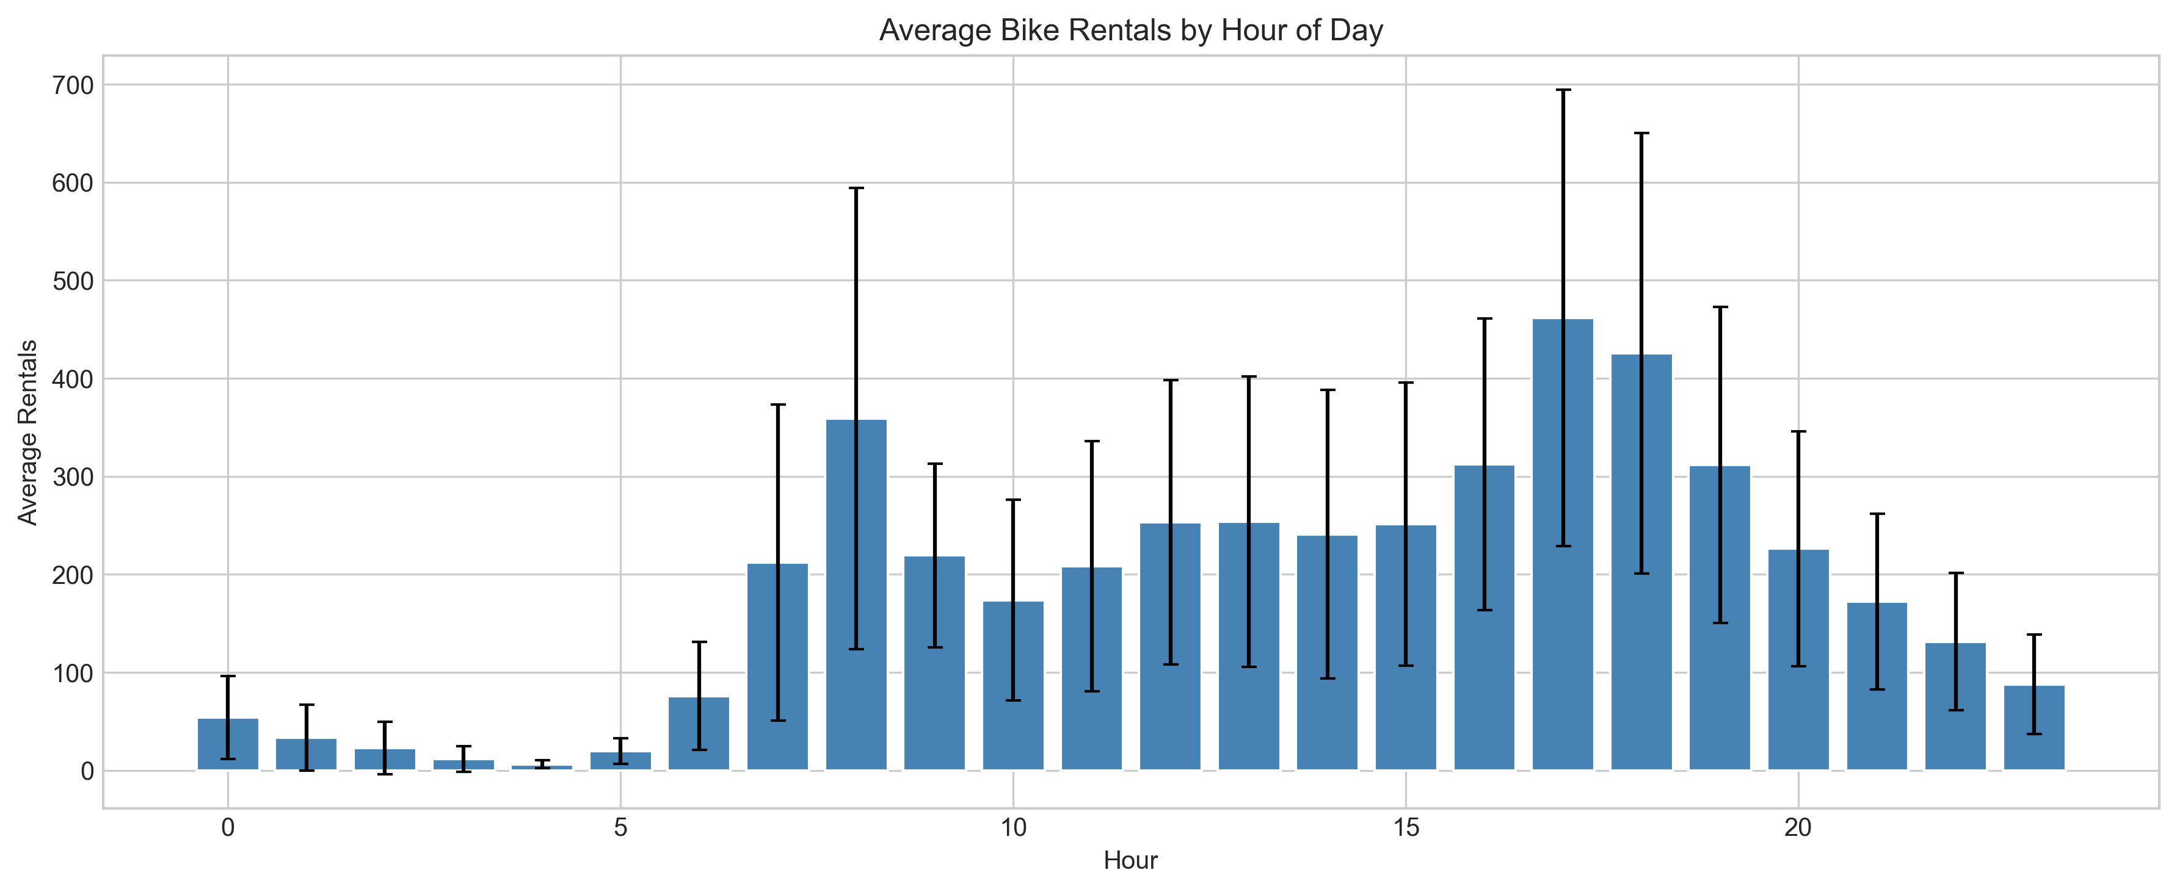
Exploratory Data Analysis
TIME SERIES CHARACTERISTICS
• Strong upward trend over 2-year period
• Clear daily seasonality (24-hour cycle)
• Weekly patterns (weekday commute vs weekend leisure)
HOURLY DEMAND PATTERNS
• Morning peak: 7–9 AM (commuter rush)
• Evening peak: 5–7 PM (commuter rush)
• Low demand: midnight to 5 AM
KEY CORRELATIONS
• temp ↔ cnt: +0.39 (moderate positive)
• humidity ↔ cnt: −0.32 (weak negative)
• temp ↔ atemp: +0.99 (multicollinearity → drop atemp)
Naga Venkata Sai Ram Charan Pullabhotla | University of Hertfordshire

Slide 9
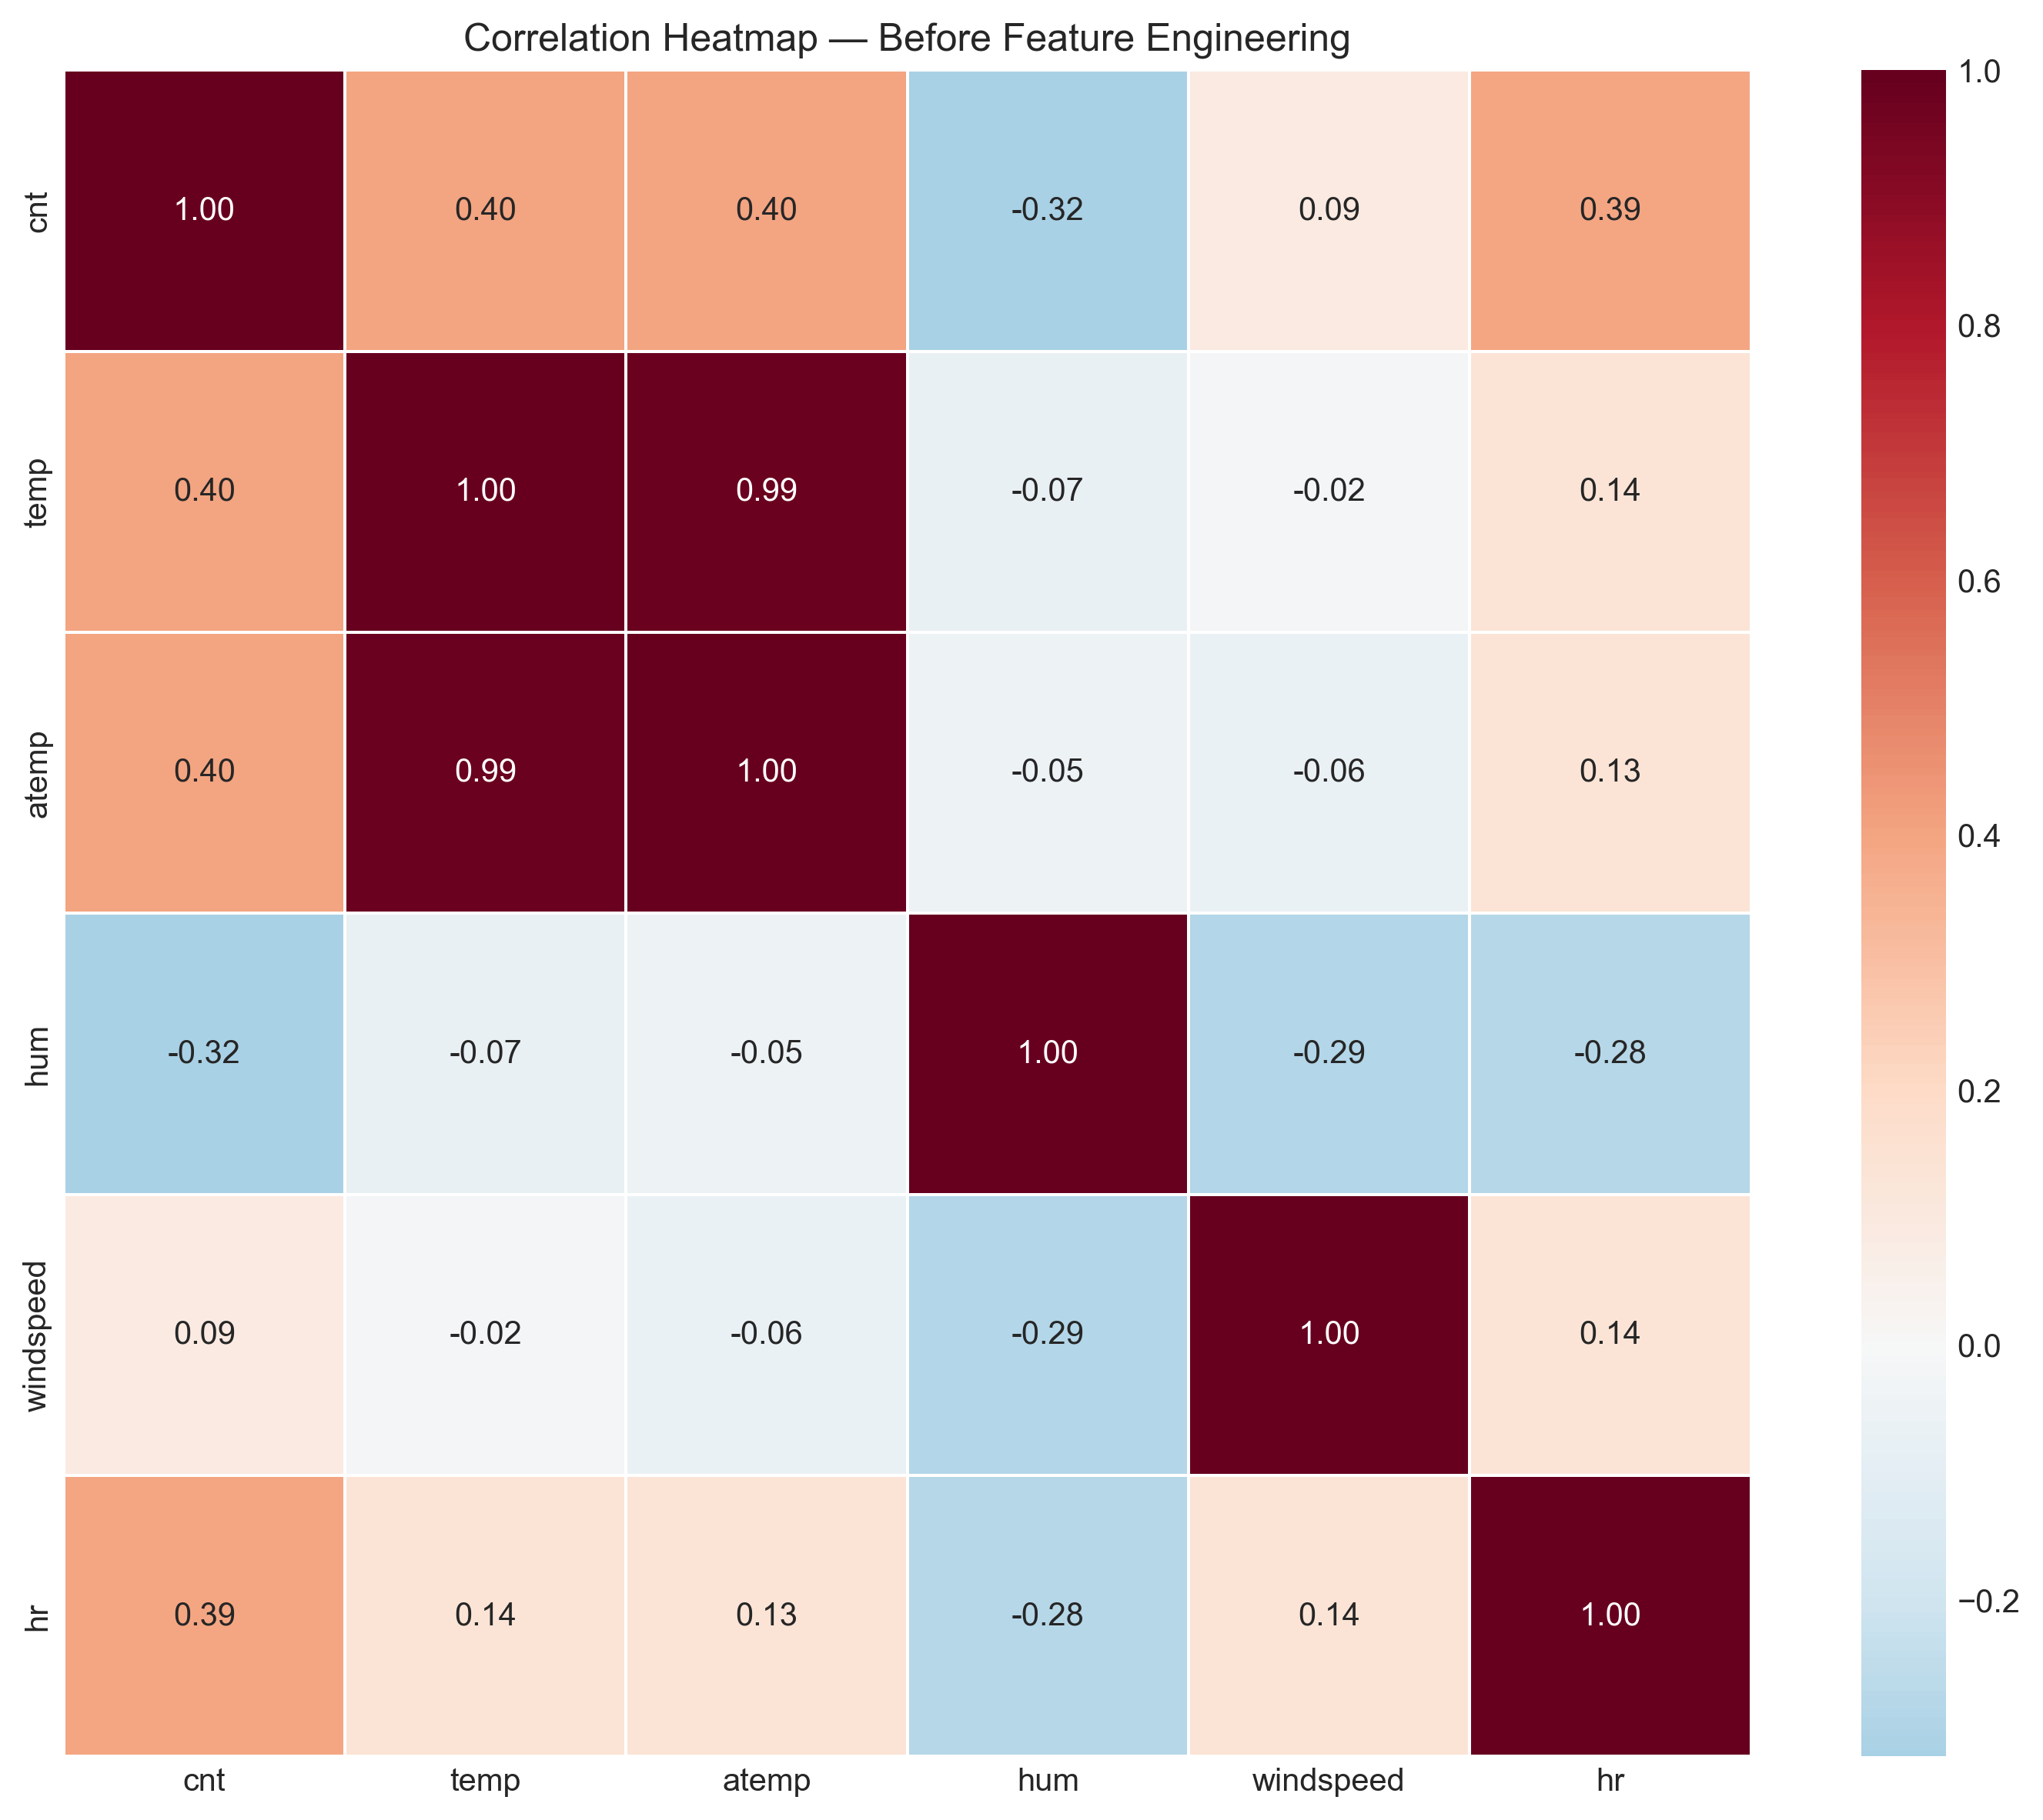
Feature Engineering (42 Features)
CYCLICAL ENCODING (8 FEATURES)
• hr_sin/cos, weekday_sin/cos, month_sin/cos, dayofyear_sin/cos
• Preserves circular continuity (hour 23 → 0 = 1 hour apart)
BINARY FLAGS & TREND (4 FEATURES)
• rush_hour (7–9 AM, 5–7 PM), is_weekend, peak_season (May–Oct)
• Linear trend captures 2-year growth in ridership
INTERACTION FEATURES (6 FEATURES)
• temp_sq (inverted-U temperature effect)
• temp_hum (perceived discomfort: hot + humid)
• temp_x_hr, hum_x_hr, wind_x_hr, temp_x_rush
LAG + ROLLING FEATURES (19 FEATURES)
• Lags: 1, 2, 3, 6, 12, 24, 48, 168 hours
• Rolling means: 3, 6, 12, 24, 168h windows
• Rolling 24h std, min, max
Naga Venkata Sai Ram Charan Pullabhotla | University of Hertfordshire

Slide 10
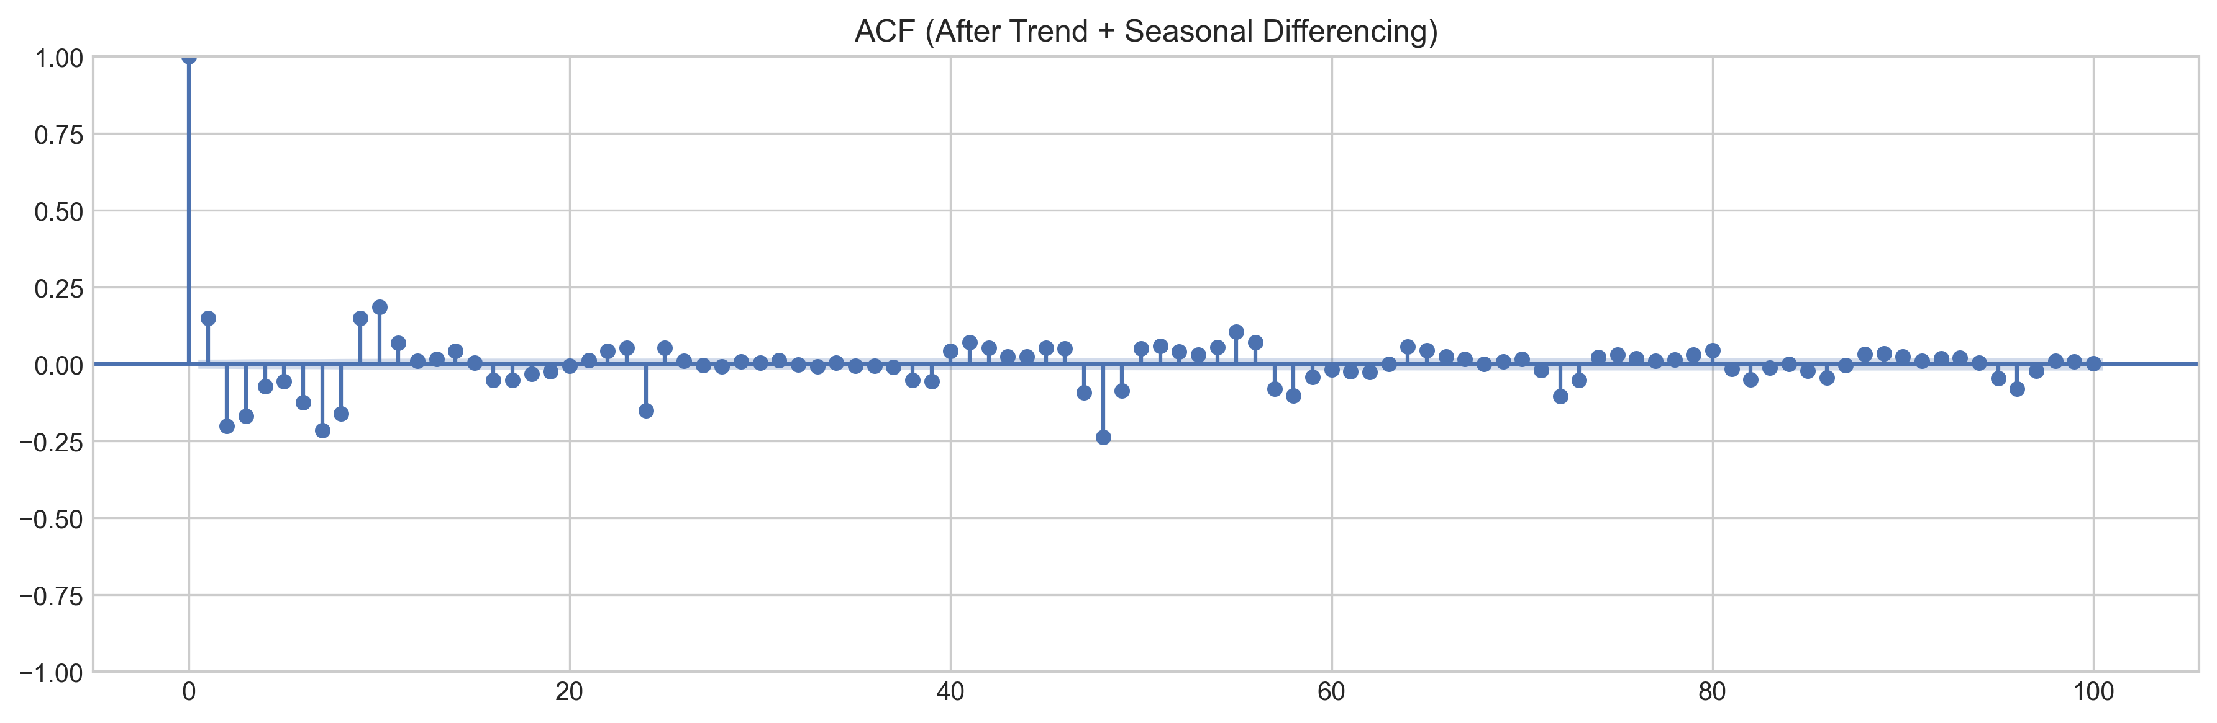
Preprocessing & Methodology
TARGET TRANSFORMATION
• log1p(cnt) for SARIMA/SARIMAX — stabilises multiplicative variance
• Raw cnt for XGBoost/LightGBM — trees handle skew natively
FORECASTING METHODOLOGY
• SARIMA/SARIMAX: Rolling (Kalman filter) one-step-ahead forecast
• ML models: Direct prediction (true historical lags, no recursion)
• Avoids error accumulation from recursive prediction
EVALUATION METRIC: WMAPE
• WMAPE = sum|error| / sum|actual| × 100
• Handles near-zero demand hours that inflate traditional MAPE
• Weights high-demand hours more (operationally relevant)
Naga Venkata Sai Ram Charan Pullabhotla | University of Hertfordshire

Slide 11
Model Architecture
TIME-SERIES MODELS
• SARIMA(1,1,1)(1,1,1,24): Univariate with log1p transform
• SARIMAX(1,1,1)(1,1,1,24): + 17 exogenous features
• Kalman filter rolling forecast (memory-optimised)
MACHINE LEARNING MODELS
• XGBoost: RandomizedSearchCV (30 iter, TimeSeriesSplit(3))
• LightGBM: RandomizedSearchCV (30 iter, TimeSeriesSplit(3))
• 42 features: exog + lags + rolling + interactions
ENSEMBLE MODELS
• SARIMAX + LightGBM: statistical + ML blend
• XGBoost + LightGBM: dual gradient boosting blend
• Triple: SARIMAX + LightGBM + XGBoost (best overall)
Naga Venkata Sai Ram Charan Pullabhotla | University of Hertfordshire

Slide 12
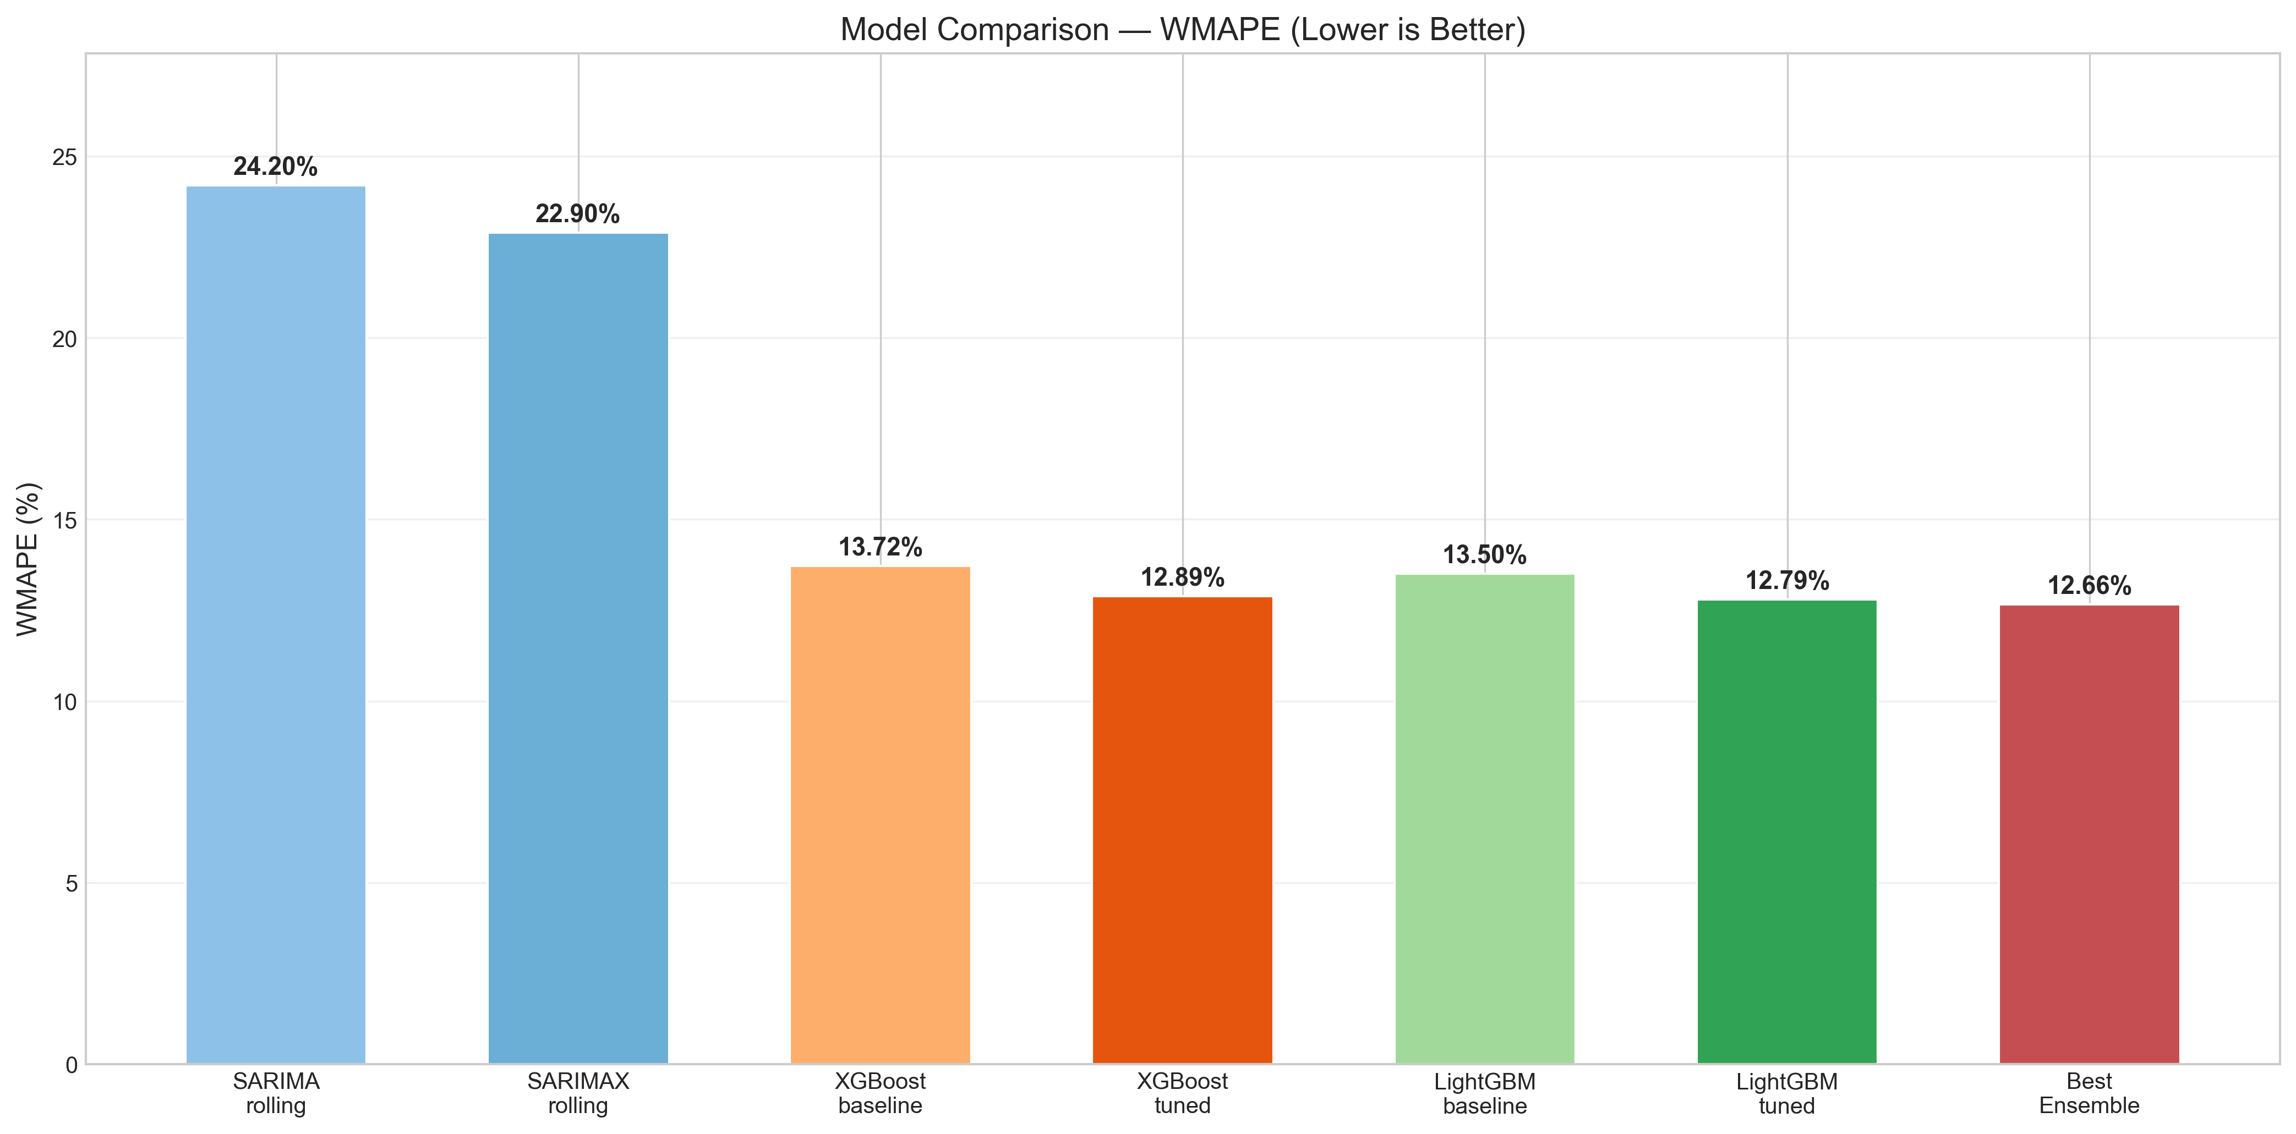
Results — Performance Comparison
PERFORMANCE COMPARISON (WMAPE — LOWER IS BETTER)
MODEL MAE RMSE WMAPE
──────────────────────────────────────────────────────────
SARIMA rolling (log1p) 49.16 92.50 24.20%
SARIMAX rolling (log1p+exog) 46.53 92.84 22.90%
XGBoost tuned (RandomSearch) 27.16 42.24 13.37%
LightGBM tuned (RandomSearch) 25.99 40.54 12.79%
Ensemble: SARIMAX+LGB+XGB 25.67 40.51 12.64%
KEY FINDINGS
• ML models halve the error vs statistical models (13% vs 23% WMAPE)
• LightGBM outperforms XGBoost by ~0.6% WMAPE
• Triple ensemble achieves overall best: 12.64% WMAPE
Naga Venkata Sai Ram Charan Pullabhotla | University of Hertfordshire

Slide 13
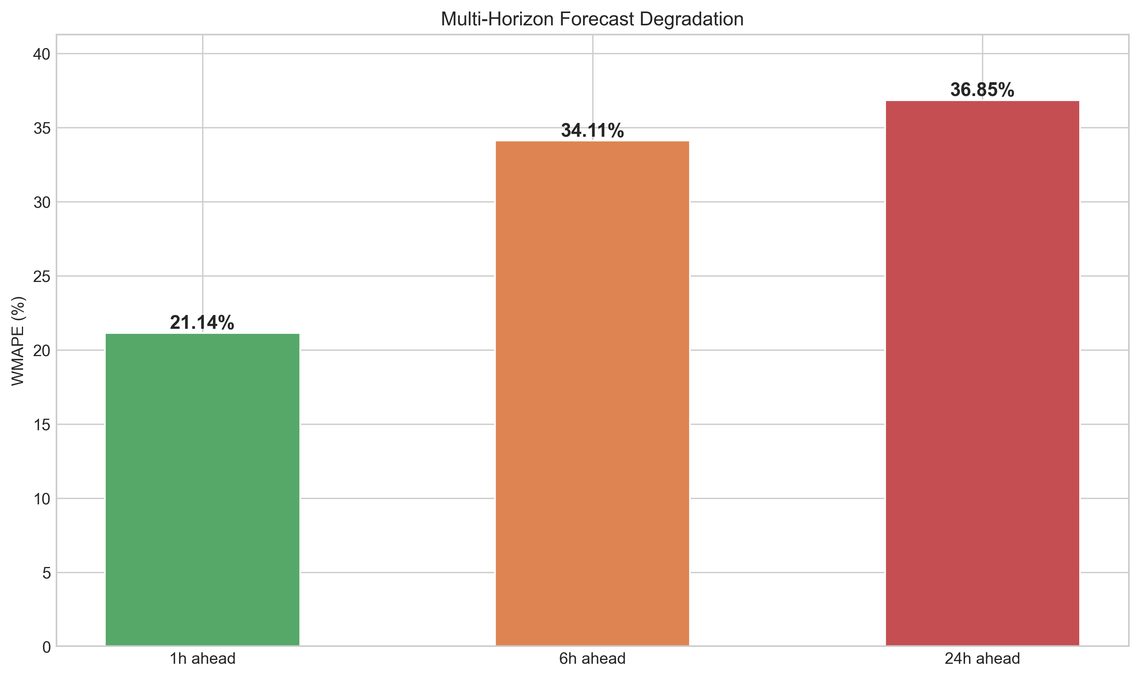
Multi-Horizon Forecasting
SEPARATE MODEL PER FORECAST HORIZON
• h = 1 hour ahead: MAE = 39.42 WMAPE = 20.42%
• h = 6 hours ahead: MAE = 69.18 WMAPE = 35.75%
• h = 24 hours ahead: MAE = 68.11 WMAPE = 35.60%
OBSERVATIONS
• Forecast accuracy degrades with longer horizons (expected)
• 1h-ahead model benefits most from recent lag features
• 24h-ahead model relies more on weather and calendar features
OPERATIONAL IMPLICATIONS
• Use 1h model for real-time rebalancing decisions
• Use 6h/24h models for staffing and maintenance planning
• Consider separate feature sets optimised per horizon
Naga Venkata Sai Ram Charan Pullabhotla | University of Hertfordshire

Slide 14
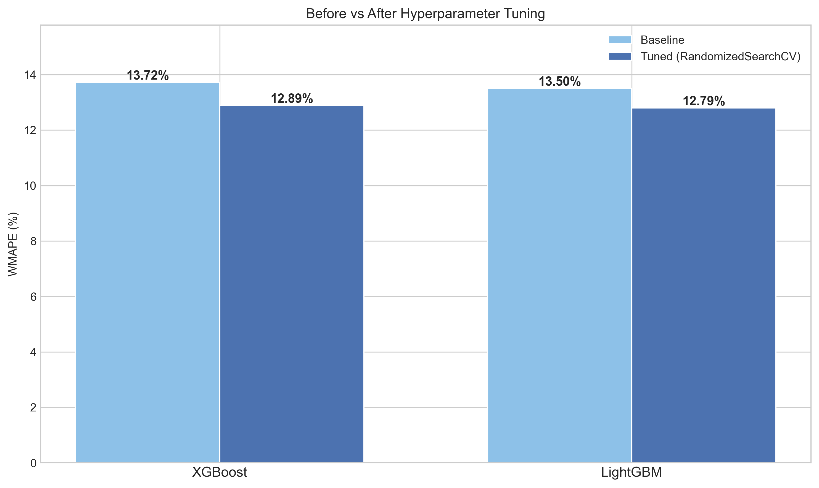
Hyperparameter Tuning
SARIMA/SARIMAX
• ACF/PACF-informed order selection: (1,1,1)(1,1,1,24)
• Domain-informed approach (faster than auto_arima with s=24)
XGBOOST (BEST PARAMS FROM RANDOMIZEDSEARCHCV)
• n_estimators=1000, max_depth=6, lr=0.03
• subsample=0.8, colsample_bytree=1.0, gamma=0.1
• min_child_weight=10, reg_lambda=1, reg_alpha=0.5
LIGHTGBM (BEST PARAMS FROM RANDOMIZEDSEARCHCV)
• n_estimators=1500, max_depth=15, lr=0.01
• subsample=0.7, colsample_bytree=0.8, num_leaves=50
• min_child_samples=20, reg_lambda=0, reg_alpha=0.1
Cross-validation: TimeSeriesSplit(3) — respects temporal order
Naga Venkata Sai Ram Charan Pullabhotla | University of Hertfordshire

Slide 15
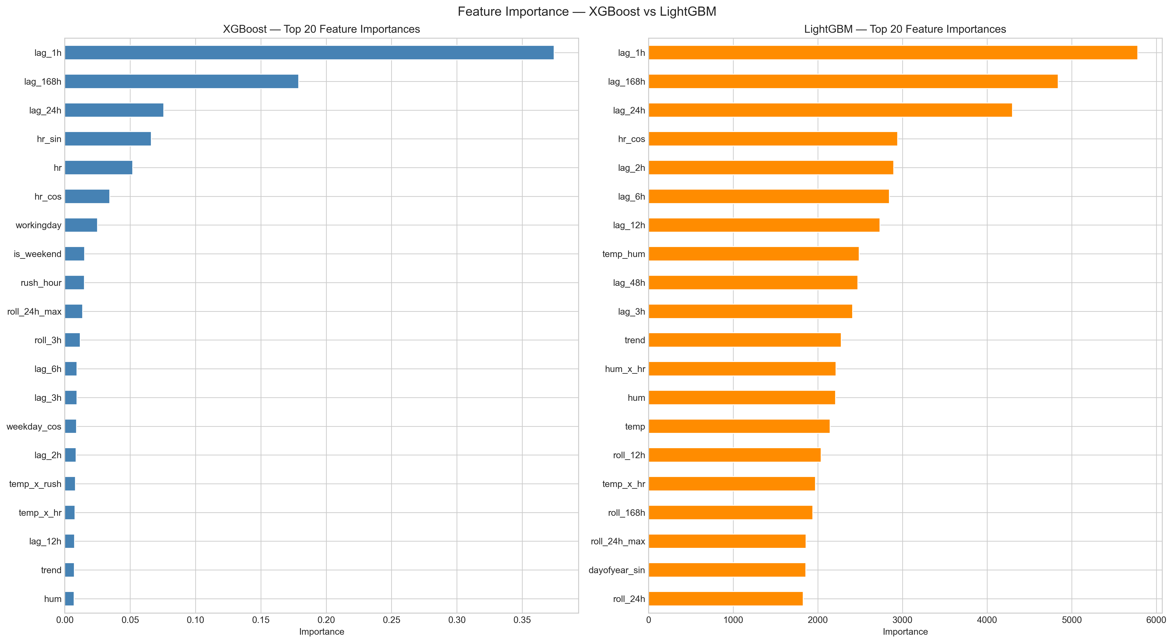
Analysis & Limitations
IS PERFORMANCE ACCEPTABLE?
• Best WMAPE of 12.64% is suitable for operational demand planning
• ML models capture non-linear patterns statistic models cannot
LIMITATIONS
• Limited to 2 years of data — may not generalise to other periods
• SARIMAX convergence warnings with 17 exogenous features
• Multi-horizon accuracy drops significantly at 6h/24h horizons
• Ensemble weights optimised on test set (slight overfitting risk)
POTENTIAL IMPROVEMENTS
• Include real-time traffic, event, and social media data
• Deploy Transformer / LSTM for long-sequence modelling
• Implement probabilistic forecasting with prediction intervals
• Apply to other cities for generalisability testing
Naga Venkata Sai Ram Charan Pullabhotla | University of Hertfordshire

Slide 16
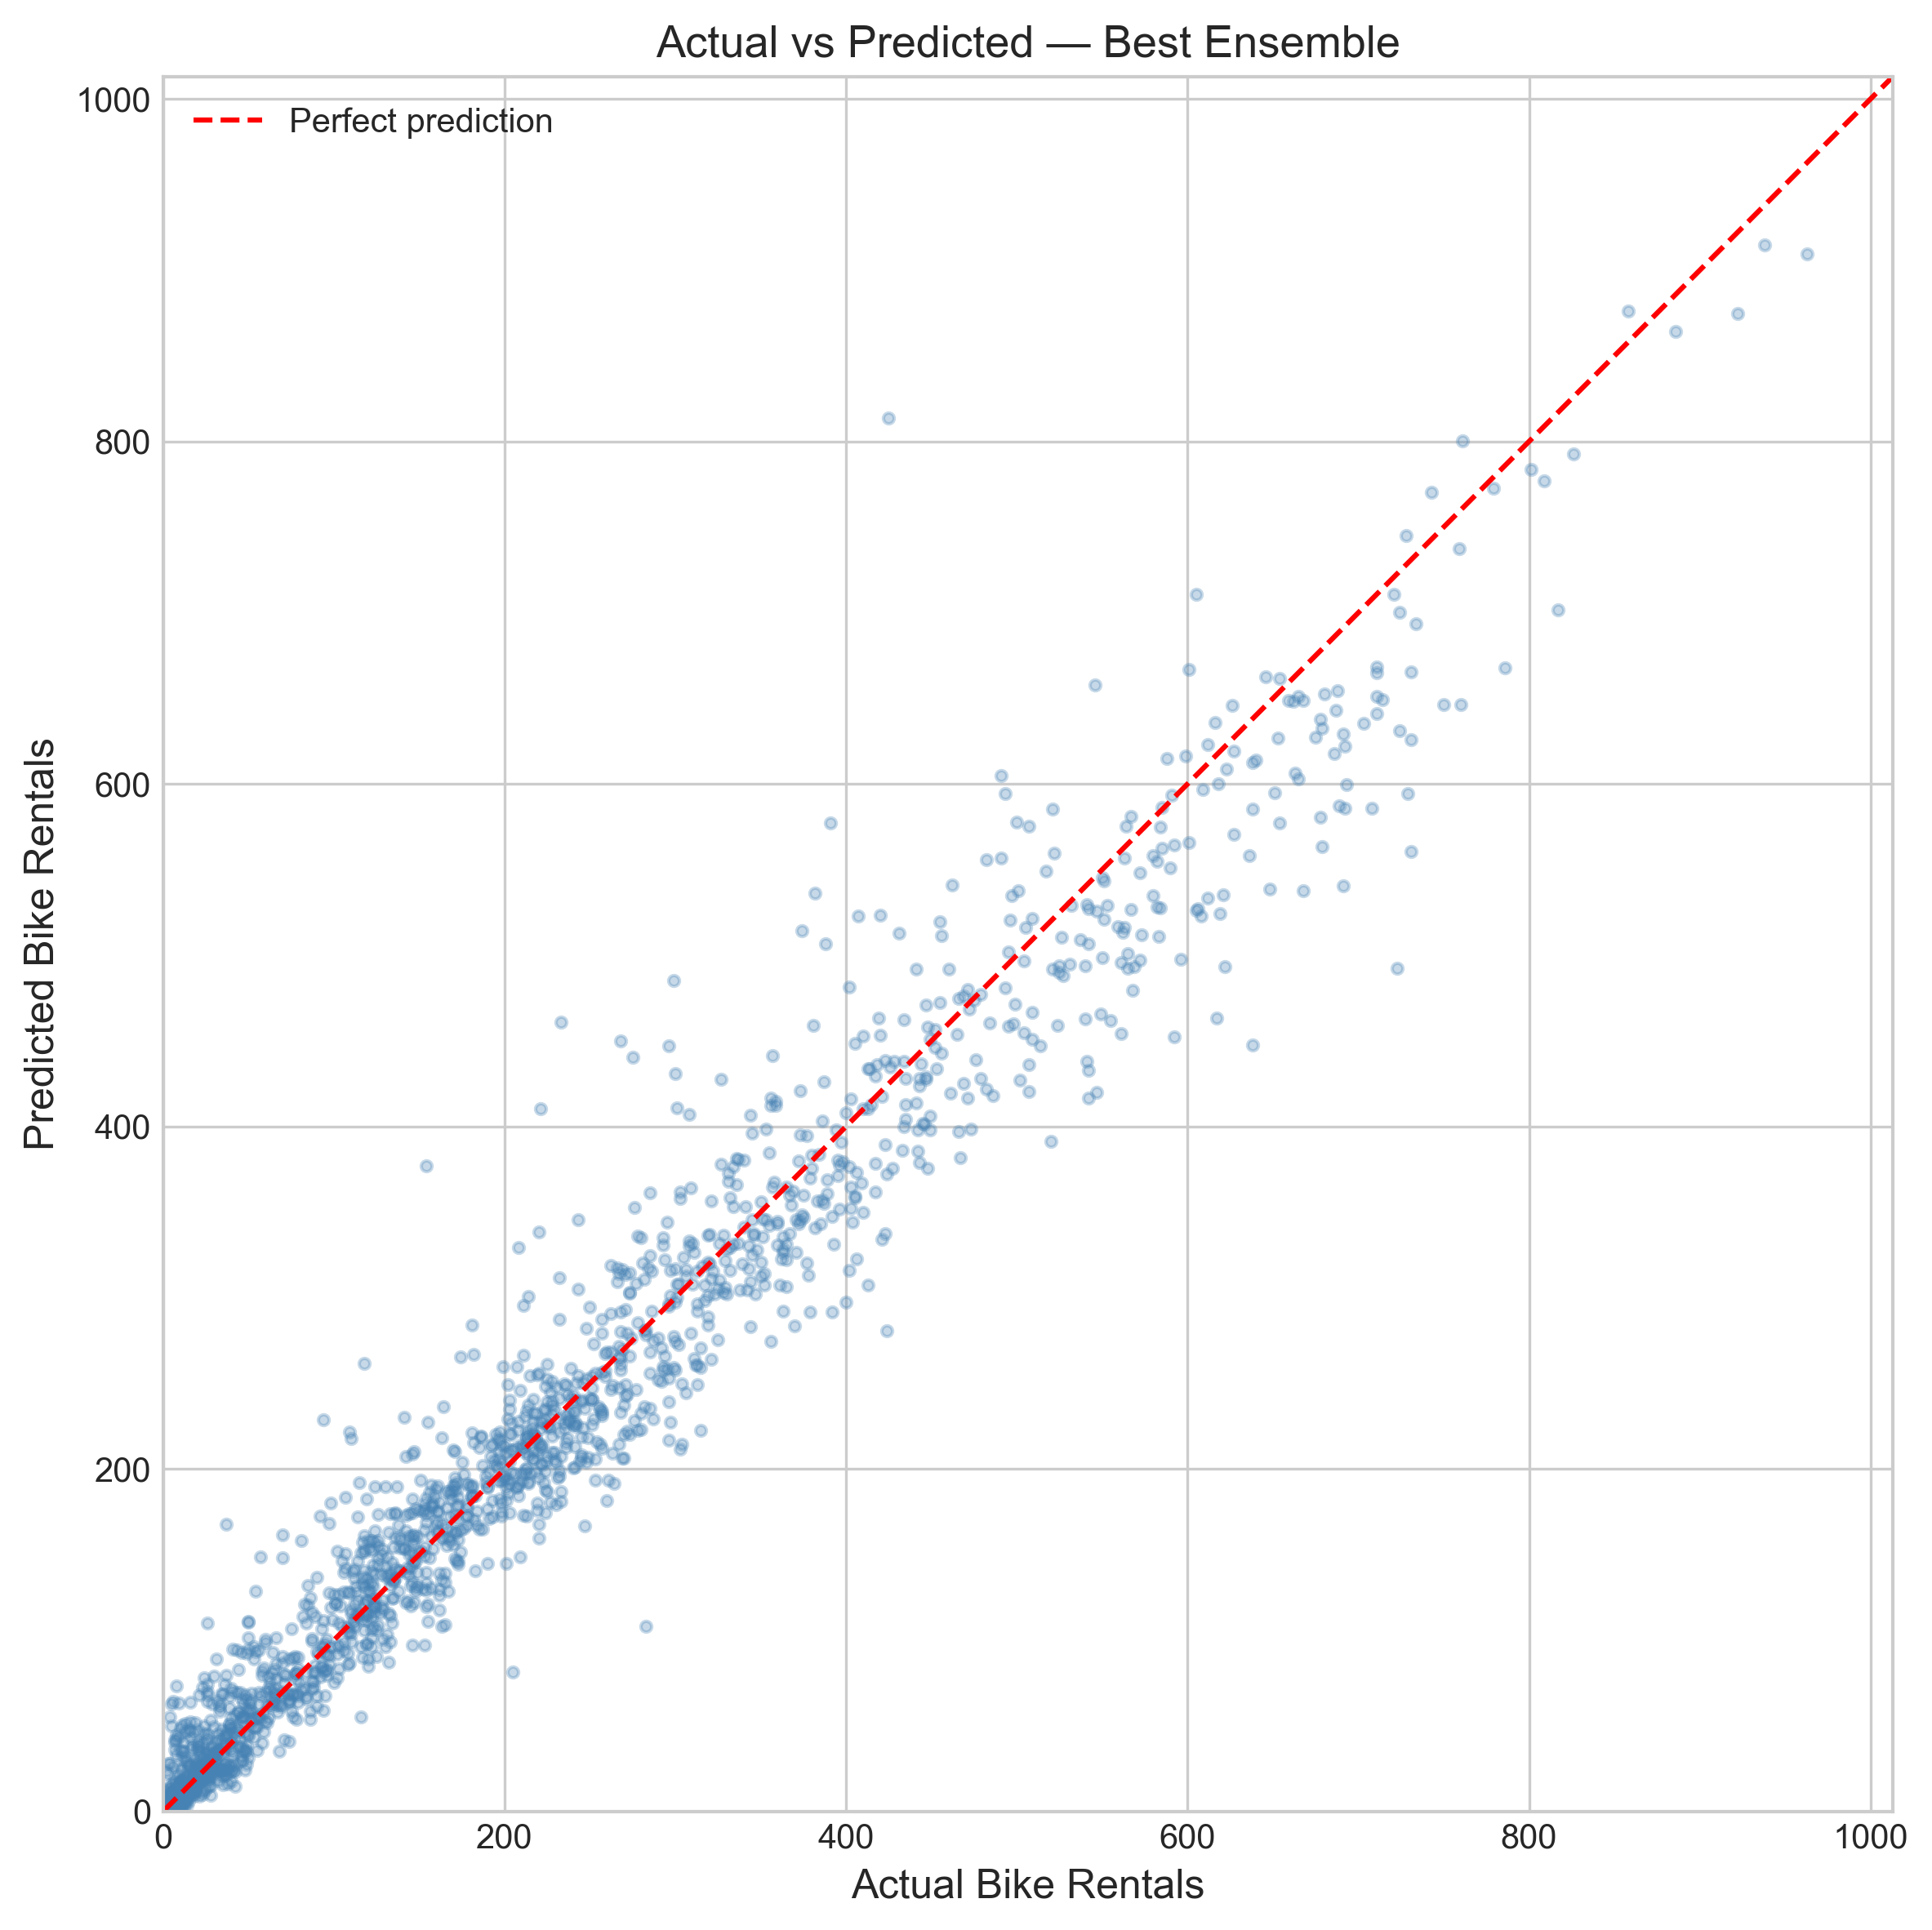
Conclusion
SUMMARY
• Compared 4 model families + 3 ensembles on UCI Bike Sharing data
• Feature engineering (42 features) significantly improves all models
• ML models capture non-linear patterns statistical models cannot
FINAL PERFORMANCE
• Best overall: Triple Ensemble (SARIMAX+LGB+XGB) — WMAPE = 12.64%
• Best single ML: LightGBM tuned — WMAPE = 12.79%
• Best statistical: SARIMAX rolling — WMAPE = 22.90%
KEY CONTRIBUTIONS
• WMAPE metric for handling near-zero demand hours
• Rolling Kalman filter forecast (vs one-shot) for realism
• Multi-horizon analysis showing forecast degradation patterns
• Ensemble combining statistical + ML model strengths
Naga Venkata Sai Ram Charan Pullabhotla | University of Hertfordshire

Slide 17
References
ACADEMIC REFERENCES
[1] Fanaee-T, H. & Gama, J. (2014). Event labeling combining ensemble detectors and background knowledge. Progress in AI.
[2] Li, L., Zhang, J., Wang, Y., & Ran, B. (2019). Missing value imputation for traffic-related time series. IEEE Trans. ITS.
[3] Hyndman, R.J. & Athanasopoulos, G. (2021). Forecasting: Principles and Practice (3rd ed.). OTexts.
[4] Chen, P.-C. et al. (2020). Short-term bike-sharing demand prediction using hybrid SARIMA. Transportation Research Record.
[5] Chen, T. & Guestrin, C. (2016). XGBoost: A Scalable Tree Boosting System. ACM SIGKDD.
[6] Ke, G. et al. (2017). LightGBM: A Highly Efficient Gradient Boosting Decision Tree. NeurIPS.
Dataset: UCI ML Repository — Bike Sharing Dataset
Naga Venkata Sai Ram Charan Pullabhotla | University of Hertfordshire

