Slide 1

SMALL ARMS Propellants (SAP) Project 4
Sai Ram Vodnala and Bibek Adhikari
Group 9
Presentation: 05/07/2025

Slide 2
Introduction
Background
Small arms propellants (SAP) – canister powders – are easily accessible, cost-effective materials that a firearms enthusiast can acquire for assembling ammunition.
SAPs are advantageous for constructing improvised explosive devices (IEDs).
The article by Jarvis et al., published in 2023, is taken as a reference for this project.
The dataset includes:
unexploded_watchlist.csv
background_data.csv
query_1.csv
query_2.csv
query_6.csv

Slide 3
Data Overview
The first two data sets (unexploded and background csv) include following features:
a. “Area” b. “Perim.” c. “Major” d. “Minor” e. “Circ.” f. “AR” g. “Round” h. “Solidity”
The query sets contain only the first four (a-d) features.
These features are the measurements for the ImageJ software.
Objectives
Exploring query objects to decide how many possible brands make up the collection of particles in the query object.
Adding a sixth class of lots, by pooling all of the brands together that are not on the watch-list, as a universal background.
Building a classifier to predict which of the six classes (1 universal background class and 5 brands) gave rise to each particle in the query object.
Aggregating the individual particle predicted within the cluster.
Concluding about the brands used in the construction of the IED.

Slide 4
Feature Engineering
Adding three derived features to all the query data sets as "Circ", "AR", and "Round”.
Clustering the Query data sets
To explore the internal composition of each IED query, Mclust clustering was used to group particles by their morphometric similarity.
This helps to predict the number of clusters present within the data set, accounting for the already present and feature-engineered design.
This clustering do not predict how many brands (six: 5 known brands from unexploded and 1 as background) we are interested in, but rather provides the naturally existing cluster (multimodal).
All provided queries were subjected to clustering.
Notes:
To explore the internal composition of each IED query, Mclust clustering was used to group particles by their morphometric similarity. This unsupervised step identified 9 natural clusters for each query object. The number of clusters is not assumed to equal the number of brands but provides useful segmentation to assess brand involvement.
We are not interpreting each cluster as a distinct brand but using it as a tool to group particles with similar shape/size features for downstream aggregation.
Mclust() uses Bayesian Information Criterion (BIC) to select the number of clusters automatically. It tries to balance model fit with complexity. It doesn’t know you're working with 5 brands. it just sees multimodal, continuous distributions in 7D feature space and identifies where natural groups exist.

Slide 5
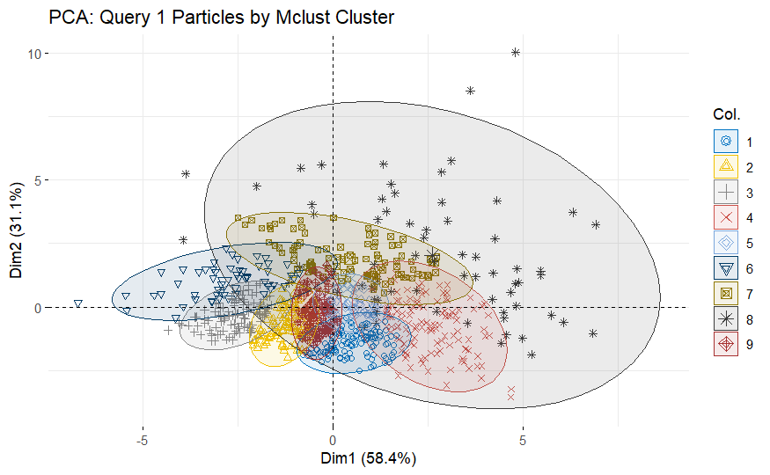
Figure 1. Clustering for Query 1.

Slide 6
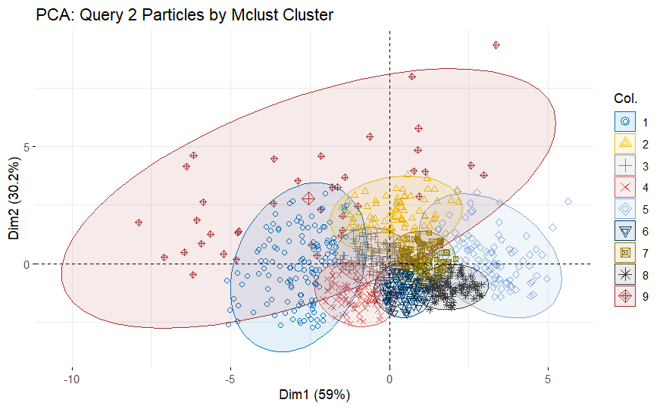
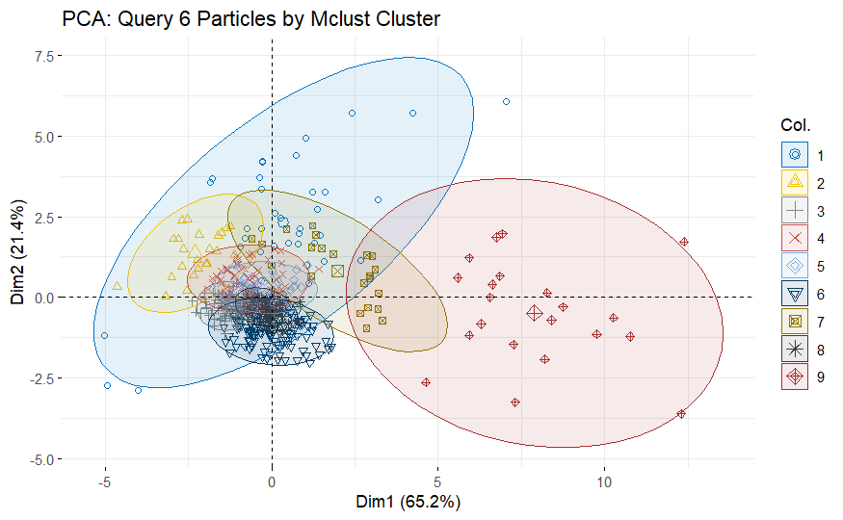
2
3
Figures Clustering for Query 2 (2) and Query 6 (3).

Slide 7
Table 1. Summary statistics for the random forest sampling.
Class | Sensitivity (Recall) | Precision (PPV) | Balanced Accuracy
Background | 0.59 | 0.99 | 0.775
BL-C(2) | 0.51 | 0.20 | 0.71
Bullseye | 0.93 | 0.21 | 0.92
H335 | 0.53 | 0.19 | 0.71
RedDot | 0.89 | 0.13 | 0.91
Reloader23 | 0.91 | 0.18 | 0.92

Slide 8
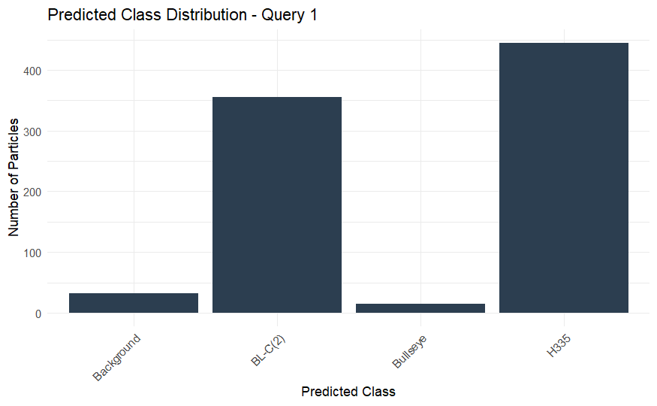
Table 2. Query 1: Summary.
Predicted Class | Particle Count
H335 | 445
BL-C(2) | 355
Background | 32
Bullseye | 15
Figure 4. Query 1: prediction class distribution.

Slide 9
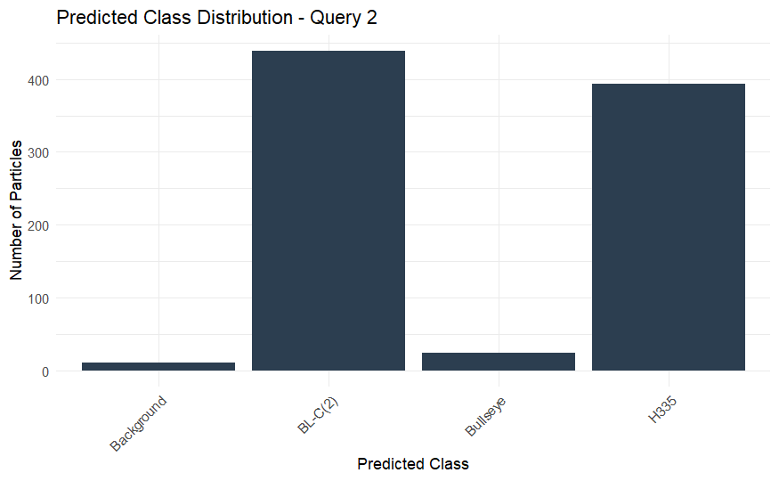
Table 3. Query 2: Summary.
Predicted Class | Particle Count
BL-C(2) | 439
H335 | 393
Bullseye | 24
Background | 11
Figure 5. Query 2: prediction class distribution.

Slide 10
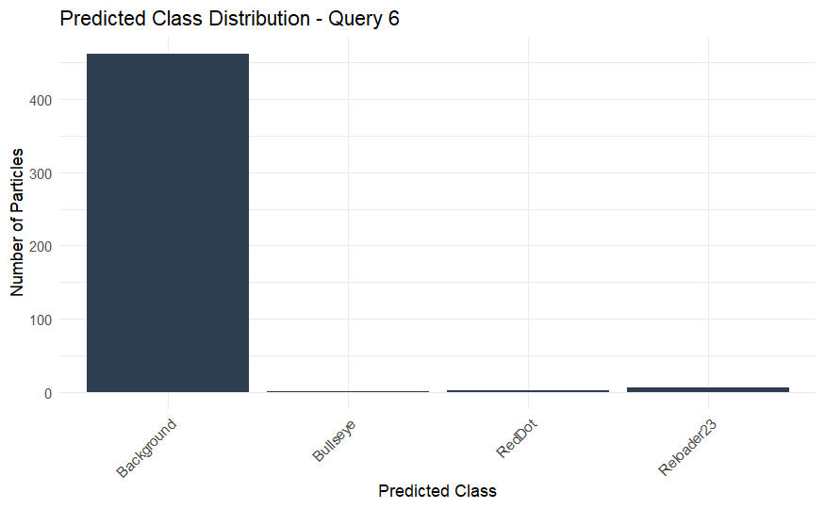
Table 4. Query 6: Summary.
Predicted Class | Particle Count
Background | 462
Reloader23 | 6
RedDot | 3
Bullseye | 1
Figure 6. Query 6: prediction class distribution.

Slide 11
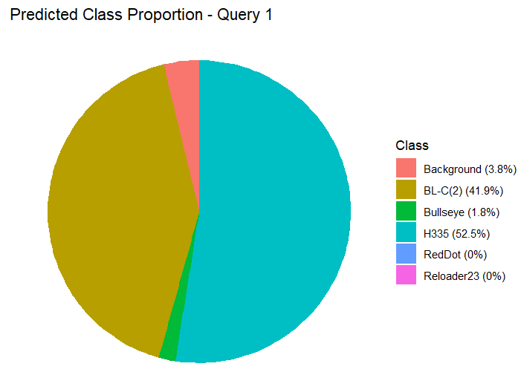
Table 5. Query 1: Summary.
Class | Proportion
H335 | 52.5%
BL-C(2) | 41.9%
Background | 3.8%
Bullseye | 1.8%
Others | 0%
Figure 7. Query 1: Pie chart for prediction class distribution.

Slide 12
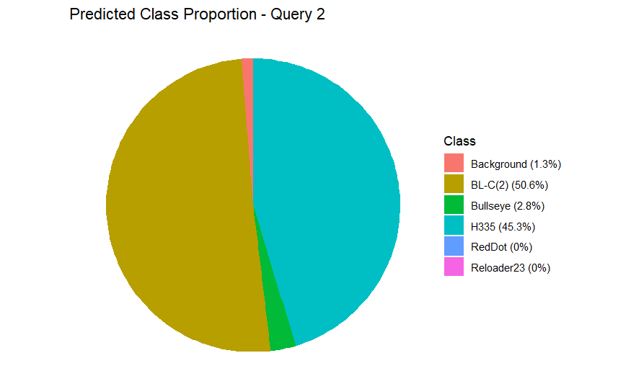
Table 6. Query 2: Summary.
Class | Proportion
BL-C(2) | 50.6%
H335 | 45.3%
Bullseye | 2.8%
Background | 1.3%
Others | 0%
Figure 8. Query 2: Pie chart for prediction class distribution.

Slide 13
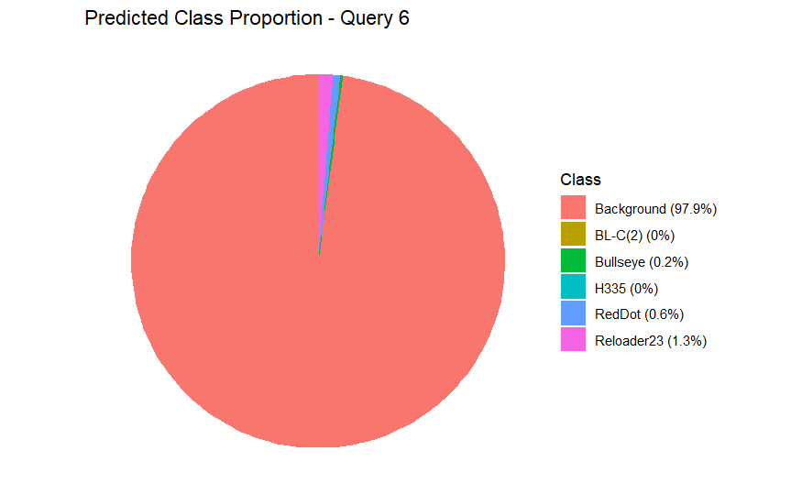
Table 7. Query 6: Summary.
Class | Proportion
Background | 97.9%
Reloader23 | 1.3%
Bullseye | 0.2%
RedDot | 0.6%
Others | 0%
Figure 9. Query 6: Pie chart for prediction class distribution.

Slide 14
Table 8. Overall summary statistics.
Query | Primary Brands Detected | Background Proportion | Conclusion
Q1 | H335, BL-C(2) | 3.8% | High-confidence dual-brand match
Q2 | BL-C(2), H335 (+ Bullseye) | 1.3% | Dual-brand IED with minor third brand
Q6 | (None) | 97.9% | Likely non-watchlist origin

Slide 15
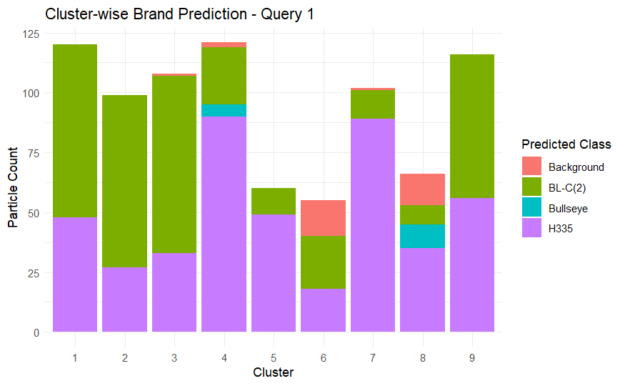
Figure 10. Query 1: Cluster-wise prediction class distribution.

Slide 16
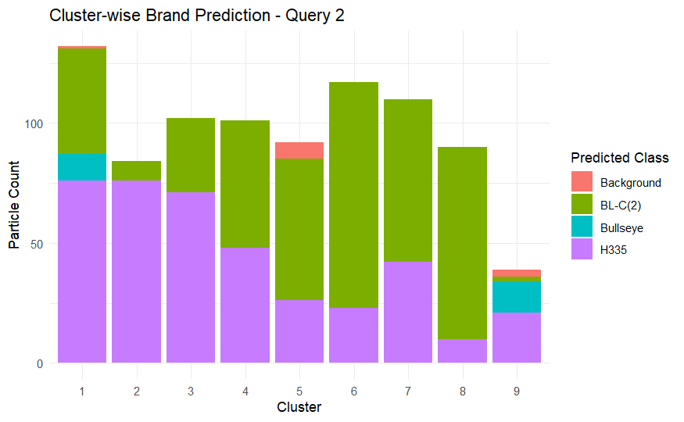
Figure 11. Query 2: Cluster-wise prediction class distribution.

Slide 17
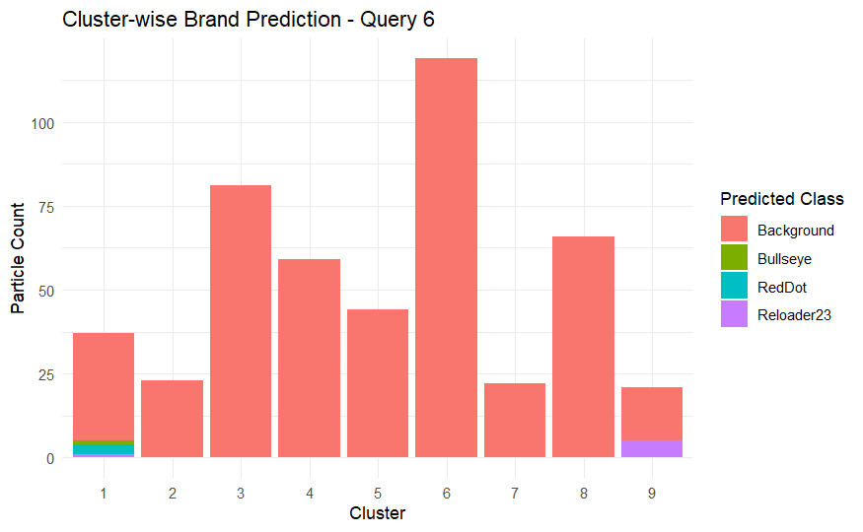
Figure 12. Query 6: Cluster-wise prediction class distribution.

Slide 18
Table 9. Overall summary statistics for cluster wise classification.
Query | Clusters with Known Brand Matches | Main Brands | Verdict
Query 1 | Clusters 1–4, 7, 9 (mostly H335, BL-C(2)) | H335, BL-C(2) | Dual-brand IED (strong match)
Query 2 | Clusters 1, 3–7, 9 (H335, BL-C(2), Bullseye) | H335, BL-C(2), Bullseye | Multi-brand IED (mainly H335 + BL-C(2))
Query 6 | Mostly Background (tiny traces in cluster 1 & 9) | None dominant | Likely not from any watchlist brand

Slide 19
Conclusion
Based on cluster-level classification and shape analysis, Query 1 and Query 2 clearly contain particles most similar to known watchlist brands, primarily H335 and BL-C(2). Query 2 also shows minor involvement of Bullseye.
Query 6, however, shows nearly full classification into the “Background” category, indicating no match to any of the five brands. This suggests the possible use of non-watch-listed powders in its construction.

Slide 20
References
Saunders C.P., STAT 600, 601, and 602 Lecture Notes.
Jarvis, C. M., Kress, D., Hanka, J., Moorehead, W., & Hietpas, J. (2023). Assessing the strengths and limitations of quantitative micromorphometry for the forensic examination of small arms propellant towards brand identification. Forensic Science International, 353, 111880.
Schindelin, J., Arganda-Carreras, I., Frise, E., Kaynig, V., Longair, M., Pietzsch, T., ... & Cardona, A. (2012). Fiji: an open-source platform for biological-image analysis. Nature methods, 9(7), 676-682.
Hothorn, T., & Everitt, B. S. (2009). A handbook of statistical analyses using R. Chapman and Hall/CRC.
Kassambara, A. (2017). Practical guide to cluster analysis in R: Unsupervised machine learning (Vol. 1). Sthda.
ChatGPT. (02/2025). Used for debugging and code cleaning. Retrieved from OpenAI.

