Slide 1

Passcode Project 2
Sai Ram Vodnala and Bibek Adhikari
Group 9
Presentation: 04/02/2025

Slide 2
Introduction
Background
Integration of typing dynamics into a Biometric system.
Data with a variable typing dynamics under similar conditions across different sessions.
Recognizing the keystroke pattern for developing authentication.
Passcode: .tie5Roaln
51 participants, 8 sessions (1 per day), and a passcode typed 50 times across each session.
Objectives
To design a method to predict the individual typist of a single passcode.
To provide a summary of the accuracy of the method.

Slide 3
Data Overview
51 subjects, 34 variables, and 20,400 observations.
The time to type the keys (in seconds) is divided into the variables, which include:
a. Hold time: duration a key is held down.
b. Up-Down time: time from releasing one key to pressing down the next key.
c. Down-Down time: time between pressing down one key to pressing down another subsequent key.
Data Curation and Feature Engineering
Last 20 passcode entries per session per user – used for predictive analysis.
All hold, up-down, and down-down times were summed individually to get total times.
Total 8160 observations and 37 variables.

Slide 4
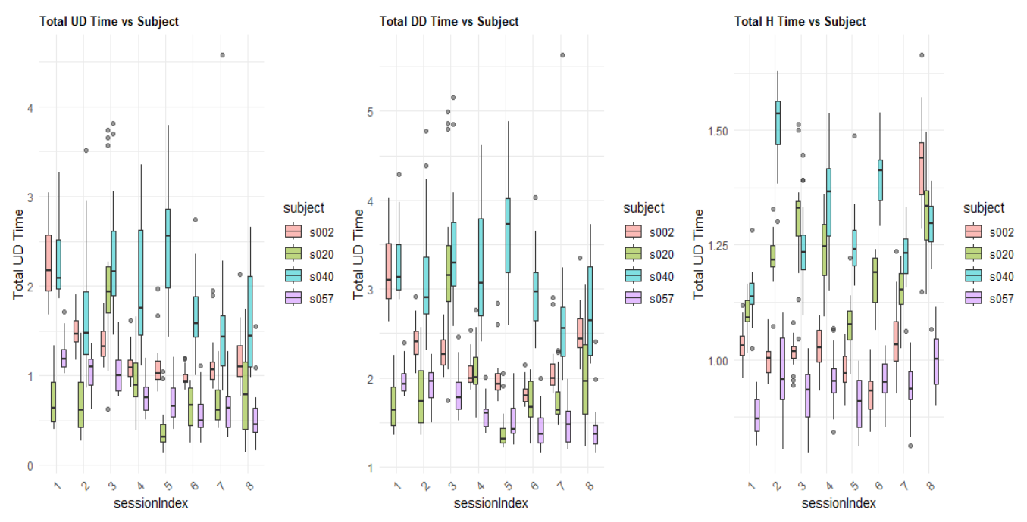
Figure: Boxplot showing the distribution of total UD, DD, and H time for some random subjects (Project 1).

Slide 5
Model Building
Data Preprocessing:
Standardizing all numeric columns.
Data Splitting:
Stratified data splitting to preserve distribution.
80% training data and 20% test data.
3. Evaluated Models:
Multinomial Logistic Regression
LDA
QDA
MclustDA
Decision tree
Random forest
XGBoost
SGM

Slide 6
Summary table – Baseline model comparison.
Summary table – Advanced model comparison.
Model | Features | Accuracy
Multinomial Logistic | 3 total_features | 0.3308824
LDA | 3 total_features | 0.3253676
QDA | 3 total_features | 0.3590686
MClustDA | 3 total_features | 0.3835784
Decision Tree | 3 total_features | 0.1838235
Random Forest | 3 total_features | 0.2616422
XGBoost | 3 total_features | 0.2665441
SVM | 3 total_features | 0.2224265
Model | Features | Accuracy
Multinomial Logistic (PCA) | Top 17 PCs | 0.8033088
LDA (PCA) | Top 17 PCs | 0.7218137
QDA (PCA) | Top 17 PCs | 0.7628676
MClustDA (PCA) | Top 17 PCs | 0.7904412
Decision Tree (Full) | ALL Features | 0.4944853
Random Forest (Full) | ALL Features | 0.9368873
XGBoost (Full) | ALL Features | 0.9099265
SVM (Full) | ALL Features | 0.8750000
Take-away
Baseline model: MclustDA (UD, DD, & H) with ~38.36% prediction accuracy.
Advanced model: Random Forest (Full) with ~93.69% prediction accuracy.
4.Model Tuning: Random Forest Tuned Accuracy: 0.9381127 ~ 93.81%

Slide 7
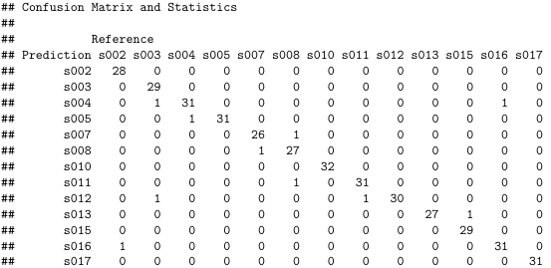
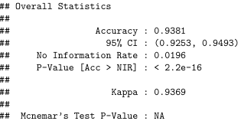
Confusion Matrix
Confusion matrix for the fine-tuned random forest model (snipped portion).
Confusion Matrix Insights: Most subjects were classified perfectly or nearly perfectly
Misclassifications were rare and usually between very similar subjects (likely with similar typing styles)

Slide 8
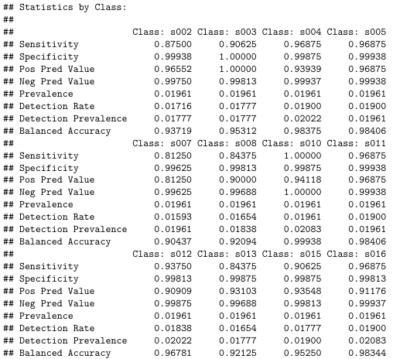
Random forest statistics (snipped).

Slide 9
Subjects with Perfect Scores.
Subject | Precision | Recall | F1 Score
s022 | 1.0 | 1.0 | 1.0
s027 | 1.0 | 1.0 | 1.0
s033 | 1.0 | 1.0 | 1.0
s036 | 1.0 | 1.0 | 1.0
s042 | 1.0 | 1.0 | 1.0
s043 | 1.0 | 1.0 | 1.0
The model consistently identified these users perfectly.
Indicates their typing behavior is:
Distinct (non-overlapping features)
Consistent (low intra-user variability)
These subjects likely have unique timing patterns or distributions
s022, s027, s033, etc. achieved perfect F1 = 1.0.
These users exhibit highly distinct and consistent typing patterns, making them easy for the model to classify.
Although the Random Forest model achieved 93.8% accuracy, misclassifications were observed, too.

Slide 10
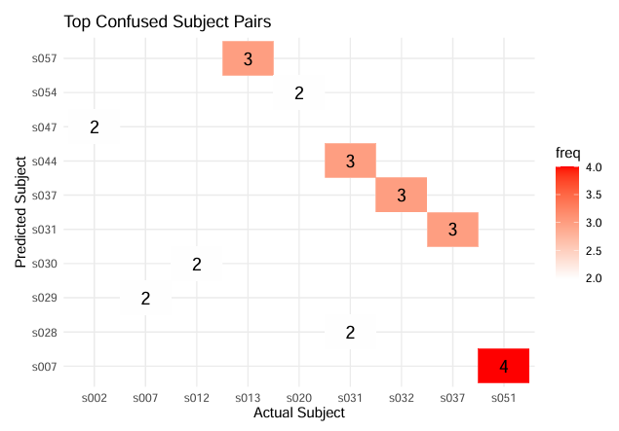
Misclassifications occurred most frequently between the following subject pairs:
s051 → s007 (4 times)
s032 ↔ s037, s031 ↔ s044, and s013 → s057 (3 times each)
These errors occurred primarily between users with very similar total timing distributions, making it difficult for the model to differentiate.

Slide 11
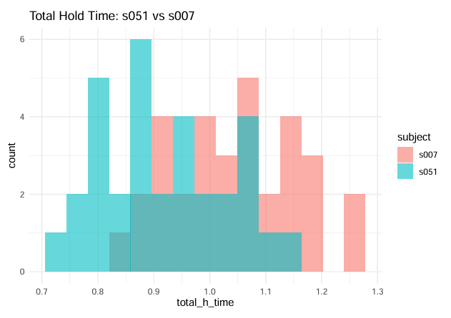
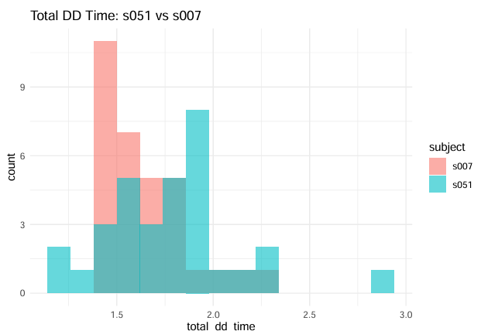
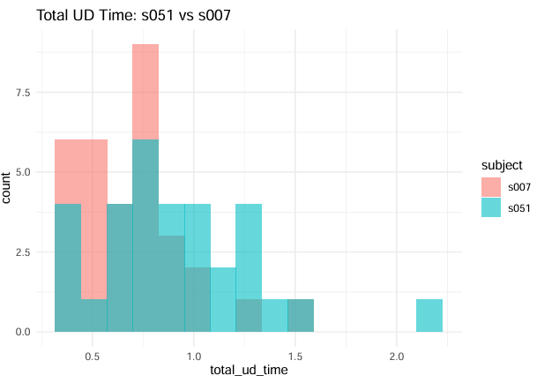
Take-away
Total Hold Time: 0.85–1.1s
Total DD Time: 1.4–2.0s
Total UD Time: 0.5–1.0s
This suggests these users have nearly indistinguishable keystroke dynamics, explaining the misclassifications.

Slide 12
Conclusion
The Random Forest model achieved the best performance with 93.81% accuracy.
Most misclassifications arose between users with overlapping typing behaviors.
Feature engineering (total timings) helped create interpretable inputs.
PCA helped reduce dimensionality for simpler models.
Recommendations
Random Forest is well-suited for this task due to its robustness and ability to handle high-dimensional, complex feature interactions without requiring aggressive preprocessing.

Slide 13
References
Lecture Notes and Resources (STAT 602)
Killourhy, K. S., & Maxion, R. A. (2009). Comparing anomaly-detection algorithms for keystroke dynamics.
Hothorn, T., & Everitt, B. S. (2014). A Handbook of Statistical Analyses using R. In Chapman and Hall/CRCeBooks. https://doi.org/10.1201/b17081
ChatGPT. (02/2025). Used for debugging and code cleaning. Retrieved from OpenAI

