Slide 1

KNN- K Nearest Neighbour
Saira Sanadi-TYC64
Under the guidance of Prof. Kapil Kadam

Slide 2

T A B L E O F C O N T E N T S
01
02
03
04
05
06
07
08
Introduction
Python Implementation of KNN
Example
Iris Data-KNN
How Does it Work?
References
Advantages & Disadvantages
Thank You!

Slide 3
I N T R O D U C T I O N
Based on- Machine Learning algorithms based on Supervised Learning technique.
Approach- Similarity between the new case/data and available cases and put the new case into the category that is most similar to the available categories. Stores all the available data and classifies a new data point based on the similarity. This means when new data appears then it can be easily classified into a well suite category.
Used for- Regression as well as for Classification but mostly it is used for the Classification.
Type- Non-parametric algorithm, which means it does not make any assumption on underlying data.
It is also called a lazy learner algorithm because it does not learn from the training set immediately instead it stores the dataset and at the time of classification, it performs an action on the dataset.

Slide 4
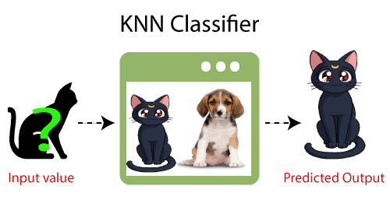
E X A M P L E
Suppose, we have an image of a creature that looks similar to cat and dog, but we want to know either it is a cat or dog.
So for this identification, we can use the KNN algorithm, as it works on a similarity measure.
Our KNN model will find the similar features
of the new data set to the cats and dogs images.
Based on the most similar features it will put it in either cat or dog category.

Slide 5
....How???

Slide 6

H O W D O E S I T W O R K ?
Step-1: Select the number K of the neighbors Step-2: Calculate the Euclidean distance of K number of neighbors
Step-3: Take the K nearest neighbors as per the calculated Euclidean distance.
Step-4: Among these k neighbors, count the number of the data points in each category.
Step-5: Assign the new data points to that category for which the number of the neighbor is maximum.
Step-6: Our model is ready.

Slide 7
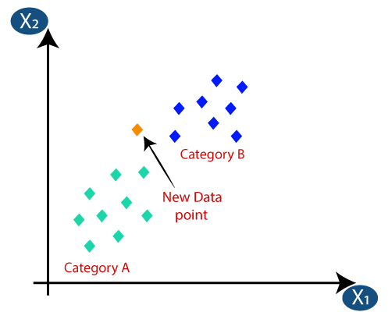
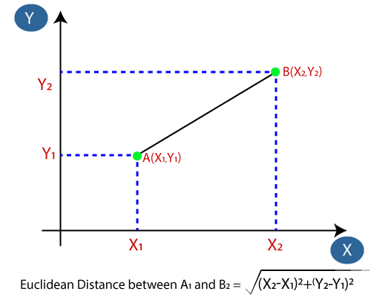
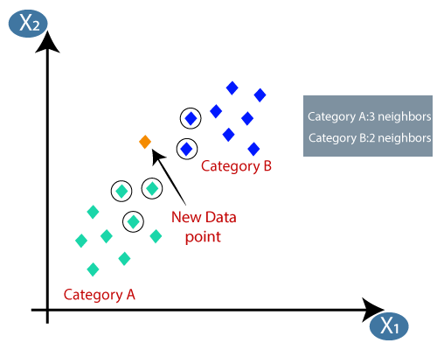

Slide 8

A D V A N T A G E S
It is simple to implement.
It is robust to noisy training data.
It is more effective if the training data is large.
D I S A D V A N T A G E S
Always needs to determine the value of K which may be complex some time.
The computation cost is high because of calculating the distance between the data points for all the training samples.

Slide 9
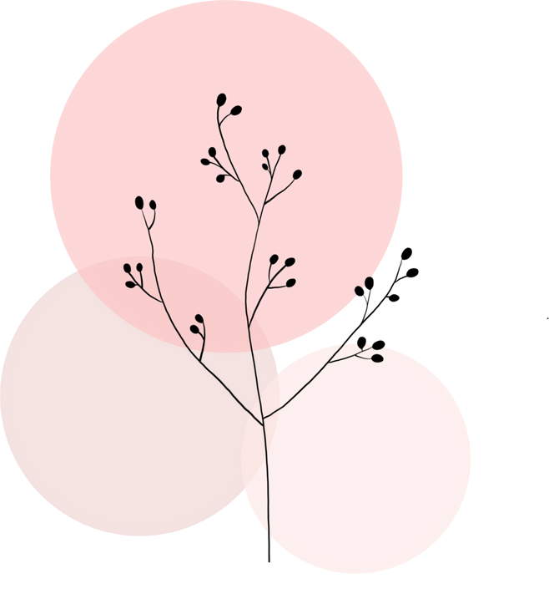
P Y T H O N I M P L E M E N T A T I O N O F K N N
Data Pre-processing step.
Fitting the K-NN algorithm to the Training set.
Predicting the test result
Test accuracy of the result(Creation of Confusion matrix)
Visualizing the test set result.

Slide 10


