Slide 1
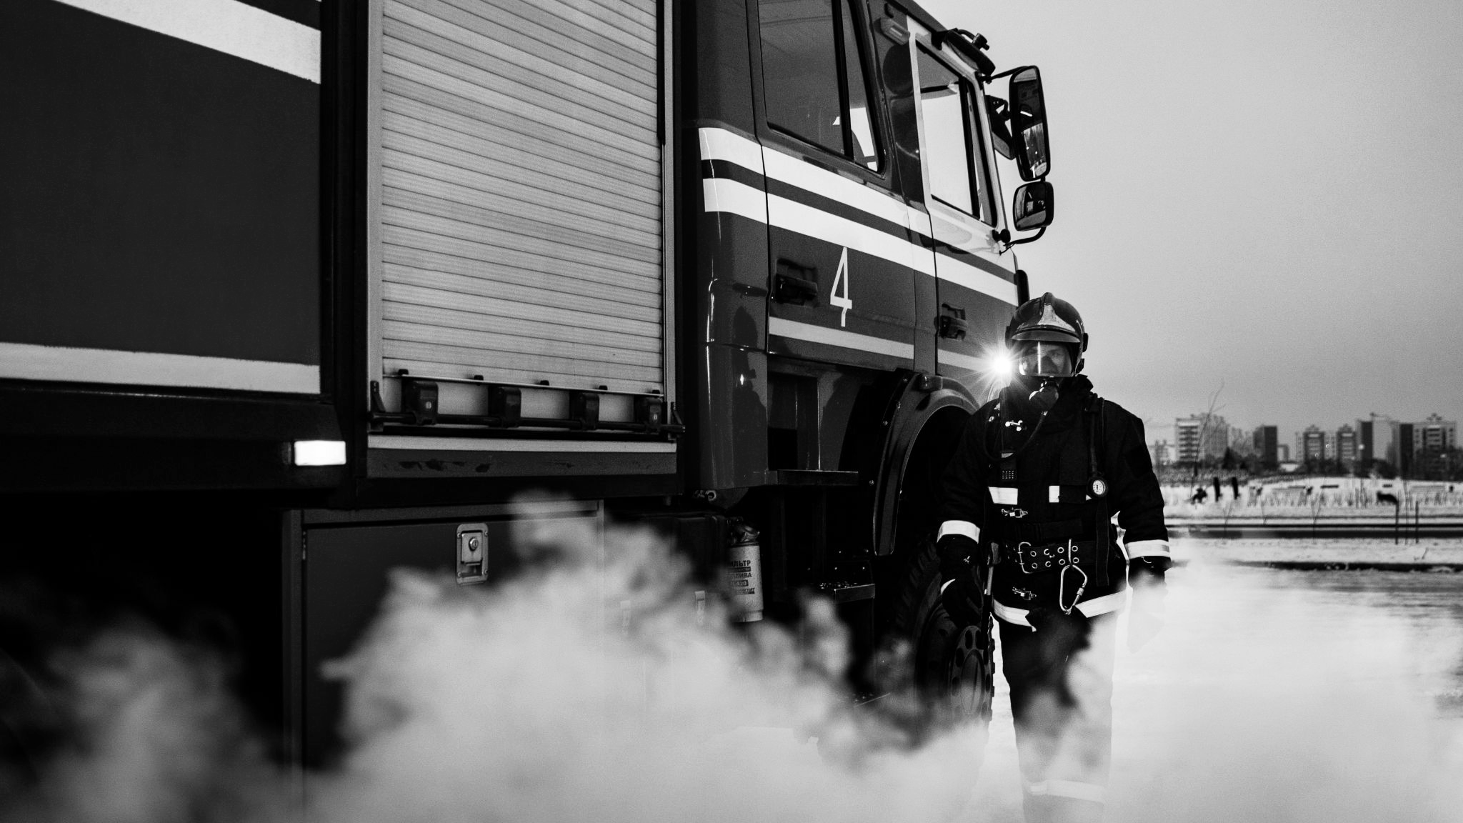
Integrated Platform for Crowdsourced Ocean Hazard Reporting and Social Media Analytics
SIH25039

Slide 2
MOTIVATION &PROBLEM STATEMENT
India’s 7,500+ km coastline is highly vulnerable to ocean hazards such as tsunamis, storm surges, high waves, swell surges, and coastal flooding. While agencies like INCOIS provide early warnings using satellite data and sensor-based models, real-time ground-level validation from citizens and coastal communities is often unavailable or delayed.During such events, valuable information is frequently shared across social media platforms, but this data remains fragmented, unstructured, and disconnected from official disaster management systems.This lack of integration creates a critical gap between predictive intelligence and real-world conditions, leading to limited situational awareness and delayed response during emergencies.

Slide 3
ABSTRACT
Coastal regions are highly vulnerable to ocean hazards such as tsunamis, storm surges, and high waves, posing serious risks to communities and infrastructure. While existing early-warning systems rely on satellite data and predictive models, they often lack real-time validation from ground-level observations. At the same time, valuable information shared by the public on social media remains unstructured and disconnected from official systems. This project proposes an integrated platform that combines crowdsourced hazard reporting with AI-driven social media analysis to provide a unified view of ongoing events. By enabling geotagged reporting, analyzing public communication trends using NLP, and visualizing data through an interactive geospatial dashboard with hotspot detection, the system enhances situational awareness and supports faster, data-driven decision-making for effective disaster response.

Slide 4

THE PROBLEM
THE NEED
• Early-warning systems rely mainly on satellite and sensor data.
• Real-time ground-level validation from citizens is often delayed.
• No unified platform integrates predictive data with public signals.
• Even minutes of delay can increase disaster impact.
• Faster validation leads to better response decisions.
• Integrating public signals can improve situational awareness.
• A platform for real-time crowdsourced hazard reporting.
• AI-based social media monitoring and classification.
• Geospatial hotspot detection and visualization.
• Role-based dashboard for officials and analysts.
• Unified disaster intelligence system for faster decision-making.

Slide 5
EXISTING SOLTUIONS
Early Warning Systems (INCOIS & Sensor-Based Models)
Traditional Disaster Reporting Platforms
Social Media Monitoring Tools
Emergency Response Dashboards
Key Limitation of Existing Systems
• Systems operate in isolation
• No unified intelligence platform
• Limited real-time ground validation
• Fragmented data sources

Slide 6
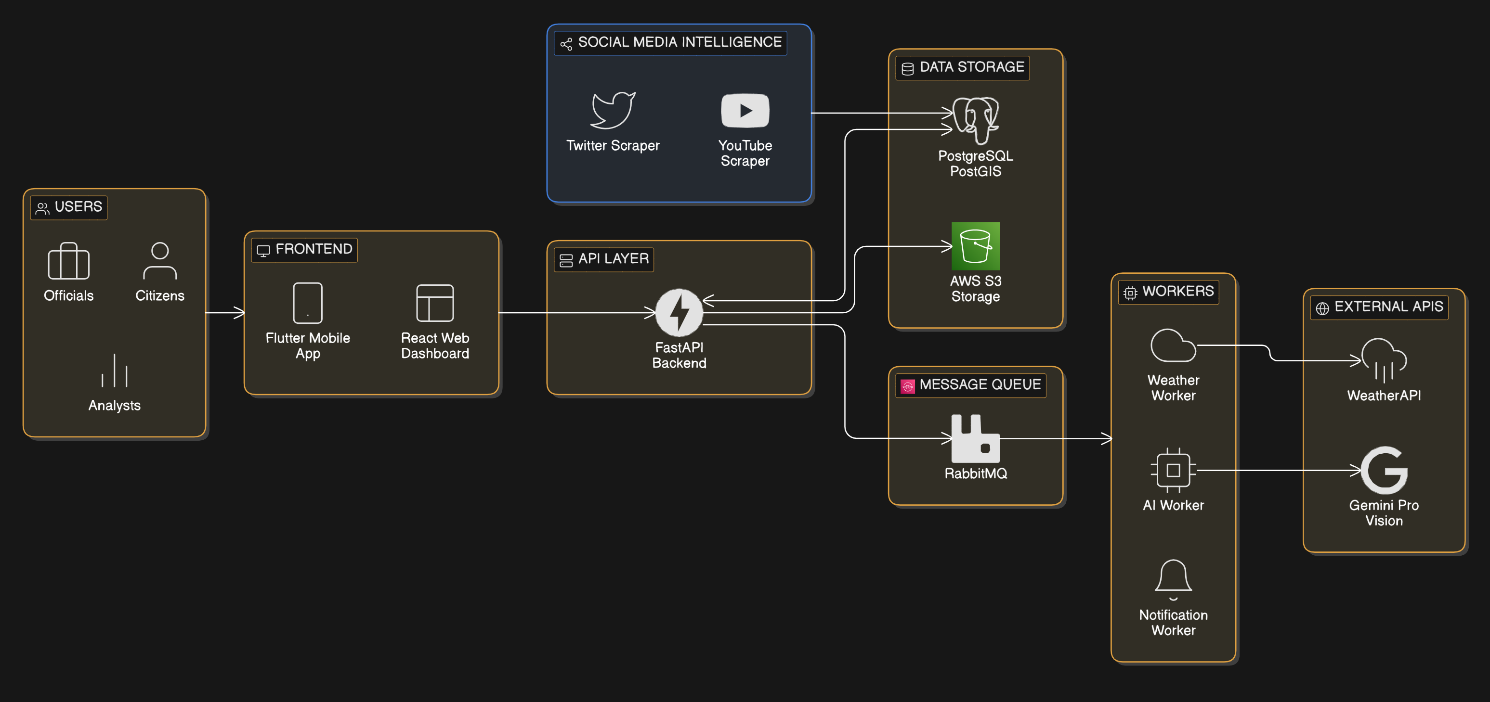
SYSTEM ARCHITECTURE

Slide 7


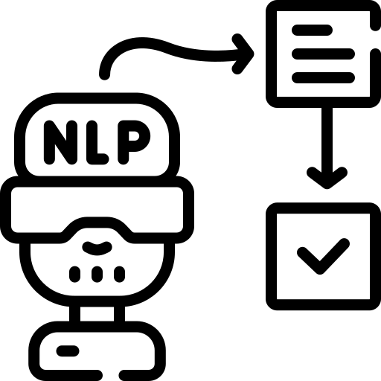



UNIQUENESS
Real-Time Geotagged Hazard Reporting
Number of reports submitted per region.
Dynamic Hotspot Detection
Automatic clustering of reports based on density and severity.
NLP-Based Social Media
Classification
AI model detects hazard-related posts from Twitter/YouTube.
Classification accuracy (%).
Role-Based Access
Control
Offline Data Collection
& Sync
Real-Time Notification & Alert Triggering
Average submission-to-display time (latency).
Users can submit reports without internet.
Separate dashboards for:
Citizens
Government Officials
Alerts generated based on report threshold or sentiment spike.
Officials receive instant notifications.
Report density per hotspot.
Auto-sync when connectivity is restored.

Slide 8













TECHNOLOGY STACK

Slide 9
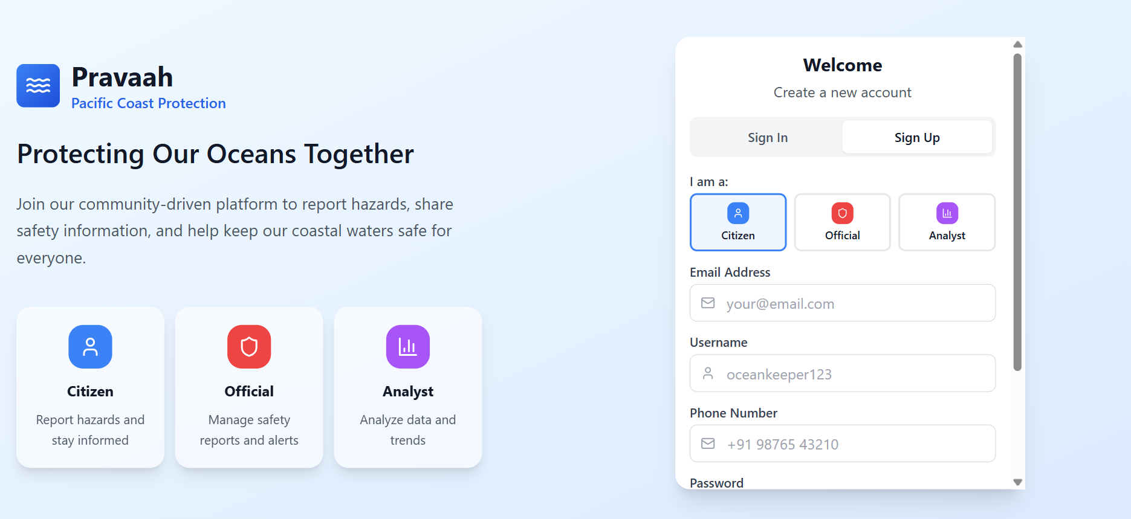

Slide 10
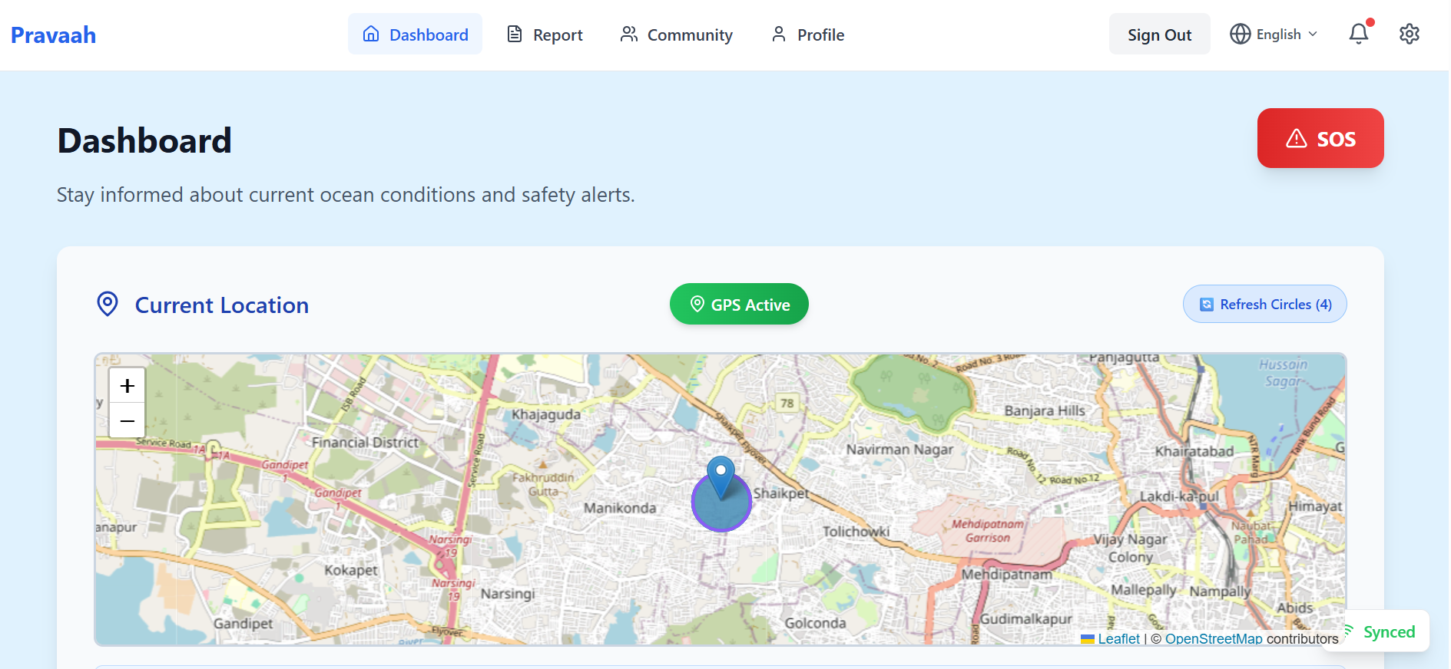

Slide 11
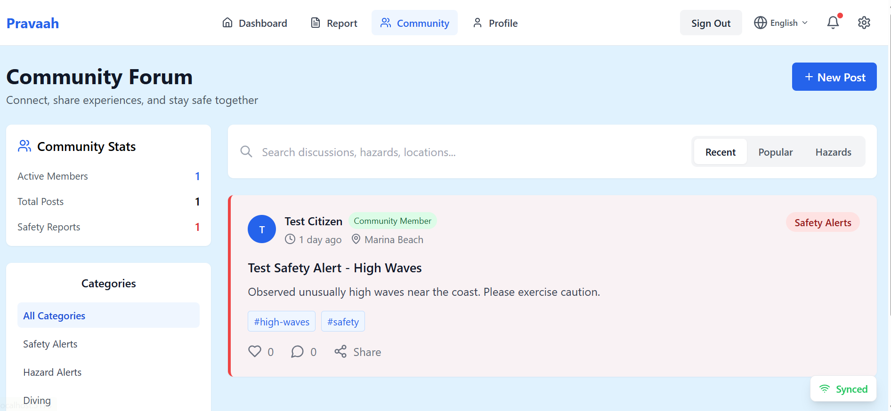

Slide 12
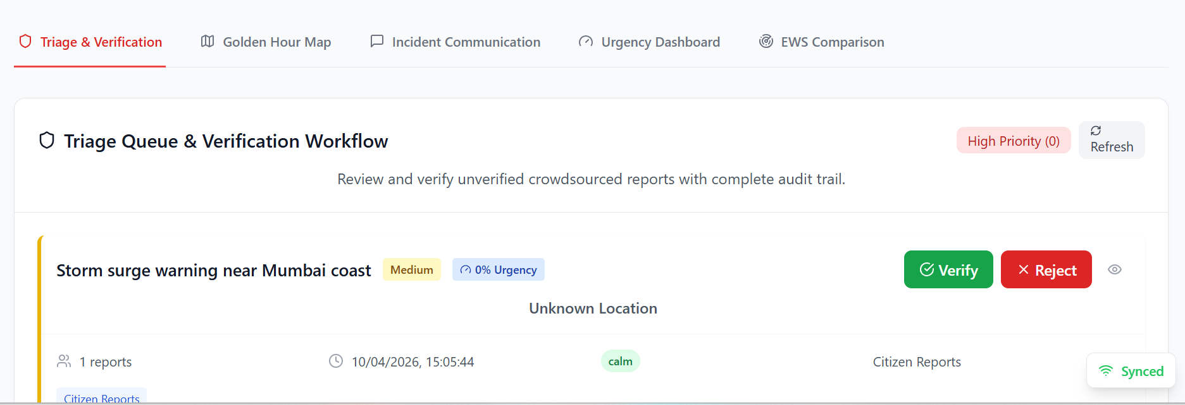

Slide 13
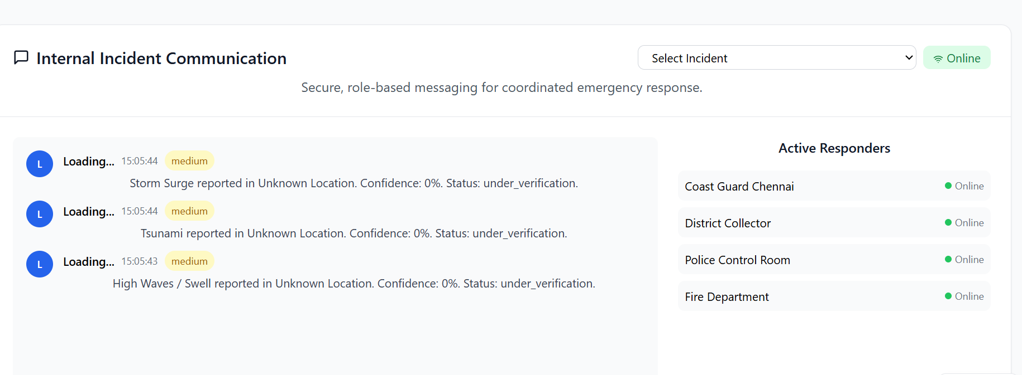

Slide 14
Conclusion
• Developed a unified platform integrating crowdsourced reporting and social media analytics
• Enabled real-time hazard detection using geotagged data and AI-based analysis
• Improved situational awareness through interactive maps and hotspot visualization
• Reduced the gap between prediction systems and ground reality
• Supported faster and more informed decision-making for disaster management
• Demonstrated a scalable solution for enhancing coastal safety and resilience

Slide 15
FutureScope
• Integration with real-time data from INCOIS and other official early warning systems
• Enhancement of AI models for predictive hazard forecasting
• Expansion to support multiple languages for wider accessibility
• Deployment as a fully scalable mobile application for large user base
• Integration with government disaster management systems for direct response action
• Incorporation of IoT sensors and real-time environmental data
• Advanced analytics for risk prediction and impact assessment

Slide 16
References
Sakaki, Takeshi, Makoto Okazaki, and Yutaka Matsuo. "Earthquake shakes twitter users: real-time event detection by social sensors." Proceedings of the 19th international conference on World wide web. 2010.
Vieweg, Sarah, et al. "Microblogging during two natural hazards events: what twitter may contribute to situational awareness." Proceedings of the SIGCHI conference on human factors in computing systems. 2010.
Imran, Muhammad, et al. "Processing social media messages in mass emergency: A survey." ACM computing surveys (CSUR) 47.4 (2015): 1-38.
Crooks, Andrew, et al. "# Earthquake: Twitter as a distributed sensor system." Transactions in GIS 17.1 (2013): 124-147.

Slide 17
THANK YOU!!

