Slide 1



Topic Modeling with LDA: A Practical Guide
In this presentation, we will explore the process of topic modeling with Latent Dirichlet Allocation (LDA). We will cover the key steps involved, including data preparation, model training, and visualization. We will illustrate these concepts using a real-world dataset and a Python code example.
by Sai Rikwith
Sai Rikwith Daggu

Slide 2
Understanding Topic Modeling
What is Topic Modeling?
Topic modeling is a statistical method used to identify hidden semantic structures or topics within a collection of documents. It helps us understand the underlying themes and patterns in text data.
Applications
Topic modeling has numerous applications in various fields, including text analysis, document classification, recommendation systems, and sentiment analysis.

Slide 3

Introducing Latent Dirichlet Allocation (LDA)
1
LDA Explained
LDA is a probabilistic generative model that assumes each document is a mixture of multiple topics.
2
Key Components
It models the distribution of words within topics and documents. This allows us to identify the topics present in a dataset and assign documents to those topics.

Slide 4
Dataset & Preprocessing
Dataset Selection
We will use the 20 Newsgroups dataset, a collection of approximately 20,000 newsgroup documents, categorized into 20 distinct topics.
Text Cleaning
Before applying LDA, we preprocess the text data by tokenizing, removing stop words, and performing stemming/lemmatization. This ensures cleaner and more consistent input for topic modeling.

Slide 5
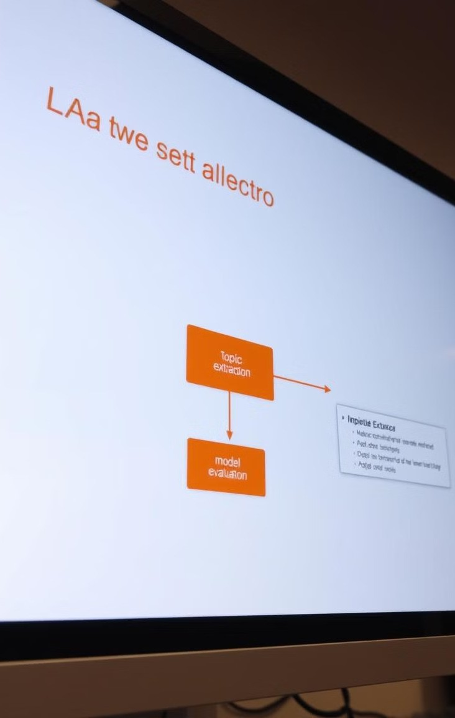
The Modeling Process
1
Vectorization
We convert the text data into a numerical representation using a bag-of-words approach, where each document is represented as a vector of word counts.
2
LDA Training
We train the LDA model on the vectorized data, specifying the number of topics to extract and other hyperparameters.
3
Topic Extraction
LDA assigns words to topics based on their co-occurrence patterns and probabilities. We can then interpret these topics based on the most representative words.

Slide 6

Visualizing the Results
Word Clouds
We create word clouds for each topic to visualize the most prominent words associated with that topic. This provides a visual representation of the topic's content.
Interactive Visualization
Using pyLDAvis, we generate an interactive visualization that allows us to explore the relationship between topics, words, and documents. This provides deeper insights into the topic structure.

Slide 7
Interpreting the Topics
Topic 1
1
Key Terms: politics, government, election, country
Topic 2
Key Terms: computer, software, hardware, internet
2
Topic 3
Key Terms: game, play, team, sport
3
By analyzing the key terms associated with each topic, we can gain insights into the underlying themes present in the dataset. For example, Topic 1 appears to focus on politics, while Topic 2 is related to technology, and Topic 3 is about sports and games.

Slide 8
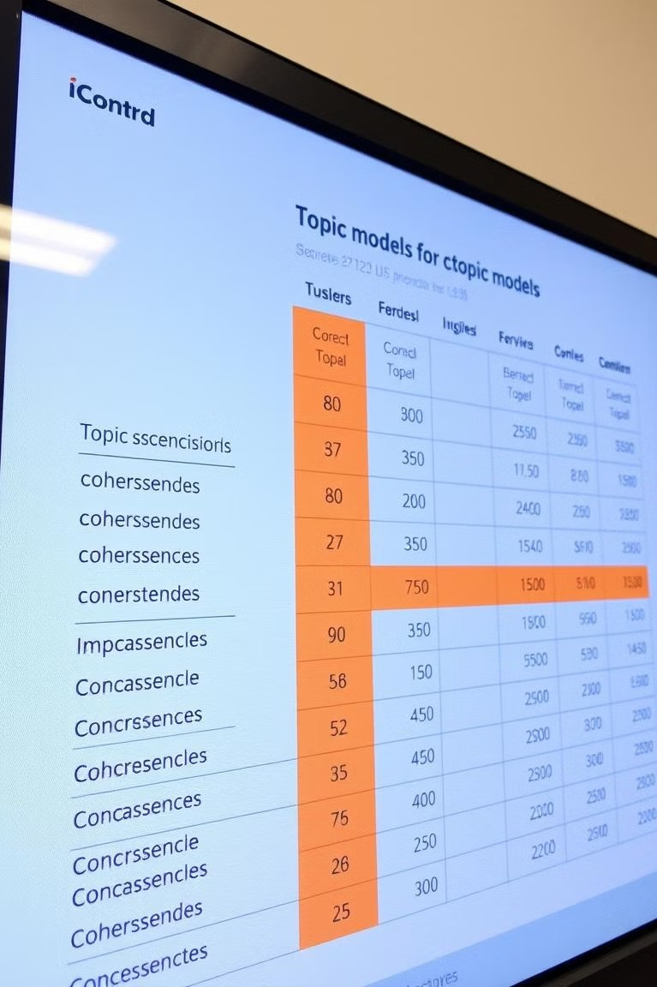
Evaluating Model Performance
1
2
Coherence Scores
Coherence scores measure how well the topics are defined and interpretable. Higher coherence scores indicate better topic models.
Model Selection
We can use coherence scores to compare different topic models and select the best performing one for our specific application.

Slide 9
Key Takeaways & Next Steps
Topic Modeling Power
1
Topic modeling provides valuable insights into text data by identifying hidden themes and patterns. It has wide applications in various domains.
Model Customization
Different datasets require fine-tuning of LDA parameters and preprocessing steps to achieve optimal results.
2
Further Exploration
Explore more advanced topic modeling techniques, such as Non-Negative Matrix Factorization (NMF), and experiment with different datasets and applications.
3

Slide 10

Any Questions ?
Open to questions and discussion about topic modeling.

